Slide 1
PARTICLES AND MEASUREMENT

Slide 2
Significant figures

Slide 3
Lesson Objectives:
Identify the precision of a measuring device
Identify the amount of significant figures in a number

Slide 4
Significant Figures
A scientist’s final calculation can only be as precise as their least precise measurement.
Count digits in your measured number to determine their level of precision.

Slide 5
Significant Figures
Indicate PRECISION of a measurement.
Sig figs in a measurement include the known digits plus a final estimated digit (precision of instrument)
3.21 cm

Slide 6
Example: (I do)

Slide 7
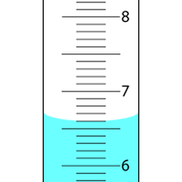
Example (We do)
What is the volume of the graduated cylinder in mL?
6.60 mL

Slide 8
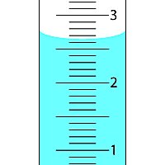
Example (You do)
What is the volume of the graduated cylinder in mL?
2.65 mL

Slide 9
Can you identify the precision of a measuring device?

Slide 10
Rules for Counting Sig Figs
All natural numbers 1-9 count once.
569 has 3 SF 3.456 has 4 SF
The number zero is tricky…
2. Zeros always count between natural numbers:
109 have 3 SF 50089 has 5 SF

Slide 11
Rules for Counting Sig Figs
3. Zeros before a decimal and natural number never count. 0.00789 has 3 SF 0.01234 has 4 SF 4. Zeros after natural numbers only count If there is a decimal present. 114.20 has 5 SF 11,420 has 4 SF

Slide 12
Recap: Counting Sig Figs
Start counting from LEFT to RIGHT at first NATURAL (non zero) number.
If decimal point is present then count any trailing zeros after the last natural (non zero) number.
If decimal is not present don’t count trailing zeros after the last natural (non zero) number.

Slide 13
Example: ( I do)
2545.300 g 4530 km 0.00453 m
6.23 x 10⁶ m
7 sig figs
3 sig figs
3 sig figs
3 sig figs
= 6,230,000

Slide 14
Example: (We do)
How many significant figures are in the following measurement? 43.40 m
4 sig figs

Slide 15
Example: (You do)
How many significant figures are in the following measurement? O.oo4520 g
4 sig figs

Slide 16
Can you identify the amount of sig figs in a number?

Slide 17
You should be able to:
Identify the precision of a measuring device
Identify the amount of significant figures in a number

Slide 18
Rounding sig figs in calculations

Slide 19
Lesson Objectives:
Round answers to proper sig figs in addition and subtraction calculations
Round answers to proper sig figs in multiplication and division calculations

Slide 20
What do I round my answer to?
An answer can never be more precise than your least precise measurement

Slide 21
Adding & Subtracting Sig Figs
Round your answer to the least number of DECIMAL PLACES.
5
3.75 mL
+ 4.1 mL
7.85 mL
1
7.9 mL

Slide 22
Examples: (I do)
2.0 + 5.61 = 7.61 =
5.67 + 102.111 = 107.781 =
23 + 11.10 = 34.10 =
_
_
_
7.6
Least precise place value is tenths place
_
_
_
107.78
Least precise place value is hundredths place
_
_
_
34
Least precise place value is ones place

Slide 23
Examples (We do)
What is the answer rounded to the correct number of sig figs?
47.1 + 52.345 =
_
99.445
_
= 99.4

Slide 24
Examples (You do)
What is the answer rounded to the correct number of sig figs?
678.21 - 45.489 =
632.721
_
_
= 632.72

Slide 25
Check your understanding:
Round answers to proper sig figs in addition and subtraction calculations

Slide 26
Multiplying & Dividing Sig Figs
Round your answer to the least number of significant figures.
(13.91 g/cm³) (23.3 cm³) = 324.103 g
4 SF
3 SF
3 SF
324 g

Slide 27
Examples: (I do)
70.
2.0 x 35.1 = 70.2 =
5.11 x 98.654 = 504.12194 =
72.1 / 3.123 = 23.0867755 =
D = 56 g
12.45mL
504
23.1
= 4.5 g/mL

Slide 28
Example: (We do)
What is the answer rounded to the correct number of sig figs?
D = 45.24 g
3.1 mL
= 14.59354839 g/mL
= 15 g/mL

Slide 29
Example: (You do)
What is the answer rounded to the correct number of sig figs?
D = 32 g
2.01 mL
= 15.92 g/mL
= 16 g/mL

Slide 30
Check Your Understanding:
Round answers to proper sig figs in multiplication and division calculations

Slide 31
You should be able to:
Round answers to proper sig figs in addition and subtraction calculations
Round answers to proper sig figs in multiplication and division calculations

Slide 32
Percent Error

Slide 33
Objectives:
Calculate the percent error of a measurement.

Slide 34
Determining Accuracy
This Formula is found on Table in your Reference Table T:

Slide 35
Example (I do)
Working in the laboratory, a student finds the density of a piece of pure aluminum to be 2.85 g/cm³. The accepted value for the density of aluminum is 2.699 g/cm³. Determine the percent error.
2.85 - 2.699
X 100 =
.151
X 100
= 5.59%
2.699
2.699
.151
X 100
= 5.30%
2.85

Slide 36
Example (We do)
The accepted value for the volume of a gas is 22.4 liters. In a laboratory experiment, a student determines the value to be 24.8 liters. What is the percent error of the student's measurement?
24.8 - 22.4
X 100 =
0.4
X 100
= 10.7%
22.4
22.4

Slide 37
Example (You do)
In an experiment, a student found that the percent of oxygen in a sample of KClO₃ was 42.3%. If the accepted value is 39.3%, then what is the experimental percent error?
42.3 - 39.3
X 100 =
3.00
X 100
= 7.63%
39.3
39.3

Slide 38
You should be able to:
Calculate the percent error of a measurement.

Slide 39
Density

Slide 40
Lesson Objectives:
Determine the volume of a substance
Calculate density, mass, and volume

Slide 41
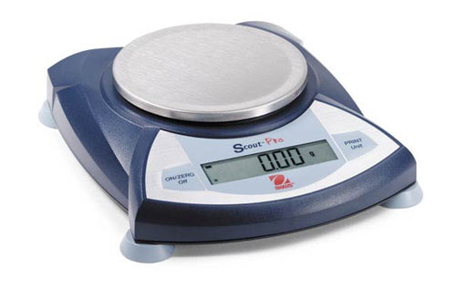
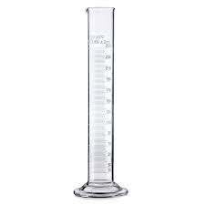
Definitions
Mass: the amount of matter an object contains.
Volume: The amount of space a substance occupies

Slide 42
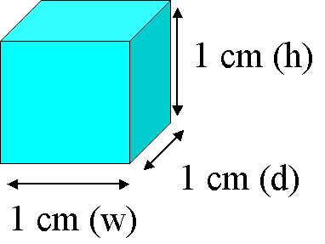
Measuring Volume
l x w x h (regular solid)
ex. V = 1cm³
Graduated cylinder (liquids)
Read bottom of MENISCUS
ex. V = 27.5 mL

Slide 43
Reading a Meniscus
10
10 mL
line of sight too high
reading too high
proper line of sight
8
reading correct
line of sight too low
6
reading too low
Graduated cylinder

Slide 44
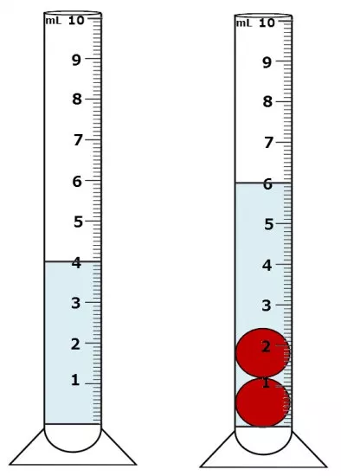
Measuring Volume of an Irregular Object
Water Displacement:
Measure initial volume
Measure final volume with object
The Difference is the volume of the object
Ex. 6.00 - 4.00 = 2.oo mL

Slide 45
Check Your Understanding
Can you Determine the volume of a substance?

Slide 46
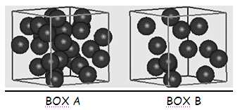
Density
Ratio of mass of an object to its volume
More particles
Same volume

Slide 47
Example: (I d0)
What is the density of an object with a mass of 60.0 g and a volume of 2.0 cm³?
D =
m
D =
60.0 g
D = 30. g/cm³
v
2.0 cm³

Slide 48
Example: (We do)
An object has a volume of 825.0 cm³ and a density of 13.60 g/cm³. Find its mass.
D =
m
13.60 g/cm³ =
x g
m = 11,220 g
v
825.0 cm³
1

Slide 49
Example: (You do)
An object has a volume of 45.0 cm³ and a density of 11.20 g/cm³. Find its mass.
D =
m
11.20 g/cm³ =
x g
m = 504 g
v
45.0 cm³
1

Slide 50
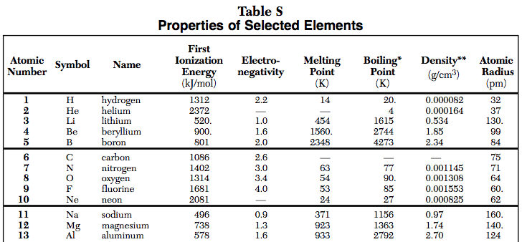
How to solve for m or v if density is not given
USE TABLE S Example: The volume of an aluminum sample is 251 cm³. What is the mass of the sample? The density of aluminum on table S is 2.70g/cm³
D =
m
v

Slide 51
How to solve for m or v if density is not given
USE TABLE S Example: The volume of an aluminum sample is 251 cm³. What is the mass of the sample?
m
2.70 g/cm³=
251 cm³
D =
m
v
= 678 g

Slide 52
Check Your Understanding:
Can you calculate density/mass/volume

Slide 53
You should be able to:
Determine the volume of a substance
Calculate density/mass/volume

Slide 54
Temperature Conversions

Slide 55
Lesson objectives:
Convert between Celsius and Kelvin temperature scales

Slide 56
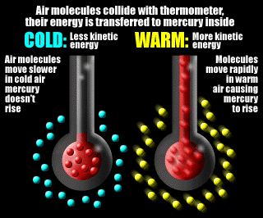
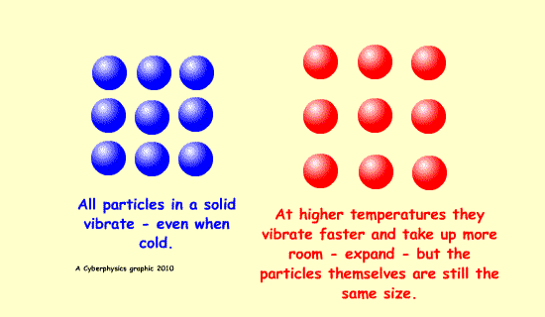
Temperature
Measure of average kinetic energy

Slide 57
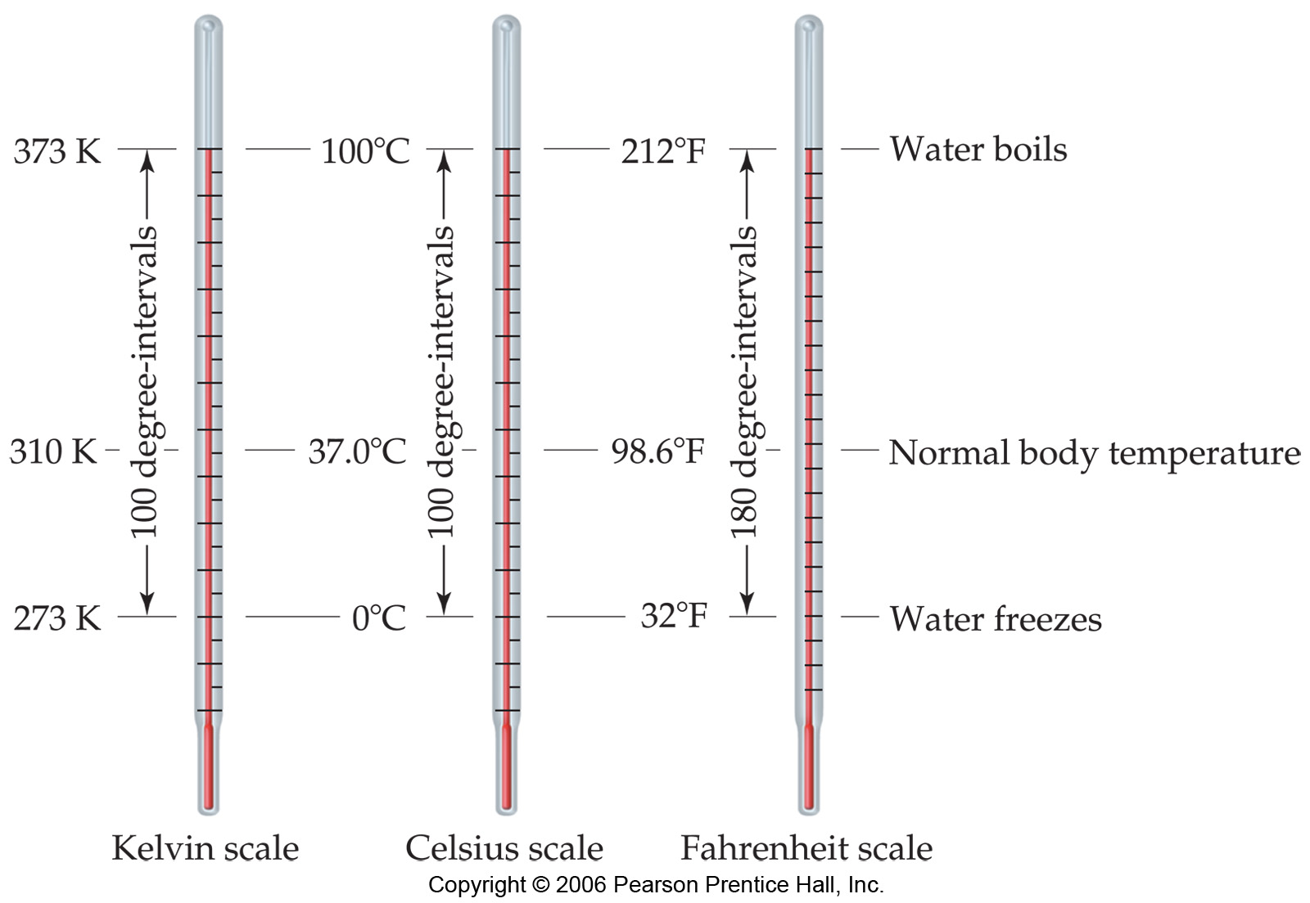
Temperature Scales

Slide 58
Celsius Scale
Freezing point of water is 0°C
Boiling point for water is 100°C
Below 0°C is NEGATIVE *****Memorize this!!!!

Slide 59
Celsius Scale

Slide 60
Kelvin Scale
Water freezes at 273K and boils at 373K
Theoretical point of ABSOLUTE ZERO is when all molecular motion stops
NO NEGATIVE NUMBERS
Divisions (degrees) are the same as in Celsius

Slide 61
Example:
What is the temperature in Celsius of an object that is 150 K? K = °C + 273
150 K = °C + 273
- 273
- 273
= -123 °C

Slide 62
Example:
What is the temperature in Kelvin of an object that is 55 C? K = °C + 273
x = 55 + 273
= 328 K

Slide 63
Check your understanding
Can you convert between Celsius and Kelvin temperature?

Slide 64
You should be able to:
Convert between Celsius and Kelvin temperature scales

Slide 65
Metric Conversions

Slide 66
Lesson objectives:
Convert between units of measurement.

Slide 67
The metric system
System of measurement used in science and in most countries
The BASE UNITS of measurement: (Found on Reference Table D)

Slide 68
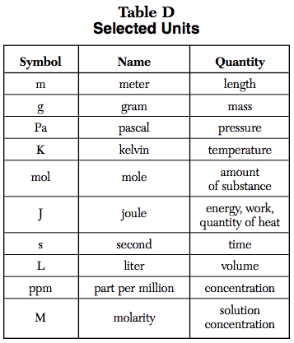
Base Units

Slide 69
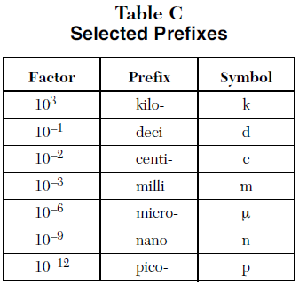
Prefixes
Used to modify base units of measurement. (Found on Reference Table C)
Factors equal the # of base units
Ex. 1 kilogram = 10³ grams
1 milliliter = 10⁻³ liters
Notes:
Factor is the number of base units equal to that particular prefix

Slide 70
Label your table
10⁰ base units (m, L g etc.)
Notes:
Unit with the prefix gets the 1 and the base unit gets the factor
What goes up must come down
Conversion factor

Slide 71
Rules
Locate the decimal. If there is no decimal present, it is at the end of the number.
If the unit gets larger, the number gets smaller
If the unit gets smaller, the number gets larger

Slide 72
Example: (I do)
Convert 45.50 mL to L
Difference between exponents = # of spaces moved
0
45.50
= .0455o L

Slide 73
Example: (We do)
Convert 502.3 kg to g
Difference between exponents = 3
= 502.3
0
0
= 502,300 g

Slide 74
Example: (You do)
Convert 22.3 cm to m
Difference between exponents = 2
= 22.3
= 0.223 m

Slide 75
Check Your Understanding:
Can you convert between units of measurement?

Slide 76
You should be able to:
Convert between units of measurement.

