Slide 1
AB Titrations and Buffers
Acid Base Equilibrium

Slide 2
pH

Slide 3
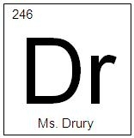
OBJECTIVES
You should already be able to…
Identify acids and bases.
Describe the pH scale.
At the end of the video you should be able to…
Calculate the concentration of ions or the pH of any strong acid or base.

Slide 4
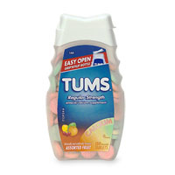
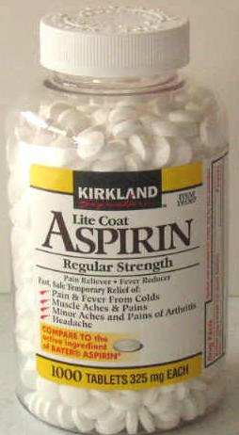
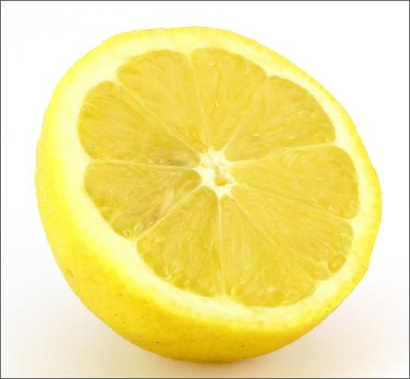
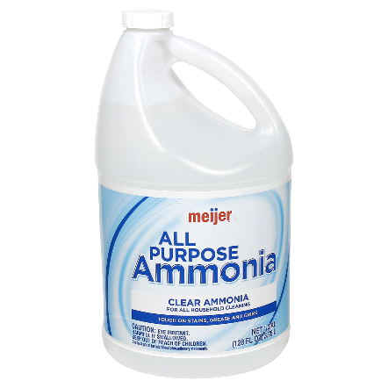
Arrhenius
Acid: Substance that, when dissolved in water, increases the concentration of hydrogen ions. pH<7
Base: Substance that, when dissolved in water, increases the concentration of hydroxide ions. pH>7

Slide 5
Brønsted–Lowry : BAAD
Acid: Proton donor
Base: Proton acceptor
Protons refer to hydrogen ions.
H
H+

Slide 6
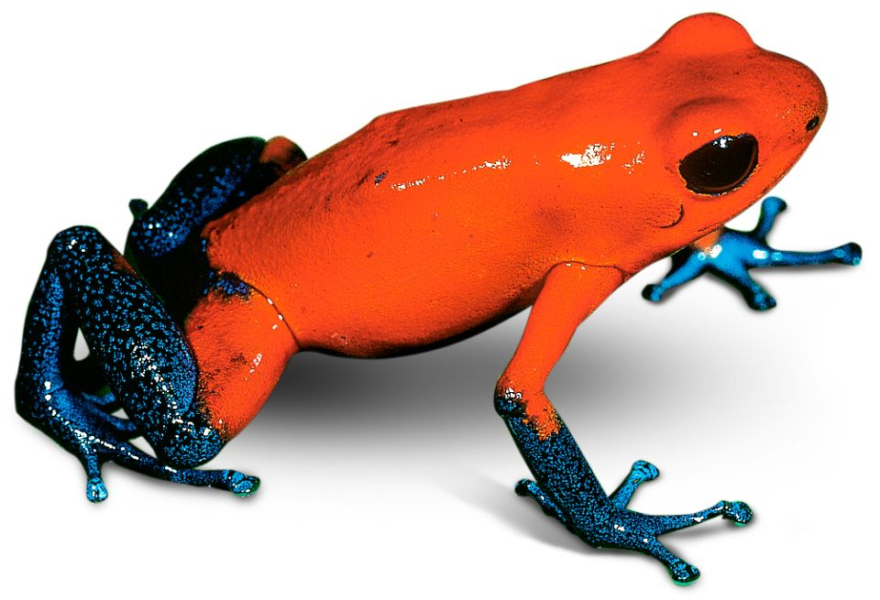
If it can be either it is amphiprotic.
HCO₃⁻
HSO₄⁻
H₂O
These all have hydrogen ions to donate and a negative charge.

Slide 7
What Happens When an Acid Dissolves in Water?
Water acts as a Brønsted–Lowry base and abstracts a proton (H⁺) from the acid.
As a result, the conjugate base of the acid and a hydronium ion are formed.

Slide 8
Conjugate Acids and Bases
Reactions between acids and bases always yield their conjugate bases and acids.

Slide 9
Acid and Base Strength
Strong acids are completely dissociated in water. Their conjugate bases are quite weak.
Weak acids only dissociate partially in water. Their conjugate bases are weak bases.

Slide 10
Find the conjugate acid:
NH₄⁺
NH₃
HS⁻
HSO₄⁻
H₂PO₄⁻
Bases gain H+ to become a conjugate acid!
H₂S
H₂SO₄
H₃PO₄

Slide 11
Find the conjugate base
HClO₄
HCl
H₂SO₄
H₃PO₄
Acids lose H+ to become a conjugate base!
ClO₄⁻
Cl⁻
HSO₄⁻
H₂PO₄⁻

Slide 12
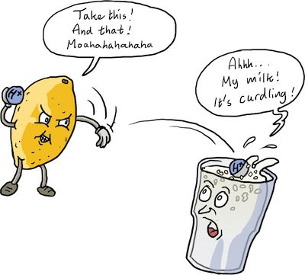
Neutralization
Acid + Base 🡪 Salt + Water
HCl + NaOH 🡪 NaCl + H₂O
When the substances neutralize, they lose their properties and the pH will equal 7.
HBr + Ba(OH)₂ 🡪 H₂O + BaBr₂

Slide 13
Question of the video:
According to the diagram, How much more acidic is your lower stomach at its most acidic versus Your upper stomach and your saliva?
Lower Stomach: pH = 1.5 [H⁺] = 10^{-1.5} = 3.2x10⁻²M
Upper Stomach: pH = 4 [H⁺] = 10⁻⁴ = 1.0x10⁻⁴M
Saliva: pH = 6.5 [H⁺] = 10^{-6.5} = 3.16x10⁻⁷M
The lower stomach is roughly 100x more acidic than the upper stomach and 100000x more acidic than saliva (based on the exponents).

Slide 14
YOU MUST BE ABLE TO
Calculate the concentration of ions or the pH of any strong acid or base.

Slide 15
Weak Acids and Bases

Slide 16
OBJECTIVES
You should already be able to…
Write mass action expressions.
Calculate the pH of a strong acid or base.
At the end of the video you should be able to…
Calculate the pH of a weak acid or base.

Slide 17
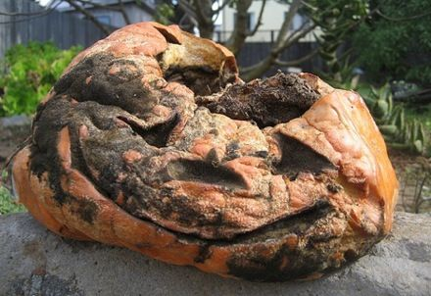
Question of the video:
Trimethylamine is a foul smelling volatile organic compound that formed during the decay of plant and animal matter.
(CH₃)₃N 🡨🡪 (CH₃)₃NH⁺ + OH⁻
The pH of a 0.50 dilute solution of trimethylamine is 11.75 at room temperature. What is the basicity of the substance?

Slide 18
Question of the video:
Trimethylamine is a foul smelling volatile organic compound that formed during the decay of plant and animal matter.
(CH₃)₃N 🡨🡪 (CH₃)₃NH⁺ + OH⁻
The pH of a 0.50 dilute solution of trimethylamine is 11.75 at room temperature. What is the basicity of the substance?
pH = 11.75 [OH⁻] = 10^{-14-11.75} = 0.00562M
Kb = [(CH₃)₃NH⁺][OH⁻]/[(CH₃)₃N] =
(0.00562)(0.00562) / 0.50 = 6.32x10⁻⁴
%I = [OH⁻]/[(CH₃)₃N] x 100 =
0.00562/0.50 x 100 = 1.12%
A weak base but just a small concentration can give such a foul odor!

Slide 19
YOU MUST BE ABLE TO
Calculate the pH of a weak acid or base.

Slide 20
Polyprotic Acids

Slide 21
OBJECTIVES
You should already be able to…
Write mass action expressions.
Calculate the pH of weak acids and bases.
At the end of the video you should be able to…
Calculate the Ka of a weak acid.
Calculate the pH of polyprotic acids.

Slide 22
Question of the video:
What is the pH of rain water that has a dissolved CO₂ concentration of 1.4x10⁻⁵?

Slide 23
Question of the video:
What is the pH of rain water that has a dissolved CO₂ concentration of 1.4x10⁻⁵? Ka = 4.3x10⁻⁷
H₂CO₃ 🡨 🡪 H₃O⁺ + HCO₃⁻
1.4x10⁻⁵ 0 0
-x +x +x
1.4x10⁻⁵-x x x
Ka = 4.3x10⁻⁷ = x²/ 1.4x10⁻⁵
X = 2.4x10⁻⁶
pH = -log (2.4x10⁻⁶) = 5.61
The second H+ ion doesn’t remove as well and will not affect the pH.

Slide 24
YOU MUST BE ABLE TO
Calculate the Ka of a weak acid and calculate the pH of polyprotic acids.

Slide 25
Properties of Acids and Bases

Slide 26
OBJECTIVES
You should already be able to…
Identify strong acids and bases.
At the end of the video you should be able to…
Explain what factors affect acid strength.
Use Lewis theory to determine if a substance is acidic or basic.
Characterize salts as acidic or basic.

Slide 27
Question of the video:
The active ingredient in bleach is sodium hypochlorite. Is bleach acidic, basic, or neutral?

Slide 28
Lewis Acids and Bases
Lewis acids are defined as electron-pair acceptors. Lewis Bases are electron-pair donators.
Atoms with an empty valence orbital can act as Lewis acids. BF₃ is the most common example, however, many metallic ions are also considered to be Lewis acids.
When in doubt, try to use another theory to determine the acid.

Slide 29
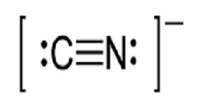
Lewis Acids and Bases
Identify the Lewis acid and base:
4CN⁻ + Cu⁺² 🡪 Cu(CN)₄⁻²
Cu⁺² has no lone pairs.
CN- donates e- and is the Lewis Base.
Cu⁺² gains e- and is the Lewis Acid.

Slide 30
Ion-Product Constant
Write the equilibrium expression for water’s ionization H₂O 🡪 H₃O⁺ + OH⁻
K_{c} = [H₃O⁺] [OH⁻]
This special equilibrium constant is the ion-product constant for water, K_{w}.
At 25°C, K_{w} = 1.0 × 10⁻¹⁴
Now calculate the [H₃O⁺] and [OH⁻].
In pure water, K_{w} = [H₃O⁺] [OH⁻] = 1.0 × 10⁻¹⁴
Because in pure water [H₃O⁺]=[OH⁻], [H₃O⁺] = (1.0 × 10⁻¹⁴)^{1/2} = 1.0 × 10⁻⁷
What is the pH of water? How?

Slide 31
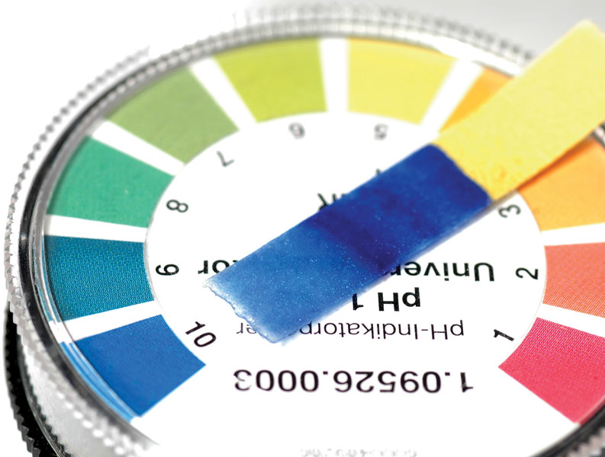
Other “p” Scales
The “p” in pH tells us to take the negative log of the quantity (in this case, hydrogen ions).
pH = -log [H₃O⁺]
pOH= -log [OH⁻]
pH + pOH = 14
[H₃O⁺][OH⁻] = 1.0x10⁻¹⁴

Slide 32
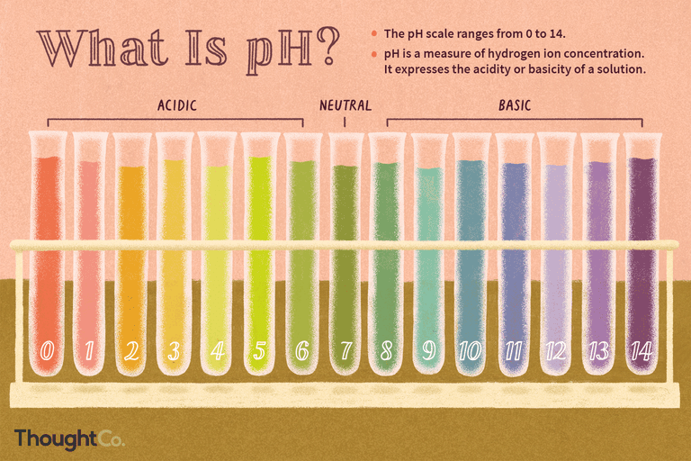
pH and pOH
If the [H₃O⁺] = 1x10⁻³ the pH is
3
If the [H₃O⁺] = 1x10⁻⁹ the pH is
9
If the [OH⁻] = 1x10⁻⁴ the pOH is
4
If the [OH⁻] = 1x10⁻¹² the pOH is
12
If the pH is 3 the pOH is
11
If the pOH is 12 the pH is
2

Slide 33
How Do We Measure pH?
For less accurate measurements, one can use
Litmus paper
“Red” paper turns blue above ~pH = 8
“Blue” paper turns red below ~pH = 5
An indicator
Phenolphthalein changes color at pH=8

Slide 34
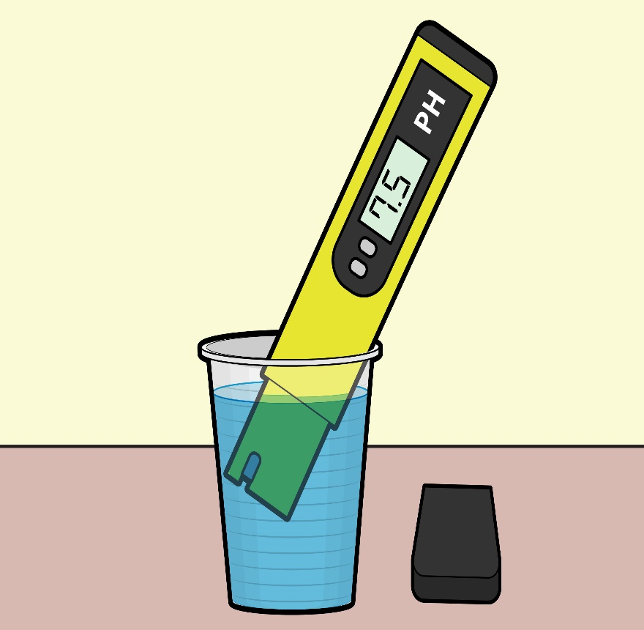
How Do We Measure pH?
Indicators and pH papers like litmus can be used to measure relative pH values.
For more accurate measurements, one uses a pH meter, which measures the voltage in the solution.

Slide 35
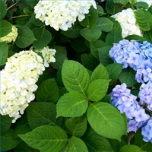
Earth’s Natural Litmus
Hydrangeas are blue when the acidity of the soil is between 5-5.5 and red if the acidity is between 6.5-7.5. A mix of colors can be seen between 5.5-6.5.

Slide 36
Strong Acids
You will recall that the seven strong acids are HCl, HBr, HI, HNO₃, H₂SO₄, H₃PO₄, and HClO₄.
These are, by definition, strong electrolytes and exist totally as ions in aqueous solution.
For the monoprotic strong acids, [H₃O⁺] = [acid].
To calculate the pH for strong acids use pH = -log [H₃O⁺]

Slide 37
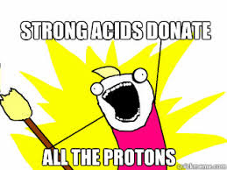
pH of Strong Acids
If the concentration of HA is 2.5x10⁻³M calculate the pH.
-log(2.5x10⁻³) = 2.60
If the concentration of HA is 3.5x10⁻⁸M calculate the pH.
-log (3.5x10⁻⁸) = 7.46

Slide 38
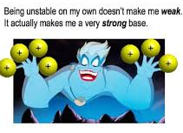
Strong Bases
Strong bases are the soluble hydroxides, which are the alkali metal and heavier alkaline earth metal hydroxides (Ca⁺² and Ba²⁺).
Again, these substances dissociate completely in aqueous solution. And [Base] = [OH⁻]
pH = 14-(-log[OH⁻])

Slide 39
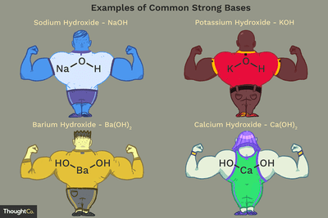
pH of Strong Bases
If the concentration of MOH is 1.5x10⁻⁴M calculate the pH.
14-[-log(1.5x10⁻⁴)] = 10.18
If the concentration of MOH is 2.2x10⁻¹³ M calculate the pH.
14-[-log (2.2x10⁻¹³)] = 1.34

Slide 40
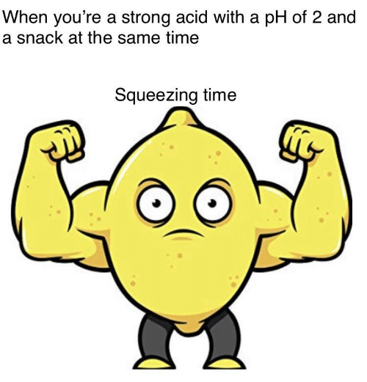
Think
What’s another way to calculate the pH of 2.2x10⁻¹³ M MOH?
1.0x10⁻¹⁴/2.2x10⁻³ = 0.045
-log(0.045) = 1.34

Slide 41
pH square

Slide 42
Dissociation Constants
For a generalized acid dissociation,
the equilibrium expression would be
This equilibrium constant is called the acid-dissociation constant, K_{a}.
HA(aq) + H₂O(l)
A⁻(aq) + H₃O⁺(aq)
[H₃O⁺] [A⁻]
[HA]
K_{c} =

Slide 43
Dissociation Constants
The greater the value of K_{a}, the stronger the acid. The strongest acids don’t report Ka values.

Slide 44
Calculating pH from K_{a}
Calculate the pH of a 0.30 M solution of acetic acid, HC₂H₃O₂, at 25°C.
HC₂H₃O₂(aq) + H₂O(l) H₃O⁺(aq) + C₂H₃O₂⁻(aq)
K_{a} for acetic acid at 25°C is 1.8 × 10⁻⁵.

Slide 45
Calculating pH from K_{a}
[H₃O⁺] [C₂H₃O₂⁻]
[HC₂H₃O₂]
K_{a} =
 | [HC₂H₃O₂], M | [H₃O⁺], M | [C₂H₃O₂⁻], M
Initially | 0.30 | 0 | 0
Change | −x | +x | +x
Equilibrium | 0.30 − x | x | x

Slide 46
Calculating pH from K_{a}
(x)²
(0.30-x)
1.8 × 10⁻⁵ =
We are assuming that x will be very small compared to 0.30 and can be ignored.
(1.8 × 10⁻⁵) (0.30) = x²
2.3 × 10⁻³ = x
pH = −log [H₃O⁺] = −log (2.3 × 10⁻³) = 2.64

Slide 47
Calculate the pH of 0.50M HF. (Ka=6.8x10⁻⁴)
HF + H₂O <-> H₃O⁺ + F⁻
 | [HF], M | [H₃O⁺], M | [F⁻], M
I | 0.50 | 0 | 0
C | −x | +x | +x
E | 0.50 − x | x | x
(x)²
(0.5)
(6.8 × 10⁻⁴) (0.5) = x²
3.4 × 10⁻⁵ = x²
5.8 × 10⁻³ = x
6.8 × 10⁻⁴ =
[H⁺] = 5.8 × 10⁻³ M
pH = −log (5.8 × 10⁻³)= 2.23

Slide 48
Calculate the pH of 0.90M HF. (Ka=6.8x10⁻⁴)
HF + H₂O <-> H₃O⁺ + F⁻
 | [HF], M | [H₃O⁺], M | [F⁻], M
I | 0.90 | 0 | 0
C | −x | +x | +x
E | 0.90 − x | x | x
(6.8 × 10⁻⁴) (0.9) = x²
6.1 × 10⁻⁴ = x²
2.4 × 10⁻² = x
(x)²
(0.9)
6.8 × 10⁻⁴ =
[H⁺] = 2.4 × 10⁻² M
pH = −log (2.4 × 10⁻²)= 1.61
Notice increasing the concentration decreased the pH

Slide 49
Calculate the pH of 0.36M HNO₂. (Ka=4.5x10⁻⁴)
HNO₂ + H₂O <-> H₃O⁺ + NO₂⁻
 | [HNO₂], M | [H₃O⁺], M | [NO₂⁻], M
I | 0.36 | 0 | 0
C | −x | +x | +x
E | 0.36 − x | x | x
(x)²
(0.36)
(4.5 × 10⁻⁴) (0.36) = x²
1.6 × 10⁻⁴ = x²
1.3 × 10⁻² = x
4.5 × 10⁻⁴ =
[H⁺] = 1.3 × 10⁻² M
pH = −log (1.3 × 10⁻²)= 1.90

Slide 50
Predict the favored direction of:
HNO₂ + F⁻ 🡨 🡪 NO₂⁻ + HF
HF (Ka=6.8x10⁻⁴)
HNO₂ (Ka=4.5x10⁻⁴)

Slide 51
Calculating Percent Ionization
[H₃O⁺]_{eq}
[HA]_{initial}
Percent Ionization = × 100
In a previous example 0.36M HNO₃ had 1.3x10⁻²M H⁺ ions.
1.3x10⁻² x 100 = 3.6% ionized
0.36
Weak acids tend to ionize less than 5% of the time

Slide 52
Weak Bases
Bases react with water to produce hydroxide ion.
[HB] [OH⁻]
[B⁻]
K_{b} =

Slide 53
Weak Bases
K_{b} can be used to find [OH⁻] and, through it, pH of weak bases.

Slide 54
What is the pH of a 0.15 M solution of NH₃?
NH₃(aq) + H₂O(l)
NH₄⁺(aq) + OH⁻(aq)
K_{b} =
[NH₄⁺] [OH⁻]
[NH₃]
= 1.8 × 10⁻⁵
 | [NH₃], M | [NH₄⁺], M | [OH⁻], M
Initially | 0.15 | 0 | 0
Change | -x | +x | +x
Equili-brium | 0.15 - x ≈ 0.15 | x | x
(x)²
(0.15)
1.8 × 10⁻⁵ =
(1.8 × 10⁻⁵) (0.15) = x²
2.7 × 10⁻⁶ = x²
1.6 × 10⁻³ = x
[OH⁻] = 1.6 × 10⁻³ M
pOH = −log (1.6 × 10⁻³)= 2.80
pH = 14.00 − 2.80 = 11.20

Slide 55
K_{a} and K_{b}
K_{a} × K_{b} = K_{w} = 1.0x10⁻¹⁴

Slide 56
Calculating K_{a} from the pH
The pH of a 0.10 M solution of HCOOH, at 25°C is 2.38. Calculate K_{a} for formic acid.
[H₃O⁺] [HCOO⁻]
[HCOOH]
K_{a} =
We can find the [H₃O⁺] from the pH.
Remember that the [H₃O⁺] = [HCOO⁻]
10^{−2.38} = [H₃O⁺] =4.2 × 10⁻³
 | [HCOOH], M | [H₃O⁺], M | [HCOO⁻], M
Initially | 0.10 | 0 | 0
Change | −x | +x | +x
Equilibrium | 0.10 − x | x 4.2 × 10⁻³ | x 4.2 × 10⁻³
[4.2 × 10⁻³] [4.2 × 10⁻³]
[0.10]
K_{a} =
= 1.8 × 10⁻⁴

Slide 57
Calculate the Ka of 2.0M acid with a pH of 5.45
pH = 5.45
[H+] = 10^{-5.45}
Ka = x²/M = (10^{-5.45})²/2
Ka = 6.3x10⁻¹²

Slide 58
Polyprotic Acids
If the difference between the K_{a} for the first dissociation and subsequent K_{a} values is 10³ or more, the pH generally depends only on the first dissociation.

Slide 59
Calculate the pH of 0.10M H₂SO₄ assuming it ionizes only once.
H₂SO₄ 🡪 H⁺ + HSO₄⁻
pH = -log(0.10) = 1.0

Slide 60
Calculate the pH of 0.10M H₂SO₄ assuming it fully ionizes.
H₂SO₄ 🡪 2H⁺ + SO₄⁻²
pH = -log(0.20) = 0.70

Slide 61
Calculate the actual pH of 0.10M H₂SO₄ (Ka₂= 1.2x10⁻²)
H₂SO₄ 🡪 H⁺ + HSO₄⁻ Strong acid fully ionizes
0.10 0.10 0.10
HSO₄⁻ 🡪 H⁺ + SO₄⁻² Weak acid ice box
0.10 0.10 0
-x +x +x
0.10-x 0.10+x x
[x(0.10+x)]/(0.10-x) = 1.2x10⁻²
0.10x/0.10 = 1.2x10⁻²
X = 1.2x10⁻²
[H⁺] = 0.10 +1.2x10⁻² = 0.112
pH = -log(0.112) = .95

Slide 62
Calculate the pH of 0.10M H₂SO₃ assuming it ionizes twice, Ka₁=1.7x10⁻² and Ka₂=6.4x10⁻⁸
Ice box both ☹
OR just remember to add the second Ka value to your x!
HSO₃⁻ 🡪 H⁺ + SO₃⁻²
1.7x10⁻³ 1.7x10⁻³ 0
-x +x +x
1.7x10⁻³-x 1.7x10⁻³ +x x
[x(1.7x10⁻³ +x)]/(1.7x10⁻³ -x) = 6.4x10⁻⁸
1.7x10⁻³ x/ 1.7x10⁻³ = 6.4x10⁻⁸
x = 6.4x10⁻⁸
H₂SO₃ 🡪 H⁺ + HSO₃⁻
0.10 0 0
-x +x +x
0.10-x x x
x=1.7x10⁻³
1.7x10⁻³ + 6.4x10⁻⁸ = 1.7x10⁻³
pH = - log(1.7x10⁻³) = 2.77

Slide 63
Factors Affecting Acid Strength
The more polar the bond between H and it’s neighboring element (or the weaker the H-X bond/IMF) the more acidic the compound (it will lose H⁺ better because the other bond is more attracted).

Slide 64
Factors Affecting Acid Strength
In oxyacids, in which an OH is bonded to another atom, Y, the more electronegative Y is, the more acidic the acid.

Slide 65
Factors Affecting Acid Strength
For a series of oxyacids, acidity increases with the number of oxygens atoms. The increased polarity and strength of the O-X bonds makes the O-H bonds will be weaker and lose H⁺ easier.

Slide 66
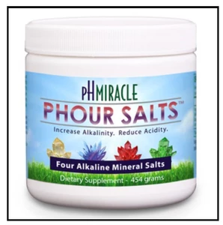
pH of salts
The cation of a salt comes from the base in a reaction. The anion of the salt comes from the acid.
NaOH + HCl 🡪 NaCl + H₂O
SA + SB 🡪 Neutral Salt
WA + SB 🡪 Basic Salt
SA+WB🡪 Acidic Salt
WA + WB🡪 depends on Ka and Kb values.
Any weak particles will react with the water (hydrolysis)

Slide 67
pH of salts
Are these salts acidic, basic, or neutral?
NaBr
Li₂CO₃
KF
Mg(NO₃)₂
CaCl₂
NaOH and HBr SB/SA Neutral
LiOH and H₂CO₃ SB/WA Basic
KOH and HF SB/WA Basic
Mg(OH)₂ and HNO₃ WB/SA Acidic
Ca(OH)₂ and HCl SA/SB Neutral

Slide 68
Calculate the pH of 0.15M CH₃COONa and the % hydrolysis. Ka= 1.8x10⁻⁵
CH₃COONa + H₂O 🡪 CH₃COO⁻ + Na⁺
CH₃COO⁻ + H₂O 🡪 CH₃COOH + OH⁻
I | .15 | 0 | 0
C | -x | +x | +x
E | .15-x | x | x
x = 9.2x10⁻⁶
pOH = 5.04
pH = 8.96
%H = 0.0060%
(x)²
(0.15)
Kb=5.6 × 10⁻¹⁰ =

Slide 69
Question of the video:
The active ingredient in bleach is sodium hypochlorite. Is bleach acidic, basic, or neutral?
NaOCl
from NaOH (Strong base) and HOCl (weak acid)
Basic solution
HOW BASIC IS A STANDARD 1M SOLUTION OF BLEACH?
Ka = 2.9x10⁻⁸
Kb = Kw/Ka = 1x10⁻¹⁴/2.9x10⁻⁸ = 3.45x10⁻⁷
Kb = 3.45x10⁻⁷ = x²/1
x = 5.87x10⁻⁴ = [OH⁻] pH = 14- -log(5.87x10⁻⁴) = 10.77

Slide 70
YOU MUST BE ABLE TO
Explain what factors affect acid strength.
Use Lewis theory to determine if a substance is acidic or basic.
Characterize salts as acidic or basic.

Slide 71
Strong Acid/Base Titrations

Slide 72
Objectives
You should already be able to…
Calculate the concentration, pH or K for any acid or base.
By the end of the video you should be able to…
Describe titration set-ups and purpose.
Read and explain a strong A/B titration graph.
Calculate the pH at any point during a strong acid and strong base reaction.

Slide 73
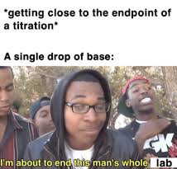
Question of the video:
Why is it so important to titrate slowly?

Slide 74
Titration Definitions
A known concentration of base (or acid) is slowly added to a solution of an unknown acid (or base) to determine it’s concentration.
This is also known as standardization if a primary standard (solid, where the moles are constant) is used to determine the molarity of a substance.

Slide 75
Titration Methods
A pH meter or indicators are used to determine when the solution has reached the equivalence point, or neutralization point, at which the moles of acid equals that of base.
The endpoint is when the indicator actually changes color. You want the endpoint close to the equivalence point.

Slide 76
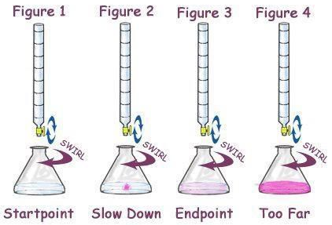
Equivalence during a Titration
Using the M=mol/L formula, MV = moles.
At this equivalence point ONLY,
the moles of acid = the moles of base.
Therefore, you can use M_{A}V_{A}=M_{B}V_{B}
to determine the molarity of the unknown
solution at the equivalence point only.

Slide 77
Example at Equivalence
An unknown concentration of NaOH was found in the stockroom. I measured 20.00mL of the 2.00M HCl into a flask and added a few drops of phenolphthalein. I filled a clean 50.00mL buret with unknown NaOH and began the titration, slowly adding NaOH drop wise until a faint pink color appeared. Initially the volume of base read 0.15mL but when the titration was complete, the volume read 35.45mL. What is the concentration of the base?
(2.00M)(0.02000L) = 0.0400 moles of HCl
0.0400 moles of HCl = moles of NaOH
0.0400moles of NaOH/(0.03545-0.00015) = 1.13M
Or (2.00M)(20.00mL) = (x)(35.45-0.15mL) = 1.13M

Slide 78
Titration of a Strong Acid with a Strong Base
From the start of the titration to near the equivalence point, the pH goes up slowly.
Just before and after the equivalence point, the pH increases rapidly.

Slide 79
Titration of a Strong Acid with a Strong Base
At the equivalence point, moles acid = moles base, and the solution contains only water and the neutral salt. The pH equals 7.

Slide 80
Strong Acid Base Titration
Once the concentrations are known, the pH can be calculated at any point during the titration.
Write the reaction. Single arrow if both species are strong.
Start an ICE box, with initial values in moles.
Determine changes in mole ratios: the x value will be equal to the lowest initial value.
Determine equilibrium values by subtraction and addition.
If a strong acid or strong base is left over, divide the left over by the TOTAL VOLUME used because they are in the same container, diluted by one another.
Calculate the pH. (-log[H₃O⁺])

Slide 81
Strong Species before Neutralization
.025L x 0.10M = .0025 mol
Calculate the pH when 25.0mL of 0.10M HCl is titrated with 10.0mL of 0.10M NaOH.
HCl + NaOH 🡪 NaCl + H₂O
I .0025 .001 0 0
C -.001 -.001 +.001 +.001
E .0015 0 .001 .001
-log (.0015/(.025+.01)) = 1.37
.010L x 0.10M = .001 mol

Slide 82
Strong Species at Neutralization
Calculate the pH when 25.0mL of 0.10M HCl is titrated with 25.0mL of 0.10M NaOH.
HCl + NaOH 🡪 NaCl + H₂O
I .0025 .0025 0 0
C -.0025 -.0025 +.0025 +.0025
E 0 0 .00125 .0025
Only salt and water left pH = 7
.025L x 0.10M = .0025 mol

Slide 83
Strong Species near the end of a Titration
.025L x 0.10M = .0025 mol
Calculate the pH when 25.0mL of 0.10M HCl is titrated with 35.0mL of 0.10M NaOH.
HCl + NaOH 🡪 NaCl + H₂O
I .0025 .0035 0 0
C -.0025 -.0025 +.0025 +.0025
E 0 .001 .0025 .0025
14-[-log (.001/(.025+.035))] = 12.22
.035L x 0.10M = .0035 mol

Slide 84
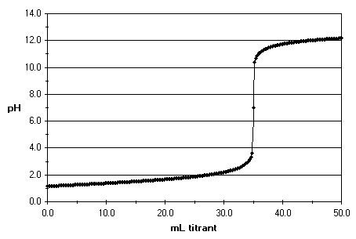
Question of the video:
Why is it so important to titrate slowly?
The equivalence point is at pH = 7 and 35 mL of 1.0M NaOH was used to neutralize 20 mL of unknown acid. What is the concentration of the acid?
1.0M (0.035L) = 0.035mole base used
0.035moles of acid/ 0.020L = 1.75M acid
What was the pH at 34mL?
1.75M (0.020L) = 0.035moles of acid still in solution.
1.0M (0.034L) = 0.034moles of base added
0.001 moles SA in (0.020L + 0.034L)
[H⁺] = 0.0185M pH= -log(0.0185) = 1.73

Slide 85
YOU MUST BE ABLE TO:
Describe the titration set-up and explain its purpose.
Read and explain points on a Strong Acid/Strong Base titration graph.
Calculate the pH during any point of a strong acid and strong base reaction.

Slide 86
Buffers

Slide 87
Objectives
You should already be able to…
Identify acids, bases and salts.
Calculate pH from hydronium and hydroxide concentrations.
By the end of the video you should be able to…
Identify and explain buffer systems.
Calculate the pH of a buffer.

Slide 88
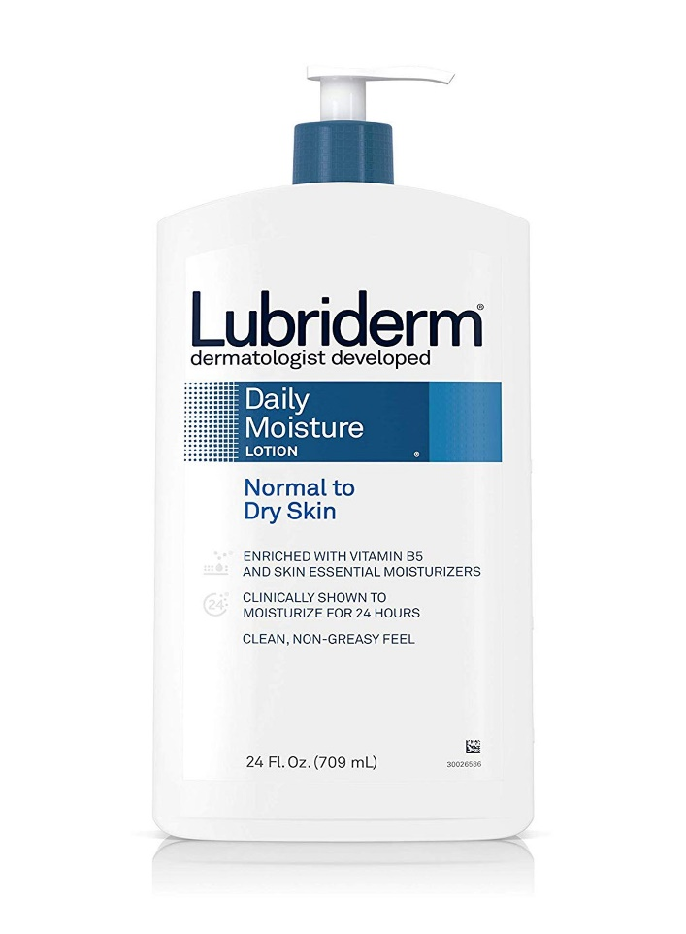
Question of the Video: What chemical property do these household products have in common?

Slide 89
The Common-Ion Effect
HC₂H₃O₂ + H₂O(l)
H₃O⁺ + C₂H₃O₂⁻
If acetate ion is added to the solution, LeChâtelier says the equilibrium will shift to the _______.
A weak acid ionizes______when a common ion is added to the solution.
Left
Less

Slide 90
Buffers
Buffers are solutions of a weak conjugate acid-base pair.
They are resistant to pH changes, even when strong acid or base is added.
Buffers are used to maintain pH balances .
Effectiveness depends on volume used.

Slide 91
Buffer pH may change slightly with the addition of chemicals but not drastically.

Slide 92
Buffers
If a small amount of hydroxide is added to an equimolar solution of HF in NaF, for example, the HF reacts with the OH⁻ to make F⁻ and water.

Slide 93
Buffers
If acid is added, the F⁻ reacts to form HF and water.

Slide 94
Which are buffer systems?
No, strong acid present
Yes, acidic buffer
Yes, acidic buffer
Yes, basic buffer
No, strong base present
KH₂PO₄/H₃PO₄
NaClO₃/HClO₃
CH₃COOH/CH₃COONa
NH₃/NH₄⁺
NaOH/NaCl
Buffers must contain weak acids or bases and their conjugates.

Slide 95
Calculate the pH of a buffer using 0.20M HF and 0.10M NaF. Ka = 6.8x10⁻⁴
 | HF | H⁺ | F⁻
I | 0.2 | 0 | 0.1
C | -x | +x | +x
E | 0.2-x | x | 0.1+x
Ka = (.1+x)(x) = 6.8x10⁻⁴
(.2-x)
Ka = (.1)(x) = 6.8x10⁻⁴
(.2)
x = 1.36x10⁻³
pH = 2.87

Slide 96
Calculate the pH of a buffer using 0.250M CH₃COOH and 0.150M CH₃COONa. Ka = 1.8x10⁻⁵
 | CH₃COOH | H⁺ | CH₃COO⁻
I | 0.250 | 0 | 0.150
C | -x | +x | +x
E | 0.25-x | x | 0.150+x
Ka = (.15+x)(x) = 1.8x10⁻⁵
(.25-x)
Ka = (.15)(x) = 1.8x10⁻⁵
(.25)
x = 3x10⁻⁵
pH = 4.52

Slide 97
Buffer Calculations
Rearranging your calculations you can use the Henderson-Hasselbalch equation found on your reference table:
[base]
[acid]
pH = pK_{a} + log
[acid]
[base]
pOH = pK_{b} + log

Slide 98
Henderson–Hasselbalch Equation
What is the pH of a buffer that is 0.12 M in lactic acid, HC₃H₅O₃, and 0.10 M in sodium lactate? K_{a} for lactic acid is1.4 × 10⁻⁴.
[base]
[acid]
pH = pK_{a} + log
(0.10)
(0.12)
pH = −log (1.4×10⁻⁴) + log
pH = 3.85 + (−0.08)
pH = 3.77

Slide 99
pH Range
The pH range is the range of pH values over which a buffer system works effectively.
It is best to choose an acid with a pK_{a} close to the desired pH. This means the [H⁺] equals Ka. Why?
Because the amounts of the acid and base will be equal so they can both sufficiently counterbalance additions of solutions.
[base]
[acid]
pH = pK_{a} + log

Slide 100
Review Buffers
Consider the reaction: CH₃COOH 🡪 CH₃COO⁻ + H⁺
CH₃COONa is a ______ salt. It ionizes into _______ and ________.
Adding sodium acetate to the reaction above will shift the reaction to the _______, and will __________ the ionization of the acid.
basic
Na+
CH₃COO-
left
decrease

Slide 101
Review Buffers
A buffer resists changes in pH since it contains both acidic and basic species.
If OH- is added, it reacts with the _____ part of the buffer.
If H+ is added, it reacts with the _____ part of the buffer.
The acidic and basic species in the buffer cannot consume each other in a _________ reaction, or it won’t work.
This is why the buffer must have ___ acids and ___ bases.
acidic
basic
neutralization
weak
weak

Slide 102
Question of the Video: What chemical property do these household products have in common?
Sodium borate and boric acid
Sodium citrate and citric acid
Sodium citrate and citric acid

Slide 103
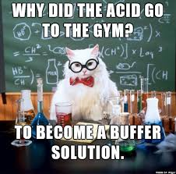
YOU MUST BE ABLE TO:
Identify and explain buffer systems.
Calculate the pH of a buffer.

Slide 104
Weak Acid/Base Titrations

Slide 105
Objectives
You should already be able to…
Identify weak acids and weak bases.
Calculate pH from ion concentrations.
Calculate the pH of a buffer system.
By the end of the video you should be able to…
Read and describe a weak acid or weak base titration curve.
Calculate the pH during a weak acid or weak base titration.
Identify and explain the significance of the half titration point.

Slide 106
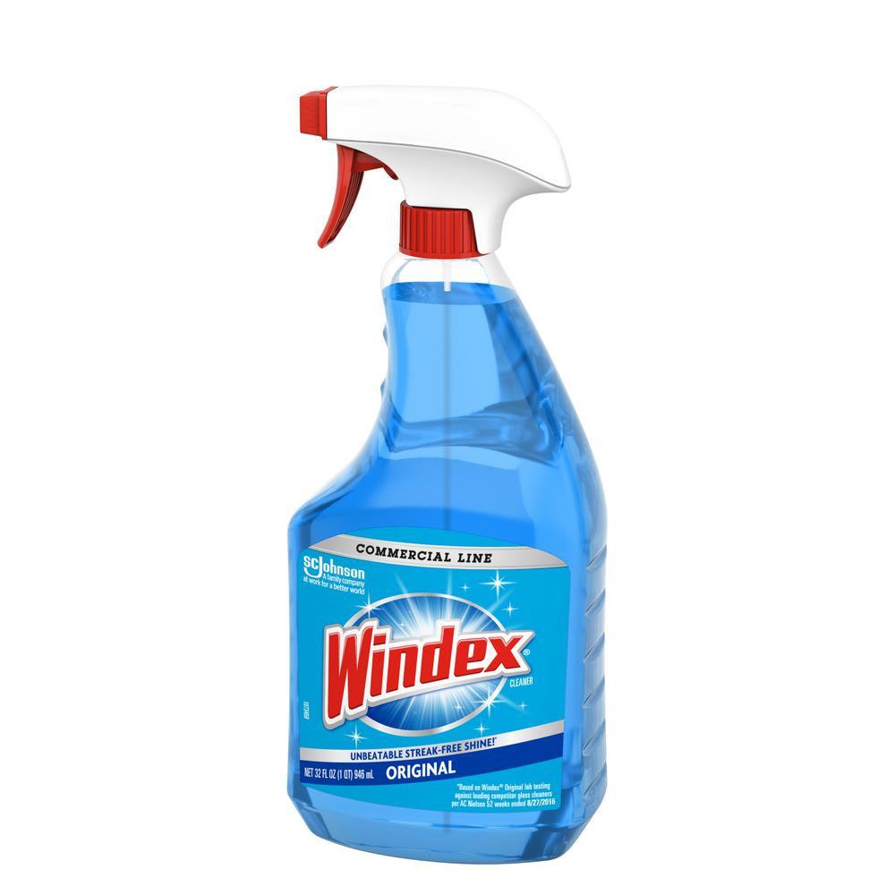
Question of the video:
What is the concentration of ammonia in Windex if 24.54mL of 1.20M HCl is needed to titrate 10.00mL of the cleaner?

Slide 107
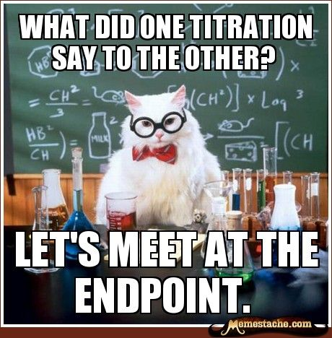
THINK:
How would a titration of a strong base with a strong acid differ from weak acid/ strong base? How are they similar?

Slide 108
Titration of a Weak Acid with a Strong Base
Now, the conjugate base of the acid affects the pH when it is formed. It creates a buffer!
The pH at the equivalence point will be >7.
The weak acid’s titration curve starts at a higher pH and has a slight bump.

Slide 109
Titration of a Weak Base with a Strong Acid
Again, the conjugate acid affects the pH at the beginning of the reaction due to the formation of a buffer.
The pH at the equivalence point in these titrations is < 7.
The pH starts very high with a base and should have a slight bump.

Slide 110
Titrations of Polyprotic Acids
In these cases there is an equivalence point for each dissociation.

Slide 111
Weak Acid or Base Titration
Steps:
Write the reaction. Double arrow if one species is weak.
Start and ICE, with initial values in moles.
Determine changes in mole ratios: the x value will be equal to the lowest initial value.
Determine equilibrium values by subtraction and addition.
If a strong acid or strong base is left over, divide the left over by the TOTAL VOLUME used.
Calculate pH. (-log[H⁺])
If a weak acid or base is left over, calculate the pH using Ka or Hasselbach.

Slide 112
Weak Acid with Strong Base before Equivalence
Calculate the pH when 25.0mL of 0.10M acetic acid (Ka=1.8x10⁻⁵) is titrated with 10.0mL of 0.10M NaOH.
HC₂H₃O₂ + NaOH 🡪 NaC₂H₃O₂ + H₂O
I .0025 .001 0 0
C -.001 -.001 +.001 +.001
E .0015 0 .001 .001
Weak acid and non-neutral salt left over
You can solve the acid’s Ka expression using ice box:

Slide 113
HC₂H₃O₂ + NaOH 🡪 NaC₂H₃O₂ + H₂O
I .0025 .001 0 0
C -.001 -.001 +.001 +.001
E .0015 0 .001 .001
Ka=[H⁺][C₂H₃O₂⁻]/[HC₂H₃O₂]
1.8x10⁻⁵ = [x][.001]/[.0015]
X= H⁺ = 2.7x10⁻⁵
pH = -log(2.7x10⁻⁵) = 4.57 (higher than SA/SB titration)
*Or hasselbach: pH = pKa + Log (S/A)
pH = -log(1.8x10⁻⁵) + log(.001/.0015)
pH = 4.57

Slide 114
Weak Acid with Strong Base after Equivalence
Calculate the pH when 25.0mL of 0.10M acetic acid (Ka=1.8x10⁻⁵) is titrated with 35.0mL of 0.10M NaOH.
HC₂H₃O₂ + NaOH 🡪 NaC₂H₃O₂ + H₂O
I .0025 .0035 0 0
C -.0025 -.0025 +.0025 +.0025
E 0 .001 .0025 .0025
Strong base left over
14-[-log(.001/.060)] = 12.22
(same as SA SB titration)

Slide 115
Strong Acid with Weak Base before Equivalence
Calculate the pH when 25.0mL of 0.10M HCl is titrated with (Kb=1.8x10⁻⁵)10.0mL of 0.10M NH_{3.}
HCl + NH₃ 🡪 NH₄Cl + H₂O
I .0025 .001 0 0
C -.001 -.001 +.001 +.001
E .0015 0 .001 .001
Strong Acid left over
-log(.0015/.035) = 1.37 (same as SA/SB titration)

Slide 116
Strong Acid with Weak Base after Equivalence
Calculate the pH when 25.0mL of 0.10M HCl is titrated with: (Kb=1.8x10⁻⁵) 35.0mL of 0.10M NH_{3.}
HCl + NH₃ 🡪 NH₄Cl + H₂O
I .0025 .0035 0 0
C -.0025 -.0025 +.0025 +.0025
E 0 .001 .0025 .0025
Weak base left over
You can solve Kb for the base using ice box:

Slide 117
HCl + NH₃ 🡪 NH₄Cl + H₂O
I .0025 .0035 0 0
C -.0025 -.0025 +.0025 +.0025
E 0 .001 .0025 .0025
Kb=[OH⁻][NH₄⁺]/[NH₃]
1.8x10⁻⁵ = [x][.0025]/[.001]
X= OH⁺ = 7.2x10⁻⁶
pH = 14-[-log(7.2x10⁻⁶)] = 8.86 (lower than SA/SB)
*Or hasselbach: pOH = pKb + Log (S/B)
pOH = -log(1.8x10⁻⁵) + log(.0025/.001)
pH = 8.86

Slide 118
The Half Titration Point
The half titration point of a weak acid can be found by halving the volume of NaOH needed to obtain neutralization. At this point the amount of origional acid equals the amount of conjugate base.

Slide 119
The Half Titration Point
HA H⁺ + A⁻
I M 0 0
C -½M +½M +½M
E ½M ½M ½M
Ka=[H⁺][A⁻]/[HA]
Ka=[½M][½M]/[½M]
Ka=[½M]
Ka=[H⁺]

Slide 120
The Half Titration Point
The Ka equals the concentration of H⁺!
You can use a titration curve to determine the Ka of a weak acid (or weak base).
The ka can be used to ID the acid.
The acid shown has a pH of 5.00 at the half point. The Ka equals
1.00x10⁻⁵

Slide 121
The Half Titration Point
Just remember, at half titration:
pH=pKa
Derived also from Hasselback:
pH=pKa + log (S/A) where S=A

Slide 122
Question of the video:
What is the concentration of ammonia in Windex if 24.54mL of 1.20M HCl is needed to titrate 10.00mL of the cleaner? (ammonia Kb = 1.8x10-5)
1.20M (0.02454) = 0.29448 moles of acid used
0.29448 moles of base /0.010L = 2.94M
What is the pH at if 12.0mL Windex was used to clean a spill of 25.00mL of the HCl?
1.20M (0.0250L) = 0.0300 moles HCl
2.94M (0.012L) = 0.0353 moles ammonia
0.0053 moles of ammonia and salt left in solution
pOH = -log (1.8x10⁻⁵) + log (0.0300/0.0053) = 5.498
pH = 14-5.498 = 8.502

Slide 123
YOU MUST BE ABLE TO:
Read and describe a weak acid or weak base titration curve.
Calculate the pH during a weak acid or weak base titration.
Identify and explain the significance of the half titration point.

Slide 124
Salt Hydrolysis

Slide 125
Objectives
You should already be able to…
Identify acidic and basic salts.
Calculate pH given ion concentrations.
By the end of the video you should be able to…
Calculate the pH of a salt.

Slide 126
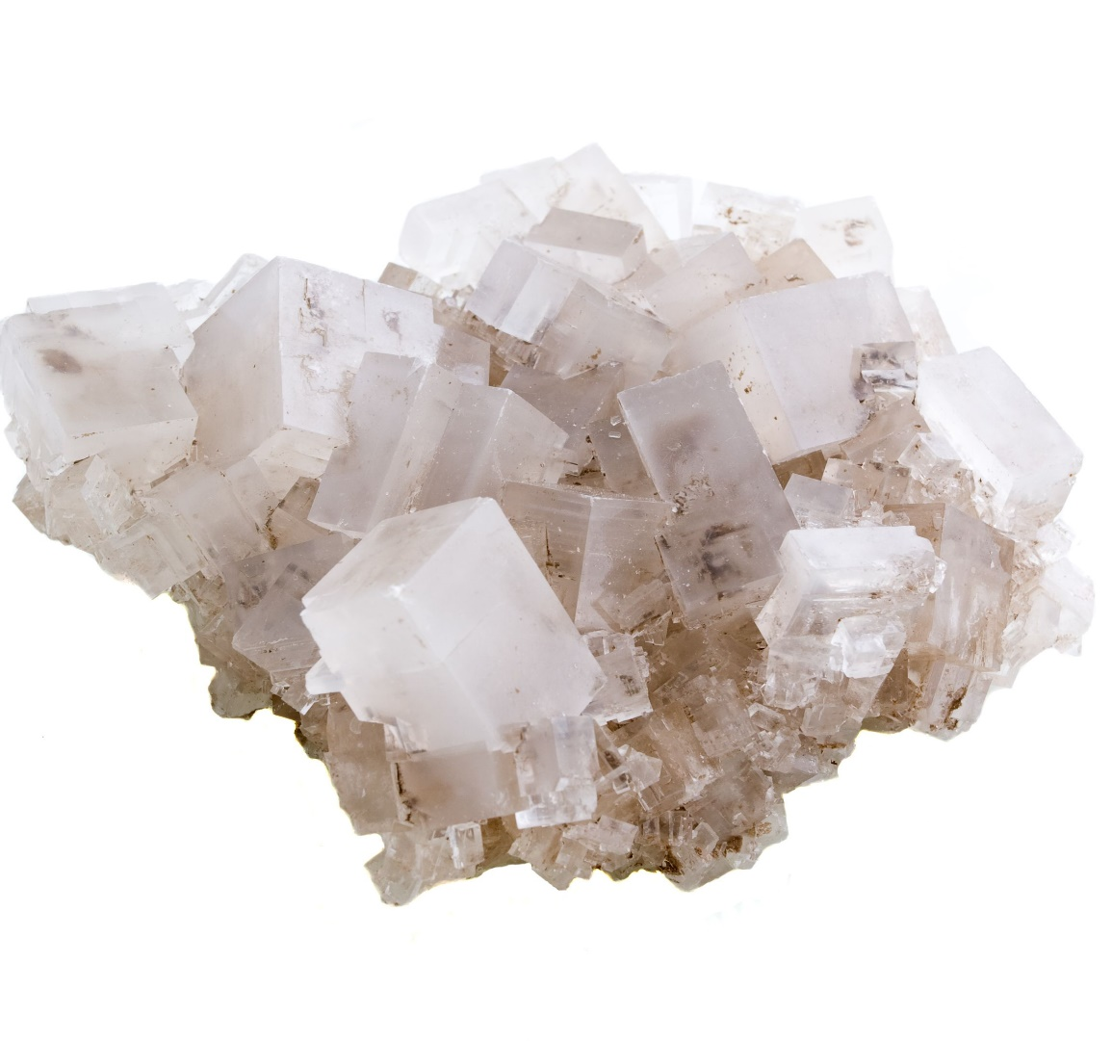
Salt Hydrolysis
When the equivalence point is reached in a titration the moles of acid equal moles of base. This can happen in three scenarios:
SA/SB: the equivalence point is 7.00 because the salt formed is neutral.
WA/SB: the equivalence point is above 7.00 because the salt formed is basic.
WB/SA: the equivalence point is under 7.00 because the salt formed is acidic.
If a basic or acidic salt is formed you must ICE BOX the salt as if it were a weak acid or weak base.

Slide 127
Salt Hydrolysis
The reason salts can create acidic or basic solutions is because the weaker ion re-react with water to create either H⁺ or OH⁻ ion in a reaction known as hydrolysis.
Remember pH is determines by the amount of H⁺ ions! Let’s track the ions that affect pH like H⁺ and OH⁻ in each salt combination.
Strong Acid and Strong Base make Neutral salts:
Molecular Equation: HCl(aq) + NaOH (aq)🡪 NaCl(aq) + H₂O(l)
Ionic Equation: H⁺ + Cl⁻ + Na⁺ + OH⁻ 🡪 Na⁺ + Cl⁻ + H₂O(l)
Net Ionic Equation: H⁺ + OH⁻ 🡪 H₂O(l)
No salt to hydrolyze! pH remains neutral.

Slide 128
Acidic Salt Hydrolysis
Strong Acid and Weak Base make Acidic salts:
Molecular Equation: HCl(aq) + NH₃(aq)🡪 NH₄⁺ +Cl⁻(aq) + H₂O(l)
Ionic Equation: H⁺ + Cl⁻ + NH₃(aq) 🡪 NH₄⁺ + Cl⁻ + H₂O(l)
Net Ionic Equation: H⁺ + NH₃(aq)🡪 NH₄⁺ + H₂O(l)
Hydrolysis: NH₄⁺ + H₂O 🡪 NH₃ + H⁺
(consider this: NH₄⁺ + H⁺OH⁻ 🡪 NH₃ + H⁺)

Slide 129
Basic Salt Hydrolysis
Weak Acid and Strong Base make Basic salts:
Molecular Equation: HF(aq) + NaOH (aq)🡪 NaF(aq) + H₂O(l)
Ionic Equation: HF + Na⁺ + OH⁻ 🡪 Na⁺ + F⁻ + H₂O(l)
Net Ionic Equation: HF + OH⁻ 🡪 F⁻ + H₂O(l)
Hydrolysis: F⁻ + H₂O 🡪 HF + OH⁻
(consider this: F⁻ + H⁺OH⁻ 🡪 HF + OH⁻ )

Slide 130
Salt Hydrolysis Example 1: SA SB
Calculate the pH when 25.0mL of 0.10M HCl is titrated with 25.0mL of 0.10M NaOH.
No Acid or Base is left over but 0.0025 mole of a strong Acid and 0.0025 moles of a strong Base were used which form 0.0025 moles of a salt in a total of 0.050L of solution (25 mL of acid and 25mL of base).
The salt is neutral so the pH = 7!
(0.025L)(0.10M) = 0.0025mol
(0.025L)(0.10M) = 0.0025mol

Slide 131
Salt Hydrolysis Example 2: SA WB
(0.025L)(0.10M) = 0.0025mol
(0.025L)(0.10M) = 0.0025mol
Calculate the pH when 25.0mL of 0.10M HCl is titrated with: 25.0mL of 0.10M NH₃. (Kb=1.8x10⁻⁵)
No Acid or Base is left over but again, 0.0025 mole of a salt were formed in 0.050L of solution (25 mL acid and 25 mL of base). ICE BOX!
_ X² = 1.0x10⁻¹⁴ (use Ka because the salt is acidic!!!)
(0.0025mol/0.050L) 1.8x10⁻⁵
x = 5.27x10⁻⁶
pH = -log(5.27x10⁻⁶) = 5.27

Slide 132
Salt Hydrolysis Example 3: WA SB
Calculate the pH when 25.0mL of 0.10M acetic acid (Ka=1.8x10⁻⁵) is titrated with 25.0mL of 0.10M NaOH.
No Acid or Base is left over but again, 0.0025 mole of a salt were formed in 0.050L of solution (25 mL acid and 25 mL of base). ICE BOX!
_ X² = 1.0x10⁻¹⁴ (use Kb because the salt is basic!!!)
(0.0025mol/0.050L) 1.8x10⁻⁵
X = 5.27x10⁻⁶
pOH = -log(5.27x10⁻⁶) = 5.27
PH = 14-5.27 = 8.73

Slide 133
YOU MUST BE ABLE TO:
Calculate the pH of a salt.

Slide 134
Complex Ions

Slide 135
Objectives
You should already be able to…
Write Ksp expressions for insoluble salts.
By the end of the video you should be able to…
Explain factors that affect the solubility of a salt.
Identify and explain complex ion formation.

Slide 136
Factors Affecting Solubility
The Common-Ion Effect
If one of the ions in a solution equilibrium is already dissolved in the solution, the equilibrium will shift to the left and the solubility of the salt will decrease.
Solutions of Ba(NO₃)₂ or Na₂SO₄ could inhibit the ionizing of BaSO₄.
BaSO₄(s)
Ba²⁺(aq) + SO₄²⁻(aq)

Slide 137
pH Affects Solubility
If a substance has a strong basic cation, it will be more soluble in an acidic solution. Substances with a strong acidic anions are more soluble in basic solutions.
Which will dissolve in an acidic solution better: NaF or AlCl₃?

Slide 138
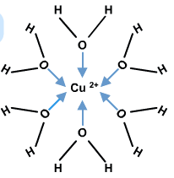
Complex Ion Formation Affects Solubility
Metal ions can act as Lewis acids and form complex ions with Lewis bases in the solvent.
The formation of these complex ions increases the solubility of these salts. The higher the Kf, the more stable the ion is, and the more soluble the substance is.

Slide 139
Sc⁺³ complex ion with H₂O
Sc [Ar] 4s²3d¹
Sc⁺³ [Ar]
Sc hydrizes the open s orbital with three open p orbitals and 2 d orbitals to form six d²sp³ orbitals.

Slide 140
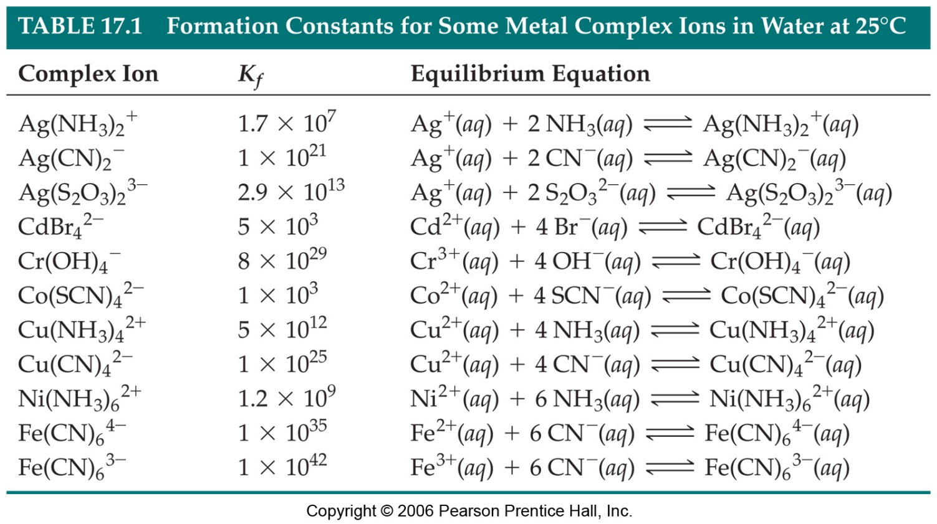

Slide 141
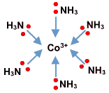
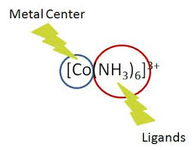
Complex ions
Co⁺² + 4Cl⁻ 🡪 CoCl₄⁻²
Double the charge on the cation to find how many anions will bond to it.

Slide 142
Complex Ions Examples
Which are not proper complex ions?
Ag(CN)₂⁻ c. HgCl₄⁻²
CdI₄⁻²
Which ion is the most stable?
Cd(CN)₄⁻² Kf= 7.1x10¹⁶
Co(NH₃)₆³⁺ Kf= 5.0x10³¹
In a complex ion formation, which substance acts like the Lewis acid, the anion or the cation?
d. Cu(NH₃)₃⁺²

Slide 143
Write the balanced net ionic equation:
Copper (II) ions react with excess ammonia
Zinc (I) ions react with excess ammonia
Silver ions react with excess cyanide ions
Cobalt (III) ions are placed in a solution of ammonia.
Cu⁺² + 4NH₃🡪 Cu(NH₃)₄⁺²
Zn⁺ + 2NH₃🡪 Zn(NH₃)₂⁺
Ag⁺ + 2CN⁻🡪 Ag(CN)₂⁻
Co⁺³ + 6NH₃🡪 Co(NH₃)₆⁺³

Slide 144
YOU MUST BE ABLE TO:
Explain factors that affect the solubility of a salt.
Identify and explain complex ion formation.

