Slide 1
Atomic Theory and Structure

Slide 2
Quantum Mechanical Model
Part 1

Slide 3
Objectives
You should already be able to...
Describe subatomic particles in terms of mass, location and charge.
Find the number of each subatomic particle in atoms, ions, and isotopes.
By the end of this video you should be able to...
Construct electron configurations using sublevels.
Describe the Heisenberg Uncertainty Principle.
Describe the shape of electron orbitals.
Explain and utilize Aufbau and Hund's Rules.

Slide 4
Question of the Video
Why does Hydrogen form this specific line spectra?

Slide 5
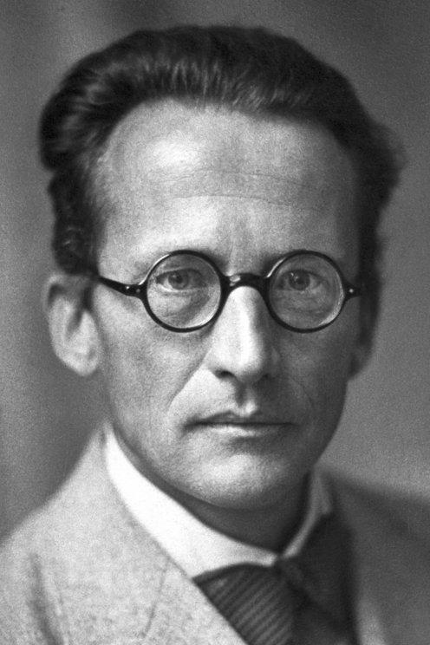
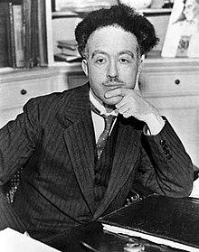
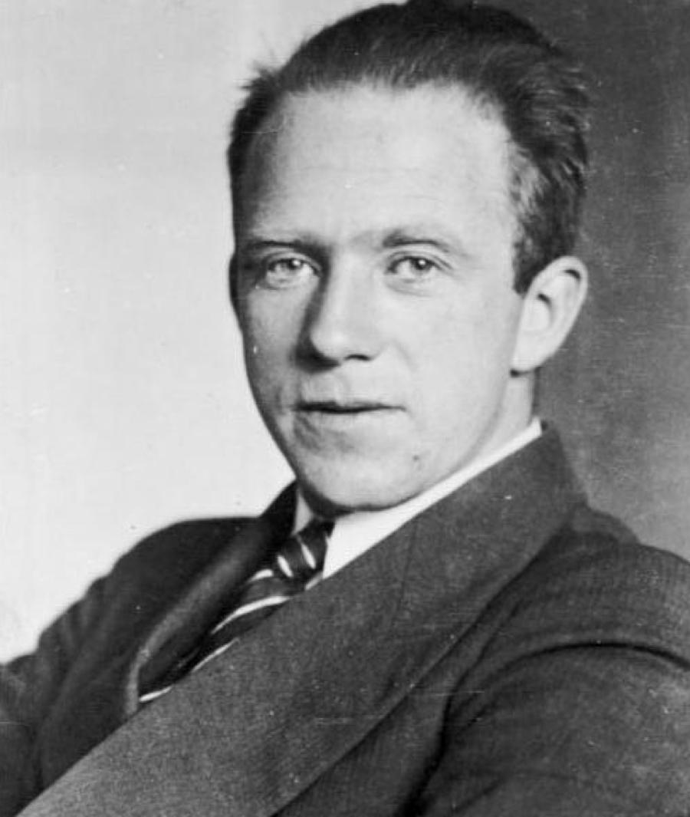
Quantum Mechanical Model
Schrodinger, de Brogli, and Heisenberg solved mathematical equations to describe the behavior of e⁻ in the H atom as being both particle and wavelike, which lead to the quantum mechanical model.

Slide 6
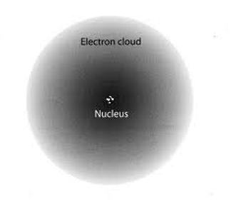
Quantum Mechanical Model
The QMM specifies that each e⁻ has a specific energy, however, they do not follow a specific path. Instead, there are areas of probable e⁻ location, which are called orbitals.

Slide 7
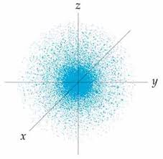
Quantum Mechanical Model
The scientists chose to study the hydrogen e⁻ with the lowest energy (ground state), which they labeled 1s. They found that the e⁻ is moving but not necessarily in circles.

Slide 8
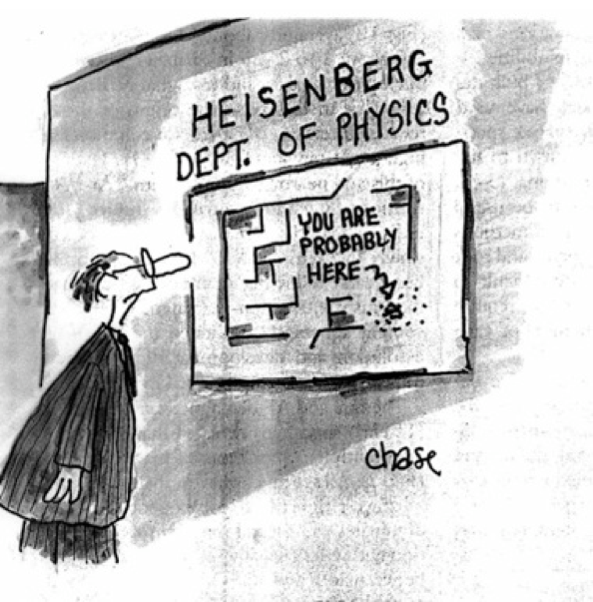
Heisenberg Uncertainty Principle
It’s impossible to know both the location of an e⁻
and its velocity (speed) at the same time.
It is more probable to find an e⁻ near the nucleus. The size of the 1s orbital is described as the radius of a sphere that encloses 90% of the total e⁻ probability.

Slide 9
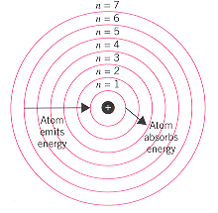
Quantum Mechanical Model
These calculations continued until they could describe any e⁻ from any element.
The first number in an electron configuration represents the overall energy level and corresponds to the row/period that the element can be found in. This is the energy level.

Slide 10
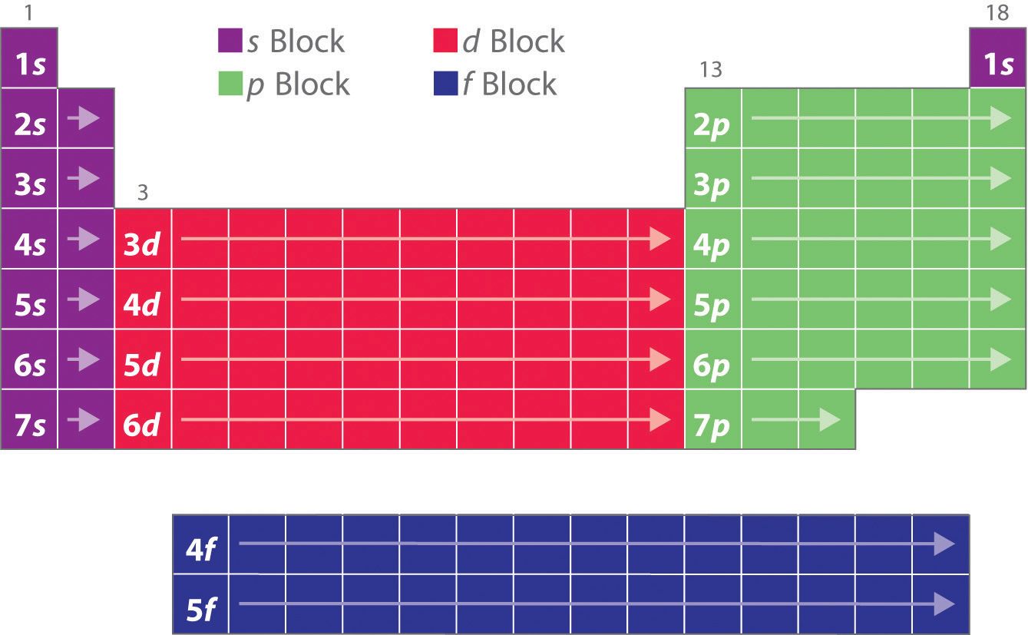
Quantum Mechanical Model
The letter represents the sublevel the electron is in, which correlates to an area of the periodic table. It will tell you the shape of the orbital. (s is spherical, p is lobes and d has 2 lobes).
s p d f

Slide 11
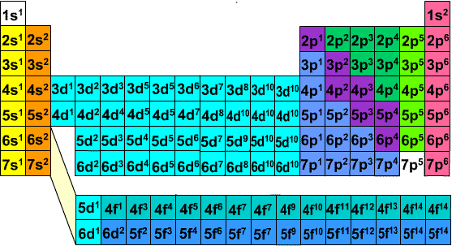
Quantum Mechanical Model
The superscript represents the number of electrons in that sublevel.

Slide 12
S p d orbitals

Slide 13
S orbitals
1s
2s
3s
Highest magnification
Lowest magnification

Slide 14
P orbitals

Slide 15
P orbitals
2p
3p
4p
Highest magnification
Lowest magnification

Slide 16
D orbitals

Slide 17
D orbitals
3d
4d
Highest magnification
Lowest magnification

Slide 18
Examples
Give the row number and sublevel of each of the following elements:
a. Fluorine
b. Carbon
c. Manganese
d. Sodium
e. Phosphorous
2p
2p
3d
3s
3p

Slide 19
Aufbau Principle
As protons are added one by one to the nucleus to build up the elements, so are e⁻.
1s² 2s² 2p⁶ 3s² 3p⁶ 4s² 3d¹⁰ 4p⁶ 5s² 4d¹⁰ 5p⁶ 6s² 4f¹⁴ 5d¹⁰ 6p⁶ 7s² 5f¹⁴ 6d¹⁰ 7p⁶

Slide 20
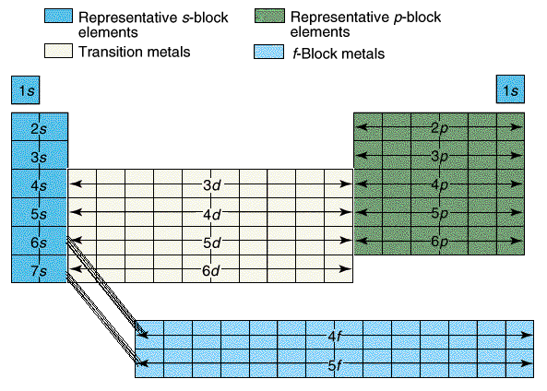
Examples
The configuration for Be ends at 2s and the second element in.
Be is 1s² 2s²
The configuration for Sulfur ends at 3p⁴.
S is 1s² 2s² 2p⁶ 3s² 3p⁴
Ti is 1s² 2s² 2p⁶ 3s² 3p⁴ 4s² 3d¹

Slide 21
Problems?
Try to write electron configurations in the order of the periodic table, denoting the increase in overall energy of the sublevels as you progress through an electron configuration.
This shows that 4s is in fact a lower energy level than 3d.

Slide 22
Orbital Energies

Slide 23
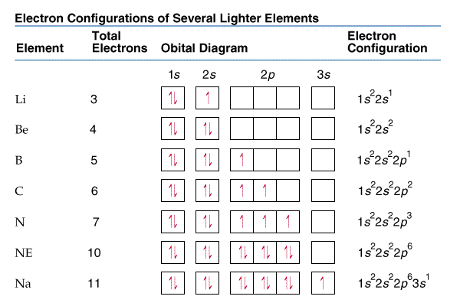

Slide 24
Hund’s Rule
Notice that Carbon’s 6th arrow is in the second p orbital.
Hund’s Rule states the lowest energy configuration is one having the maximum number of unpaired electrons allowed by Pauli Principle in a particular set of degenerate orbitals. They should have parallel spins.
In English? Put one up
arrow in each box
before any get two.

Slide 25
Examples
How many unpaired electrons does Nitrogen have?
How many unpaired electrons does Carbon have?

Slide 26
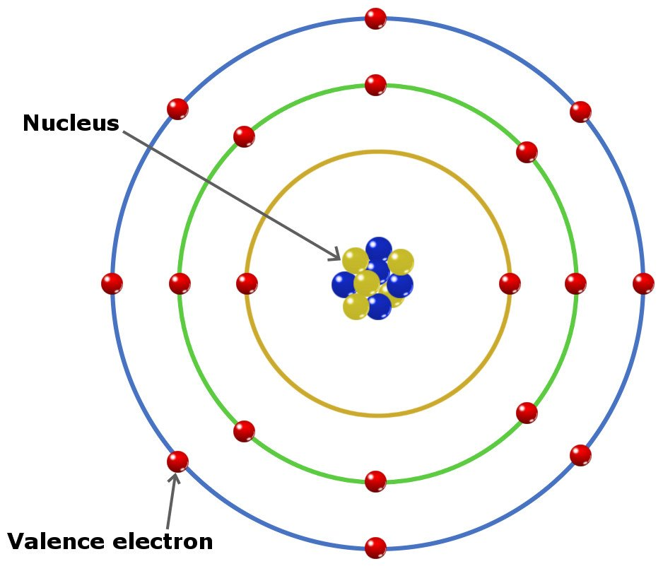
Valence electrons
Valence e⁻ are e⁻ in the outermost principal energy level. The rule still holds: the elements in the same group have the same number of valence e⁻. Therefore, Nitrogen with a configuration of 1s²2s²2p³ and Phosphorous with a configuration of 1s²2s²2p⁶3s²3p³ both have 5 valence e⁻ because they are both in group 15.

Slide 27
You must be able to...
Construct electron configurations using sublevels.
Describe the Heisenberg Uncertainty Principle.
Describe the shape of electron orbitals.
Explain and utilize Aufbau and Hund's Rules.

Slide 28
Quantum Mechanical Model
Part 2

Slide 29
Objectives
You should already be able to...
Describe the difference between atoms, cations, and anions.
Write electron configurations for atoms.
By the end of this video you should be able to...
Construct electron configurations using sublevels for ions including exceptions to the Aufbau principle.
Understand and utilize the noble gas short cut.
Label atoms as diamagnetic or paramagnetic.
Define and identify isoelectric atoms.

Slide 30
Question of the Video
Why is iron magnetic?

Slide 31
Ions
When ions form, electrons are added or subtracted to the valence shell.
Fluorine is 1s² 2s² 2p⁵
The F⁻ is 1s² 2s² 2p⁶
Manganese is 1s² 2s² 2p⁶ 3s² 3p⁶ 4s² 3d⁵
The Mn⁺² ion is 1s² 2s² 2p⁶ 3s² 3p⁶ 3d⁵

Slide 32
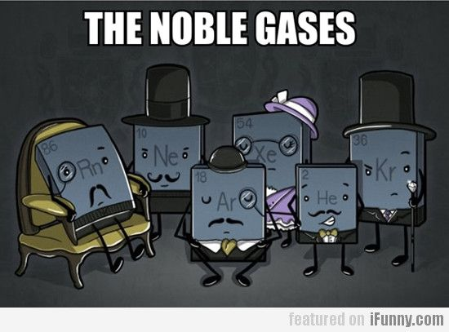
Noble Gas Shortcut
Larger elements will have extremely long configurations. A shortcut is to use noble gas configurations.
Sodium has 11e- and a configuration of 1s²2s²2p⁶3s¹ or [Ne]3s¹.
Sulfur has 16e- and a configuration of 1s²2s²2p⁶3s²3p⁴ or [Ne]3s²3p⁴.

Slide 33
Exceptions
Half filled sublevels are not as stable as filled sublevels, but they are more stable than other configurations.
Ex. Cr looks like it should be 1s²2s²2p⁶3s²3p⁶4s²3d⁴
But it is 1s²2s²2p⁶3s²3p⁶4s¹3d⁵

Slide 34
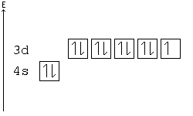
Exceptions
Ex. Cu looks like it should be 1s²2s²2p⁶3s²3p⁶4s²3d⁹
But it is 1s²2s²2p⁶3s²3p⁶4s¹3d¹⁰
This rule is for all transition metals in groups 6 and 11.

Slide 35
Examples
Give the electron configurations using the noble gas shortcut for gold.
[Xe] 6s² 5d⁹
[Xe] 6s¹ 5d¹⁰

Slide 36
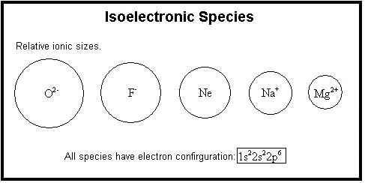
Isoelectronic
When two ions or atoms have the same number of electrons.
Example: Ar and K⁺¹.
Argon: 1s² 2s² 2p⁶ 3s² 3p⁶
Potassium: 1s² 2s² 2p⁶ 3s² 3p⁶ 4s¹
Potassium Ion: 1s² 2s² 2p⁶ 3s² 3p⁶

Slide 37
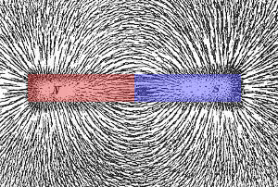
Magnetism
Paramagnetism: A type of induced magnetism associated with unpaired electrons that cause a substance to be attracted to the inducing electric field.
Diamagnetism: a type of magnetic field associated with paired electrons that cause a substance to be repelled from the inducing electric plate.

Slide 38
M a g n e t I s m

Slide 39
You must be able to...
Construct electron configurations using sublevels for ions including exceptions to the Aufbau principle.
Understand and utilize the noble gas short cut.
Label atoms as diamagnetic or paramagnetic.
Define and identify isoelectric pairs of atoms.

Slide 40
Photoelectron Spectrum (PES)

Slide 41
Objectives
You should already be able to...
Describe ionization energy.
Construct electron configurations.
By the end of this video you should be able to...
Compare ionization energies of various atoms.
Determine an element's photoelectron spectrum.

Slide 42
Question of the video:
How are we so sure this spdf thing is real? Why couldn’t we just stick to Bohr models?

Slide 43
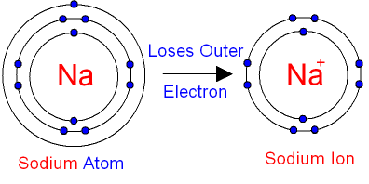
Ionization Energy
IE: The energy needed to remove the valence electron for a gaseous ground state element creating a positive ion.
The second ionization energy corresponds to the removal of the second valence electron (after the first IE)…
Would the second IE require more or less energy than the first and why?

Slide 44
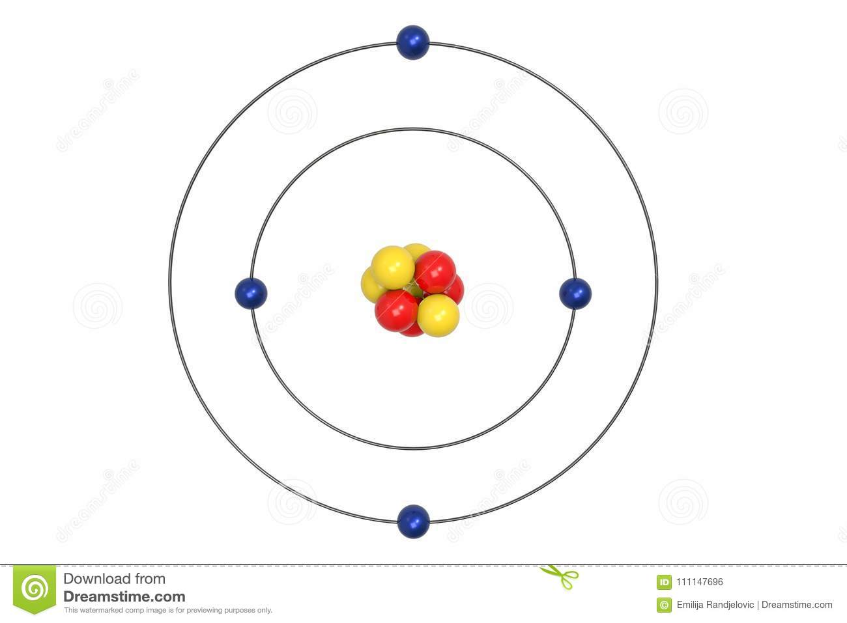
Ionization Energy
As electrons are removed for an atom, the atom’s nucleus can tighten the pull on the fewer electrons, creating a smaller radius and a tighter hold on the valence electrons. Therefore, the second IE will always be greater than the first IE.
1st IE
2nd IE

Slide 45
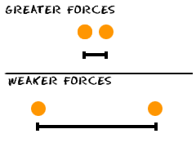
Coulomb’s Law
Opposites attract (protons and electrons), Likes repel (p/p or e/e)
The closer the particles are, the more force the particles have on each other.
E = k Q₁Q₂
r
Q =charge of particle
r = distance between particles.

Slide 46
Ionization Energy Trends E=kQ₁Q₂/r
Hydrogen only has one proton pulling on the one electron.
Helium has two protons pulling on the same level of electrons. The size gets smaller (r), so the energy (E) required increases.

Slide 47
Ionization Energy Trends E=kQ₁Q₂/r
Lithium has added a whole new energy level. The electrons between the nucleus and the valence shell shield the valence shell for the pull of the protons. Therefore, the atom is larger (r) and the energy (E) required decreases.

Slide 48
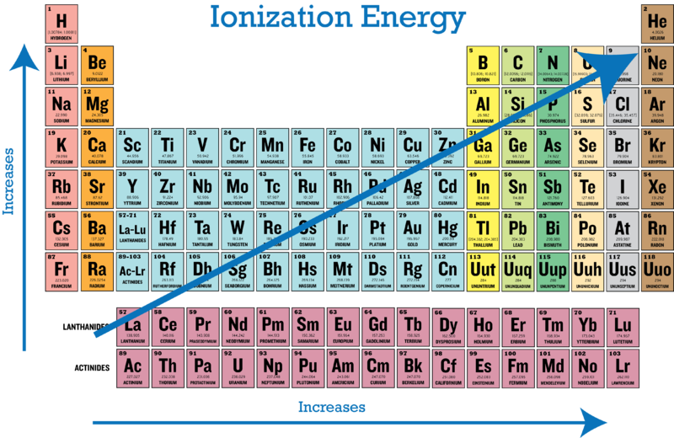
Ionization Energy Trends Summary
Across a period, increases in protons (nuclear charge) increases the attraction for electrons and decreases the radius of the atom (or distance r from the nucleus to the valence), therefore increasing the columbic force and IE increases.
Down a group, more energy levels are created, increasing the distance (r) from the valence shell to the nucleus, thus decreasing the columbic force and decreasing the IE.

Slide 49
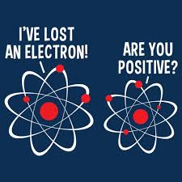
Binding Energy
Binding Energy: The minimum energy required to eject a given electron from the atom corresponding to the sublevel in which the electron resides.

Slide 50
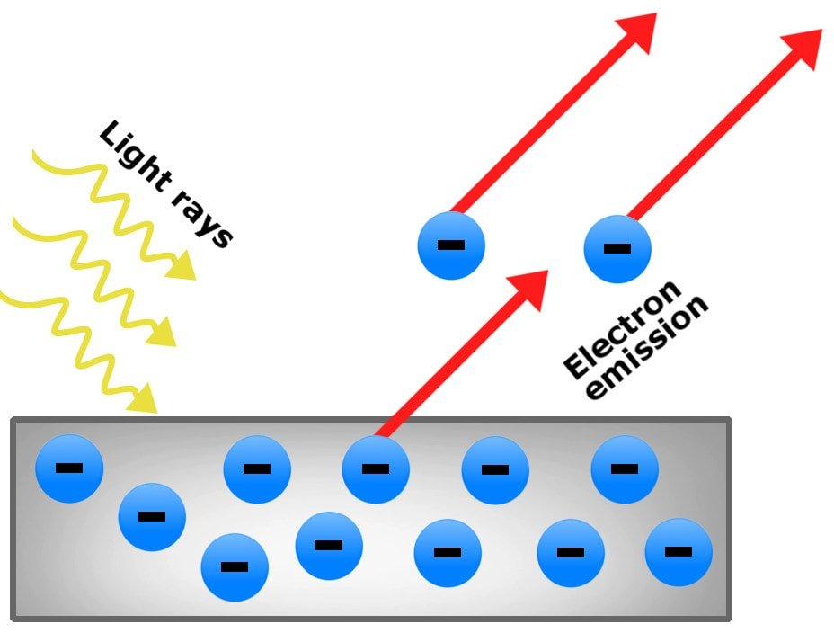
Photoelectric Effect
The photoelectric effect is the emission of electrons when light hits a material.

Slide 51
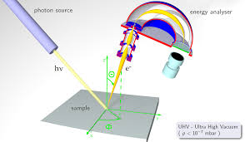
PES
Photoelectric spectrums are created when each electron from an atom are removed (IE) one by one. The sample is bombarded by photons of light which makes the atom emit the valence electron. The energy required in graphed.

Slide 52
PES Hydrogen 1s¹
This graph corresponds to the energy needed to remove hydrogen’s only valence electron, 1s.
1
Energy: High to low

Slide 53
PES Helium 1s²
This graph corresponds to the energy needed to remove helium’s valence electrons from 1s.
2
1
Energy: High to low

Slide 54
PES Berylium 1s²2s²
This graph corresponds to the energy needed to remove Beryllium’s valence electrons from 1s and 2s.
2
1
Energy: High to Low

Slide 55
PES Carbon 1s²2s²2p²
This graph corresponds to the energy needed to remove Carbon’s valence electrons from 1s, 2s and 2p.

Slide 56
PES: What is the electron configuration? Which element is it?
2p⁶
3p⁴
Sulfur
2s²
1s²
3s²

Slide 57
Bohr and PES of Carbon
Why was Bohr revised?

Slide 58
You must be able to…
Compare ionization energies of various atoms.
Determine an element's photoelectric spectrum.

Slide 59
Mass Spectrometry

Slide 60
Objectives
You should already be able to...
Identify isotopes and calculate atomic mass
By the end of this video you should be able to...
Use mass spectrometry graphs to determine isotopes and atomic masses.

Slide 61
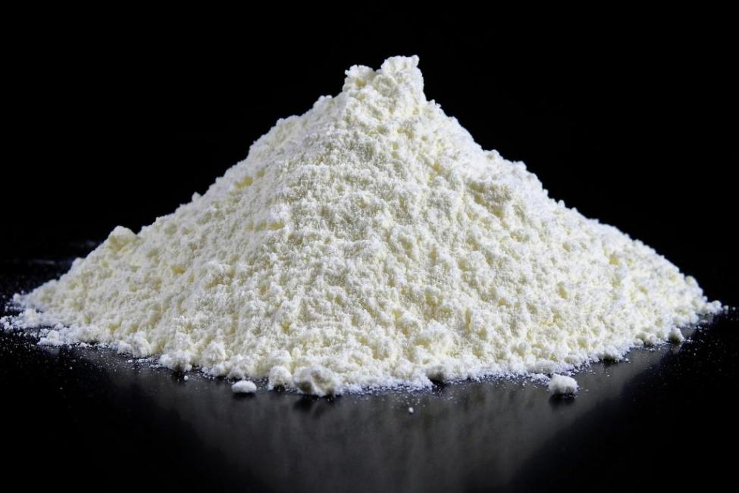
Question of the video:
How can we determine if this is sugar or illegal drugs?

Slide 62
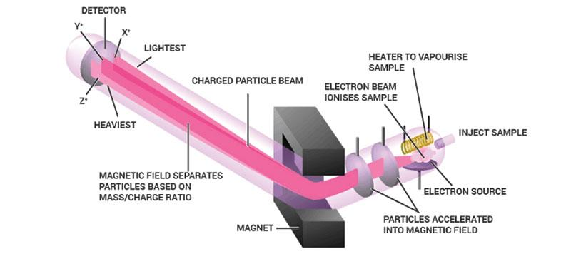
How does it work?

Slide 64
Chlorine Mass Spec Analysis
Atomic Mass = (mass)(abundance) = (mass)(abundance)….
(34.97)(.7576) + (36.96)(.2424) = 35.45amu

Slide 65
Mass Spec Analysis: What element is this?
Mo

Slide 66
Mass Spec Analysis: diatomic Bromine

Slide 67
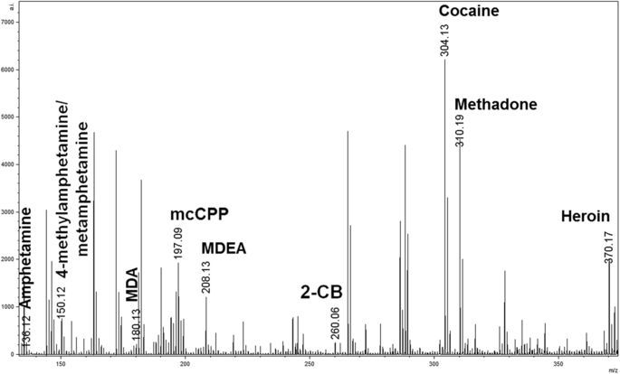
Uses
Identify isotope percentages in elemental samples
Confirm identity of unknowns, such as illegal drugs in a system
Identify is samples are pure or mixtures

Slide 68
You must be able to...
Use mass spectrometry graphs to determine isotopes and atomic masses.

Slide 69
Electromagnetic Radiation

Slide 70
Objectives
You should already be able to...
Describe how light spectra can be formed by excited electrons.
By the end of this video you should be able to...
Calculate the wavelength, frequency, and energy of waves.

Slide 71
Questions of the video:
How did the hulk become incredible?
How do we hear music on the radio from far locations?

Slide 72
ER
ER is energy that exhibits wave like behavior and travels through space at the speed of light
(c = 3x10⁸m/s)
Wavelength(λ):distance between 2 peaks.
Frequency(v): waves per second

Slide 73
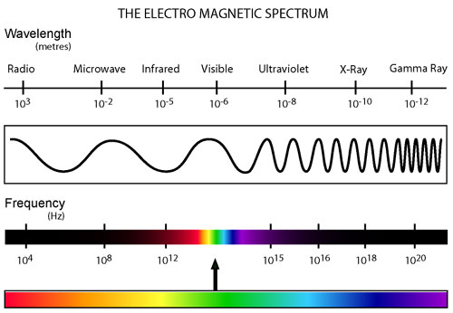

Slide 74
ER examples
c=λv
If the wavelength is 650nm, calculate the frequency of light with units.
If the frequency is 200.s⁻¹, calculate the wavelength.
v = 4.6x10¹⁴s⁻¹
(3.0x10⁸m/s) = (650x10⁻⁹m)(v)
(3.0x10⁸m/s) = (λ)(200./s)
λ = 1.5x10⁶m

Slide 75
Planck
Matter can transform into energy but only in packets of energy called quantum. Planck found that these energy packets are in multiples of hv.
∆E=hv
h=Planck’s constant = 6.63x10⁻³⁴Js

Slide 76
Planck
CuCl in fireworks give off blue light with a wavelength of 450nm. What is the amount of energy emitted?
c = λv
(3.0x10⁸ m/s) = (450x10⁻⁹m)(v)
v = 6.7x10¹⁴/s
E = hv
E = (6.626x10⁻³⁴J/s)(6.7x10¹⁴/s)
E = 4.4x10⁻¹⁹J

Slide 77
Einstein
Einstein stated that ER or light is a stream of particles called photons.
Between Plank and Einstein, light is both wave-like and particle-like.
E= hv = hc/λ
Because v=c/λ

Slide 78
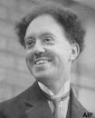
deBroglie
If light is both wave and particle-like, can matter be both as well?
deBroglie found electrons (which are particles) are so small that they have a measurable wavelength! So, YES!
λ=h/mυ υ= velocity

Slide 79
Remember Light Spectra and Bohr?
Energy is released in quanta (packets) to produce light.
When light is passed through a prism, colors may be seen at various wavelengths.
Bohr measured the energy emitted to create his quantum model of the atom.

Slide 80
Light Spectra and Bohr
E_{n}= -2.178x10⁻¹⁸J
n²
n= energy level

Slide 81
You must be able to…
Calculate the wavelength, frequency, and energy of waves.

Slide 82
Orbitals Energy Levels: where is the largest jump?

Slide 83
Atomic Radii and Ionization Energy

Slide 84
Objectives
You should already be able to...
Describe atomic radius using nuclear charge and shielding.
Define Ionization Energy and explain trends with in groups and periods.
By the end of this video you should be able to...
Compare atomic radii for atoms and ions.
Compare ionization energies for atoms and ions.

Slide 85
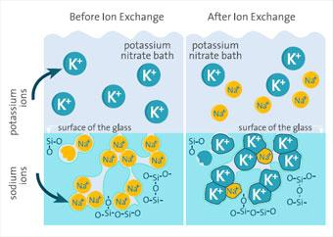
Question of the video:
Why is gorilla glass so strong yet flexible?

Slide 86
Atomic Radius
The size of the atom in the ground state.
Across a period, the radius decreases due to a higher nuclear charge (more protons) pulling the electrons in tighter.

Slide 87
Atomic Radius
Down a group, the radius increases due to more energy levels, electron-electron repulsions, and shielding of the kernel electrons.

Slide 89
Atomic Radius Examples
Predict the trend in radius for Be, Mg, Ca and Sr.
Predict the trend for N, O, F and Ne.
Predict the trend in radius for Be⁺², Mg⁺², Ca⁺² and Sr⁺².
Be, Mg, Ca, and Sr increase due to increased number of principle energy levels, therefore a weaker pull on further electrons.
N, O, F, and Ne decrease due to a stronger nuclear charge pulling in valence electrons tighter.
That order. The fact that they all have lost 2e- doesn’t really change the answer in this case.

Slide 90
Ionic Radius
When atoms gain electrons, the size ___________.
When the atom loses electrons, the size ____________.
increases
decreases

Slide 91
Ionic Radii
When species are isoelectronic their size comes down to nuclear charge. Species with stronger nuclear charges are smaller.
Example: S⁻², Cl⁻, Ar, K⁺, and Ca⁺² all have 18 electrons. So which is smaller?
Ca⁺² because it has the most protons pulling on the same number of electrons.

Slide 92
Ionization Energy
The energy needed to remove an electron from the valence shell of a gaseous atom or ion in the ground state.
Across a period, IE increases because electrons are more tightly bound to a stronger nuclear charge, therefore they are harder to remove.
Down a group, IE decreases because electrons are less bound to the nucleus due to higher shielding from the nucleus by more inner electrons.
Formula Examples: X⁻ 🡪 X + e⁻ or X 🡪 X⁺ + e⁻

Slide 93
More Examples
1. Aluminum’s IE: 1st: 580 kJ/mol
2nd: 1,815
3rd: 2,740
4th: 11,600
Explain the sudden increase in IE at the 4th IE.
2. Why is Na IE higher than K?
3. Why is the IE of O lower than F?
Al: 1s²2s²2p⁶3s²3p¹
When the 4th e- is removed, it is removed from an octet in a inner energy level.
Na has less shielding, it’s e- are closer to the nucleus and bound tighter.
F has a stronger nuclear charge, so e- are bound tighter.

Slide 94
Exceptions
Only worry about these exceptions when specifically asked:
Be 🡪 B: according to the rule, IE should increase, however, the filled 2s of Be is full and stable and to remove an electron would be much harder than removing the 2p¹ electron.

Slide 95
Exceptions
N 🡪 O: according to the rule, IE should increase, however, the half filled 2p orbital with parallel spins of N is more stable than the 2p⁴ electron which is more easily removed.
These rules also apply to lower elements in the same groups.

Slide 96
You must be able to…
Compare atomic radii for atoms and ions.
Compare ionization energies for atoms and ions.

Slide 97
Electronegativity and Bonds

Slide 98
Objectives
You should already be able to...
Describe electronegativity of an atom.
Identify bonds as covalent, ionic or metallic using electronegativity values and metallic properties.
By the end of this video you should be able to...
Compare species’ electronegativity values.
Identify and explain dipolar molecules.

Slide 99
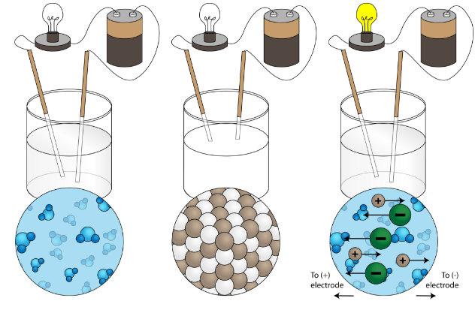
Question of the video:
What are the major causes of observable properties such as conductivity, solubility in water, and melting and boiling points?

Slide 100
Electronegativity
Ability of an atom to attract electrons.
Across a period, electronegativity increases due to stronger nuclear charge and needing to fill the octet.
Down a group, electronegativity decreases due to higher shielding from the nucleus by inner electrons.
These values range from 0-4 and are not energy values.
Notice the trend and explanations are similar to IE.
Example: X + e⁻ 🡪 X⁻ or X⁺ + e⁻ 🡪 X

Slide 101
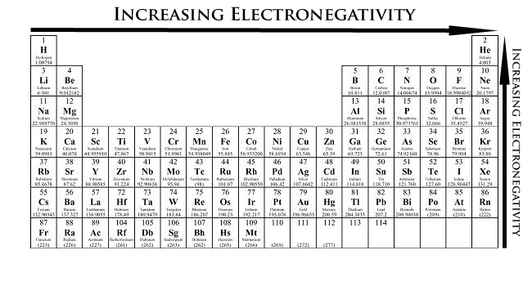
Electronegativity
Fluorine has the highest electronegativity, and one of the highest IE so the trends increase across a period and decrease down a group. BUT THAT IS JUST A MEMORIZATION TOOL! If you are asked to explain you must recite the reasons using nuclear charge and shielding/energy levels.

Slide 102
Electronegativity
0 .4 .5 1.7 1.8 4
Non-Polar Covalent Polar Covalent Ionic
(shares e- equally (shares e- unequally (transfers e- from
due to similar EN due to a small difference metal to nonmetal due to
values) in EN values) great EN differences,

Slide 103
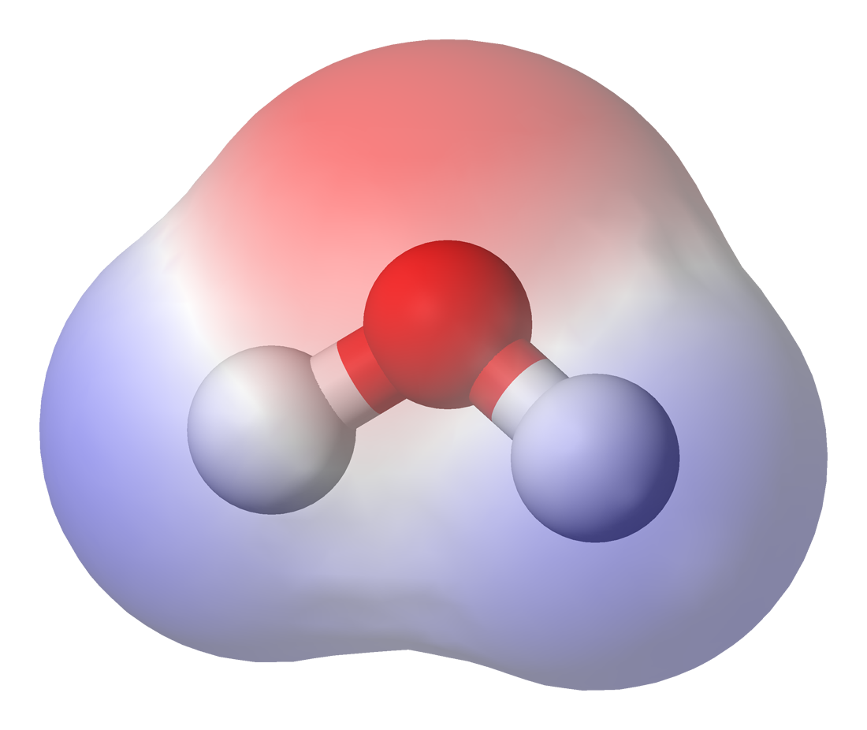
Using the Regents reference tables determine the electronegativity differences required to make a compound polar, nonpolar, or ionic.
Examples:
H₂ has nonpolar bonds
CH₄ has nonpolar bonds
HCN has nonpolar bonds
CO₂ has polar bonds
CCl₄ has polar bonds
HF has polar bonds
NaI has ionic bonds
KF has ionic bonds
Differences:
0.0
0.4
0.4
0.8
0.6
1.8
1.8
3.2

Slide 104
Octet Rule
Atoms bond with other atoms by sharing or transferring electrons in order to achieve a stable octet (8 valence electrons).
When bonds are formed energy is ___________.
When bonds are broken energy is ___________.
released
absorbed

Slide 105
Ionic Bonds
Transfer e-
Metals and
nonmetals
High mp and bp
Soluble
Conduct as liquid
Mostly solid

Slide 106
Ionic Bonds have a crystalline structure.

Slide 107
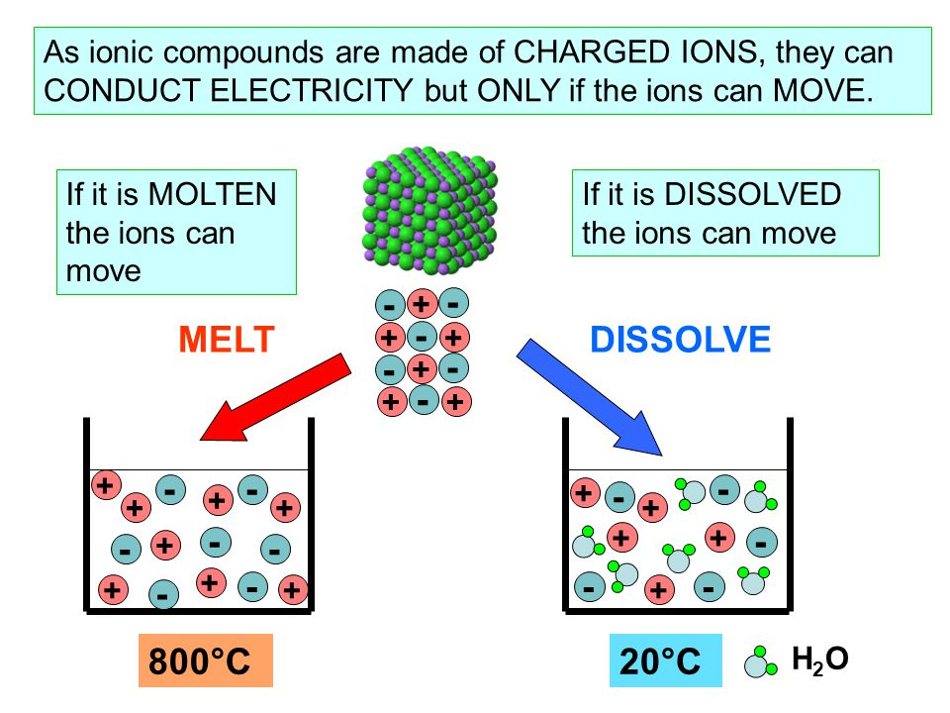

Slide 108
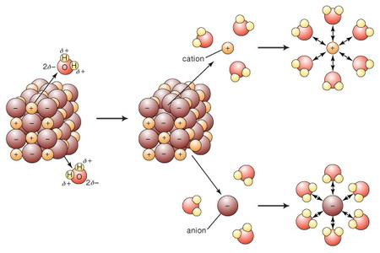
Solubility

Slide 109
Metallic Bonds
Sea of e-
Metals only
High mp and bp
Insoluble
Conduct always
All other metallic properties

Slide 110
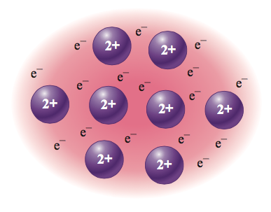
Metallic Bonds

Slide 111
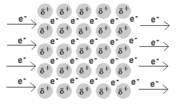
Metallic Bonds

Slide 112
Covalent Bonds (Molecular)
Share e-
Nonmetals only
Low mp and bp
Insoluble unless polar
Never conduct
Creates molecules

Slide 113
Ionic, Metallic,Covalent or both I & C?
NaCl
Mg
H₂S
MgCl₂
HCl
CH₄
AlCl₃
NH₄Cl
PBr₃
CuI₂
SiO₂
Au
O₂
RbF
I
I/C
M
C
C
I
I
C
I/C
M
C
C
I
I

Slide 114
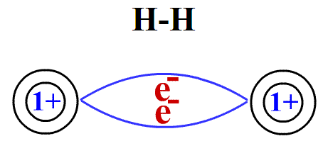
Covalent Bonding (Molecular Bonding)
If 2 atoms or more form a bond with the same electronegativity the bonds are nonpolar and they share e- equally.

Slide 115
Equal sharing

Slide 116
If there is an electronegativity difference between bonded atoms, the bonds are polar and e- are pulled toward the more electronegative atom.

Slide 117
If a molecule is polar, it will have a slightly negative and slightly positive side, like 2 poles of a magnet. This is called a dipole moment or a dipolar molecule.

Slide 118
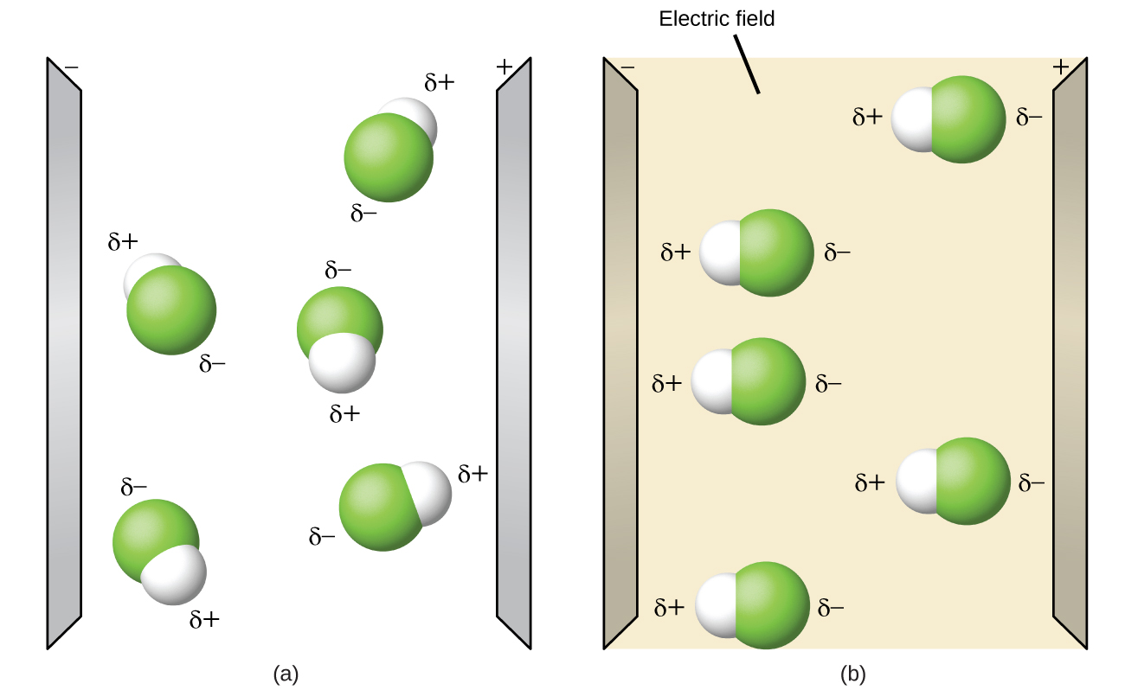
Dipolar Molecules
As you can see, normally polar molecules are unaligned.
When a electric source comes by, the molecules quickly align themselves.

Slide 119
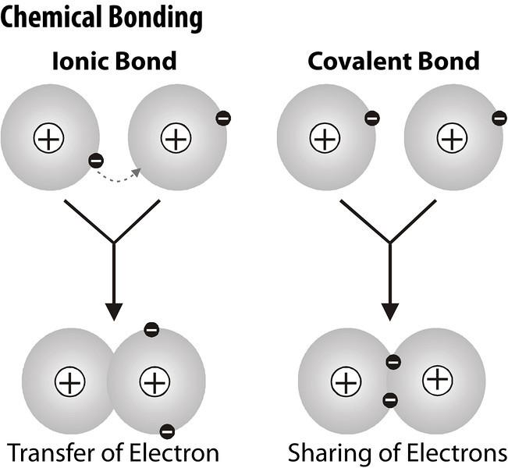
Something to think about…
What even is a bond? Is it a physical thing?

Slide 120
You must be able to...
Describe and compare electronegativity values of atoms.
Identify bonds as covalent, ionic or metallic using electronegativity values and metallic properties.
Identify and explain dipolar molecules.

