Slide 1
ATTRACTIVE FORCES

Slide 2
JJ Thomson

Slide 3
Lesson Objectives
Differentiate between Dalton’s and Thomson’s model of the atom

Slide 4
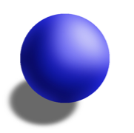
Dalton (1808)
His Model of Atom:
All elements composed of tiny particles called ATOMS
All atoms in an element are identical
Different elements are made of different atoms
Atoms were solid and indivisible
Na
Na
Na
Na

Slide 5
Thomson’s Model of the atom
Proposed that atoms actually have parts
How did he determine this?

Slide 6
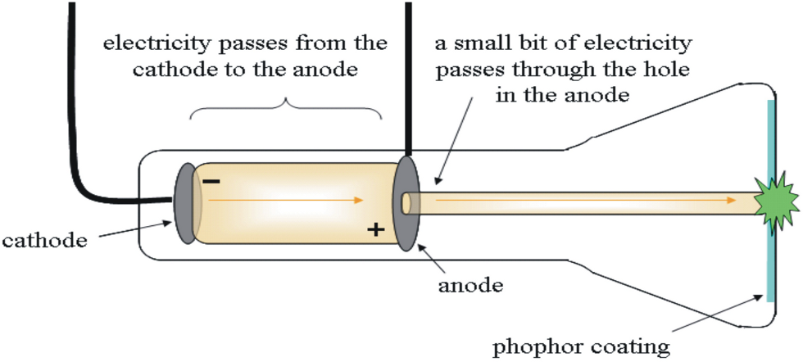
Cathode Ray Tube Experiments
A vacuum tube (air removed) is connected to a power source and particles seemed to move between the electrodes
-
+
Power source
-
-
-
-
Notes:
Describe the CRT parts and how it works

Slide 7
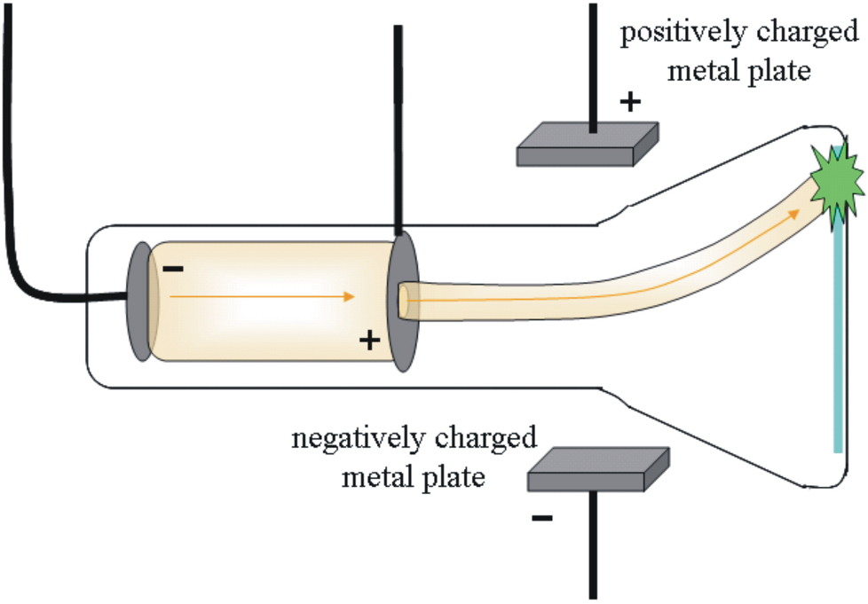
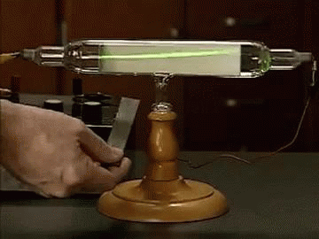
Determining Charge
When he placed charged plates around the CRT he saw the beam pulled towards the positive plate.
The particles must be negatively charged
-
-
-

Slide 8
Thomson’s Conclusions
Determines the beam is made of particles that are negatively charged called ELECTRONS
These particles are 1,000 smaller than a hydrogen atom (smallest atom)
Different metals all give off cathode rays
Notes:
Already known that all matter is made of atoms so electrons must be coming from atoms. Different metals all had electrons

Slide 9
Additional Conclusions
Thompson also found that the atom as a whole was electrically neutral (no charge)
So there must be positive charges in the atom to balance out the negative electron charge

Slide 10
J. J. Thomson’s Model (1897)
“plum pudding” model
Atom is positively charged with negative electrons “stuck” in it.
+ charged “muffin”
+ charged “pudding”
- charged electrons “chocolate chips”
- charged electrons “plums”

Slide 11
Differentiate between Dalton’s and Thomson’s model of the atom

Slide 12
Ionic Compounds

Slide 13
Lesson Objectives:
Determine which atoms form cations and which atoms form anions
Determine the charge of representative elements on the periodic table
Construct chemical formulas for binary compounds

Slide 14
When ionic compounds are dissolved
The metal particles tend to form positively charged ions (cations)
The non-metal particles tend to form negatively charged ions (anions)
+1
-1
NaCl

Slide 15
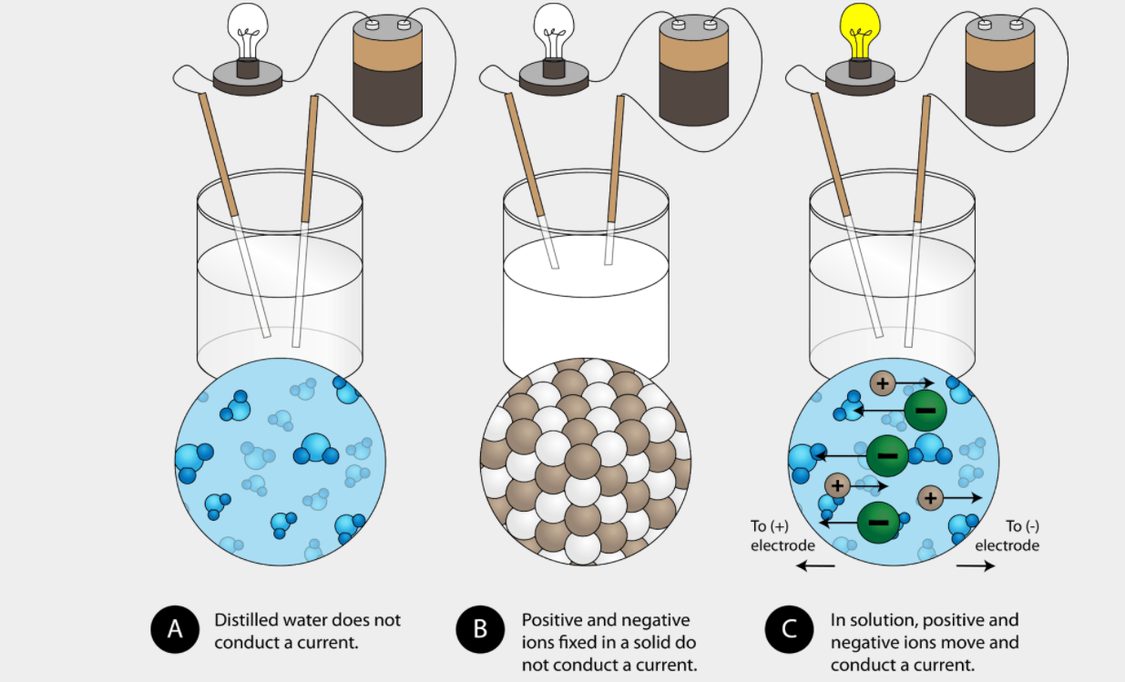
Electrolytes
These charged particles allow for the conduction of electricity

Slide 16
Ionic Compounds
Ratio of atoms in ionic compounds based upon the charge of each ion they form
Examples: NaCl CaCl₂
+1
-1
-1
+2
-1

Slide 17
Group 1 metals
Form +1 Cations
Example: NaCl
+1
-1

Slide 18
Group 2 metals
Form +1 Cations
Example: BaCl₂
-1
+2
-1

Slide 19
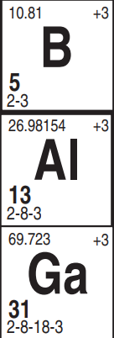
Group 13 metals
Form +3 ions
Ex. AlCl₃
-1
+3
-1
-1

Slide 20
Group 15 nonmetals
Form -3 ions
Example: NaP
+1
-3
+1
+1

Slide 21
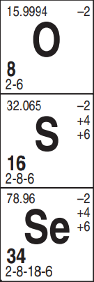
Group 16 nonmetals
Form -2 ions
Example: NaO
+1
-2

Slide 22
Group 17 nonmetals
Form -1 ions
Example: NaCl
+1
-1

Slide 23
Group 18 non-metals
Don’t form ions
Unreactive (inert) so they don’t form compounds
Ex. Ne_{(g)}

Slide 24
Writing Chemical Formulas
Sum of charges (oxidation numbers) in a compound equal zero
Don’t write 1’s for subscripts Example: Na⁺¹Cl⁻¹
(+1) + (-1) = 0
NaCl

Slide 25
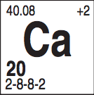
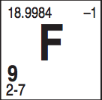
Example 1:
Write the chemical formula for a compound containing calcium and Fluorine.
+2
-1
-1
-1
+2
-1
Ca⁺² F⁻¹
F⁻¹
CaF₂
1(+2) + (-1) = 0
2

Slide 26
Example 2:
Write the chemical formula for a compound containing Lithium and Sulfur.
+1
+1
-2
+1
-2
+1
Li⁺¹
Li⁺¹ S⁻²
Li₂S
2
(+1) + 1(-2) = 0

Slide 27
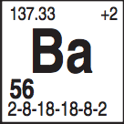
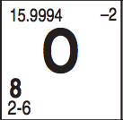
Example 3:
Write the chemical formula for a compound containing barium and oxygen.
+2
-2
+2
-2
Ba₁O₁
Ba⁺² O⁻²
(+2) + (-2) = 0
BaO

Slide 28
Determine which atoms form cations and which atoms form anions
Determine the charge of representative elements on the periodic table
Can you construct chemical formulas for binary compounds

Slide 29
Oxidation numbers

Slide 30
Lesson Objective:
Determine the oxidation number of atoms in a chemical reaction

Slide 31
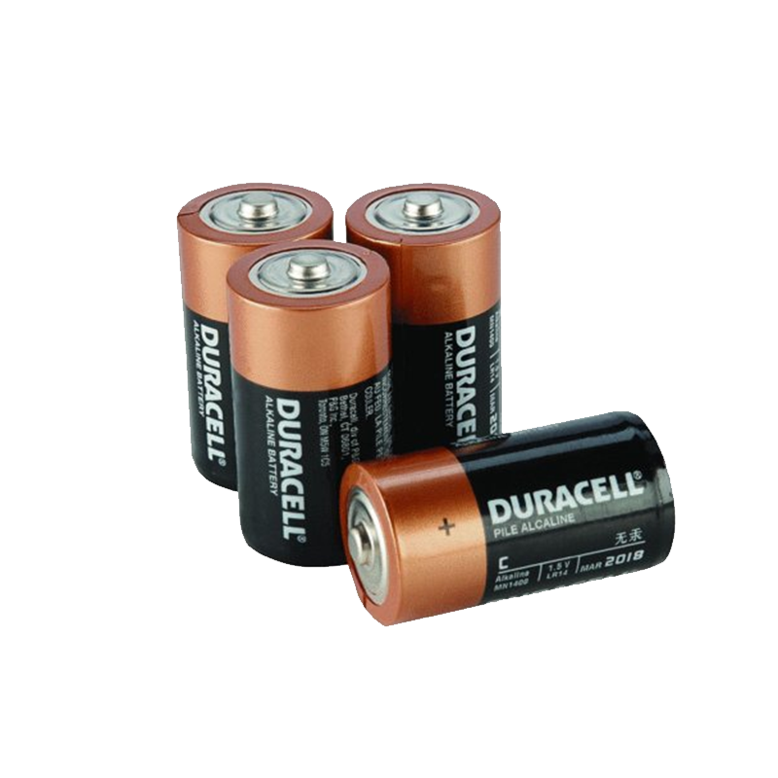
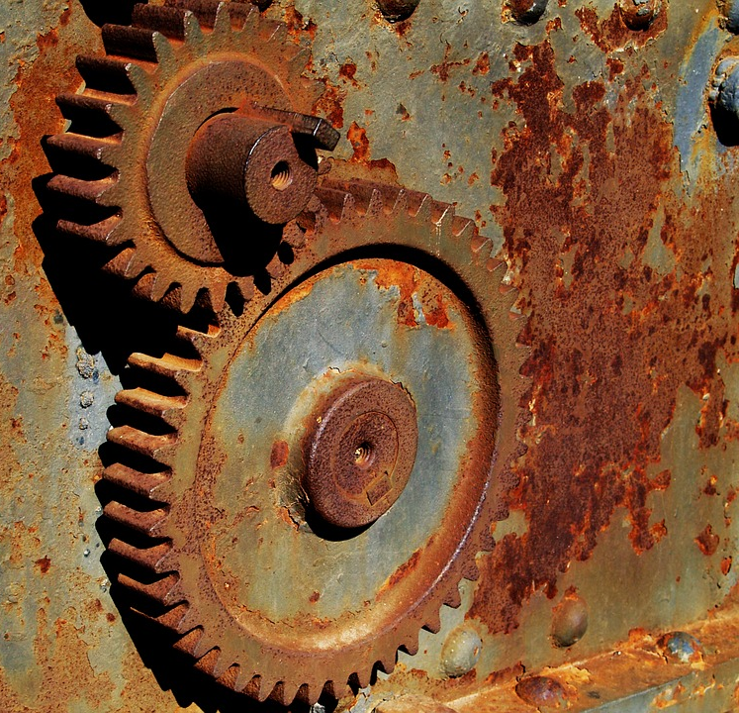
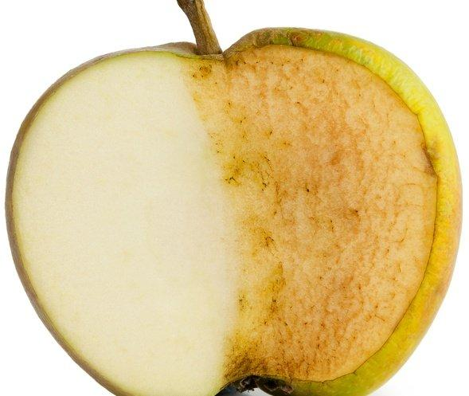
Redox Reactions
In redox reactions, electrons are transferred from one species to another.
This can cause a multitude of outcomes.

Slide 32
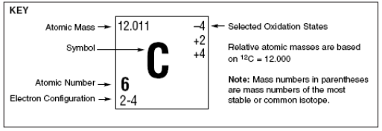
Oxidation States
To follow the flow of electrons, we assign oxidation numbers.
Notes:
But how do you know if there is a transfer of e-

Slide 33
Rules for Oxidation Numbers
An uncombined element (not in a compound) has an oxidation number of ZERO. This includes diatomic elements.
Ca + Cl₂→ CaCl₂
Oxidation # Ca = 0
Oxidation # Cl₂ = 0
0
0

Slide 34
Rules for Oxidation Numbers
2. Elements in compounds have the oxidation number listed on the periodic table. For nonmetals use the negative oxidation #.
Example: Group 1 Oxidation # = +1
Group 2 Oxidation # = +2
Group 17 oxidation # = -1

Slide 35
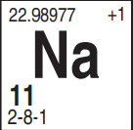
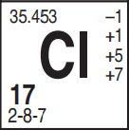
Rules for Oxidation Numbers
3. In an ionic compound, the metal (positive ion) is written first and the non metal (negative ion) is written last.
Example: NaCl Oxidation # Na = ⁺ 1
Oxidation # Cl = ⁻ 1
+1
-1
Notes:
More electronegative

Slide 36
Rules for Oxidation Numbers
4. The sum of oxidation numbers in a compound must equal ZERO.
Example: CaCl₂
+2(1) + -1(2)
2 - 2 = 0
+2
-1
HINT: Be sure to multiply oxidation # by the number of atoms in the subscript.

Slide 37
Determine the oxidation number of atoms in a chemical reaction

Slide 38
Identifying a Redox Reaction

Slide 39
Lesson Objectives
Identify oxidized and reduced species.
Determine the characteristics of a redox reaction.

Slide 40
Redox Reactions
Redox stands for reduction/oxidation reaction. When one happens, the other must be happening, as well.
They involve the transfer of electrons!

Slide 41
Oxidation
The LOSS of electrons by an atom or ion to form a cation (positive ion). As a result:
Oxidation number goes UP or INCREASES
Becomes more POSITIVE (+)
Na
Na⁺¹

Slide 42
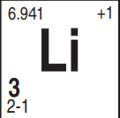
Oxidation
Metals oxidize (lose electrons) to from positive ions
-
-
-
+1
Li

Slide 43
Reduction
The GAIN of electrons by an atom or ion to form an anion. As a result:
Oxidation number REDUCES or DECREASES
Becomes more NEGATIVE (-)
F
F⁻¹

Slide 44
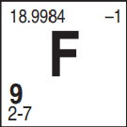
Reduction
Nonmetals reduce (gain electrons) to form negative ions
-
-
-
-
-
-
-
-
-
-
-1
F

Slide 45
Reduction
Why is it called reduction when you gain electrons?
Ox # +2
Gains 3e⁻
Goes to -1
3
2
Oxidation number reduces
1
0
-1
-2-3

Slide 46
Example
Zn oxidation number goes UP, loses e⁻, OXIDIZED.
H⁺ oxidation number goes DOWN, gains e⁻, REDUCED.

Slide 47
LEO GER

Slide 48
Example (I do)
Which species is oxidized and which is reduced?
2Na + Cl₂ → 2NaCl
0
0
+1
-1
LEO
LEO says GER
GER
Na went from 0 → +1
Cl went from 0 → -1
OXIDIZED
REDUCED

Slide 49
Example (We do)
Which species is oxidized and which is reduced?
2H₂ + O₂ → 2H₂O
0
0
+1
-2
LEO says GER
LEO
GER
H went from 0 → +1
O went from 0 → -2
OXIDIZED
REDUCED

Slide 50
Example (You Do)
Which species is oxidized and which is reduced?
GER
+1
-2
0
+1
-2
0
K₂O + Li → Li₂O + K
LEO
K went from +1 → 0
Li went from 0 → +1
Reduced
Oxidized

Slide 51
Identifying a Redox Reaction
If the oxidation #’s don’t change it’s not a redox reaction
Li + F₂ → LiF
LiBr + 2NaF → NaBr + LiF
0
0
+1
-1
YES
+1
-1
+1
-1
+1
-1
+1
-1
NO

Slide 52
Identify oxidized and reduced species.
Determine the characteristics of a redox reaction.

Slide 53
Half Reactions

Slide 54
Identify if a half reaction is oxidation or reduction
Write half reactions for oxidation and reduction.

Slide 55
Redox Reactions have...
An oxidation half reaction and a reduction half reaction.
Example: 2Mg + O₂ → 2MgO
LEO
LEO says GER
0
0
+2
-2
GER
Loss of electrons
Oxidation Half Reaction: Mg ⁰ → Mg⁺²
+ 2e⁻
Reduction Half Reaction: O₂ ⁰ →2O⁻²
+ 4e⁻
Gain electrons

Slide 56
Half reactions
A half reaction shows either the oxidation or reduction portion of a redox equation including if the electrons are gained or lost.

Slide 57
Half reaction: Reduction
A reduction half reaction shows an atom or ion gaining one or more electrons
Fe³⁺ + → Fe⁰
Notice that the e- are on the left.
3e-

Slide 58
Half reaction: oxidation
An oxidation half reaction shows an atom or ion losing one or more e-:
Mgº → Mg⁺² + 2e-
Notice that the e- is on the right.

Slide 59
Example: I do
Add in electrons to balance the charge
The total charge on each side must be equal
K → K⁺¹
0
+ 1e-
Oxidation half reaction
0 →
+1 -1 = 0

Slide 60
Example: We do
Add in electrons to balance the charge
Mg⁺² → Mg⁰
2e- +
reduction half reaction
+2 -2=0 →
0

Slide 61
Example: You do
Add in electrons to balance the charge
Cu → Cu⁺²
0
+ 2e-
Oxidation half reaction
+2 -2 = 0
0 →

Slide 62
Spontaneous Reactions
& Table J

Slide 63
Lesson Objectives
Use Table J to determine if a species is oxidized or reduced.
Determine if a reaction will occur spontaneously.

Slide 64
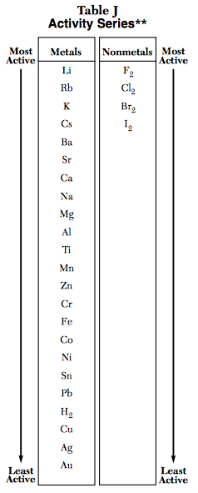
Easily OXIDIZED
EASY to lose electrons
More active metals
Less active metals

Slide 65
More active metals
HARD to lose electrons
Less active metals
Not easily OXIDIZED

Slide 66
Easily REDUCED
EASY to gain electrons
More active nonmetals
Less active nonmetals

Slide 67
HARD to gain electrons
More active nonmetals
Not easily REDUCED
Less active nonmetals

Slide 68
Example
Compare nickel and aluminum. Which will be oxidized and which will be reduced?
Nickel is reduced
Aluminum is oxidized

Slide 69
When are rxn’s Spontaneous
Spontaneous reactions occur without the addition of energy to the system.
If the “single” element on the reactant side is more active than the “combined” element on the reactant side, then the reaction is spontaneous.
Example: Zn + PbCl₂ → ZnCl₂ + Pb

Slide 70
When are rxn’s Not Spontaneous
If not, the reaction is nonspontaneous and will require the addition of energy.
Example: Zn + AlCl₃ → no rxn

Slide 71
Example
Would this reaction occur spontaneously?
Li + MgSO₄ → Mg + LiSO₄

Slide 72
Use Table J to determine if a species is oxidized or reduced.
Determine if a reaction will occur spontaneously.

