Slide 1
Ballistics

Slide 2
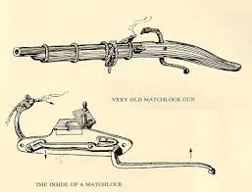
History of Gunpowder and Firearms
The Chinese invented gunpowder over a thousand years ago using KNO₃, charcoal and sulfur.
Muzzle-loading matchlocks used wicks to ignite the gunpowder.
The cartridge and breech loading followed.

Slide 3
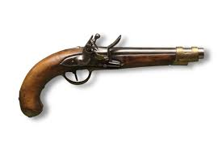
History of Gunpowder and Firearms
Later, flintlock weapons were used using sparks from flint to ignite the gun power (better in wet conditions).
Gun power was forced down the muzzle (barrel) and packed down.

Slide 4
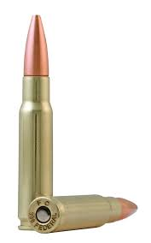
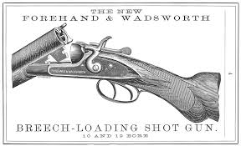
History of Gunpowder and Firearms
Next, cartridges were developed that held the bullet, primer powder, and gun power.
A hammer hit the primer powder, the powder exploded to ignite the gunpowder and project the bullet.
We still use cartridges today, loaded into the gun opposite the barrel, known as the breech.

Slide 5
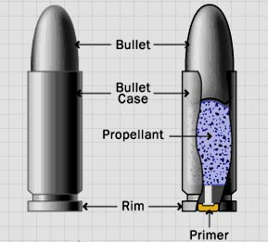
Bullets, Cartridges, and Calibers
Bullets and cartridges are packaged together.
The bullet, usually of metal, is out front with the cartridge, holding the primer and propellant powders, behind.

Slide 6
How a Firearm Works
The firing pin hits the base of the cartridge, igniting the primer powder.
The primer powder sparks through the flash hole to the main propellant supply.
The pressure of the explosion pushes the bullet from the casing into the barrel.
The bullet follows the lands and grooves spiraling out of the barrel.

Slide 7
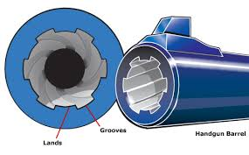
Lands and Grooves
Rifling allowed the gun to shoot more accurately using
Lands: raised areas in the barrel
Grooves: indentations in the barrel
Today, we can look at the lands and grooves to identify the gun used.

Slide 8
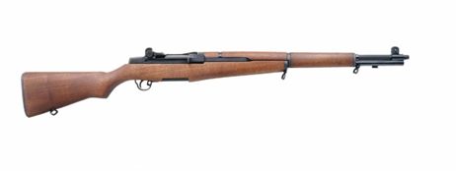
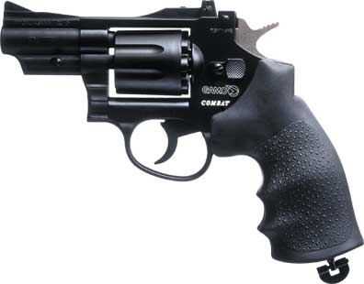
Firearms Now
Long guns need two hands:
Rifles fire bullets
Shotguns fire small pellets (shot) or a slug.
Handguns need only one hand:
Pistols are fired with one hand.

Slide 9
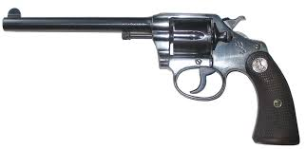
Colt
Samuel Colt developed a hand gun that shot multiple bullets, known as a revolver. These hold six cartridges.

Slide 10
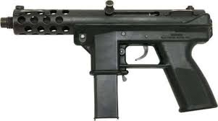
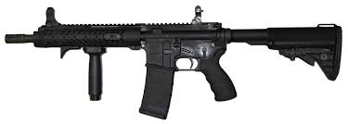
Types of fire arms
Semiautomatic weapons hold ten cartridges in a magazine or clip. Each pull on the trigger releases one cartridge.
Fully Automatic weapons fire for as long as the trigger is pressed.

Slide 11
Caliber of the Cartridge
Caliber is a measure the diameter of the cartridge.
These usually are hundredths of an inch.
Common calibers include .22, .25, .357, .38, .44, and .45.
Why should the caliber of ammunition match the firearm that shoots it? If they do not match, what could go wrong?
.45-caliber = 45/100 of an inch

Slide 12
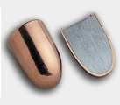
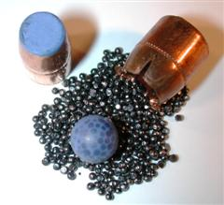
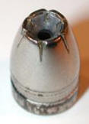
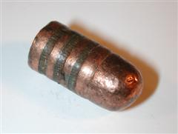
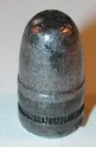
Bullet Basics
Materials:
Lead
Copper
Brass
Bronze
Steel
Aluminum
Jacketed Bullets (travel faster):
Non-jacketed Bullets:

Slide 13
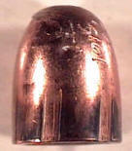
The Study of Bullets and Cartridge Casings
Matching lands (elevations)
Matching grooves (indentations)
How is each fired bullet marked?
What is the procedure to match a spent bullet to the firearm that shot it?
What makes up a test-firing, and why is it done?

Slide 14
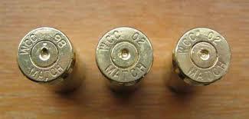
Marks on the Spent Cartridge Casings
Firing pin marks on a spent cartridge can be used to match it to a firearm.
The fire pin marks can appear on the rim or on the center of the spent cartridge.

Slide 15
Marks on the Spent Cartridge Casings
Breechblock marks are produced as the cartridge casing slams backward and strikes the breechblock.
Other marks left on spent cartridge casings include minute scratch extractor and ejector nicks.

Slide 16
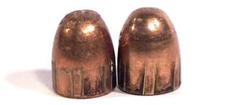
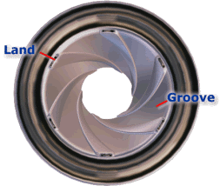
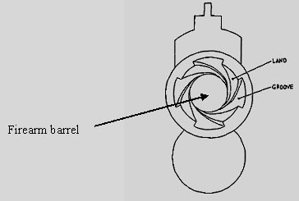
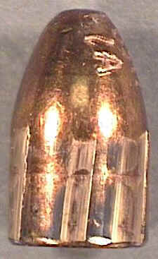
Rifling
Grooves cut or formed in a spiral down the barrel of a firearm
Increases accuracy and range
Notes:
Rifling consists of grooves cut or formed in a spiral nature, lengthwise down the barrel of a firearm.

Slide 17
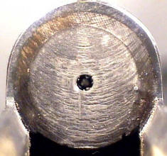
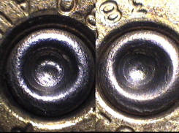
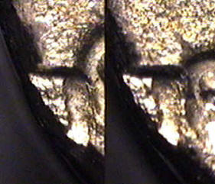
Types of marks
Rifling pattern
Breech mark
Firing pin impressions
Extractor mark
Ejector marks

Slide 18
Firearms Examiners will:
Test firearms
Test for gunshot residue to determine distance from muzzle to target
Determine caliber and manufacturer of ammunition components
Match bullets or cartridge casings to firearms

Slide 19
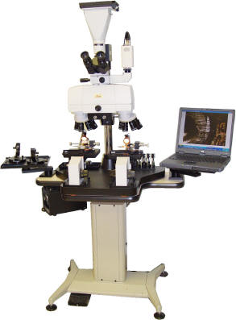
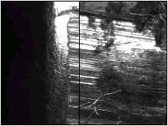
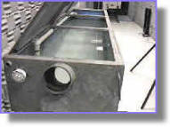
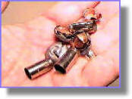
Bullet Identification
Obtain standard from firearm
Compare crime scene bullet to standard using comparison macroscope
Unique marks made by imperfections or irregularities = individual evidence

Slide 20
Firearms Evidence
Firearm
Fired bullets
Spent cartridge cases
Spent shot shells
Shot
Shot shell wadding
Live ammunition
Gunshot residue (GSR)
Clothing

Slide 21
Firearms Database
NIBIN: National Integrated Ballistics Information Network
Database of images
Ballistics markings of firearms used in previous crimes
Cartridge casings

Slide 22
Gunshot Residue
Particles of unburned powder and traces of smoke are the residues of gunshots.
They can leave a trace on the hand, arm, face, hair, or clothing of the shooter.
They can also leave a trace on the victim.
Chemical testing often can detect residue even if removal is attempted.
The distance from the victim to the shooter can be determined by examination of the residue pattern on the victim.

Slide 23
Trajectory
Two reference points are needed to define the trajectory.
Investigators can figure the shooter discharged the firearm somewhere along that line.
Reference points can be bullet holes in objects or victims.
An entry point and exit point on a victim can be used.
Gunshot residue or spent cartridge casings can be less specific reference points.
Investigators can use lasers to trace a straight-line path to help determine the position of the shooter.

Slide 24
Bullet Trajectory
Points used are the broken windshield and the point of impact on the victim.
Angle of trajectory = 2°
Path of bullet
X= height of shooter
Building to car 40 feet
Distance to ground =4 ft

Slide 25
Determining the Location of the Shooter :
Using the illustration on the previous slide, and adding that the shot came from a nearby building, these conclusions can be made:
TanΦ = Opposite/adjacent
Tan2 = x/40
0.035 = x/40
X = 0.035*40 = 1.34 ft above head wound.
1.34 ft + 4ft = 5.34 ft… first floor.

Slide 26
Bullet Wounds
Generally, entrance wounds and smaller than exit wounds
Entrance: skin stretches when bullet enters body
Exit: bullet carries body tissue and bone with it
Other signs: fibers in wound, GSR, stippling (burnt skin)
Pass through: larger bullets, high-speed bullets

Slide 27
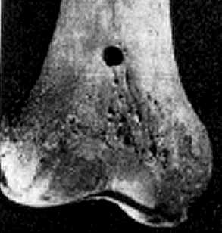
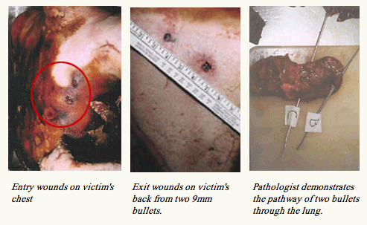
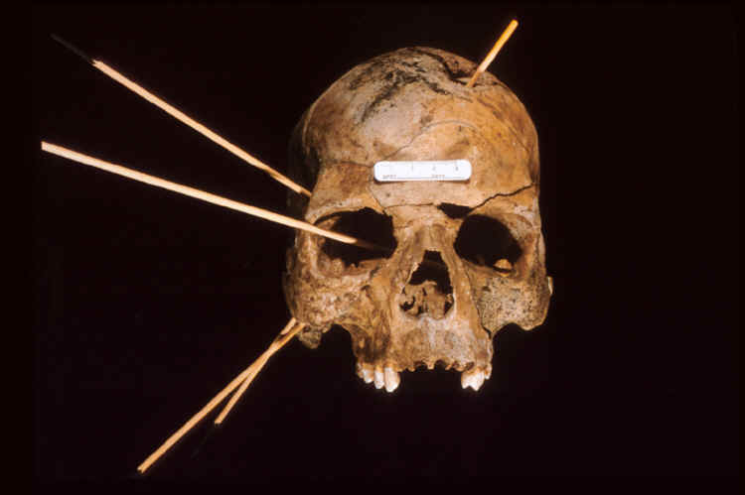
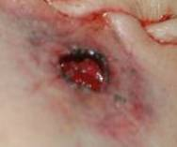
Gunshot Wounds

Slide 28
Links
Son of Sam
https://www.youtube.com/watch?v=jB3aZqzeGC4
Ballistics technology https://www.youtube.com/watch?v=e8HR5TxlPMc
Bullets in water
https://www.youtube.com/watch?v=Dihs9JcVt3E
Bullets in ballistics gel
https://www.youtube.com/watch?v=6sas9N3OmuM
JFK Ballistics
https://www.youtube.com/watch?v=R5JDhi4URds

Slide 29
Objective: Develop a plan for their own forensic investigation of a local, unsolved serial killer case using techniques and analysis they have learned in the Forensics Course.
Describe what you know about the highly publicized serial killer case on Long Island.
Watch the following 48 hours episode: https://www.youtube.com/watch?v=y7N-bLHZ5j8
While watching, answer the following:
1. Do you feel that the fact that the victims were prostitutes affected the investigation in any way?
2. Why was Shannon Gilbert the most important victim in this case even though her murder did not fit the profile of the killer?

