Slide 1
Bonding

Slide 2
Ionic Bonding

Slide 3
Objectives
You should already be able to...
Identify and describe ionic bonds.
By the end of this video you should be able to...
Calculate and describe lattice energy.
Calculate ionic bond energies of formation.

Slide 4
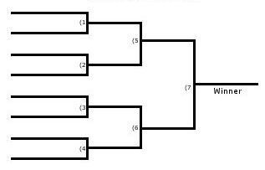
Question of the video:
Are all ionic compounds created equal?
MgSe
MgS
KCl
KI
LiF
CsBr
SrO
KF

Slide 5
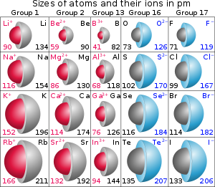
Ionic Radius Review
IR increases down a group due to increase in energy levels, e-e repulsions and shielding.
Across a period the ionic radius depends on it’s charge and configuration.

Slide 6
Ionic Radius Review
Consider O²⁻, F⁻, Na⁺, Mg²⁺ and Al³⁺. These are isoelectric, which means they have the same number of electrons. Their size decreases respectively due to an increase in nuclear charge and eventually, energy levels.
Example: Arrange in order of increasing radius:
Se²⁻, Br⁻, Rb⁺, Sr²⁺
Sr²⁺ ,Rb⁺, Br⁻, Se²⁻

Slide 7
Lattice Energy
LiF is a compound that should form naturally, therefore the heat of it’s formation should be exothermic (stable and negative value).
When LiF forms, Li and F must become ions. Write out these equations:
It seems that if you sum these parts, the heat is still positive. Something else must play a part in the heat of formation…
IE: Li 🡪 Li⁺ + e⁻ 520kJ
EA: F +e⁻ 🡪 F⁻ -328kJ
EA is the Electron Affinity, or the opposite of IE, when an atom gains an electron

Slide 8
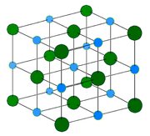
Lattice Energy
Lattice Energy is the change in energy that takes place when separate gaseous ions are packed together to form an ionic solid.
Lattice energy is generally exothermic and has a major affect on whether a compound can be made.

Slide 9
Lattice Energy
Coulomb’s Law can be used to calculate and compare the lattice energy of compounds: k = constant
Q = charge of ion
LE= k(Q₁Q₂/r) r = distance between ions

Slide 10
Lattice Energy
LE= k(Q₁Q₂/r)
Compounds with ions that have higher charges (+3 versus +1 or -3 versus -1) have larger lattice energies due to more electrons being transferred, creating a stronger ionic bond.
Compounds with ions that have smaller radii have larger lattice energies since the ions can get closer together, creating a stronger ionic bond.

Slide 11
Lattice Energy
1. What would happen to the lattice energy if the radii was tripled?
If the radii triples, the LE decreases.
2. If charges were doubled?
If the radii triples, the LE decreases.
3. If the radii was halved?
If the radii halves, the LE doubles.

Slide 12
Lattice Energy
Which compound has a more exothermic lattice energy?
NaCl or KCl
MgCl₂ or LiF
LiF or LiCl
Mg(OH)₂ or MgO
NaCl or Na₂O
Look for large charges and small radii!

Slide 13
Question of the video:
Are all ionic compounds created equal?
MgSe
MgS
MgS
MgS
KCl
KCl
KI
MgS
LiF
LiF
CsBr
SrO
SrO
SrO
KF

Slide 14
Heat of Formation
IE, EA, and Lattice Energy are not the only factors that affect formation.
The lattice energy requires the ions be gaseous, therefore, sublimation may be necessary.
Also, some elements, like fluorine, are diatomic. Therefore, dissociation is necessary.
Generally the following steps must be taken:
Sublimation, Ionization, Dissociation, Electron Affinity, and Lattice Energy.

Slide 15
Find the Heat of Formation (∆H_{f}) of LiF: Li_{(s)} + ½ F_{2(g)} 🡪LiF_{(s)}
Sublimation: Li_{(s)} 🡪 Li_{(g)} 161 kJ/mol
Ionization: Li_{(g)} 🡪 Li⁺_{(g)} + e⁻ 520
Dissociation: ½ F_{2(g)} 🡪 F_{(g)} ½ (154)
Electron Affinity: F_{(g)} + e⁻ 🡪 F⁻_{(g)} -328
Lattice Energy: Li⁺_{(g)} + F⁻_{(g)} 🡪 LiF_{(s)} -1047
_____________________________________
These values are in your textbook appendix. Notice the overall sign is (-) and favorable. Also the dissociation had to be halved since we need ½ F₂.
Li_{(s)} + ½ F_{2(g)} 🡪LiF_{(s)} -617 kJ/mol

Slide 16
You must be able to...
Identify and describe ionic bonds.
Calculate and describe lattice energy.
Calculate ionic bond energies of formation.

Slide 17
Covalent Bonds

Slide 18
Objectives
You should already be able to...
Describe and identify covalent bonds.
Draw simple Lewis structures for molecular solids and determine their dipole moment.
By the end of this video you should be able to...
Calculate the heat of formation of a covalent bond.

Slide 19
Question of the video:
Are all covalent bonds created equal?
Do all bonds that break require the same amount of energy?
Breaking bonds
Absorbs energy
- - -
Releasing energy
Forms bonds

Slide 20
Lewis Structures Rules: CCl₄
Add up all valence e⁻
Draw a skeletal structure with bonds between elements.
Subtract 2e⁻ from total for each bond drawn.
Draw in remaining e⁻ to fill each atom’s octet.
Evaluate: each atom should have 8 e- only.
C: 4 + 4Cl: 7 = 32 valence e⁻
Cl
Cl—C—Cl
Cl
32-8=24

Slide 21
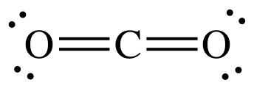
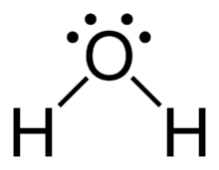
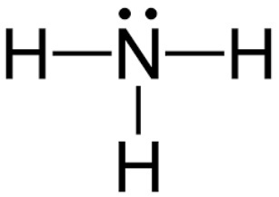
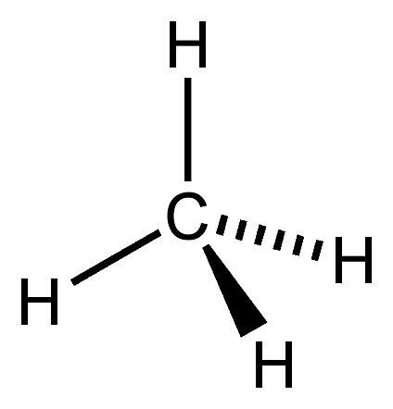
Geometry
Molecules have a specific geometry:
Linear: The molecule is on one plane (flat) such as CO₂ or H₂.
Bent: The molecule is bent at angle like H₂O due to unshared electrons and two bonding pairs on the central atom.
Pyramidal: The molecule has a triangular shape like NH₃ due to a lone pair and three bonding pairs on the central atom.
Tetrahedral: The molecule has four bonding pairs and no lone pairs on the central atom like CH₄.

Slide 22
Dipolar Molecules
Polar bonds can create polar or nonpolar molecules.
A polar molecule will have polar bonds and be asymmetrical.
A nonpolar molecule will either have nonpolar bonds or polar bonds with a symmetrical shape.
Water is polar, and like dissolves like, so only polar molecules are soluble in water. Polar (dipolar) molecules are also attracted to an electric field.

Slide 23
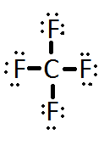
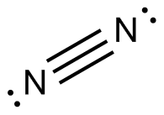
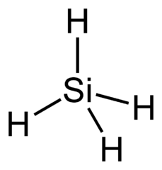
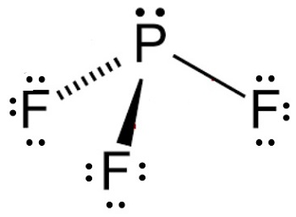
Draw the following. Identify the geometry and polarity:
O₂
CF₄
N₂
SF₂
PF₃
SiH₄
Notice, 4 elements is showing pyramidal, 5 elements is showing tetrahedral. Its not always that easy… stay tuned for more shapes! ☺

Slide 24
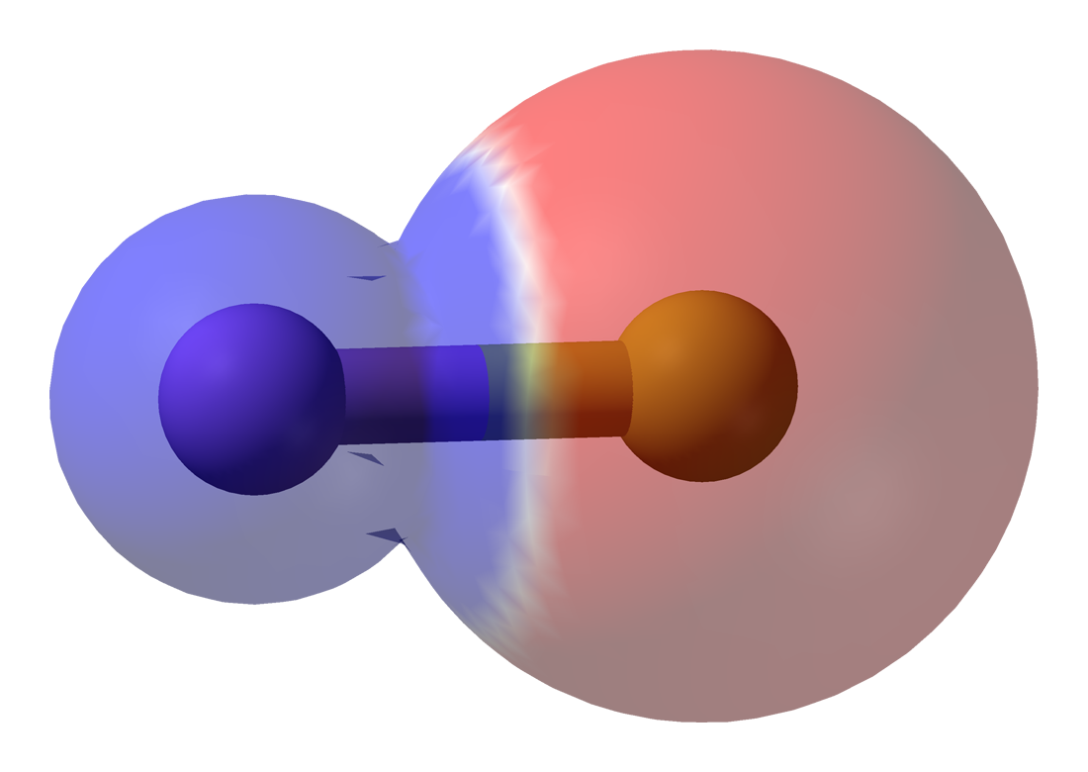
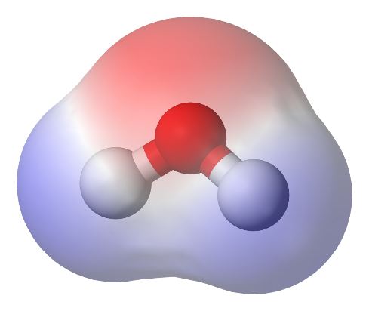
Examples
Draw the electric field lines through the molecule , head of the arrow toward the more negative side:
H
H---Cl H--C--H
H
Cl---Cl
S---H
H
nonpolar
nonpolar

Slide 25
Bond Energy
As you saw in the calculating the heat of formation of ionic compounds, an important step was breaking the covalent bond. Bond Energies are in the appendix of your textbook.
Forming bonds is exothermic and need to be negated.
Breaking bonds is endothermic and are positive.
Heat of formation of covalent reactions = the sum of all (-)bonds formed and (+) broken

Slide 26
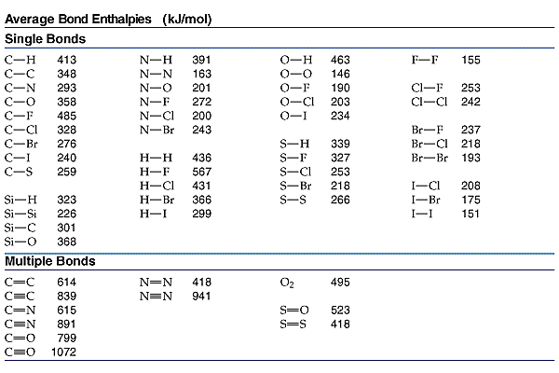
Bond Energy
What patterns emerge when we compare single versus double or triple bonds?
What patterns emerge when elements in the same group are compared?

Slide 27
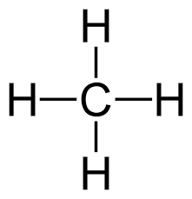
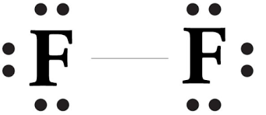
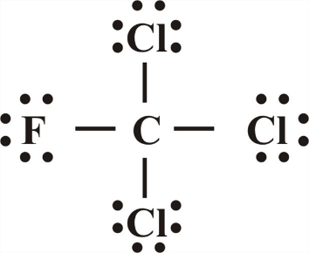
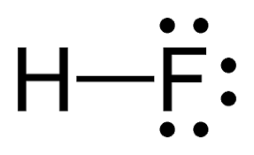
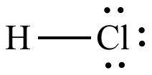
Bond Energy
Using bond energies in your textbook calculate the heat of formation. (It is recommended that you draw the compounds)
CH₄ + 2Cl₂+ 2F₂🡪 CF₂Cl₂ + 2HF + 2HCl (all gases)
[4(413) + 2(242) + 2(155)] – [2(485) + 2(328) + 2(567) + 2(431) =
-1176kJ

Slide 28
You must be able to...
Describe and identify covalent bonds.
Draw simple Lewis structures for molecular solids and determine their dipole moment.
Calculate the heat of formation of a covalent bond.

Slide 29
Exceptions to the Octet

Slide 30
Objectives
You should already be able to...
Draw Lewis structures for compounds that abide by the octet rule and identify their shape and polarity.
By the end of this video you should be able to...
Draw Lewis structures for compounds that disobey the octet rule and identify their polarity.
Identify which elements can be octet deficient and which can exceed the octet and explain why.

Slide 31
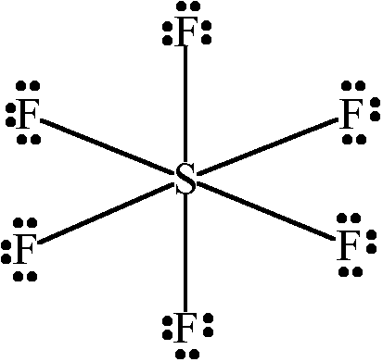
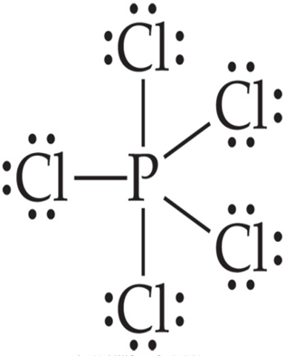
Question of the video:
How on Earth can these exist?!?

Slide 32
Exceptions to the Octet Rule ☹
1. Boron tends to form compounds with an incomplete octet. It can have 6e⁻. Al and Be can also do this but prefer not to.

Slide 33
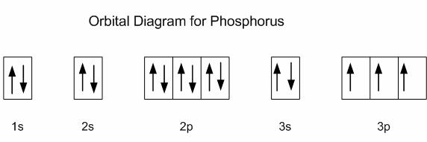
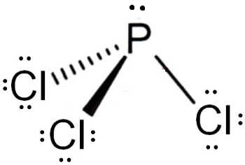
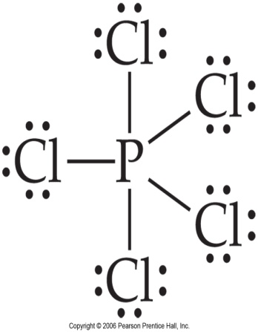
Exceptions to the Octet Rule ☹
2. Some elements can exceed the octet when needed. Only elements that have an open d orbital can do this. That means only in periods 3-7!

Slide 34
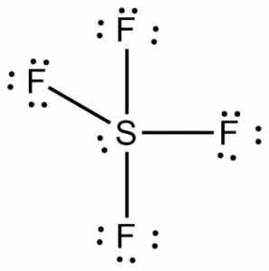
General rules
An atom will bond as many times it needs to fill the octet (P had 5 valence electrons and needed 3 electrons to fill it’s octet.)
If there is an abundance of reactants under high pressure, the atom may bond as many times as it has valence electrons. (P had 5 valence electrons so it could bond up to 5 times.)

Slide 35
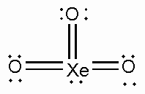
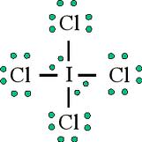
Examples
Draw the following molecules:
ClF₃
XeO₃
BCl₃
I₃⁻
ICl₄⁻

Slide 36
Polarity reminder:

Slide 37
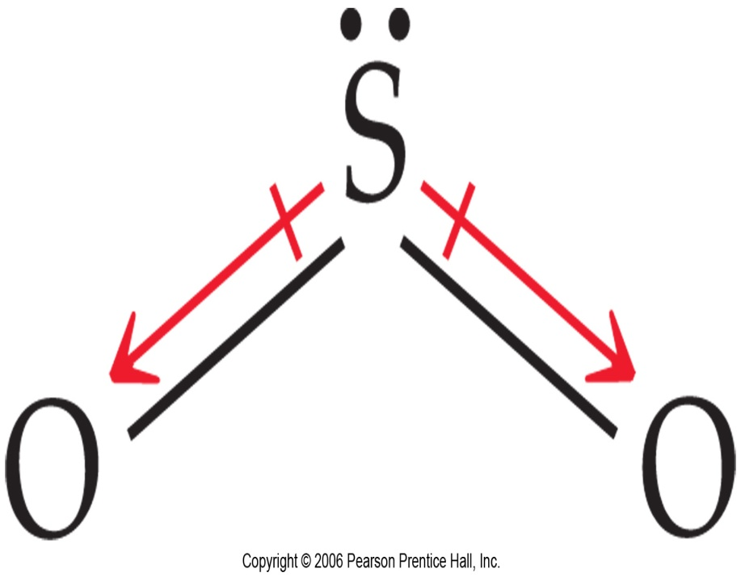

Slide 38
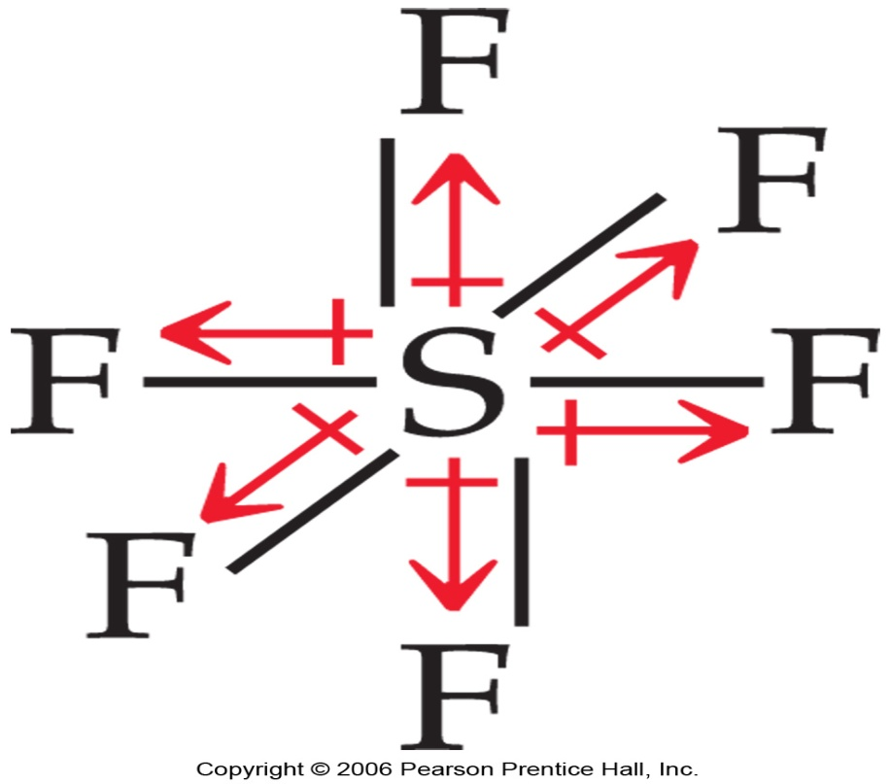
No Dipole Moment if Symmetrical

Slide 39
You must be able to…
Draw Lewis structures for compounds that disobey the octet rule and identify their polarity.
Identify which elements can be octet deficient and which can exceed the octet and explain why.

Slide 40
Resonance

Slide 41
Objectives
You should already be able to...
Draw Lewis structures for all compounds and identify their polarity.
By the end of this video you should be able to...
Draw Lewis structures for compounds with resonance structures and determine which resonance structure is the most favorable using formal charges.
Determine the bond order of a compound.

Slide 42
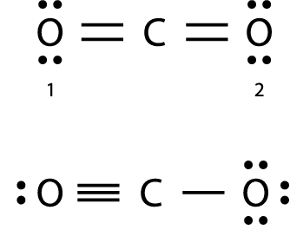
Question of the video:
Is there more than one way to obey the octet?

Slide 43
Practice
Draw the Lewis structure for NO₃⁻.
Notice that the nitrate ion can be written 3 different ways. It appears that there are two single bonds and one double bond. However, when measured, the bonds are actually the same length. This is called resonance.

Slide 44
Resonance
When one or more valid structures (that obey octet) can be drawn for one molecule they are called resonance structures.
The electron placement changes but not the nucleus.
Arrows between structures mean they are all equal, not that the structure is changing.
Resonance is used to fix the localized electron model which we use (Lewis structures). In fact, electrons are delocalized, meaning all electrons are able to move about the molecule, not fixed in a position.

Slide 45
Resonance
34 e-
Draw all resonance forms of N₂O₄.

Slide 46
Resonance
Some molecules and ions exceed the octet rule and then have nonequivalent resonance structures (they have a different number of single double or triple bonds).
To determine the best structure formal charge is calculated:
Formal Charge = (Valence e⁻ of the atom) - (valence e⁻ assigned to the atom in the structure)

Slide 47
Resonance rules
Lone pairs around an atom only belong to that atom.
In shared pairs, one electron belongs to the 1st atom and the other electron belongs to the 2nd atom.
Compare the following structures of SO₄²⁻. Which is better and why?
0
-1
-1
0
+2
-1
-1
0
-1
-1

Slide 48
Structures that obey the octet are the best structure. After that, structures with lower formal charges are usually the better structure.

Slide 49
Practice
Draw resonance structures for the following and pick the best:
XeO₃
O₃

Slide 50
Bond Order
Bond Order refers to how many bonds are shared between the atoms in a bond.
Single bonds (1)
Double bonds (2)
Triple bonds (3)
The higher the bond order, the stronger the bond due to more electrons being shared.

Slide 51
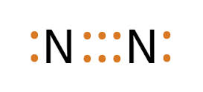
Bond Order
What is the bond order of:
2
1
1.5
3

Slide 52
Back to the Question of the video:
Is there more than one way to obey the octet?
0
0
0
They both have atoms with 8 valence electrons.
They both have bond orders of 2.
They both have a linear geometry.
Could they be equally correct?
We have been drawing the top diagram because it has the lowest formal charge.
+1
0
-1

Slide 53
You must be able to...
Draw Lewis structures for compounds with resonance structures and determine which resonance structure is the most favorable using formal charges.
Determine the bond order of a compound.

Slide 54
VSEPR

Slide 55
Objectives
You should already be able to...
Draw Lewis structures for all compounds and identify their polarity.
By the end of this video you should be able to...
Draw Lewis structures for compounds and determine their shape and bond angles.

Slide 56
Question of the video:
If these exists, what is their shape and polarity?

Slide 57
VSEPR
The structure of a molecule is determined by reducing electron repulsion between pairs. (Non bonded pairs should be as far apart as possible.) When determining the shape:
Double and triple bonds count as single bonds.
You may use any resonance structure.
If there is no central atom, it is not a classified shape.

Slide 58
Total bonds and lone pairs on central atom | electron shape
2 | Linear
3 | Trigonal Planar
4 | Tetrahedral
5 | Trigonal Bipyramidal
6 | Octahedral

Slide 61
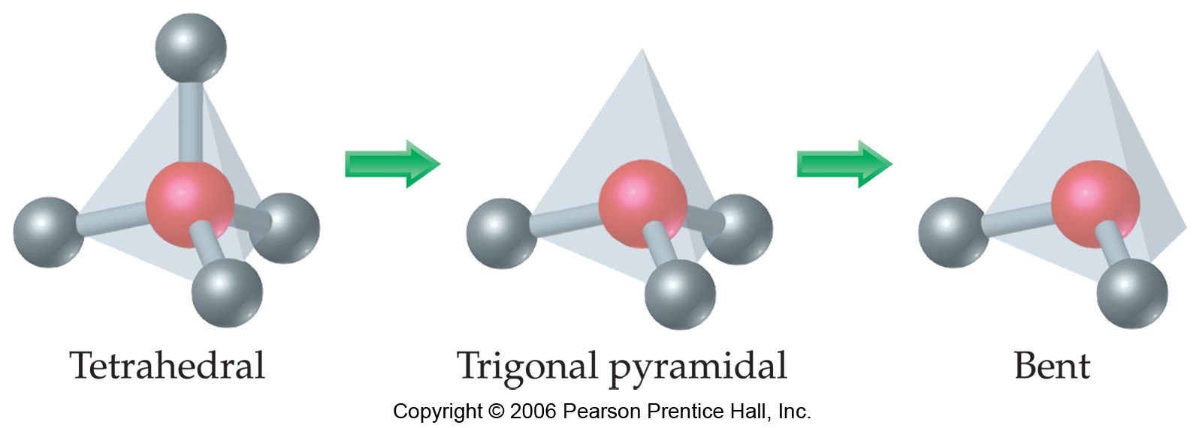
Tetrahedral

Slide 62
Tetrahedral

Slide 63
Bipyramidal

Slide 64
Octahedral

Slide 65
L
Total e- pairs on central atom | Lone pairs on central atom | electron shape (central atom) | Lewis Dot | Overall Shape (geometry) | Bond angle
1-2 | 0 | Linear |  | Linear | 180
3 | 0 | Trigonal planar |  | Trigonal planar | 120
3 | 1 | Trigonal planar |  | Bent | 120

Slide 66
L
Total e- pairs on central atom | Lone pairs on central atom | electron shape (central atom) | Lewis Dot | Overall Shape (geometry) | Bond angle
4 | 0 | Tetrahedral |  | Tetrahedral | 109.5
4 | 1 | Tetrahedral |  | Trigonal pyramidal | 109.5
4 | 2 | Tetrahedral |  | Bent | 109.5
4 | 3 | Tetrahedral |  | linear | 180

Slide 67
Total e- pairs on central atom | Lone pairs on central atom | Electron shape (central atom) | Lewis dot | Overall Shape (geometry) | Bond angle
5 | 0 | Trigonal bipyramidal |  | Trigonal bipyramidal | 90 and 120
5 | 1 | Trigonal bipyramidal |  | See –saw | 90 and 120
5 | 2 | Trigonal bipyramidal |  | T-shaped | 90 and 120
5 | 3 | Trigonal bipyramidal |  | Linear | 180

Slide 68
Total e- pairs on central atom | Lone pairs on central atom | Electron shape (central atom) | Lewis dot | Overall Shape (geometry) | Bond angle
6 | 0 | octahedral |  | Octahedral | 90
6 | 1 | octahedral |  | Square pyramidal | 90
6 | 2 | octahedral |  | Square planar | 90

Slide 69
What’s the Difference?

Slide 70
Back to the Question of the video:
If these exists, what is their shape and polarity?

Slide 71
You must be able to...
Draw Lewis structures for compounds and determine their shape and bond angles.

Slide 72
Hybridization

Slide 73
Objectives
You should already be able to...
Draw Lewis structures for all compounds and identify their shape and polarity.
By the end of this video you should be able to...
Identify atoms’ hybridization when bonded in a compound and relate it to the shape and bond angles of the molecule.
Identify and explain sigma and pi bonds.

Slide 74
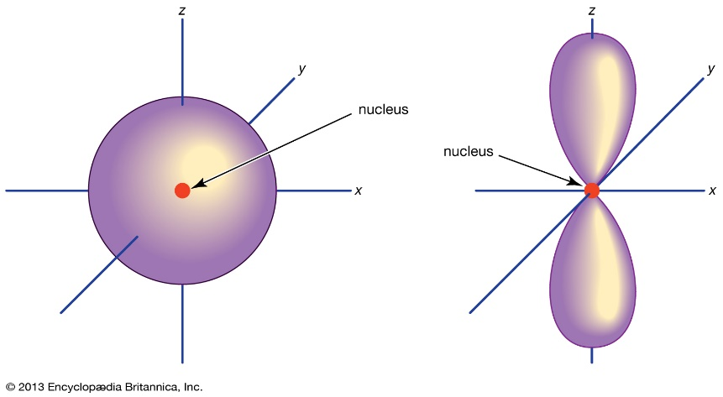
Questions of the video:
Considering the nonmetallic elements that bond to form molecular compounds use electrons from both s and p orbitals, are all single bonds created equal?
What makes a triple bond harder to break than a double or single bond?

Slide 75
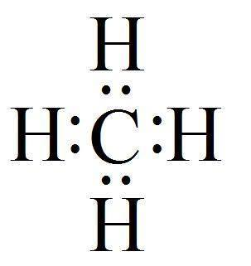
Draw Methane
Electrons from hydrogen’s 1s orbital and carbon’s 2s and 2p orbitals bond together. Is there a difference if hydrogen’s electron bonds with the 2s or the 2p electron?
No, because that is not what actually happens. Each bond is exactly the same because all 4 of carbon’s electrons hybridize.
p
s
p
p

Slide 76
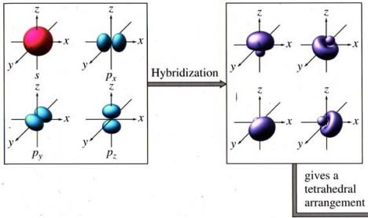
Hybridization
Carbon’s valence shell is 2s²2p². The one circular s orbitals hybridize with the three lobed p orbitals to make four sp³ orbitals which are all equal (degenerate).

Slide 78
Sp³ hybridization
Whenever a set of four similar bonds are needed sp³ hybridization occurs.

Slide 79
Sigma and Pi Bonds
Single bonds created between hybridized orbitals are referred to as sigma bonds and have the symbol σ. These bonds occur due to overlap of the orbitals.
Multiple bonds created between hybridized orbitals are referred to as pi bonds and have the symbol Π. These bonds occur because double and triple bonds do not touch but are parallel to each other above and below the bond.

Slide 80
Sigma and pi bonds

Slide 81
Hybridization
Draw ethene (C₂H₄).
The carbons in ethene (C₂H₄). have three effective pairs. This means 3 similar bonds are needed. Can it sp³ hybridize?
No! Each carbon will now combine the 2s with only two 2p orbitals to make sp² hybridization.
Whenever three similar bonds are needed the atom sp² hybridizes.

Slide 83
Ethene

Slide 84
Now draw CO₂
How many effective pairs does the carbon have?
How many similar bonds are needed?
Can you predict the hybridization?
The carbon will sp hybridize because it has 2 effective pairs needing 2 similar bonds.
How many effective pairs does each oxygen have in CO₂? What is each oxygen’s hybridization?
3 effective pairs means sp² hybridization.

Slide 87
Draw nitrogen and determine its hybridization.

Slide 88
dsp³ and d²sp³ hybridization
dsp³ hybridization is needed for 5 similar bonds like in Phosphorous pentachloride (PCl₅).
d²sp³ hybridization is needed for 6 similar bonds like in sulfur hexafluoride (SF₆).

Slide 89
In summary…
Effective pairs | Shape | Hybridization | angle
2 | Linear | sp | 180
3 | T. Planar | sp² | 120
4 | Tetrahedral | sp³ | 109.5
5 | T. Bipyramidal | dsp³ | 120 and 90
6 | Octahedral | d²sp³ | 90

Slide 90
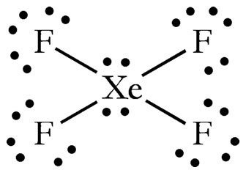
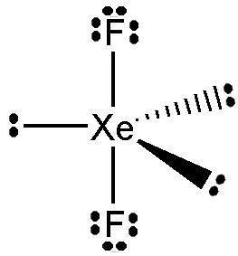
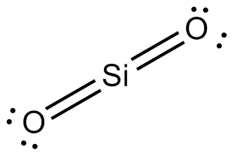
Examples
Predict the hybridization, shape, bond angles and sigma/pi bonds of the following:
XeF₄
XeF₂
SF₄
SiO₂
Square planar, d²sp³, 90, 4 sigma
Linear, dsp³, 90, 2 sigma
See saw, dsp³, 120 and 90, 4 sigma
linear, sp, 180, 2 sigma and 2 pi

Slide 91
You must be able to...
Identify atoms hybridization when bonded in a compound and relate it to the shape and bond angles of the molecule.
Identify and explain sigma and pi bonds.

Slide 92
Intermolecular Forces of Attraction

Slide 93
Objectives
You should already be able to...
Draw Lewis structures for all compounds.
By the end of this video you should be able to...
Identify the type of intermolecular forces used to hold multiple molecules together and use it to determine properties of the compound.

Slide 94
Question of the video: How does this happen?

Slide 95
Intermolecular forces
Intermolecular forces of attraction are weaker than bonds, but are responsible for holding a substance together. Strength of IMF determines properties like mp, bp, hardness, solubility and phase.
Substances with strong IMF have _________ melting points, _________ boiling points, and are most likely in the __________ phase at room temperature. Liquids will have __________ surface tension and __________ viscosity.
high
high
solid
strong
high

Slide 96
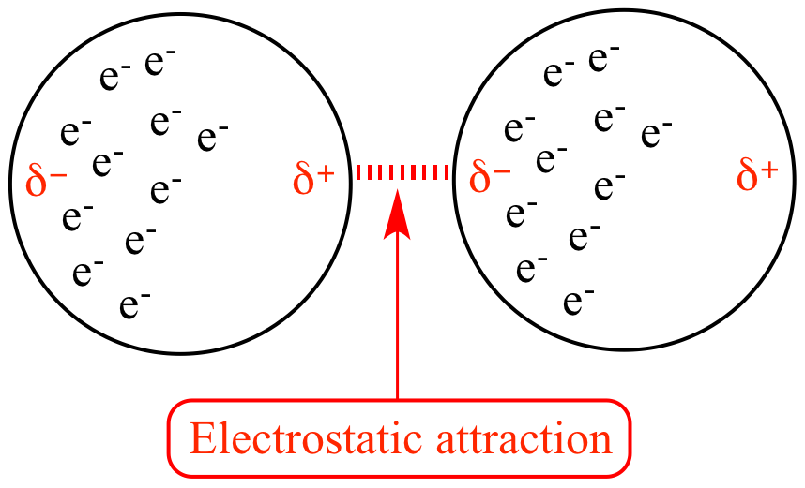
London Dispersion Forces
Weakest attractions between covalent (mostly nonpolar) molecules. The electrons of one atom attract the nucleus of another. This causes a temporary shift of electrons making one side of the molecule positive and the other negative.
The more electrons there are, the stronger the force. (Example: CH₄ is a gas, C₈H₁₈ is liquid and C₅₀H₁₀₂ is a solid at room temperature).

Slide 97
LDF

Slide 98
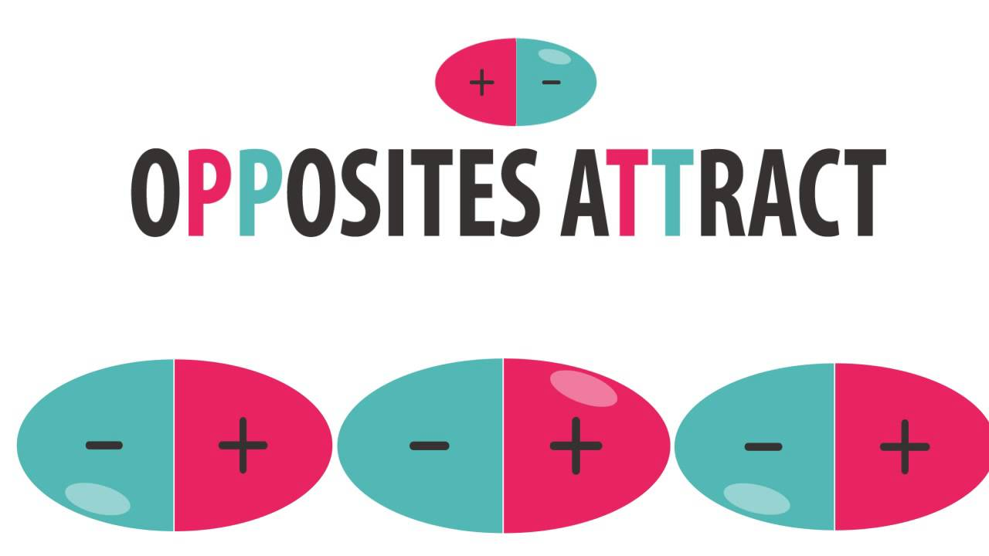
Dipole-Dipole Attractions
Occur between polar molecules. (Note: Polar molecules also have LDF but dipole dipole is stronger in most cases.)
The greater the polarity of the molecules, the greater the force of attraction.
LDF and Dipole-Dipole forces are also known as Van der Waals Forces because they both involve covalent substances.

Slide 99
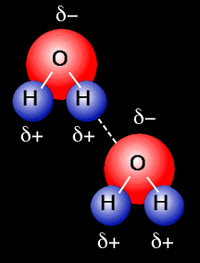
Hydrogen Bonds
A special IMF exists between H and F, O, N due to their high electronegativity values. (H bonds are FON!) These have very high melting point and boiling point!

Slide 100
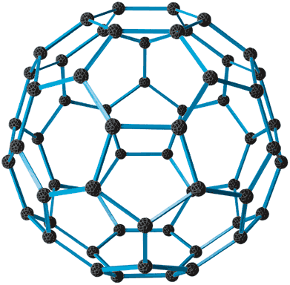
Network solids
Another special case of IMF includes forces between C and SiO₂. These from network solids with more strength than normal VDW forces. They are actually covalently bonded.

Slide 101
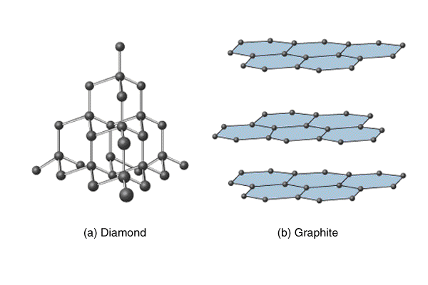
Carbon’s allotropes

Slide 102
Common Network Solids

Slide 103
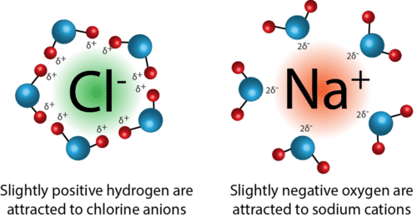
Ion-Dipole Attractions
The strongest attraction exists between ionic compounds and polar compounds.
Polar substances like water can ionize ionic substances due to strong attractions.
This is why polar substances and ionic substances are mostly miscible.

Slide 104
Summary of Strength
Strong
Weak
Ionic/Metallic Bonds
Covalent Bonds
Network Solids
Ion-Dipole Forces
Hydrogen Bonds
Dipole Dipole
LDF

Slide 105
You must be able to...
Identify the type of intermolecular forces used to hold multiple molecules together and use it to determine properties of the compound.

