Slide 1
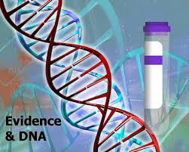
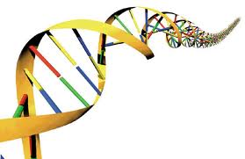
DNA Evidence
How can DNA be used to solve Crimes?

Slide 2
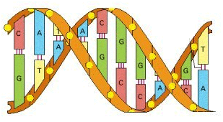
What is DNA?
Do Now: Why is DNA considered circumstantial evidence?
DNA contains genetic information.
Found on chromosomes located in the nucleus of our cells**
Individual Evidence
Notes:
**mDNA not in nucleus

Slide 3
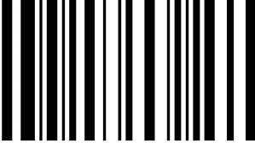
What is DNA?
Made up of base pairs: (think of a bar code)
A – T
C – G
The order of the base pairs determines the genetic code
CYTOSINE
THYMINE
GUANINE
ADENINE

Slide 4
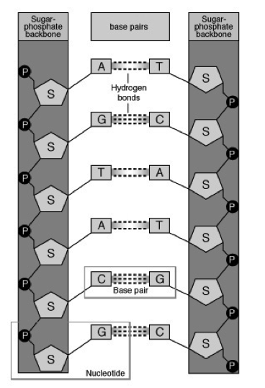
Complimentary Base Pairing
AGTACG
TCATGC

Slide 5
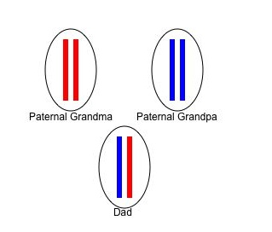
Human DNA
50% of a person’s DNA comes from each parent
23 pairs (46 chromosomes) in nucleus of most cells*
1 chromosome in each pair is inherited from mother and other from the father
Every person has a different DNA
sequence expect identical twins.
**How can we distinguish between
identical twins apart?
Notes:
*Except sperm and egg
**fingerprints (new research shows non coding DNA differences)
**copy number variants can be different in identical twins

Slide 6
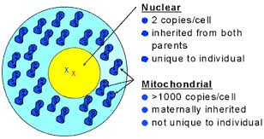
Types of Human DNA
NUCLEAR DNA: found in chromosomes
Used for DNA Fingerprinting
Unique to individual
MITOCHONDRIAL DNA: Found in mitochondria
Inherited from mother
Not unique
Example: bone, hair shaft

Slide 7
Why use mDNA?
More stable over time/conditions*
Can get more DNA if sample is limited
Can get DNA from a highly degraded source
Notes:
*More stable because located in double membrane organelle

Slide 8
How is DNA used?
Identify a victim
Link or exclude suspect to crime scene/evidence
Link multiple crime scenes
Establish Maternity/Paternity

Slide 9
What Factors Affect DNA evidence?
Heat, sunlight, moisture, bacteria, and mold (this was a major issue in the O.J. Simpson Case)
Not all DNA evidence will result in a usable DNA profile.
DNA testing cannot identify when the suspect was at the crime scene or for how long.

Slide 10
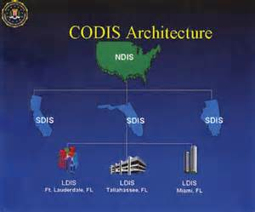
What is CODIS?
Electronic database of DNA profiles that can identify suspects.
DNA profiles from individuals convicted of certain crimes, such as rape, murder, and child abuse, are entered into CODIS and help identify possible suspects when no prior suspect existed.
Notes:
Combined DNA Index System

Slide 11
2 Main Types of DNA Testing
RFLP: * analyzes variable lengths of DNA cut by restriction enzymes.
requires large amounts of DNA and no degradation
*RFLP: Restriction Fragment Length Polymorphism.

Slide 12
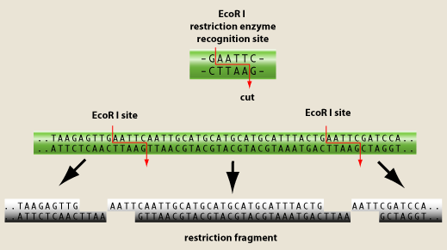
Restriction enzymes:
cut DNA at specific base sequences resulting in variable lengths of DNA

Slide 13
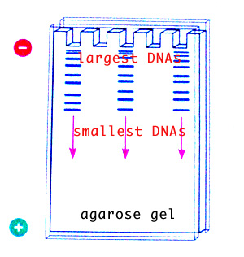
Gel Electrophoresis
Method of separating molecules of DNA within an electric field based on the size and charge of DNA fragments

Slide 14
DNA Testing
http://www.dnalc.org/resources/animations/gelelectrophoresis.html
More probes taken, the better the match probability will be.
Denim blue jeans actually interfere with the restriction enzymes!

Slide 15
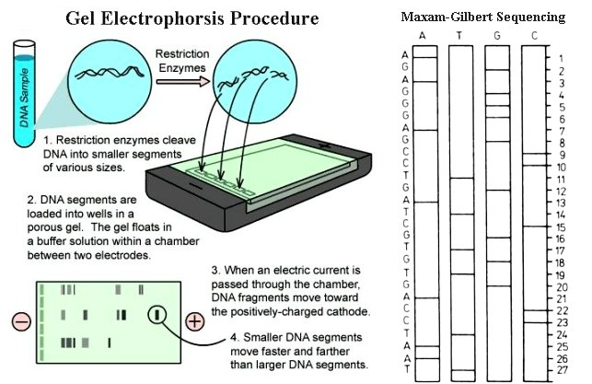

Slide 16
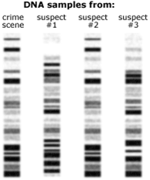
How are gel electrophoresis results analyzed?

Slide 17
DNA and Paternity

Slide 18
2nd Main type of DNA testing:
PCR: (Polymerase Chain Reactions) specific sequences of DNA that have high variability (differences) are copied millions of times
Less DNA needed and can be partially degraded

Slide 19
Newest type of DNA testing:
STR: Evaluates specific short repeating regions (loci) within nuclear DNA
FBI uses 13 standard specific STR regions for CODIS
STR match probabilities are 1 in a quintillion (1x10¹⁸) or more

Slide 20
For 1 STR sequence at 1 locus
Person A
Forensic sample
STR
STR
G-G-C-C-X-X-X-G-G-C-C-X-X..
G-G-G-C-C-X-X-G-G-C-C-X-X…..
PCR amplify
STR region
C-C-X-X-G-G
C-C-X-X-X-G-G
well
well
Gel
electrophoresis
Notes:
This will be done 13 times

Slide 21
Introduction to DNA Fingerprinting
http://www.youtube.com/watch?v=RLpalVirlTk#t=322

Slide 22
Watch the video and then answer the questions.
Video Link: http://videos.howstuffworks.com/tlc/29325-understanding-using-genes-to-help-solve-crimes-video.htm
1. When did DNA start to be an important tool in forensics? A. 1880s B. 1960s C. 1980s
2. What type of evidence does the FBI consider its most powerful tool? A. Fingerprints B. Blood C. DNA
3. What program is used to match DNA samples to possible contributors? A. CODIS B. AFIS C. DNA Code
4. What is it called when the program makes a match? A. Hot Hit B. Cold Hit C. Dead Hit
5. How many criminals have been convicted based on this software? A. 300 B. 900 C. 1,500

Slide 23
The answers are …
1. When did DNA start to be an important tool in forensics? A. 1880s B. 1960s C. 1980s
2. What type of evidence does the FBI consider its most powerful tool? A. Fingerprints B. Blood C. DNA
3. What program is used to match DNA samples to possible contributors? A. CODIS B. AFIS C. DNA Code
4. What is it called when the program makes a match? A. Hot Hit B. Cold Hit C. Dead Hit
5. How many criminals have been convicted based on this software? A. 300 B. 900 C. 1,500

Slide 24
OJ DNA
http://law2.umkc.edu/faculty/projects/ftrials/Simpson/Dna.htm

