Slide 1
ENERGY AND STATES OF MATTER

Slide 2
Energy Transfer

Slide 3
Lesson objectives:
Determine the direction of heat flow
Identify substances with the highest average kinetic energy

Slide 4
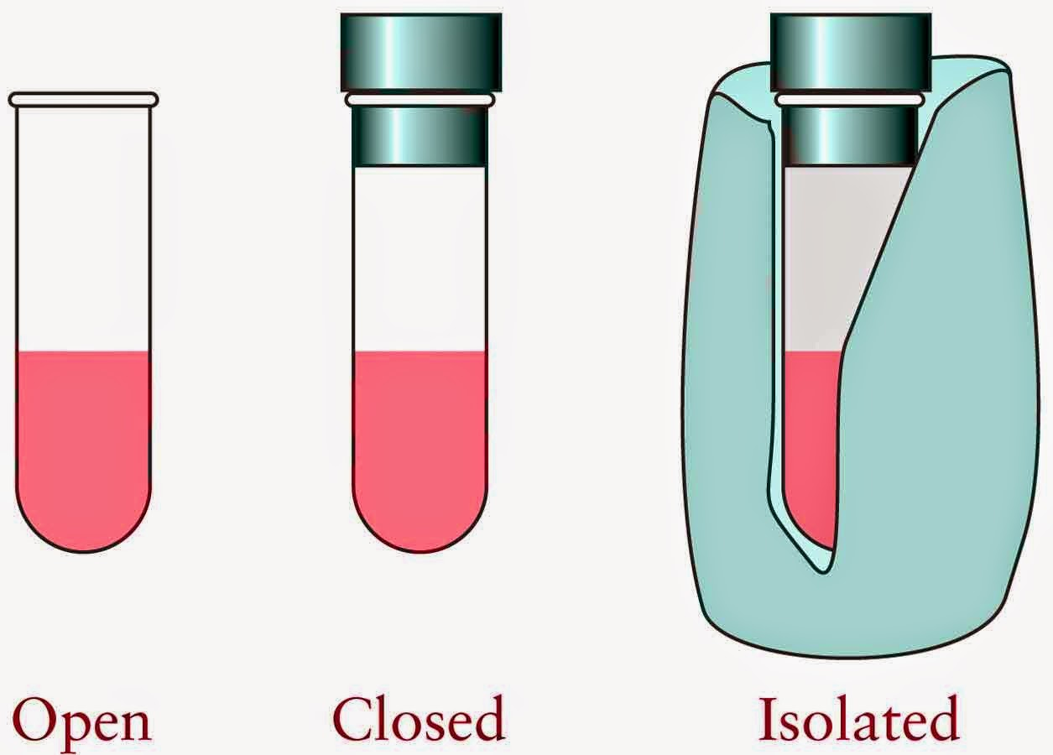
Systems and Surroundings
The system includes the particles we want to study
Open: exchanges energy and mass
Closed: exchanges energy but no mass
Isolated: doesn’t exchange energy or mass

Slide 5
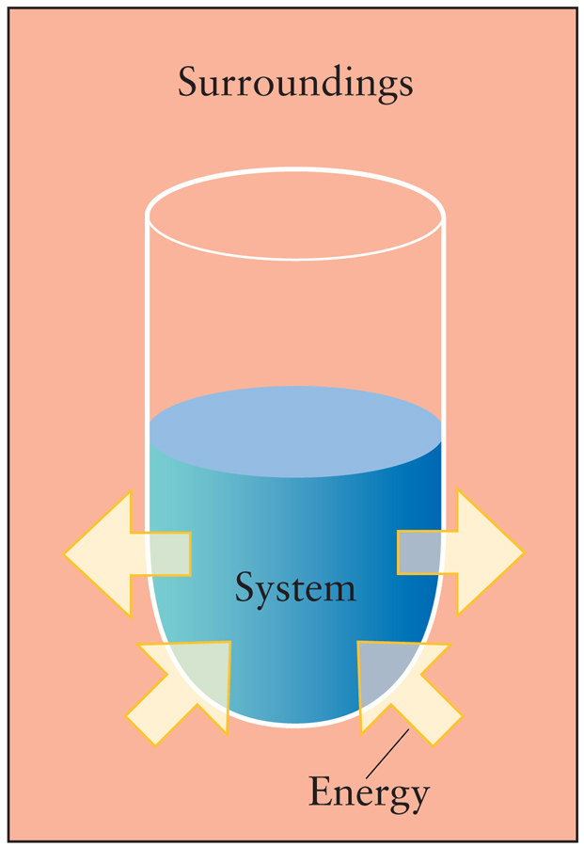
Systems and Surroundings
The surroundings are everything else (ex. container, top, surroundings)

Slide 6
Types of energy
Kinetic (thermal) energy: energy of motion
Potential (phase) energy: stored energy

Slide 7
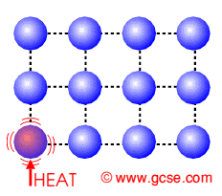
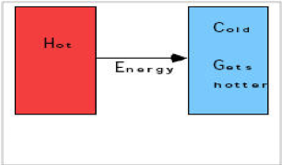
What is heat?
The movement of energy from one object to another
Moves from HOTTER (higher KE) object to COOLER (lower KE) object

Slide 8
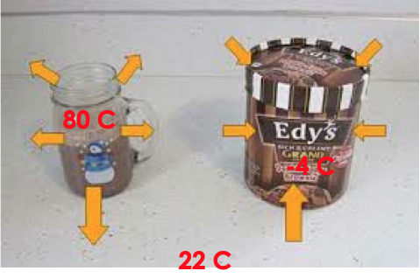
Example:

Slide 9
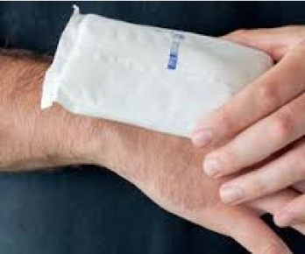
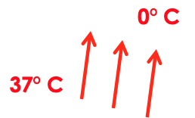
Example:
In terms of heat flow what happens when an ice pack is placed on your skin?

Slide 10
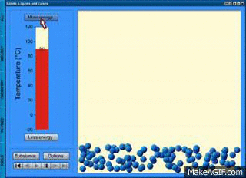
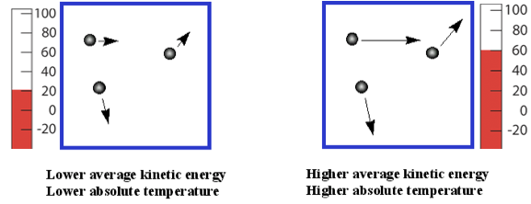
Temperature
Measure of the AVERAGE KINETIC ENERGY of the particles in matter

Slide 11
Example:
In which sample of water do the molecules have the highest average kinetic energy? 20. mL at 100. °C 40. mL at 80. °C 60. mL at 60. °C 80. mL at 40. °C
temperature

Slide 12
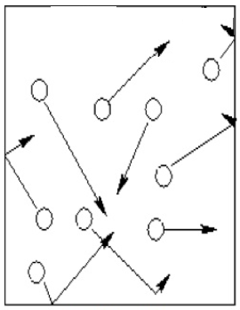
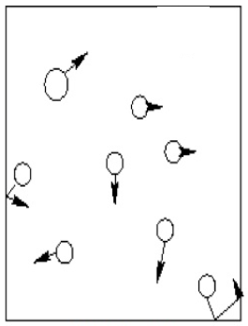
Particle model of heat transfer
Energy (heat)
Room: 25 C
Room: 25 C
Hot coffee: 85 C
Cold coffee: 25 C

Slide 13
Determine the direction of heat flow
Identify substances with the highest average kinetic energy

Slide 14
phase changes

Slide 15
Lesson Objectives:
Identify if a substance is a solid, liquid or gas
Determine if a phase change is endothermic or exothermic
Differentiate between potential and kinetic energy changes on a phase change diagram

Slide 16
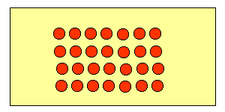
Solids
Definite shape
Definite volume
Particles are packed tightly in a geometric (crystalline) pattern
Constant vibration

Slide 17
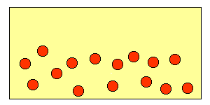
Liquids
No definite shape (take shape of container)
Definite volume
Particles further apart than solids but closer than gas
Constant motion

Slide 18
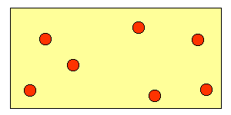
Gas
No definite volume (fill container)
No definite shape
Constant motion (most amount of movement)
No arrangement
Particles are farthest apart

Slide 19
“Force” holding particles together
Solids – STRONGEST force of attraction between particles Liquids – MODERATE force of attraction between particles Gases – WEAKEST force of attraction between particles

Slide 20
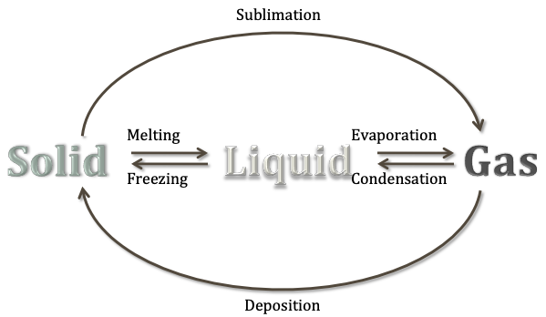
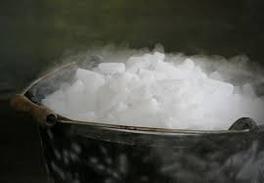
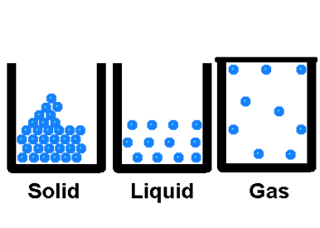
Phase Changes
Endothermic (adding heat) →
← Exothermic (removing heat)

Slide 21
Endothermic
(s) + heat → (l) (melting) (l) + heat → (g) (vaporization, boiling) (s) + heat → (g) (sublimation)

Slide 22
Exothermic
(l) → (s) + heat (freezing) (g) → (l) + heat (condensing) (g) → (s) + heat (deposition)

Slide 23
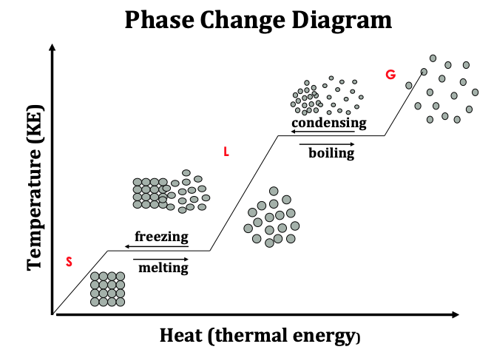

Slide 24
Identify if a substance is a solid, liquid or gas
Determine if a phase change is endothermic or exothermic
Differentiate between potential and kinetic energy changes on a phase change diagram

Slide 25
Calculating Heat

Slide 26
Lesson Objectives:
Calculate heat, specific heat, mass and change in temperature of a reaction

Slide 27
Calculating Heat of Reactions:
q = symbol for Heat
Measured in joules or kilojoules
If q is (+) the reaction is endothermic
If q is (-) the reaction is exothermic

Slide 28
The heat of the reaction q
Recall that q is based upon:
The mass of the substance
The temperature change it undergoes
Specific heat of the substance

Slide 29
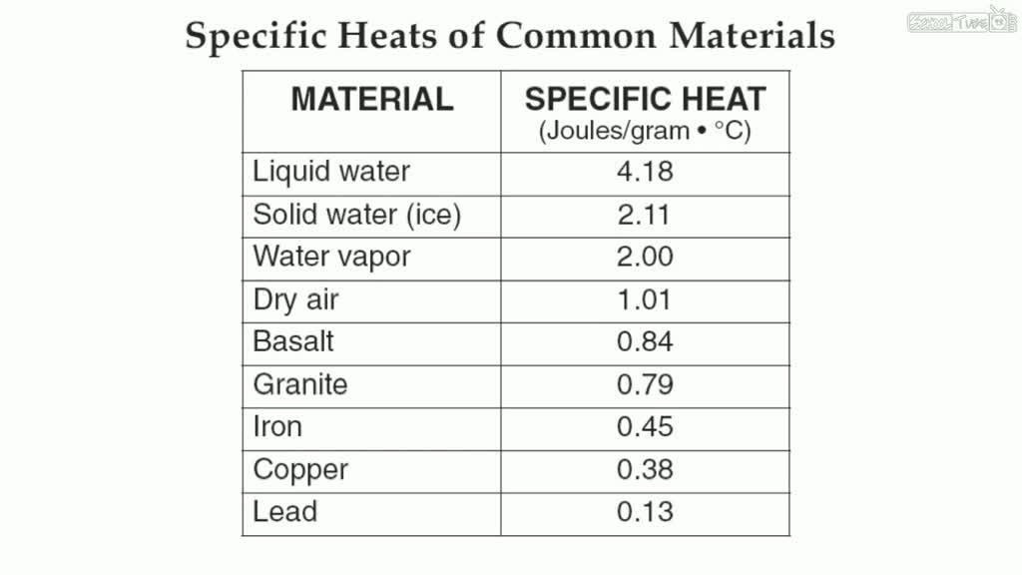
Specific heat
Amount of heat energy needed to raise the temperature of 1 gram of a substance 1 degree Celsius

Slide 30
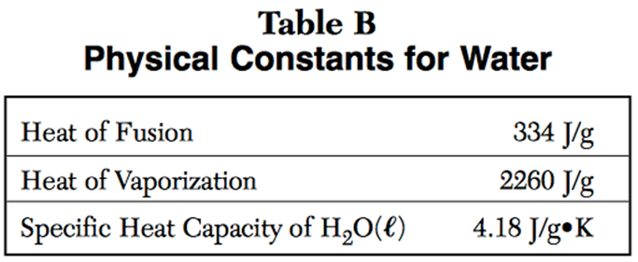
Specific Heat of Water
When heat is added to water, it takes a lot of energy to move the particles due to the strong attractive forces between the particles.

Slide 31
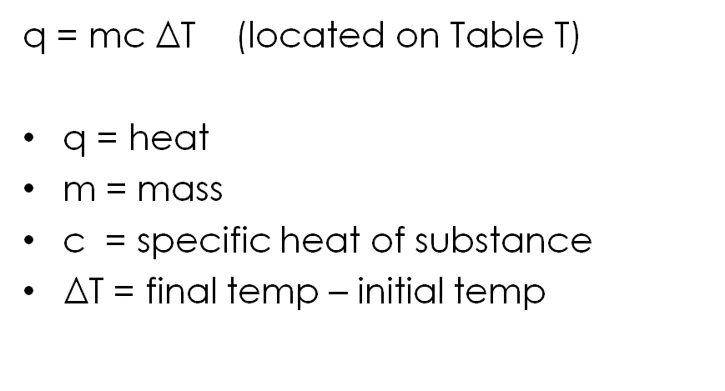
Calculating Heat

Slide 32
Example: I do
How much heat is needed to raise the temperature of 500. g of water by 15°C? Step 1: List the known variables
m = 500. g
c = 4.18 J/g°C (from Table B)
ΔT = 15°C

Slide 33
Example: I do
How much heat is needed to raise the temperature of 500. g of water by 15°C? Step 2: Determine the product
q = mCΔT
q = (500. g)(4.18 J/g°C)(15°C)
q = 31,500 J
= 32,000 J

Slide 34
Example: You do
How many joules of heat are absorbed when 50.0g of water are heated from 30.2°C to 58.6°C?
m = 50.0 g
q = mCΔT
C = 4.18 J/g°C
q = (50.o g)(4.18 J/g°C)(28.4°C)
q = 5935.6 J
ΔT = 28.4°C
q = 5940 J

Slide 35
Example: Solving for mass
When 520. joules of heat energy are added to water at 20.0 °C, the water incrases to 30.0°C. What is the mass of the water?
q = 520. J
q = mCΔT
m = ? g
520.J = (x)(4.18 J/g°C)(10)
c = 4.18 J/g°C
X = 12.4g
ΔT = 10

Slide 36
Example: Solving for specific heat
When 77J of heat are added to 10.0 grams of substance x at 20.0°C the final temperature is 25.0°C. What is the specific heat of substance X?
q = 77. J
q = mCΔT
m = 10.0 g
77J = (10.o g)(x)(5.0)
c = 4.18 J/g°C
X = 1.5J/gC
ΔT = ?

Slide 37
Example: Solving for final temperature
When 418. joules of heat energy are added to 10.0 grams of water at 20.0 °C, what will the final temperature of the water be?
q = 418. J
q = mCΔT
m = 10.0 g
418.J = (10.o g)(4.18 J/g°C)(ΔT)
c = 4.18 J/g°C
(ΔT) = 10.0°C
ΔT = ?
Initial temp 20.0°C + 10.0°C =
30.0°C

Slide 38
Calculate heat, specific heat, mass and change in temperature of a reaction

Slide 39
Calculating Heat of Phase Changes

Slide 40
Lesson objectives:
Determine the effect of forces on the heat of fusion and vaporization of a substance
Calculate the heat required by a substance to go through a phase change
Determine the changes in energy of a substance

Slide 41
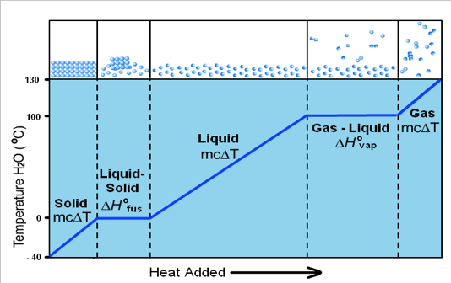
When do we use Q=mcΔT
Only where there is a a change in temp ΔT(on the solid, liquid and gas only lines.

Slide 42
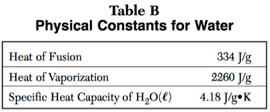
Heat of fusion
Heat needed to change a substance from solid to liquid or liquid to solid.
q=mH_{f} (table T)

Slide 43
Heat of Vaporization
Heat needed to change a substance from liquid to gas or a gas to a liquid
q=mH_{v} (table T)

Slide 44
Effects of attractive forces
If the attractive force between particles is strong, the heats of vaporization and fusion is high (high melting/boiling point)

Slide 45
Effects of attractive forces
It takes more energy to go from liquid to solid (vaporizing) than solid to liquid (melting) because you have to “break the force of attraction”

Slide 46
Heat of Fusion Example: (I do)
How many joules does it take to melt a 16.0 gram sample of water at 0°C?
q = ?
q = mH_{f}
m = 16.0 g
q = (16.0 g)(334 J/g)
H_{f} = 334 J/g
q = 5344 J
5340 J

Slide 47
Heat of Fusion Example: (We do)
How much heat is needed to melt ice at 0°C if the sample weighs 255g?
q = mH_{f}
q = ?
m = 255 g
q = (255 g)(334 J/g)
q = 85,170 J
H_{f} = 334 J/g
85,200 J

Slide 48
Heat of Fusion Example: (You do)
How much heat is needed to melt ice at 0°C if the sample weighs 134g?
q = mH_{f}
q = ?
m = 134 g
q = (134 g)(334 J/g)
q = 44,756 J
H_{f} = 334 J/g
44,800 J

Slide 49
Heat of Vaporization Example: (I do)
How many joules does it take to boil a 250. gram sample of water at 100°C?
q = mH_{v}
q = ?
m = 250. g
q = (250. g)(2260 J/g)
H_{v} = 2260 J/g
q = 565,000 J

Slide 50
Heat of Vaporization Example: (We do)
How many joules does it take to vaporize a 75.7 gram sample of water at 100°C?
q = mH_{v}
q = ?
m = 75.7 g
q = (75.7g)(2260 J/g)
H_{v} = 2260 J/g
q = 171,000 J

Slide 51
Heat of Vaporization Example: (You do)
How many joules does it take to boil a 50.0 gram sample of water at 100°C?
q = mH_{v}
q = ?
m = 50.0 g
q = (50.g)(2260 J/g)
H_{v} = 2260 J/g
q = 113,000 J

Slide 52
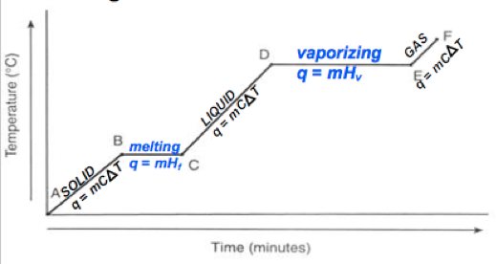
Heating Curve (heat added over time)
Vertical parts:
Temp inc
Avg kinetic energy inc
Potential energy constant
Horizontal parts:
Temp remains same
Avg kinetic energy remains the same
Potential energy increases

Slide 53
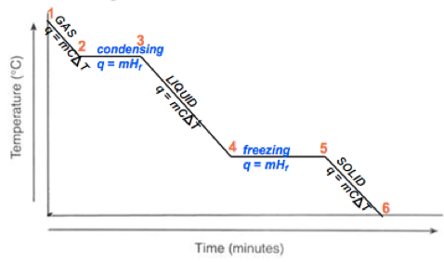
Cooling Curve (heat removed over time)
Vertical parts:
Temp dec
Avg kinetic energy dec
Potential energy constant
Horizontal parts:
Temp remains same
Avg kinetic energy remains the same
Potential energy decreases

Slide 54
Remember the 3 P’s
Plateau Phase change Potential energy change **diagonal Parts: Temperature is changing….therefore kinetic energy is changing

Slide 55
Determine the effect of IMF’s on the heat of fusion and vaporization of a substance
Calculate the heat required by a substance to go through a phase change
Determine the changes in energy of a substance

Slide 56
Phenomenon: Ice melt block
Feel the blocks. Report your observations
Predict: Which block will melt the ice faster and why?
Draw a model of what you think will happen
Block A
Block B

Slide 57
Phenomenon: Ice melt block
Results:
Which block melted the ice cube faster?
Refine your model.
Block A
Block B

