Slide 1
Equilibrium

Slide 2
Mass Action Expressions

Slide 3
OBJECTIVES
You should already be able to…
Define and describe chemical equilibrium.
By the end of the video you should be able to…
Create a mass action expression.
Use the mass action expression to calculate concentrations of species at equilibrium.

Slide 4
Question of the video:
CO(g) + Cl₂(g) 🡨 🡪 COCl₂ Phosgene gas is a highly toxic nerve gas used in WWII.
The manufacturing of the gas is an equilibrium reaction with a K_{c}=1.2x10⁻³ at 400°C. If the manufacturer uses 1M CO and 1M Cl₂, will 1M of COCl₂ form?

Slide 5
The Concept of Equilibrium
As a system approaches equilibrium, both the forward and reverse reactions are occurring at different rates.
At equilibrium, the forward and reverse reactions are proceeding at the same rate.

Slide 6
Equilibrium
Like this picture, the amount remains CONSTANT and the rates are EQUAL.

Slide 7
A System at Equilibrium
Once equilibrium is achieved, the amount of each reactant and product remains constant.

Slide 8
Depicting Equilibrium
N₂O_{4 (g)}
2 NO_{2 (g)}
In a system at equilibrium, both the forward and reverse reactions are being carried out. We write its equation with a double arrow.

Slide 9
The Equilibrium Constant
Forward reaction:
N₂O_{4 (g)} → 2 NO_{2 (g)}
Rate law:
Rate = k_{f} [N₂O₄]
Reverse reaction:
2 NO_{2 (g)} → N₂O_{4 (g)}
Rate law:
Rate = k_{r} [NO₂]²

Slide 10
The Equilibrium Constant
Therefore, at equilibrium
Rate_{f} = Rate_{r}
k_{f} [N₂O₄] = k_{r} [NO₂]²
This is called the Mass Action expression
k_{f}
k_{r}
[NO₂]²
[N₂O₄]
=

Slide 11
The Equilibrium Constant
To generalize this expression, consider the reaction
aA + bB
cC + dD
The equilibrium expression for this reaction would be
[C]^{c}[D]^{d}
[A]ª[B]^{b}
K_{c} =
Pure solids and liquids should be omitted.

Slide 12
The Equilibrium Constant
Because pressure is proportional to concentration for gases in a closed system, the equilibrium expression can also be written
(P_{C})^{c} (P_{D})^{d}
(P_{A})ª (P_{B})^{b}
K_{p} =
Only gases should be in the Pressure mass action expression.

Slide 13
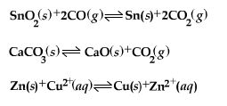
What Are the Equilibrium Expressions for These Equilibria?
Kp = P(CO₂)²/(P(CO)²
Kp = P(CO₂)
Kc = [Zn²⁺]/[Cu²⁺]

Slide 14
Mass Action Expressions
MAE can be used to calculate the concentrations or pressures of species in an equilibrium expression. Just plug and chug…

Slide 15
Example 1
At 230°C, the concentration of NO is 0.0542M, the concentration of oxygen is 0.127M, and the concentration on NO₂ is 15.5M. Calculate K.
2NO_{(g)} + O_{2(g)} ↔ 2NO_{2(g)}
Kc= [NO₂]²/[NO]²[O₂]
Kc= (15.5)²/(0.0542)²(0.127)
644000
Large K values such as this shows the reaction goes almost to completion

Slide 16
Example 2
The Kp of the following reaction equals 1.05 at 250°C. Find the pressure of Cl₂ if PCl₅ equals 0.875 atm and PCl₃ equals 0.463 atm at equilibrium.
PCl_{5(g)} ↔ PCl_{3(g)} + Cl_{2(g)}
Kp= P(Cl₂)P(PCl₃)/P(PCl₅)
1.05 = (x)(0.463)/(0.875)
1.98atm

Slide 17
Equilibrium Can Be Reached from Either Direction
It does not matter whether we start with N₂ and H₂ or whether we start with NH₃. We will have the same proportions of all three substances at equilibrium.

Slide 18
What Does the Value of K Mean?
If K >> 1, the reaction is product-favored; product predominates at equilibrium (products are on the numerator).
Extremely large K values may show the reaction goes nearly to completion
If K << 1, the reaction is reactant-favored; reactant predominates at equilibrium.
Extremely small values of K show the reaction may not proceed at all.

Slide 19
Question of the video:
CO(g) + Cl₂(g) 🡨 🡪 COCl₂ Phosgene gas is a highly toxic nerve gas used in WWII.
The manufacturing of the gas is an equilibrium reaction with a K_{c}=1.2x10⁻³ at 400°C. If the manufacturer uses 1M CO and 1M Cl₂, will 1M of COCl₂ form?
K = [COCl₂]/[CO][Cl₂]
Considering K is small, this reaction hardly occurs at this temperature
1.2x10⁻³ = [x]/[1][1]
x =1.2x10⁻³ M much lower than expected!
How could more phosgene be made??????

Slide 20
You Must be Able To…
Create a mass action expression.
Use the MAE to calculate species at equilibrium.

Slide 21
Manipulating Mass Action Expressions

Slide 22
OBJECTIVES
You should already be able to…
Construct a mass action expression.
Use the MAE to solve for concentrations or pressures.
By the end of the video you should be able to…
Manipulate mass action expressions.

Slide 23
Question of the video:
CO(g) + Cl₂(g) 🡨 🡪 COCl₂ Phosgene gas is a highly toxic nerve gas used in WWII.
The manufacturing of the gas is an equilibrium reaction with a K_{c}=1.2x10⁻³ at 400°C, which we have seen to result in poor manufacturing of the phosgene when 1M solutions were used.
Will the reverse reaction occur with better results?
How will doubling the reaction affect the concentrations?

Slide 24
Manipulating Equilibrium Constants
If you reverse an equation, you must take the reciprocal of the equilibrium constant.
2 NO₂(g)
[NO₂]²
[N₂O₄]
N₂O₄ (g)
K_{c} = = 0.212 at 100°C
N₂O₄(g)
[N₂O₄]
[NO₂]²
1
0.212
K_{c} =
= 4.72 at 100°C
2 NO₂ (g)
=

Slide 25
Manipulating Equilibrium Constants
If you multiply the reaction by any number, you must raise the equilibrium constant to that number.
[NO₂]²
[N₂O₄]
N₂O₄ (g)
2 NO₂ (g)
K_{c} = = 0.212 at 100°C
[NO₂]⁴
[N₂O₄]²
2 N₂O₄ (g)
4 NO₂ (g)
K_{c} = = (0.212)² at 100°C

Slide 26
Manipulating Equilibrium Constants
If two equations are combined, you must multiply their Keq.
H⁺ + F⁻ ↔ HF K₁=2
HF + Na⁺ ↔ NaF + H⁺ K₂=3
_________________ _______
K₁ = [HF] K₂ = [NaF][H⁺]
[H⁺][F⁻] [HF][Na⁺]
x
F⁻ + Na⁺ ↔ NaF K=6

Slide 27
Question of the video:
CO(g) + Cl₂(g) 🡨 🡪 COCl₂ Phosgene gas is a highly toxic nerve gas used in WWII. The manufacturing of the gas is an equilibrium reaction with a K_{c}=1.2x10⁻³ at 400°C, which we have seen to result in poor manufacturing of the phosgene when 1M solutions were used.
Will the reverse reaction occur with better results?
How will doubling the reaction affect the concentrations?
K_{f} = [COCl₂]/[CO][Cl₂]
K_{r} = [CO][Cl₂] /[COCl₂]
K_{r} = 1/Kf = 1/1.2x10⁻³
K_{r} = 833
= x²/1
Kr = 833 = [x][x]/[1]
x = 29M!
K² = [COCl₂]²/[CO]²[Cl₂]²
= [(1.2x10)⁻³]²
= 1.4x10⁻⁶
A smaller K implies the reaction would proceed less if all concentrations were doubled.

Slide 28
YOU MUST BE ABLE TO
Manipulate and combine mass action expressions.

Slide 29
Initial, Change, Equilibrium

Slide 30
OBJECTIVES
You should already be able to…
Construct a mass action expression.
Manipulate and calculate mass action expressions.
By the end of the video you should be able to…
Use reaction quotients to determine if a system is at equilibrium.
Use ICE Box to calculate species that are not at equilibrium.

Slide 31
Question of the video:
CO(g) + Cl₂(g) 🡨 🡪 COCl₂ Phosgene gas is a highly toxic nerve gas used in WWII.
The manufacturing of the gas is an equilibrium reaction with a K_{c}=1.2x10⁻³ at 400°C. If a environmental chemist studies a contained sample of polluted air in which 1.0M CO, 2.5M Cl₂, and 1.0M of COCl₂ is initially present, in which direction will the reaction proceed?

Slide 32
The Reaction Quotient (Q)
To calculate Q, substitute the initial concentrations of reactants and products into the equilibrium expression.
Q gives the same ratio the equilibrium expression gives, but for a system that is not at equilibrium.

Slide 33
K or Q = P/R
If Q=K At equilibrium
If Q>K Too many products, shifts left (reverse) to make reactants.
If Q<K Too many reactants, shifts right (forward) to make products.

Slide 34
Example
The Kc of the following equation equals 54.3 at 430C. Initially, 0.243moles of hydrogen, 0.0146moles of iodine and 1.98 moles of hydrogen iodide are placed in a sealed 1.00L container. Which way will the reaction shift to achieve equilibrium?
H₂ + I₂ ↔ 2HI
Q = (1.98)²/[(0.0146)(0.243)]
Q = 1110, shifts left to make reactants

Slide 35
ICE BOX
Only use an ice box if you are given initial conditions and need to change to equilibrium conditions.
Question 1 on Part 2 of every AP Exam will need an ice box!!!
The initial concentration of A is 0.850M. Calculate the final concentration of A and B.
A ↔ B Kc=24 at STP

Slide 36
Kc = [B]/[A]
24 = [x]/[0.850-x]
X=0.816
[A] = 0.850 - .816 = 0.034M
[B] = 0.816M
STEPS:
Write the Kc
Construct an ice box
Fill in initial []
Fill in the changes based on the number of moles and equation
Combine I and C to get E
Plug E into the Kc
Solve for x
Calculate the Final [] from E and x.
 | [A] | [B]
I | 0.850 | 0
C | -X | +x
E | 0.850-x | x

Slide 37
A mixture of 0.50mole of H₂ and 0.50mol of I₂ is placed in a 1L flask at 430C. If the Kc equals 54.3 for H₂ + I₂ 🡪 2HI, calculate the concentrations at equilibrium.
 | H₂ | I₂ | HI
I | 0.50 | 0.50 | 0
C | -x | -x | +2X
E | 0.50-X | 0.50-X | 2X
Kc= [HI]²/[H₂][I₂] = 54.3 = [2x]²/[0.50-x]²
√54.3 = 2x/[.5-x]
x= 0.393M
[HI] = 0.786M [H₂] = [I₂] = 0.107M

Slide 38
Try the example again but with an additional initial concentration of 0.040M for HI.
 | H₂ | I₂ | HI
I | 0.50 | 0.50 | 0.040
C | -x | -x | +2X
E | 0.50-X | 0.50-X | 0.040+2X
Kc= [HI]²/[H₂][I₂] = 54.3 = [0.040+2x]²/[0.50-x]²
x = 0.39M
[HI] = 0.82M [H₂] = [I₂] = 0.11M

Slide 39
Now suppose [H₂] = 0.00623, [I₂] = 0.00414 and [HI] = 0.0224M. (HINT: First find out which way the reaction will shift!)
Q=19.5, product favored
 | H₂ | I₂ | HI
I | 0.00623 | 0.00414 | 0.0224
C | -x | -x | +2X
E | 0.00623-X | 0.00414-X | 0.0224+2X
Only use the approximation of the shift will be small and you can’t use the square root rule
Kc= [HI]²/[H₂][I₂] =
54.3 = [0.0224+2x]²/[0.00623-x][0.00414-x]
x= 0.0114M or .00156
[HI] = 0.0255M
[H₂] = 0.00467 M
[I₂] = 0.00258M

Slide 40
Question of the video:
CO(g) + Cl₂(g) 🡨 🡪 COCl₂ Phosgene gas is a highly toxic nerve gas used in WWII. The manufacturing of the gas is an equilibrium reaction with a K_{c}=1.2x10⁻³ at 400°C. If a environmental chemist studies a contained sample of polluted air in which 1.0M CO, 2.5M Cl₂, and 1.0M of COCl₂ is initially present, in which direction will the reaction proceed?
Q = [COCl₂]/[CO][Cl₂]
= 0.40
= [1.0]/[1.0][2.5]
Q >K
Reaction proceeds in reverse to decrease the abundance of phosgene
What will the equilibrium concentration of COCl₂ be?

Slide 41
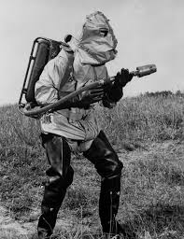
Question of the video:
INITIAL, CHANGE, EQUILIBRIUM!
 | CO | Cl₂ | COCl₂
Initial | 1.0 | 2.5 | 1.0
Change
Equilibrium
K_{c}=1.2x10⁻³
+x
+x
-x
1.0+x
2.5+x
1.0-x
K = [COCl₂]/[CO][Cl₂]
1.2x10⁻³ = [1.0-x]/[1.0+x][2.5+x]
1.2x10⁻³ = [x]/[1.0][2.5]
x = 3.0x10⁻³M
Thank goodness it disappears after some time.

Slide 42
YOU MUST BE ABLE TO
Use reaction quotients to determine if a system is at equilibrium.
Use ICE Box to calculate species that are not at equilibrium.

Slide 43
LeChatelier’s Principle

Slide 44
OBJECTIVES
You should already be able to…
Define and describe equilibrium reactions.
By the end of the video you should be able to…
Use LeChatelier’s principle to determine how a reaction will change to restore equilibrium.

Slide 45
Question of the video:
CO(g) + Cl₂(g) 🡨 🡪 COCl₂ Phosgene gas is a highly toxic nerve gas used in WWII.
The manufacturing of the gas is an equilibrium reaction with a K_{c}=1.2x10⁻³ at 400°C. If the manufacturer uses 1M CO and 1M Cl₂, and only 1.2x10⁻³M COCl₂ formed. How did the scientists create the phosgene?

Slide 46
Le Châtelier’s Principle
If a change is imposed on a system at equilibrium, the position of the equilibrium will shift in a direction that tends to reduce that change.

Slide 47
The Haber Process
The transformation of nitrogen and hydrogen into ammonia (NH₃) is of tremendous significance in agriculture, where ammonia-based fertilizers are very important.

Slide 48
The Haber Process
If H₂ is added to the system, N₂ will be consumed and the two reagents will form more NH₃.

Slide 49
The Effects of Changes in Concentration
If a species is added, the reaction will shift away from that species to restore equilibrium.
If a species is removed, the reaction will shift toward that species to restore equilibrium.

Slide 50
The Effects of Changes in Volume
A decrease in volume increases the pressure and causes a shift that favors less moles of gas
An increase in volume decreases the pressure and causes a shift that favors more moles of gas
N₂O_{4(g)} 🡨 🡪 2NO_{2(g)} Volume shifts right
Volume shifts left

Slide 51
2Red 1Gray

Slide 52
The Effect of Changes in Temperature
Endothermic Reactants + Heat ↔ Products
Exothermic Reactants ↔ Heat + Products
Heat is considered a reactant and product

Slide 53
Catalysts
Catalysts increase the rate of both the forward and reverse reactions.
Equilibrium is achieved faster, but the reactants and products do not change.

Slide 54
Common Ion Effect
If a common ion is added, shift away from that ion:
In the reaction:
Na⁺_{(aq)} + F⁻_{(aq)} ↔ NaF_{(aq)}
If NaCl is added, how the reaction affected?
NaCl contains Na⁺ ions which will shift the reaction towards the products.

Slide 55
Reactions to Remove Ions
If a substance is added that is known to react with a species in the reaction, treat the reaction as if that species is decreasing.
In the reaction:
Na⁺_{(aq)} + F⁻_{(aq)} ↔ NaF_{(aq)}
If H⁺ is added, how the reaction affected?
H⁺ will react with F⁻ to decrease the F⁻ and shift the reaction towards the reactants.

Slide 56
LeChatelier Problems
Consider the following equation:
N_{2(g)} + 3H_{2(g)} ↔ 2NH_{3(g)} + 92KJ
Predict how the H₂ will be affected by:
Ammonia being added
Nitrogen being added
Heat being added
Pressure decreasing
Ammonia being removed
Nitrogen being removed
Decreasing the volume
H₂ increases
H₂ decreases
H₂ increases
H₂ increases
H₂ decreases
H₂ increases
H₂ decreases

Slide 57
LeChatelier Answers Wording
Catalysts/Increasing Surface Area of a solid: “Has no effect on equilibrium.”
Solids: “Has no effect on equilibrium”. HOWEVER, equilibrium can produce more solid (Think saturation)
Addition of a species X: “Additional X will react with Y (or decompose) to shift the reaction away from that side (towards the other side, forming __, removing __, etc).”
Removing a species X:“Removing X will force the reaction to shift towards X to restore it, thus increasing ____ (decreasing ____, etc.)”
Increasing Pressure/Decreasing Volume: “A reaction with lower volume will favor the side with less moles of gas, thus increasing ___ (decreasing ___, shifting ___, etc.)”
Increasing Temperature: “Increasing the temperature favors endothermic reaction, thus favoring the ___ reaction (decreasing ___, increasing ___, shifting ___, etc.)”

Slide 58
More Difficult Examples
Explain which way the reaction will shift with the following stresses:
NaCl(s) 🡪 Na⁺ + Cl⁻
Addition of Pb⁺²
Addition of NaCl (s)
Pulverizing NaCl(s)
Explain how the pressure of O₂ will change with the following stresses:
2H₂O(g) 🡪 2H₂(g) + O₂(g)
Addition of He
Addition of He at constant P
Removal of O₂
PbCl₂ ppt so Cl⁻ is removed and reaction shifts right.
No effect. Solids don’t change equilibrium.
No effect. Solids don’t change equilbrium.
No effect. He is inert and doesn’t interfere.
He takes up space in the reaction chamber. Therefore if volume decreases for the remaining gases, the side with fewer moles increases. O₂ decreases.
What you remove will never be fully restored. O₂ overall decreases.

Slide 59
Question of the video:
CO(g) + Cl₂(g) 🡨 🡪 COCl₂ + 6.0kJ Phosgene gas is a highly toxic nerve gas used in WWII.
The manufacturing of the gas is an equilibrium reaction with a K_{c}=1.2x10⁻³ at 400°C. If the manufacturer uses 1M CO and 1M Cl₂, and only 1.2x10⁻³M COCl₂ formed. How did the scientists create the phosgene?
Decreasing the temperature, increasing concentrations of the reactants only, or taking out the phosgene as it is formed will shift the reaction towards the products.

Slide 60
YOU MUST BE ABLE TO
Use LeChatelier’s principle to determine how a reaction will change to restore equilibrium.

Slide 61
Solubility Product Constant, Ksp

Slide 62
Objectives
You should already be able to…
Write mass action expressions.
By the end of the video you should be able to…
Calculate the concentration of ions in an insoluble salt.

Slide 63
Question of the video:
Unfortunately, may homes (especially in MI) have lead in their water. The lead is particularly unsafe to drink. Besides filtration systems that use reverse osmosis, how can solubility help clean the water?

Slide 64
Solubility Products
Solubility is generally expressed as the mass of solute dissolved in 1 L of solution (g/L)
Molar solubility is in mol/L (M).
Ksp must be in Molarity units.

Slide 65
Solubility versus Molar Solubility
The solubility of CaSO₄ is 0.67g/L. Calculate the molar solubility.
The molar solubility of Cu(OH)₂ is 1.8x10⁻⁷ . Calculate the solubility in g/L.
0.67g x 1 mole =
1L 136.14g
4.9x10⁻³M
1.8x10⁻⁷ mole x 97.55g =
1L 1 mole
1.8x10⁻⁵g/L

Slide 66
Solubility Products
Consider the equilibrium that exists in a saturated solution of BaSO₄ in water:
BaSO₄(s)
H₂O
Ba²⁺(aq) + SO₄²⁻(aq)
K_{sp} = [Ba²⁺] [SO₄²⁻]
where the equilibrium constant, K_{sp}, is called the solubility product.
Notice: no water or Barium sulfate because they are pure liquids and solids!

Slide 67
Write the solubility product expression (Ksp).
MgF₂
Ag₂CO₃
Ca₃(PO₄)₂
Ksp= [Mg⁺²][2F⁻]²
Ksp=[2Ag⁺]²[CO₃⁻²]
Ksp=[3Ca⁺²]³[2PO₄⁻³]²
Ksp = [X product]^{X}
[Y reactant]^{Y}

Slide 68
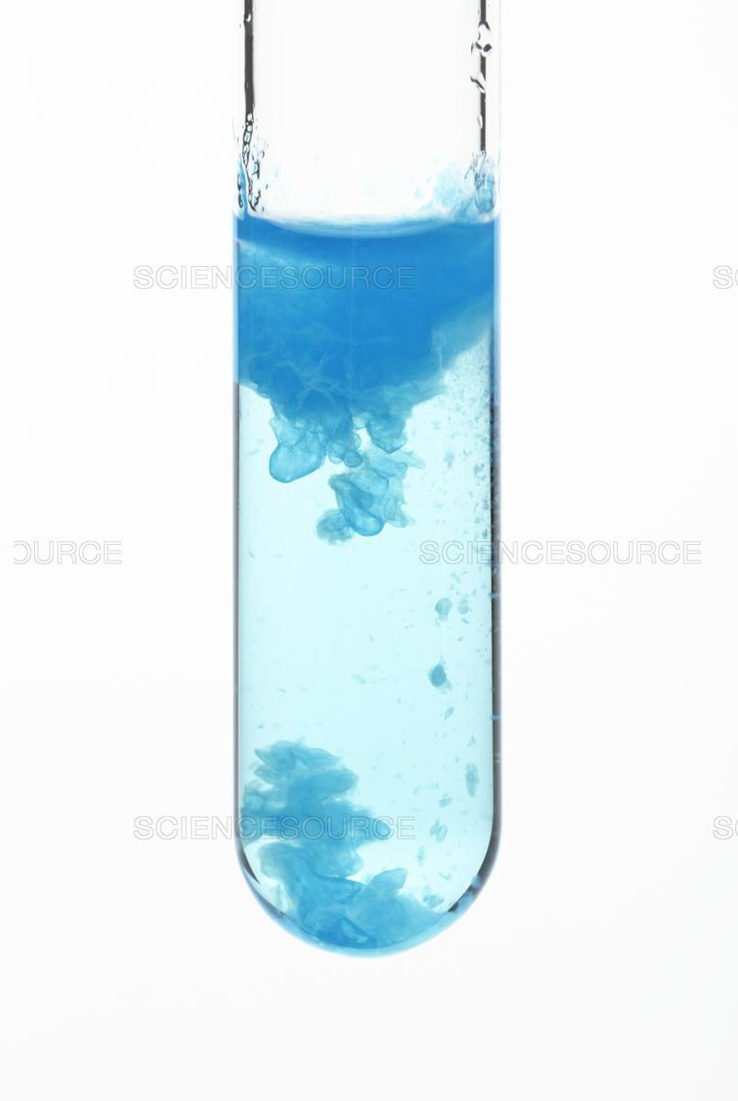
Calculate the Ksp of Cu(OH)_{2.} The molar solubility is 1.8x10⁻⁵
Ksp=[Cu⁺²][2OH⁻]²
Ksp = 4x³
Ksp=4(1.8x10⁻⁵)³
Ksp=2.3x10⁻²⁰
Cu(OH)₂ 🡪 Cu⁺² + 2OH⁻
I unknown 0 0
C -x +x +2x
E unknown-x x 2x

Slide 69
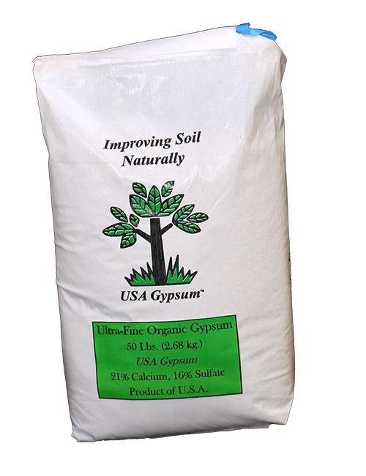
Calculate the Ksp of CaSO₄. Molar solubility is 4.9x10⁻³
CaSO₄ 🡨 🡪 Ca⁺² + SO₄⁻²
amount 0 0
-x +x +x
A-x x x
Ksp=[Ca⁺²][SO₄⁻²]
Ksp = x²
Ksp=(4.9x10⁻³)²
Ksp=2.4x10⁻⁵

Slide 70
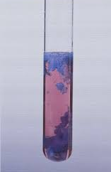
Calculate the molar solubility of compound XY₃ if the Ksp equals 1.5x10⁻²
XY₃ 🡨 🡪 X⁺³ + 3Y⁻¹
Unknown 0 0
-x +x +3x
U-x x 3x
Ksp=[x][3x]³
Ksp = 27x⁴
1.5x10⁻²=27x⁴
x=0.15M

Slide 71
Question of the video:
How can solubility help clean the water?
Add anions that make lead insoluble!
Ex. Lead sulfate in insoluble and can be filtered out.
PbSO₄ → Pb⁺² + SO₄⁻² Ksp = 1.4x10⁻⁴
How much lead can the water hold?
Ksp = [Pb⁺²][SO₄⁻²]
1.4x10⁻⁴ = x²
x= 0.012M
P.S. a concentration of only 7.24x10⁻⁸ or higher is considered unsafe.

Slide 72
YOU MUST BE ABLE TO:
Calculate the concentration of ions in an insoluble salt.

Slide 73
Ksp versus Q, pH and ΔG

Slide 74
Objectives
You should already be able to…
Identify salts as basic or acidic.
Write mass action expressions.
Calculate the concentration of ions in an insoluble salt.
By the end of the video you should be able to…
Determine the shift in equilibrium of an insoluble salt.

Slide 75
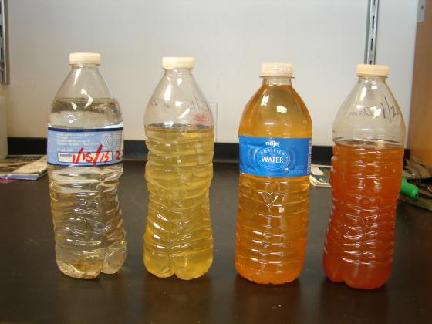
Question of the video:
Hydroxide ions are added to precipitate the lead in water. The lead was at an unhealthy value of 2.0x10⁻⁷M so the same amount of hydroxide was added to precipitate it. What type of solution is created when these chemicals are reacted?
Ksp= 1.42x10⁻²⁰

Slide 76
Calculating Q
If Q is less than Ksp, it is unsaturated and more solute can dissolve.
If Q is equal to Ksp, it is saturated. No more will dissolve and no solute will precipitate.
If Q is more than Ksp, it is supersaturated and the extra solute will precipitate out.
Qsp = [X product]^{X}
[Y reactant]^{Y}

Slide 77
XY₂ has a Ksp equal to 1.0x10⁻⁶. If 0.010M X⁺² reacts with 0.020M Y⁻, is the solution saturated? Will it precipitate out or dissolve more?
XY₂ 🡨 🡪 X⁺² + 2Y⁻
unknown 0 0
-x +x +2x
U-x x 2x
Q=[X⁺²][2Y⁻]²
Q=[0.010][0.020]²
Q=4x10⁻⁶
Ksp<Q so SS and some will precipitate.

Slide 78
200.0mL of 0.0040M BaCl₂ is added to 600.0mL of 0.0080M K₂SO₄. Will a precipitate form? (Ksp=1.1x10⁻¹⁰)
BaCl₂ + K₂SO₄ 🡪 2KCl_{(aq)} + BaSO_{4(s)}
BaSO₄ 🡨 🡪 Ba⁺² + SO₄⁻²
U 0 0
-x +x +x
U-x x x
(200)(.0040)=(800)(x) x=1.0x10⁻³ Ba⁺²
(600)(0.0080)=(800)(x) x= 6.0x10⁻³ SO₄⁻²
Q=[Ba⁺²][SO₄⁻²] = (1.0x10⁻³)(6.0x10⁻³)
Q= 6x10⁻⁶ Q>K so SS and
precipitate forms.

Slide 79
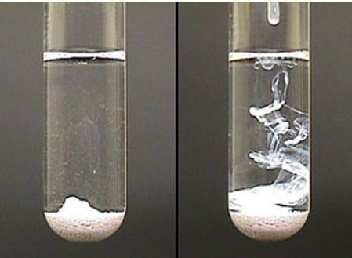
The Ksp of AgCl is 1.6x10⁻¹⁰. How many grams of AgCl must be added to a 20.00L sample of water in order for precipitation to occur?
AgCl 🡨 🡪 Ag+ + Cl-
U 0 0
-x +x +x
U-x x x
Ksp=[Ag⁺][Cl⁻]
1.6x10⁻¹⁰=x²
x=1.26x10⁻⁵M (20.00L)(143.32g/mol)
0.036 grams very insoluble!

Slide 80
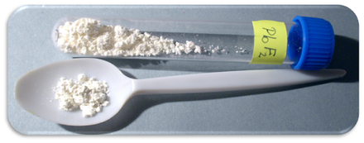
The Ksp of Lead (II) fluoride is 4.1x10⁻⁸. 4.50 grams of lithium fluoride is added to 4000.mL of water and it dissolves completely. After the addition of how many grams of Lead (II) nitrate does the lead(II)fluoride precipitate?
PbF₂ 🡨 🡪 Pb⁺² + 2F-
U 0 0
-x +x +2x
U-x x 2x
Ksp=[Pb⁺²][2F⁻]²
4.5g/25.94g/mol/4.0L=0.043M
4.1x10⁻⁸=[x][0.043]²
x=2.22x10⁻⁵M (4.0L)(331.22g/mol)
0.029 grams

Slide 81
The addition of a common ion will decrease solubility of a salt.
When CaF₂ is the only substance in the water Ksp = 3.9x10⁻¹¹. calculate the concentration of Ca⁺².
If 0.50M NaF is also present, recalculate the [Ca⁺²].
Ksp = [Ca⁺²][2F⁻]² = x(2x)² = 4x³ = 3.9x10⁻¹¹
x = 2.14x10⁻⁴M
Ksp = [Ca⁺²][2F⁻]²
3.9x10⁻¹¹ = x(0.50)²
x = 1.56x10⁻¹⁰M

Slide 82
The addition of an acid or base can affect solution pH and salt solubility.
Recall that bases have pH values higher than 7 and acids have pH values lower than 7.
Mg(OH)₂(s) → Mg⁺²(aq) + 2OH⁻(aq)
If any base containing OH⁻ is added, the pH increases and the additional OH⁻ can shift the reaction in the reverse direction, Mg(OH)₂ decreasing the amount of that dissolves.
If any acid containing H₃O⁺ is added, the pH decreases and the additional H₃O⁺ reacts with OH⁻ can shift the reaction in the forward direction, Mg(OH)₂ increasing the amount of that dissolves.

Slide 83
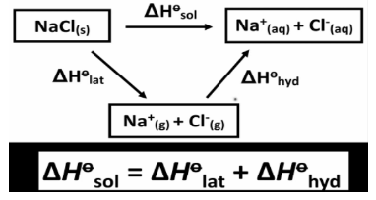
Enthalpy
The change in enthalpy (ΔH) represents the change in energy, usually in the form of heat, that is associated with a physical or chemical change.
If ΔH is positive, energy is absorbed by the system. endothermic
If ΔH is negative, energy is released by the system. exothermic
Recall that Enthalpy can be the net heat change of multiple steps (Hess’ law).
When NaCl dissolves in water it must break
lattice energy (endo) and hydrate with water (exo).
Thus some substance have a net exo (hot) reaction
and others have a net endo (cold) dissolving process.

Slide 84
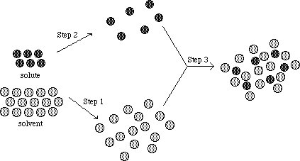
Entropy
The change in entropy (ΔS) is related to changes associated with the dispersal of matter and/or energy. Entropy increases when:
matter becomes more dispersed and the particles have more freedom to move around.
the number of possible arrangements of the particles increases.
energy is dispersed (e.g., the temperature of a sample of matter increases, resulting in a broader distribution of the kinetic energies of the particles).

Slide 85
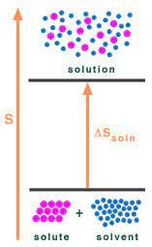
Entropy
If ΔS is positive, the particles of matter are more dispersed and more disordered. There is a greater number of possible arrangements of the particles.
If ΔS is negative, the particles of matter are less dispersed and more ordered. There is a smaller number of possible arrangements of the particles.

Slide 86
Gibbs Free Energy
Gibbs Free energy can be calculated to determine if a reaction actually takes place. It takes into account both the Enthalpy and Entropy of the reaction as well as the temperature.
For example, more salts dissolve better at higher temperatures.

Slide 87
Gibbs
NaOH
NH₄Cl
ΔH = - hot/exo/favorable
ΔS = - decrease in entropy due to
order with water/unfavorable
ΔG= - spontaneous (observed
dissolving) at room and other temperatures so enthalpy value must be larger than entropy value.
ΔH = + cold/endo/unfavorable
ΔS = + increase in entropy due to
disorder with water /favorable
ΔG= - spontaneous (observed
dissolving) at room and other temperatures so entropy value must be larger than enthalpy value.

Slide 88
Question of the video:
Hydroxide ions are added to precipitate the lead in water. The lead was at an unhealthy value of 2.0x10⁻⁷M so the same amount of hydroxide was added to precipitate it. What type of solution is created when these chemicals are reacted?
Ksp= 1.42x10⁻²⁰
Q=[Pb⁺²][2OH⁻]²
Q= (2x10⁻⁷)(2x10⁻⁷)²
Q=8.0x10⁻²⁰
Q>K
so some lead will ppt but only to get to equilibrium!
How can we get more to ppt???

Slide 89
YOU MUST BE ABLE TO:
Determine the shift in equilibrium of an insoluble salt.

