Slide 1
the Script on Flipped Classroom
FLIP
Kristen Drury
William Floyd High School, NY
AP, Honors, General Chemistry LIMT 2014-2018
www.chemisme.com
chemisme@gmail.com
@APChemIsMe

Slide 2
About Me
I have been flipping my classroom since 2012
Started using PowerPoint, screen recorder (Screencastomatic) and YouTube!
Using EdPuzzle since 2014

Slide 3
Part 1 Early Days

Slide 4
The “Flipped Lesson” Hook:
Reverses the roles of homework & lecture
Homework
Classwork
Review concepts and practice difficult problem sets
Take notes and practice introductory problem sets
Notes:
Jess

Slide 5
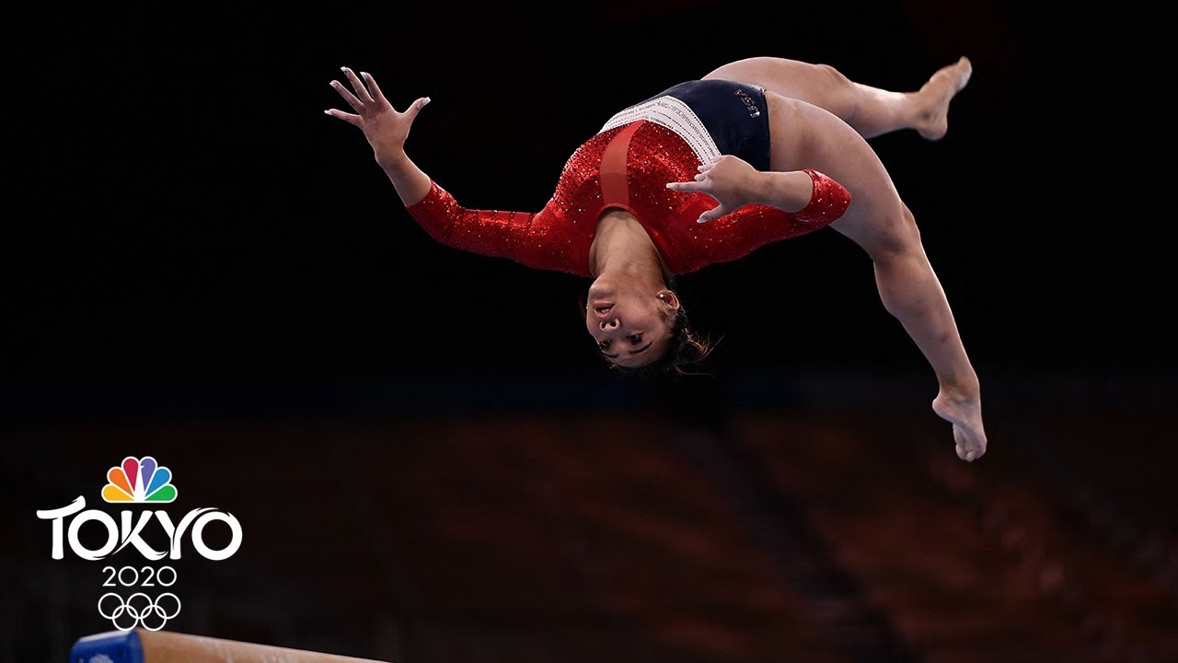
Why I was convinced to flip:
Allows students to take control of the lecture:
Watch and re-watch as many times as needed
Pause and take notes, annotate slides
Watch early, at any time of day
Allows more class time for application of chemistry:
More opportunities to detect misunderstandings
More labs, activities, and modeling
Notes:
Jess

Slide 6
Initial flipping misconceptions:
Videos do not replace the teacher.
Flipping does not take the place of an actual classroom.
Classes are still structured.
Students are not isolated while learning.
Flipped videos are not just videos… they are tools.

Slide 7
Initial Flipping Benefits
All students were more engaged in class discussions and activities. More student centered.
Absent students can easily catch up.
Homework is assessed before students come into class:
Misconceptions are identified faster.
Immediate feedback can be given to students.

Slide 8
Research based effective educational practices
One to one student-teacher contact.
Cooperation among students.
Active learning.
Prompt feedback.
Increased time on task.
Communicate high expectations.
Respect diverse talents and ways of knowing.
Flipping the classroom can foster this culture!
Cross, K. P. (1999). What Do We Know About Students' Learning, and How Do We Know It?. Innovative Higher Education, 23(4), 255-270.

Slide 9
Class time is free for:
Lab experiments (inquiry)
Demonstrations
POGIL activities
Hands on discovery
Literacy strategies
Modeling Instruction
Class discussions
Group work and practice
Notes:
Jess

Slide 10
Small Bundles of Information
Choose 1-3 small objectives per lesson, 10 min max
Examples: Atomic Structure Outline
AP Chemistry
Configurations Intro
Configurations II
PES
Isotopes and Mass Spec
Light Equations
General Chemistry
Rutherford Theory
Subatomic Particles
Ions
Isotopes
Atomic Mass Calcuations
Bohr Lewis
Bright Line Spectra

Slide 11
Why EDpuzzle?
Every student has a log in.
Tracks students:
When they watch
How many times they watch
Skipping is prevented.
An app is available for phones and tablets.
Assess your students prior to class to drive class instruction.

Slide 12
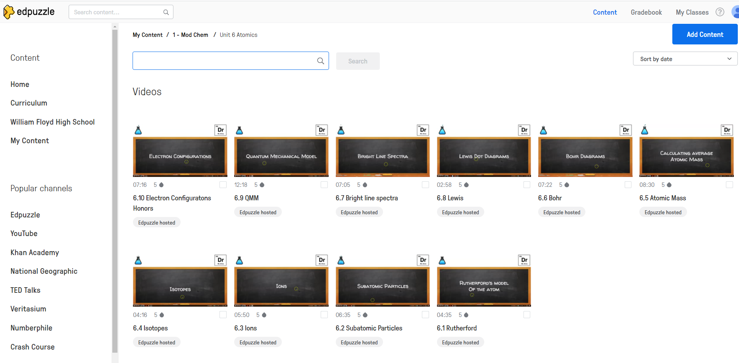
Upload Your Own Video

Slide 13
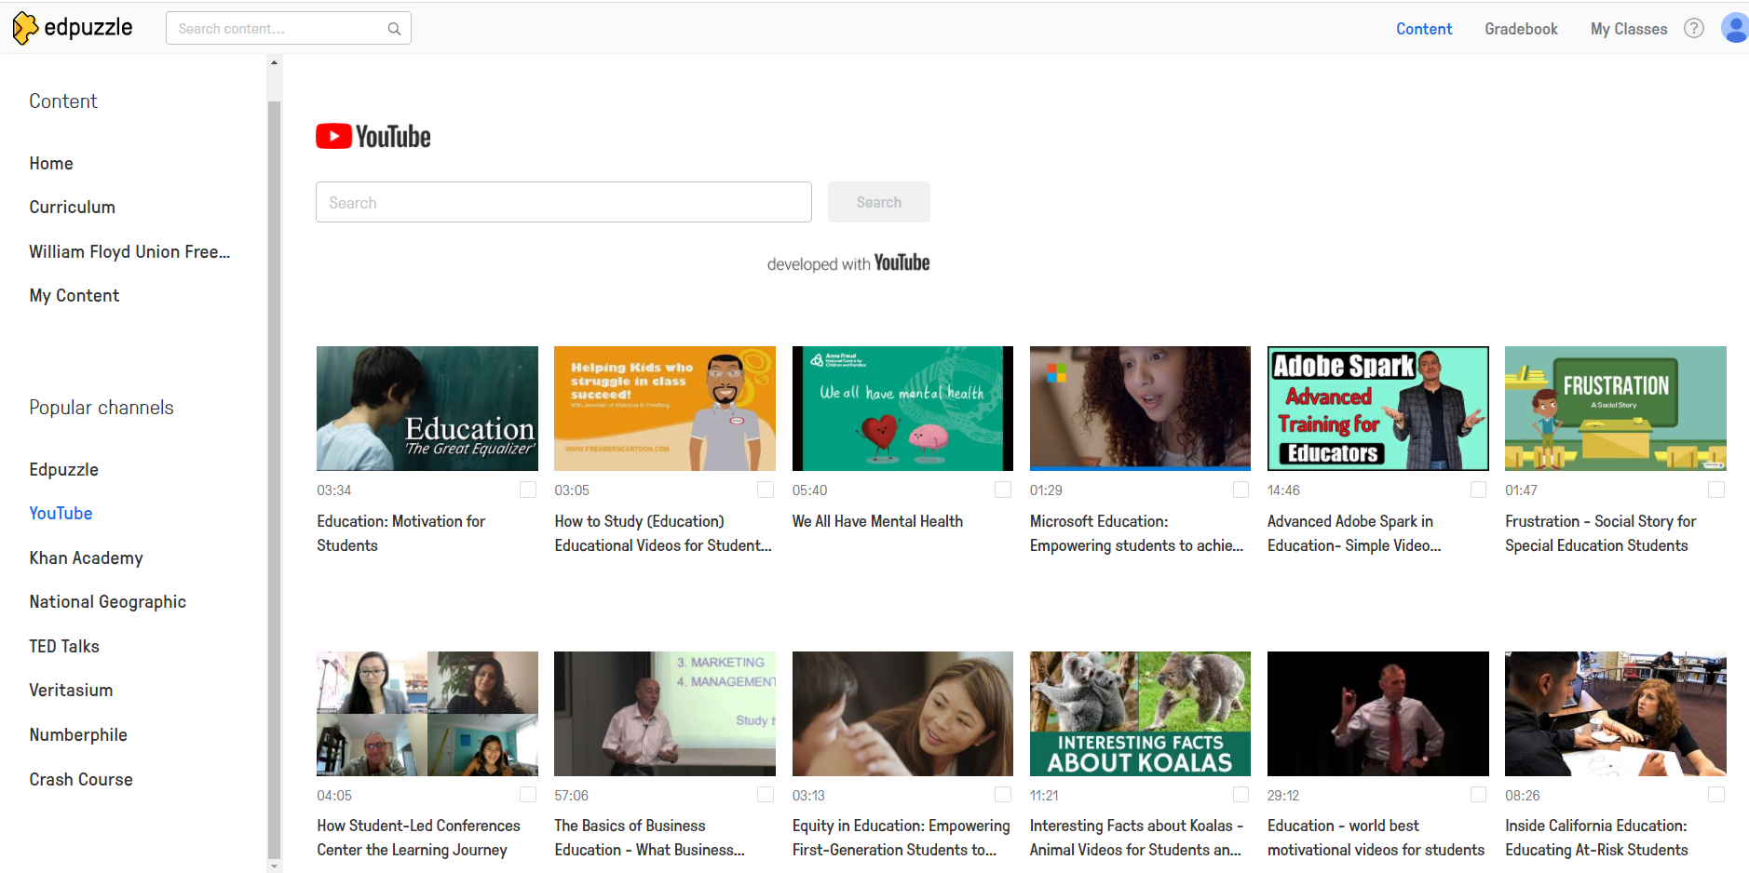
Other Videos are Available

Slide 14
You can edit the length of those videos, add voice overs, and add questions to any point in the video

Slide 15
Free Response Questions

Slide 16
Multiple Choice Questions

Slide 17
Save and Upload
Auto-Saved
Choose classes
Prevent Skipping
Turn on CCs
Assign start and due date

Slide 18
Assess Progress

Slide 19
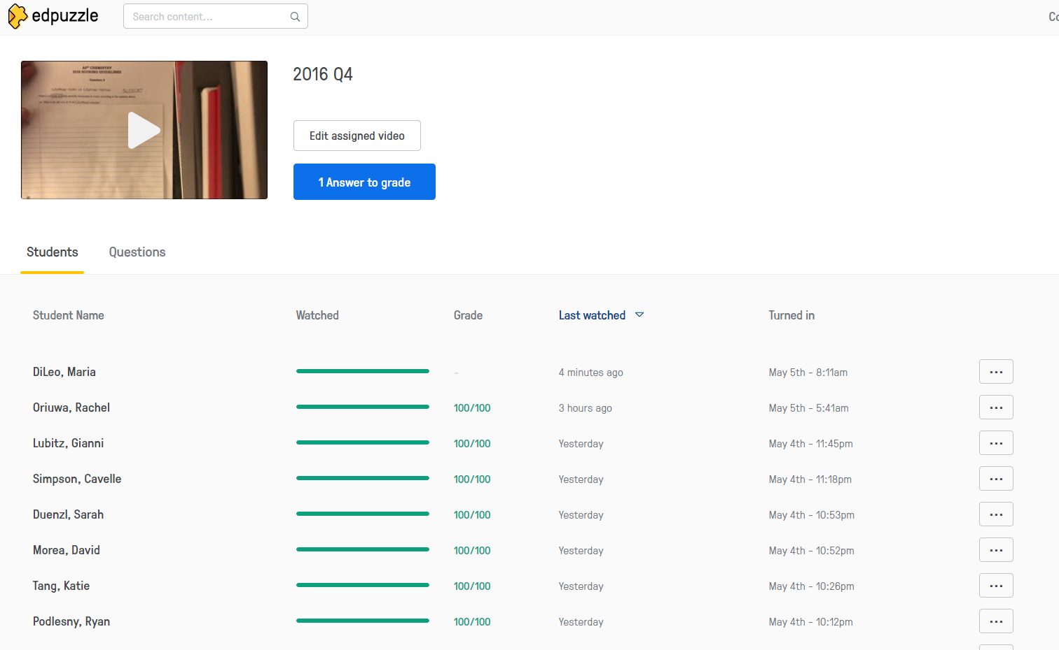
Assess Progress

Slide 20
Assess Answers

Slide 21
Typical Lesson Flow
Introductory Flipped Video
Formative assessment
Review flipped video
Additional Active Learning
In class Lesson

Slide 22
Part 2 Now

Slide 23
Activity before Concept, Concept before Vocabulary
Activity
Concept
Vocabulary

Slide 24
Typical Lesson Flow
In class Inquiry Lesson
Active Learning
Formative Assessment
Flipped video

Slide 25
In class Inquiry
In class Inquiry Lesson
Active Learning
Formative Assessment
Flipped video
Inquiry lab
Inquiry Modeling Activity
Driving Question Boards/ QFT
POGIL

Slide 26
Active Learning
In class Inquiry Lesson
Active Learning
Formative Assessment
Flipped video
Additional Labs
New problems
Simulations
Argumentation sessions

Slide 27
Formative assessment
In class Inquiry Lesson
Active Learning
Formative Assessment
Flipped video
Do Now/Ticket Out
Student presentations
Lab CER summaries
Student generated videos
Small quizzes
Reflections

Slide 28
Flipped Videos
Activity
Concept
Vocabulary
The Learning Cycle

Slide 29
Part 3 How

Slide 30
1. Create & Record Video
2. Upload to Platform
3. Edit/Embed Questions
4. Upload/ Assign to Students
5. Assess Progress
Notes:
Mike – Quick Overview

Slide 31
Tools
Hyperlinked and Free!

Slide 32
1. Create & Record
PowerPoint/Keynote/Prezi → Record using Screencast-o-Matic
Notes:
Show EXAMPLE! Ions powerpoint … show how to use screen cast SAYING EDIT

Slide 35
2. Upload to Platform

Slide 36
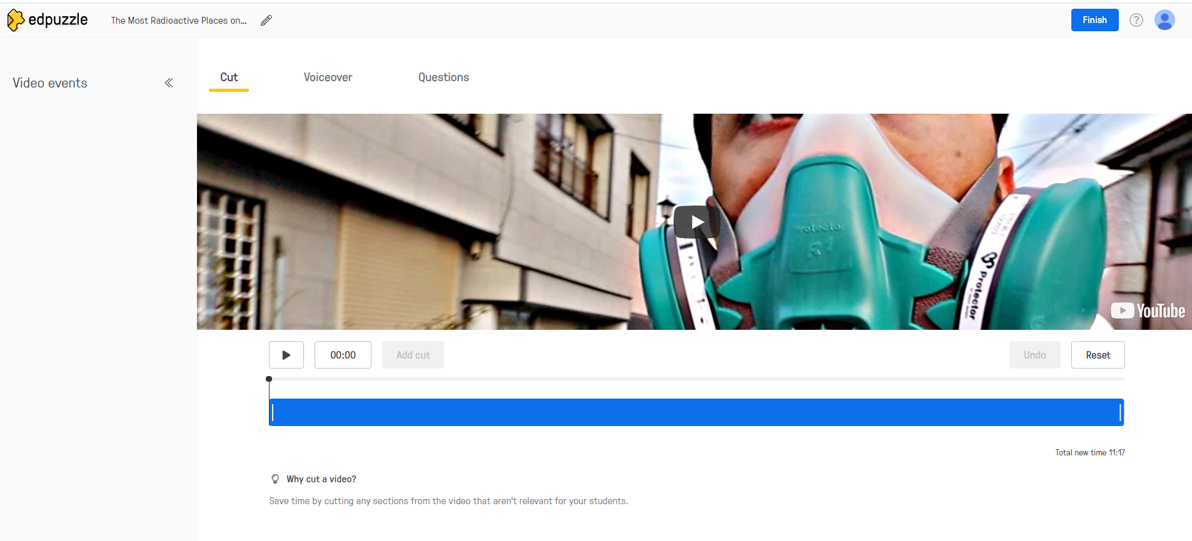
3. Edit…

Slide 37
Crop

Slide 38
Add an Audio Note

Slide 39
And Embed Questions

Slide 40
Free Response Questions

Slide 41
Multiple Choice Questions

Slide 42
Save and Upload
Auto-Saved
Choose classes
Prevent Skipping
Turn on CCs
Assign start and due date

Slide 43
Part 4 Tips

Slide 44
Recommendations
Use your own videos.
Students prefer their teachers voices and methods.
You know the video content.
Students feel you put in the effort.
If you use other videos, watch the whole video and edit it.
Model appropriate video watching techniques including note taking and time management skills.
Assess student notes periodically: note fill ins, checks, quizzes.

Slide 45
Recommendations
Do not allow students to fast forward.
Grade questions before class and use questions to create do-now or discussions.
Grade your homework so students put effort into their work.
Provide additional videos for practice problems and redemption points.

Slide 46
Recommendations
Consistently give video homework so students think about chemistry every night and know to log in.
Start slow: pre-labs, review, test corrections, every other unit, trade off with teachers…

Slide 47
Pitfalls
Technology Concerns (proficiency, access, reliability)
Videos are too long (no more than 15 min)
Videos go passed the scope of the class
Don’t re-teach! It tells students that the video wasn’t important

Slide 48
Worried they didn’t watch it?
Give open note quizzes periodically.
Have students outline that topic in the textbook individually before joining group work.

Slide 49
Questions? Contact Me ☺
Kristen Drury
www.chemisme.com
chemisme@gmail.com
@APChemIsMe

