Slide 1
Kinetics

Slide 2
Rate Expression

Slide 3
Objectives
You should already be able to...
  Explain collision theory.
  Describe the rate of a reaction.
  Describe what factors affect the rate.
By the end of this video you should be able to...
  Write the rate expression for a reaction.
  Use rate expression to calculate concentrations, times, and rates for various data.

Slide 4
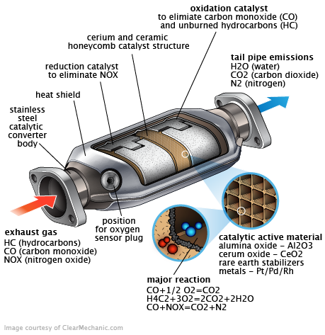
Question of the video:
Catalytic converters in cars decrease air pollution by converting NO (lead to acid rain) and poisonous CO to N₂ and CO₂:
2CO + 2NO → N₂ + 2CO₂
How is the rate of consumption of CO and NO relate to the rate of production of N₂ and CO₂?

Slide 5
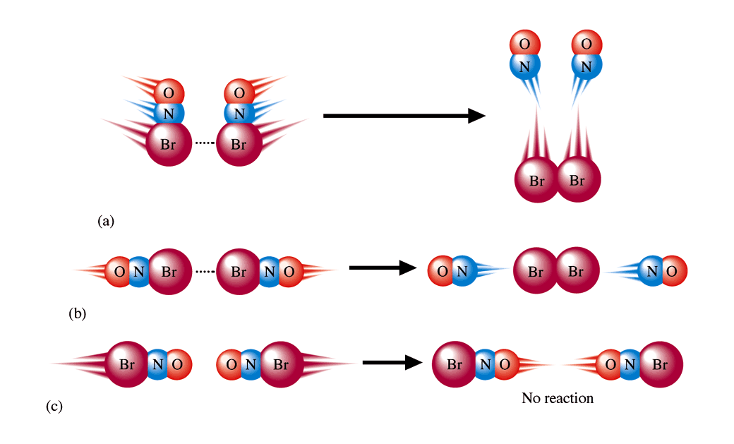
How fast does a reaction proceed?
    Collision Theory: When two chemicals react, their molecules have to collide with each other with proper energy and orientation.

Slide 6
What affects the rate of reactions?
The rate of reaction can increase (or speed up) by
  Increasing the temperature of the system
  Increasing the concentration of the reactants in solution
  Increasing the pressure of gaseous reactants
  Increasing the surface area of solid reactants
  Introducing a catalyst
  Agitating the solution (stirring to increase collisions)
The rate will decrease (will take longer) if you decrease T, M, P, SA, or if you introduce an inhibitor.
The reaction rate has nothing to do with how much of the reactants actually react. That is dependent on limiting reactants and equilibrium.

Slide 7
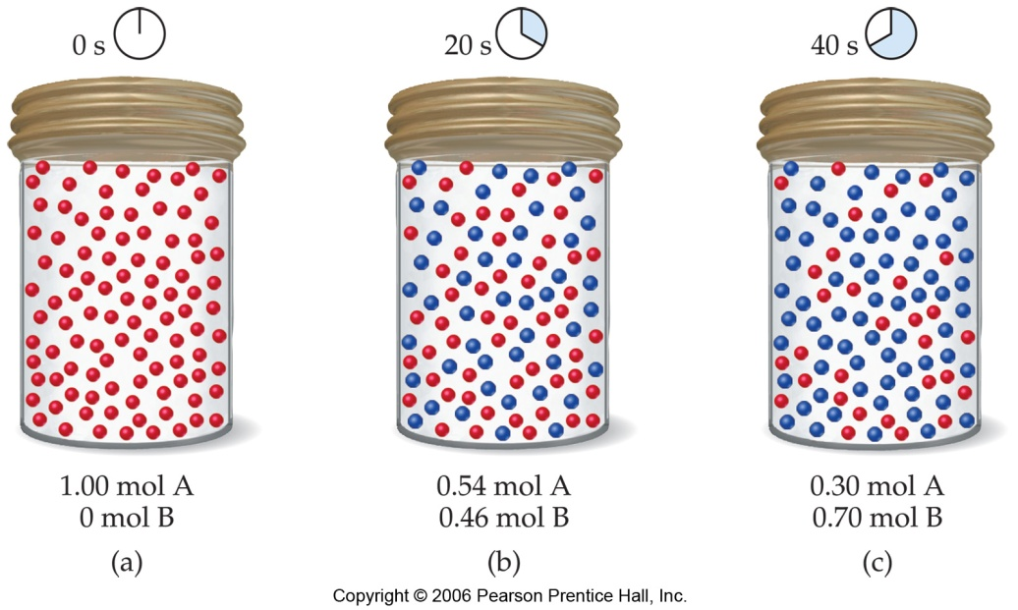
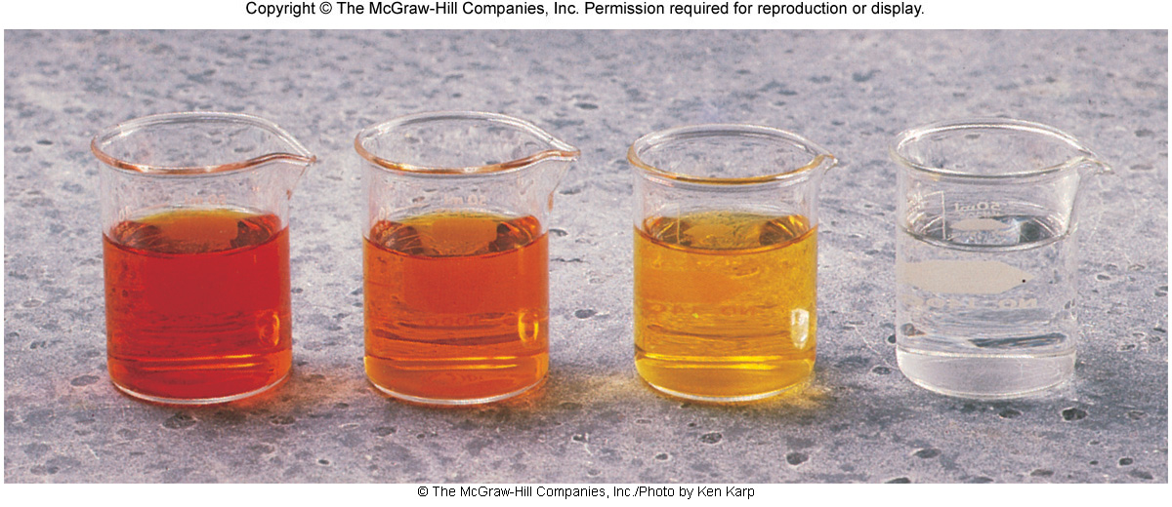
Rates of reactions can be determined by monitoring the change in concentration of either reactants or products as a function of time.

Slide 8
Reaction rate is the change in the concentration of a reactant or a product with time (M/s). This can be calculated using a rate expression in terms of reactants or products.
A B
Δ[A]
Δ[A] = change in concentration of A over
time period Δt
rate = -
Δt
Δ[B]
Δ[B] = change in concentration of B over
time period Δt
rate =
Δt
Because [A] decreases with time, Δ[A] is negative.

Slide 9
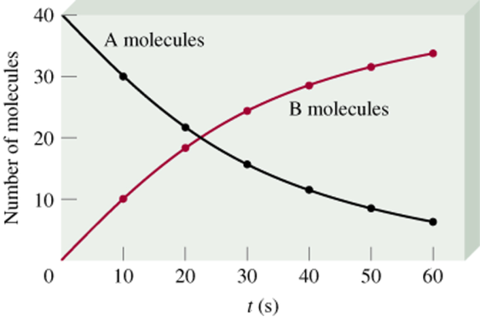
Δ[A]
rate = -
Δt
Δ[B]
rate =
Δt

Slide 10
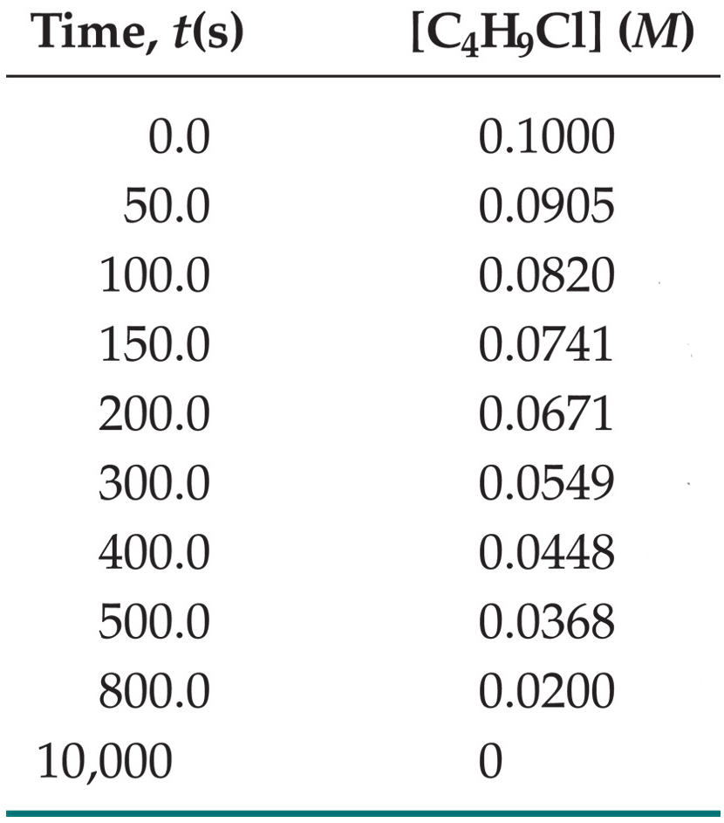
C₄H₉Cl(aq) + H₂O(l) ⎯⎯→ C₄H₉OH(aq) + HCl(aq)
In this reaction, the concentration of chlorobutane, C₄H₉Cl, was measured at various times, t.

Slide 11
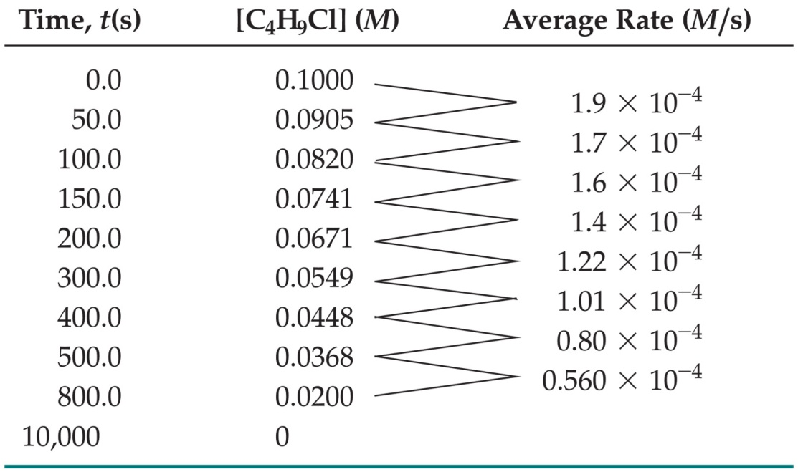

C₄H₉Cl(aq) + H₂O(l) ⎯⎯→ C₄H₉OH(aq) + HCl(aq)
The average rate of the reaction over each interval is the change in concentration divided by the change in time:

Slide 12
C₄H₉Cl(aq) + H₂O(l) ⎯⎯→ C₄H₉OH(aq) + HCl(aq)
Note that the average rate decreases as the reaction proceeds.
This is because as the reaction goes forward, there are fewer collisions between reactant molecules.

Slide 13
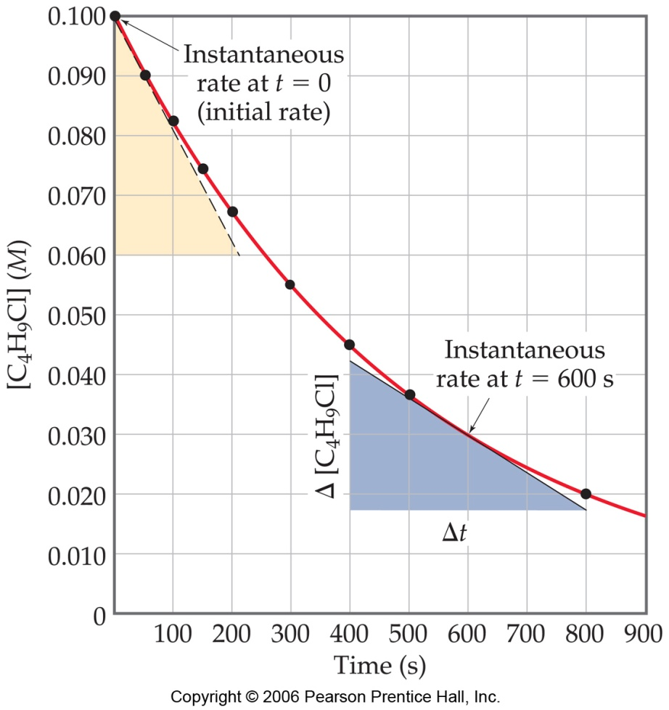
C₄H₉Cl(aq) + H₂O(l) ⎯⎯→ C₄H₉OH(aq) + HCl(aq)
A plot of concentration vs. time for this reaction yields a curve like this.
The slope of a line tangent to the curve at any point is the instantaneous rate at that time.

Slide 14
C₄H₉Cl(aq) + H₂O(l) ⎯⎯→ C₄H₉OH(aq) + HCl(aq)
In this reaction, the ratio of C₄H₉Cl to C₄H₉OH is 1:1.
Thus, the rate of disappearance of C₄H₉Cl is the same as the rate of appearance of C₄H₉OH.
-Δ[C₄H₉Cl]
Δt
Δ[C₄H₉OH]
Δt
Rate =
=

Slide 15

What if the ratio is not 1:1?
H₂(g) + I₂(g) ⎯⎯→ 2 HI(g)
HI forms at half the rate H₂ disappears.

Slide 16
aA + bB
cC + dD
Reactants (decrease)
Products (increase)

Slide 17
Example Questions
Write the rate expressions:
  2H₂ + O₂ → 2H₂O
  3O₂ → 2O₃
How is the rate of disappearance of O₂ related to the rate of appearance of O₃ if the O₃ rate equals 6.0x10⁵M/s?
-½ ΔH₂/Δt = -ΔO₂/Δt = ½ ΔH₂O/Δt
-1/3 ΔO₂/Δt = ½ ΔO₃/Δt
-1/3 ΔO₂/Δt = ½ ΔO₃/Δt
-1/3 x = ½ (6.0x10⁵)
6.0x10⁵M/s O₃ x 3O₂ = 9.0x10⁵M/s 1 2 O₃
9.0x10⁵M/s

Slide 18
Time (s) | [Br₂] | Rate (M/s)
0 | .0120 | 4.20x10⁻⁵
50 | .0101 | 3.52x10⁻⁵
100 | .00846 | 2.96x10⁻⁵
200 | .00710 | 2.49x10⁻⁵
ΔBr₂/ Δ t
The student obtained the following data for the change of concentration of Br₂:
Calculate the average rate for the interval from 0 to 50s.
Calculate the average rate for the interval from 50 to 100s.
Explain why the rate is not the same for each time and how it was obtained.
(.0120-.0101)/(50)
-3.80x10⁻⁵M/s
-3.28x10⁻⁵M/s

Slide 19
Question of the video:
Catalytic converters in cars decrease air pollution by converting NO (lead to acid rain) and poisonous CO to N₂ and CO₂:
2CO + 2NO → N₂ + 2CO₂
How is the rate of consumption of CO and NO relate to the rate of production of N₂ and CO₂?
-½ ΔCO/Δt = -½ ΔNO/Δt =ΔN₂/Δt = ½ ΔCO₂/Δt

Slide 20

You Must be Able To…
Construct rate expressions.
Use rate expressions in calculations.

Slide 21
Rate Laws

Slide 22
Objectives
You should already be able to…
  Describe the rate of reaction and how it is affected by changes in concentration.
By the end of the video you should be able to…
  Construct a rate law.
  Use the rate law to calculate how changes in concentration affect the reaction rate.
  Use the rate law to calculate the rate constant WITH UNITS.

Slide 23
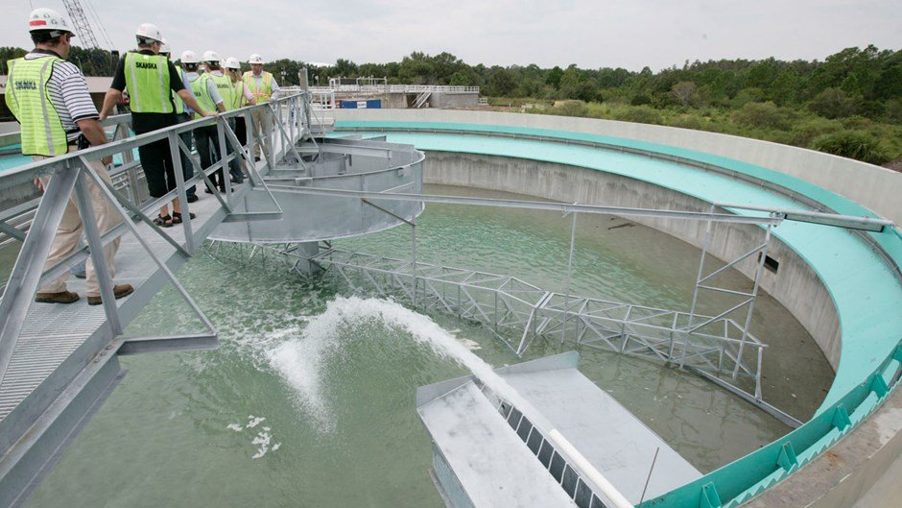
Question of the video:
ClO₂ is used as a disinfectant in water treatment plants:
2ClO₂ + 2OH⁻ → ClO₃⁻ + ClO₂⁻ + H₂O
Trial | [ClO₂] | [OH⁻] | Rate (M/s)
1 | 0.060 | 0.030 | 0.0248
2 | 0.020 | 0.030 | 0.00827
3 | 0.020 | 0.090 | 0.0247
How fast would 0.020M of the disinfectant dissolve if the [OH⁻] increased to 0.50M?

Slide 24
The rate law expresses the relationship of the rate of a reaction to the rate constant and the concentrations of the reactants raised to some powers. These powers are found experimentally and are referred to as orders.
aA + bB cC + dD
Rate = k [A]^{x}[B]^{y}

Slide 25
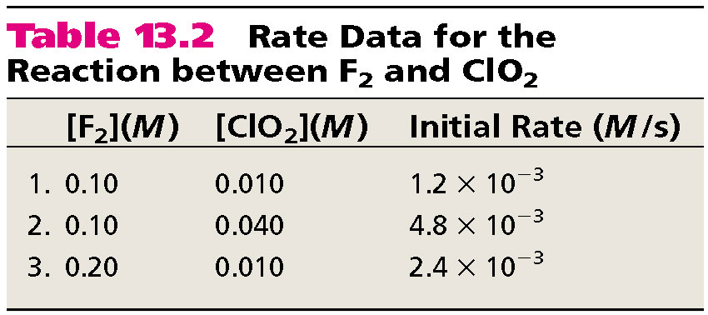
F₂ (g) + 2ClO₂ (g) 2FClO₂ (g)
rate = k [F₂]^{x}[ClO₂]^{y}
Find a trial where F₂ changes and ClO₂ remains the same.
F₂ doubles and the rate doubles, which is first order.

Slide 26
F₂ (g) + 2ClO₂ (g) 2FClO₂ (g)
Find a trial where ClO₂ changes and F₂ remains the same.
ClO₂ quadrupled and the rate quadrupled, which is 1st order.
rate = k [F₂][ClO₂]

Slide 27
Rules
If the concentration and the rate change the same way(1:1), it is first order.
If the concentration changes but the rate does not, it is zero order.
If the rate squares what the concentration does, it is second order.
The reaction order is the sum of all individual orders.
You may come across some questions with negative orders which means the rate changes the same magnitude the concentration does, just in the opposite direction.

Slide 28
Run # | Initial [A] ([A]₀) | Initial [B] ([B]₀) | Initial Rate (v₀)
1 | 1.00 M | 1.00 M | 1.25 x 10⁻² M/s
2 | 1.00 M | 2.00 M | 2.5 x 10⁻² M/s
3 | 2.00 M | 2.00 M | 2.5 x 10⁻² M/s
What is the order with respect to A?
What is the order with respect to B?
What is the overall order of the reaction?
0
1
1

Slide 29
[NO_{(g)}] (mol dm⁻³) | [Cl_{2(g)}] (mol dm⁻³) | Initial Rate (mol dm⁻³ s⁻¹)
0.250 | 0.250 | 1.43 x 10⁻⁶
0.250 | 0.500 | 2.86 x 10⁻⁶
0.500 | 0.500 | 1.14 x 10⁻⁵
2
What is the order with respect to NO?
What is the order with respect to Cl₂?
What is the overall order of the reaction?
1
3

Slide 30
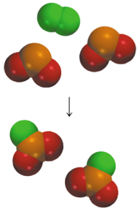
Summary of Rate Laws
Rate laws are always determined experimentally.
Reaction order is always defined in terms of reactant (not product) concentrations.
The order of a reactant is not related to the stoichiometric coefficient of the reactant in the balanced chemical equation.
F₂ (g) + 2ClO₂ (g) 2FClO₂ (g)
1
rate = k [F₂][ClO₂]

Slide 31
Find the overall rate order and the rate constant:
[NO] | [H₂] | Rate (M/s)
.0050 | .0020 | .0013
.010 | .0020 | .0050
.010 | .0040 | .010
Rate =k[NO]²[H₂]
Overall order = 3
.0013 = k[.005]²[.002]
k = 26000/M²s

Slide 32
Find the overall rate order and the rate constant:
[S₂O₈⁻²] | [I⁻] | Rate (M/s)
.080 | .034 | .00022
.080 | .017 | .00011
.160 | .017 | .00022
Rate =k[S₂O₈⁻²][I⁻]
Overall order = 2
.00022 = k[.080][.034]
k = .081/Ms

Slide 33
Find the overall rate order and the rate constant:
[S₂O₈⁻²] | [I⁻] | Rate (M/s)
.080 | .034 | .00022
.080 | .017 | .00011
.160 | .017 | .00022
Recall: Rate =k[S₂O₈⁻²][I⁻]
k = .081/Ms
A student is asked to run an additional trial using 2M S₂0₈⁻² and 4M I⁻. Calculate the rate of this trial.
Rate = 0.081(2)(4)
Rate = .648M/s

Slide 34
Question of the video:
ClO₂ is used as a disinfectant in water treatment plants:
2ClO₂ + 2OH⁻ → ClO₃⁻ + ClO₂⁻ + H₂O
Trial | [ClO₂] | [OH⁻] | Rate (M/s)
1 | 0.060 | 0.030 | 0.0248
2 | 0.020 | 0.030 | 0.00827
3 | 0.020 | 0.090 | 0.0247
How fast would 0.020M of the disinfectant dissolve if the [OH⁻] increased to 0.50M?
Rate = k[ClO₂][OH⁻]
0.0248 = k[0.060][0.030]
k = 138 M⁻¹s⁻¹
Rate = 138[0.020][0.50]
Rate = 1.38 M/s

Slide 35
You Must be Able To…
Construct a rate law.
Use the rate law to calculate how changes in concentration affect the reaction rate.
Use the rate law to calculate the rate constant WITH UNITS.

Slide 36
Rate Equations

Slide 37
Objectives
You should already be able to…
  Describe the rate of reaction and how it is affected by changes in concentration.
By the end of the video you should be able to…
  Calculate the final or initial concentration of a substance during a first or second order reaction.
  Calculate the rate constant or time the reaction takes during a first of second order reaction.

Slide 38
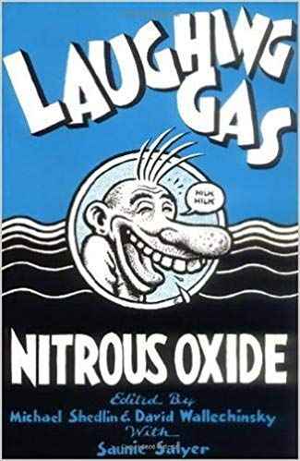

Question of the video:
N₂O is used as an anesthetic and as a propellant in aerosol spray cans.
2N₂O → 2N₂ + O₂ How quickly does it leave a system?

Slide 39
First-Order Reactions: the rate depends on the
concentration to the first power.
Δ[A]
rate = -
rate = k [A]
Δt
ln[A]_{t} - ln[A]₀ = - kt
[A]_{t} is the concentration of A at any time t
[A]₀ is the initial concentration of A (at time t=0)

Slide 40
The reaction 2A B is first order in A with a rate constant of 2.8 x 10⁻² s⁻¹ at 80⁰C. How long will it take for A to decrease from 0.88 M to 0.14 M
ln[A] - ln[A]₀ = - kt
[A]₀ = 0.88 M
[A] = 0.14 M
ln[0.14] – ln[.88]
= 66 s
-2.8x10⁻²

Slide 41
Cyclopropane changes to propene in a first order reaction with k=7.8x10⁻⁴ s⁻¹. If the initial concentration of cycloproane is 0.35M, calculate the final concentration after 9.8 min.
ln[A] - ln[A]₀ = - kt
ln[x] – ln [0.35] = -7.8x10⁻⁴(9.8*60)
0.22M
Now, find out how long it takes to decrease the concentration from 0.75M to 0.05M.
3500s

Slide 42
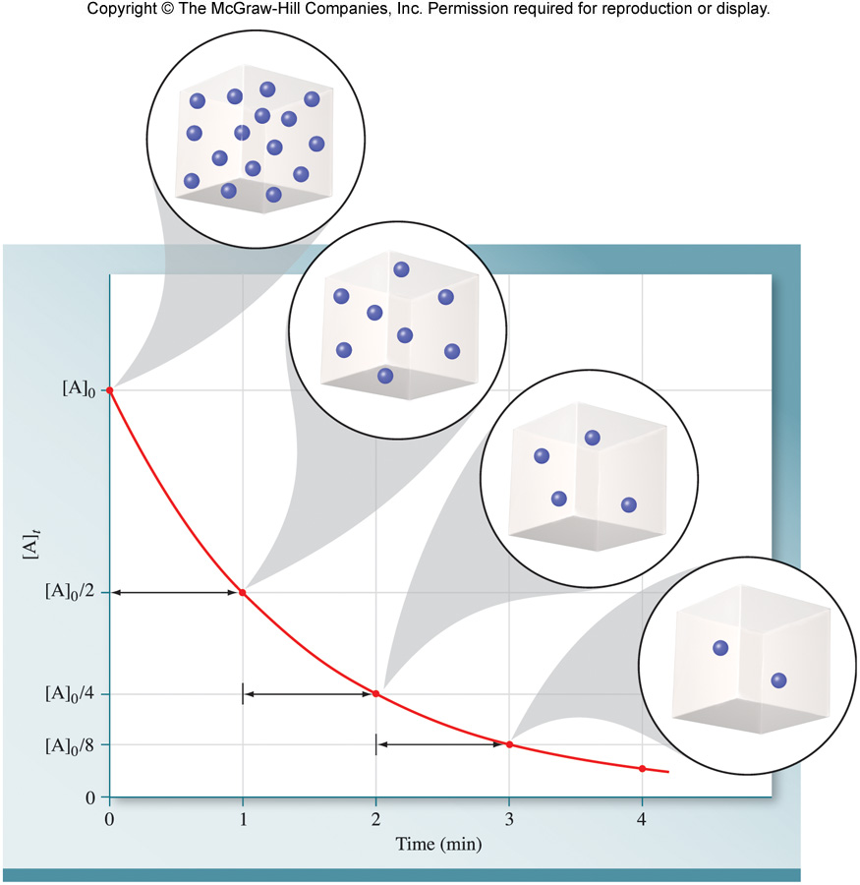
First-Order Reactions
The half-life, t_{½}, is the time required for the concentration of a reactant to decrease to half of its initial concentration.
What is the half-life of N₂O₅ if it decomposes with a rate constant of 5.7 x 10⁻⁴ s⁻¹?

Slide 43
First-Order Reactions
What is the half-life of N₂O₅ if it decomposes with a rate constant of 5.7 x 10⁻⁴ s⁻¹?
ln[1] – ln[2]
= 1200 s = 20. minutes
-5.7x10⁻⁴
0.693
= 1200 s = 20. minutes
-5.7x10⁻⁴
How do you know decomposition is first order?
units of k (s⁻¹)

Slide 44
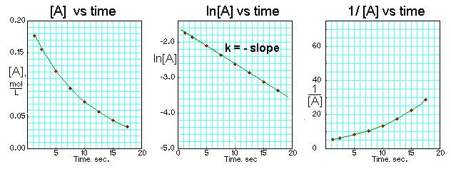
Graphically:
ln[A] - ln[A]₀ = - kt
A plot of ln[A] vs t gives a straight line
y - b = mx

Slide 45
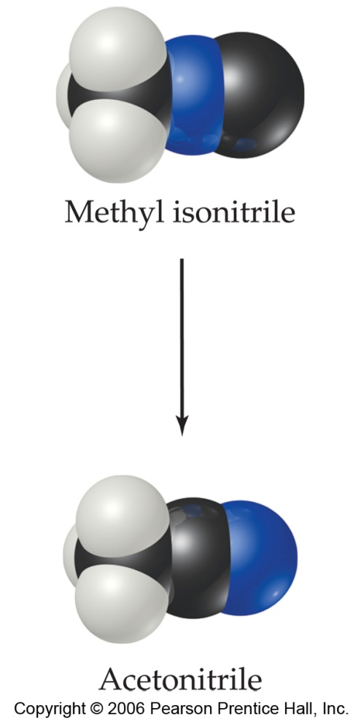
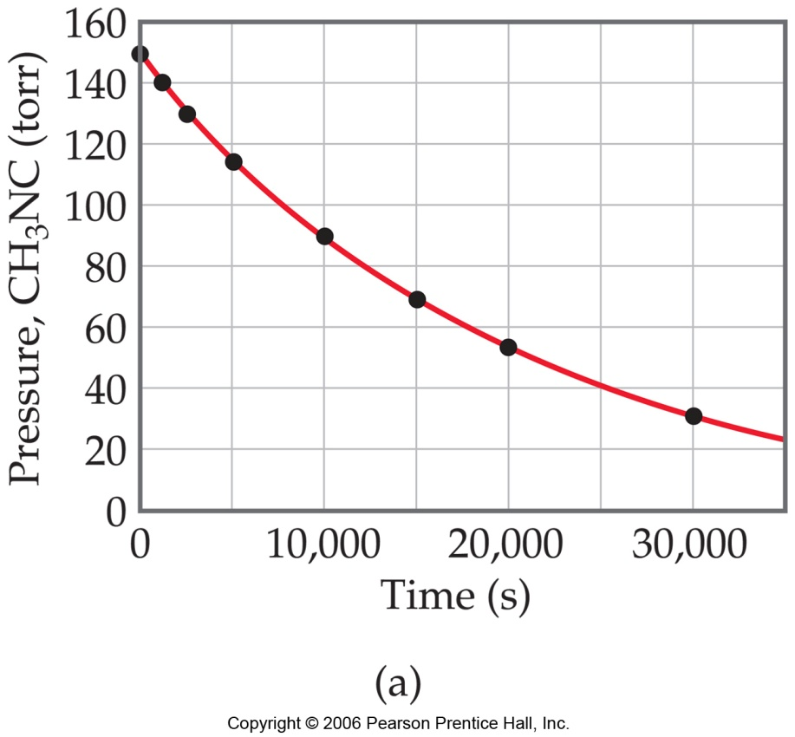
First-Order Processes
Consider the process in which methyl isonitrile is converted to acetonitrile.
CH₃NC
CH₃CN
How do we know this is a first order rxn?

Slide 46
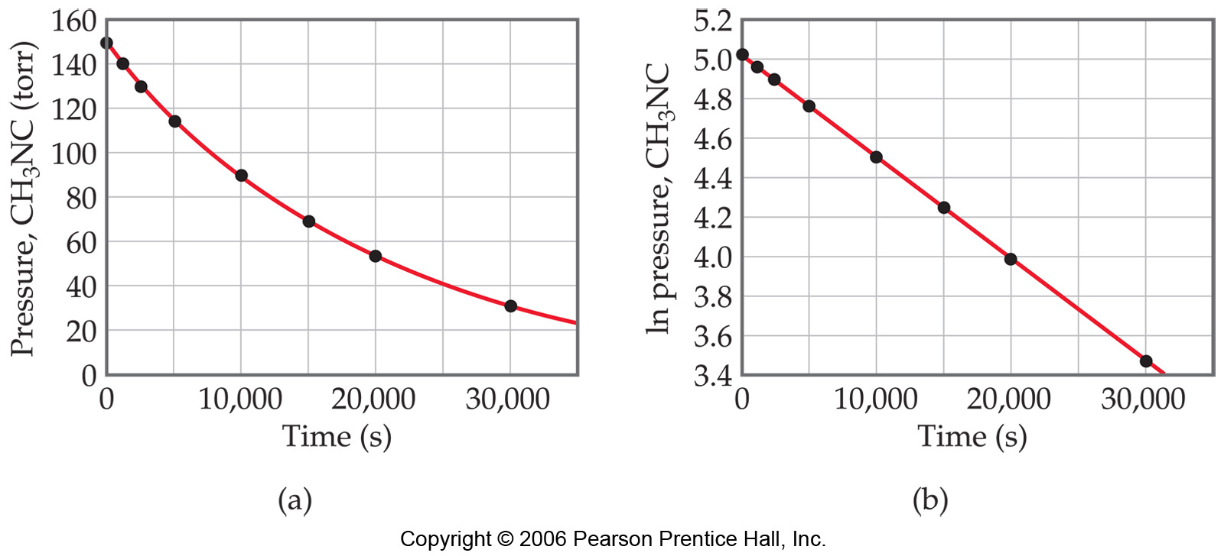
First-Order Processes
When ln P is plotted against time, a straight line forms.
  The process is first-order.
  k is the negative slope: 5.1 × 10⁻⁵ s⁻¹.

Slide 47
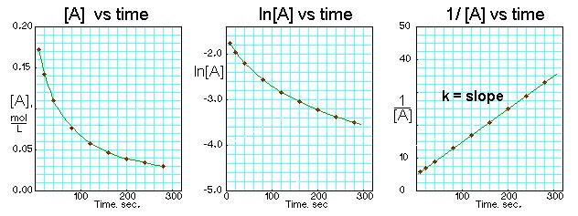
Second-Order Reactions
Δ[A]
rate = k [A]²
rate = -
Δt
1
1
-
= kt
[A]
[A]₀
y - b = mx

Slide 48
A second order reaction with k = 7.0x10⁹/Ms at 23C. Find the final [I] after 22s if the initial equals 0.086M.
1
1
-
= kt
[A]
[A]₀
1/x -1/0.086 = (7.0x10⁹)(22)
6.5x10⁻¹²M
Now, calculate the time it takes for [I] to change from 0.60M to 0.42M.
1/.42 -1/0.60 = (7.0x10⁹)(x)
1.0x10⁻¹⁰s

Slide 49
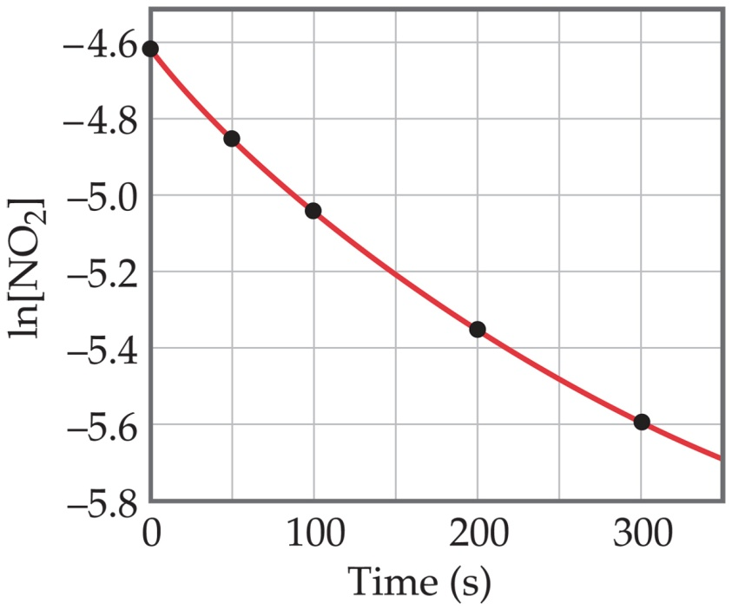
Determining reaction order
NO₂ (g)
NO (g) + 1/2 O₂ (g)
Time (s) | [NO₂], M
0.0 | 0.01000
50.0 | 0.00787
100.0 | 0.00649
200.0 | 0.00481
300.0 | 0.00380
Graphing ln [NO₂] vs. t yields:
The plot is not a straight line, so the process is not first-order in [A].

Slide 50

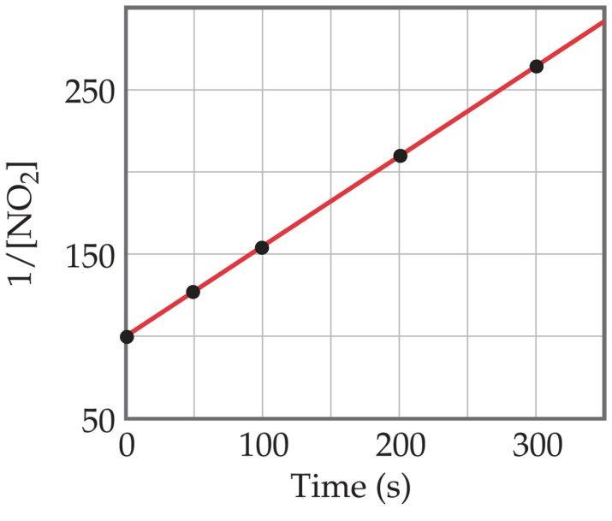
A graph of 1/[NO₂] vs. t gives this plot.
This is a straight line. Therefore, the process is second order in [NO₂].
K=.543/Ms

Slide 51
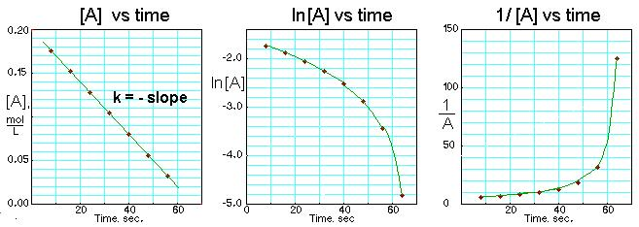
Zero-Order Reactions: not dependent on concentration.
Δ[A]
rate = k [A]⁰ = k
rate = -
Δt

Slide 52
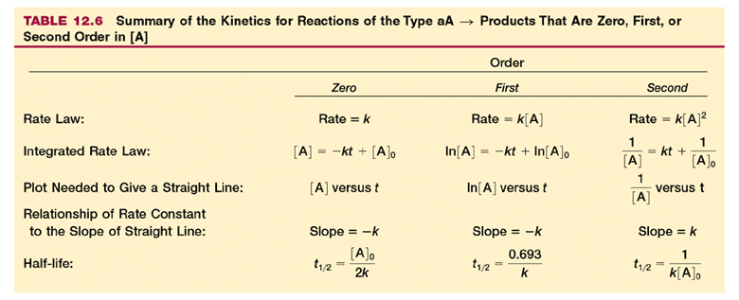
Since rate is dependant on T, so is k.

Slide 53
Question of the video:
N₂O is used as an anesthetic and as a propellant in aerosol spray cans.
2N₂O → 2N₂ + O₂ How quickly does it leave a system?
The plot of ln[N₂O] as a function of time is linear. k =0.00231s⁻¹
It is first order!
T_{1/2} = .693 = 300.s = 5 min
0.00231

Slide 54
You Must be Able To…
  Calculate the final or initial concentration of a substance during a first or second order reaction.
  Calculate the rate constant or time the reaction takes during a first of second order reaction.

Slide 55
Reaction Mechanisms

Slide 56
Objectives
You should already be able to…
  Identify reactants and products.
  Combine reactions to form one overall reaction.
  Explain what a catalyst does to a reaction.
By the end of the video you should be able to…
  Identify catalysts and intermediates in a reaction.
  Find the overall reaction and determine molecularity.
  Write the rate law based on the rate determining step.

Slide 57
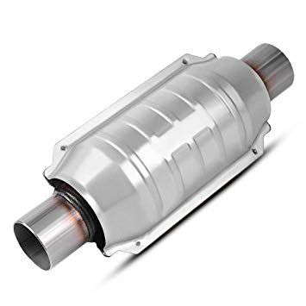

Question of the video:
Catalytic converters in cars decrease air pollution by converting NO (lead to acid rain) and poisonous CO to N₂ and CO₂:
2CO + 2NO → N₂ + 2CO₂
But do all of the reactant species collide at the same time to create this reaction?

Slide 58
The overall progress of a chemical reaction can be represented at the molecular level by a series of simple elementary steps or elementary reactions.
The sequence of elementary steps that leads to product formation is the reaction mechanism.
2NO (g) + O₂ (g) 2NO₂ (g)
N₂O₂ is detected during the reaction!
Elementary step:
NO + NO N₂O₂
Elementary step:
N₂O₂ + O₂ 2NO₂
Overall reaction:
2NO + O₂ 2NO₂

Slide 59
Intermediates are species that appear in a reaction mechanism but not in the overall balanced equation.
An intermediate is always formed in an early elementary step and consumed in a later elementary step.
Elementary step:
NO + NO N₂O₂
+
Elementary step:
N₂O₂ + O₂ 2NO₂
Overall reaction:
2NO + O₂ 2NO₂

Slide 60
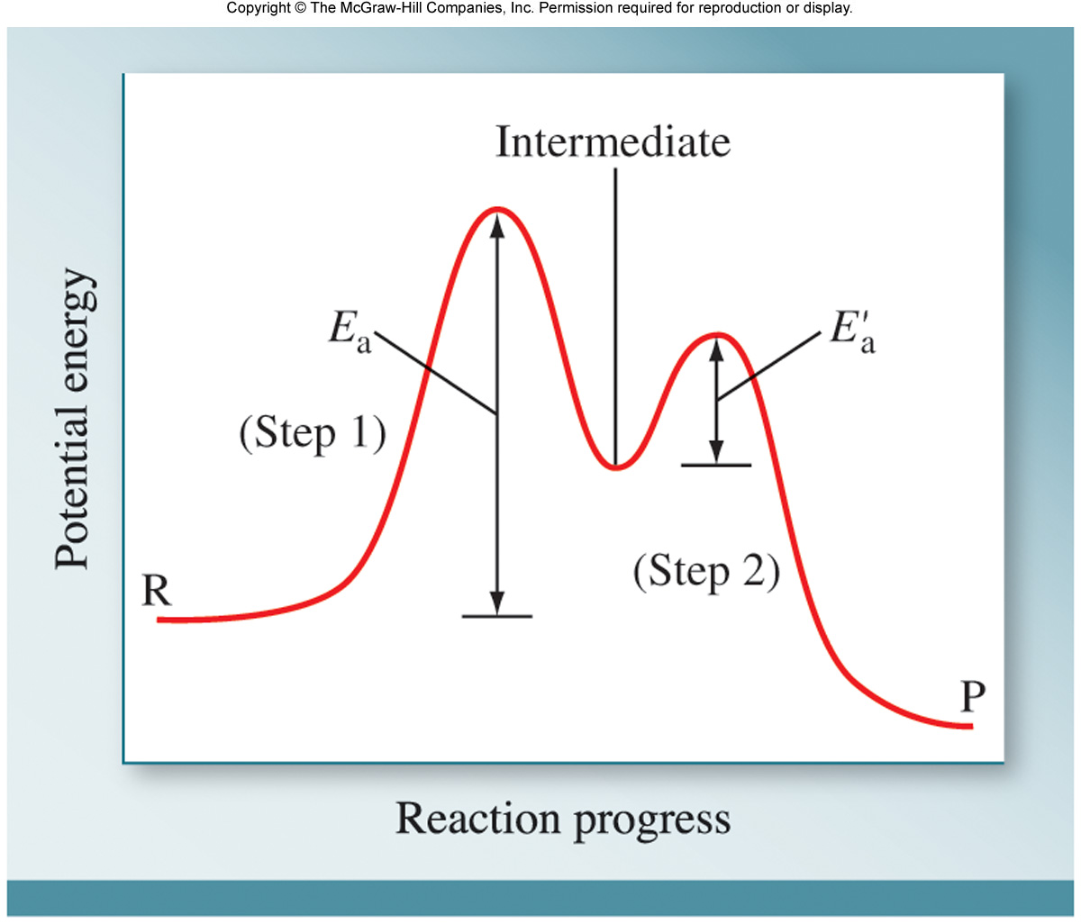

Slide 61
Catalysts
Catalysts speed up the reaction and are found in the reactants of the first elementary step and the products of the last step.
A + C → AC
AC + B → ABC
ABC → AB + C
A catalyst is homogeneous if it is in the same phase as the other reactants. If not, it is heterogeneous.

Slide 62
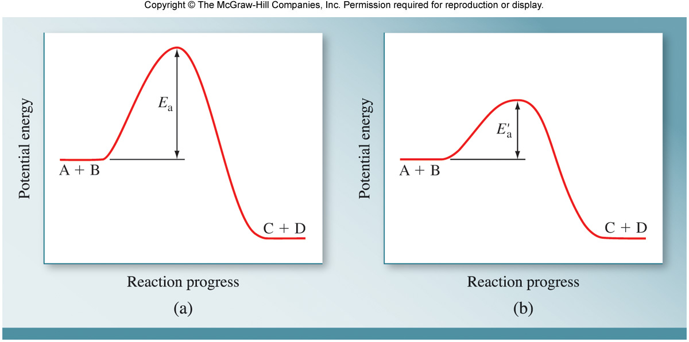
Reaction Progress with a catalyst

Slide 63
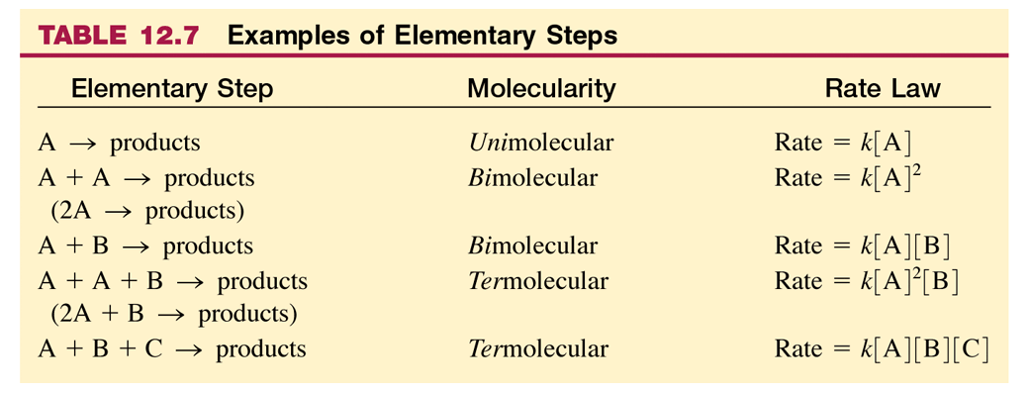

Slide 64

Rate Determining Step
The Rate Determining Step is always the slowest step.
It will have a similar Rate law as the overall reaction’s rate law.

Slide 65
NO₂ (g) + CO (g) ⎯⎯→ NO (g) + CO₂ (g)
The rate law for this reaction is found experimentally to be
Rate = k [NO₂]²
CO is necessary for this reaction to occur, but the rate of the reaction does not depend on its concentration.
This suggests the reaction occurs in two steps.

Slide 66
NO₂ (g) + CO (g) ⎯⎯→ NO (g) + CO₂ (g)
A proposed mechanism for this reaction is
Step 1: NO₂ + NO₂ ⎯⎯→ NO₃ + NO (slow)
Step 2: NO₃ + CO ⎯⎯→ NO₂ + CO₂ (fast)
The NO₃ intermediate is consumed in the second step.
As CO is not involved in the slow, rate-determining step, it does not appear in the rate law.

Slide 67
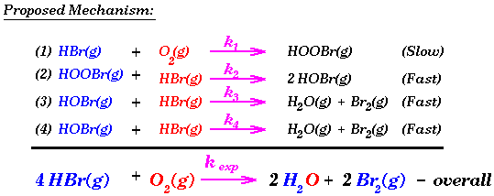
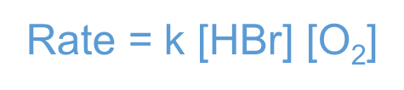
You should be able to create a rate law for each step in a mechanism.
Rate = k [HBr] [O₂]
Rate = k [HOOBr] [HBr]
Rate = k [HOBr] [HBr]
Rate = k [HOBr] [HBr]
Notice the overall rate law and the rate law of the slow step are identical.

Slide 68
Write the rate law for this reaction.
Rate = k [HBr] [O₂]
List all intermediates in this reaction.
HOOBr, HOBr
List all catalysts in this reaction.
None

Slide 69
Reaction Mechanisms
Given overall equation: H₂(g) + I₂(g) → 2HI(g)
Step 1: I₂ ← → 2I (fast)
Step 2: H₂ + 2I → 2HI (slow)
rate = k₂[H₂] [I]²
This rate expression is not acceptable because an intermediate is listed in the rate law but is not part of the overall reaction. I is an intermediate and should not appear in the rate expression.

Slide 70
Reaction Mechanisms
Consider the first equilibrium step: I₂ ← → 2I (fast)
The forward rate is equal to the reverse rate: k_{f}[I₂] = k_{r} [I]²
k_{f}/k_{r} [I₂] = [I]²
If we substitute the previous rate law rate = k₂[H₂] [I]² for [I]² , the rate law becomes
  rate = k[H₂] [I₂]
  This now matches the overall balanced equation! H₂(g) + I₂(g) → 2HI(g)

Slide 71
Example 1
The overall reaction 2NO₂(g) + F₂(g) →2NO₂F(g) has an experimental rate law Rate = k[NO₂][F₂].
The accepted mechanism is
NO₂(g) + F₂(g) → NO₂F(g) + F(g) [slow; rate determining]
NO₂(g) + F(g) → NO₂F(g) [fast]
2NO₂(g) + F₂(g) →2NO₂F(g)
The elementary steps sum to the overall balanced equation:
Both steps are bimolecular and are therefore reasonable.
The elementary rate law has the same species as the overall reaction rate law.
The mechanism is therefore reasonable.

Slide 72
Example 2
The overall reaction 2NO (g) + O₂(g) →2NO₂(g) has an experimental rate law Rate = k[NO]²[O₂].
A proposed mechanism is
NO(g) + O₂(g) D NO₃(g) [fast]
NO₃(g) + NO(g) → 2NO₂(g) [slow; rate determining]
2NO (g) + O₂(g) →2NO₂(g)
The elementary steps sum to the overall balanced equation:
Both steps are bimolecular and are therefore reasonable.
The elementary rate law DOES NOT HAVE the same species
as the overall reaction rate law.

Slide 73
NO(g) + O₂(g) D NO₃(g)
NO₃(g) + NO(g) → 2NO₂(g)
rate_{1(f)} = k₁[NO][O₂] rate_{1(r)} = k_{r}[NO₃]
rate₂ = k₂[NO₃][NO]
2NO (g) + O₂(g) →2NO₂(g)
When equilibrium (1) has been established rate_{1(f)} = rate_{1(r)}
k_{f}[NO][O₂] = k_{r}[NO₃]
k_{f}
k_{r}
[NO₃] =
[NO][O₂]
k_{f}
k_{r}
rate₂ = k₂[NO₃][NO] = k₂
[NO][O₂]
[NO]
rate₂ = k[NO]²[O₂] which is consistent with the observed rate law of the overall reaction.

Slide 74
Reaction Mechanisms Summary
The elementary steps must add up to the overall balanced equation.
The rate determining (slow) step determines the overall rate law.
Overall rate laws’ order is found through experimentation, NOT by the coefficient in the balanced equation.
Elementary steps in a reaction mechanism have rate laws that ARE determined by their molecularity/coefficients.
Any reversible reactions will have a forward rate equal to its reverse rate, therefore, a forward rate law equal to its reverse rate law. This can be used to substitute intermediates in the rate deterring step’s rate law.
A mechanism is a hypothesis –we cannot prove it is correct, but if it is consistent with the data, and can be used to predict results accurately, it is a useful model for the reaction.

Slide 75
Question of the video:
Catalytic converters in cars decrease air pollution by converting NO (lead to acid rain) and poisonous CO to N₂ and CO₂:
2CO + 2NO → N₂ + 2CO₂
But do all of the reactant species collide at the same time to create this reaction?
Pd, Pt, Rh are used to increase the rate of reaction as a catalyst.
NO → N₂ + O₂
CO + O₂ → CO₂
½
½
O₂ is an intermediate!
½
CO + NO → ½ N₂ + CO₂

Slide 76
You Must be Able To…
Identify catalysts and intermediates in a reaction.
Find the overall reaction and determine molecularity.
Write the rate law based on the rate determining step.

Slide 77
Class slides

Slide 78
Determine the rate law and calculate the rate constant for the following reaction from the following data:
S₂O₈²⁻ (aq) + 3I⁻ (aq) 2SO₄²⁻ (aq) + I₃⁻ (aq)
Experiment | [S₂O₈²⁻] | [I⁻] | Initial Rate (M/s)
1 | 0.08 | 0.034 | 2.2 x 10⁻⁴
2 | 0.08 | 0.017 | 1.1 x 10⁻⁴
3 | 0.16 | 0.017 | 2.2 x 10⁻⁴
rate = k [S₂O₈²⁻]^{x}[I⁻]^{y}
X = 1
Y = 1
Overall = 2
rate = k [S₂O₈²⁻]¹[I⁻]¹

Slide 79
Find the overall rate order and the rate constant:
[NO] | [Cl₂] | Rate (M/min)
0.10 | 0.10 | 0.18
0.10 | 0.20 | 0.35
0.20 | 0.20 | 1.45
Rate =k[NO]²[Cl₂]
Overall order = 3
.18 = k[.1]²[.1]
k = 180/M²min

Slide 80
Find the rate constant graphically:
Time (s) | [N₂O₅]
0 | 0.91
300 | 0.75
600 | 0.64
1200 | 0.44
3000 | 0.16
Calculator steps:
Stat
Enter (edit)
List t in L1
List Ln(N₂O₅) in L2
Stat
Right (calc)
4
Enter
Enter
a = slope(m) = -k = -5.8x10⁻⁴
k = 5.8x10⁻⁴/s

Slide 81
Find the rate constant graphically:
Time (s) | Pressure (kPa)
0 | 284
100 | 220
150 | 193
200 | 170
250 | 150
k= 2.6x10⁻³/s

Slide 82
Determine the order and rate constant:
Time (s) | Pressure (kPa)
0 | 15.76
181 | 12.64
513 | 8.73
1164 | 4.44
First order
r = -0.99957
m = -0.00108
Second Order
r = .99138
m = 1.41x10⁻⁴
First Order
k = .00108/s

