Slide 1
KINETCIS AND EQUILIBRIUM

Slide 2
collision theory & factors affecting reaction rate

Slide 3
Lesson Objectives:
Determine the effect of effective collisions on reaction rate
Determine how factors affect reaction rate according to collision theory

Slide 4
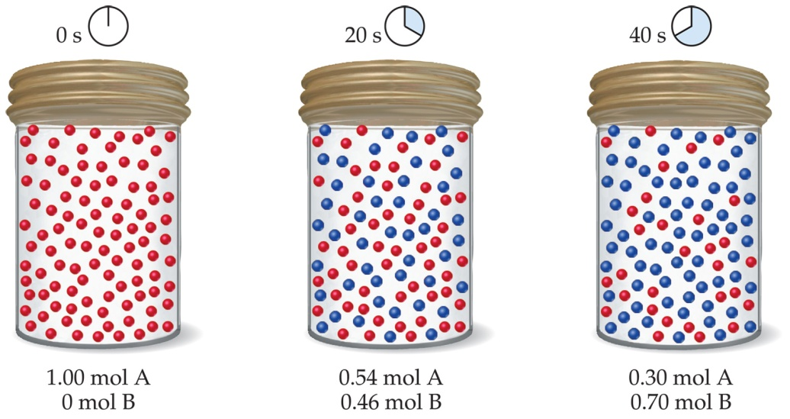
Kinetics
Study of the RATE or SPEED at which REACTIONS occur

Slide 5
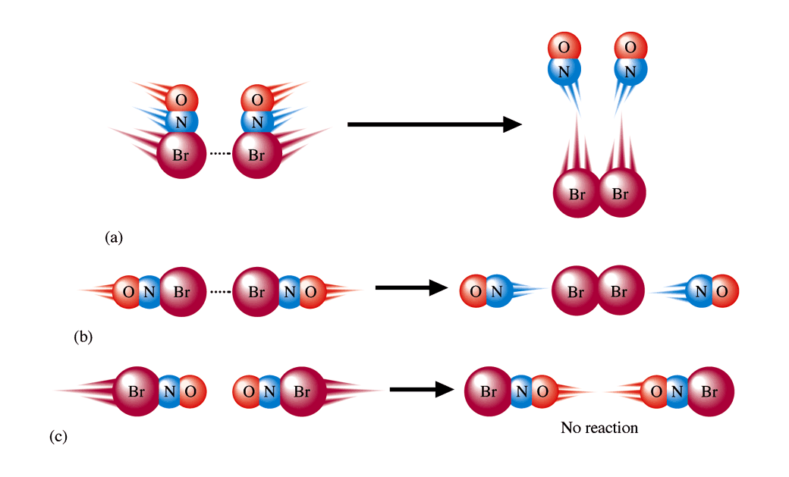
Effective Collisions
In order for a reaction to occur, reactant PARTICLES MUST COLLIDE (effectively) with the following:
1. Proper amount of ENERGY 2. Proper ORIENTATION (angle)

Slide 6
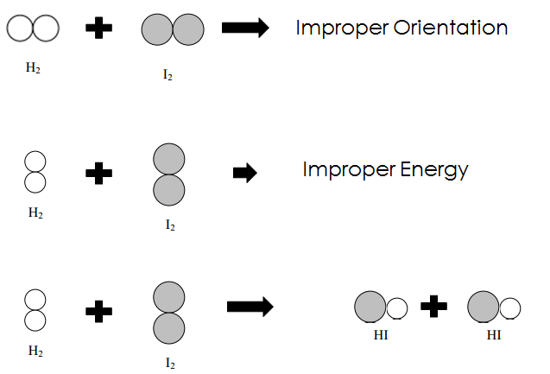
H₂ + I₂ → 2HI

Slide 7
Factors Affecting the Rate of Reaction
6 factors that affect the rate of reaction by increasing number of effective collisions
The MORE EFFECTIVE COLLISIONS, THE FASTER THE REACTION!

Slide 8
Type of Reactant
Ionic substances in aqueous solution react faster (already broken down into ions)
Example: AgNO_{3 (aq)} → Ag⁺ + NO₃⁻
Covalent substances react slower (more energy and time to break the bonds between H₂ and I₂)
Example: H_{2 (g)} +I_{2 (g)} → 2 HI _{(g)}

Slide 9
2. Concentration
INCREASE CONCENTRATION INCREASE reaction rate (speed)
More particles increases chance of effective collisions

Slide 10
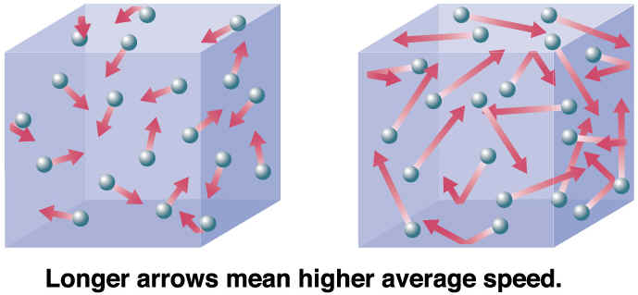
3. Temperature
INCREASE temperature INCREASES Reaction Rate:
Increases # of effective collisions
Reactants have more energy when colliding and collidee more often

Slide 11
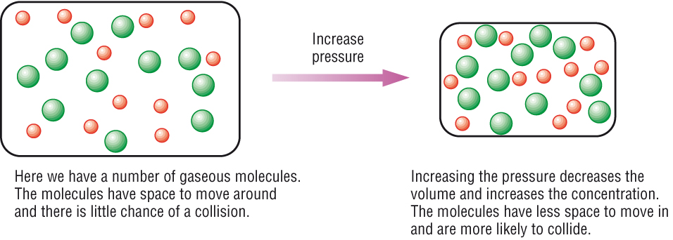
4. Pressure
INCREASE pressure, INCREASE reaction rate (affects GASES ONLY!)
Particles are closer together resulting in more collisions

Slide 12
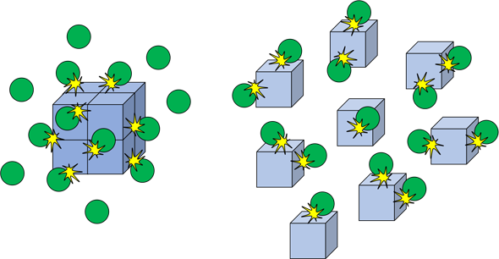
5. Surface Area
INCREASE in surface area INCREASES the reaction rate.
Due to more exposed particles that can react (more effective collisions)

Slide 13
Surface Area

Slide 14
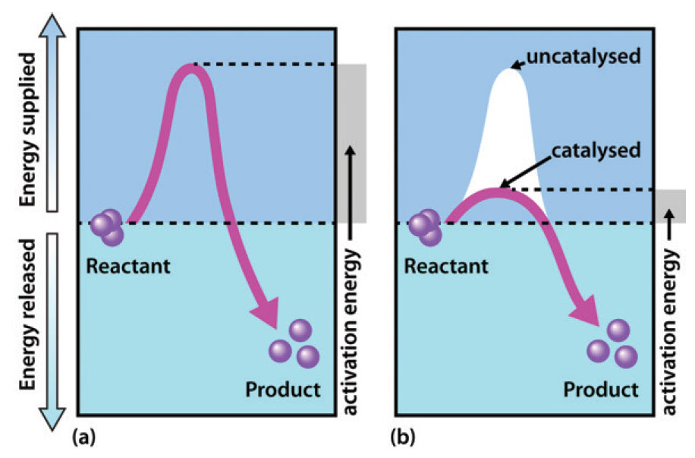
6. Catalyst
Substance that increases reaction rate without being consumed in the reaction

Slide 15
Now you should be able to…
Determine how adding a catalyst affects reaction rate according to collision theory

Slide 16
Rate Expressions

Slide 17
Lesson Objectives:
Write rate expression to calculate speed of reactions.

Slide 18
Rates of Reaction
Rates of reactions can be determined by monitoring the change in concentration of either reactants or products as a function of time.

Slide 19
Reaction rate is the change in the concentration of a reactant or a product with time (M/s). This can be calculated using a rate expression in terms of reactants or products.
A → B
∆[A]
∆[A] = change in concentration of A over
time period Dt
rate = -
∆ t
∆[B]
rate =
∆[B] = change in concentration of B over
time period Dt
∆ t
Because [A] decreases with time, D[A] is negative.

Slide 20
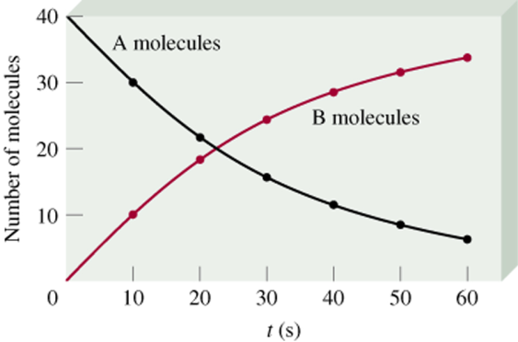
Rates Expression
Δ[A]
rate = -
Δt
Δ[B]
rate =
Δt

Slide 21
C₄H₉Cl(aq) + H₂O(l) ⎯⎯→ C₄H₉OH(aq) + HCl(aq)
In this reaction, the concentration of chlorobutane, C₄H₉Cl, was measured at various times, t.

Slide 22
C₄H₉Cl(aq) + H₂O(l) ⎯⎯→ C₄H₉OH(aq) + HCl(aq)
The average rate of the reaction over each interval is the change in concentration divided by the change in time:

Slide 23
C₄H₉Cl(aq) + H₂O(l) ⎯⎯→ C₄H₉OH(aq) + HCl(aq)
Note that the average rate decreases as the reaction proceeds.
This is because as the reaction goes forward, there are fewer collisions between reactant molecules.

Slide 24
C₄H₉Cl(aq) + H₂O(l) ⎯⎯→ C₄H₉OH(aq) + HCl(aq)
A plot of concentration vs. time for this reaction yields a curve like this.
The slope of a line tangent to the curve at any point is the instantaneous rate at that time.

Slide 25
C₄H₉Cl(aq) + H₂O(l) ⎯⎯→ C₄H₉OH(aq) + HCl(aq)
In this reaction, the ratio of C₄H₉Cl to C₄H₉OH is 1:1.
Thus, the rate of disappearance of C₄H₉Cl is the same as the rate of appearance of C₄H₉OH.
-Δ[C₄H₉Cl]
Δt
Δ[C₄H₉OH]
Δt
Rate =
=

Slide 26
What if the ratio is not 1:1?
H₂(g) + I₂(g) ⎯⎯→ 2 HI(g)
HI forms at half the rate H₂ disappears.

Slide 27
Rate Expressions
aA + bB
cC + dD
Reactants (decrease)
Products (increase)

Slide 28
Example
Write the rate expressions:
2H₂ + O₂ → 2H₂O
3O₂ → 2O₃
How is the rate of disappearance of O₂ related to the rate of appearance of O₃ if the O₃ rate equals 6.0x10⁵M/s?
-½ ΔH₂/Δt = -ΔO₂/Δt = ½ ΔH₂O/Δt
-1/3 ΔO₂/Δt = ½ ΔO₃/Δt
9.0x10⁵M/s
-1/3 ΔO₂/Δt = ½ ΔO₃/Δt
-1/3 x = ½ (6.0x10⁵)
9.0x10⁵)

Slide 29
Now you should be able to…
Write rate expression to calculate speed of reactions.

Slide 30
Rate Laws

Slide 31
Lesson Objectives
Construct a rate law.
Use the rate law to calculate how changes in concentration affect the reaction rate.
Use the rate law to calculate the rate constant with units.

Slide 32
Rate Laws
aA + bB → cC + dD
Rate = k [A]^{x}[B]^{y}
The rate law expresses the relationship of the rate of a reaction to the rate constant and the concentrations of the reactants raised to some powers. These powers are found experimentally and are referred to as orders.

Slide 33
F₂ (g) + 2ClO₂ (g) → 2FClO₂ (g)
rate = k [F₂]^{x}[ClO₂]^{y}
Find a trial where F₂ changes and ClO₂ remains the same.
F₂ doubles and the rate doubles, 1:1 which is first order.

Slide 34
F₂ (g) + 2ClO₂ (g) → 2FClO₂ (g)
rate = k [F₂]^{x}[ClO₂]^{y}
Find a trial where ClO₂ changes and F₂ remains the same.
ClO₂ quadruples and the rate quadruples, 1:1, which is first order.

Slide 35
Rules
If the concentration and the rate change the same way(1:1), it is first order.
If the concentration changes but the rate does not, it is zero order.
If the rate squares what the concentration does, it is second order.
The reaction order is the sum of all individual orders.
You may come across some questions with negative orders which means the rate changes the same magnitude the concentration does, just in the opposite direction.

Slide 36
Example
Run # | Initial [A] ([A]₀) | Initial [B] ([B]₀) | Initial Rate (v₀)
1 | 1.00 M | 1.00 M | 1.25 x 10⁻² M/s
2 | 1.00 M | 2.00 M | 2.5 x 10⁻² M/s
3 | 2.00 M | 2.00 M | 2.5 x 10⁻² M/s
0
What is the order with respect to A?
What is the order with respect to B?
What is the overall order of the reaction?
1
1

Slide 37
[NO_{(g)}] (mol dm⁻³) | [Cl_{2(g)}] (mol dm⁻³) | Initial Rate (mol dm⁻³ s⁻¹)
0.250 | 0.250 | 1.43 x 10⁻⁶
0.250 | 0.500 | 2.86 x 10⁻⁶
0.500 | 0.500 | 1.14 x 10⁻⁵
2
What is the order with respect to NO?
What is the order with respect to Cl₂?
What is the overall order of the reaction?
1
3

Slide 38
Now you should be able to…
Construct a rate law.
Use the rate law to calculate how changes in concentration affect the reaction rate.
Use the rate law to calculate the rate constant with units.

Slide 39
Reaction mechanisms

Slide 40
Lesson Objectives
Identify catalysts and intermediates in a reaction.
Find the overall reaction and determine molecularity.

Slide 41
The overall progress of a chemical reaction can be represented at the molecular level by a series of simple elementary steps or elementary reactions.
The sequence of elementary steps that leads to product formation is the reaction mechanism.
2NO (g) + O₂ (g) 2NO₂ (g)
N₂O₂ is detected during the reaction!
Elementary step:
NO + NO N₂O₂
Elementary step:
N₂O₂ + O₂ 2NO₂
Overall reaction:
2NO + O₂ 2NO₂

Slide 42
Intermediates are species that appear in a reaction mechanism but not in the overall balanced equation.
An intermediate is always formed in an early elementary step and consumed in a later elementary step.
Elementary step:
NO + NO N₂O₂
+
Elementary step:
N₂O₂ + O₂ 2NO₂
Overall reaction:
2NO + O₂ 2NO₂

Slide 43
Catalysts
Catalysts speed up the reaction and are found in the reactants of the first elementary step and the products of the last step.
A + C → AC
AC + B → ABC
ABC → AB + C
A catalyst is homogeneous if it is in the same phase as the other reactants. If not, it is heterogeneous.

Slide 44
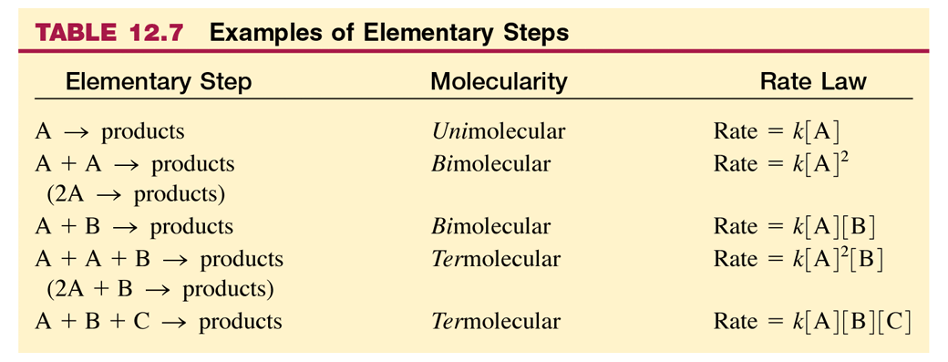
Molecularity

Slide 45
Rate Determining Step
The Rate Determining Step is always the slowest step.
It will have a similar Rate law as the overall reaction’s rate law.

Slide 46
NO₂ (g) + CO (g) ⎯⎯→ NO (g) + CO₂ (g)
The rate law for this reaction is found experimentally to be
Rate = k [NO₂]²
CO is necessary for this reaction to occur, but the rate of the reaction does not depend on its concentration.
This suggests the reaction occurs in two steps.

Slide 47
NO₂ (g) + CO (g) ⎯⎯→ NO (g) + CO₂ (g)
A proposed mechanism for this reaction is
Step 1: NO₂ + NO₂ ⎯⎯→ NO₃ + NO (slow)
Step 2: NO₃ + CO ⎯⎯→ NO₂ + CO₂ (fast)
The NO₃ intermediate is consumed in the second step.
As CO is not involved in the slow, rate-determining step, it does not appear in the rate law.

Slide 48
The overall reaction 2NO₂(g) + F₂(g) →2NO₂F(g) has an experimental rate law Rate = k[NO₂][F₂].
The accepted mechanism is
NO₂(g) + F₂(g) → NO₂F(g) + F(g) [slow; rate determining]
NO₂(g) + F(g) → NO₂F(g) [fast]
2NO₂(g) + F₂(g) →2NO₂F(g)
The elementary steps sum to the overall balanced equation:
Both steps are bimolecular and are therefore reasonable.
The elementary rate law has the same species as the overall reaction rate law.

Slide 49
The overall reaction 2NO (g) + O₂(g) →2NO₂(g) has an experimental rate law Rate = k[NO]²[O₂].
A proposed mechanism is
NO(g) + O₂(g) D NO₃(g) [fast]
NO₃(g) + NO(g) → 2NO₂(g) [slow; rate determining]
2NO (g) + O₂(g) →2NO₂(g)
The elementary steps sum to the overall balanced equation:
Both steps are bimolecular and are therefore reasonable.
The elementary rate law DOES NOT HAVE the same species
as the overall reaction rate law.

Slide 50
Reaction Mechanisms Summary
The elementary steps must add up to the overall balanced equation.
The rate determining (slow) step determines the overall rate law.
Overall rate laws’ order is found through experimentation, NOT by the coefficient in the balanced equation.
Elementary steps in a reaction mechanism have rate laws that ARE determined by their molecularity/coefficients.
Any reversible reactions will have a forward rate equal to its reverse rate, therefore, a forward rate law equal to its reverse rate law. This can be used to substitute intermediates in the rate deterring step’s rate law.
A mechanism is a hypothesis –we cannot prove it is correct, but if it is consistent with the data, and can be used to predict results accurately, it is a useful model for the reaction.

Slide 51
Lesson Objectives
Identify catalysts and intermediates in a reaction.
Find the overall reaction and determine molecularity.

Slide 52
Enthalpy

Slide 53
Lesson Objectives:
Determine if a reaction is endothermic or exothermic
Use Table I to Identify the type of reaction

Slide 54
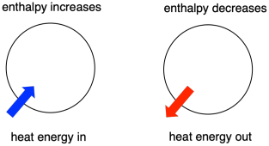
ΔH (Heat of the Reaction)
The net amount of HEAT ENERGY LOST or GAINED throughout a REACTION ΔHheat of reaction = H_{products} - H_{reactants} (ΔH = entHalpy)

Slide 55
Conservation of Energy
Energy on reactant side = Energy on product side
A + B + 50kJ → C A = 40 kJ
B = 20 kJ
C = 110 kJ
40 kJ
20 kJ
110 kJ

Slide 56
Endothermic Reactions
Heat is ABSORBED by REACTANTS
Energy stored in chemical bonds of products
ΔH is (+)
A + B + ENERGY → C + D
energy absorbed as reactant

Slide 57
Example from Table I:
(+) sign indicated energy was absorbed (endothermic)

Slide 58
Exothermic Reactions
Heat is RELEASED as a PRODUCT
ΔH is (-)
More stable reaction + spontaneous
A + B → C + D + ENERGY
energy released as a product

Slide 59
Example from Table I:
(-) sign indicated energy was released (exothermic)

Slide 60
Example: Reverse Reaction on Table I
What is the ΔH of the following reaction? Is this exothermic or endothermic? 2H₂O_{(l)} → 2H_{2(g)} + O_{2(g)}
+571.6 kJ (endothermic)
***For reverse reactions switch signs of ΔH

Slide 61
You should be able to…
Determine if a reaction is endothermic or exothermic
Use Table I to Identify the type of reaction

Slide 62
Potential Energy Diagrams

Slide 63
Lesson Objectives:
Determine if a rx is endothermic or exothermic based on the PE of the products and reactants
Label all parts of a PE Diagram
Calculate the heat of a reaction
Draw a catalyst on a PE diagram and describe how it affects the reaction

Slide 64
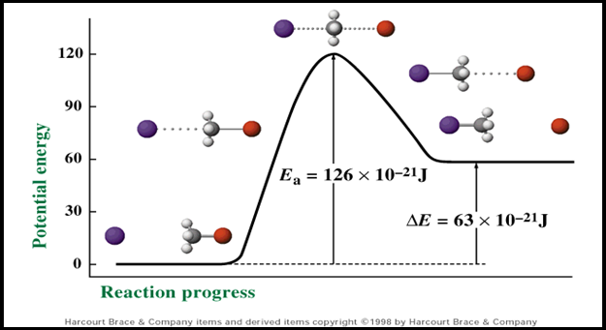
Potential Energy Diagrams
Shows the change in potential (stored) energy during a chemical reaction

Slide 65
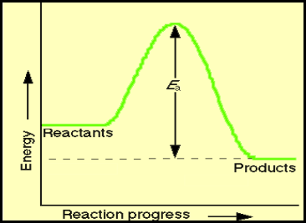
Exothermic PE Diagram
Product side LOWER than reactant side
WHY? Energy is released as a product, so the net amount of potential energy decreases.
(-) ΔH

Slide 66
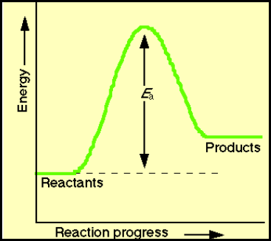
Endothermic PE Diagram
Product side HIGHER than reactant side
WHY? Energy is absorbed by the reactants, so the net amount of potential energy increases.
(+) ΔH

Slide 67
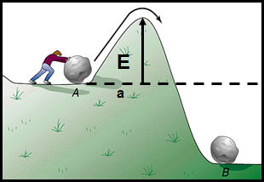
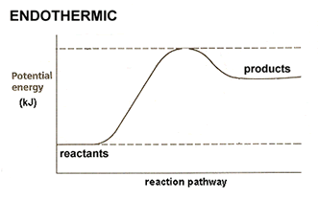
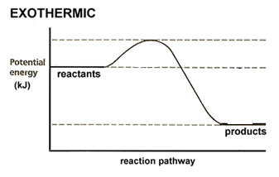
Activation Energy (E_{a})
Minimum energy required for a reaction to occur (energy needed to get over the hill)

Slide 68
Activated Complex
Highest energy point of reaction
Temporary
Where bonds are broken and reformed

Slide 69
Heat of Reactants/Products
How much energy the reactants or products have

Slide 70
Heat of Reaction ΔH
Amount of energy lost/gained in a reaction
ΔH = H_{(products)} – H_{(reactants)}

Slide 71
Effects of adding a CATALYST
LOWERS the activation energy (energy needed to start the reaction)
Reaction occurs faster

Slide 72
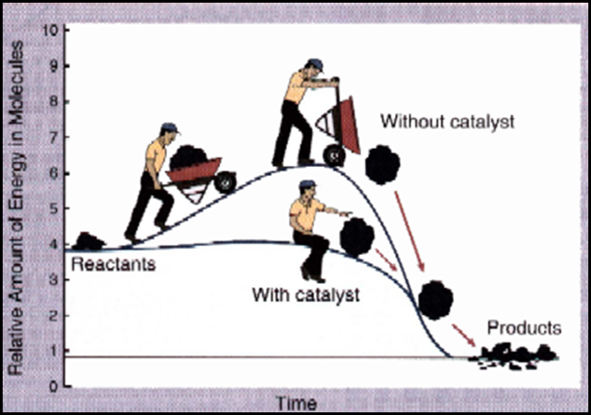
Catalysts

Slide 73
You should be able to…
Determine if a rx is endothermic or exothermic based on the PE of the products and reactants
Label all parts of a PE Diagram
Calculate the heat of a reaction
Draw a catalyst on a PE diagram and describe how it affects the reaction

Slide 74
Entropy

Slide 75
Lesson Objectives
Compare entropies of various substances

Slide 76
Spontaneous Processes
Spontaneous processes are those that can proceed without any outside intervention.
The gas in vessel B will spontaneously effuse into vessel A, but once the gas is in both vessels, it will not spontaneously change.

Slide 77
Spontaneous Processes
Processes that are spontaneous at one temperature may be nonspontaneous at other temperatures.
Above 0°C it is spontaneous for ice to melt.
Below 0°C the reverse process is spontaneous.

Slide 78
Spontaneous Processes
Spontaneity depends on two important issues:
Entropy can be thought of as a measure of the randomness of a system.
Enthalpy is the heat change of a reaction.

Slide 79
Entropy
The number of possible arrangement of particles that can occur (the disorder of the system)

Slide 80
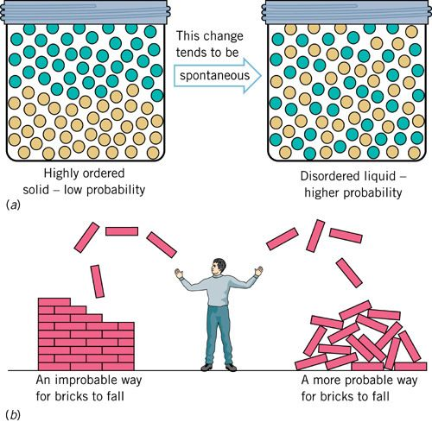
Second Law of Thermodynamics
The second law of thermodynamics states that the entropy of the universe increases for spontaneous processes.

Slide 81
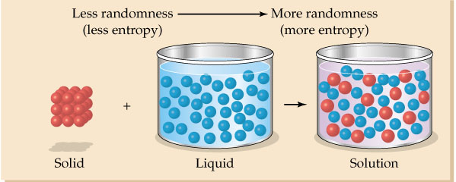
Entropy is dependent on:
Temperature (phase changes)
S(g) > S(l) > S(s)
The number of independently moving molecules: Ssolute < Ssolution
The change in phase usually has a larger affect than the number of molecules.

Slide 82
Third Law of Thermodynamics
The entropy of a pure crystalline substance at absolute zero is 0.

Slide 83
Standard Entropy
These are molar entropy values of substances in their standard states.
Standard entropies tend to increase with increasing molar mass.

Slide 84
Standard Entropies
Larger and more complex molecules have greater entropies.

Slide 85
Examples
Which has a greater entropy?
NaCl_{(s)} or NaCl_{(aq)}
CO_{2(s)} or CO_{2(g)}
KI_{(aq)} at 45C or 100C

Slide 86
Examples
Is the entropy positive (increasing) or negative?
2H_{2(g)} + O_{2(g)} → 2H₂O_{(l)}
NH₄Cl_{(s)} → NH_{3(g)} + HCl_{(g)}

Slide 87
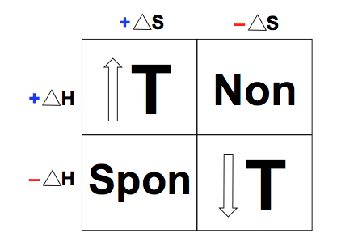
Spontaneous Processes
Spontaneity depends on two important issues: Entropy & Enthalpy
Gibbs Free Energy can be calculate to determine If a reaction is spontaneous.

Slide 88
Gibbs changes with Temperature ΔG= ΔH −TΔS

Slide 89
Examples
Will the following reactions be spontaneous?
A reaction that is exothermic and produces many moles of gas.
A reaction that is endothermic and produces solids.
A reaction that is cold to the touch and condenses.
A reaction that is hot to the touch and forms smoke.

Slide 90
Examples that are Temperature Dependent
The following will be spontaneous only at high or low temperatures:
H₂O(g) → H₂O(l) + Heat
Heat + Cu(s) → Cu(l)
Heat + C₆H₁₂O₆(s)→ 6H₂O(g) + 6C(s)

Slide 91
You should be able to…
Compare entropies of various substances

Slide 92
Equilibrium

Slide 93
Lesson Objectives:
Define and explain equilibrium including:
Phase equilibrium
Solution equilibrium
Chemical equilibrium

Slide 94
Equilibrium
In a system at equilibrium, both the forward and reverse reactions are taking place.
Write the equations with a double arrow

Slide 95
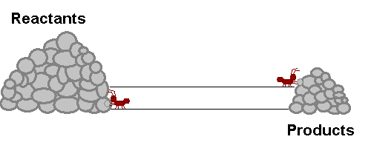
Equilibrium
The RATE of the forward reaction is EQUAL to the rate of the reverse reaction
Equilibrium is Dynamic (in constant motion)

Slide 96
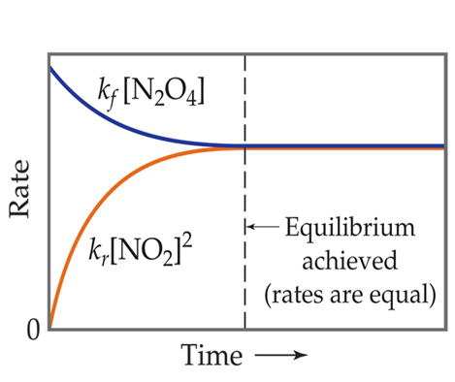
The Concept of Equilibrium
As system approaches equilibrium, both the forward and reverse reactions are occurring at different rates (speeds)

Slide 97
The Concept of Equilibrium
At equilibrium, the forward and reverse reactions are proceeding at the same rate (speed)

Slide 98
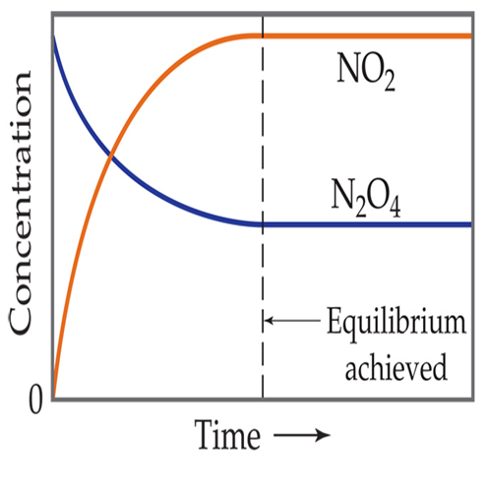
The System at Equilibrium
Like the picture, the amount of each reactant and product remain constant because the rates are equal.

Slide 99
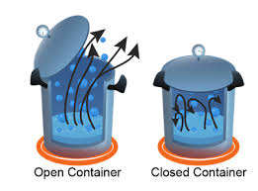
Phase equilibrium
Rate of forward phase change equals rate of reverse phase change
Rate_{vaporizing} = Rate_{condensing}
Ex. H₂O (l) H₂O (g)

Slide 100
Solution Equilibrium
Not at equilibrium
Dissolves more than it precipitates
At equilibrium
Dissolves and precipitates equally
Not at equilibrium
Dissolves less than it precipitates

Slide 101
Chemical Equilibrium
Equilibrium is achieved when the rates of the forward and reverse reactions are equal so concentration become constant.

Slide 102
You should be able to…
Define and explain equilibrium including:
Phase equilibrium
Solution equilibrium
Chemical equilibrium

Slide 103
Equilibrium Expressions

Slide 104
Lesson Objectives
Calculate equilibrium constants and concentrations

Slide 105
The Equilibrium Constant
To generalize this expression, consider the reaction
aA + bB ← →
cC + dD
The equilibrium expression for this reaction would be
[C]^{c}[D]^{d}
[A]ª[B]^{b}
K_{c} =
Pure solids and liquids should be omitted.

Slide 106
The Equilibrium Constant
Since pressure is proportional to concentration for gases in a closed system, the equilibrium expression can also be written
(P_{C})^{c} (P_{D})^{d}
(P_{A})ª (P_{B})^{b}
K_{p} =
Only gases should be in the Pressure expression.

Slide 107
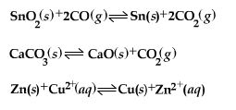
What Are the Equilibrium Expressions for These Equilibria?
Kp = P(CO₂)²/(P(CO)²
Kp = P(CO₂)
Kc = [Zn²⁺]/[Cu²⁺]

Slide 108
Mass Action Expressions
MAE can be used to calculate the concentrations or pressures of species in an equilibrium expression. Just plug and chug…

Slide 109
Examples
At 230C, the concentration of NO is 0.0542M, the concentration of oxygen is 0.127M, and the concentration on NO₂ is 15.5M. Calculate Kp
2NO_{(g)} + O_{2(g)} ↔ 2NO_{2(g)}
Kp= P(NO₂)²/P(NO)²P(O₂)
Kp= (15.5)²/(0.0542)²(0.127)
644000

Slide 110
Examples
The Kp of the following reaction equals 1.05 at 250C. Find the pressure of Cl₂ if PCl₅ equals 0.875 atm and PCl₃ equals 0.463 atm at equilibrium.
PCl_{5(g)} ↔ PCl_{3(g)} + Cl_{2(g)}
Kp= P(Cl₂)P(PCl₃)/P(PCl₅)
1.05 = (x)(0.463)/(0.875)
1.98atm

Slide 111
Equilibrium Can Be Reached from Either Direction
It does not matter whether we start with N₂ and H₂ or whether we start with NH₃. We will have the same proportions of all three substances at equilibrium.

Slide 112
What Does the Value of K Mean?
If K >> 1, the reaction is product-favored; product predominates at equilibrium (products are on the numerator).
If K << 1, the reaction is reactant-favored; reactant predominates at equilibrium.

Slide 113
You should be able to…
Calculate equilibrium constants and concentrations

Slide 114
Le Chatelier’s
Principle

Slide 115
Lesson Objectives:
Determine the shift in equilibrium when a stress is placed on a system
Determine the change in products and reactants when a stress is placed on a system

Slide 116
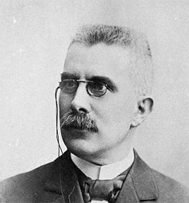
LeChatelier’s Principle
If a change is imposed on a system at equilibrium, the position of the equilibrium will shift in a direction that tends to reduce that change.

Slide 117
The Haber Process
The transformation of nitrogen and hydrogen into ammonia (NH₃) is of tremendous significance in agriculture, where ammonia-based fertilizers are very important.

Slide 118
The Haber Process
If H₂ is added to the system, N₂ will be consumed and the two reagents will form more NH₃.

Slide 119
Le Chatelier’s Principle
If a change (stress) is imposed on a system at equilibrium, the position of the equilibrium will shift in a direction that tends to reduce that change (stress).

Slide 120
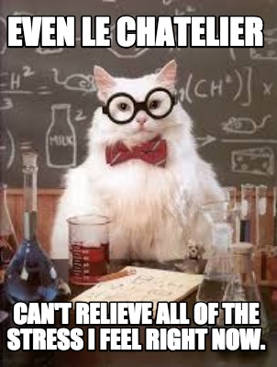
Types of Stress
Concentration
Temperature
pressure for gases

Slide 121
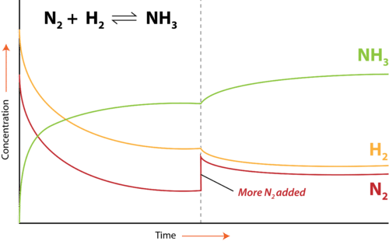
Changes in Concentration
If a substance is Added (increase concentration) the reaction shifts Away from the side of the reaction that you added to in order to reduce the excess.

Slide 122
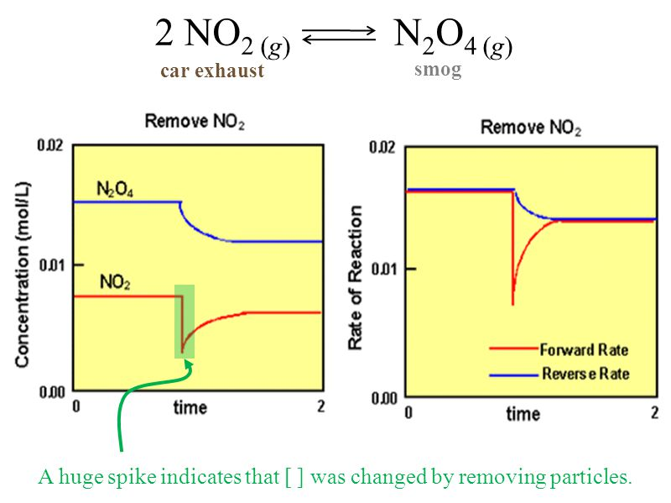
Changes in Concentration
If a substance is Taken away (decrease concentration) the reaction shifts Towards the side of the reaction that you took away from to restore it.

Slide 123
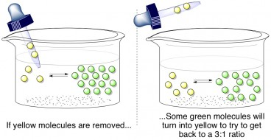
Concentration Changes

Slide 124
Example: Increase in concentration (reactant)
2CO_{(g)} + O_{2(g)} ← → 2CO_{2(g)}
If more CO is added to the reaction at equilibrium the reaction will shift right. The CO will react with O₂ to form CO₂.
If more O₂ is added to the reaction at equilibrium the reaction will shift right. The O₂ will react with CO to form CO₂.

Slide 125
Example: Increase in concentration (product)
2CO_{(g)} + O_{2(g)} ← → 2CO_{2(g)}
If more CO₂ is added to the reaction at equilibrium the reaction will shift left. The extra CO₂ will decompose to form O₂ and CO₂.

Slide 126
Example: Decrease in concentration (reactant)
2CO_{(g)} + O_{2(g)} ← → 2CO_{2(g)}
If CO is removed from the reaction at equilibrium the reaction will shift left. The CO₂ will break down to restore the removed CO and also form O₂.
If O₂ is removed from the reaction at equilibrium the reaction will shift left. The CO₂ will break down to restore the removed O₂ and also form CO

Slide 127
Example: Decrease in concentration (product)
2CO_{(g)} + O_{2(g)} ← → 2CO_{2(g)}
If CO₂ is removed from the reaction at equilibrium the reaction will shift right. The CO will react with O₂ to restore the removed CO_{2.}

Slide 128
Change in temperature
(Endothermic) Reactants + Heat → Products (Exothermic) Reactants → Heat + Products Heat is considered a reactant or product:
When heat is added, the reaction shifts away from the heat in the reaction.
When heat is taken out, the reaction shifts toward the heat in the reaction.

Slide 129
Example: Increase in temperature (exo)
2CO_{(g)} + O_{2(g)} ← → 2CO_{2(g)} + 566 kJ
If heat is added to the reaction at equilibrium the reaction will shift left. The heat will break down the CO₂ to form CO and O₂.

Slide 130
Example: Decrease in temperature (exo)
2CO_{(g)} + O_{2(g)} ← → 2CO_{2(g)} + 566 kJ
If heat is removed from the reaction at equilibrium the reaction will shift right. The CO and O₂ will react to restore the heat removed and form CO₂.

Slide 131
Example: Increase in temperature (endo)
182.6kJ + N₂(g) + O₂(g) → 2NO(g)
If heat is added to the reaction at equilibrium the reaction will shift right. The heat will cause N₂ and O₂ to collide, react, and form NO.

Slide 132
Example: Decrease in temperature (endo)
182.6kJ + N₂(g) + O₂(g) → 2NO(g)
If heat is removed from the reaction at equilibrium the reaction will shift left. The NO will decompose to for N₂, O₂, and restore the heat removed.

Slide 133
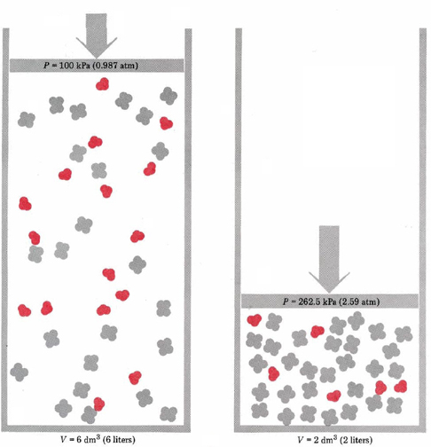
Change in pressure (gases only)
2Red → 1Gray
An increase in pressure causes a shift away from the side of the reaction with more moles of gas
A decrease in pressure causes a shift towards the side of the reaction with more moles of gas

Slide 134
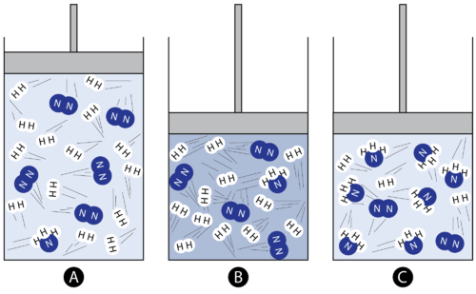
Example: Increase in pressure
N_{2(g)} + 3H_{2(g)} ←→ 2NH_{3(g)} 6 13 1
2 1 7
-4
-12
+6

Slide 135
Example: Decrease in pressure
2CO_{(g)} + O_{2(g)} ← → 2CO_{2(g)}
If pressure decreases, the space the gases take up increases which provides more room for more moles of gas. Simce the reactants have 3 moles of gas (2CO and 1O₂) and the products only have 2 moles of gas (2CO₂), the raction will shift left to create more CO and O₂

Slide 136
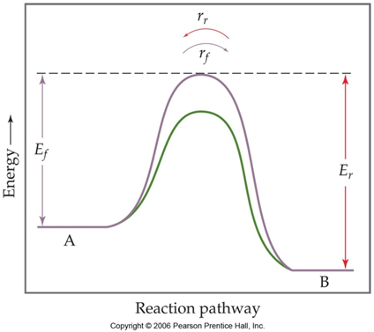
Catalyst
Increases the rate of both the forward and reverse reactions
Equilibrium is achieved faster but there is no shift

Slide 137
You should be able to…
Calculate equilibrium constants and concentrations

Slide 138
Equilibrium Shifts

Slide 139
Lesson Objectives
Manipulate Mass Action Expressions.
Calculate equilibrium quotients
Determine which way a reaction will shift in order to restore equilibrium

Slide 140
Manipulating Equilibrium Constants
If you reverse an equation, you must take the reciprocal of the equilibrium constant.
2 NO₂(g)
[NO₂]²
[N₂O₄]
N₂O₄ (g)
K_{c} = = 0.212 at 100°C
N₂O₄(g)
[N₂O₄]
[NO₂]²
1
0.212
K_{c} =
= 4.72 at 100°C
2 NO₂ (g)
=

Slide 141
Manipulating Equilibrium Constants
If you multiply the reaction by any number, you must raise the equilibrium constant to that number.
[NO₂]²
[N₂O₄]
N₂O₄ (g)
2 NO₂ (g)
K_{c} = = 0.212 at 100°C
[NO₂]⁴
[N₂O₄]²
2 N₂O₄ (g)
4 NO₂ (g)
K_{c} = = (0.212)² at 100°C

Slide 142
Manipulating Equilibrium Constants
If two equations are combined, you must multiply their Keq.
K₁ = [HF] K₂ = [NaF][H⁺]
[H⁺][F⁻] [HF][Na⁺]
H⁺ + F⁻ ↔ HF K₁=2
HF + Na⁺ ↔ NaF + H⁺ K₂=3
_________________ _______
F⁻ + Na⁺ ↔ NaF K=6

Slide 143
The Reaction Quotient (Q)
To calculate Q, substitute the initial concentrations of reactants and products into the equilibrium expression.
Q gives the same ratio the equilibrium expression gives, but for a system that is not at equilibrium.

Slide 144
K or Q = P/R
If Q=K
At equilibrium
If Q>K
Too many products, shifts left (reverse) to make reactants.
If Q<K
Too many reactants, shifts right (forward) to make products.

Slide 145
Example
The Kc of the following equation equals 54.3 at 430C. Initially, 0.243moles of hydrogen, 0.0146moles of iodine and 1.98 moles of hydrogen iodide are placed in a sealed 1.00L container. Which way will the reaction shift to achieve equilibrium?
H₂ + I₂ ↔ 2HI
Q = (1.98)²/[(0.0146)(0.243)]
Q = 1110, shifts left to make reactants

Slide 146
Now you should be able to…
Manipulate Mass Action Expressions.
Calculate equilibrium quotients
Determine which way a reaction will shift in order to restore equilibrium

