Slide 1
MOLES

Slide 2
Molar Mass

Slide 3
Lesson Objectives:
Determine the number of atoms in a molecule
Calculate the molar mass of elements and compounds

Slide 4
Stoichiometry
The study of the amounts of reactants and products in chemical reactions (the study of chemical recipes).

Slide 5
Chemical Formulas
Subscripts: number of atoms in a formula Coefficients: TOTAL number of molecules or compounds Ex. 3Ca₃(PO₄)₂
{
PO₄
Ca
Ca₃(PO₄)₂
P=2 O=8
Ca
Ca₃(PO₄)₂
1
PO₄
Ca = 9 P= 6 O= 24
Ca
Ca₃(PO₄)₂

Slide 6
Example
NH₄NO₃
3Al₂(SO₄)₃
N= 2 H= 4 O= 3
SO₄
SO₄
SO₄
Al= 6 S= 9 O= 36

Slide 7
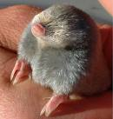
The mole (mol)
Unit that measures the amount (number of particles) of a substance
1 mol = 6.02 x 10²³ particles (things)
1 mol = gram formula mass
1 mol

Slide 8
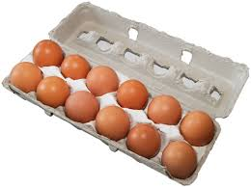
The mole
12 eggs = 1 dozen eggs 6.02 x 10²³ eggs = 1 mol of eggs Example: 3 dozen roses = 3 (12) = 36 roses 3 mol roses = 3 (6.02 x 10²³ ) = 1.8 x 10²⁴ roses

Slide 9
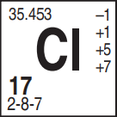
Molar Mass (gram formula mass)
Mass of the formula expressed in grams
Equal to 1 mole
Units (g/mol)

Slide 10
Molar Mass Examples: Elements
What is the molar mass of iron? What is the molar mass of copper?
55.8 g/mol
63.5 g/mol

Slide 11
Calculating Molar Mass (gfm)
Count the atoms in the compound
Look up mass of each atom on periodic table
Multiply mass by the # of atoms of each element
Add up the total mass

Slide 12
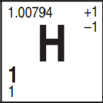
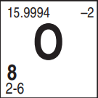
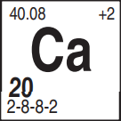
Molar Mass Examples: compounds
What is the molar mass of water? What is the gram-formula-mass of calcium chloride?
H₂O = 2(1.0) + 16.0 = 18.0g/mol
CaCl₂ = 40.1 + 2(35.5) = 111.1 g/mol

Slide 13
Determine the number of atoms in a molecule Calculate molar mass

Slide 14
Calculating Moles

Slide 15
Lesson Objectives:
Calculate moles given the number of grams
Calculate grams given the number of moles

Slide 16
Mole Conversions: grams to moles
Use MOLE FORMULA from Table T Given mass is the mass in grams of the sample

Slide 17
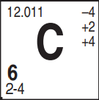
Think About it...
If 1 mole of carbon is 12.o grams, how many moles would 24.o grams be?

Slide 18
Converting from grams to moles
Calculate the GFM for the compound. (round to nearest tenth)
Plug the given value and the GFM into the “mole calculations” formula and solve for the number of moles.

Slide 19
Example 1:
How many moles are in 39.0 grams of LiF?
mol = 39.0 g 25.9 g/mol
Li = 6.9g
F = 19.0g
+
= 25.9g/mol
= 1.51 mol

Slide 20
Example 2:
What is the number of moles of potassium chloride present in 148 g?
mol = 148 g
74.6 g/mol
K= 39.1g
Cl= 35.5 g
+
= 74.6 g/mol
= 1.98 mol

Slide 21
Think About it...
If the mass of one mole of 1 mole of Lithium is 6.9 grams, how much would the mass be for 2 moles of lithium?

Slide 22
Mole Conversions: moles to grams
Use the same mole formula to solve for grams by setting mole over 1 and cross multiplying

Slide 23
Example 3:
What is the mass of 2 moles of Li?
2 mol
= x
1
6.941 g/mol
= 13.88 g

Slide 24
Example 4:
What is the mass of 4.5 moles of KOH?
K= 39.1 g
O= 16.0 g
4.5 mol
= x
H= 1.0 g
1
56.1 g/mol
+
= 56.1 g/mol
= 253.5 g
= 250 g

Slide 25
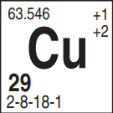
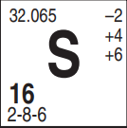
Example 5:
What is the mass of 0.50 mol of CuSO₄?
Cu= 63.5 g
S= 32.1 g
= x
.50 mol
O= 16.0 x 4= 64.0 g
+
1
159.6 g/mol
= 159.6 g/mol
= 79.8 g
= 80. g

Slide 26
Calculate moles given the number of grams
Calculate grams given the number of moles

Slide 27
MOLE RATIOS

Slide 28
Lesson objectives:
Calculate mole ratios for chemical reactions

Slide 29
Chemical recipes
Mix + 2 Eggs + 1 cup water → Cake Reactants Products Just like a recipe in a chemical Rx you can double, triple, halve etc. the amounts of the ingredients to change how much product you make

Slide 30
Chemical recipes
Mix + 2 Eggs + 1 cup water → 1 Cake Reactants Products Example:
2 Mix → 2 Cakes
6 Eggs → 3 Cakes

Slide 31
Chemical reactions
4Al + 3O₂ → 2Al₂O₃ reactants products Coefficients: How many MOLES of the substance are needed in a reaction.

Slide 32
Example:
If you double the H₂ in the reaction below, how much H₂O do you produce?
2H₂ + O₂ → 2H₂O
8 H’s
8 H’s
4 O’s
4H₂ + 2O₂ → 4H₂O
4 O’s

Slide 33
Example
If you triple the N₂ in the reaction below, how much NH₃ do you produce? N₂ + 3H₂ → 2NH₃
3N₂ + 9H₂ → 6NH₃

Slide 34
Relating Moles
To relate moles of one substance to another, simply create a proportion:
4Al + 3O₂ 🡪 2Al₂O3
If 3 moles of oxygen react, how many moles of Aluminum oxide form?
If 4 moles of aluminum react, how many moles of oxygen are needed?
If 4 moles of aluminum oxide are formed, how many moles of oxygen were used?
If 8 moles of aluminum react, how many moles of oxygen are needed?
2
3
6
6

Slide 35
Calculating Mole Ratios
Set up a ratio of moles (proportion) of SUBSTANCES in the balanced equation to the ACTUAL MOLE values and solve for the unknown
Check to make sure the new ratios are the same as the original ratios….remember from our POGIL, the ratios can’t change!!!

Slide 36
Example: (I do)
How many moles of oxygen are consumed when 0.6 moles of hydrogen burns to produce water? 2 H₂(g) + O₂(g) ➝ 2 H₂O
2:1 ratio
0.6 mol H₂
x mol O₂
2 mol H₂ = 1 mol O₂
= 0.3 mol O₂
0.6 mol H₂ x

Slide 37
Example: (We Do)
How many moles of nitrogen gas (N₂) would be needed to produce 10 moles of ammonia (NH₃) in the following rx?
N₂(g) + 3H₂(g) ➝ 2NH₃
1 mol N₂ = 2mol NH₃
x mol N₂
10 mol NH₃
x mol N₂ 10
1:2 ratio
= 5 mol N₂

Slide 38
Example (You Do)
If 12 moles of C₃H₈ react completely, how many moles of H₂O are formed in the reaction below? C₃H₈ + 5O₂ → 3CO₂ + 4H₂O
12 mol C₃H₈
X mol H₂O
1:4 ratio
=48 mol H₂O

Slide 39
Calculate mole ratios for chemical reactions

Slide 40
Balancing Reactions

Slide 41
Lesson Objectives:
Analyze reactions for conservation of mass
Balance chemical reactions using coefficients

Slide 42
Think about it…..
How would the mass of the reactants compare to the mass of the products in this balanced equation?

Slide 43
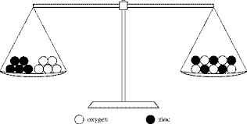
Law of Conservation of Mass
In all chemical reactions there is a CONSERVATION of mass, energy, and charge “what goes in must come out”
The number of ATOMS of each element must be EQUAL on BOTH SIDES of the equation.

Slide 44
Conservation of mass
An unbalanced equation does not show conservation of mass. H₂ + O₂ → H₂O
2g + 32g ≠ 18g

Slide 45
Conservation of Mass
A balanced equation shows conservation of mass.
2H₂ + O₂ → 2H₂O
2(2g) + 32g = 2(18g)
36g = 36g

Slide 46
Balancing Equations
Balance with COEFFICIENTS ONLY
H₂ + O₂ → H₂O
**NOTE: WE NEVER CHANGE THE SUBSCRIPTS IN A FORMULA!
2
H₂ + O₂ → H₂O
2

Slide 47
Steps for Balancing Equations
Balance using the smallest whole number coefficients (reduce if not)
Check to see if each atom is balanced (same # on both sides of the reaction

Slide 48
Example (I do)
3
2
N₂ + H₂ → NH₃
Find the least common multiple of 2 and 3 = 6
N =
H =
2
2
2
6
N =
H =
1
3
2
6

Slide 49
Example (We Do)
2
3
3
2
Al + CuCl₂ → Cu + AlCl₃
Find the least common multiple of 2 and 3 = 6
Al =
Cu =
Cl =
1
1
2
Al =
Cu =
Cl =
2
3
6
2
3
6
1
1
3

Slide 50
Example: (You Do)
2
2
H₂ + O₂ → H₂O

Slide 51
Example with polyatomics
2
2
BaCl₂ + AgNO₃ → Ba(NO₃)₂ + AgCl
If a group of elements are the same on both sides of the equation, you can balance the entire group instead of each individual atom.

Slide 52
Analyze reactions for conservation of mass
Balance chemical reactions using coefficients

Slide 53
Types of chemical reactions

Slide 54
Lesson objectives:
Determine the type of chemical reaction
Complete single replacement reactions
Complete double replacement reactions

Slide 55
Types of Chemical Reactions
Synthesis: A + 2B → AB₂ Decomposition: AB₂ → A + 2B Combustion: CH₄ + O₂ → CO₂ + H₂O Single Replacement: AB + C → CB +A Double Replacement: AB + CD → AD + CB
Notes:
Notice synthesis and decomposition are opposites. Also, combustion can have any carbon compound as a reactant.

Slide 56
Synthesis Reaction
4Li + O₂ → 2Li₂O
2 reactants forming 1 product

Slide 57
Decomposition Reaction
2AuBr₃ → 2Au + 3Br₂
Opposite of synthesis
1 reactant breaking into multiple products

Slide 58
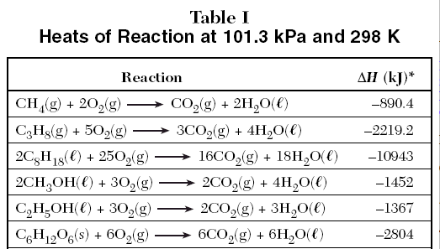
Combustion Reactions
CH₄ + 2O₂ → CO₂ + 2H₂O Oxygen as a reactant… 1st 6 reactions on table E

Slide 59
Single Replacement Reactions
Ni + CuCl₂ → NiCl₂ + Cu
A single element replaces another in a compound
Look for a single element on both sides of rx

Slide 60
Double Replacement Reactions
BaCl₂(aq) + Na₂S(aq) → 2NaCl (aq) + BaS(aq)
2 substances switch places
2 compounds on either side

Slide 61
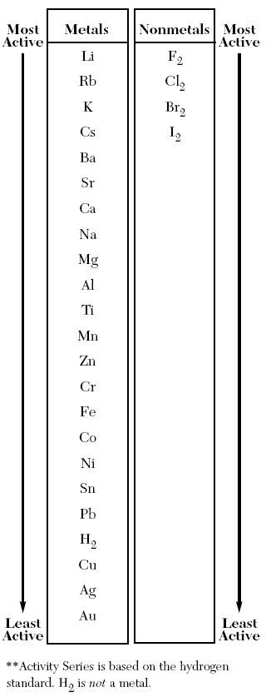
Completing a Single Replacement Rx
The single element must be higher up on table J than the 1st element in compound
Mg + HCI →
2
MgCl₂ +
H
₂
( Mg⁺² Cl⁻¹ )
(+2)
2(-1) = 0

Slide 62
Example
3Li + AlP →
Li₃P +
Al
( Li⁺¹ P⁻³ )

Slide 63
Completing a double replacement rx
3AgCl + K₃P →
Ag₃P +
3KCl
( Ag⁺¹ Cl⁻)
( K⁺¹ P-³ )

Slide 64
Completing a Double Replacement Rx
FeS + HCl →
FeCl₂
H₂S
( Fe⁺² Cl⁻¹ )
( H⁺¹ S⁻² )

Slide 65
You should be able to…
Determine the type of chemical reaction
Complete single replacement reactions
Complete double replacement reactions

Slide 66
Limiting Reactants

Slide 67
Determine the limiting reactant and the amount produced in a reaction

Slide 68
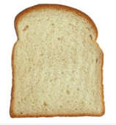
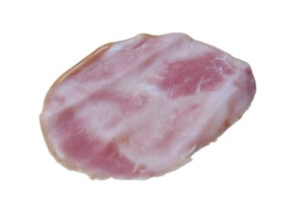
Limiting Reactants
Given: 20 11 36
1 sandwich =2 1 3
How many sandwiches can I make if I used all of the bread with unlimited other resources?
How many sandwiches can I make if I used all of the cheese with unlimited other resources?

Slide 69
Limiting Reagents
Given: 20 11 36
1 sandwich = 2 1 3
3. How many sandwiches can I make if I used all of the ham with unlimited other resources?
4. How many sandwiches can I make if I used only what is given?
5. What ingredient was the limiter? Why?

Slide 70
Limiting Reactants Examples
1. S + 3F₂ 🡪 SF₆
Suppose you have 4 moles of sulfur and 3 moles of fluorine, which is the limiter and which is in excess? How many moles of SF₆ can be produced?
4S produces 4 SF₆
3F₂ produces 1 moles of SF₆
(F₂ Limiter!)

Slide 71
Limiting Reactants Examples
2. 2NH₃ + CO₂ 🡪 (NH₂)₂CO + H₂O
If 4 moles of ammonia react with 4 moles of carbon dioxide, find the limiter and the amount of urea produced.
4 moles of ammonia produces 2 urea
4 moles of Carbon dioxide produces 4 urea
Ammonia is the limiter and 2 moles of urea are produced

Slide 72
Limiting Reactants Examples
3. 5Ca + V₂O₅ 🡪 5CaO + 2V
If 10 moles of calcium react with 3 moles of V₂O₅. Find the limiter and the amount of V produced.
10 moles of Ca produce 4V
3 moles of V₂O₅ produce 6V
Ca is the limiter and 4 mole of V are produced

Slide 73
Determine the limiting reactant and the amount produced in a reaction

Slide 74
Percent Composition

Slide 75
Lesson Objectives:
Calculate the percent composition of a substance
Calculate the percent composition of water in a hydrate

Slide 76
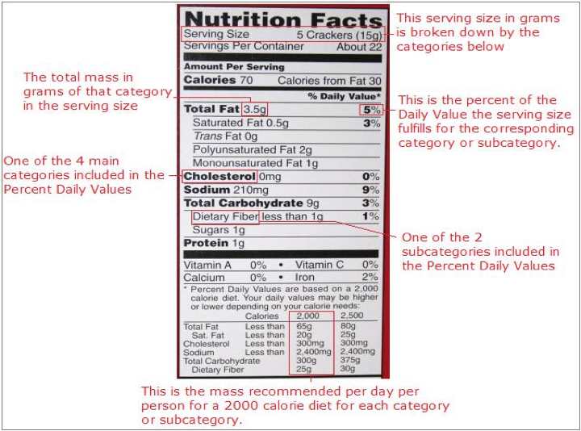
3.5g
65g
X100 = 5%

Slide 77
Percent Composition
Percentage by mass of each element in a compound

Slide 78
Calculating Percent Composition
Calculate GFM of compound (mass of whole)
Plug into % composition formula

Slide 79
Example
What is the percent composition of Calcium in CaCl₂?
gfm= = 111.1 g/mol
GFM CaCl₂: Ca = 40.1g x 1 = 40.1g Cl = 35.5g x 2 = 71.0g
gfm = 111.1 g/mol
% comp= 40.1g 111.1g/mol
36.1%
x 100 =

Slide 80
Example
What is the percent by mass of nitrogen in NH₄NO₃?
N= 14.0g x 2 = 28.0g H= 1.0g x 4 = 4.0g O= 16.0g x 3 = 48.0g +
28.0g
80.0g
x 100
= 35.0%
= 80.0g/mol

Slide 81
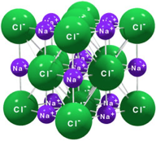
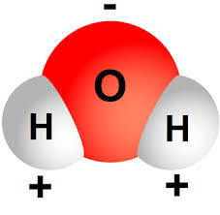
How does water get trapped in crystal?
Crystal lattices have open spaces where water molecules get trapped.
Water have charged ends that are attracted to the charged ions in the crystal

Slide 82
Composition of a hydrate
Hydrate- Ionic solids with water trapped in the crystal lattice. It is written like this:
Ionic Compound’s Formula • n H₂O (n) is a whole number
The dot shows that 5 H₂O molecules are attached to 1 CuSO₄ molecule.
Ex. CuSO₄ . 5H₂O

Slide 83
Anhydrate
A crystal with NO WATER trapped inside its lattice (opposite of a hydrate)

Slide 84
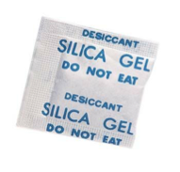
Anhydrate example
The crystals in silica gel packet are anhydrous and absorb moisture (water) readily from the air.
Ex. packaged with shoes, electronic devices, etc.

Slide 85
Which is the hydrate and the anhydrate?

Slide 86
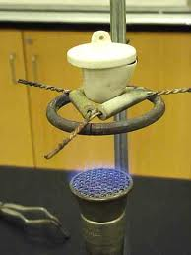
Hydrates
The reaction must be performed in a crucible on a clay triangle on a ring stand.
Clean and heat crucibles before use
Careful they get really hot!
Always reheat your sample to ensure all water has left the hydrate
Record all measurements!

Slide 87
Calculate % Composition of Hydrate
Calculate GFM of HYDRATE including the water (mass of whole)
Plug into % composition formula T
**If heated, the water in hydrates evaporates away. So any difference in starting and ending mass of a hydrate is the mass of the water

Slide 88
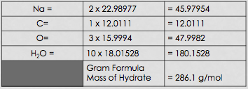
Example
What is the percentage by mass of water in sodium carbonate crystals (Na₂CO₃ . 10H₂O)?
Step 1- Calculate GFM of Hydrate

Slide 89
Step 2: Plug Values into Formula
% H₂O by mass = 180.2g X 100 = 286.1g
Mass of H₂O
63.0 %
Na₂CO₃ . 10H₂O
Mass of hydrated compound

Slide 90
Example
What is the percent by mass of water in BaCl₂ . 2H₂O?
Ba= 137.3 x 1= 137.3g Cl = 35.5 x 2 = 71.0g H = 1.0 x 4 = 4.0g O = 16.0 x 2 = 32.0g =
36.0g
x 100
= 14.7%
244.3g
244.3g/mol

Slide 91
Hydrates
Once the hydrate is heated, you can calculate the moles of water that evaporated, and figure out the formula. The steps are as follows:
Calculate the mass of hydrate, anhydrate and water by subtraction.
Find the moles of anhydrate and water separately.
Find the mole ratio of anhydrate to water (1 to ?).

Slide 92
Hydrate Example:
Data:
Mass of crucible: 28.00 g
Mass of crucible and hydrate: 29.60 g
Mass of crucible and anhydrate: 29.24 g
Calculate the hydrate formula and the percent water if the anhydrate is CuSO₄.

Slide 93
Answer
29.60-28.00 = 1.60 g of hydrate
29.24-28.00 = 1.24 g of anhydrate
1.60-1.24 = 0.36 g of water
0.36/1.60 * 100 = 23% water
0.36/18.016 = 0.1998 moles of water
1.24/159.6 = 0.007769 moles of anhydrate
CuSO₄.3H₂O

Slide 94
Calculate the percent composition of a substance
Calculate the percent composition of water in a hydrate

Slide 95
Determining Empirical & Molecular Formulas

Slide 96
Lesson Objectives:
Determine the empirical formula from the molecular formula
Calculate the molecular from the empirical formula

Slide 97
Empirical Formula (ratio)
Smallest whole number ratio of atoms in a compound (cannot be reduced any further)
Ex. B₁₀G₂₀
B₁G₂ (empirical formula)

Slide 98
Determining the Empirical Formula
Divide subscripts by the greatest common factor Example: molecular formula = C₄H₁₀
Divide by 2 (greatest common factor)
C₂H₅

Slide 99
Examples: Empirical from Molecular
C₆H₁₂O₆
N₂O₄
BaCl₂
C₂H₆
CH₃
CH₂O
NO₂
BaCl₂
CH₃
CH₃

Slide 100
Molecular Formula
“Actual Formula” - the actual number of atoms in a molecule or compound
Whole # multiple of empirical
If the empirical formula is CH₄ a molecular formula could be CH₄, C₂H₈, C₃H₁₂ etc.

Slide 101
Calculating Molecular from Empirical
Calculate Gram Formula Mass of the EMPIRICAL FORMULA
Divide molecular mass given by the empirical formula mass
Multiply all of the subscripts in the empirical formula by the number (multiple) you calculated in step 2

Slide 102
Example
The empirical formula for ethylene is CH₂. Find the molecular formula if the molecular mass is 28.1 g/mol?
empirical mass CH₂ = (1 C X 12.0 g/mol) + (2 H X 1.0 g/mol) = 14.0 g/mol
=28g
28.1 g/mol
= 2
(CH₂) x 2 →
C₂H₄
14.0 g.mol

Slide 103
Example:
What is the molecular formula of a compound that has an empirical formula of NO₂ and molecular mass of 92.0 g?
N= 14.0 x 1 = 14.0g
O= 16.0 x 2 = 32.0g
+ = 46.0g/mol
92.0 g/mol
=92g
= 2
46.0 g/mol
N₂O₄
(NO₂) x 2 →

Slide 104
Calculating Empirical Formulas From Percent Composition
Rules:
Find the empirical formula of a compound with 40.92% C, 4.58% H and 54.50% O by mass.
1. Convert the % to grams, assuming the total mass of the sample is 100 grams 4.58gH, 54.50g O, 40.92g C
2. Convert mass to moles, using atomic masses.
40.92/12 = 3.40 moles C
4.58/ 1 = 4.58 moles H
54.50/16 = 3.4o moles O
3. Divide each element’s moles by the smallest number of moles.
4. Find a whole number ratio.
1 mole C, 1.5 mole H, 1 mole O
C₂H₃O₂

Slide 105
Example 1
A sample of nitrogen and oxygen contains 1.52 g N and 3.47g O and a molar mass of about 90 grams. Find the empirical and molecular formulas.
1.52g N / 14g = .10857 mol N
3.47g O / 16g = .216875 mol O
NO2

Slide 106
Example 2
Find the empirical and molecular formula of a 41 gram sample with 6.44 grams of Boron and 1.803 grams of hydrogen.
6.44g B / 10.81g = .595 mol B
1.803 g H /1g = 1.803 mol H
BH₃ is empirical and weighs (10.8+1+1+1) 13.8 so this is a multiple of 3. Molecular formula is B₃H₉

Slide 107
Determine the empirical formula from the molecular formula
Calculate the molecular from the empirical formula

Slide 108
Concentration

Slide 109
Lesson Objectives
By the end of this video you should be able to…
Compare concentrated and dilute solutions.
Calculate the molarity of a solution.
Calculate the mass added or volume needed to create a specific concentration of a solution.

Slide 110
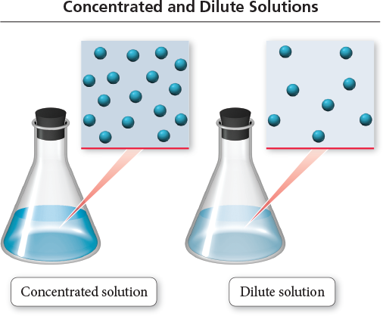
Concentration
Concentrated solutions contain large amounts of solutes dissolved in the solvent.
Dilute solutions contain small amounts of solutes dissolved in solvent.

Slide 111
Example
Which is more concentrated?

Slide 112
Concentration
On Table G, concentrated solutions are near the top and dilute solutions are near the bottom.
You can add more solvent to a solution in order to dilute the solution.
There are many ways to calculate the concentration of a solution.

Slide 113
Molarity (M)
mol of solute
L of solution
M =
Because volume is temperature dependent, molarity can change with temperature.
The equation can be found on table T.

Slide 114
Example:
A solution has a volume of 2.5 liters and contains 0.70 mol of NaCl. What is the molarity? M =
.70 mol NaCl
= 0.28M
2.5 L solution

Slide 115
Calculating Molarity and Volume
Calculate the volume needed to create a 2M solution with 3.5 moles of Li2O.
2 = 3.5 mol
X = 1.75L
x

Slide 116
Calculating Moles and Mass
Determine the moles required to create a 6.0M solution of HCl using 2.0L of solution.
6.0M = x/2.0L
X = 12 moles

Slide 117
Calculating Moles and Mass
Calculate the mass needed to create a 2.50M solution of C₆H₁₂O₆ (sugar) in 3.00L of solution.
2.50M=x/3.00L
7.50mol = x/180.0g
x = 7.50mol
x = 1350 g

Slide 118
You should be able to…
Compare concentrated and dilute solutions.
Calculate the molarity of a solution.
Calculate the mass added or volume needed to create a specific concentration of a solution.

Slide 119
Percent and Parts Per Million

Slide 120
Lesson Objectives
By the end of this video you should be able to…
Calculate the percent of a solute in solution.
Calculate the parts per million of a solute in solution.
Calculate the mass dissolved to create a specific percent or ppm.
Convert between percent and parts per million.

Slide 121
Mass Percentage
mass of solute
total mass of solution
Mass % of A =
× 100

Slide 122
Example:
What is the percent by mass of glucose if 2.8 grams of glucose is dissolved in a 100 g solution? % mass =
2.8 g glucose
x 100
= 2.8 % glucose
100 g solution

Slide 123
Calculate the mass dissolved
Calculate the mass of solute dissolved in 200.0 g of solution in order to create a 35% sugar solution.
x/200 x 100 = 35
x/200 = 35/100
x = 70.g

Slide 124
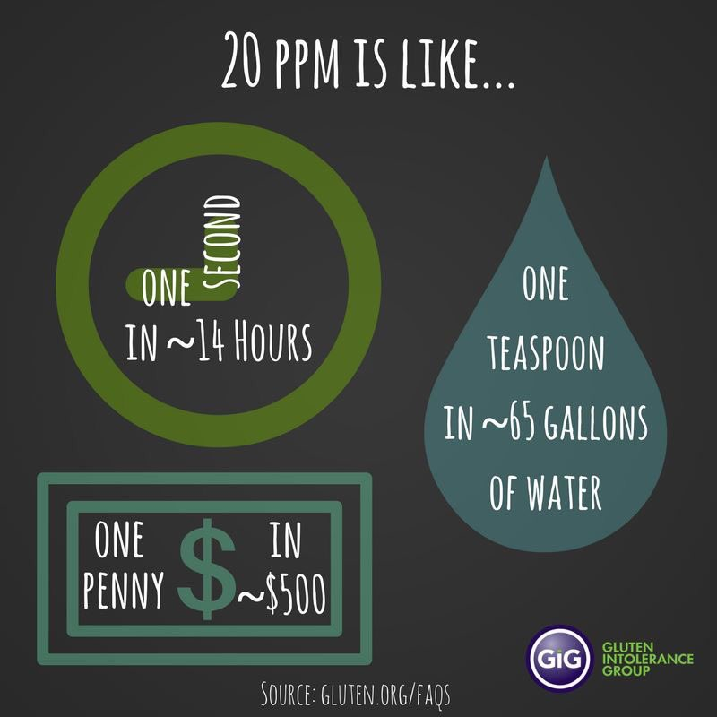
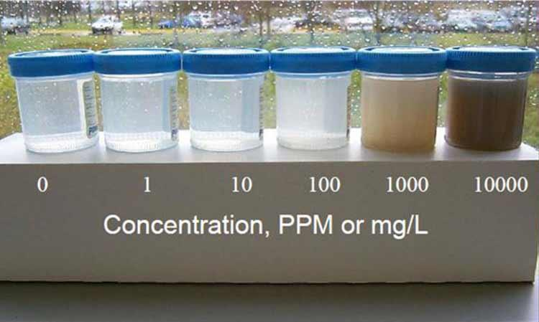
Parts per Million
ppm =
mass of A in solute
total mass of solution
× 10⁶

Slide 125
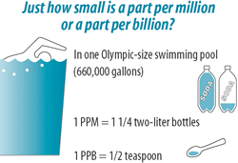
PPM

Slide 126
Example
A sample of water is found to contain 0.010 g lead in 15. g solution. What is the concentration in ppm?
ppm =
0.010g lead
x 1,000,000 =
670 ppm
15.g solution

Slide 127
Parts per Million
CO concentration over 70 ppm can cause illness. Over 150ppm can cause death.
Ocean water contains over 35000 ppm of salt.
350ppm of CO2 is considered safe. We are at 380ppm in our atmosphere. Global warming?

Slide 128
Calculate the mass dissolved
Calculate the mass of solute dissolved in 200.0 g of solution in order to create a 15ppm sugar solution.
x/200 x 10⁶ = 15
x/200 = 15/1000000
x = 0.0030g

Slide 129
You should be able to…
Calculate the percent of a solute in solution.
Calculate the parts per million of a solute in solution.
Calculate the mass dissolved to create a specific percent or ppm.
Convert between percent and parts per million.

Slide 130
Colligative Properties

Slide 131
Lesson Objectives
By the end of this video you should be able to…
Define and explain colligative properties including
Freezing point depression
Boiling point elevation
Osmotic pressure

Slide 132
Colligative Properties
Changes in colligative properties depend only on the number of solute particles present, not on the identity of the solute particles.

Slide 133
Colligative Properties of Electrolytes
Since these properties depend on the number of particles dissolved, solutions of electrolytes (which break down into ions in solution) should show greater changes than those of nonelectrolytes. But it also depends on the Molarity.

Slide 134
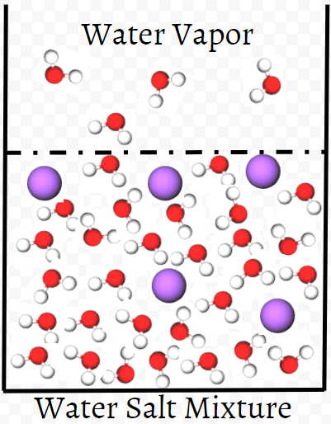
Boiling Point Elevation
Boiling Point INCREASES when solute is added Ex: Adding salt to water allows you to boil pasta at 102-103ºC

Slide 135
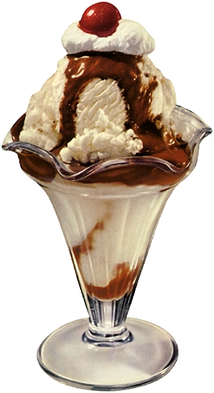
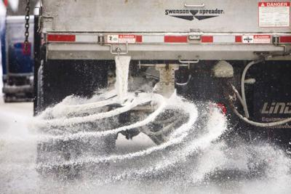
Freezing Point Depression
Freezing Point DECREASES when solute is added
Ex: Putting salt on roads causes ice to melt because it drops the freezing point below 0ºC.

Slide 136
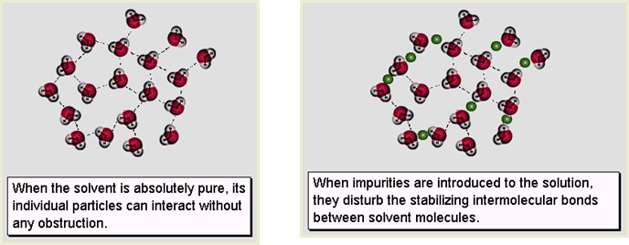
Freezing Point Depression

Slide 137
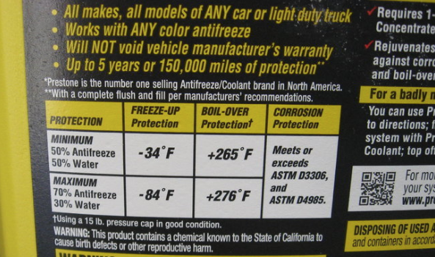
Applications
Salting Icy roads Making ice cream Antifreeze in vehicles

Slide 138
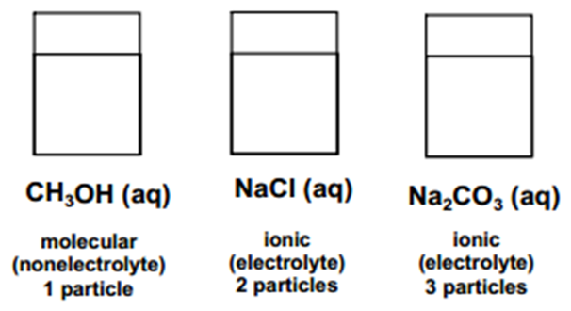
The more particles the greater the effect on BP & FP
Increasing effect on BP & FP

Slide 139
Example:
What occurs when NaCl(s) is added to water
The boiling point of the solution increases, and the freezing point of the solution decreases.
The boiling point of the solution increases, and the freezing point of the solution increases.
The boiling point of the solution decreases, and the freezing point of the solution decreases.
The boiling point of the solution decreases, and the freezing point of the solution increases.

Slide 140
Example:
Compared to a 2.0 M aqueous solution of NaCl a 3.0 M aqueous solution of NaCl has a (1) lower boiling point and a higher freezing point (2) lower boiling point and a lower freezing point (3) higher boiling point and a higher freezing point (4) higher boiling point and a lower freezing point

Slide 141
Examples
Which compound when dissolved in water, will have the highest boiling point?
CaCl₂
NaI
C₆H₁₂
Which compound when dissolved in water, will have the lowest freezing point?
1M NaOH
2M NH₃
0.5M Mg₃N₂

Slide 142
Osmosis
Some substances form semipermeable membranes, allowing some smaller particles to pass through, but blocking other larger particles.
In biological systems, most semipermeable membranes allow water to pass through, but solutes are not free to do so.

Slide 143
Osmosis
In osmosis, there is net movement of solvent from the area of higher solvent concentration to the are of lower solvent concentration.

Slide 144
Osmosis in Blood Cells
If the solute concentration outside the cell is greater than that inside the cell water will flow out of the cell.

Slide 145
Osmosis in Cells
If the solute concentration outside the cell is less than that inside the cell, water will flow into the cell.

Slide 146
You should be able to…
Define and explain colligative properties including
Freezing point depression
Boiling point elevation
Osmotic pressure

Slide 147
Double Replacement Reactions

Slide 148
Lesson Objectives:
Complete double replacement reactions to determine if the product is soluble or insoluble (forms a precipitate) using Table F.

Slide 149
Double Replacement Reactions
2 aqueous IONIC compounds mixed together the reactants switch partners
1 product must form a precipitate (insoluble solid) for reaction to take place
Table F tells you whether products are soluble or insoluble
Pb(NO₃)_{2 (aq)} + NaBr_{(aq)} → PbBr_{(s)} + NaNO_{3 (aq)}

Slide 150
Example:
Pb(NO₃)_{2 (aq)} + 2NaBr_{(aq)} → PbBr_{(s)} + 2NaNO_{3 (aq)}

Slide 151
Completing a Double Replacement Rxn
Positive ions switch partners
Look up the charges of each ion in the new products and determine the subscripts (compound must = zero)

Slide 152
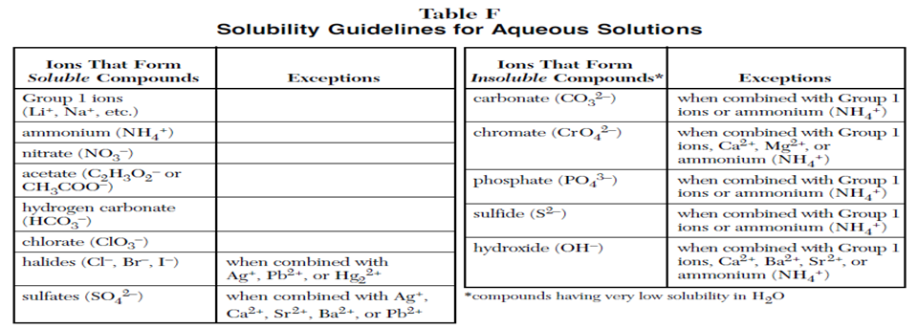
Completing a Double Replacement Rxn
Use table F to determine which (if any) product forms a precipitate.

Slide 153
Example:
Complete the following double replacement rx and determine the insoluble product: AgCl_{(aq)} + Na₂SO_{4 (aq)} →
Ag⁺¹
Cl⁻¹
2Na⁺¹
SO₄⁻²
Ag⁺¹
SO₄⁻²
Na⁺¹
→
⁺
NO₃ ⁻¹
²
(s)
(aq)

Slide 154
Example:
Complete the following double replacement rx and determine the insoluble product: CaBr_{2(aq)} + MgCO_{3(aq)} →
Ca⁺²
Br⁻¹
Mg⁺²
CO₃⁻²
Ca⁺²
→
CO₃⁻²
⁺
Mg⁺²
Br ⁻¹
(s)
²
(aq)

Slide 155
Example:
Complete the following double replacement rx and determine the insoluble product: NaNO_{3(aq)} + AlPO_{4(aq)} →
Na⁺¹
NO₃⁻¹
Al⁺³
PO₄⁻³
Na⁺¹
PO₄⁻³
Al⁺³
NO₃ ⁻¹
→
⁺
⁽
⁾
³
(aq)
³
(aq)

Slide 156
You should be able to…
Complete double replacement reactions to determine if the product is soluble or insoluble (forms a precipitate) using Table F.

Slide 157
Real world Net ionic Equations (that don’t really come up on the Regents Exam)
Ca(NO₃)₂ + LiOH 🡪
KNO₃ + NaC₂H₃O₂ 🡪
CaCrO₄ + Al₂(SO₄)₃ 🡪

