Slide 1
ORGANIC CHEMISTRY

Slide 2
Introduction to
Organic Chemistry

Slide 3
Lesson Objectives:
Identify the properties of organic compounds
Identify hydrocarbons based upon their formulas
Name Hydrocarbons using table P and Q
Determine if a compound is saturated or unsaturated

Slide 4
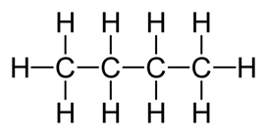
Organic Chemistry
Organic Compound: Contains CARBON
Hydrocarbon: Conatins CARBON and HYDROGEN Major sources of organic compounds are: petroleum, coal, wood, plants, & animals

Slide 5
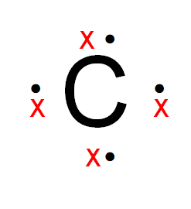
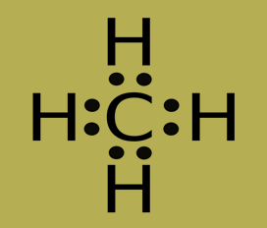
Properties of Carbon
Carbon has 4 valence electrons therefore it will bond four times to achieve an octet.

Slide 6
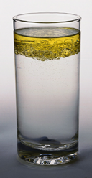
Properties of Organic Compounds
Generally NONPOLAR
INSOLUBLE in Water (like dissolves like)
SOLUBLE in Nonpolar substances
POOR Conductors of Electricity (non electrolytes) because they do not form ions
React slowly due to covalent bonds.

Slide 7
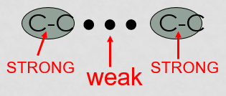
Properties of Organic Compounds
4. Have LOW melting points due to WEAK INTERMOLECULAR FORCES of attraction
5. Combustible (flammable)

Slide 8
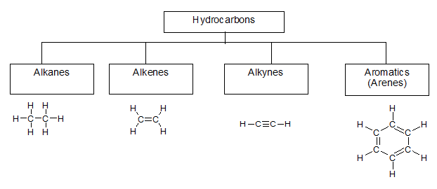
Hydrocarbons
Organic compounds that ONLY contain CARBON and HYDROGEN

Slide 9
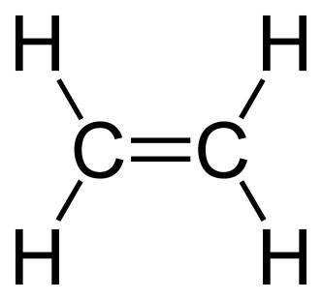
Organic molecules
Sometimes double and triple bond will be needed to fulfill all octets.
A double bond shares four electrons.
A triple bond shares six electrons.

Slide 10
Organic Molecules
All single bonded hydrocarbons are in the same family known as alkanes.
All double bonded hydrocarbons are in the same family known as alkenes.
All triple bonded hydrocarbons are in the same family known as alkynes.
Refer to table Q

Slide 11
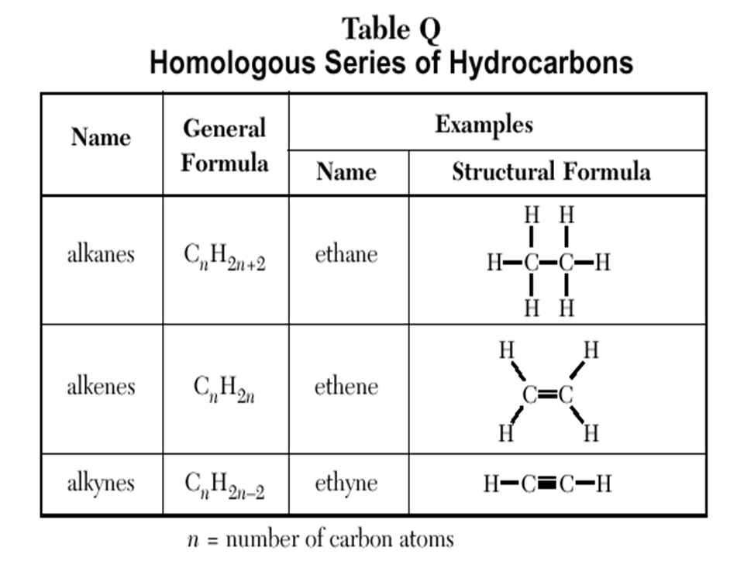
Homologous Series
Group of organic compounds with similar properties and structures
TABLE Q gives the general formula and examples (name and structure)

Slide 12
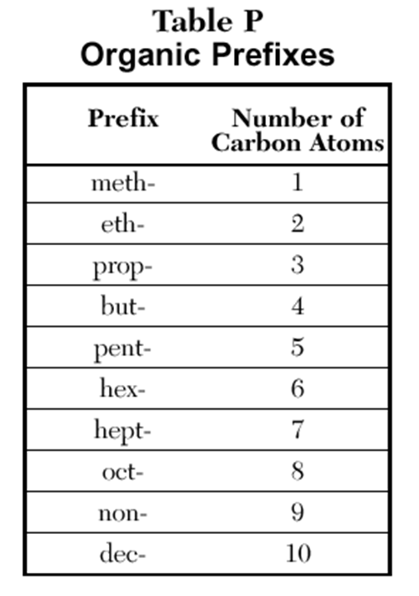
Prefixes
Table P shows prefixes to determine how many Carbon atoms a compound has.

Slide 13
Example: Give the prefix for the following:
C₂H₆
C₃H₆
C₄H₆
C₅H₁₂
eth
C₆H₁₂
C₇H₁₄
C₈H₁₈
C₉H₁₆
hex
prop
hept
but
oct
pent
non

Slide 14
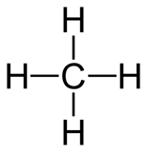
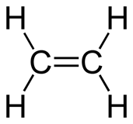
Naming Hydrocarbons
Putting P and Q together we can name simple hydrocarbons:
meth
ane
eth
ene

Slide 15
Naming Hydrocarbons
Putting P and Q together we can name simple hydrocarbons:
eth
yne
but
ane

Slide 16
Determining type of Hydrocarbon
Count up the number of carbons
If the # of Hydrogen are double the # of carbons its an alkene
If more than double its an alkane, less than double its an alkyne
Example: C₅H₁₂
(12 is more than double
5 so its an alkane)

Slide 17
Example: Naming Hydrocarbons
C₂H₆
C₅H₁₂
C₃H₆
C₄H₆
eth
ane
pent
ane
prop
ene
but
yne

Slide 18
Saturation
Compounds like fats that are saturated have many hydrogen atoms. This requires Single bonds. Alkanes are Saturated with single bonds.

Slide 19
Saturation
Compounds that are unsaturated have double and triple bonds, therefore, they have less hydrogen atoms. Alkenes and alkynes are unsaturated.

Slide 20
Identify the properties of organic compounds
Identify hydrocarbons based upon their formulas
Name Hydrocarbons using table P and Q
Determine if a compound is saturated or unsaturated

Slide 21
Structural Formulas

Slide 22
Lesson Objectives:
Differentiate between the structural formulas of alkanes, alkenes and alkynes
Construct structural formulas of alkanes, alkenes, and alkynes

Slide 23
Types of Formulas
Molecular Formula: shows the # OF ATOMS of each ELEMENT in a compound; least informative formula
C₂H₆

Slide 24
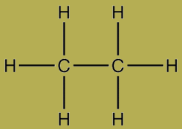
Types of Formulas
Structural Formula: diagram of the molecular structure of compound
Condensed Structural Formula: each carbon is written separately followed by atoms bonded to it.
CH₃CH₃

Slide 25
Example: Formulas for Methane
CH₄
Molecular:
Structural:
Condensed:
H
H
C
H
H
CH₄

Slide 26
Example: Formulas for Ethane
Molecular:
Structural:
Condensed:
C₂H₆
H
H
H
C
C
H
H
H
CH₃CH₃

Slide 27
Drawing Structural Formulas of Alkenes
Same as Alkanes except….
If there are more than 3 carbons you need to give the location of DOUBLE BOND
Always START numbering the carbons at the end CLOSEST to the double bond to give the bond the lowest # (molecules can be read in either direction)

Slide 28
Example: Ethene
Molecular:
Structural:
Condensed:
C₂H₄
H
H
C
C
H
H
CH₂CH₂

Slide 29
Example: propene
Molecular:
Structural:
Condensed:
C₃H₆
H
H
H
C
C
C
H
H
H
CH₂CHCH₃

Slide 30
Example: 1-butene
Molecular:
Structural:
Condensed:
C₄H₈
H
H
H
H
C
C
C
C
H
H
H
H
CH₂CHCH₂CH₃

Slide 31
Example: 2-butene
Molecular:
Structural:
Condensed:
C₄H₈
H
H
H
H
H
C
C
C
C
H
H
H
CH₃CHCHCH₃

Slide 32
Drawing Structural Formulas of Alkynes
Same as alkenes except you add a TRIPLE BOND

Slide 33
Example: 1-butyne
Molecular:
Structural:
Condensed:
C₄H₆
H
H
H
C
C
C
C
H
H
H
CHCCH₂CH₃

Slide 34
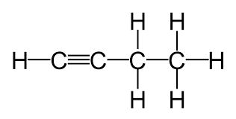
Example: 2-butyne
Molecular:
Structural:
Condensed:
C₄H₆
H
H
H
C
C
C
C
H
H
H
CH₃CCCH₃

Slide 35
Differentiate between the structural formulas of alkanes, alkenes and alkynes
Construct structural formulas of alkanes, alkenes, and alkynes

Slide 36
Branched Hydrocarbons

Slide 37
Lesson Objectives
Determine the name of branched hydrocarbons

Slide 38
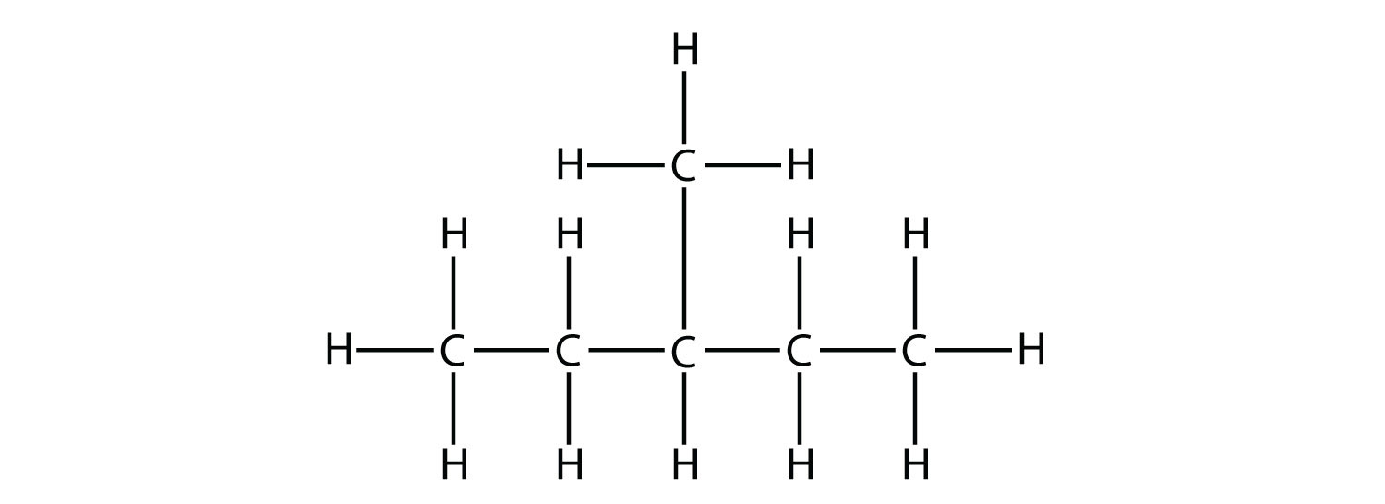
Branched Hydrocarbons

Slide 39
Naming Branched Alkanes
When naming branched alkanes, name the longest chain of CARBONS and use that as the ‘last name.’
Name the shorter chains (ALKYL GROUP), specifying the position of each branch.
Make sure that your branches are numbered as low as possible.

Slide 40
Locate the Parent Chain of C’s
These are all just butane!!!

Slide 41
NAMING ALKYL GROUPS (BRANCHES)
Count # of carbons in alkyl group (branch)
Use prefix (TABLE P)
Add Suffix “yl” to prefix
Ex. –CH₃ (Methyl)

Slide 42
Example: Branched Alkane
CH3 - CH2 - CH2 – CH – CH₂ – CH - CH3
CH2
CH3
CH3
Step 1: Find the longest continuous chain of carbons (parent chain)
heptane
There are 7 continuous carbons, so the parent chain is

Slide 43
Example: Branched Alkane
7
6
5
4
3
2
1
CH3 - CH2 - CH2 – CH – CH₂ – CH - CH3
CH2
CH3
CH3
Step 2: Number the carbons in parent chain starting with the end that will give the attached groups the smallest #.
The chain is numbered from right to left giving the attached groups the lowest #

Slide 44
Example: Branched Alkane
7
6
5
4
3
2
1
CH3 - CH2 - CH2 – CH – CH₂ – CH - CH3
CH2
CH3
CH3
Step 3 : Add numbers to the names of the groups to identify their positions on the chain.
heptane
2
- methyl - ethyl
4
In this example the positions are:

Slide 45
Example: Branched Alkane
7
6
5
4
3
2
1
CH3 - CH2 - CH2 – CH – CH₂ – CH - CH3
CH2
CH3
CH3
Step 4: List the alkyl groups in alphabetical order.
4-ethyl 2-methyl
heptane

Slide 46
Example: Branched Alkane
7
6
5
4
3
2
1
CH3 - CH2 - CH2 – CH – CH₂ – CH - CH3
CH2
CH3
CH3
Step 5: Use punctuation
Commas separate numbers
Hyphens separate numbers and words.
4-ethyl, 2-methyl
heptane

Slide 47
Example: Branched Alkane
6
5
4
3
2
1
Step 1: 6 carbons = hex with single bonds -ane
Step 2: number right to left

Slide 48
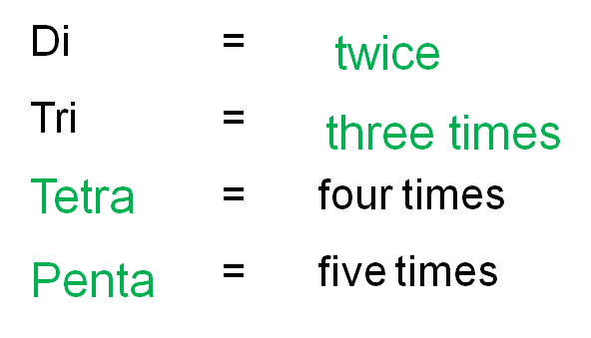
Example: Branched Alkane
6
5
4
3
2
1
Step 3: 2 methyl and 4 methyl
2,4-dimethyl
Step 5: 2,4- dimethyl hexane

Slide 49
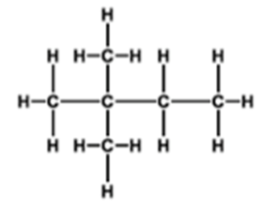
Example:
2,2 -
dimethyl
butane
1
2
3
4

Slide 50
Cyclic hydrocarbons
To name them, use the prefix “cyclo”:
A four member ring is cyclobutane
A five member ring is cyclopentane
A six member ring in cyclohexane

Slide 51
Name
cyclopentyne
1,3-cyclohexadiene
1, 3, 5-cyclooctatriene

Slide 52
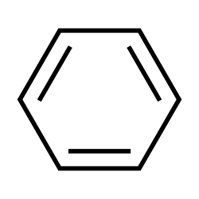
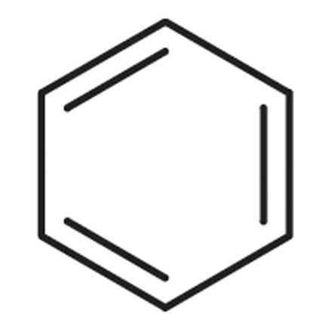
Benzene
An important aromatic hydrocarbon is benzene.
It has alternating double and single bonds.
It is very stable and gives off pleasant odors like cinnamon and vanilla. (“aroma”)

Slide 53
Determine the name of branched hydrocarbons

Slide 54
Isomers

Slide 55
Lesson Objectives:
Identify isomers of alkanes, alkenes and alkynes
Construct isomers of alkanes, alkenes and alkynes

Slide 56
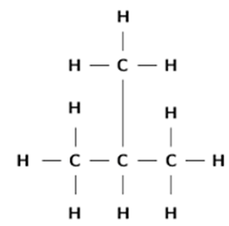
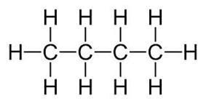
Isomers of Alkanes
Isomers have the same molecular formula but rearranged in a different structure with different properties.
Example: Both C₄H₁₀

Slide 57
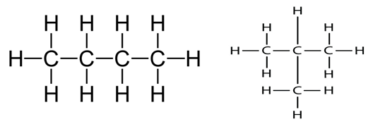
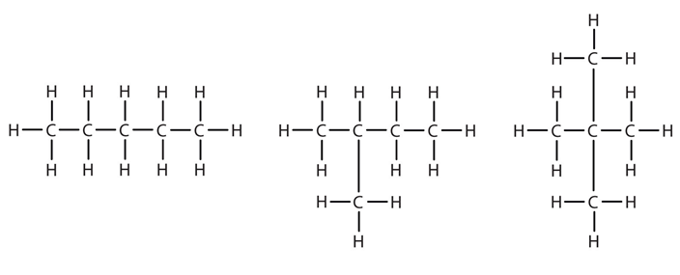
Match the Isomers
C₄H₁₀
C₅H₁₂

Slide 58
Drawing an Isomer of An Alkane
Use same molecular formula
Draw a different structural formula
(if name of compound is different but it has the same molecular formula it is an isomer)

Slide 59
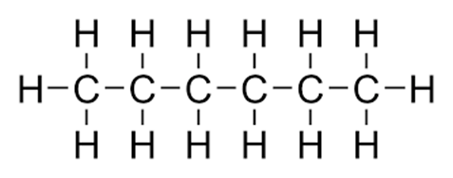
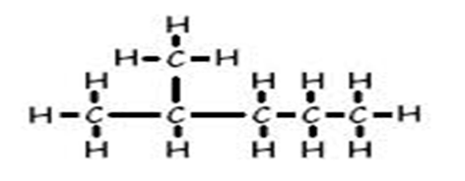
Example: Isomer of hexane
C₆H₁₄

Slide 60
Isomers of Alkenes/Alkynes
Double or Triple bond in different locations Example: Isomers of butene
C₄H₈

Slide 61
Drawing an isomer of an alkene/alkyne
Use same molecular formula
Move the location of the double or triple bond
****Be careful not to move it into the same position. Remember you can read compounds left to right or right to left.

Slide 62
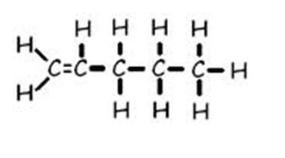
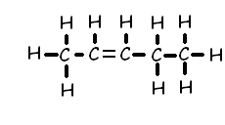
Example: Draw an isomer of 1-pentene
C₅H₁₂

Slide 63
Identify isomers of alkanes, alkenes and alkynes
Construct isomers of alkanes, alkenes and alkynes

Slide 64
functional Groups

Slide 65
Lesson Objectives:
Identify functional groups
Name substituted hydrocarbons

Slide 66
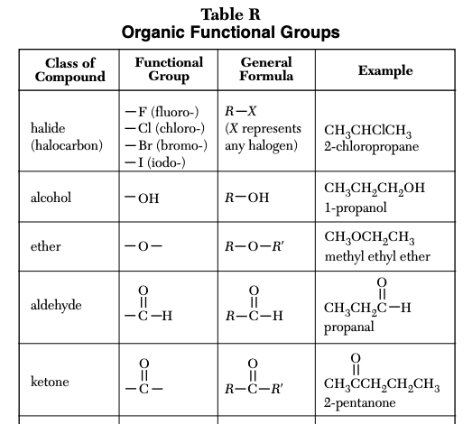

Slide 67
To Name or Draw substituted Hydrocarbons use Table R:
Use the example given in table R and compare to your problem.
Locate the class of compound and see how it is named or drawn in the example:
Use it as a model to draw or name your problem

Slide 68
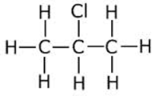
Halides
Have one or more of the halogens as a branched group.
Name chain
Add halogen prefix
# location of halogen
1
2
3

Slide 69
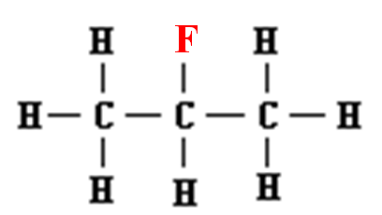
Example:
2-fluoropropane

Slide 70
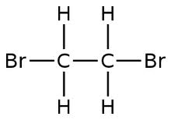
Example:
If more than one of the same halogen use di, tri etc.
1
2
1,2- dibromoethane

Slide 71
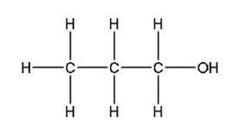
Alcohol
Functional group (OH)
Name chain
Suffix ol
# location of OH
Fammable
soluble

Slide 72
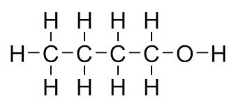
Example:
1-butanol

Slide 73
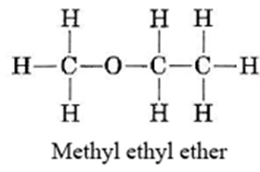
Ether
Name each chain then place in alpha order (*this is an exception)
suffix: -ether
Anestethic
Mostly soluble

Slide 74
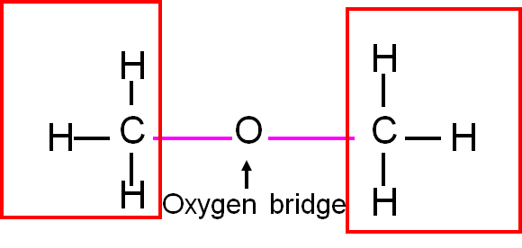
Example:
dimethyl ether

Slide 75
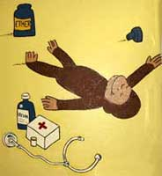
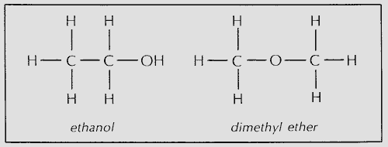
Alcohol and ethers
Alcohols and ethers may be isomers if they have the same number of carbon atoms.

Slide 76
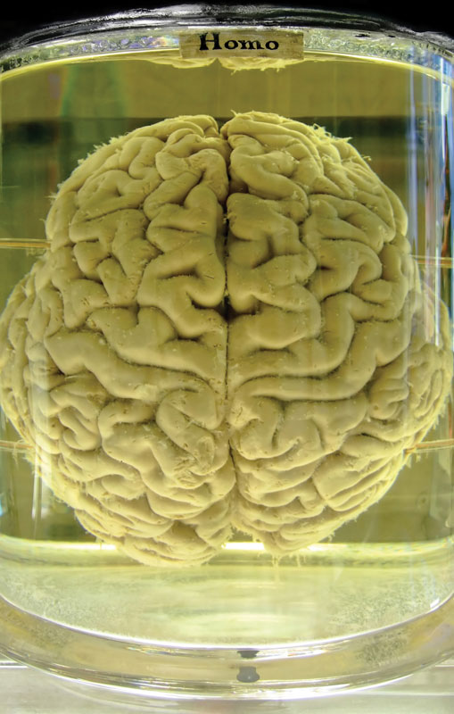
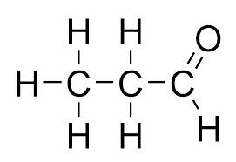
Aldehyde
Name chain
Suffix: al
Soluble
reactive

Slide 77
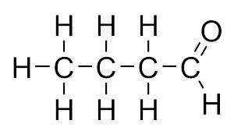
Example:
butanal

Slide 78
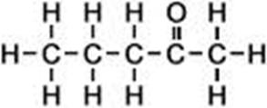
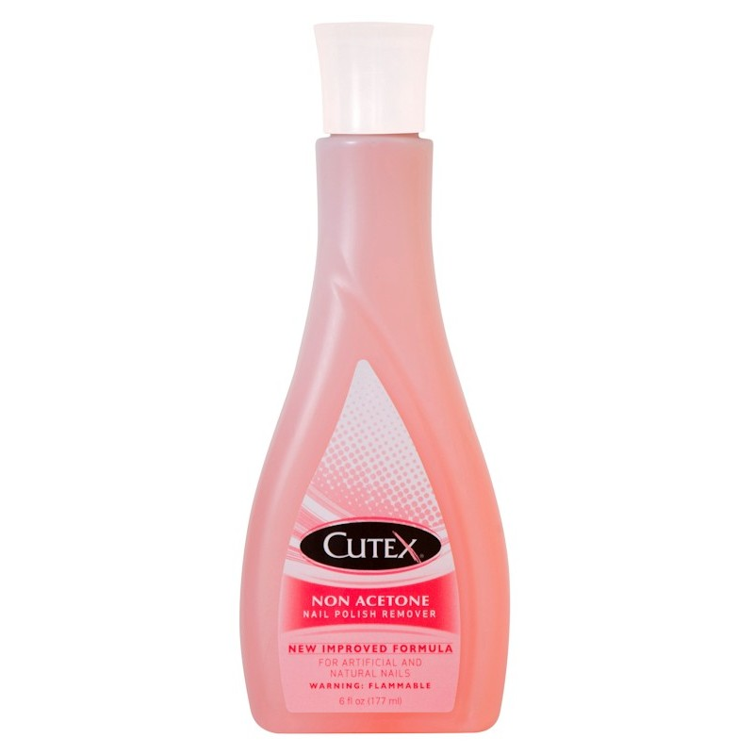
Ketone
Name parent chain
Suffix: -one
# location of functional group

Slide 79
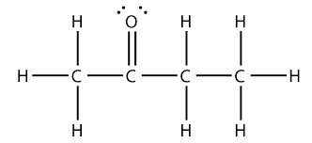
Example:
2-butanone

Slide 80
Aldehydes and ketones
Aldehydes and ketones may be isomers if they have the same number of carbon atoms.

Slide 81
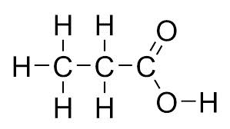
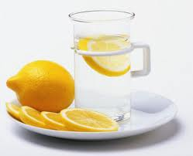
Organic acids
Name parent chain
Drop ending and add -oic acid
Weak acids, soluble, weak electrolytes

Slide 82
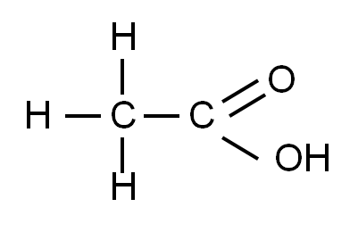
Example:
Ethanoic acid

Slide 83
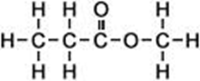
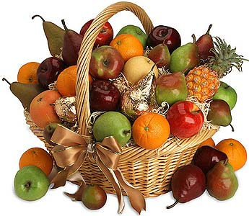
Ester
Name chain bonded to O first
Name chain with double bond =O last
Suffix: -oate
Smells great!

Slide 84
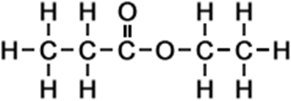
Example:
Ethyl propanoate

Slide 85
Acids and Esters
Acids and Esters may be isomers if they have the same number of carbon atoms.
C₃H₆O₂

Slide 86
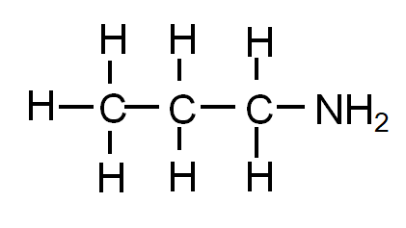
Amines
Name chain
Suffix: amine
Basic, found in DNA

Slide 87
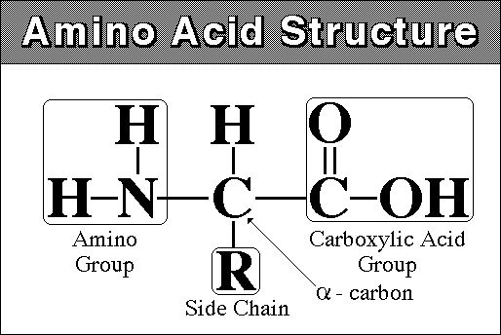
Amino acids

Slide 88
Example:
ethanamine

Slide 89
Amides
Different than amines due to double bonded =O
Name parent chain
Suffix: amide
Use in dyes

Slide 90
Example:
butanamide

Slide 91
Identify functional groups
Name substituted hydrocarbons

Slide 92
Organic reactions

Slide 93
Lesson Objectives:
Identify the type of reactions
Determine the product of substitution and addition reactions

Slide 94
Combustion
Organic Compound is burned in the presence of oxygen to produce CO₂ and H₂O
O₂ is always a REACTANT!

Slide 95
Table I

Slide 96
Substitution
Similar to single replacement: two atoms switch
First compound is saturated (single bonds)
One H is switched with one Halogen (group 17). CH₄ + Cl₂ → CH₃Cl + HCl

Slide 97
Example:

Slide 98
Addition
Double or Triple Bond is broken and two or more atoms are added
Molecule must be unsaturated C₂H₄ + Br₂ → C₂H₄Br₂

Slide 99
Example:
H
H
H
H
C
C
F₂
→
F
C
C
F
H
H
H
H

Slide 100
Esterification
Forms esters (smells) Identify ester as product (Use TABLE R)

Slide 101
Esters

Slide 102
Fermentation
Enzymatic breakdown of sugar into alcohol (ethanol) and CO₂
Identify Alcohol and CO₂ as product C₆H₁₂O₆ → 2C₂H₅OH + 2CO₂

Slide 103
Saponification
Hydrolysis of fats using a base Produces soap and glycerol (alcohol) Identify soap as product and base as reactant

Slide 104
Polymers
Long Carbon chains
(C₂H₄)_{n}
Used in all plastics, rubber, nylons…

Slide 105
Polymerization
Formation of long-chain molecules (polymers) from small repeating subunits (monomers)
Can be natural (proteins) or artificial (plastics)
starch – long chains of sugars
proteins – long chains of amino acids
cellulose – made of repeating units of sugar

Slide 106
Polymerization

Slide 107
Addition Polymerization
Adding small alkenes together by breaking the double bond, to create a large chain.
Identify by “n” which represents a large number

Slide 108
Condensation Polymerization
Adding acids and alcohols by extracting water.

Slide 109
Cracking
Breaking large hydrocarbons into smaller chains by heating them.
Fossil fuels are cracked into many components such as octane (gasoline) propane, etc.

Slide 110
Cracking

Slide 111
Identify the type of reactions
Determine the product of substitution and addition reactions

Slide 112
Functional Group Activity
Read through infographic
Identify any and all functional groups: circle and identify the type
Identify 2 additional interesting facts
Choose a reporter to explain the functional groups and interesting facts to the class

