Slide 1
PARTICLES AND MOVEMENT

Slide 2
Measuring Pressure of a gas

Slide 3
Objectives
Read a manometer to calculate the pressure of a gas.
Convert between units of pressure

Slide 4
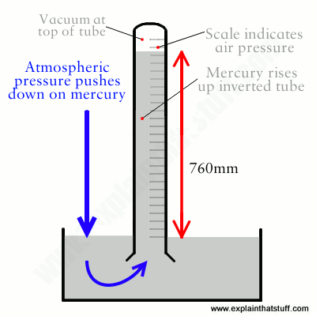
Atmospheric Pressure
atm = atmospheric pressure
Measured with a barometer
Dependant on collisions of the air with the mercury in the container
1 atmosphere = 760 mmHg

Slide 5
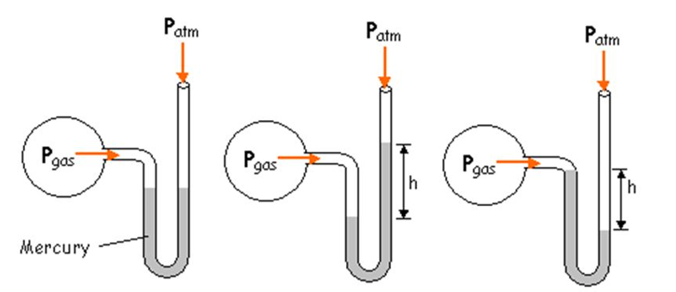
Manometer
Pressure gauges use height differences to calculate pressure.

Slide 6
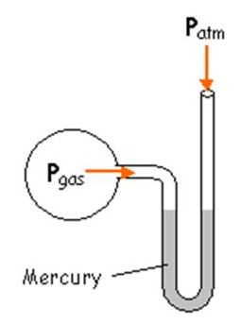
Manometer
Equal pressures → equal heights
atm stands for atmospheric pressure

Slide 7
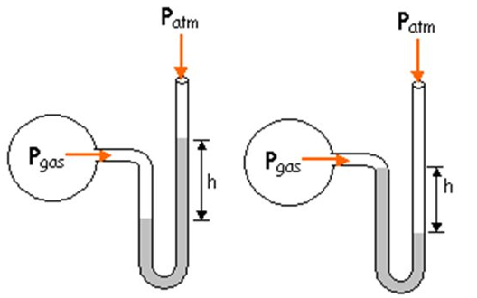
Manometer
Different pressure → different heights

Slide 8
Example:
If atmospheric pressure is 760.0mm Hg and the height of the manometer is 36.0mmHg, what is the pressure of the gas?
760.0 + 36.0 = 796.0 mmHg

Slide 9
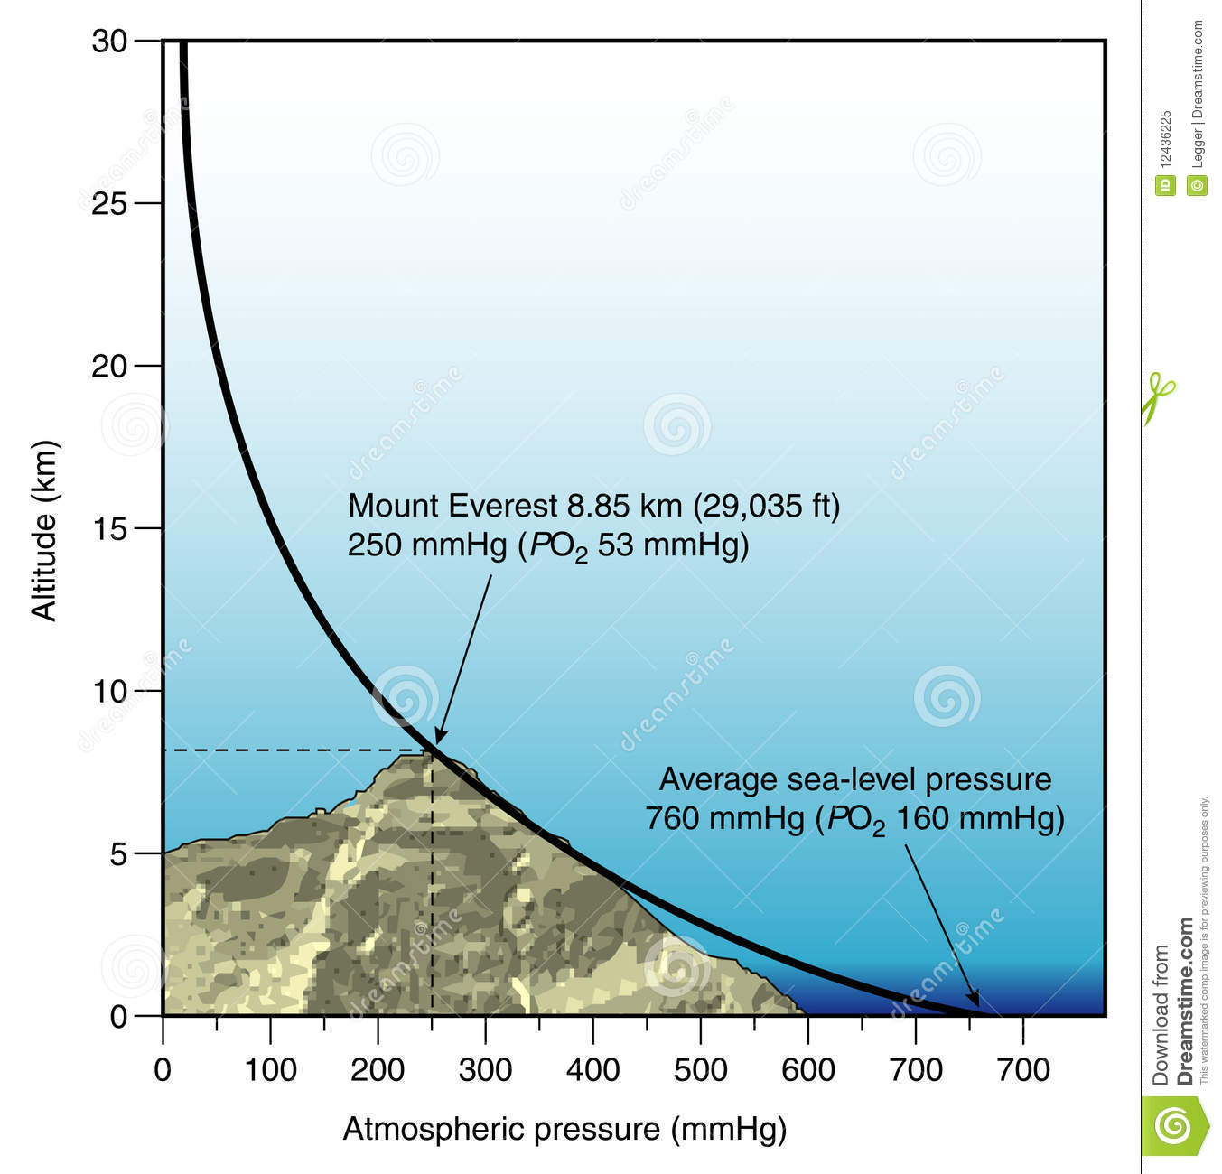
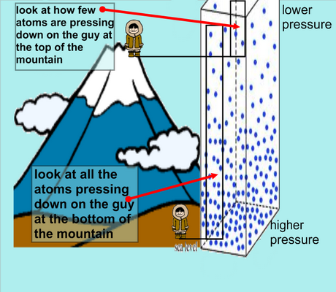
Differences in atmospheric pressure

Slide 10
Example: I do
Convert pressure measurements from one system of units to another. How many atm is equal to 200. mmHg?
1 atm =
760 mmHg
X = 0.26 atm
X atm
200. mmHg

Slide 11
Example: We do
Convert pressure measurements from one system of units to another. How many atm is equal to 400. mmHg?
1 atm =
760 mmHg
X = 0.53 atm
X atm
400. mmHg

Slide 12
Example: You do
Convert pressure measurements from one system of units to another. How many atm is equal to 900. mmHg?
1 atm =
760 mmHg
X = 1.2 atm
X atm
900. mmHg

Slide 13
You should be able to...
Read a manometer to calculate the pressure of a gas.
Convert between units of pressure

Slide 14
Kinetic Molecular Theory

Slide 15
Lesson Objectives:
Differentiate between ideal and real gases

Slide 16
Kinetic Molecular Theory of Gases:
Scientists construct models to explain the behavior of substances
A study of behavior of gases has led to a model called the kinetic molecular theory of gases (KMT)
Describes the relationships among pressure, volume, temperature, velocity, frequency and force of collisions

Slide 17
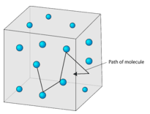
Assumptions of the KMT:
Gases are composed of a large number of particles that are in constant, random, straight line motion, until they collide with another particle or the walls of a container
The volume of a gas is negligible (zero) because the particles are much smaller than the distance between them so most of the volume of a gas is therefore empty space.

Slide 18
Assumptions of the KMT:
There is no force of attraction between gas particles or between the particles and the walls of the container.
Collisions between gas particles or collisions with the walls of the container are perfectly elastic. None of the energy of a gas particle is lost during a collision.

Slide 19
KMT
Remember, the kinetic theory of gases is theoretical and describes the “ideal” behavior of a gas. No “real” gas behaves exactly like this theoretical model.

Slide 20
Real Gases
In real gases, the following factors contribute to the deviations from the ideal model: 1. Real gases have a small but significant volume. 2. Gas particles do exert some attractive force on each other.

Slide 21
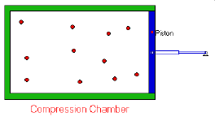
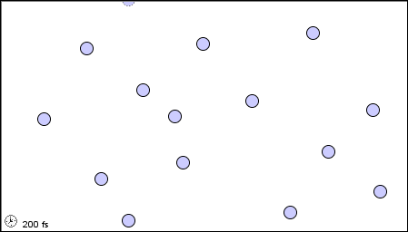
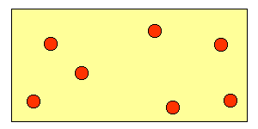
Gases behave most IDEALLY under conditions of:
HIGH temperature and LOW pressure BECAUSE:
particles are moving faster
particles are farther apart
}
Why? Less chance of gas particles attracting each other

Slide 22
Gases deviate (stray) from ideal under conditions of:
Low temperature and High pressure BECAUSE:
particles are moving slower
particles are closer together
}
Why? Gas particles can more easily attract each other

Slide 23
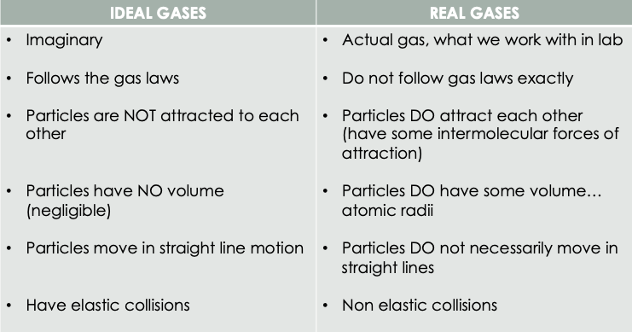
Summary of Ideal vs Real Gases

Slide 24
Example:
Under which conditions of temperature and pressure would a gas behave most like an ideal gas? A) 50 K and 20 kPa B) 50 K and 600 kPa C) 750 K and 20 kPa D) 750 K and 600 kPa
C) 750 K and 20 kPa

Slide 25
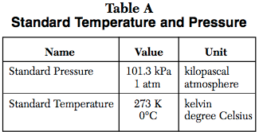
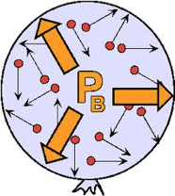
Gas Pressure
Force exerted on container walls by particles in a gas Units we use: kPa, atm
STP (Standard Temperature and Pressure) refer to Table A

Slide 26
Example:
An assumption of the kinetic theory of gases is that the particles of a gas have
little attraction for each other and a significant volume
little attraction for each other and an insignificant volume
strong attraction for each other and a significant volume
strong attraction for each other and an insignificant volume

Slide 27
Differentiate between ideal and real gases

Slide 28
Pressure, Temperature, volume Of a Gas

Slide 29
Objectives:
Determine the relationships between temperature, pressure and volume
Calculate changes in pressure, temperature and volume

Slide 30
Recap of what we know so far...
When pressure increases volume decreases
Inverse relationship
P V = P V
(1)(2) = (2)(1)
NOT:
P = P
V V
1 = 2
2 1

Slide 31
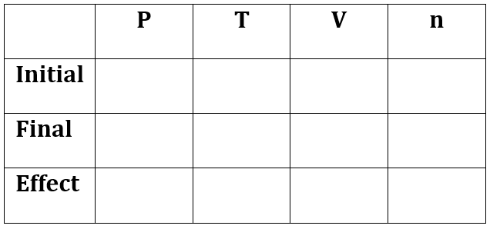
Example: I do
What would be the new pressure of 350 cm³ of gas at standard pressure is compressed
to a volume of 250 cm³ ? (n and T = constant)
P/V is an inverse relationship
PV = PV
1.0 atm
-------
350 cm³
------
1 (350) = x (250)
?
-------
250 cm³
-------
250 250
-------
-------
X = 1.4 atm

Slide 32
Example: We do
What would be the new pressure of 100. cm³ of gas at 1.5 atm is expanded
to a volume of 400. cm³ ? (n and T = constant)
P/V is an inverse relationship
PV = PV
1.5 atm
-------
100. cm³
-------
1.5 (100.) = x (400.)
?
-------
400. cm³
-------
400. 400.
-------
-------
X = .38 atm

Slide 33
Example: You do
What would be the new pressure of 50. cm³ of gas at 4.0 atm is expanded
to a volume of 200. cm³ ? (n and T = constant)
P/V is an inverse relationship
PV = PV
4.0 atm
-------
50. cm³
-------
4.0 (50.) = x (200.)
?
-------
200. cm³
-------
200. 200.
-------
-------
X = 1.0 atm

Slide 34
Recap of what we know so far...
When temperature increases pressure increases
When temperature increases volume increases
Direct relationship
P = P
1
2
V
V
=
=
T
T
2
4
T
T

Slide 35
Example: I do
A sample of gas occupies 200. mL at 25 ˚C. What is its volume when the temperature is increased to 70.˚C? (P and n = constant)
V/T is a direct relationship
V =
V
-------
25. C
200. mL
-------
T
T
-------
70. C
?
-------
200. = x
(25 +273) (70+273)
-------
-------
X = 230 mL

Slide 36
Example: We do
The pressure in a car tire is 45 psi at 25˚C. When the temperature changes to 3.0˚C what is the new pressure in the tire? (V and n = constant)
P/T is a direct relationship
P =
P
45 psi
25. C
-------
-------
T
T
?
3.0 C
-------
-------
45 = x
(25+273) (273+3.0)
-------
-------
X = 41.7 psi

Slide 37
Example: You do
A sample of gas occupies 150. mL at 45 ˚C. What is its volume when the temperature is decreased to 15˚C? (P and n = constant)
V/T is a direct relationship
P =
P
-------
45. C
150 mL
-------
T
T
-------
15. C
-------
150. = x
?
(273+45) (273+15)
-------
-------
X = 140 mL

Slide 38
You should be able to:
Determine the relationships between temperature, pressure and volume
Calculate changes in pressure, temperature and volume

Slide 39
Combined Gas Law

Slide 40
Lesson Objectives:
Convert between units of temperature & pressure
Determine the relationship between temperature, volume and pressure

Slide 41
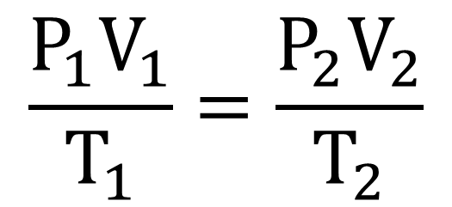
Combined Gas Law
Located on Table T:
P = pressure (kPa or atm) V = volume (L, mL, cm³) T = temperature (K)

Slide 42
Important!!!!
Temperature Must be in KELVIN to avoid negative values
Use the same units for BOTH volumes and BOTH pressures
If one variable remains the same (constant) or not mentioned, leave it out of the equation

Slide 43
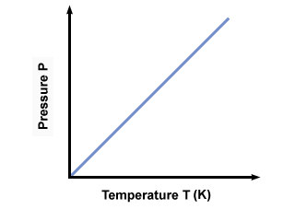
Example: I do
A gas in a rigid container has a pressure of 3.5 atm at 200. K. Calculate the pressure at 273K.
3.5 atm
=
x atm
200. K
273 K
P₂ = 4.8 atm
200. (x) = (3.5)(273)
200.
200.

Slide 44
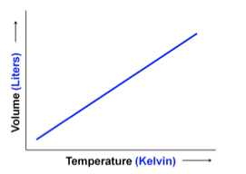
Example: We do
A 32.9 L sample of a gas at constant pressure increases in temperature from 25C to 45C. Should the volume increase or decrease? Calculate the new volume.
32.9 L
=
x L
298. K
318 K
298 (x) = (32.9)(318)
V₂ = 35.1 L
298
298

Slide 45
Example: You do
A 45 mL sample of gas at standard pressure is heated from 20.°C to 50.°C. The pressure of the gas increases to 107.9 kPa. What is the new volume of the gas?
(101.3 kPa)(45mL)
(107.9 kPa)(x mL)
=
293 K
323 K
V₂ = 47 mL

Slide 46
Convert between units of temperature & pressure
Determine the relationship between temperature, volume and pressure

Slide 47
Other Gas Laws

Slide 48
Lesson Objectives:
Determine the number of particles of a substance using Avogadro's Law
Identify the diffusion of gases
Determine the partial pressure of gases in a gaseous mixture

Slide 49
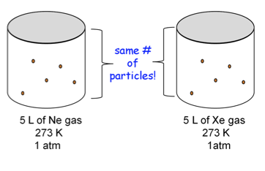
Avogadro's Law
Two different gases as the same temperature, volume, and pressure have the same number of particles.

Slide 50
Example:
At the same temperature and pressure, which sample contains the same number of particles as 1 liter of O₂ (g)? (a) 1 L Ne (g) (b) 0.5 L SO₂ (g) (c) 2 L O₂ (g) (d) 7 L of H₂O (l)
1 L Ne (g)

Slide 51
Check Your Understanding:
Determine the number of particles of a substance using Avogadro's Law

Slide 52
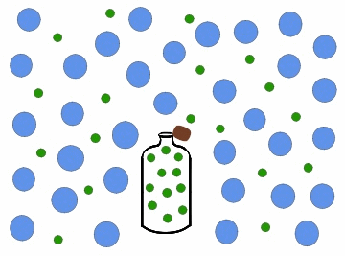
Graham’s Law of Diffusion
Gases move from high to low concentrations.

Slide 53
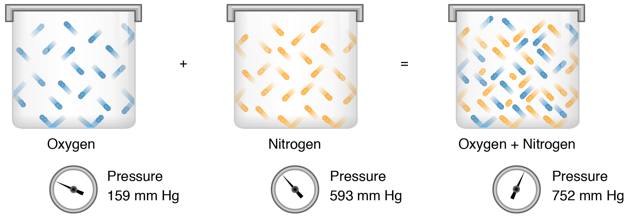
Dalton’s Law of Partial Pressures
The total pressure in a system of gases equals the pressure of each individual gas combined.

Slide 54
Example:
If the total pressure of a container of gases is 3 atm and it contains 1 atm of oxygen, 0.5 atm of nitrogen, 0.75 atm of methane, what is the partial pressure of the remaining gas?
P_{total} = P₁ + P₂ + P₃ + …….
3 atm = 1 atm + 0.5 atm + .75 atm + x
3 atm = 2.25 + x
X = .75 atm

Slide 55
Example:
What is the total pressure of a container of gases if it contains 1.5 atm of nitrogen, 2.1 atm of oxygen and 1.35 atm of carbon dioxide?
P_{total} = P₁ + P₂ + P₃ + …….
P_{total} = 1.5 atm + 2.1 atm + 1.35 atm
P_{total} = 4.95 atm

Slide 56
Determine the number of particles of a substance using Avogadro's Law
Identify the diffusion of gases
Determine the partial pressure of gases in a gaseous mixture

