Slide 1
Questioned Documents Unit

Slide 2
Objectives: Determine the origin of a writing sample using the 12 exemplars
Questioned Documents:
  Any document about which some issue has been raised or that is the subject of an investigation.

Slide 3
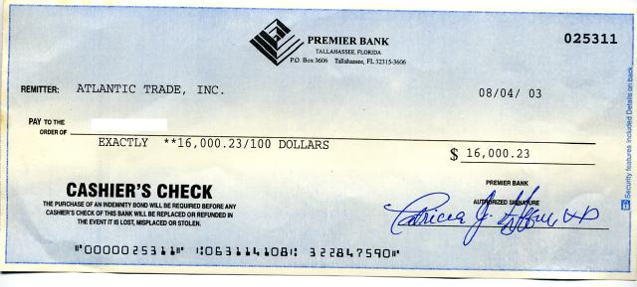
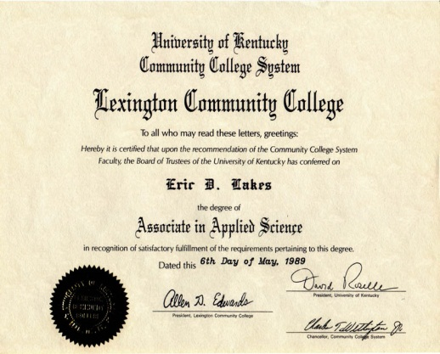
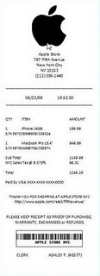
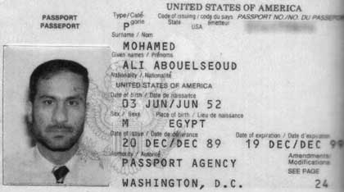
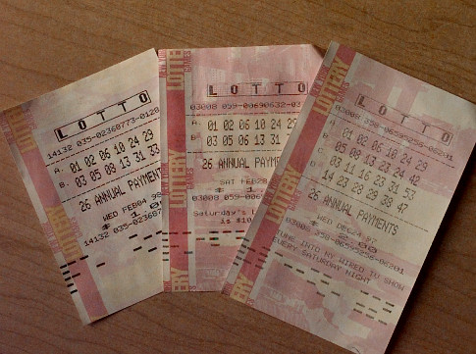
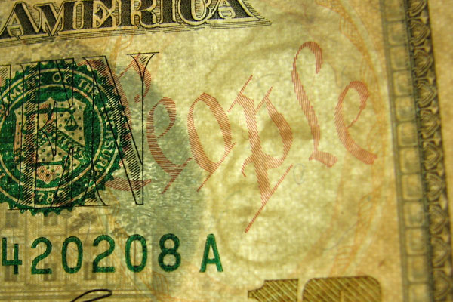
Examples of Questioned Documents
Objectives: Determine the origin of a writing sample using the 12 exemplars
Checks
Licenses and Certificates
Passports
(Counterfeit) Money
Receipts
Lottery tickets
Historical documents
Ransom and
suicide notes
Forgeries of Art

Slide 4
Objectives: Determine the origin of a writing sample using the 12 exemplars
Document Examiners:
Mostly examine handwriting to originate its source or its authenticity
Will also examine typed writings, computer printings, photocopies, inks, papers, and forgeries, and decode altered and charred documents
May need to use microscopes, photographs, chromatography, and other lab examinations on the questioned documents
Many work in federal, local, and state crime labs, but they may also work in private practices

Slide 5
Objectives: Determine the origin of a writing sample using the 12 exemplars
Handwriting:
Two individuals cannot have exactly identical handwriting
Since handwriting is associated with mechanical, physical, and mental functions, it is almost impossible to reproduce exactly
Handwriting can be almost as individual as a person’s fingerprint

Slide 6
Objectives: Determine the origin of a writing sample using the 12 exemplars
  A positive comparison must be based on an ample number of common characteristics between known and questioned writings
  Collecting a lot of exemplars (known writings) is critical in order to make a comparison
  Exemplars should contain some of the same words or combinations of letters that are present in the questioned document(s)

Slide 7
Objectives: Determine the origin of a writing sample using the 12 exemplars
Two writings came from one person if:
  their similarities are unique and
  no unexplainable difference(s) are found
Examine the questionable document for detectable traits and record them
Obtain a known sample of the suspect’s writing (an exemplar)
Compare and draw conclusions about the authorship of the questionable document
Notes:
Collecting a lot of exemplars is critical in order to make a comparison. Exemplars should contain combinations of letters that are present in the questioned document(s)

Slide 8
Objectives: Determine the origin of a writing sample using the 12 exemplars
12 Handwriting Characteristics (Exemplars)
Line quality: Are the lines smooth, free-flowing? Or shaky and wavering?
Spacing: Are the letters and words equally spaced or crowded?

Slide 9
Objectives: Determine the origin of a writing sample using the 12 exemplars
Size consistency: Examine the relative height, width and size of letters. Is it consistent?
Continuous: Is the writing continuous or does the writer lift the pen?
  Forgeries may have lifts or separations in unusual places, such as within a letter

Slide 10
Objectives: Determine the origin of a writing sample using the 12 exemplars
Connecting letters: Compare the strokes between upper and lower case letters. Are they connected?
Letters complete: Look at beginning and ending strokes. Are letters completely formed? Are parts missing?

Slide 11
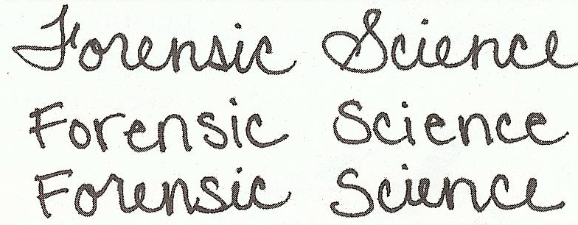
Objectives: Determine the origin of a writing sample using the 12 exemplars
Cursive and printed letters: Are there printed letters, cursive letters, or both?
Pen pressure: Differing amounts of pressure used by the writer can make lines light or dark, narrow or wide. Is pressure equal when applied to upward and downward strokes?

Slide 12
Objectives: Determine the origin of a writing sample using the 12 exemplars
Slant: analyzing the writing slant- left, right, straight, or variable?
Line habits: are the writer’s letters on, above, or below the baseline?

Slide 13
Objectives: Determine the origin of a writing sample using the 12 exemplars
Fancy curls or loops: Are there any fancy letters, curls, loops, circles, or other embellishments?
Letter characteristics: Are t’s crossed in the middle, towards the top, or bottom? Where is the placement of the dot (or circle, heart, etc.) above lowercase i’s?

Slide 14
Objectives: Determine the origin of a writing sample using the 12 exemplars
Factors that affect handwriting samples:
Position of writer (sitting or standing)
Position of Document (flat, vertical or horizontal surface)
Other Factors (under the influence of drugs, illness or injury)

Slide 15
Objectives: Determine the origin of a writing sample using the 12 exemplars
Type of writing instrument
Writing surface
Underlying surface
Mood of writer
Age of writer
Writing speed

Slide 16


Objectives: Determine the origin of a writing sample by analyzing tops & bottoms of letters and the Slants of letters
Analysis of the Tops & Bottoms of Letters and the Slants of Letters
Draw a dot at the top of each letter and connect the dots
Draw a line through the center of each letter (maintaining the slant of the letter)

Slide 17
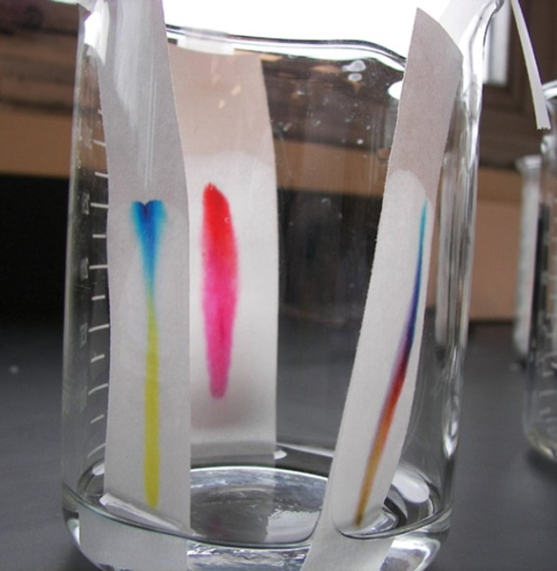
Objectives: Determine the origin of a writing sample by analyzing chromatography results
Analyzing Ink
Chromatography is a method of physically separating the components of inks.
Types:
  HPLC—high-performance liquid chromatography
  TLC—thin-layer chromatography
  Paper chromatography

Slide 18
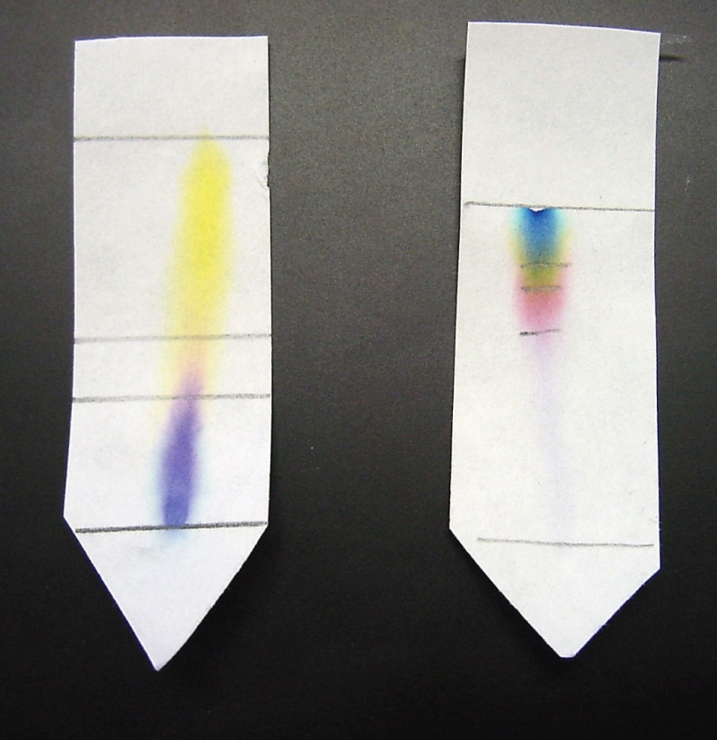
Objectives: Determine the origin of a writing sample by analyzing chromatography results
Paper Chromatography of Ink
Example:
Two samples of black ink from two different manufacturers have been characterized using paper chromatography.

Slide 19
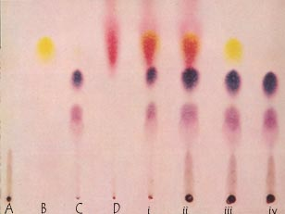

Slide 20
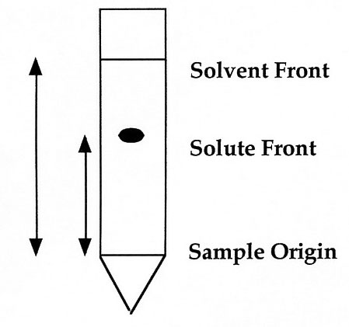
Objectives: Determine the origin of a writing sample by analyzing chromatography results
Retention Factor (R_{f})
R_{f} is a number that represents how far a compound travels in a particular solvent
It is determined by measuring the distance the compound traveled and dividing it by the distance the solvent traveled.

Slide 21
Objectives: Determine the origin of a writing sample by analyzing chromatography results
Which spot below (A-D, i-iv) has the greatest retention factor?

Slide 22
Forgery
Objectives: Determine the measures used to prevent forgery and counterfeiting
Forged documents include:
  checks
  employment records
  legal agreements
  licenses
  wills
Fraudulence—forgery for material gain

Slide 23
Objectives: Determine the measures used to prevent forgery and counterfeiting
Check forgery can include:
  ordering another’s checks from a deposit slip
  altering a check
  intercepting another’s check, altering, and cashing it
  creating a check from scratch

Slide 24
Check Forgery
Objectives: Determine the measures used to prevent forgery and counterfeiting
Americans write 70 billion checks per year – approximately $27 million worth of illegitimate checks are cashed each day.

Slide 25
Preventing Check Forgery
Objectives: Determine the measures used to prevent forgery and counterfeiting
Chemically sensitive paper
Large font size requires more ink and makes alterations more difficult
High resolution borders that are difficult to copy
Multiple color patterns
Embed fibers that glow under different light
Use chemical wash detection systems that change color when a check is altered

Slide 26
Literary Forgery
Objectives: Determine the measures used to prevent forgery and counterfeiting
Forgery of a piece of writing such as a historic letter or manuscript is literary forgery.

Slide 27
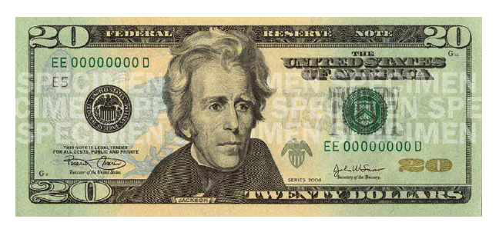
Counterfeiting
Objectives: Determine the measures used to prevent forgery and counterfeiting
When false documents or other items are copied for the purpose of deception, it is called counterfeiting.
This is a criminal activity existing since antiquity
Items commonly forged today include:
  Currency
  Traveler’s checks
  Food stamps
  Certain bonds
  Postage stamps

Slide 28
Counterfeit Currency
Objectives: Determine the measures used to prevent forgery and counterfeiting
Security features are added to paper currency that scanning cannot reproduce
Regular printer paper contains starch; Paper currency contains rag fiber instead of starch.
  Number one reason people suspect fakes is because it doesn’t feel right.

Slide 29
Intaglio Printing
Objectives: Determine the measures used to prevent forgery and counterfeiting
Intaglio printing process is used for the black print on the front side of the notes and the green print on the back side.
Treasury seal, Federal Reserve seal, and serial numbers are printed by a typographic or letterpress process

Slide 30
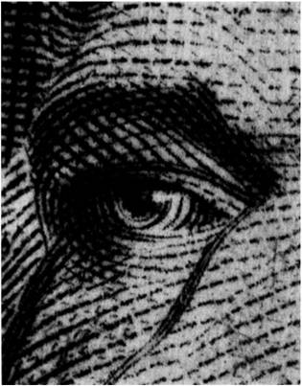
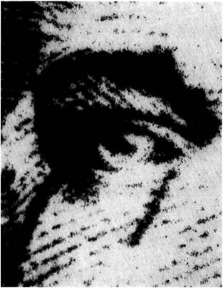
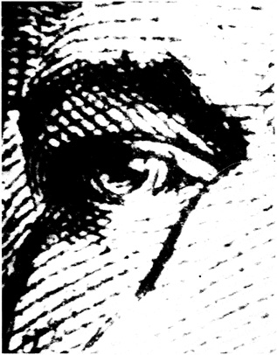
Objectives: Determine the measures used to prevent forgery and counterfeiting
Intaglio
Photocopied
Counterfeit

Slide 31
Serial Numbers
Objectives: Determine the measures used to prevent forgery and counterfeiting
Two serial numbers printed in green ink on the face of each note.
No two notes of the same series, bank, and denomination have the same serial number.
The Federal Reserve banks are designated by a letter and a corresponding numeral. The first character of the serial number is a letter that designates the Federal Reserve Bank and matches the letter in the Federal reserve seal.
Corresponding numerical designation of the Federal Reserve Bank is printed in four locations on the face of each note.

Slide 32
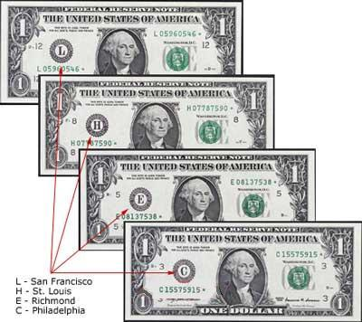
Objectives: Determine the measures used to prevent forgery and counterfeiting

Slide 33
Objectives: Determine the measures used to prevent forgery and counterfeiting
Currency is always being redesigned to make it more difficult to counterfeit.
New bills:
  $20 – October 9, 2003
  $50 – September 28, 2004
  $10 – March 2, 2006
  $5 – Early 2008

Slide 34
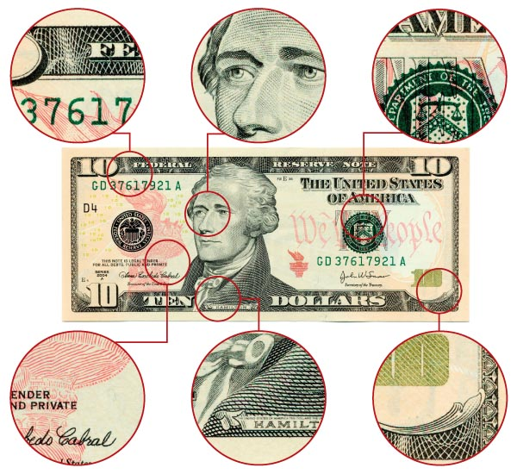
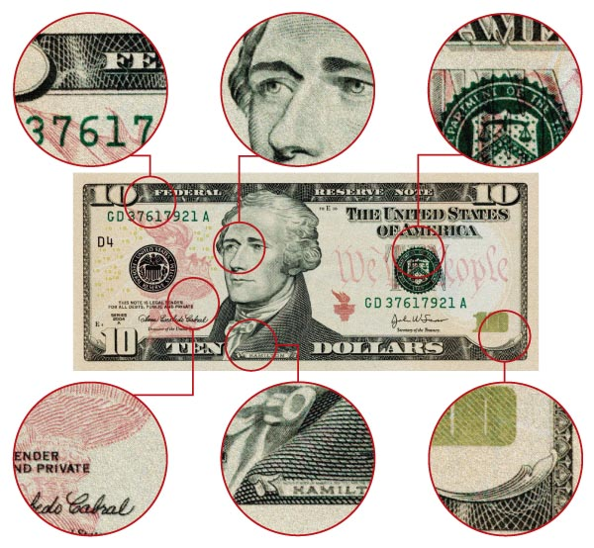
Authentic vs. Counterfeit
Objectives: Determine the measures used to prevent forgery and counterfeiting
The tiny, intricate lines and details on paper money do not always print well in counterfeit bills.

Slide 35
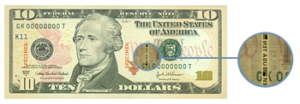
Verifying Authentic Currency
Objectives: Determine the measures used to prevent forgery and counterfeiting
New Security Features:
Portrait stands out and appears raised off the paper
Contains clear red and blue fibers woven throughout the bill
Has clear, distinct border edges
Treasury seal is shown with clear, sharp saw-tooth points
Watermark appears on the right side of the bill in the light

Slide 36
Verifying Authentic Currency
Objectives: Determine the measures used to prevent forgery and counterfeiting
The security thread is evident—a thin embedded vertical strip with the denomination of the bill printed in it
There is minute printing on the security threads, as well as around the portrait
When the bill is tilted, the number in the lower right-hand corner makes a color shift from copper to green

Slide 37
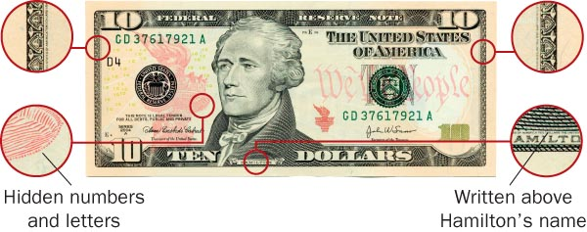
Examples of Security Features
Objectives: Determine the measures used to prevent forgery and counterfeiting

Slide 38
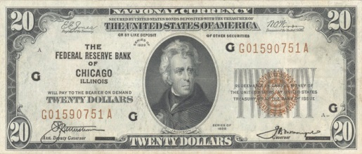
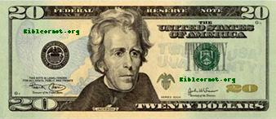
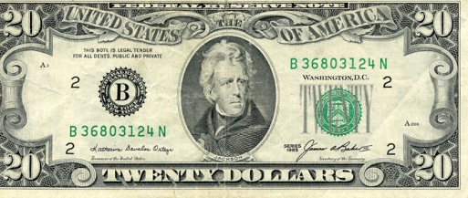
Objectives: Determine the measures used to prevent forgery and counterfeiting
Closure: List some comparisons in the evolution of the $20 bill below:
1929
Current
1985

Slide 39
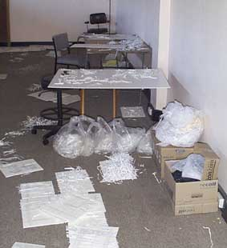
Shredded Material Recovery
Objectives: Determine how Forensic document examiners reconstruct shredded documents
The purpose of our work was to turn bags of shredded documents like these...

Slide 40
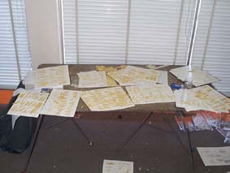
Shredded Material Recovery
Objectives: Determine how Forensic document examiners reconstruct shredded documents
Into legible documents like these...

Slide 41
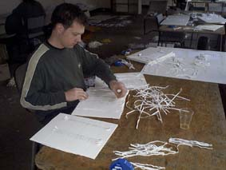
Shredded Material Recovery
Objectives: Determine how Forensic document examiners reconstruct shredded documents
Which involved separation of individual shreds from the pile and re-assembling them piece by piece.

Slide 42
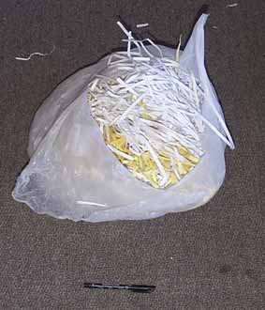
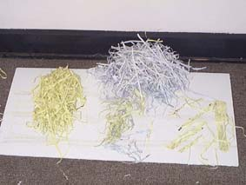
Shredded Material Recovery
Objectives: Determine how Forensic document examiners reconstruct shredded documents
Each bag of shredded paper contained an average of 100 recoverable documents.

Slide 43
LINKS
Counterfeit Money: https://www.youtube.com/watch?v=lzYtozBwOxQ
Counterfeit Passports: https://www.youtube.com/watch?v=Uzt4VVDX-T0
Graphology: https://www.youtube.com/watch?v=aoCAcLB1LbI
Zodiac Killer: https://www.youtube.com/watch?v=KnkeOuPEuo0
BTK:
https://www.youtube.com/watch?v=_D8GXNmpJPY

