Slide 1
Reactions

Slide 2
Definitions of Acids and Bases

Slide 3
OBJECTIVES
You should already be able to...
Identify acids and bases.
Name acids and bases
By the end of this video you should be able to...
Classify acids and bases based on TWO theories.
Identify conjugate acids and bases.
Identify strong acids and bases.
Explain and write acid base reactions.

Slide 4
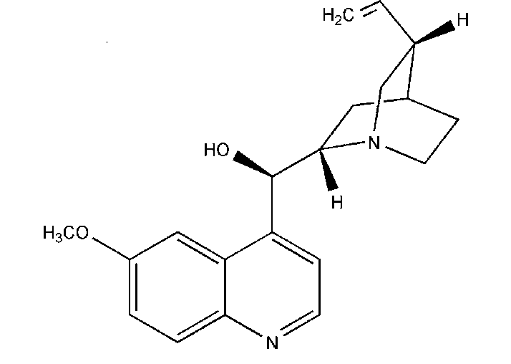
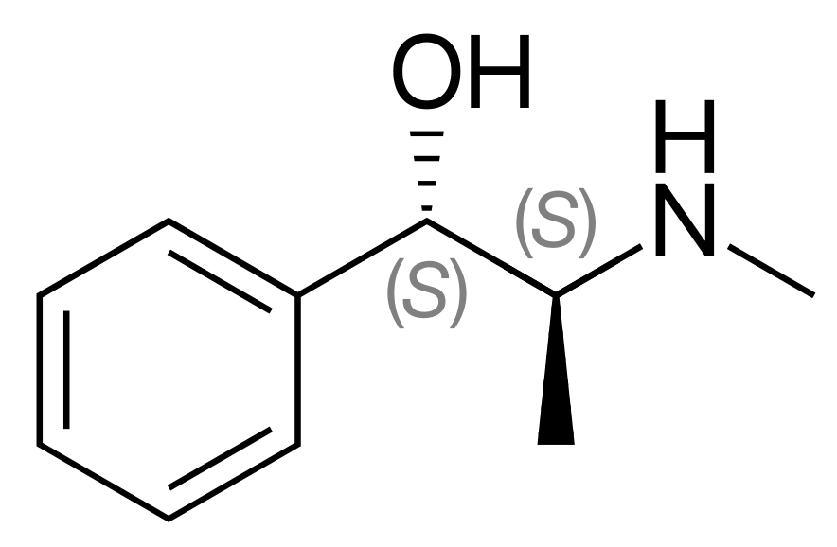
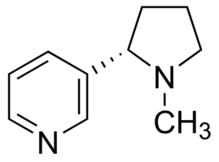
Question of the video: Are the following acidic, basic, or neutral?
Pseudoephedrine Quinine Nicotine
(Sudafed) (treats malaria pH high) (in cigarettes pH = 3)

Slide 5
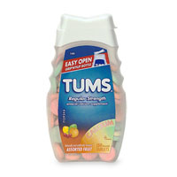
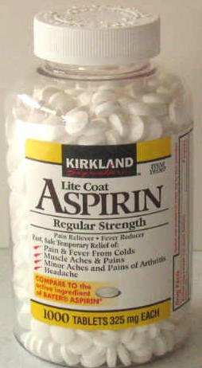
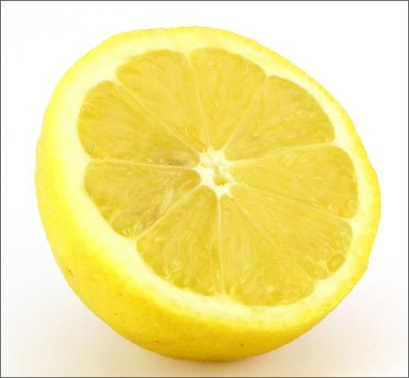
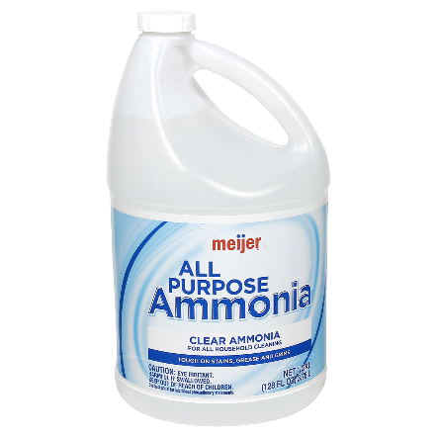
Arrhenius
Acid: Substance that, when dissolved in water, increases the concentration of hydrogen ions. pH<7
Base: Substance that, when dissolved in water, increases the concentration of hydroxide ions. pH>7

Slide 6
Brønsted–Lowry : BAAD
Acid: Proton donor
Base: Proton acceptor
Protons refer to hydrogen ions.
H
H+

Slide 7
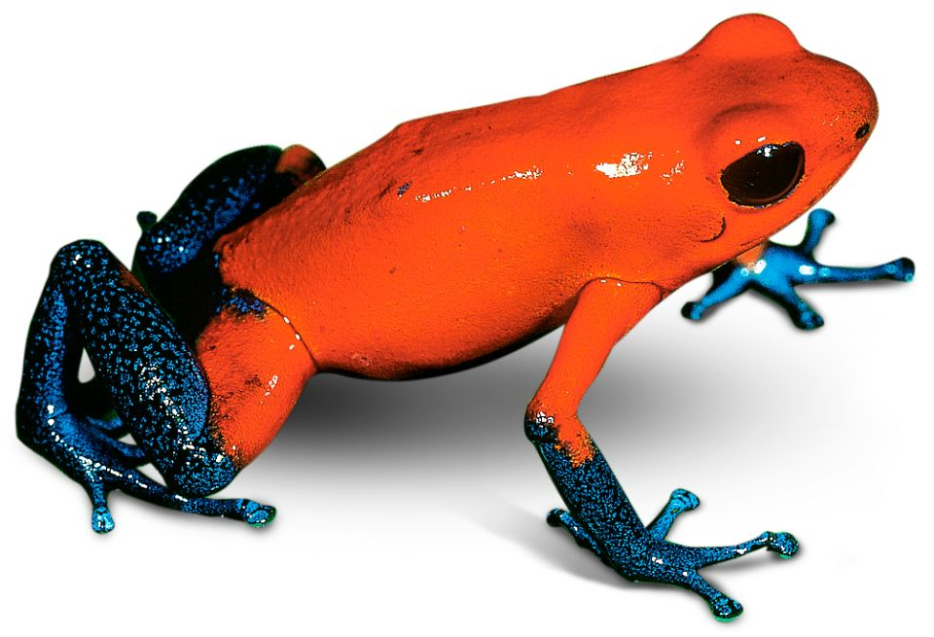
If it can be either it is amphiprotic.
HCO₃⁻
HSO₄⁻
H₂O
These all have hydrogen ions to donate and a negative charge.

Slide 8
What Happens When an Acid Dissolves in Water?
Water acts as a Brønsted–Lowry base and abstracts a proton (H⁺) from the acid.
As a result, the conjugate base of the acid and a hydronium ion are formed.

Slide 9
Conjugate Acids and Bases
Reactions between acids and bases always yield their conjugate bases and acids.

Slide 10
Acid and Base Strength
Strong acids are completely dissociated in water. Their conjugate bases are quite weak.
Weak acids only dissociate partially in water. Their conjugate bases are weak bases.

Slide 11
Strong Acids and Bases
Strong Acids
Strong Bases
HCl
HBr
HI
HNO₃
HClO₄
H₂SO₄
H₃PO₄
LiOH
NaOH
KOH
RbOH
CsOH
Ba(OH)₂
Ca(OH)₂

Slide 12
Find the conjugate acid:
NH₄⁺
NH₃
HS⁻
HSO₄⁻
H₂PO₄⁻
Bases gain H+ to become a conjugate acid!
H₂S
H₂SO₄
H₃PO₄

Slide 13
Find the conjugate base
HClO₄
HCl
H₂SO₄
H₃PO₄
Acids lose H+ to become a conjugate base!
ClO₄⁻
Cl⁻
HSO₄⁻
H₂PO₄⁻

Slide 14
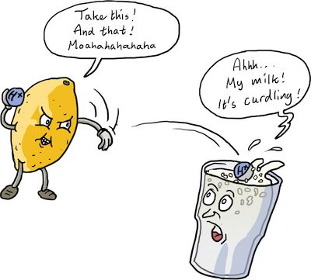
Neutralization
Acid + Base 🡪 Salt + Water
HCl + NaOH 🡪 NaCl + H₂O
When the substances neutralize, they lose their properties and the pH will equal 7.
HBr + Ba(OH)₂ 🡪 H₂O + BaBr₂

Slide 15
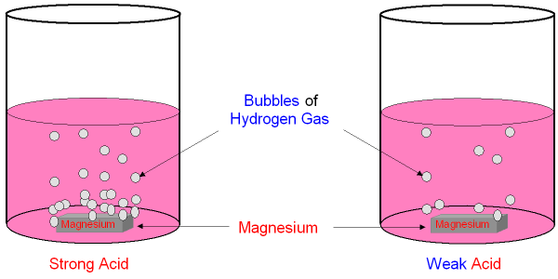
Acids react with most metals
One hydrogen will be replaced by a more active metal. (Unreactive metals include Cu, Ag, and Au.)
2HCl + Mg 🡪 MgCl₂ + H₂(g)
2HCl + Zn 🡪 ZnCl₂ + H₂

Slide 16
Question of the video: Are the following acidic, basic, or neutral?
Pseudoephedrine Quinine Nicotine
(Sudafed) (treats malaria) (pH = 3)
Basic Basic Acidic

Slide 17
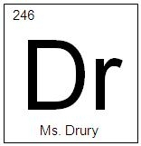
YOU MUST BE ABLE TO
Classify acids and bases based on TWO theories.
Identify conjugate acids and bases.
Identify strong acids and bases.
Explain and write acid base reactions.

Slide 18
Strong Acid/Base Titrations

Slide 19
Objectives
You should already be able to…
Calculate the concentration, pH or K for any acid or base.
By the end of the video you should be able to…
Describe titration set-ups and purpose.
Read and explain a strong A/B titration graph.
Calculate the pH at any point during a strong acid and strong base reaction.

Slide 20
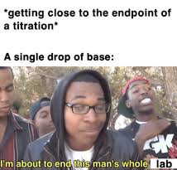
Question of the video:
Why is it so important to titrate slowly?

Slide 21
Titration Definitions
A known concentration of base (or acid) is slowly added to a solution of an unknown acid (or base) to determine it’s concentration.
This is also known as standardization if a primary standard (solid, where the moles are constant) is used to determine the molarity of a substance.

Slide 22
Titration Methods
A pH meter or indicators are used to determine when the solution has reached the equivalence point, or neutralization point, at which the moles of acid equals that of base.
The endpoint is when the indicator actually changes color. You want the endpoint close to the equivalence point.

Slide 23
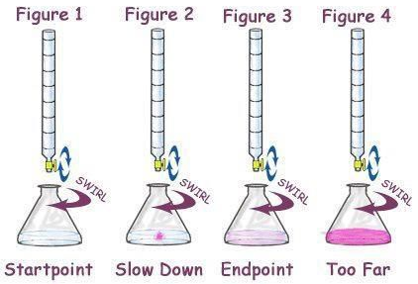
Equivalence during a Titration
Using the M=mol/L formula, MV = moles.
At this equivalence point ONLY,
the moles of acid = the moles of base.
Therefore, you can use M_{A}V_{A}=M_{B}V_{B}
to determine the molarity of the unknown
solution at the equivalence point only.

Slide 24
Example at Equivalence
An unknown concentration of NaOH was found in the stockroom. I measured 20.00mL of the 2.00M HCl into a flask and added a few drops of phenolphthalein. I filled a clean 50.00mL buret with unknown NaOH and began the titration, slowly adding NaOH drop wise until a faint pink color appeared. Initially the volume of base read 0.15mL but when the titration was complete, the volume read 35.45mL. What is the concentration of the base?
(2.00M)(0.02000L) = 0.0400 moles of HCl
0.0400 moles of HCl = moles of NaOH
0.0400moles of NaOH/(0.03545-0.00015) = 1.13M
Or (2.00M)(20.00mL) = (x)(35.45-0.15mL) = 1.13M

Slide 25
Titration of a Strong Acid with a Strong Base
From the start of the titration to near the equivalence point, the pH goes up slowly.
Just before and after the equivalence point, the pH increases rapidly.

Slide 26
Titration of a Strong Acid with a Strong Base
At the equivalence point, moles acid = moles base, and the solution contains only water and the neutral salt. The pH equals 7.

Slide 27
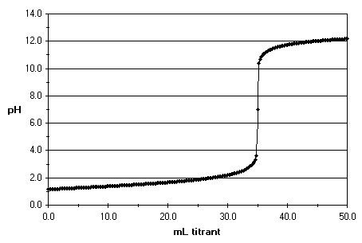
Question of the video:
Why is it so important to titrate slowly?
The equivalence point is at pH = 7 and 35.0 mL of 1.0M NaOH was used to neutralize 0.50M HCl. How much acid was used?
MaVa=MbVb
(0.50)x = (1.0)(35.0)
x = 70.0mL of acid
What was the pH when only 34mL added to the acid?

Slide 28
YOU MUST BE ABLE TO:
Describe the titration set-up and explain its purpose.
Read and explain points on a Strong Acid/Strong Base titration graph.
Calculate the pH during any point of a strong acid and strong base reaction.

Slide 29
Redox Reactions

Slide 30
Objectives
You should already be able to...
Identify redox reactions.
Assign oxidation numbers for elements and compounds.
By the end of this video you should be able to...
Identify which species are oxidizing and which species are reducing.

Slide 31
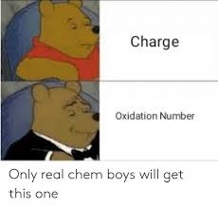
Electrochemical Reactions
In electrochemical reactions, electrons are transferred from one species to another.
In order to keep track of what loses electrons and what gains them, we assign oxidation numbers.

Slide 33
Oxidation and Reduction
A species is oxidized when it loses electrons.
Here, zinc loses two electrons to go from neutral zinc metal to the Zn²⁺ ion.
A species is reduced when it gains electrons.
Here, each of the H⁺ gains an electron and they combine to form H₂.

Slide 34
Oxidation and Reduction
What is reduced is the oxidizing agent.
H⁺ oxidizes Zn by taking electrons from it.
What is oxidized is the reducing agent.
Zn reduces H⁺ by giving it electrons.

Slide 35
You must be able to…
Identify which species are oxidizing and which species are reducing.

Slide 36
Net Ionic Reactions

Slide 37
Objectives
You should already be able to...
Identify and write acid base and redox reaction equations.
Balance reactions and draw particle diagrams.
By the end of this video you should be able to...
Write net ionic equations for any reaction and draw particle diagrams for reactions.

Slide 38
Solubility
The ability to dissolve in water depends on many factors such as polarity (defined later), chemical nature of ions, and attractive forces. There are varying degrees of solubility.
Substances that are characterized as “mostly soluble” will dissolve in water under most conditions- but will still have a limit to dissolving known as saturation.
Moderately soluble ions are soluble dependent on the other ion it is bonded to.
Insoluble substances may not actually be INSOLUBLE, per se. They are just not visibly soluble and may only dissolve a few molecules.

Slide 39
Memorize this list of soluble ions
Group 1 ions: Li⁺ Na⁺ K⁺ Rb⁺ Cs⁺
Ammonia NH₄⁺
Acetate C₂H₃O₂⁻
Nitrate NO₃-
Note: these are all +1 or -1 ions… If these are with ANY other ion, they are soluble. For the purposes of the AP Exam, all other substances are insoluble unless noted in the question.

Slide 40
Net Ionic Equations
Molecular Equations are frequently used to show what chemicals are mixed in a reaction, not which actually react. Net Ionic Equations are a simplified form of molecular equations that eliminate spectator ions and shows only those species that react.

Slide 41
Net Ionic Equations
Molecular Equation:
BaCl₂ + Na₂SO₄ 🡪 BaSO₄ + 2NaCl
Ionic Equation:
Ba⁺² + 2Cl⁻ + 2Na⁺ + SO₄²⁻ 🡪 BaSO₄ + 2Na⁺ + 2Cl⁻
Net Ionic Equation:
Ba⁺² + SO₄²⁻ 🡪 BaSO₄
Why did Na⁺ and Cl⁻ cancel???

Slide 42
Tips:
For practice, write out the ionic form, breaking down only soluble aqueous substances. Then cancel and re-write the net ionic.
Don’t worry about writing the phases, although it may help to write if a substance is a solid or gas, to remind you not to ionize it.
The AP will always give reactions that have a net ionic reaction, but your exercises may not. If every substance ionizes, then the reaction does not occur.

Slide 43
THINK
How will you know if a substance is solid, aqueous, liquid, or gas?
Substances are only aqueous if they are soluble and water is present.
All insoluble compounds that contain metals are solids. Also, if the compound has a metal but no water is present, it is a solid.
Most compounds that do not contain metals are not soluble and will not be broken down into ions.

Slide 44
Practice
3
+ NaNO₃
Al(OH)
3
₃
Al(NO₃)₃ + NaOH 🡪
Al⁺³ + 3NO₃⁻ + 3Na⁺ + 3OH⁻ 🡪 Al(OH)3 + 3Na⁺ + 3NO₃⁻
Al⁺³ + 3OH⁻ 🡪 Al(OH)₃
2K₃PO₄ + 3 Ca(NO₃)₂ 🡪
6K⁺ + 2PO₄⁻³ + 3Ca⁺² + 6NO₃⁻ 🡪 6K⁺ + 6NO₃⁻ + Ca₃(PO₄)₂
2PO₄⁻³ + 3Ca⁺² 🡪 Ca₃(PO₄)₂
₃ ₂
KNO₃
+ Ca (PO₄)
6

Slide 45
Recall: Strong Acids and Bases ionize completely. All other stay bonded.
Strong Acids
Strong Bases
HCl
HBr
HI
HNO₃
HClO₄
H₂SO₄
H₃PO₄
LiOH
NaOH
KOH
RbOH
CsOH
Ba(OH)₂
Ca(OH)₂

Slide 46
Acid Base Reactions
Strong Acid and Strong Base: HI + LiOH → HOH + LiI
Strong Acid and Weak Base: HCl + Sr(OH)₂ → SrCl₂ + HOH
H⁺ + I⁻ + Li⁺ + OH⁻ → HOH + Li⁺ +I⁻
H⁺ + OH⁻ → HOH
H⁺ + Cl⁻ + Sr(OH)₂ → SrCl₂ + HOH

Slide 47
Acid Base Reactions
3. Weak Acid and Strong Base: HClO + NaOH → NaClO + HOH
4. Bronsted Acid and Base: HBr + NH₃ → NH₄⁺ + Br⁻
HClO + Na⁺ + OH⁻ → Na⁺ + ClO⁻ + HOH
HClO + OH⁻ → ClO⁻ + HOH
H⁺ + Br⁻ + NH₃ → NH₄⁺ + Br⁻
H⁺ + Br⁻ + NH₃ → NH₄⁺ + Br⁻

Slide 48
Redox Reactions
Zn(s) + Ni(NO₃)₂(aq) → Zn(NO₃)₂(aq) + Ni(s)
Br₂(aq) + 2 KI(aq) → 2 KBr(aq) + I₂(aq)
Zn(s) + Ni²⁺(aq) + 2NO₃⁻(aq) → Zn²⁺(aq) + 2NO₃⁻(aq) + Ni(s)
Zn(s) + Ni²⁺(aq) → Zn²⁺(aq) + Ni(s)
Br₂(aq) + 2K⁺(aq) + 2 I–(aq) → 2K⁺(aq) + 2 Br–(aq) + I₂(aq)
Br₂(aq) + 2 I–(aq) → 2 Br–(aq) + I₂(aq)

Slide 49
You must be able to…
Write net ionic equations for any reaction and draw particle diagrams for reactions.

