Slide 1
ELECTROCHEMISTRY

Slide 2
Redox Review

Slide 3
Lesson Objective:
Determine the oxidation number of atoms and ions in a chemical reaction
Identify oxidized and reduced species.
Determine the characteristics of a redox reaction.
Use Table J to determine if a species is oxidized or reduced.
Determine if a reaction will occur spontaneously.

Slide 4
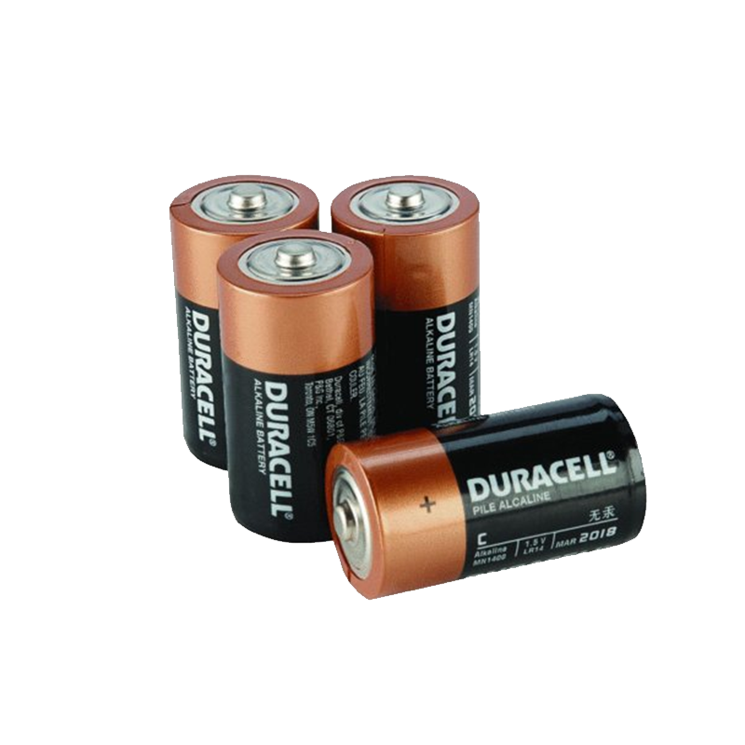
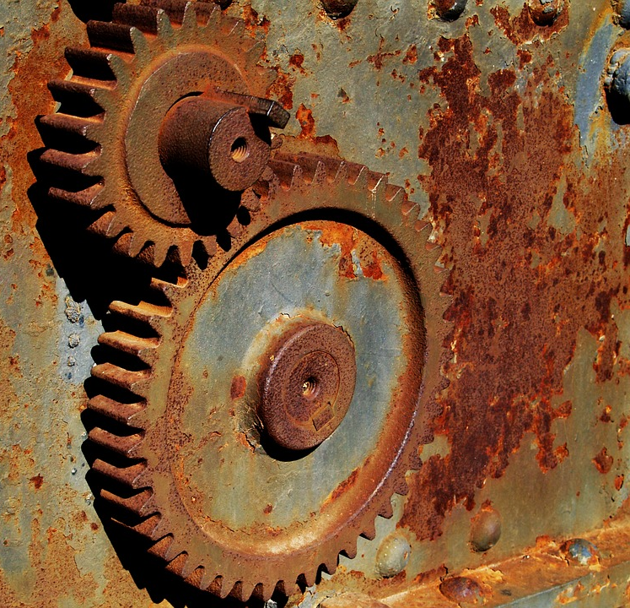
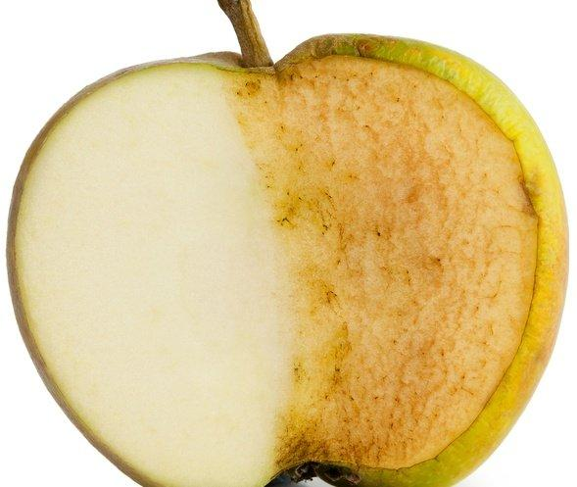
Redox Reactions
In redox reactions, electrons are transferred from one species to another.
This can cause a multitude of outcomes.

Slide 5
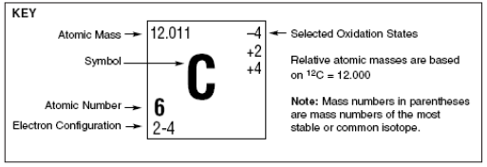
Oxidation States
To follow the flow of electrons, we assign oxidation numbers
Notes:
But how do you know if there is a transfer of e-

Slide 6
Rules for Oxidation Numbers
An uncombined element has an oxidation number of ZERO. This includes diatomic elements.
Ca + Cl₂→ CaCl₂
Oxidation # Ca = 0
Oxidation # Cl₂ = 0
0
0

Slide 7
Rules for Oxidation Numbers
2. If an element only has one oxidation number listed on the periodic table, that’s it !
Example: Group 1 Oxidation # = +1
Group 2 Oxidation # = +2

Slide 8
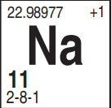
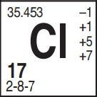
Rules for Oxidation Numbers
3. In an ionic compound, the metal (positive ion) is written first and the non metal (negative ion) is written last.
Example: NaCl Oxidation # Na = ⁺ 1
Oxidation # Cl = ⁻ 1
+1
-1
Notes:
More electronegative

Slide 9
Rules for Oxidation Numbers
4. Hydrogen is usually has a +1 when it’s listed first, and -1 when it’s listed last. (if it’s more the more electronegative element in the compound it is -1.
Example:
HBr LiH
+1
-1
+1
-1

Slide 10
Rules for Oxidation Numbers
5. The sum of oxidation numbers in a compound must equal ZERO.
Example: CaCl₂
+2(1) + -1(2)
2 - 2 = 0
+2
-1
HINT: Be sure to multiply oxidation # by the number of atoms in the subscript.

Slide 11
Rules for Oxidation Numbers
6. If an element has more than one oxidation state listed on the periodic table, use the rest to figure it out.
Assign oxidation # to elements that have only one oxidation state listed.
Assign oxidation # to the element so that the charge on the compound is ZERO.
Notes:
Work out in

Slide 12
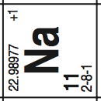
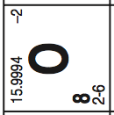
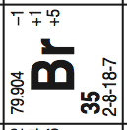
Example
NaBrO₃
+1(1) + -2(3) = 0
+1 +5 - 6 = 0
+1
+5
-2

Slide 13
Rules for Oxidation Numbers
7. The sum of the oxidation numbers of an ion should equal the charge of that ion.
Cr₂O₇ ⁻²
+6
-2
+6(2) + -2(7) = -2
+12 + -14 = -2

Slide 14
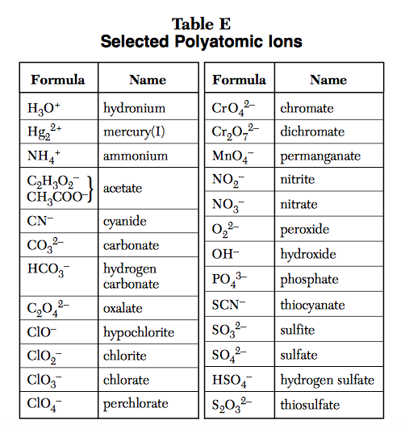
Working with Polyatomic Ions
Use Table E for charge which is the oxidation number.
Ex. SO₄⁻ ²
oxidation # for whole ion = -2

Slide 15
Redox Reactions
Redox stands for reduction/oxidation reaction. When one happens, the other must be happening, as well.
They involve the transfer of electrons!

Slide 17
Oxidation
The LOSS of electrons by an atom or ion. As a result:
Oxidation number goes UP or INCREASES
Becomes more POSITIVE (+)
Na
Na⁺¹

Slide 18
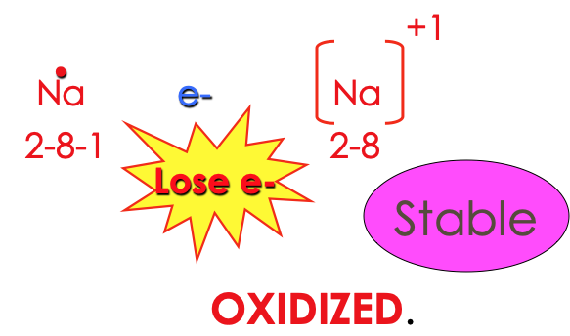
Oxidation Example

Slide 19
Reduction
The GAIN of electrons by an atom or ion. As a result:
Oxidation number goes DECREASES or REDUCES
Becomes more NEGATIVE (-)
F
F⁻¹

Slide 20
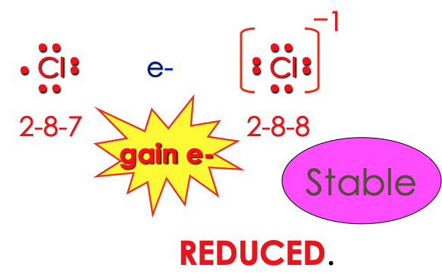
Reduction Example

Slide 21
Reduction????
Why is it called reduction when you gain electrons?
Ox # +2
Gains 3e⁻
Goes to -1
3
2
Oxidation number reduces
1
0
-1
-2-3

Slide 22
Example
Zn oxidation number goes UP, loses e⁻, OXIDIZED.
H⁺ oxidation number goes DOWN, gains e⁻, REDUCED.

Slide 23
LEO GER
L E O the lion
Says G E R
ose
lectrons
xidize
ain
lectrons
educe

Slide 24
Example
Oxidation numbers can change as a result of a reaction.
2Na + Cl₂ → 2NaCl
0
0
+1
-1
LEO
LEO says GER
GER
Na went from 0 → +1
Cl went from 0 → -1
OXIDIZED
REDUCED

Slide 25
Example
Oxidation numbers can change as a result of a reaction.
2H₂ + O₂ → 2H₂O
0
0
+1
-2
LEO says GER
LEO
GER
H went from 0 → +1
O went from 0 → -2
OXIDIZED
REDUCED

Slide 26
Identify Species
0
+1
-1
0
+1
-1
Li is oxidized, Na is reduced, F is a spectator ion because it doesn’t change
Li + NaF → Na + LiF
K₂O + Li → Li₂O + K
2Na + Cl₂ → 2NaCl₂
+1
-2
0
+1
-2
0
Li is oxidized, K is reduced, O is a spectator ion because it doesn’t change
0
0
+1
-1
Na is oxidized, Cl is reduced

Slide 27
Are these Redox Reactions?
0
0
+1
-1
Li + F₂ → LiF
Mg + 2HNO₃ → Mg(NO₃)₂ + H₂
NaOH + LiBr → LiOH + NaBr
YES
Redox = transfer of e⁻ tracked by oxidation numbers. If oxidation #’s don’t change it’s not a redox rxn.
0
+1
-1
+2
-2
0
YES
+1
-1
+1
-1
+1
-1
+1
-1
NO

Slide 28
Trick to Identify Redox
Single Replacement rxns are ALWAYS redox
Zn + HCl₂ → H₂ + ZnCl₂
Double Replacement rxns are NEVER redox
NaOH + HCl → H₂O + NaCl
0
+1
-1
0
+2
-1
Look for elements not in a compound to help identify redox reactions
+1
+1
-1
-1
+1
-1
+1
-1

Slide 29
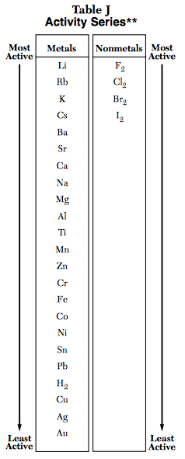
Easily OXIDIZED
EASY to lose electrons
More active metals
Less active metals

Slide 30
More active metals
HARD to lose electrons
Less active metals
Not easily OXIDIZED

Slide 31
Easily REDUCED
EASY to gain electrons
More active nonmetals
Less active nonmetals

Slide 32
HARD to gain electrons
More active nonmetals
Not easily REDUCED
Less active nonmetals

Slide 33
Example
Compare nickel and aluminum. Which will be oxidized and which will be reduced?
Nickel is reduced
Aluminum is oxidized

Slide 34
When are rxn’s Spontaneous
Spontaneous reactions occur without the addition of energy to the system.
If the “single” element is more active than the “combined” element, then the reaction is spontaneous.
Example: Zn + PbCl₂ → ZnCl₂ + Pb

Slide 35
When are rxn’s Not Spontaneous
If not, the reaction is nonspontaneous and will require the addition of energy.
Example: Zn + AlCl₃ → no rxn

Slide 36
Example
Determine the products of the following reaction. Would it occur spontaneously?
Li + MgSO₄ →
Mg + LiSO₄

Slide 37
Determine the oxidation number of atoms and ions in a chemical reaction
Identify oxidized and reduced species.
Determine the characteristics of a redox reaction.
Use Table J to determine if a species is oxidized or reduced.
Determine if a reaction will occur spontaneously.

Slide 38
Half Reactions

Slide 39
Lesson Objective:
Write half reactions for oxidation and reduction.
Balance redox reactions from half reactions.

Slide 40
Half Reactions
A half reactions breaks a redox reaction into its two parts: oxidation and reduction.
These reactions include the electrons so that the reaction can be balanced.

Slide 41
Redox Reactions have...
An oxidation half reaction and a reduction half reaction.
Example: 2Mg + O₂ → 2MgO
LEO
LEO says GER
0
0
+2
-2
GER
Loss of electrons
Oxidation Half Reaction: Mg ⁰ → Mg⁺²
+ 2e⁻
Reduction Half Reaction: O₂ ⁰ →2O⁻²
+ 4e⁻
Gain electrons

Slide 42
Half reaction: Reduction
A reduction half reaction shows an atom or ion gaining one or more electrons
Fe³⁺ + → Fe⁰
Notice that the e- are on the left.
3e-

Slide 43
Half reaction: Oxidation
An oxidation half reaction shows an atom or ion losing one or more e-:
Mgº → Mg⁺² + 2e-
Notice that the e- is on the right.

Slide 44
Rules for Half Reactions
1. Assign oxidation numbers to all elements in the reaction and determine if its a redox reaction (change in oxidation #).
Cu + 2AgNO₃ → Cu(NO₃)₂ + 2Ag
0
+1
-1
+2
-1
0

Slide 45
Rules for Half Reactions
2. Determine which species is oxidized (LEO) and which species is reduced (GER).
Cu + 2AgNO₃ → Cu(NO₃)₂ + 2Ag
oxidized
0
+1
-1
+2
-1
0
reduced

Slide 46
Rules for Half REactions
3. Break the overall reaction into oxidation and reduction reactions (leave out spectator ions).
Cu + 2AgNO₃ → Cu(NO₃)₂ + 2Ag
oxidized
0
+1
-1
+2
-1
0
reduced
Oxidation: Cu ⁰ → Cu ⁺²
Reduction: Ag ⁺¹ → Ag ⁰

Slide 47
Rules for Half REactions
4. Fill in electrons: Oxidized: electrons lost → add on left
Reduced: electrons gained → add on right
Cu + 2AgNO₃ → Cu(NO₃)₂ + 2Ag
oxidized
+2
-1
0
+1
-1
0
reduced
Oxidation: Cu ⁰ → Cu ⁺²
2e⁻
Reduction: Ag ⁺¹ → Ag ⁰
+ 1e⁻

Slide 48
Example
Set up both half reactions
Ca(s) + Cu⁺² (aq) → Ca⁺²(aq) + Cu(s)
oxidized
0
0
reduced
Oxidized: Ca⁰ → Ca⁺²
2e⁻
Ox #
Ox #
Reduced: Cu⁺² → Cu⁰
2e⁻

Slide 49
Balancing Redox Rxns
In all redox reactions, there must be conservation of mass and charge. This includes transferring electrons!

Slide 50
Steps for Balancing Redox
1. Write out the half reactions including electrons
Cu + AgNO₃ → Cu(NO₃)₂ + Ag
oxidized
+2
-1
0
+1
-1
0
reduced
Oxidation: Cu ⁰ → Cu ⁺²
2e⁻
Reduction: Ag ⁺¹ → Ag ⁰
+ 1e⁻

Slide 51
Steps for Balancing Redox
2. Make sure mass is balanced in each half reaction then balance
Charge (electrons lost = electrons gained)
Cu + AgNO₃ → Cu(NO₃)₂ + Ag
oxidized
+2
-1
0
+1
-1
0
reduced
Oxidation: Cu ⁰ → Cu ⁺²
2e⁻
Reduction: Ag ⁺¹ → Ag ⁰
2
+ 1e⁻

Slide 52
Steps for Balancing Redox
3. Multiply through. Notice electrons cancel out
Cu + AgNO₃ → Cu(NO₃)₂ + Ag
oxidized
+2
-1
0
+1
-1
0
reduced
Oxidation: Cu ⁰ → Cu ⁺²
2e⁻
2Ag ⁺¹ → 2Ag ⁰
Reduction: Ag ⁺¹ → Ag ⁰
+ 2e⁻
2
+ 1e⁻

Slide 53
Steps for Balancing Redox
4. Now add the coefficients into the original equal. Mass and charge
Are not conserved.
Cu + AgNO₃ → Cu(NO₃)₂ + Ag
oxidized
+2
-1
0
+1
-1
0
2
2
reduced
Oxidation: Cu ⁰ → Cu ⁺²
2e⁻
2Ag ⁺¹ →2Ag ⁰
Reduction: Ag ⁺¹ → Ag ⁰
+ 2e⁻
2
+ 1e⁻

Slide 54
Example
Mg_{(s)} + N₂ _{(aq)} → Mg₃N₂
oxidized
0
0
+2
-3
3
reduced
0
+2
3
OX: Mg → Mg
+ 6e⁻
3
0
-3
RED: N₂ → N
+ 6e⁻
2

Slide 55
Write half reactions for oxidation and reduction.
Balance redox reactions from half reactions.

Slide 56
Voltaic Cells

Slide 57
Lesson Objective:
Label the parts of a voltaic cell
Determine the flow of electrons in a voltaic cell
Determine which electrode increases and which decreases in mass

Slide 58
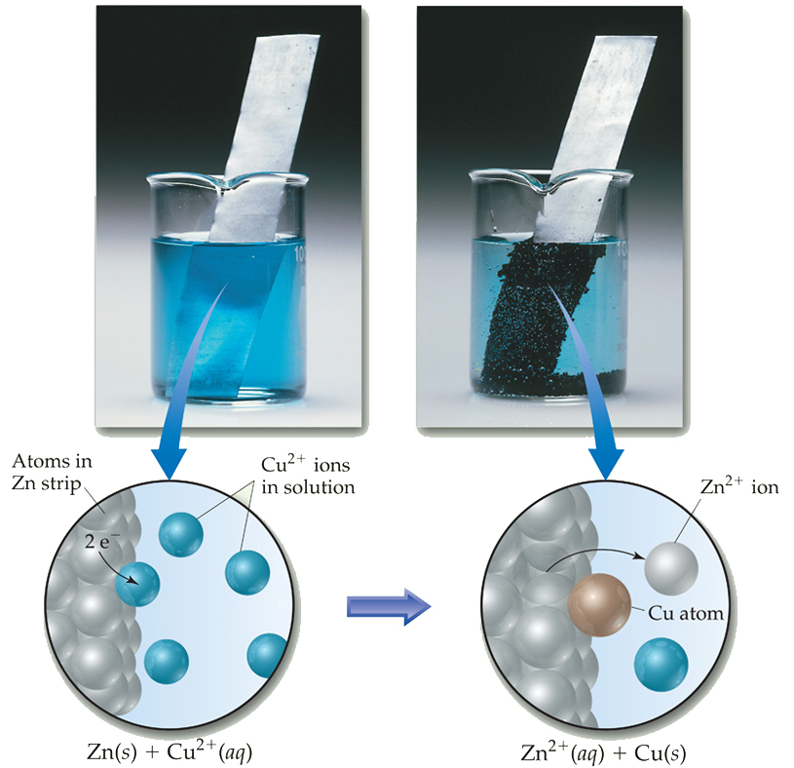
Problem: What is electricity & how is it formed?
In a spontaneous redox rxn, electrons are transferred and ENERGY is released.
This energy can be used to do work in a voltaic cell

Slide 59
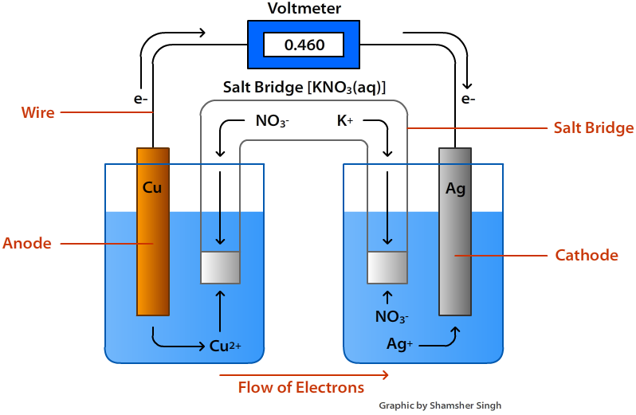
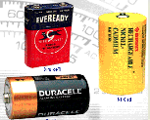
Voltaic Cell (Battery)
SPONTANEOUS redox reaction
-Converts chemical energy into electrical energy
The flow of electrons produces electricity

Slide 60
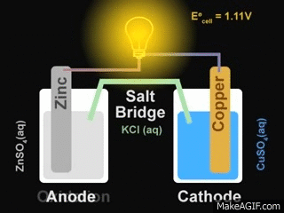
How does a voltaic cell work
Electrons flow SPONTANEOUSLY from the ANODE (more active metal) to the CATHODE (less active metal)
Anode: Negative electrode where oxidation (loss of e-) occurs
Cathode: Positive electrode where reduction (gain of e-) occurs
Remember:
An ox
Red Cat

Slide 61
Voltaic Cells
As the electrons reach the cathode, cations in the cathode are attracted to the now negative cathode.
The electrons are taken by the cation, and the neutral metal is deposited on the cathode.

Slide 62
Example
Zn is higher on table J so electrons flow from Zn to Cu.
Zn is anode and Cu is cathode
Remember:
An ox
Red Cat

Slide 63
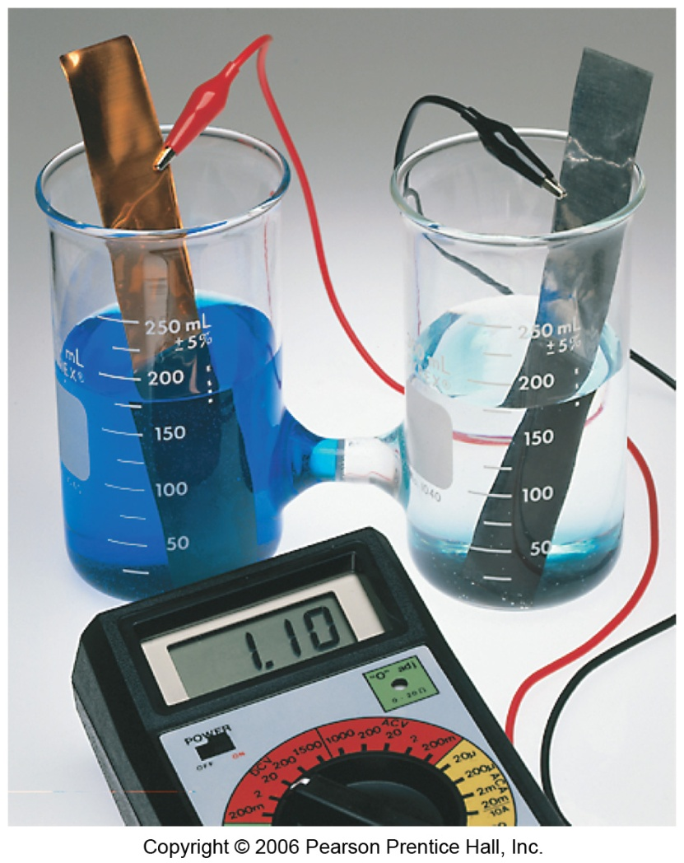
Parts of a voltaic Cell
2 half cells (1 for oxidation and 1 for reduction half reactions)
Electrodes (site of ox and red)
Wire (connects to electrodes- allows electrons to flow)

Slide 64
Parts of a voltaic Cell
Salt Bridge (allows ions to flow and prevents the build up of charges (maintains electrical neutrality)
Voltmeter (measures electric current)

Slide 65
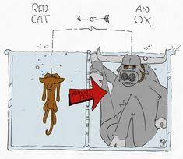
How to label a Voltaic cell
Determine which electrode is the anode and which is the cathode (Use Table J)
Identify where oxidation and reduction take place
Determine the direction of electron flow

Slide 66
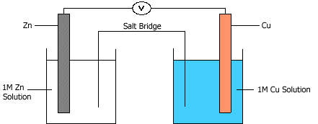
More active metal is oxidized
Remember this:
Electrons will flow
from high to low
Remember:
An ox
Red Cat
Ox: Zn Red: Cu

Slide 67
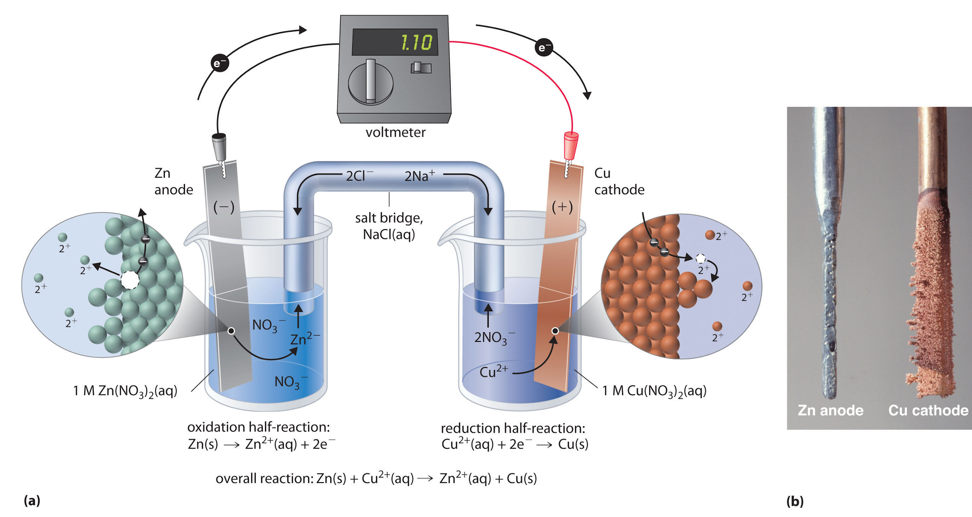
What happens to electrodes
Cathode (Cu) increases in mass
Anode (Zn) decreases in mass

Slide 68
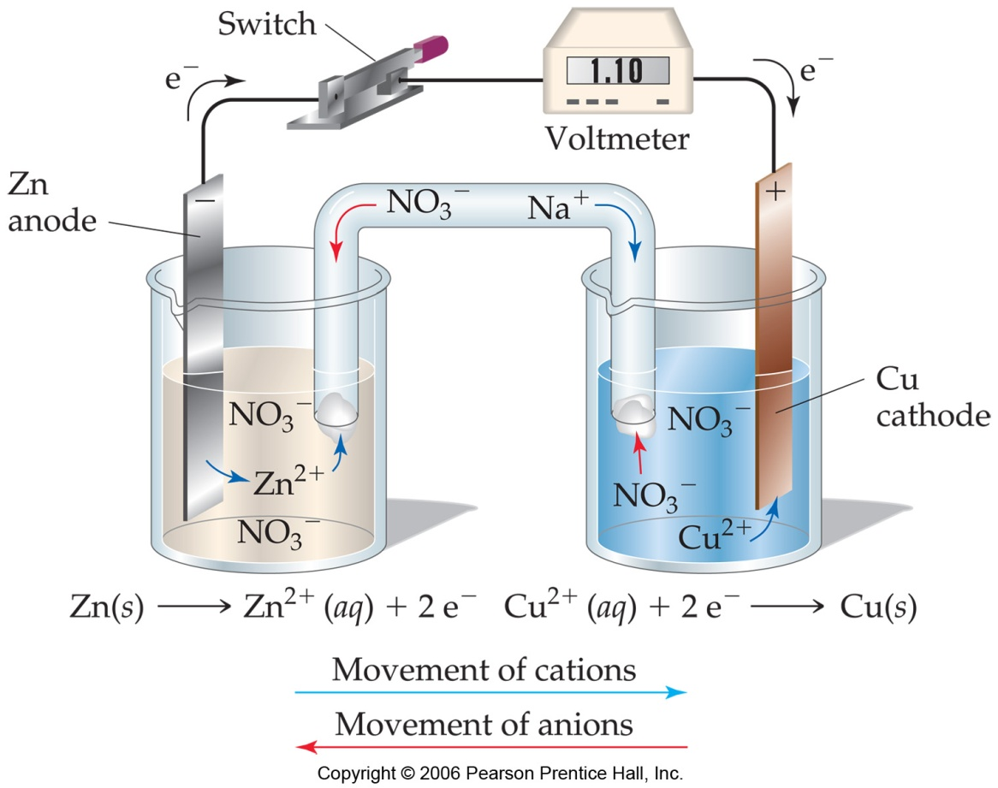
Function of salt bridge
The salt bridge allows for the flow of ions to prevent a build up of charge at each electrode
Positive ions flow to cathode
Negative ions flow to anode

Slide 69
Remove salt bridge?
The voltage will go to zero because electrons stop flowing.

Slide 70
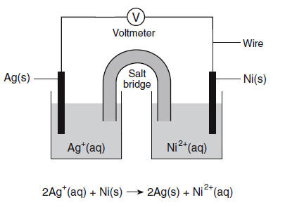
Example (I do)
Label the following: anode, cathode, where ox and red take place and direction of e- flow

Slide 71
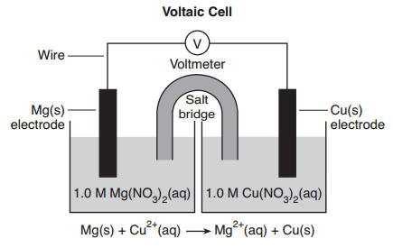
Example (We do)
Label the following: anode, cathode, where ox and red take place and direction of e- flow

Slide 72
Label the parts of a voltaic cell
Determine the flow of electrons in a voltaic cell
Determine which electrode increases and which decreases in mass

Slide 73
Electrolytic Cells

Slide 74
Lesson Objective:
Identify features of an electrolytic cell.
Differentiate between a voltaic and electrolytic cell.

Slide 75
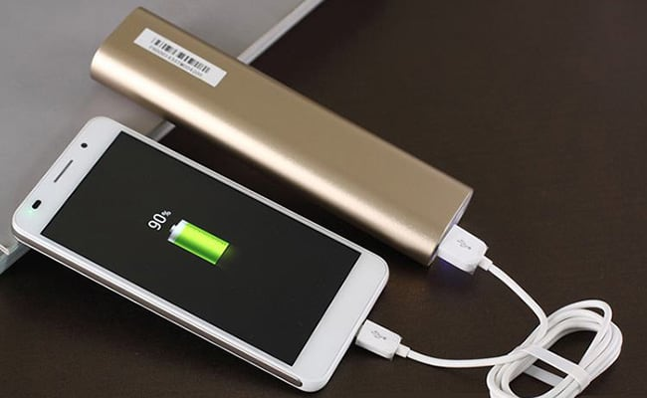
Electrolytic Cells
These cells are:
Nonspontaneous (require energy)
Outside power source must be supplied
No flow of electrons to produce a current
Converts electrical energy
Into chemical energy

Slide 76
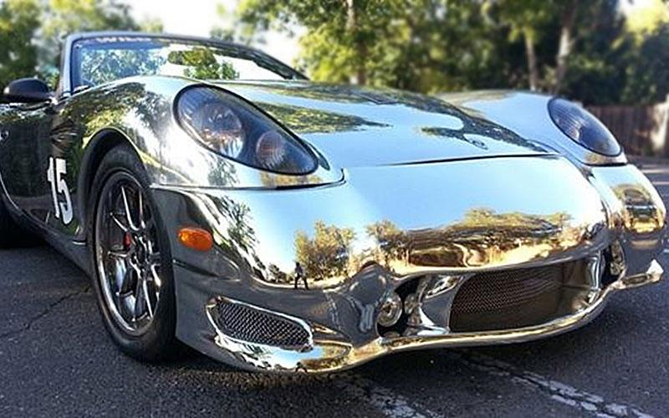
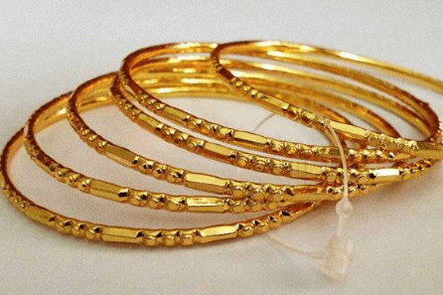
Electroplating
The process of layering one metal on top of another.
Examples: plated jewelry, chrome bumpers

Slide 77
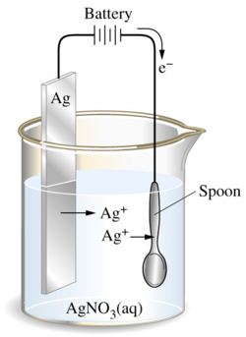
Electroplating Process
e⁻
e⁻
The battery forces electrons to travel to the spoon.
The spoon is negative and will attract Ag⁺ ions. The silver ions will reduce onto the spoon.
e⁻
e⁻
e⁻

Slide 78
Electroplating Process
e⁻
e⁻
AN OX, RED CAT
Ag⁰ → Ag⁺¹ + 1e⁻
e⁻
OXIDIZED = ANODE
Atoms will form ions in solution (mass decreases)
e⁻
Ag⁺¹ + 1e⁻ → Ag⁰
e⁻
ANODE
++++++
REDUCED = CATHODE
Ions will form atoms on the spoon (mass increases)
CATHODE
- - - - - - - - -

Slide 79
Electrolysis of water
Water and other solutions can be electrolyzed in order to break them into their pure elemental state.
2H₂O → 2H₂ + O₂
Notice more oxygen is being formed.
H⁺ is reduced to H₂ at the cathode
O⁻² is oxidized to O₂at the anode.

Slide 80
Electrolysis of Salts
NaCl_{(aq)}, is zapped with electricity to separate. However, the diagram shows H₂ and Cl₂ gases evolve, Not sodium metal. The Na⁺ ions stay in solution. Why?
Water is better at reducing than sodium so the water in the solution reduces instead of sodium.

Slide 81
Voltaic Electrolytic
Electrons flow from anode to cathode
An Ox, Red Cat
Spontaneous
Makes electricity
Converts chemical energy into electrical energy
Salt bridge
Anode (-) cathode (+)
Electrons flow from anode to cathode
An Ox, Red Cat
Not Spontaneous
Needs electricity
Converts electrical energy into chemical energy
No Salt bridge
Anode (+) cathode (-)

Slide 82
Identify features of an electrolytic cell.
Differentiate between a voltaic and electrolytic cell.

