Slide 1
Regents review

Slide 2
Unit 1 PARTICLES AND MEASUREMENT

Slide 3
Significant Figures
A scientist’s final calculation can only be as precise as their least precise measurement.
Count digits in your measured number to determine their level of precision.

Slide 4
Significant Figures
Indicate PRECISION of a measurement.
Sig figs in a measurement include the known digits plus a final estimated digit (precision of instrument)
3.21 cm

Slide 5
Example 1

Slide 6
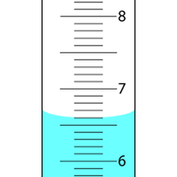
Example 2
What is the volume of the graduated cylinder in mL?
6.60 mL

Slide 7
Rules for Counting Sig Figs
All natural numbers 1-9 count once.
569 has 3 SF 3.456 has 4 SF
The number zero is tricky…
2. Zeros always count between natural numbers:
109 have 3 SF 50089 has 5 SF

Slide 8
Rules for Counting Sig Figs
3. Zeros before a decimal and natural number never count. 0.00789 has 3 SF 0.01234 has 4 SF 4. Zeros after natural numbers only count If there is a decimal present. 114.20 has 5 SF 11,420 has 4 SF

Slide 9
Recap: Counting Sig Figs
Start counting from LEFT to RIGHT at first NATURAL (non zero) number.
If decimal point is present then count any trailing zeros after the last natural (non zero) number.
If decimal is not present don’t count trailing zeros after the last natural (non zero) number.

Slide 10
Examples
2545.300 g 4530 km 0.00453 m
6.23 x 10⁶ m
7 sig figs
3 sig figs
3 sig figs
3 sig figs
= 6,230,000

Slide 11
What do I round my answer to?
An answer can never be more precise than your least precise measurement

Slide 12
Adding & Subtracting Sig Figs
Round your answer to the least number of DECIMAL PLACES.
5
3.75 mL
+ 4.1 mL
7.85 mL
1
7.9 mL

Slide 13
Examples
2.0 + 5.61 = 7.61 =
5.67 + 102.111 = 107.781 =
23 + 11.10 = 34.10 =
_
_
_
7.6
Least precise place value is tenths place
_
_
_
107.78
Least precise place value is hundredths place
_
_
_
34
Least precise place value is ones place

Slide 14
Multiplying & Dividing Sig Figs
Round your answer to the least number of significant figures.
(13.91 g/cm³) (23.3 cm³) = 324.103 g
4 SF
3 SF
3 SF
324 g

Slide 15
Examples
70.
2.0 x 35.1 = 70.2 =
5.11 x 98.654 = 504.12194 =
72.1 / 3.123 = 23.0867755 =
D = 56 g
12.45mL
504
23.1
= 4.5 g/mL

Slide 16
Determining Accuracy
This Formula is found on Table in your Reference Table T:

Slide 17
Example 1
Working in the laboratory, a student finds the density of a piece of pure aluminum to be 2.85 g/cm³. The accepted value for the density of aluminum is 2.699 g/cm³. Determine the percent error.
2.85 - 2.699
X 100 =
.151
X 100
= 5.59%
2.699
2.699
.151
X 100
= 5.30%
2.85

Slide 18
Example 2
The accepted value for the volume of a gas is 22.4 liters. In a laboratory experiment, a student determines the value to be 24.8 liters. What is the percent error of the student's measurement?
24.8 - 22.4
X 100 =
0.4
X 100
= 10.7%
22.4
22.4

Slide 19
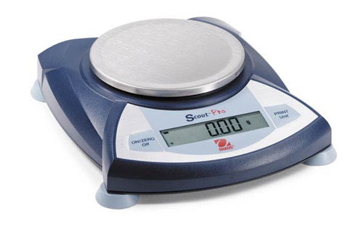
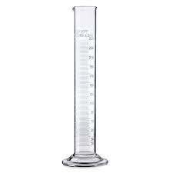
Density definitions
Mass: the amount of matter an object contains.
Volume: The amount of space a substance occupies

Slide 20
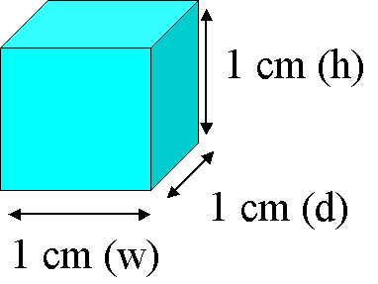
Measuring Volume
l x w x h (regular solid)
ex. V = 1cm³
Graduated cylinder (liquids)
Read bottom of MENISCUS
ex. V = 27.5 mL

Slide 21
Reading a Meniscus
10
10 mL
line of sight too high
reading too high
proper line of sight
8
reading correct
line of sight too low
6
reading too low
Graduated cylinder

Slide 22
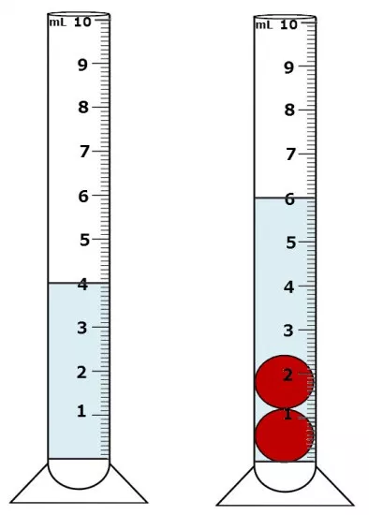
Measuring Volume of an Irregular Object
Water Displacement:
Measure initial volume
Measure final volume with object
The Difference is the volume of the object
Ex. 6.00 - 4.00 = 2.oo mL

Slide 23
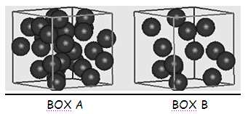
Density
Ratio of mass of an object to its volume
More particles
Same volume

Slide 24
Example:
What is the density of an object with a mass of 60.0 g and a volume of 2.0 cm³?
D =
m
D =
60.0 g
D = 30. g/cm³
v
2.0 cm³

Slide 25
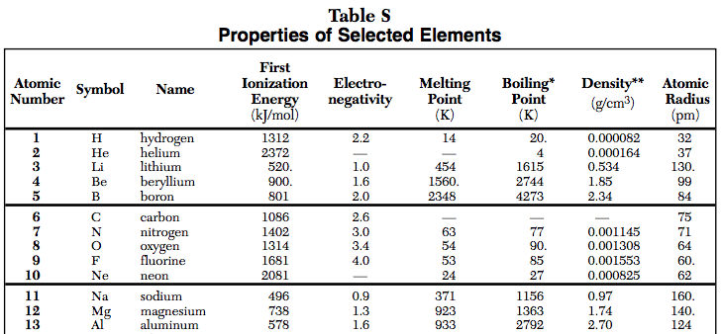
How to solve for m or v if density is not given
USE TABLE S Example: The volume of an aluminum sample is 251 cm³. What is the mass of the sample? The density of aluminum on table S is 2.70g/cm³
D =
m
v

Slide 26
How to solve for m or v if density is not given
USE TABLE S Example: The volume of an aluminum sample is 251 cm³. What is the mass of the sample?
m
2.70 g/cm³=
251 cm³
D =
m
v
= 678 g

Slide 27
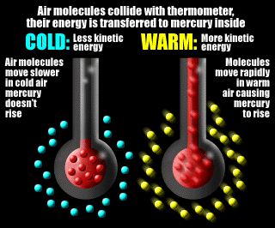
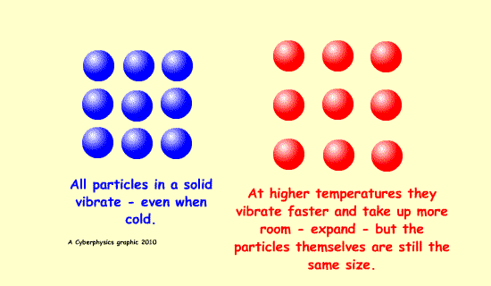
Temperature
Measure of average kinetic energy

Slide 28
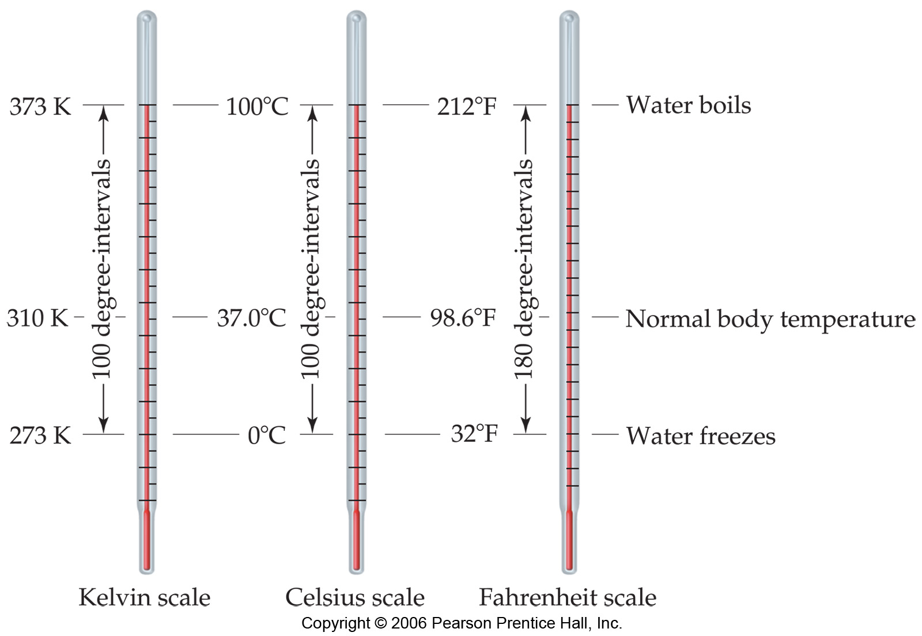
Temperature Scales

Slide 29
Celsius Scale
Freezing point of water is 0°C
Boiling point for water is 100°C
Below 0°C is NEGATIVE *****Memorize this!!!!

Slide 30
Celsius Scale

Slide 31
Kelvin Scale
Water freezes at 273K and boils at 373K
Theoretical point of ABSOLUTE ZERO is when all molecular motion stops
NO NEGATIVE NUMBERS
Divisions (degrees) are the same as in Celsius

Slide 32
Example:
What is the temperature in Celsius of an object that is 150 K? K = °C + 273
150 K = °C + 273
- 273
- 273
= -123 °C

Slide 33
Example:
What is the temperature in Kelvin of an object that is 55 C? K = °C + 273
x = 55 + 273
= 328 K

Slide 34
The metric system
System of measurement used in science and in most countries
The BASE UNITS of measurement: (Found on Reference Table D)

Slide 35
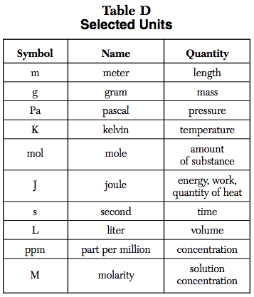
Base Units

Slide 36
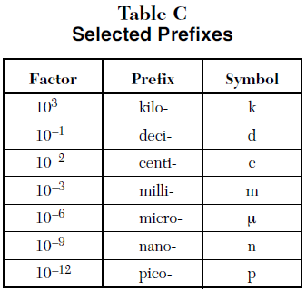
Prefixes
Used to modify base units of measurement. (Found on Reference Table C)
Factors equal the # of base units
Ex. 1 kilogram = 10³ grams
1 milliliter = 10⁻³ liters
Notes:
Factor is the number of base units equal to that particular prefix

Slide 37
Label your table
10⁰ base units (m, L g etc.)
Notes:
Unit with the prefix gets the 1 and the base unit gets the factor
What goes up must come down
Conversion factor

Slide 38
Rules
Locate the decimal. If there is no decimal present, it is at the end of the number.
If the unit gets larger, the number gets smaller
If the unit gets smaller, the number gets larger

Slide 39
Example 1
Convert 45.50 mL to L
Difference between exponents = # of spaces moved
0
45.50
= .0455o L

Slide 40
Example 2
Convert 502.3 kg to g
Difference between exponents = 3
= 502.3
0
0
= 502,300 g

Slide 41
Example 3
Convert 22.3 cm to m
Difference between exponents = 2
= 22.3
= 0.223 m

Slide 42
Unit 2: PARTICLES AND MOVEMENT

Slide 43
Measuring Pressure of a gas

Slide 44
Kinetic Molecular Theory of Gases:
Scientists construct models to explain the behavior of substances
A study of behavior of gases has led to a model called the kinetic molecular theory of gases (KMT)
Describes the relationships among pressure, volume, temperature, velocity, frequency and force of collisions

Slide 45
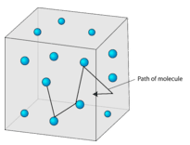
Assumptions of the KMT:
Gases are composed of a large number of particles that are in constant, random, straight line motion, until they collide with another particle or the walls of a container
The volume of a gas is negligible (zero) because the particles are much smaller than the distance between them so most of the volume of a gas is therefore empty space.

Slide 46
Assumptions of the KMT:
There is no force of attraction between gas particles or between the particles and the walls of the container.
Collisions between gas particles or collisions with the walls of the container are perfectly elastic. None of the energy of a gas particle is lost during a collision.

Slide 47
KMT
Remember, the kinetic theory of gases is theoretical and describes the “ideal” behavior of a gas. No “real” gas behaves exactly like this theoretical model.

Slide 48
Real Gases
In real gases, the following factors contribute to the deviations from the ideal model: 1. Real gases have a small but significant volume. 2. Gas particles do exert some attractive force on each other.

Slide 49
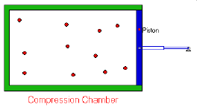
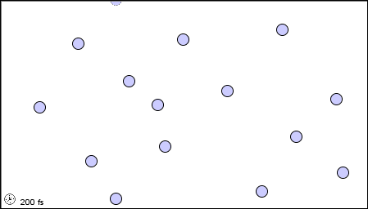
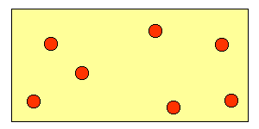
Gases behave most IDEALLY under conditions of:
HIGH temperature and LOW pressure BECAUSE:
particles are moving faster
particles are farther apart
}
Why? Less chance of gas particles attracting each other

Slide 50
Gases deviate (stray) from ideal under conditions of:
Low temperature and High pressure BECAUSE:
particles are moving slower
particles are closer together
}
Why? Gas particles can more easily attract each other

Slide 51
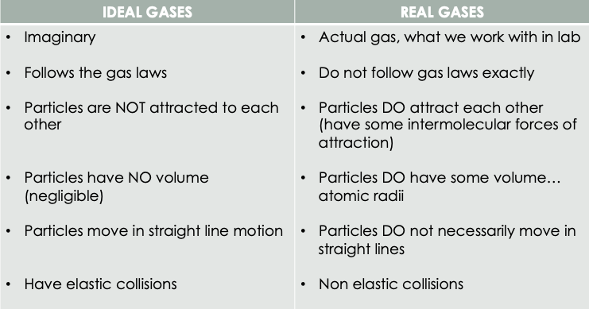
Summary of Ideal vs Real Gases

Slide 52
Example:
Under which conditions of temperature and pressure would a gas behave most like an ideal gas? A) 50 K and 20 kPa B) 50 K and 600 kPa C) 750 K and 20 kPa D) 750 K and 600 kPa
C) 750 K and 20 kPa

Slide 53
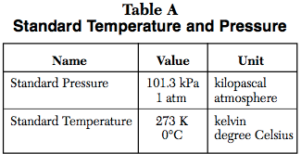
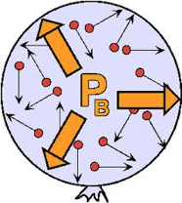
Gas Pressure
Force exerted on container walls by particles in a gas Units we use: kPa, atm
STP (Standard Temperature and Pressure) refer to Table A

Slide 54
Example:
An assumption of the kinetic theory of gases is that the particles of a gas have
little attraction for each other and a significant volume
little attraction for each other and an insignificant volume
strong attraction for each other and a significant volume
strong attraction for each other and an insignificant volume

Slide 55
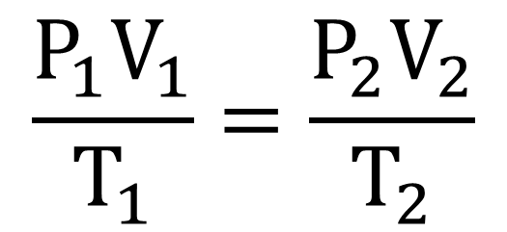
Combined Gas Law
Located on Table T:
P = pressure (kPa or atm) V = volume (L, mL, cm³) T = temperature (K)

Slide 56
Important!!!!
Temperature Must be in KELVIN to avoid negative values
Use the same units for BOTH volumes and BOTH pressures
If one variable remains the same (constant) or not mentioned, leave it out of the equation

Slide 57
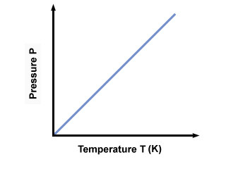
Example 1
A gas in a rigid container has a pressure of 3.5 atm at 200. K. Calculate the pressure at 273K.
3.5 atm
=
x atm
200. K
273 K
P₂ = 4.8 atm
200. (x) = (3.5)(273)
200.
200.

Slide 58
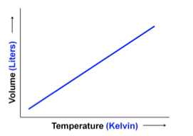
Example 2
A 32.9 L sample of a gas at constant pressure increases in temperature from 25C to 45C. Should the volume increase or decrease? Calculate the new volume.
32.9 L
=
x L
298. K
318 K
298 (x) = (32.9)(318)
V₂ = 35.1 L
298
298

Slide 59
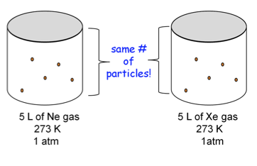
Avogadro's Law
Two different gases as the same temperature, volume, and pressure have the same number of particles.

Slide 60
Example:
At the same temperature and pressure, which sample contains the same number of particles as 1 liter of O₂ (g)? (a) 1 L Ne (g) (b) 0.5 L SO₂ (g) (c) 2 L O₂ (g) (d) 7 L of H₂O (l)
1 L Ne (g)

Slide 61
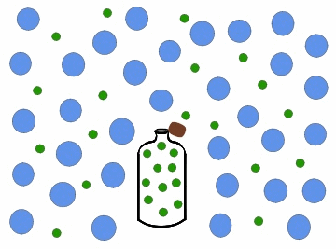
Graham’s Law of Diffusion
Gases move from high to low concentrations.

Slide 62
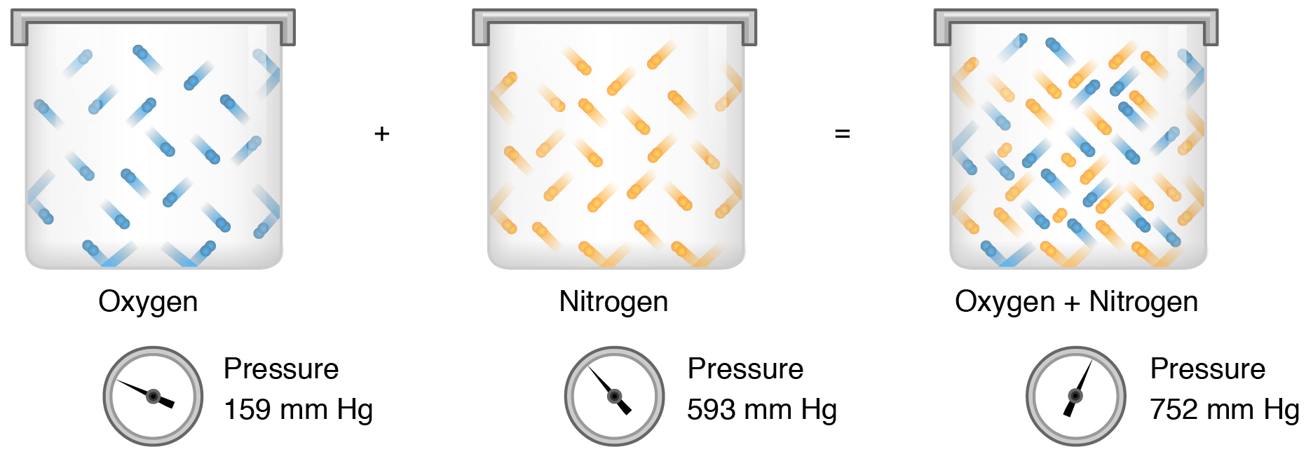
Dalton’s Law of Partial Pressures
The total pressure in a system of gases equals the pressure of each individual gas combined.

Slide 63
Example:
If the total pressure of a container of gases is 3 atm and it contains 1 atm of oxygen, 0.5 atm of nitrogen, 0.75 atm of methane, what is the partial pressure of the remaining gas?
P_{total} = P₁ + P₂ + P₃ + …….
3 atm = 1 atm + 0.5 atm + .75 atm + x
3 atm = 2.25 + x
X = .75 atm

Slide 64
Example:
What is the total pressure of a container of gases if it contains 1.5 atm of nitrogen, 2.1 atm of oxygen and 1.35 atm of carbon dioxide?
P_{total} = P₁ + P₂ + P₃ + …….
P_{total} = 1.5 atm + 2.1 atm + 1.35 atm
P_{total} = 4.95 atm

Slide 65
Unit 3: ENERGY AND STATES OF MATTER

Slide 66
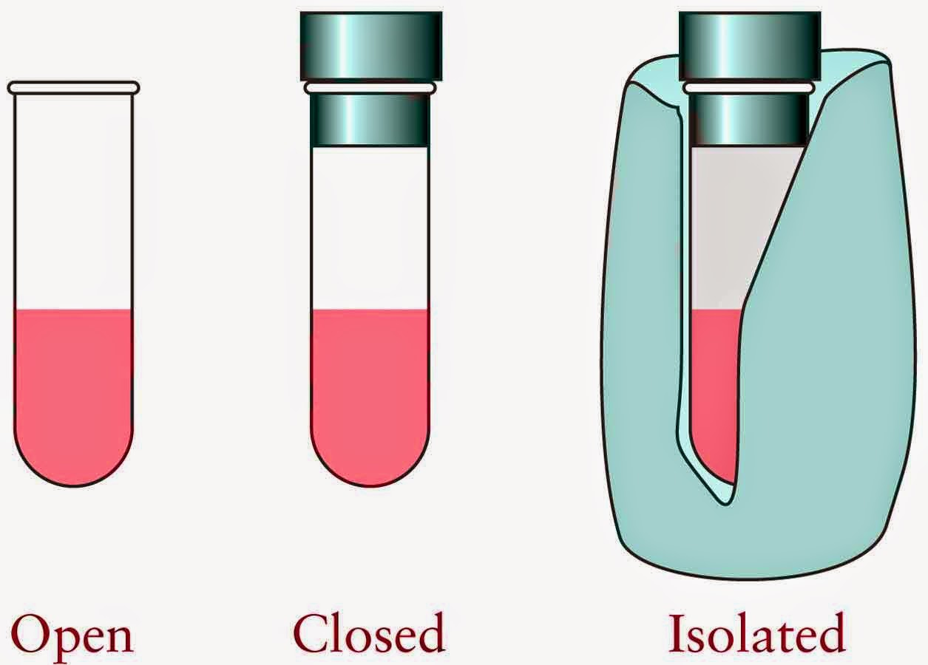
Systems and Surroundings
The system includes the particles we want to study
Open: exchanges energy and mass
Closed: exchanges energy but no mass
Isolated: doesn’t exchange energy or mass

Slide 67
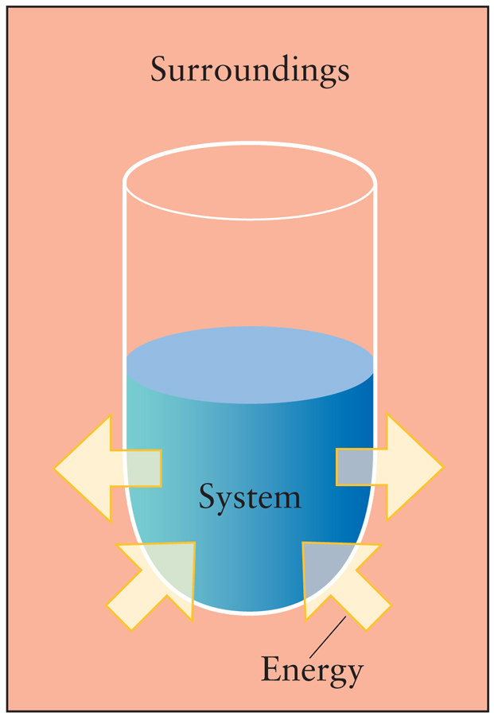
Systems and Surroundings
The surroundings are everything else (ex. container, top, surroundings)

Slide 68
Types of energy
Kinetic (thermal) energy: energy of motion
Potential (phase) energy: stored energy

Slide 69
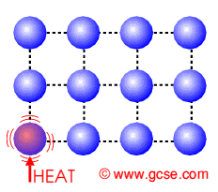
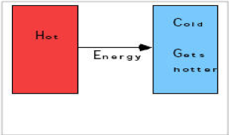
What is heat?
The movement of energy from one object to another
Moves from HOTTER (higher KE) object to COOLER (lower KE) object

Slide 70
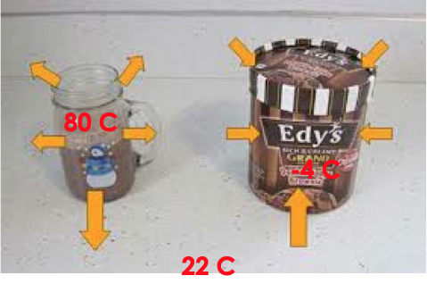
Example:

Slide 71
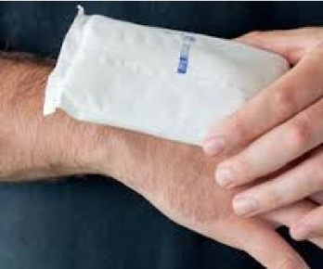
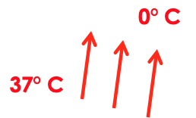
Example:
In terms of heat flow what happens when an ice pack is placed on your skin?

Slide 72
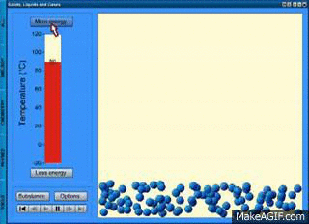
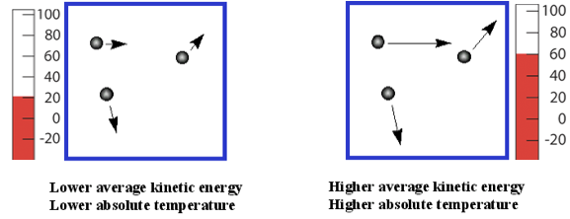
Temperature
Measure of the AVERAGE KINETIC ENERGY of the particles in matter

Slide 73
Example:
In which sample of water do the molecules have the highest average kinetic energy? 20. mL at 100. °C 40. mL at 80. °C 60. mL at 60. °C 80. mL at 40. °C
temperature

Slide 74
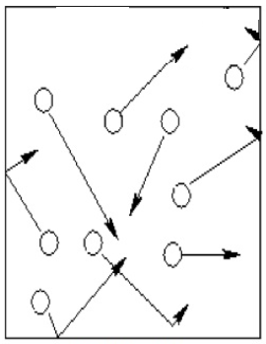
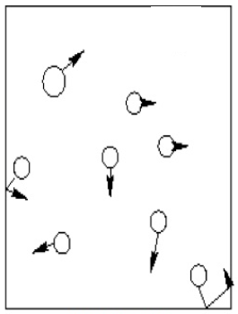
Particle model of heat transfer
Energy (heat)
Room: 25 C
Room: 25 C
Hot coffee: 85 C
Cold coffee: 25 C

Slide 75
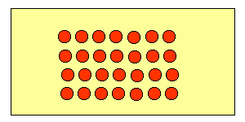
Solids
Definite shape
Definite volume
Particles are packed tightly in a geometric (crystalline) pattern
Constant vibration

Slide 76
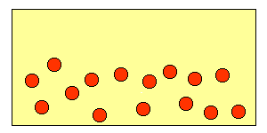
Liquids
No definite shape (take shape of container)
Definite volume
Particles further apart than solids but closer than gas
Constant motion

Slide 77
Gas
No definite volume (fill container)
No definite shape
Constant motion (most amount of movement)
No arrangement
Particles are farthest apart

Slide 78
“Force” holding particles together
Solids – STRONGEST force of attraction between particles Liquids – MODERATE force of attraction between particles Gases – WEAKEST force of attraction between particles

Slide 79
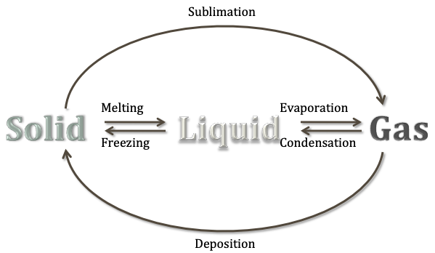
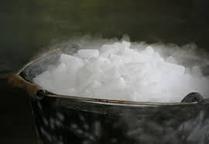
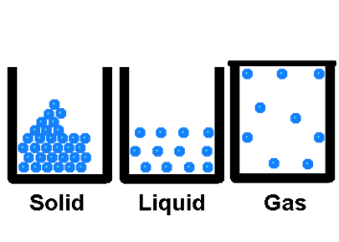
Phase Changes
Endothermic (adding heat) →
← Exothermic (removing heat)

Slide 80
Endothermic
(s) + heat → (l) (melting) (l) + heat → (g) (vaporization, boiling) (s) + heat → (g) (sublimation)

Slide 81
Exothermic
(l) → (s) + heat (freezing) (g) → (l) + heat (condensing) (g) → (s) + heat (deposition)

Slide 82
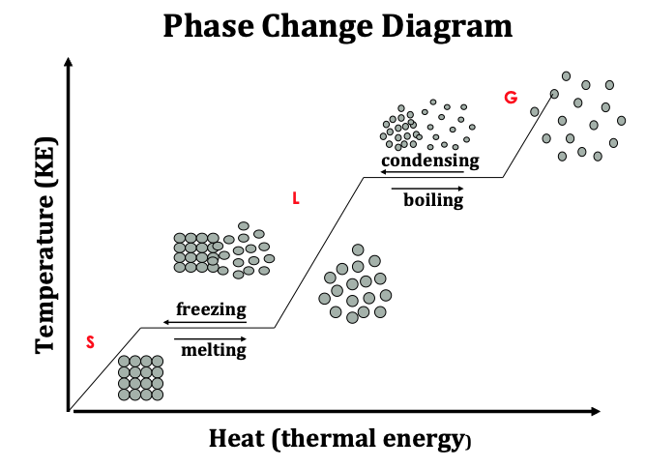

Slide 83
Calculating Heat of Reactions:
q = symbol for Heat
Measured in joules or kilojoules
If q is (+) the reaction is endothermic
If q is (-) the reaction is exothermic

Slide 84
The heat of the reaction q
Recall that q is based upon:
The mass of the substance
The temperature change it undergoes
Specific heat of the substance

Slide 85
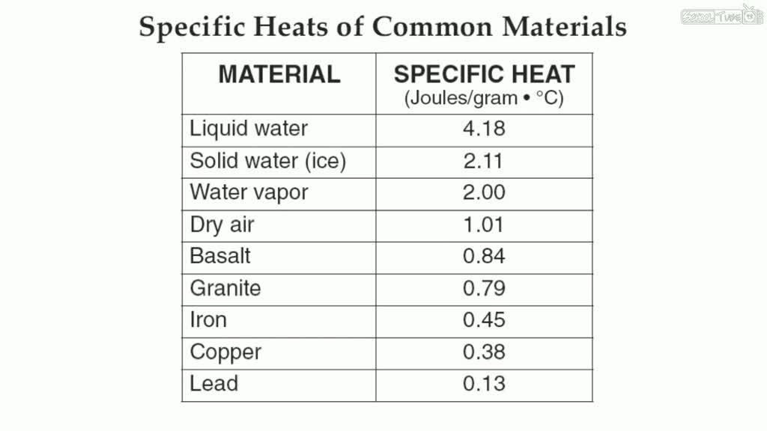
Specific heat
Amount of heat energy needed to raise the temperature of 1 gram of a substance 1 degree Celsius

Slide 86
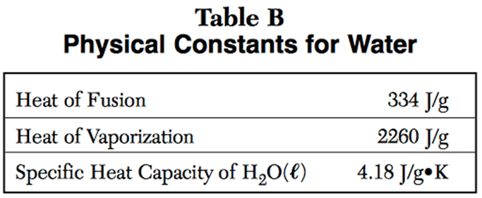
Specific Heat of Water
When heat is added to water, it takes a lot of energy to move the particles due to the strong attractive forces between the particles.

Slide 87
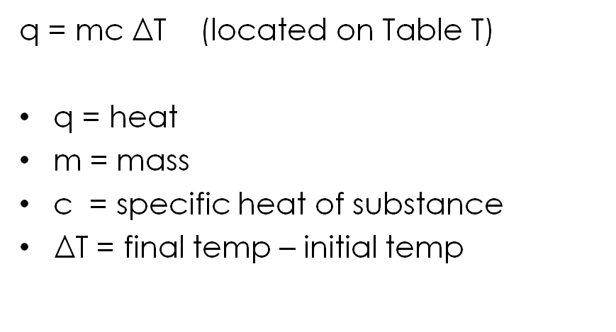
Calculating Heat

Slide 88
Example 1
How many joules of heat are absorbed when 50.0g of water are heated from 30.2°C to 58.6°C?
m = 50.0 g
q = mCΔT
C = 4.18 J/g°C
q = (50.o g)(4.18 J/g°C)(28.4°C)
q = 5935.6 J
ΔT = 28.4°C
q = 5940 J

Slide 89
Example: Solving for mass
When 520. joules of heat energy are added to water at 20.0 °C, the water incrases to 30.0°C. What is the mass of the water?
q = 520. J
q = mCΔT
m = ? g
520.J = (x)(4.18 J/g°C)(10)
c = 4.18 J/g°C
X = 12.4g
ΔT = 10

Slide 90
Example: Solving for specific heat
When 77J of heat are added to 10.0 grams of substance x at 20.0°C the final temperature is 25.0°C. What is the specific heat of substance X?
q = 77. J
q = mCΔT
m = 10.0 g
77J = (10.o g)(x)(5.0)
c = 4.18 J/g°C
X = 1.5J/gC
ΔT = ?

Slide 91
Example: Solving for final temperature
When 418. joules of heat energy are added to 10.0 grams of water at 20.0 °C, what will the final temperature of the water be?
q = 418. J
q = mCΔT
m = 10.0 g
418.J = (10.o g)(4.18 J/g°C)(ΔT)
c = 4.18 J/g°C
(ΔT) = 10.0°C
ΔT = ?
Initial temp 20.0°C + 10.0°C =
30.0°C

Slide 92
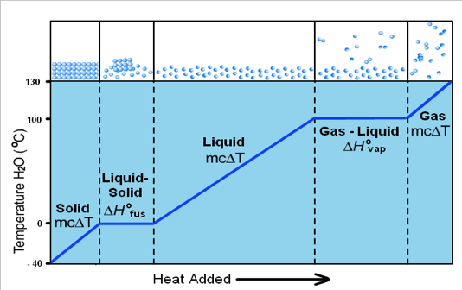
When do we use Q=mcΔT
Only where there is a a change in temp ΔT(on the solid, liquid and gas only lines.

Slide 93
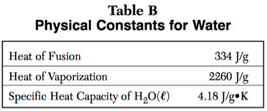
Heat of fusion
Heat needed to change a substance from solid to liquid or liquid to solid.
q=mH_{f} (table T)

Slide 94
Heat of Vaporization
Heat needed to change a substance from liquid to gas or a gas to a liquid
q=mH_{v} (table T)

Slide 95
Effects of attractive forces
If the attractive force between particles is strong, the heats of vaporization and fusion is high (high melting/boiling point)

Slide 96
Effects of attractive forces
It takes more energy to go from liquid to solid (vaporizing) than solid to liquid (melting) because you have to “break the force of attraction”

Slide 97
Heat of Fusion Example
How many joules does it take to melt a 16.0 gram sample of water at 0°C?
q = ?
q = mH_{f}
m = 16.0 g
q = (16.0 g)(334 J/g)
H_{f} = 334 J/g
q = 5344 J
5340 J

Slide 98
Heat of Vaporization Example
How many joules does it take to boil a 250. gram sample of water at 100°C?
q = mH_{v}
q = ?
m = 250. g
q = (250. g)(2260 J/g)
H_{v} = 2260 J/g
q = 565,000 J

Slide 99
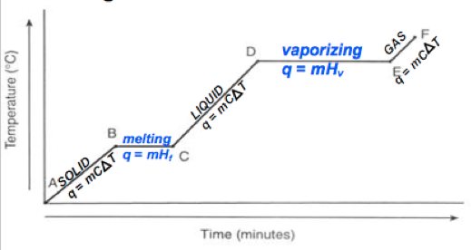
Heating Curve (heat added over time)
Vertical parts:
Temp inc
Avg kinetic energy inc
Potential energy constant
Horizontal parts:
Temp remains same
Avg kinetic energy remains the same
Potential energy increases

Slide 100
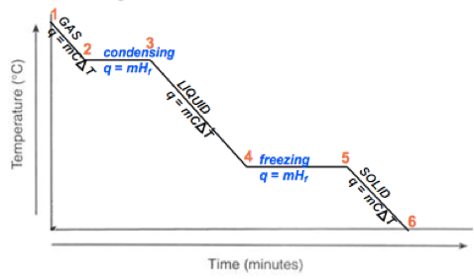
Cooling Curve (heat removed over time)
Vertical parts:
Temp dec
Avg kinetic energy dec
Potential energy constant
Horizontal parts:
Temp remains same
Avg kinetic energy remains the same
Potential energy decreases

Slide 101
Remember the 3 P’s
Plateau Phase change Potential energy change **diagonal Parts: Temperature is changing….therefore kinetic energy is changing

Slide 102
Unit 4: TYPES OF MATTER

Slide 103
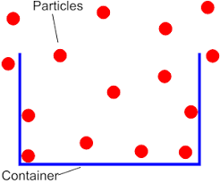
Matter
Matter is anything that:
Has mass
Takes up space (volume)

Slide 104
What isn’t matter?
Light
Heat
Sound

Slide 105
Classification of Matter
MATTER
yes
no
Can it be physically separated?
MIXTURE
PURE SUBSTANCE
yes
no
yes
no
Is the composition uniform?
Can it be chemically decomposed?
Homogeneous Mixture
(solution)
Heterogeneous Mixture
Compound
Element

Slide 106
PUre Substances
Elements & Compounds
Each substance has exactly the SAME composition throughout

Slide 107
Elements
Substances that CANNOT be broken down
Made up of all the same ATOMS.
Elements symbols:
1 letter capitalized
If it has a second letter it’s always lower case
Examples of elements: H, N, Pb

Slide 108
Monoatomic Elements
Composed of a single type of atom not bonded to each other Ex. Sodium (Na)
Na
Na
Na
Na

Slide 109
Diatomic Elements
Composed of two of the same types of atoms bonded to each other Ex. H₂
H
H
H
H
H
H

Slide 110
Memorize These!!!
Elements that exist as diatomic molecules
Br I N Cl H O F Bromine (Br₂) Hydrogen (H₂) Iodine (I₂) Oxygen (O₂) Nitrogen (N₂) Fluorine (F₂) Chlorine (Cl₂)

Slide 111
The 7 Diatomic Elements

Slide 112
Compounds
Made up of 2 or more different atoms chemically combined
Have a fixed composition (doesn’t change e.g. H₂O)
Can be broken apart into elements
O
H
H

Slide 113
Elements
Elements: Consist of one type of particle and cannot be broken down by chemical means
Na
Na
H
H
H
H
Na
Na
H
H

Slide 115
Properties of Metals:
Luster (shiny)
Excellent conductors of heat and electricity
Malleable (can be hammered or rolled into thin sheets)
Ductile (can be drawn into a wire)
Solid @ STP (except Hg)
Na
Na
Na
Na

Slide 116
Why are metals Malleable & Ductile?
Metals consist of layers of particles that can slide over each other

Slide 117
Metal Alloys
Alloys such as brass (mixture of copper and zinc) are harder than the original metals
Irregularity in the structure helps to stop slipping over each other

Slide 118
Properties of Metalloids
Semiconductors (Good/moderate conductor)
Luster (like metals) and Brittle (like nonmetals)
Used for making computer microchips

Slide 119
Properties of Nonmetals
Poor conductors of heat and electricity
Brittle (shatter when struck)
Dull

Slide 120
Atom vs Molecule
Atom: single particle
Molecule: made up of 2 or more atoms chemically combined
O
C
O
O
O

Slide 121
Compounds
Two or more different types of atoms chemically bonded together in a definite, whole number ratio
C
O
O
H
H
Ex. CO
Ex. H₂O

Slide 122
Ionic Substances
Made up of a metal and a nonmetal element
Example: NaCl
Na
Cl

Slide 123
Properties of Ionic Substances
Hard, crystalline structure
HIGH Melt/Boiling Pt
SOLUBLE in water
Conduct ELECTRICITY
only when dissolved in water (aq)

Slide 124
Covalent Substances
Made up of 2 or more nonmetal elements
Example: CO₂
O
C
O

Slide 125
Properties of Covalent Substance
Low melting and boiling pts
due to weak attraction between particles
Do not conduct electricity

Slide 126
Properties of Covalent Substances
Polar Covalent: dissolves in water
Nonpolar covalent: insoluble in water
insoluble
Soluble

Slide 127
Subscripts
The little number following an element symbol.
Indicates the # of ATOMS of ONLY THAT ELEMENT in the compound. Example: H₂O CO₂ (2 H’s and 1 O) (1 C and 2 O’s)
O
O
C
O
H
H

Slide 128
Coefficients
The big number in front of a formula
Indicates the number of molecules/compounds there are Example: 3H₂O is 3 molecules of the compound H₂O
O
H
H

Slide 129
Example
How many atoms of Hydrogen are indicated by the formula: 2H₂O?
O
O
4 atoms of H
H
H
H
H
How many molecules of water are indicated by the formula: 2H₂O?
2 molecules of water

Slide 130
Classification of Matter
MATTER
yes
no
Can it be physically separated?
MIXTURE
PURE SUBSTANCE
yes
no
yes
no
Is the composition uniform?
Can it be chemically decomposed?
Homogeneous Mixture
(solution)
Heterogeneous Mixture
Compound
Element

Slide 131
Mixture
Combinations of 2 or more different elements, compounds or both, in no fixed ratio, and not bonded together
Each substance in mixture keeps its own properties
Ex. Mixture of element and compound

Slide 132
Homogeneous Mixture
Substances are uniformly (evenly) mixed
All solutions are homogeneous mixtures
Example: Salt water NaCl (aq)
(aq) aqueous (dissolved in water)

Slide 133
Heterogeneous Mixture
Substances are not uniformly (unevenly) mixed
Example: oil and water

Slide 134
Heterogeneous vs homogeneous

Slide 135
Example:
Classify as an element compound or mixture:
NaCl (s)
NaCl (aq)
compound
mixture

Slide 136
Symbols
If a single symbol, with one capital letter = element.
Example: Au (gold)
If two or more combined symbols, with two or more capital letters = compound.
Example: PbO (lead oxide)

Slide 137
Example
Which represents a mixture of substances?

Slide 138
Separating Mixtures
Separating mixtures can be done based on physical properties as:
1. boiling point/freezing pt
2. Density
4
3. particle size
3. particle size
4. Solubility
5. magnetism

Slide 139
Filtration
Separates a solid from a liquid
Must be a heterogenous mixture

Slide 140
Evaporation
Separates an aqueous solution
Ex. NaCl (aq)

Slide 141
Distillation
Separates a mixture of 2 0r more different liquids based on boiling point

Slide 142
Chromatography
Separates particles based upon size and polarity

Slide 143
Example
A student wants to separate a solution of sugar water. What method would they use?

Slide 144
Physical Properties/Changes
Characteristics that don’t change the substance
NO NEW SUBSTANCE is produced
Examples: density, crushing, solubility, conductivity, melting/boiling pt, phase changes etc.

Slide 145
Physical Change
The particles don’t change during a physical change

Slide 146
Signs of a physical property/change
Still the same substance but in a different form or state of matter (s,l,g) Words to look for: Dissolves, phase change, melts or boils, Is a solid, liquid or gas etc

Slide 147
Chemical properties/changes
Characteristics that change the substance A NEW SUBSTANCE is made Examples: Reactivity, flammable, corrosive, bubbling

Slide 148
Chemical Change
New substances are formed during a chemical change
CO₂
C and O₂
O
C
O
C
O
O

Slide 149
Signs of a chemical property/change
A NEW substance is made that has different properties than its elements
Words to look for: reacts with (water etc.) Combusts corrodes

Slide 150
Examples:
rusting iron
dissolving in water
burning a log
crushing a compound
chemical
physical
chemical
physical

Slide 151
Physical vs Chemical Change
Chemical change -> compounds formed or broken down by changing the bonds between them
Physical change -> phase change or mixtures created or separated by changing the forces between them

Slide 152
Unit 5: ATTRACTIVE FORCES

Slide 153
Dalton (1808)
His Model of Atom:
All elements composed of tiny particles called ATOMS
All atoms in an element are identical
Different elements are made of different atoms
Atoms were solid and indivisible
Na
Na
Na
Na

Slide 154
Thomson’s Model of the atom
Proposed that atoms actually have parts
How did he determine this?

Slide 155
Cathode Ray Tube Experiments
A vacuum tube (air removed) is connected to a power source and particles seemed to move between the electrodes
-
+
Power source
-
-
-
-
Notes:
Describe the CRT parts and how it works

Slide 156
Determining Charge
When he placed charged plates around the CRT he saw the beam pulled towards the positive plate.
The particles must be negatively charged
-
-
-

Slide 157
Thomson’s Conclusions
Determines the beam is made of particles that are negatively charged called ELECTRONS
These particles are 1,000 smaller than a hydrogen atom (smallest atom)
Different metals all give off cathode rays
Notes:
Already known that all matter is made of atoms so electrons must be coming from atoms. Different metals all had electrons

Slide 158
Additional Conclusions
Thompson also found that the atom as a whole was electrically neutral (no charge)
So there must be positive charges in the atom to balance out the negative electron charge

Slide 159
J. J. Thomson’s Model (1897)
“plum pudding” model
Atom is positively charged with negative electrons “stuck” in it.
+ charged “muffin”
+ charged “pudding”
- charged electrons “chocolate chips”
- charged electrons “plums”

Slide 160
When ionic compounds are dissolved
The metal particles tend to form positively charged ions (cations)
The non-metal particles tend to form negatively charged ions (anions)
+1
-1
NaCl

Slide 161
Electrolytes
These charged particles allow for the conduction of electricity

Slide 162
Ionic Compounds
Ratio of atoms in ionic compounds based upon the charge of each ion they form
Examples: NaCl CaCl₂
+1
-1
-1
+2
-1

Slide 163
Group 1 metals
Form +1 Cations
Example: NaCl
+1
-1

Slide 164
Group 2 metals
Form +1 Cations
Example: BaCl₂
-1
+2
-1

Slide 165
Group 13 metals
Form +3 ions
Ex. AlCl₃
-1
+3
-1
-1

Slide 166
Group 15 nonmetals
Form -3 ions
Example: NaP
+1
-3
+1
+1

Slide 167
Group 16 nonmetals
Form -2 ions
Example: NaO
+1
-2

Slide 168
Group 17 nonmetals
Form -1 ions
Example: NaCl
+1
-1

Slide 169
Group 18 non-metals
Don’t form ions
Unreactive (inert) so they don’t form compounds
Ex. Ne_{(g)}

Slide 170
Writing Chemical Formulas
Sum of charges (oxidation numbers) in a compound equal zero
Don’t write 1’s for subscripts Example: Na⁺¹Cl⁻¹
(+1) + (-1) = 0
NaCl

Slide 171
Example 1:
Write the chemical formula for a compound containing calcium and Fluorine.
+2
-1
-1
-1
+2
-1
Ca⁺² F⁻¹
F⁻¹
CaF₂
1(+2) + (-1) = 0
2

Slide 172
Example 2:
Write the chemical formula for a compound containing Lithium and Sulfur.
+1
+1
-2
+1
-2
+1
Li⁺¹
Li⁺¹ S⁻²
Li₂S
2
(+1) + 1(-2) = 0

Slide 173
Example 3:
Write the chemical formula for a compound containing barium and oxygen.
+2
-2
+2
-2
Ba₁O₁
Ba⁺² O⁻²
(+2) + (-2) = 0
BaO

Slide 174
Redox Reactions
In redox reactions, electrons are transferred from one species to another.
This can cause a multitude of outcomes.

Slide 175
Oxidation States
To follow the flow of electrons, we assign oxidation numbers.
Notes:
But how do you know if there is a transfer of e-

Slide 176
Rules for Oxidation Numbers
An uncombined element (not in a compound) has an oxidation number of ZERO. This includes diatomic elements.
Ca + Cl₂→ CaCl₂
Oxidation # Ca = 0
Oxidation # Cl₂ = 0
0
0

Slide 177
Rules for Oxidation Numbers
2. Elements in compounds have the oxidation number listed on the periodic table. For nonmetals use the negative oxidation #.
Example: Group 1 Oxidation # = +1
Group 2 Oxidation # = +2
Group 17 oxidation # = -1

Slide 178
Rules for Oxidation Numbers
3. In an ionic compound, the metal (positive ion) is written first and the non metal (negative ion) is written last.
Example: NaCl Oxidation # Na = ⁺ 1
Oxidation # Cl = ⁻ 1
+1
-1
Notes:
More electronegative

Slide 179
Rules for Oxidation Numbers
4. The sum of oxidation numbers in a compound must equal ZERO.
Example: CaCl₂
+2(1) + -1(2)
2 - 2 = 0
+2
-1
HINT: Be sure to multiply oxidation # by the number of atoms in the subscript.

Slide 180
Redox Reactions
Redox stands for reduction/oxidation reaction. When one happens, the other must be happening, as well.
They involve the transfer of electrons!

Slide 181
Oxidation
The LOSS of electrons by an atom or ion to form a cation (positive ion). As a result:
Oxidation number goes UP or INCREASES
Becomes more POSITIVE (+)
Na
Na⁺¹

Slide 182
Oxidation
Metals oxidize (lose electrons) to from positive ions
-
-
-
+1
Li

Slide 183
Reduction
The GAIN of electrons by an atom or ion to form an anion. As a result:
Oxidation number REDUCES or DECREASES
Becomes more NEGATIVE (-)
F
F⁻¹

Slide 184
Reduction
Nonmetals reduce (gain electrons) to form negative ions
-
-
-
-
-
-
-
-
-
-
-1
F

Slide 185
Reduction
Why is it called reduction when you gain electrons?
Ox # +2
Gains 3e⁻
Goes to -1
3
2
Oxidation number reduces
1
0
-1
-2-3

Slide 186
Example
Zn oxidation number goes UP, loses e⁻, OXIDIZED.
H⁺ oxidation number goes DOWN, gains e⁻, REDUCED.

Slide 187
LEO GER

Slide 188
Example
Which species is oxidized and which is reduced?
2Na + Cl₂ → 2NaCl
0
0
+1
-1
LEO
LEO says GER
GER
Na went from 0 → +1
Cl went from 0 → -1
OXIDIZED
REDUCED

Slide 189
Identifying a Redox Reaction
If the oxidation #’s don’t change it’s not a redox reaction
Li + F₂ → LiF
LiBr + 2NaF → NaBr + LiF
0
0
+1
-1
YES
+1
-1
+1
-1
+1
-1
+1
-1
NO

Slide 190
Redox Reactions have...
An oxidation half reaction and a reduction half reaction.
Example: 2Mg + O₂ → 2MgO
LEO
LEO says GER
0
0
+2
-2
GER
Loss of electrons
Oxidation Half Reaction: Mg ⁰ → Mg⁺²
+ 2e⁻
Reduction Half Reaction: O₂ ⁰ →2O⁻²
+ 4e⁻
Gain electrons

Slide 191
Half reactions
A half reaction shows either the oxidation or reduction portion of a redox equation including if the electrons are gained or lost.

Slide 192
Half reaction: Reduction
A reduction half reaction shows an atom or ion gaining one or more electrons
Fe³⁺ + → Fe⁰
Notice that the e- are on the left.
3e-

Slide 193
Half reaction: oxidation
An oxidation half reaction shows an atom or ion losing one or more e-:
Mgº → Mg⁺² + 2e-
Notice that the e- is on the right.

Slide 194
Example
Add in electrons to balance the charge
The total charge on each side must be equal
K → K⁺¹
0
+ 1e-
Oxidation half reaction
0 →
+1 -1 = 0

Slide 195
Easily OXIDIZED
EASY to lose electrons
More active metals
Less active metals

Slide 196
More active metals
HARD to lose electrons
Less active metals
Not easily OXIDIZED

Slide 197
Easily REDUCED
EASY to gain electrons
More active nonmetals
Less active nonmetals

Slide 198
HARD to gain electrons
More active nonmetals
Not easily REDUCED
Less active nonmetals

Slide 199
Example
Compare nickel and aluminum. Which will be oxidized and which will be reduced?
Nickel is reduced
Aluminum is oxidized

Slide 200
When are rxn’s Spontaneous
Spontaneous reactions occur without the addition of energy to the system.
If the “single” element on the reactant side is more active than the “combined” element on the reactant side, then the reaction is spontaneous.
Example: Zn + PbCl₂ → ZnCl₂ + Pb

Slide 201
When are rxn’s Not Spontaneous
If not, the reaction is nonspontaneous and will require the addition of energy.
Example: Zn + AlCl₃ → no rxn

Slide 202
Example
Would this reaction occur spontaneously?
Li + MgSO₄ → Mg + LiSO₄

Slide 203
Unit 6
Subatomic particles

Slide 204
Recall: J. J. Thomson (1897)
Discovered ELECTRONS using a cathode ray tube.
His Model of the Atom:
“plum pudding” model
Atom is positively charged with negative electrons “stuck” in it.

Slide 205
Rutherford’s Gold Foil Experiment
The experiment:
Shot positively charged alpha particles at gold foil.
+
+

Slide 206
Rutherford’s Gold Foil Experiment
The Results:
Most particles went straight through.
A few were deflected.
+

Slide 208
Rutherford’s Gold Foil Experiment
+
+

Slide 209
Rutherford’s Model of the atom
Discovered the NUCLEUS
His Model of the Atom:
Small dense positive nucleus
Atom is mostly empty space

Slide 210
Subatomic Particles

Slide 211
Parts of the atom
Nucleons = protons + neutrons

Slide 212
Parts of the atom
Atoms are neutral
# of protons (+) = # of electrons (-)
+
+
+
+3 -3 = 0

Slide 213
Atomic Number
Equal to the number of protons
Every element has its own atomic number
How periodic table is arranged

Slide 214
Mass Number
Equal to the sum of the protons and the neutrons (whole number)
Can be written as carbon-12

Slide 215
To Find: # of Protons
Look up atomic number on Periodic Table Ex. Lithium has 3 protons

Slide 216
To find the # of electrons
The # of electrons are equal to the # of protons in a neutral atom
Ex. Lithium has 3 electrons

Slide 217
To Find: # of neutrons
Protons + Neutrons = Mass
# of neutrons = mass # - number of protons
Ex. Lithium has 4 neutrons (7 – 3) = 4

Slide 218
Example
Element | Atomic # | Mass # | # of protons | # of neutrons | # of electrons
Boron (B)
5
11
5
6
5

Slide 219
Ions
Charged particles
Formed when atoms gain or lose electrons

Slide 220
Cation
The atom loses electron(s) becomes positively charged (oxidation) Ex. Na⁺
11 e-
10 e-

Slide 221
Anion
The atom gains electron(s) becomes negatively charged (reduction) Ex. Cl⁻¹
9 e-
10 e-

Slide 222
Example cation
Element | Atomic # | Mass # | p⁺ | n | e⁻
Fe | 26 | 56 | 26 | 30 | 26
Fe⁺³ | 26
56
26
30
23
26⁺
23⁻
= ⁺3

Slide 223
Example anion
Element | Atomic # | Mass # | p⁺ | n | e⁻
Br | 35 | 80 | 35 | 45 | 35
Br⁻¹ | 35
80
35
45
36
35⁺
36⁻
= ⁻1

Slide 224
Nuclear Charge
The only charged particle in nucleus is protons (+)
Ex. nuclear charge of N is +7
+7
+6

Slide 225
Example:
What is the nuclear charge of the sodium atom and the sodium ion?
11 +
11 +
11 -
10 -
Na atom
Na⁺ ion

Slide 226
Isotopes
Elements that have the same # of protons (atomic #) but different # of neutrons resulting in a different mass.

Slide 227
Isotope Symbols
Show the mass of isotope
Same atomic #, different mass #
Ex. isotope symbol of element X X
Mass #
Atomic #

Slide 228
Common Isotopes of Hydrogen

Slide 229
Example
Write the isotope symbol for oxygen-17
How many neutrons does it have?
17
O
8
9

Slide 230
Example:
Which isotope of hydrogen is most abundant?

Slide 231
Why is atomic mass not a whole #?
Mass number = protons + neutrons
Atomic mass on the periodic table is a weighted avg. of all the naturally occurring isotopes of that element and the relative abundances (amounts)
Chlorine-35 (67.49%) chlorine-37 (32.51%)

Slide 232
Example of a general weighted avg
50% exams 85 10% quizzes 100. 15% labs 95 25% HW/CW 80
(50 x 85) + (10 x 100.) + (15 x 95) + (25 x 80.) =
87 avg
100

Slide 233
Example 1
Boron-10 19.78% 10.013 amu Boron-11 80.22% 11.009 amu Multiply the mass of each isotope by its percent abundance then divide by 100
10.013 amu
11.009 amu
(19.78 x 10.013) + (80.22 x 11.009)
=
10.82 amu
100

Slide 234
Example 2
Determine weighted atomic mass Potassium-39 93.12% 38.964 amu Potassium-41 6.88% 40.962 amu
40.962 amu
38.964 amu
(93.12 x 38.964) + (6.88 x 40.962)
= 39.10 amu
100

Slide 235
Bohr’s Model of the atom
Problems with Rutherford’s Model:
Bohr knew any charged particle that is moving like an electron would give off electromagnetic radiation (energy)
Notes:
Would quickly spiral into the middle of the atom and destroy the atom and he knew this wasn’t the case

Slide 236
Bohr Model of the Atom
He also knew that if it was giving off energy, the wavelength of that radiation would vary producing a continuous spectrum of electromagnetic energy in the form of visible light.

Slide 237
What Bohr Discovered
The energy given off wasn’t continuous
Had discrete units of energy

Slide 238
Bohr’s Model of the Atom
Determined that electrons are located in energy levels called orbits.
Each energy level (orbit):
is a fixed distance from the nucleus
can hold a specific number of electrons
has a definite amount of energy
+

Slide 239
Bohr’s Model of the Atom
The further away from nucleus the greater the energy of the electrons
Increasing energy

Slide 240
Constructing Bohr Diagrams
Look up electron configuration on periodic table
Draw a circle for nucleus and write # of protons and neutrons in it.
Draw in energy levels and write the # of electrons in each shell

Slide 241
Example: Bohr Diagram of Mg
12 p+
12 e-
0
8 e-
12p+
12n⁰
2 e-
2 e-

Slide 242
Example: Mg⁺²
12 p+
10 e-
2 e-
8 e-
+2
12p+
12n⁰
2 e-

Slide 243
Example: O⁻²
8 p+
10 e-
2 e-
6e-
-2
8p+
8n⁰
8e-
2e-

Slide 244
Ground State
Ground State- When electrons occupy the LOWEST available ENERGY LEVELS. (configuration on periodic table)

Slide 245
Excited State
Excited State- Electrons NO LONGER occupy the lowest available energy levels (different than electron configuration)

Slide 246
Example: Possible Excited States of Na
Energy
11p+
12n⁰
Total # of electrons doesn’t change
11
11
11
11

Slide 247
How to determine if configuration is ground or excited
Add up total # of electrons in configuration
Determine element
If it matches element configuration on periodic table = GROUND
If it doesn’t match = EXCITED

Slide 248
Example
Identify the electron configuration as being ground state or excited state: 2-6-1
2+6+1 = 9
Fluorine
Excited State

Slide 249
Absorption
Excited State: Electrons absorb energy as they move to higher energy levels
This excited state is temporary and unstable.

Slide 250
Emission
Ground State: Lowest energy configuration. Electrons will eventually lose the absorbed energy and return back to ground state.
They give off the energy in the form of light energy

Slide 251
Light Energy
The color of light (wavelength) is determined by the amount of energy lost by the electron when it falls back to its ground state.

Slide 252
Bright Line Spectra
Each element has its own bright line spectra that is unique. (like a fingerprint)
Can be used to identify an unknown mixture of gases.

Slide 253
Example: What gases make up the unknown?

Slide 254
Lewis Dot Diagrams
Only show VALENCE ELECTRONS
Valence shell: outermost shell of an atom that contains electrons
Valence electrons: electrons that occupy the valence shell (last number in electron configuration)

Slide 255
Steps for Drawing Lewis Dot Diagrams
Draw the element’s symbol
Locate the valence electron number (last # in the electron configuration
Give out 1 electron to each side. Once all sides have 1 valence e- then give another to each side

Slide 256
Example: Carbon Dot Diagram
C

Slide 257
Example: Oxygen Dot Diagram
O

Slide 258
Example: Aluminum Dot Diagram
Al

Slide 259
Lewis Dot Diagrams: Ions
Draw brackets around the element symbol
Write charge of ion outside bracket on top right corner of symbol
Positive ions no dots
Negative ions 8 dots

Slide 260
Example: Positive Ion
Potassium IOn K⁺
2-8-8
-1
[
]
K

Slide 261
Example: Negative Ion
Sulfide IOn S⁻²
8
2-8-
6

Slide 262
Example: Negative Ion
oxide IOn O⁻²
2-
6
8
[
]
O

Slide 263
Unit 7: PERIODICITY AND BONDING

Slide 264
Mendeleev
Originally organized elements based upon ATOMIC MASS

Slide 265
Periodic Law
Similar properties recur periodically when elements are arranged according to increasing atomic number.

Slide 266
The Result….
Can fill in gaps to predict undiscovered elements and their properties

Slide 267
How is the Table Organized?
PERIODS (horizontal rows)
Equal to the # of energy levels (shells)
GROUPS (vertical columns)
Elements have the SAME # of VALENCE ELECTRONS resulting in similar chemical properties

Slide 270
Reactivity of Elements
Determined by the # of valence electrons
All atoms (except hydrogen) are stable when they have 8 VALENCE ELECTRONS (full valence shell)
Called a STABLE OCTET

Slide 271
Octet Rule
The closer to a stable octet, the more reactive the element is
****Period 1 elements need only 2 electrons to be stable and have a full valence shell

Slide 272
Example
Which two elements have similar chemical properties and why? Na, K, Li, Be Na & K are in the same group and have the same number of valence electrons

Slide 274
Group 1: Alkaline Metals
1 valence electron
Lose 1 electron to form +1 ions
Extremely reactive with water
Most REACTIVE metal is Fr

Slide 275
Group 2: Alkaline Earth Metals
2 valence electrons
Lose 2 electrons to form +2 ions
Fairly reactive in water

Slide 276
Groups 3-12: Transition Metals
Least reactive metals Form COLORED IONS in solution

Slide 277
Group 17: Halogens
7 valence electrons Gain 1 electron to form -1 ions Most REACTIVE nonmetal is F

Slide 278
Group 18: Noble Gases
Unreactive or INERT
Stable octet (8 valence electrons)
Exception is He which has 2 valence electrons
Always monoatomic

Slide 279
Hydrogen
Not officially part of a group
Nonmetal
Gas at STP

Slide 280
Atomic Radius
SIZE of the atom
Located on Table S

Slide 281
Across a Period
Trend: DECREASES……...Why?
Nuclei have greater NUCLEAR PULL (larger positive charges) which PULL electrons CLOSER

Slide 282
radius= 124 pm
radius= 100 pm

Slide 283
Down a Group
Trend: INCREASES…..Why?
GREATER number of ENERGY SHELLS (indicated by the PERIOD #)

Slide 286
Why?
Atomic radius decreases across a period
(Period, Proton, Pull)
Atomic radius increases down a group
(more electron shells)

Slide 287
Ion Size: Metals
Ion radius SMALLER than atomic radius
Why?
Metal atoms Oxidize and
LOSE electrons to form Cations

Slide 288
Ion Size: Nonmetals
Ion radius LARGER than atomic radius
Why?
Nonmetal atoms Reduce
and GAIN electrons to form anions

Slide 289
Atomic and Ionic Radius

Slide 290
Ionization Energy
Energy required to REMOVE the most loosely bound ELECTRON in the valence shell
Located on Table S

Slide 291
Trends in Ionization Energy
INCREASES across a PERIOD
Why?
Stronger PROTON (nuclear) PULL makes it more difficult to remove electrons

Slide 292
Less nuclear pull
greater nuclear pull
Al
Cl

Slide 293
Trend in Ionization Energy
DECREASES down a GROUP
Why?
Larger atomic radius means LESS NUCLEAR PULL on outer electrons

Slide 295
Example:
What is the trend in ionization energy going down a group? Why does this trend occur?
Decreasing
More electron shells

Slide 296
Electronegativity
Measure of the ATTRACTION for electrons
Located on Table S

Slide 297
EN
FLUORINE most electronegative (4.0)
The closer an atom is to Fluorine the HIGHER the electronegativity
Scale of 0 - 4

Slide 298
Trends in Electronegativity
INCREASES across period
Why?
Greater PROTON PULL (Nuclear charge) to attract electrons

Slide 300
Trend in Electronegativity
DECREASES down group
Why?
Larger atomic radius means LESS NUCLEAR PULL to attract electrons to the valence shell

Slide 302
Example:
What is the trend in electronegativity going across a period? Why does this trend occur?
Increasing
More proton pull

Slide 304
Summary of Trends

Slide 305
What is a bond?
Force of attraction between two atoms
-
+
+
-

Slide 306
Attraction of protons to other electrons

Slide 307
What occurs when atoms bond?
Atoms achieve a full valence shell of electrons (stable electron configuration)

Slide 308
Forming a Bond
Energy is RELEASED spontaneously (EXOTHERMIC)
Forms a STABLE compound

Slide 309
Breaking a Bond
Energy is ABSORBED (ENDOTHERMIC)
Stability DECREASES
Ex. Moving two atoms apart requires the addition of ENERGY to overcome the attractive forces

Slide 310
Recall: Three Types of Bonds
Ionic
Covalent
Metallic

Slide 311
Ionic Bond
Transfer of Electrons from METAL to NONMETAL to form an bond (electrostatic attraction)
Due to large differences in electronegativities

Slide 312
Properties of Ionic Compounds
Hard
Crystalline structure
HIGH Melt/Boiling Pt
SOLUBLE in water
Conduct ELECTRICITY….only in solution (aq)

Slide 313
Electrolytes
Ionic compounds separate into ions in water and conduct electricity

Slide 315
Covalent Bond
Share valence
SHARING of electrons between NONMETAL & NONMETAL due to similar electronegativities
Forms molecular substances

Slide 316
Properties of Covalent Compounds
Low melting and boiling pts (due to weak attraction between molecules)
Do not conduct electricity due to lack of charged particles (ions)

Slide 317
Metallic Bonds
Occurs among METAL atoms of the SAME element
Sharing of a “sea of mobile electrons”
Ex. Au atoms in a gold ring

Slide 318
Properties of Metallic bonds
High MP and high BP because bonds are strong.
Always capable of conducting electricity because of mobile electrons (freely flowing delocalized electrons)

Slide 319
Recall
Dot diagrams for positive ions (metals) Dot diagrams for negative ions (nonmetals)

Slide 320
Examples
0.9
3.2
Dot diagram of NaCl Dot diagram of CaCl₂
Ionic bond formed by the electrostatic attraction
3.2
1.0
Ionic bonds formed by the electrostatic attraction
3.2

Slide 321
Lewis Dot Diagrams: Ionic Compounds
Draw ion dot diagrams next to each other making sure that:
The ion charges add up to zero
Ex.

Slide 322
Examples: Aluminum Oxide
⁻²
⁻²
⁻²
⁺³
⁺³
[Al]
[O]
[Al]
[O]
[O]

Slide 323
Forming a Covalent Bond
All atoms must have a full valence shell of electrons
For an atom to form a bond with another atom they must share a pair of electrons

Slide 324
Example: H₂
H
H
H
H
1 + 1 = 2

Slide 325
Example: Br₂
Shared pair of electrons
Br
Br
7 + 7 = 14

Slide 326
Example: HBr
Shared pair of electrons
H
Br
7 + 1 = 8

Slide 327
Example: H₂O
Shared pair of electrons
H
O
H
Shared pair of electrons
6 + 1 + 1 = 8

Slide 328
Multiple Bonds
What happens when some atoms do not have a full valence shell of electrons?
Form MULTIPLE BONDS (shared pairs of electrons)

Slide 329
How many electrons can be shared?
Single bond = sharing a pair (2) electrons Double bond = sharing 2 pair (4) electrons Triple bond = sharing 3 pair (6) electrons

Slide 330
Example: CO₂
O
O
O
C
O
C
4 + 6 + 6 = 16

Slide 331
Example: O₂
O
O
6 + 6 = 12

Slide 332
Example: O₂
O
O
6 + 6 = 12

Slide 333
Non-Polar Covalent Bond
Equal sharing of electrons
Electronegativity difference (E.N.D.) between atoms is (0.0 - 0.4)
Usually between identical atoms Ex. H₂
e-
EN 2.2
EN 2.2

Slide 334
Polar Covalent Bond
Unequal sharing of electrons
E.N.D. between atoms greater than (0.4)
One atom is slightly negative and one atom is slightly positive.
This is known as a dipole. Ex: HF
e-

Slide 335
Dipole
Dipole: When one atom attracts electrons more than another it becomes more negative, while the other atom becomes more positive (POLAR BOND)

Slide 336
Comparing Covalent & Ionic Bonds
Nonpolar Covalent
Polar Covalent
Ionic

Slide 337
How to determine the type of bond

Slide 338
Example:
Na-S C-Br O-F
M & NM
→
Ionic
NM & NM
END: 3.0-2.6= 0.4
→
Nonpolar Covalent
NM & NM
END: 4.0-3.4= 0.6
→
Polar Covalent

Slide 339
Types of electrons pairs
BONDING PAIRS: Form Bonds
LONE PAIRS: Nonbonding electrons

Slide 340
Polar vs Nonpolar Molecule
POLAR MOLECULE: If the negative charges (electrons) are not evenly (asymmetrically) distributed around a molecule
NONPOLAR MOLECULE: If the negative charges (electrons) are evenly (symmetrically) distributed around a molecule

Slide 341
Determining polarity of a molecule
A Polar Molecule has in uneven (asymmetrical) distribution of charge making one side more negative 𝛅⁻ and the other more positive 𝛅⁺
𝛅⁻
𝛅⁺

Slide 342
Determining polarity of a molecule
Determine if the bonds are polar (END >0.4) or nonpolar (END<0.4).
If bonds are nonpolar then the molecule is automatically nonpolar.

Slide 343
Determining a Polar Molecule
If the bonds are polar, draw in the for each bond pointing towards the more electronegative atom.
If there is unequal (asymmetrical) distribution of charge (electrons) the molecule is POLAR.
3.4
2.2
Unequal distribution of charge
2.2

Slide 344
Determining a Nonpolar molecule
If there is equal (symmetrical) distribution of charge (electrons) the molecule is NONPOLAR.
3.4
2.6
3.4
Symmetrical distribution of charge
NONPOLAR

Slide 345
Example:
Determine if the molecule is polar or nonpolar
2.6
3.4
Polar Molecule due to asymmetrical distribution of charge

Slide 346
Example
Determine if the molecule is polar or nonpolar
3.0
2.2
2.2
Polar Molecule due to asymmetrical distribution of charge
2.2

Slide 347
Shape of molecules caused by: VSEPR
The Valence Shell Electron Pair Repulsion
Valence electrons are arranged as far from one another as possible to minimize the repulsion between them (Like charges repel each other)

Slide 348
Linear
Atoms are in a straight line

Slide 349
Bent
The atoms are “bent”
Contains 1 central atom (with 1 or 2 lone pair of electrons) bonded to 2 atoms

Slide 350
Pyramidal
Forms a pyramid shape
1 central atom bonded to 3 attached atoms

Slide 351
Tetrahedral
Central atom bonded to 4 atoms

Slide 352
Example:
Determine the Determine the molecular shape and molecular polarity of of CCl₄
Non polar
Tetrahedral

Slide 353
Example:
Determine the molecular shape and molecular polarity of H₂S
Polar
Bent

Slide 354
What forces hold molecules together?
INTERMOLECULAR FORCES: (IMF’s)
Weak forces of attraction BETWEEN molecules (covalent compounds)

Slide 355
Dispersion Forces
Weakest IMF
Occurs between Nonpolar molecules
Explains how nonpolar molecules can exist in solid and liquid phase

Slide 356
Dipole-Dipole
Between polar covalent molecules
Partial negative end of dipole attracted to partial positive end of another dipole
Greater polarity = Stronger IMF

Slide 357
Hydrogen Bonding
Extreme Dipole due to most electronegative elements
STRONGEST IMF
Occurs between hydrogen of one molecule and F, O or N in another molecule
“H bonding is FON”

Slide 358
Hydrogen bonding
This force of attraction accounts for the high surface tension of water

Slide 359
IMF effects on Boiling Point
The stronger the intermolecular force the greater the melting and boiling point of a substance
Takes more energy to separate the molecules

Slide 360
Example: which has a higher m.p.?
H₂ (g) H₂O (l)
----
Dispersion forces of attraction between molecules (very weak)
Take very little energy to separate the molecules
Hydrogen bond (strongest IMF)
Takes more energy to separate the molecules

