Slide 1
States Of Matter

Slide 2
Ideal and Real Gases

Slide 3
Objectives
You should already be able to...
Identify gases and explain their properties based on their intermolecular forces of attraction.
Calculate the pressure, volume, or temperature of a gas using the combined gas law.
Memorize and utilize STP values.
By the end of this video you should be able to...
Explain properties of an ideal gas.
Convert pressure units.
Calculate the pressure, volume, temperature, or moles of an ideal gas.

Slide 4
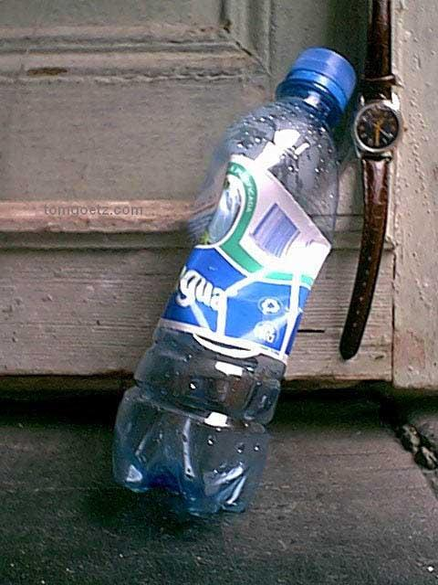
Questions of the video:
How do we breathe?
How do hot air
balloons work?
Why do water bottle left in cars implode?

Slide 5
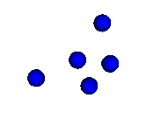
Kinetic Molecular Theory of Ideal Gases
Have no attractive or repulsive forces.
Have a negligible volume (compared to the distance between atoms).
Molecules are in constant, rapid, random, straight-line motion.
The kinetic energy is proportional to the temperature. (Any two gases with the same T have the same KE)

Slide 6
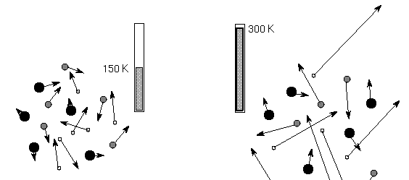
Average Kinetic Energy
KE = ½ mv²
m = mass
v = velocity

Slide 7
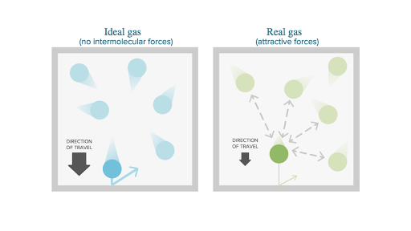
When do real gases behave like ideal gases?
At low pressure and high temperatures…
…because then they are spread out with low forces and negligible volumes. Also, low masses help make them more ideal.

Slide 8
Under Pressure
Gases exert a pressure on the surface of a substance and can be measured in a variety of units:
Standard Pressure Units
Kilopascal (kPa) | 101.3
Atmospheres (atm) | 1.0
Torr (mmHg) | 760
You should set up dimensional analysis… BUT My trick? Just divide by the unit you have and multiply by the unit you want.

Slide 9
Pressure: convert the following:
850mmHg = _______ atm
560mmHg = _______ kPa
3.43 atm = _______ mmHg
1.97 atm = _______ kPa
103 kPa = _______ atm
1008 kPa = ________ mmHg
1.10
75
2610
200.
1.02
7562

Slide 10
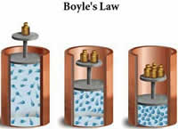
Boyle’s Law
Pressure and volume have an indirect relationship.
P₁V₁=P₂V₂

Slide 12
Q1: How do we breathe?

Slide 13
Charles’ Law
Volume and temperature have a direct relationship.
V₁/T₁ = V₂/T₂

Slide 15
Q2: Why is Charles’ Law important in hot air ballooning?

Slide 16
Gay Lussac’s law
Pressure and temperature have a direct relationship.
P₁/T₁ = P₂/T₂

Slide 17
Q3:

Slide 18
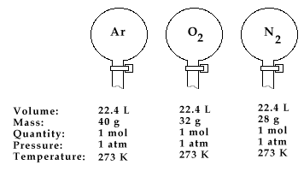
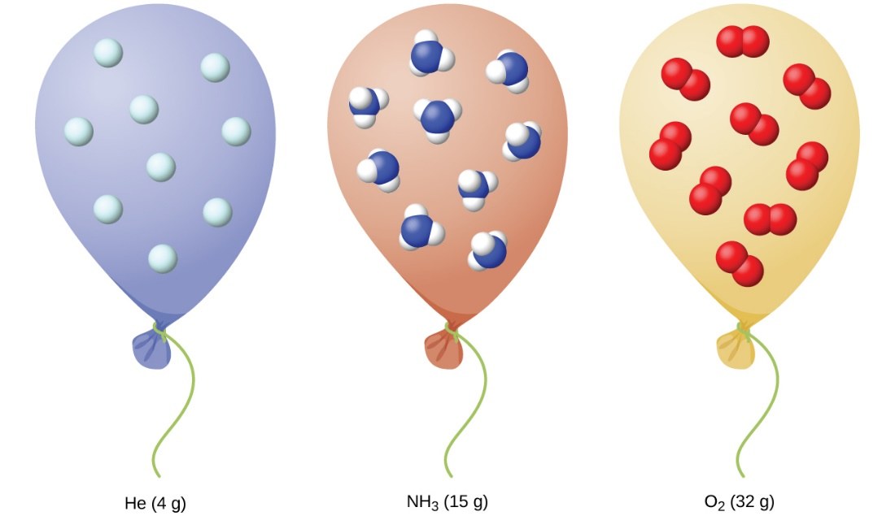
Avogadro’s Law
Equal volumes of gases at the same temperature and pressure have the same number of molecules.

Slide 19
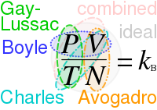
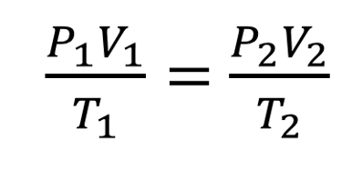
Combined Gas law
Only use this equation when discussing initial and final conditions of a gas.
If a factor is held constant, cross it out of the equation.
Temperature must be in Kelvin!!!

Slide 20
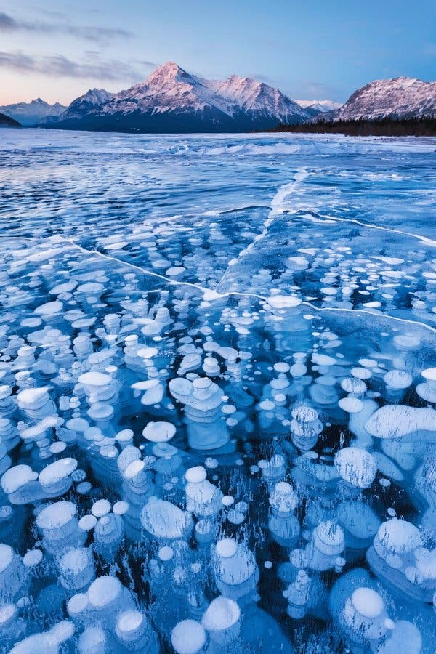
Combined Gas Law
A bubble rises from the bottom of a lake at 8.0ºC with a pressure of 6.4 atm and a volume of 2.1 mL. Calculate the new volume of the bubble at STP.
(6.4)(2.1) = (1)(x)
(8+273) (273)
x = 13mL

Slide 21
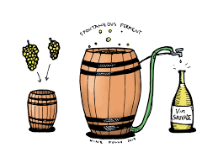
Combined Gas Law
A gas evolved during the fermentation of glucose has a volume of 0.78 L at 20.1C and 1 atm. What is the volume of this gas if the temperature changes to 40.C and 1.2 atm?
(1)(0.78) = (1.2)(x)
(20.1+273) (40+273)
x = 0.69 L

Slide 22
Ideal Gas law
n= moles
R=0.0821 L atm mol⁻¹ K⁻¹
Used when one gas is calculated & doesn’t change values.
The units must be the same as the R units.

Slide 23
Ideal Gas Law
Calculate the pressure of 1.82 moles of SF₆ when it is at 69.5C, and 5.43L.
PV = nRT
(x)(5.43) = (1.82)(0.0821)(69.5+273)
x = 9.42atm

Slide 24
Ideal Gas Law
Calculate the temperature of a 2.56 moles of a gas at 1200mL and 680mmHg.
PV = nRT
(680/760)(1.2) = (2.56)(0.0821)(x)
x = 5.11 K

Slide 25
You must be able to...
Explain properties of an ideal gas.
Convert between units of pressure.
Calculate the pressure, volume, temperature, or moles of an ideal gas.

Slide 26
More Gas Laws

Slide 27
Objectives
You should already be able to...
Identify gases and explain their properties based on their intermolecular forces of attraction.
Calculate the pressure, volume, moles or temperature of a gas using the combined gas law and the ideal gas law.
Memorize and utilize STP values.
Convert pressure units.
By the end of this video you should be able to...
Determine which gases diffuse fastest.
Calculate partial pressures of gases in a mixture.
Calculate the density of a gas.

Slide 28
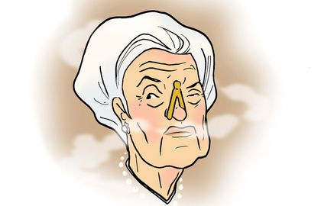
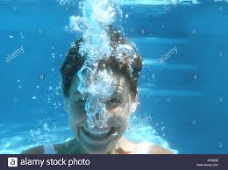
Questions of the video:
How do we smell certain smells from a distance?
Why do CO₂ bubbles float to the top of water when we exhale under water?

Slide 29
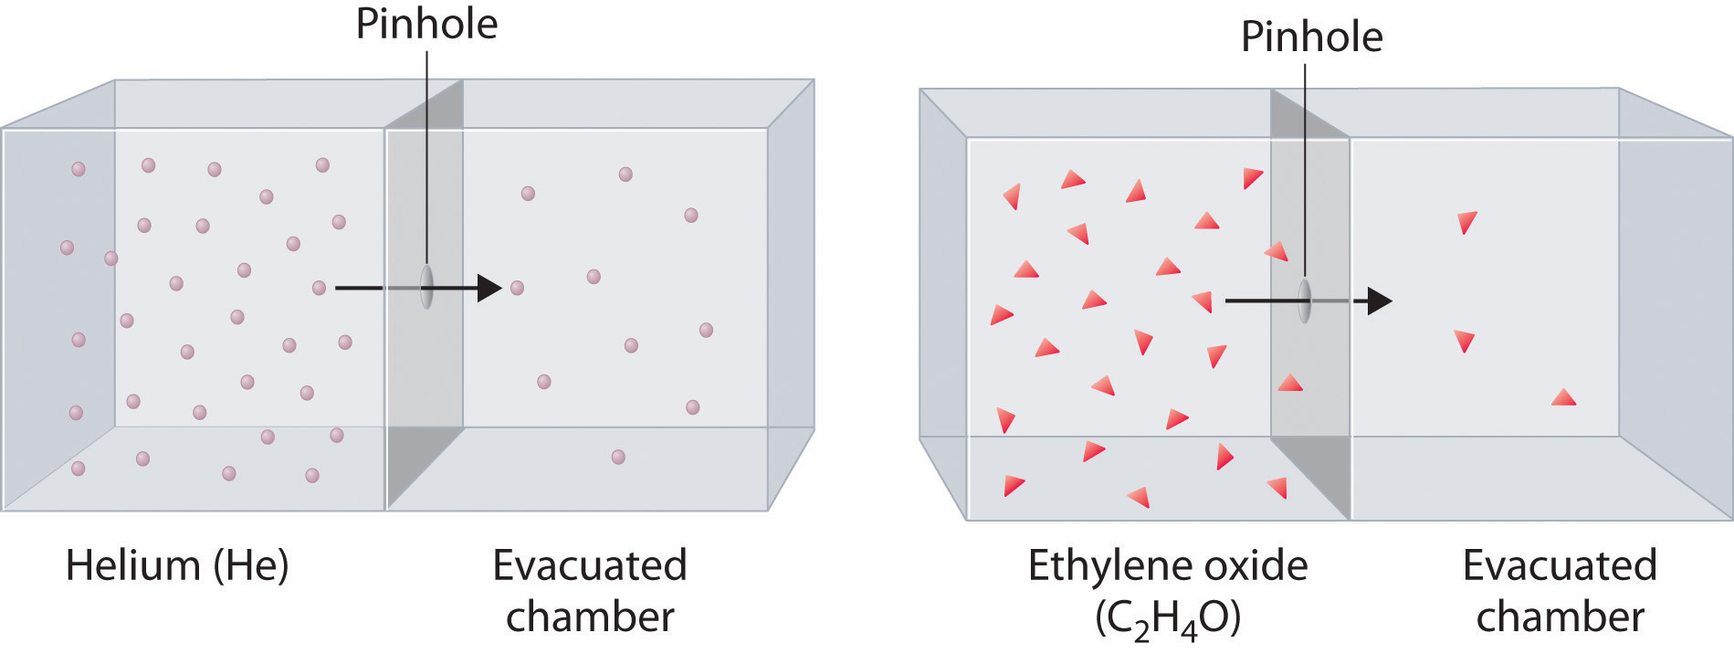
Graham’s Law of Diffusion
Gases move from high to low concentrations. Lighter gases diffuse faster.
V_{rms} = √(3RT)
M

Slide 30
Graham’s Law of Diffusion

Slide 31
Graham’s Law of Diffusion
Compare the speeds of Gases using:
KE = ½ mv²
Gases at the same temperature will have the same KE therefore the equation becomes
½ mv²=1/2 mv²
And the ½ drops and becomes
mv² = mv²

Slide 32
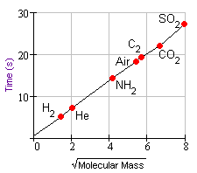
Graham’s Law of Diffusion
Compare the speeds of Hydrogen and water vapor.
mv² = mv²
(m₁/m₂)= (v₂/v₁)²
√(18/2) = 3
The hydrogen travels three times faster than water.

Slide 33
Q1: So how come we can sell certain perfumes from a distance and other colognes only up close?
Cheap body sprays have weaker IMF due to fewer polarizable electrons, therefore they are easier to diffuse.
Expensive perfumes and colognes have stronger IMF due to a greater number of polarizable electrons, therefore they are harder to diffuse.

Slide 34
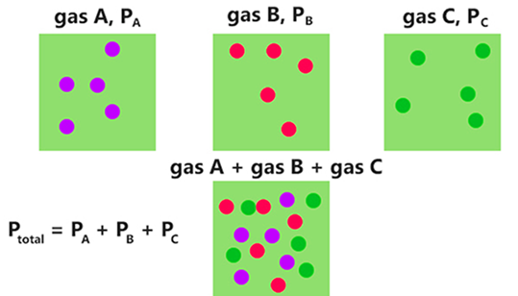
Dalton’s Law of Partial Pressure
The total pressure in a system of gases equals the pressure of each individual gas combined.

Slide 35
Dalton’s Law of Partial Pressure

Slide 37
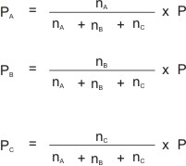
Dalton’s Law of Partial Pressure
It’s just a ratio!

Slide 38
Dalton’s Law of Partial Pressure
A mixture of gases contain 4.46 moles Ne, .74 moles of Ar, and 2.15 moles of Xe. Calculate the partial pressure of each gas if the total pressure is 2 atm.
P_{Ne}= (4.46/7.35)(2) = 1.21 atm
P_{Ar}= (0.74/7.35)(2) = 0.201 atm

Slide 39
Partial Pressure Example
A 128mL sample of oxygen is generated by the decomposition of KClO₃ and is collected over water at 24C and 762 mmHg. Calculate the mass obtained if the pressure of water is 22.4 mmHg.
PV = nRT
(762-22.4)(.128) = x (.0821)(24+273)
760
x= .00511 mol
.00511 x 32g/mol =
0.163g O₂

Slide 40
Q2: Why do CO₂ bubbles float to the top of water when we exhale under water?

Slide 41
Density and Molar Mass
Calculate the density of CO₂ at 760.mmHg and 27.0C.
Assume 1 mol… (760/760)(x)= (1)(.0821)(27.0+273)
x = 24.63L
Now solve for density: mass/volume
44.0g/24.63L=
Now Compare to water’s density of 1g/mL
Which is 1g/0.001L or 1000g/L…. Does CO₂ sink or float?
1.78g/L

Slide 42
You must be able to...
Determine which gases diffuse fastest.
Calculate partial pressures of gases in a mixture.
Calculate the density of a gas.

Slide 43
Phases

Slide 44
Objectives
You should already be able to...
Identify gases, liquids and solids and explain their properties based on their intermolecular forces of attraction.
Use and explain points on a phase change diagram.
By the end of this video you should be able to...
Explain specific properties of liquids such as viscosity, heats, and surface tension in terms of intermolecular forces of attraction.

Slide 45
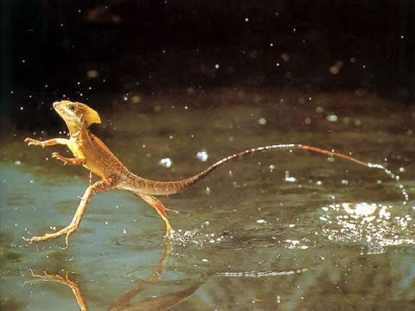
Question of the video:
Why can “Jesus” lizards
walk on water?

Slide 46
Properties of Liquids
Surface Tension: elastic force on the liquid surface.
The higher the force, the higher the surface tension.

Slide 47
Properties of Liquids
Viscosity: measure of a liquid’s resistance to flow.
The greater its IMF, the greater the viscosity, the slower it flows.
If you increase the temperature, viscosity decreases.

Slide 48
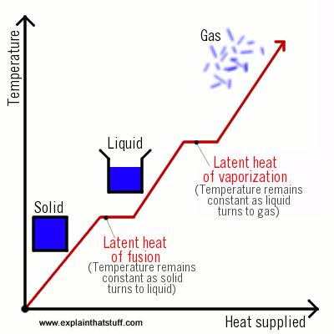
Heats
Heat of vaporization: g ←→ l
Heat of fusion: s ←→ l
Heat of sublimation: s ←→ g
If the IMF is strong, the heats of vaporization, fusion, and sublimation is high.

Slide 49
Phase Change Diagrams
When temperature increases,
Kinetic Energy increases and Potential Energy is stable.
If Temperature is stable, Potential Energy increases and Kinetic Energy is stable.

Slide 50
Phase Change Diagrams
Explain phase changes.
Identify PE and KE changes.
Are bonds or forces changing?

Slide 51
You must be able to...
Explain specific properties of liquids such as viscosity, heats, and surface tension in terms of intermolecular forces of attraction.
Use and explain points on a phase change diagram.

Slide 52
Solutions

Slide 53
Objectives
You should already be able to...
Explain the general solubility of solids and gases.
Define saturated, unsaturated, and supersaturated.
By the end of this video you should be able to...
Explain solubility in terms of intermolecular forces of attraction.
Draw particle diagrams representing the saturation of solutions.
Calculate concentration using molarity, molality, mole fraction, percent, and parts per million.

Slide 54
Question of the video:

Slide 55
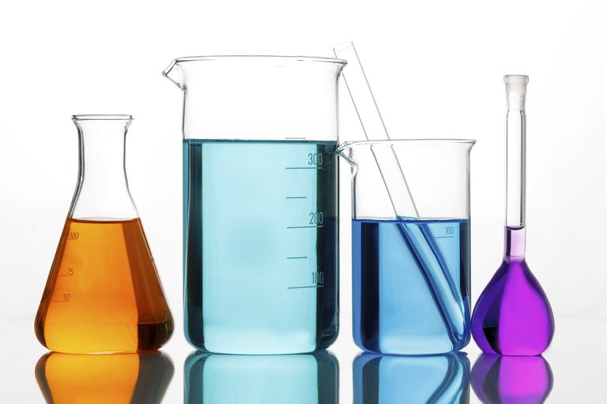
Solutions
Solutions are homogeneous mixtures of two or more pure substances.
In a solution, the solute is dispersed uniformly throughout the solvent.

Slide 56
Solutions
The intermolecular forces between solute and solvent particles must be strong enough to compete with those between solute particles only and those between solvent particles only.

Slide 57
Types of Solutions
Saturated
Solvent holds as much solute as is possible at that temperature.
Dissolved solute is in dynamic equilibrium with solid solute particles (some may dissolve and some may precipitate out at the same time).

Slide 58
Types of Solutions
Unsaturated
Less than the maximum amount of solute for that temperature is dissolved in the solvent.

Slide 59
Types of Solutions
Supersaturated
Solvent holds more solute than is normally possible at that temperature.
These solutions are unstable; crystallization can usually be stimulated by adding a “seed crystal” or scratching the side of the flask.

Slide 60
Factors Affecting Solubility
Polar substances tend to dissolve in polar solvents.
Nonpolar substances tend to dissolve in nonpolar solvents.
The more similar the intermolecular attractions, the more likely one substance is to be soluble in another.

Slide 61
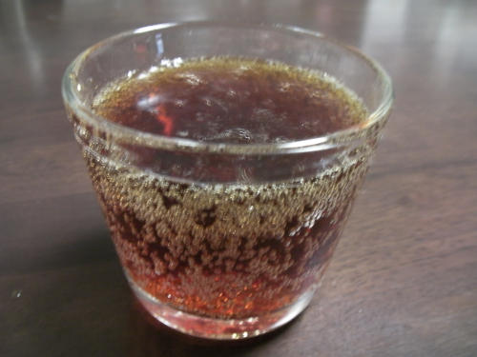
Gases in Solution
The solubility of gases in water increases with increasing mass.
Larger molecules have stronger London dispersion forces.

Slide 62
Gases in Solution
The solubility of liquids and solids does not change appreciably with pressure.
The solubility of a gas in a liquid is directly proportional to its pressure.

Slide 63
Temperature
Generally, the solubility of solid solutes in liquid solvents increases with increasing temperature.

Slide 64
Temperature
The opposite is true of gases

Slide 65
Gas Solubility depends on temperature and pressure
Soda on an airplane
Soda chilled

Slide 66
Molarity Review
M= moles of solute
L solution
Calculate the molarity of a solution formed by dissolving 202.0g of KNO₃ (MM=101.0g/mol) in 250.mL of water.
202.0/101.0 = 2.000 moles /0.250L = 4.00M

Slide 67
Molality Not T dependent ☺
m= moles of solute
kg solution
Calculate the molarity of a solution formed by dissolving 202.0g of KNO₃ (MM=101.0g/mol) in 250.0mL of water.
202.0/101.0 = 2.000 moles solute
D= 1.000 g/mL so 250.0 mL = 250.0 g water + 202.0 g KNO₃ = 452.0 g solution = 0.4520 kg solution
2.000 moles / .4520 kg = 4.420m

Slide 69
Percent and ppm Review

Slide 70
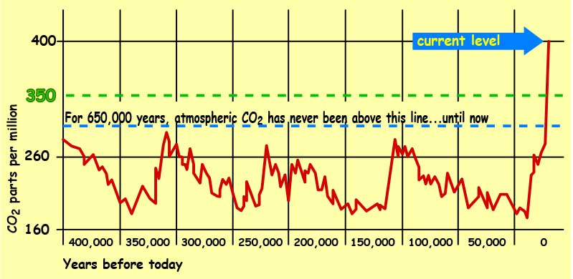
Parts per Million Review

Slide 71
You must be able to...
Explain solubility in terms of intermolecular forces of attraction.
Draw particle diagrams representing the saturation of solutions.
Calculate concentration using molarity, molality, mole fraction, percent, and parts per million.

Slide 72
Colligative Properties

Slide 73
Objectives
You should already be able to...
Explain and calculate the concentration of a solution.
By the end of this video you should be able to...
Describe changes in freezing point, boiling point, and vapor pressures and concentrations are changed due to intermolecular forces of attraction.

Slide 74
Questions of the video:

Slide 75
Colligative Properties
Changes in colligative properties depend only on the number of solute particles present, not on the identity of the solute particles.

Slide 76
Vapor Pressure Lowering
Because of solute-solvent intermolecular attraction, higher concentrations of solutes make it harder for solvent to escape to the vapor phase.
Therefore, the vapor pressure of a solution is lower than that of the pure solvent.
This works best when both solutions have nearly identical IMF.

Slide 77
Raoult’s Law
P_{A} = X_{A}P°_{A}
where
X_{A} is the mole fraction of compound A
P°_{A} is the normal vapor pressure of A at that temperature, in a pure form
NOTE: Make sure you have the vapor pressure of the solvent. Therefore, have the X of the solvent. Otherwise, this is the same formula as partial pressures of gases.

Slide 78
Vapor Pressure Lowering
Calculate the vapor pressure of a solution formed with 1.0 moles of NaCl dissolving in 3.0 moles of water at STP? (normal vapor pressure of water at STP = 0.006atm).
X_{water} = ¾ P_{A} = X_{A}P°_{A}
¾(0.006) = 0.0045 atm

Slide 79
Osmosis
Some substances form semipermeable membranes, allowing some smaller particles to pass through, but blocking other larger particles.
In biological systems, most semipermeable membranes allow water to pass through, but solutes are not free to do so.

Slide 80
Osmotic Pressure
The pressure required to stop osmosis, known as osmotic pressure, π, is
π = iMRT
where M is the molarity of the solution

Slide 81
Osmosis in Blood Cells
If the solute concentration outside the cell is greater than that inside the cell water will flow out of the cell.

Slide 82
Osmosis in Cells
If the solute concentration outside the cell is less than that inside the cell, water will flow into the cell.

Slide 83
Colligative Properties of Electrolytes
Since these properties depend on the number of particles dissolved, solutions of electrolytes (which dissociate in solution) should show greater changes than those of nonelectrolytes. But it also depends on the Molarity.

Slide 84
The van’t Hoff Factor
We modify the previous equations by multiplying by the van’t Hoff factor, i.
Example: find the van’t Hoff factors:
CaCl₂ Mg₃N₂
NaF C₆H₁₂

Slide 85
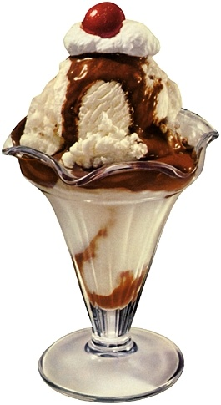
Boiling Point Elevation and Freezing Point Depression
Solute-solvent interactions also cause solutions to have higher boiling points and lower freezing points than the pure solvent.

Slide 86
Boiling Point Elevation
The change in boiling point is proportional to the molality of the solution:
ΔT_{b} = i K_{b}  m
where K_{b} is the molal boiling point elevation constant, a property of the solvent.
ΔT_{b} is added to the normal boiling point of the solvent.

Slide 87
Freezing Point Depression
The change in freezing point can be found similarly:
ΔT_{f} = i K_{f}  m
Here K_{f} is the molal freezing point depression constant of the solvent.
ΔT_{f} is subtracted from the normal freezing point of the solvent.

Slide 88
You must be able to...
Describe changes in freezing point, boiling point, and vapor pressures and concentrations are changed due to intermolecular forces of attraction.

