Slide 1
Time of Death

Slide 2
Meaning of Death
Objectives: Differentiate between, meaning manner and cause of death
End of life
“irreversible cessation of circulation of blood”
Brain activity stopped

Slide 3
Objectives: Differentiate between, meaning manner and cause of death
Manner of Death: Means by which they died
Natural
Accidental
Suicidal
Homicidal
Undetermined

Slide 4
Cause of Death: Reason they died
Objectives: Differentiate between, meaning manner and cause of death
Ex. Natural
Ex. Homicide/Suicide
Heart attack
Stroke
Respiratory failure
Hanging
Drowning
Asphyxiation
Poison

Slide 5
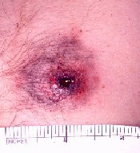
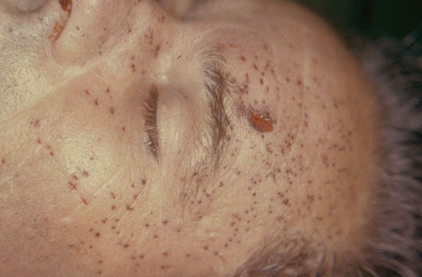
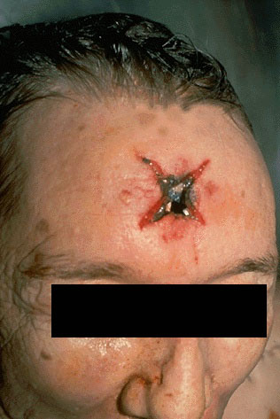
Objectives: Differentiate between, meaning manner and cause of death
Gunshot wound
Stippling (powder burns) indicating gun was a few inches away
Starring indicating barrel touching skin

Slide 6
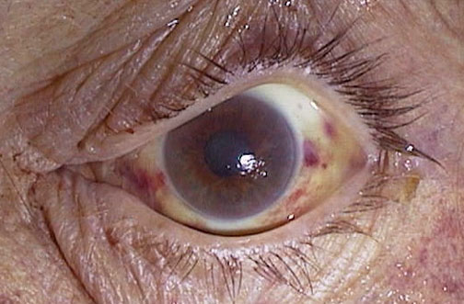
Objectives: Differentiate between, meaning manner and cause of death
Strangulation
Petechial hemorrhage as a result of strangulation

Slide 7
Objectives: Differentiate between, meaning manner and cause of death
Mechanism of death: is the specific change in the body that brought about the end of life
Cause Mechanism
Shooting Loss of blood

Slide 8
Time of Death: When they died
Objectives: Determine time of death using rigor mortis
Examples:
Livor Mortis
Rigor Mortis
Algor Mortis
Stomach and intestinal contents
Changes of the eye
Stages of decomposition
Insects (forensic entomology)

Slide 9
Objectives: Determine time of death using rigor mortis
Factors affecting Livor Mortis
Hot day/area– blood pools faster
Cool day/area: slower process

Slide 10
Rigor Mortis: stiffening of skeletal muscles after death
Objectives: Determine time of death using rigor mortis
Cause: no oxygen to cells → calcium buildup → muscle fibers remain contracted
Starts 1-2 hrs. after death
Starts at head → legs
12 hrs: most rigid
Stiffness disappears after 24-48 hrs.

Slide 11
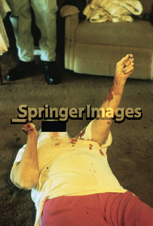
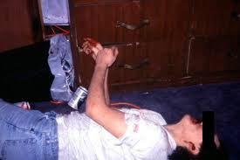
Objectives: Determine time of death using rigor mortis

Slide 12
Factors affecting rigor mortis:
Objectives: Determine time of death using rigor mortis
Ambient temperature
Person’s weight
Type of clothing
Illness
Level of physical activity shortly before death
Sun exposure

Slide 13
Livor Mortis: pooling of blood in tissues after death (lividity)
Objectives: Determine time of death using rigor mortis
Can determine if body was moved
Begins 1-2 hrs. after death
2-8 hrs.: color disappears when skin is pressed
>8 hrs.: permanent discoloration

Slide 14
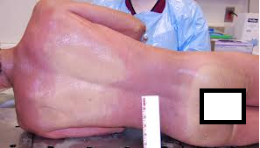
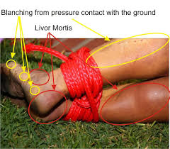
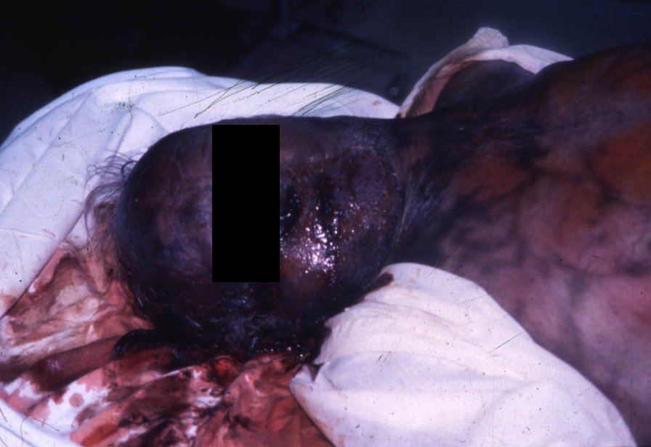
Objectives: Determine time of death using rigor mortis

Slide 15
Algor Mortis: cooling of body after death
Objectives: Determine time of death using algor and rigor mortis
Temperature loss in a corpse
Thermometer inserted in liver
1 hr. after death: cools 1.4°F per hour
After 1st 12 hrs: cools 0.7°F per hour until it reaches surrounding temp.

Slide 16
Factors affecting algor mortis:
Objectives: Determine time of death using algor and rigor mortis
Cooler environment – lose heat faster
Windy – fast heat loss
Excess body fat – slows heat loss
Clothing – slows heat loss
Rule of thumb: 1°F per hour

Slide 17
Stomach and Intestinal Contents
Objectives: Determine time of death using algor and rigor mortis
0-2 hours after last meal: undigested stomach contents present
4-6 hours after meal: stomach empty, food in S.I.
12+ hours after meal: S.I. empty, wastes in L.I.

Slide 18
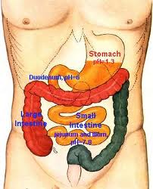
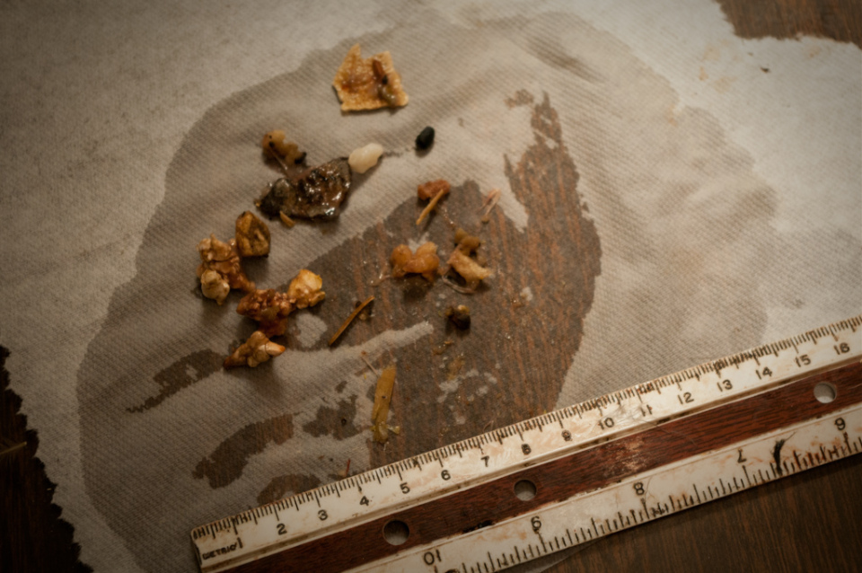
Objectives: Determine time of death using algor and rigor mortis

Slide 19
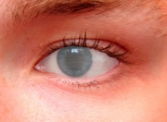
Eye after death
Objectives: Determine time of death using algor and rigor mortis
Thin film on eye surface:
2-3 hours (eyes open)
24 hours (eyes closed)

Slide 20
Autopsy Report
What does post-mortem mean?
Underline information pertaining to the cause, mechanism and manner of death.
Circle information that can be used to help determine time of death.

Slide 21
Body Farm
https://www.youtube.com/watch?v=GCyiczAcRBY

Slide 22
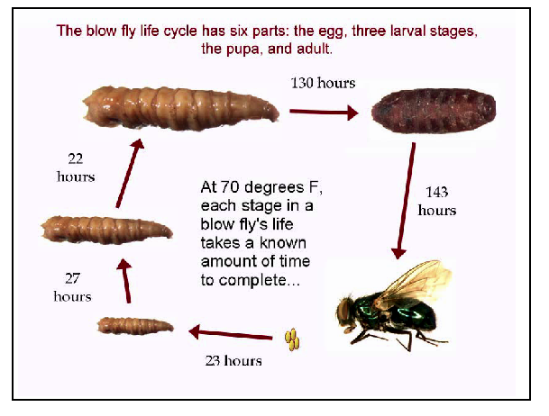
Objectives: Determine time of death using insects (etymology)
Forensic Entymology: study of insects in criminal investigations
Flies and maggots also provide an approximate time of death, very useful for cases where the body has been long dead.
Only certain insects will feed and lay eggs on a dead corpse and forensic entomologists study these insects, their larvae cycles and thereafter can determine whether a body has been dead for just one day or up to 3 or 4 weeks.

Slide 23
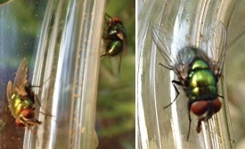
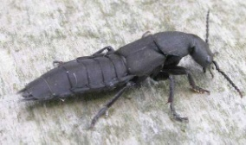
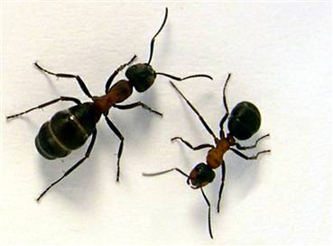
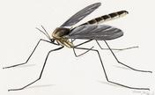
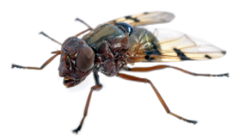
Time Physical Appearance of Body Insects Present at that Stage
0-3 days
Proteins and carbohydrates in the Blowflies e.g. Bluebottle flies, Syrphidae flies deceased body begin to break down. 4-7 days
Body is starting to decay and causes the Fly larvae and beetle e.g. Rove Beetles abdomen to inflate because of the gases inside.
8-18 days
Decay is well and truly setting in; the Ants, cockroaches, beetles and flies
abdomen wall begins to break down. 19-30 days
The decaying body enters a stage know Beetles and mites e.g. Springtail beetle, Acari, as 'post-decay'; in wet, humid conditions, Nematocera (present only during the winter months), the body is sticky and wet; in hot dry Brachycera conditions, the body is dried out .
31 and over days The bones, skin and hair that remain no longer give off a powerful stench and smell just like the soil surrounding it.

Slide 24
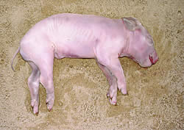
Stages of Decomposition
Objectives: Determine time of death using insects (etymology)
0-2 Days:
Green, purplish stains
Skin: marbled appearance
Face discolored
Flies lay eggs on corpse

Slide 25
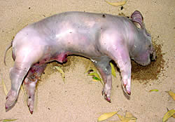
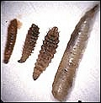
Objectives: Determine time of death using insects (etymology)
4 Days:
Skin blisters
Abdomen swells (CO₂ gas released by bacteria in intestines)
Maggots on corpse

Slide 26
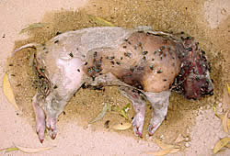
Objectives: Determine time of death using insects (etymology)
6-10 Days:
Corpse bloats with CO₂, chest and abdomen burst and collapse
Fluids leaks from body openings
Eyeballs and other tissues liquify
Skin sloughs off
More eggs, maggots, flies, beetles

Slide 27
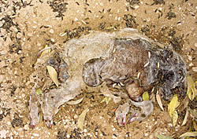
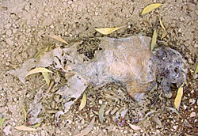
Objectives: Determine time of death using insects (etymology)
10-20 Days:
Bloated body collapses
Flattened body, creamy flesh
Strong smell of decay
Fluids drain and seep
50-365 Days:
Body dry; decays slowly
Hair disappears, leaving bones

Slide 28
Time lapse video of pig decaying
Objectives: Determine time of death using insects (etymology)
http://www.youtube.com/watch?v=yN8S6viF3Lw

