Slide 1
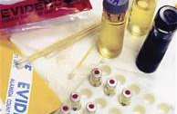
Unit: Drug Identification & Toxicology

Slide 2
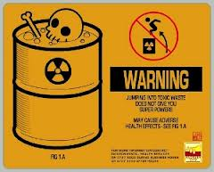
Drug Identification & Toxicology
Objective: SWBAT Define key vocabulary terms associated with the toxicology unit.
Toxicology:
  The study of poisons
  Identification of drugs a person may have used
  Effects of drugs on the body

Slide 3
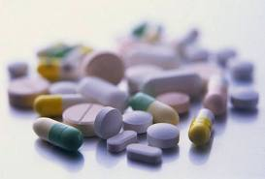
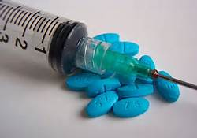
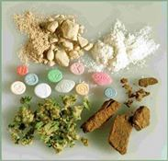
Vocabulary
Objective: SWBAT Define key vocabulary terms associated with the toxicology unit.
Controlled Substance: a drug or chemical compound that is regulated and controlled by the legal system.
Drug (including alcohol): a chemical substance that effects the mind or body (used in the treatment or prevention of a disease) or used recreationally for its effect on the mind or body.
Narcotic: a class of drug that is used to relieve pain but may be habit forming (causes euphoria, sleep, or feeling of mental numbness).

Slide 4
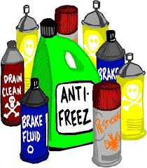
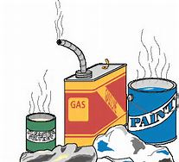
Vocabulary - continued
Objective: SWBAT Define key vocabulary terms associated with the toxicology unit.
Poison – a substance that can cause health problem or death if ingested, absorbed into the skin or inhaled.
Toxicity – the degree to which a poison can cause injury.

Slide 5
Vocabulary - continued
Objective: SWBAT Define key vocabulary terms associated with the toxicology unit.
Toxin – a poisonous substance (usually natural) that is produced by plants, animals, or bacteria that can harm/kill humans.
    Botulism – most common poisonous substance known to humans. May be ingested from contaminated food (canned vegetables, raw fish). Can be destroyed by cooking and heating.
  ***Pure botulism toxin is commonly referred to as “Botox” – used to treat muscle spasms, eye conditions, etc.
    Tetanus – bacteria that causes a potentially deadly nervous system disease. “Lockjaw” – begins with spasms in the jaw

Slide 6
Controlled Substances Act
Objective: SWBAT Classify drugs into one of 5 schedules of controlled substances.
Federal Law established 5 schedules of classification of controlled substances based on:
Drug’s potential for abuse
  Potential to physical and psychological dependence
  Medical Value
Note: Federal law also controls materials that are used in making drugs and those that are manufactured to resemble drugs

Slide 7
Drug Schedules
Objective: SWBAT Classify drugs into one of 5 schedules of controlled substances.
Schedule I:
Drugs with high potential for abuse and addiction, NO medical value:
Ex: Heroin, LSD, Ecstasy, Marijuana
Schedule II:
Drugs with high potential for abuse and addiction, have some medical value with restrictions
Ex: PCP, Cocaine, Amphetamines, Most Opiates, Some Barbiturates

Slide 8
Drug Schedules
Objective: SWBAT Classify drugs into one of 5 schedules of controlled substances.
Schedule III:
Drugs with less potential for abuse and addiction, currently acceptable for medical use
Ex: Some Barbiturates, Codeine, Steroids
Schedule IV:
Drugs with low potential for abuse and addiction, currently acceptable for medical use
Ex: Tranquilizers like Valium, Xanax, Librium

Slide 9
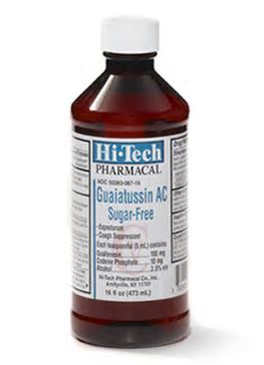
Drug Schedules
Objective: SWBAT Classify drugs into one of 5 schedules of controlled substances.
Schedule V:
Drugs with low potential abuse, medical use, lowest potential dependency
Ex: Some Opiates with Non-Narcotic Ingredients, Robitussin AC

Slide 10
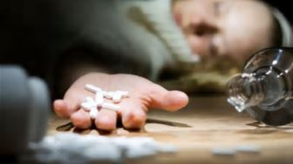
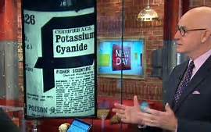
Exposure to Toxic Substances
Objective: SWBAT compare various types of exposure to toxic substances.
Accidental/Unintentional – overdose
Intentional – medical or recreational purposes
Deliberate – suicide or criminal actions

Slide 11
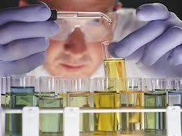
Role of the Forensic Toxicologist
Objective: SWBAT discuss the role of the forensic toxicologist in solving mysterious deaths.
Determines cause and effect between exposure to drug or other substances and the lethal effects of exposure to humans.
Questions a Forensic Toxicologist can answer:
1. Are drugs involved?
2. What did the person take?
3. When did they take it?
4. How much did they take?
5. How did it affect them?
6. How certain are you?

Slide 12

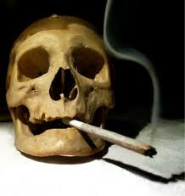
Types of Drugs
Objective: SWBAT Classify drugs into one of 5 categories of controlled substances.
“Drug” can mean different things…
  Illicit or illegal drugs that have no accepted medical use in the US
  Controlled substances: legal drugs whose sale, possession, and use are restricted because of their effects and the potential for abuse.
Drugs can fall into one of several different classes: narcotics, hallucinogens, depressants, stimulants, club drugs, and steroids

Slide 13

Narcotics
Objective: SWBAT Classify drugs into one of 5 categories of controlled substances.
Varieties of narcotics:
  Opiates: derived from the Asian Poppy
    Heroine, morphine, codeine
  Synthetic opiates: man-made
    Methadone: given to heroine addicts to try and break their addiction
    Oxycodone (OxyContin or Percocet)
    Hydrocodone (Vicodin)
Overdose on narcotics can result in difficulty breathing, low blood pressure, loss of consciousness, and possibly coma and death.

Slide 14

Hallucinogens
Objective: SWBAT Classify drugs into one of 5 categories of controlled substances.
Hallucinogens alter the user’s perceptions, thinking, self-awareness, and emotions.
  Some hallucinogens can cause panic attacks, seizures, headaches, and sometimes psychosis that can last for weeks.
  Many hallucinogens, particularly PCP, increase the user’s heart rate, which could lead to heart failure.

Slide 15

Hallucinogens: Types
Objective: SWBAT Classify drugs into one of 5 categories of controlled substances.
  Marijuana (from cannabis plant)
    The most widely used illicit drug in the U.S.
    Contains tetrahydrocannabinol (THC)
    Has medical uses such as treating glaucoma and relieving nausea due to chemotherapy
  MDMA (“Ecstacy”)
  Mescaline (from Peyote cactus)
  LSD (Lysergic Acid, or simply “Acid”)
  PCP (phencyclidine or “Angel Dust”)
  Mushrooms (contain psilocybin)

Slide 16

Depressants
Objective: SWBAT Classify drugs into one of 5 categories of controlled substances.
Depressants are used to relieve anxiety and produce sleep.
  Depressants reduce body functions such as heart rate.
  Overdose can cause coma and death.
  Mixing depressants with other drugs or alcohol can increase their effects and health risks.

Slide 17
Depressants: Types
Objective: SWBAT Classify drugs into one of 5 categories of controlled substances.
  Alcohol
  Barbiturates: “downers” such as Phenobarbital and Methaqualone (also called Quaaludes, illegal)
  Anti-psychotic and anti-anxiety drugs including benzodiazepines such as Diazepam (Valium)
  Inhalants (“huffing”)
  Sedatives, muscle relaxers, etc.
  Marijuana and opiates (like morphine) are also considered depressants.

Slide 18
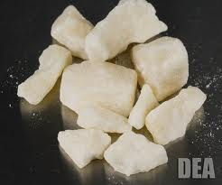
Stimulants
Objective: SWBAT Classify drugs into one of 5 categories of controlled substances.
Stimulants increase feelings of energy and alertness while suppressing fatigue and appetite.
  Also called “uppers.”
  Depression often results as the drug wears off.
  Stimulants are highly addictive.
  Overdose can result in irregular heart beat, heart attack, stroke, seizures, coma, and death.

Slide 19

Stimulants: Types
Objective: SWBAT Classify drugs into one of 5 categories of controlled substances.
  Amphetamines, also called “speed.”
  Cocaine, including crack cocaine
    Derived from the South American coca plant
    Addictions to cocaine are very difficult to overcome
  Methamphetamines, also called “meth.”
    Typically methamphetamines are more potent and dangerous than amphetamines

Slide 20
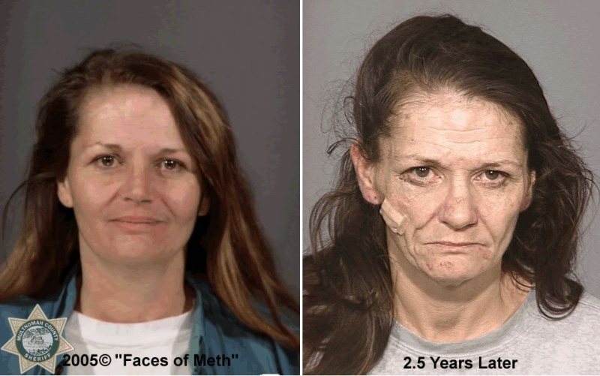
Meth Addiction
Objective: SWBAT Classify drugs into one of 5 categories of controlled substances.

Slide 21
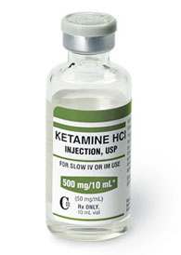
“Club Drugs”
Objective: SWBAT Classify drugs into one of 5 categories of controlled substances.
Club drugs are called such because they are most often used at nightclubs, bars, and raves (all night dance parties)
Varieties of Club Drugs:
  Methylenedioxymethamphetamine (aka MDMA or Ecstasy)
    Chronic use can cause body system breakdown, severe brain damage, memory loss, and seizures
  Ketamine or “Special K” is an animal anesthetic used by veterinarians

Slide 22

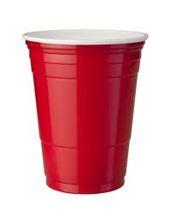
“Club Drugs”
Objective: SWBAT Classify drugs into one of 5 categories of controlled substances.
Date Rape Drugs are called that because they are often associated with drug-facilitated sexual assault, rape, and robbery.
These drugs can produce increased libido and depress the central nervous system, resulting in loss of consciousness and memory.
Varieties include GHB and Rohypnol (also called “Roofies”)

Slide 23

Anabolic Steroids
Objective: SWBAT Classify drugs into one of 5 categories of controlled substances.
Anabolic Steroids promote cell division and tissue growth
Athletes take steroids to increase muscle mass
Anabolic steroids are chemically related to testosterone
Side effects include liver malfunction, cancer, breast development in males, masculinizing effects in females, diminished sex drive in males, unpredictable moods (“roid rage”), personality changes, depression, hypertension, and high cholesterol

Slide 24
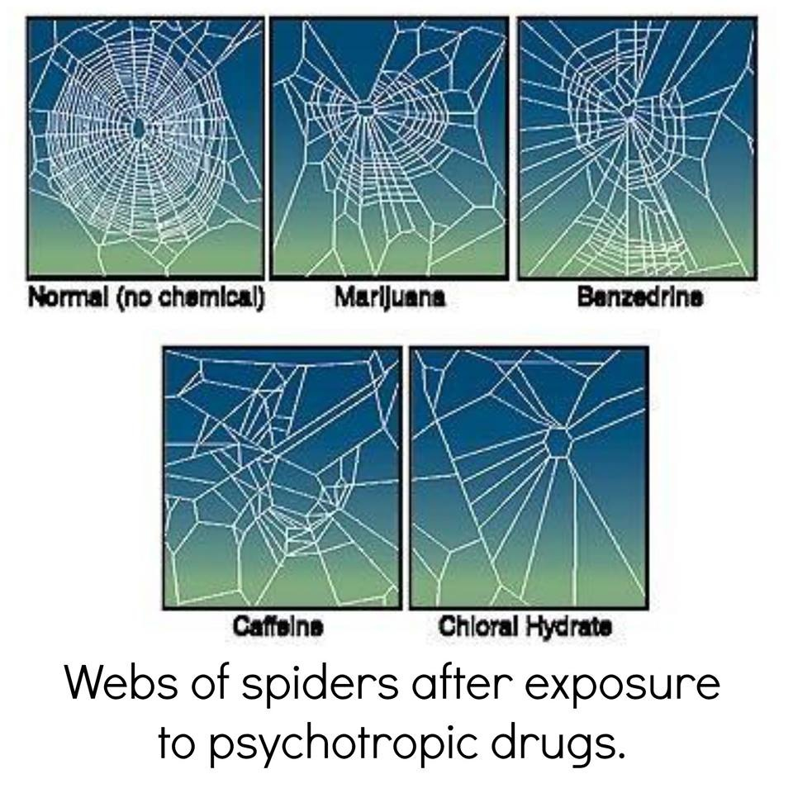

Slide 25
Drug Tests

Slide 26
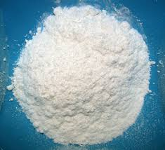
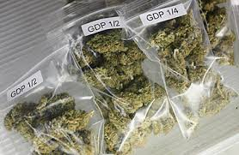
Types of Drug Tests
Objective: SWBAT Compare and contrast presumptive vs. confirmatory tests.
Tests for drugs usually include:
  Marijuana – from the hemp plant - hallucinogenic
  Amphetamines - stimulant
  Cocaine – illegal drug used for its stimulant and euphoric properties
  Opiates – narcotic sedative used for sleep or relieving pain
  Phencyclidines – used as a tranquilizer or illegal hallucinogen

Slide 27
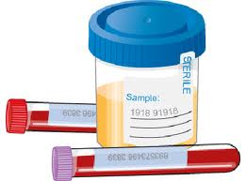
Objective: SWBAT Compare and contrast presumptive vs. confirmatory tests.
  What samples can be analyzed for toxins?
  Urine
  Saliva
  Blood
  Hair
  Sweat
  Vitreous humor – (fluid from eye)
  Stomach contents
Other samples can be collected during an autopsy such as:
Brain, liver and spleen samples may also be analyzed.

Slide 28
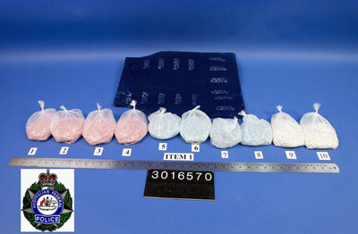
Objective: SWBAT Compare and contrast presumptive vs. confirmatory tests.
Forensic Labs can identify unknown powders, liquids and pills (legal or illegal)
Two types of tests:
  Presumptive Tests: Color test to determine what substances are present but cannot specifically identify the substance.
  Confirmatory Test: Can identify substance (mass spectrometer or gas chromatography).

Slide 29
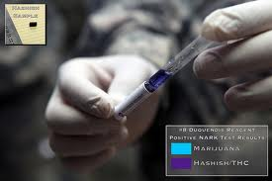
Presumptive Tests
Objective: SWBAT Compare and contrast presumptive vs. confirmatory tests.
  Spot or color tests
  Microcrystalline test
      A reagent is added that produces a crystalline precipitate which is unique for a certain drug
  Chromatography (colors)

Slide 30
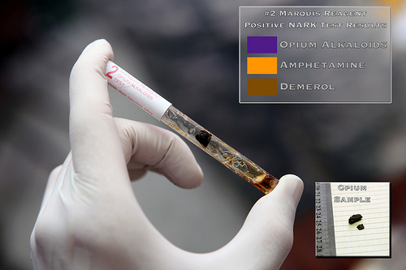
Spot or Color Tests
Objective: SWBAT Compare and contrast presumptive vs. confirmatory tests.
  Marquis
    Turns purple in the presence of most opium derivatives and orange-brown with amphetamine
  Dillie-Koppanyi
    Turns violet-blue in the presence of barbiturates
  Duquenois-Levine
    Turns a purple color in the presence of marijuana
  Van Urk
    Turns blue-purple in the presence of LSD
  Scott test
    Turns blue in the presence of cocaine

Slide 31
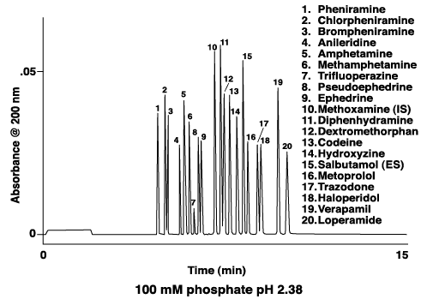
Confirmatory Tests
Objective: SWBAT Compare and contrast presumptive vs. confirmatory tests.
  Spectrophotometry
      Ultraviolet (UV)
      Visible
      Infrared (IR)
  Mass spectrometry
  http://www.youtube.com/watch?v=_AJ8otqVvwA

Slide 32

Did you know?
Objective: SWBAT Compare and contrast presumptive vs. confirmatory tests.
If two people use the exact same amount of a drug and are tested, the person with the darker hair will retain more drug in his/her hair than a lighter haired person…

Slide 33
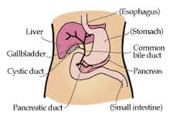
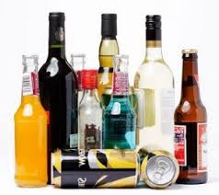
Toxicology of Alcohol
Objective: SWBAT describe the effects of alcohol on the body
Alcohol (the form found in many beverages is ethanol) is absorbed through the stomach and intestines.
Once absorbed, alcohol is:
  Metabolized in the liver —converted to acetaldehyde and then turned into acetic acid
      When too much acetaldehyde accumulates in the blood it produces dehydration and classic symptoms of a hangover (headache, nausea, weakness, etc.)
  Excreted by breath, perspiration, and kidneys

Slide 34
Objective: SWBAT describe the effects of alcohol on the body
Symptoms of Alcohol Intoxication:
Alcohol interferes with the CNS’s ability to analyze sensory information. This results in the typical symptoms of being drunk:
Decreased motor coordination and balance
Slurred speech
Blurred vision
Sweating
Loss in judgment
Dulling one’s sensation of pain (The dulling of pain is why alcohol was used in the past as an anesthetic).
Loss of the ability to judge distance and heights
Dizziness
Video – Alcohol and your Brain

Slide 35
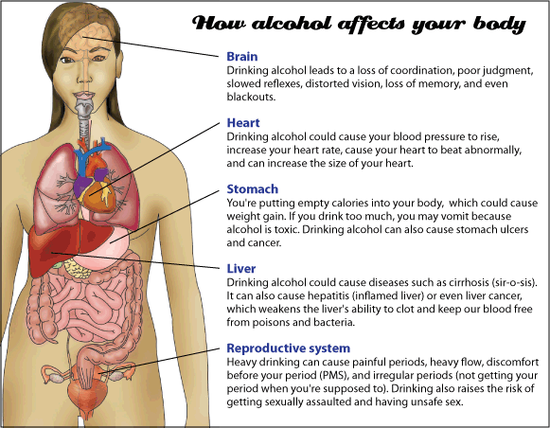
Objective: SWBAT analyze factors that can affect intoxication
Some Factors that Affect Intoxication
Food
Strength of Drink/Rate of Consumption
Body Weight/Body Type
Women
Functional Tolerance
Medications
Illness

Slide 36
How is Alcohol Content Measured?
Objective: SWBAT explain how blood alcohol content can be measured.
Field Sobriety Test used to assess if further testing is needed
Breath analysis – Most commonly measured through the use of a portable breathalyzer, this test indirectly measures blood alcohol concentration by estimating the amount of alcohol on the subject’s breath. A formula is used to convert breath alcohol level to an approximate blood alcohol level.
Urine analysis – A urine sample can be analyzed to determine alcohol content, although it can take up to two hours for alcohol to show up in urine. This test is also an indirect measurement of blood alcohol concentration through an estimate of the amount of alcohol in the urine that is used to determine the overall blood alcohol concentration.
Blood analysis – A sample of blood is drawn from the subject to directly determine the blood alcohol concentration in the body. Although the amount of alcohol is at its highest level about an hour after drinking, alcohol is quickly absorbed into the blood and can easily be measured through a blood sample.

Slide 37
Toxins and Poisons

Slide 38
Objective: SWBAT explain poisoning with examples and side effects.
A poison is any substance that causes disturbance to an organism
More specifically, a toxin is poison produced naturally by an organism
  Examples: snake venom, poison ivy

Slide 39
Objective: SWBAT explain poisoning with examples and side effects.
Poisons enter and affect the body in different ways:
  Ingestion (poisons are eaten)
    90% of all poisonings involve children swallowing household products or medicine
  Inhaled
    Example: carbon monoxide, sarin nerve gas
  Injected
    Heroine
  Absorbed (through skin, eyes, or mucous membranes)
    Poison sumac

Slide 40
Objective: SWBAT explain poisoning with examples and side effects.
Murder by Poison:
  Accidental Death – usually from a drug overdose
  Deliberate- poisoning deaths
  Intentional- Food poisoning

Slide 41
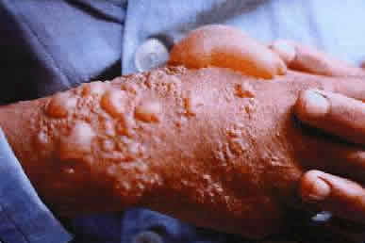
Objective: SWBAT explain poisoning with examples and side effects.
Acute poisoning – high doses of poisoning over a short period of time (cyanide).
Chronic poisoning – lower doses over a long period of time (mercury or lead poisoning).

Slide 42
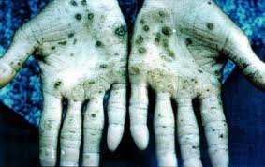
Types of Poisons
Objective: SWBAT explain poisoning with examples and side effects.
Pesticides
  Ex. DDT
Heavy Metals: Metals are stored in soft body tissues and damage organs
  Examples: Lead, Mercury, Arsenic

Slide 43
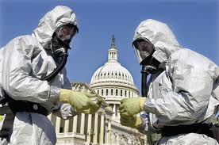

Bioterrorism
Objective: SWBAT explain poisoning with examples and side effects.
Terrorist acts involving the use of harmful agents and products of biological origin, as disease-producing microorganisms or toxins.

Slide 44
Objective: SWBAT explain poisoning with examples and side effects.
Bioterrism examples include:
  Ricin
  Anthrax
  Mustard Gas
    used in World War I
    A man-made gas
    Forms large blisters on exposed skin and the lungs

Slide 45
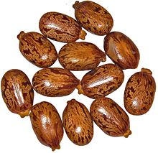
Breaking Bad
Objective: SWBAT explain poisoning with examples and side effects.
Ricin comes from castor beans.
  Can be inhaled as a mist or powder, or ingested in food
  Amount the size of a pin head can be deadly!
  Within a few hours of exposure the victim may die

Slide 46
Cases

Slide 47



Objective: SWBAT explain poisoning with examples and side effects.
Jonestown
https://www.youtube.com/watch?v=w8VU2hbQVoI
https://www.youtube.com/watch?v=c3yzkhJVXE4

Slide 48

Objective: SWBAT classify the death of Whitney Houston as accidental or deliberate based on their case analysis.
Case Study on Whitney Houston
http://www.youtube.com/watch?v=feRFn_gCFV0
Closure:Was the cause of Whitney’s death Accidental, intentional, or deliberate?

Slide 49
Objective: SWBAT investigate some current events and determine what forensic evidence was used to solve them.
Do Now: Yesterday was the first completed Boston Marathon since last years abrupt end. What happened at last year’s Boston Marathon?
https://www.youtube.com/watch?v=EFk9Sliuj9E
Read the article and complete the questions. Hand in.
http://www.cnn.com/2013/10/17/world/africa/kenya-mall-attack-footage/
Closure: List possible ways that forensics can be used to identify the men responsible for the attack.

