Slide 1
TYPES OF MATTER

Slide 2
Types of Matter

Slide 3
Lesson Objectives:
Differentiate between elements, compounds and mixtures
Identify the diatomic elements

Slide 4
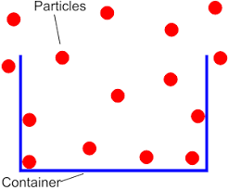
Matter
Matter is anything that:
Has mass
Takes up space (volume)

Slide 5
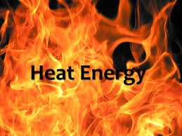
What isn’t matter?
Light
Heat
Sound

Slide 6
Classification of Matter
MATTER
yes
no
Can it be physically separated?
MIXTURE
PURE SUBSTANCE
yes
no
yes
no
Is the composition uniform?
Can it be chemically decomposed?
Homogeneous Mixture
(solution)
Heterogeneous Mixture
Compound
Element

Slide 7
PUre Substances
Elements & Compounds
Each substance has exactly the SAME composition throughout

Slide 8
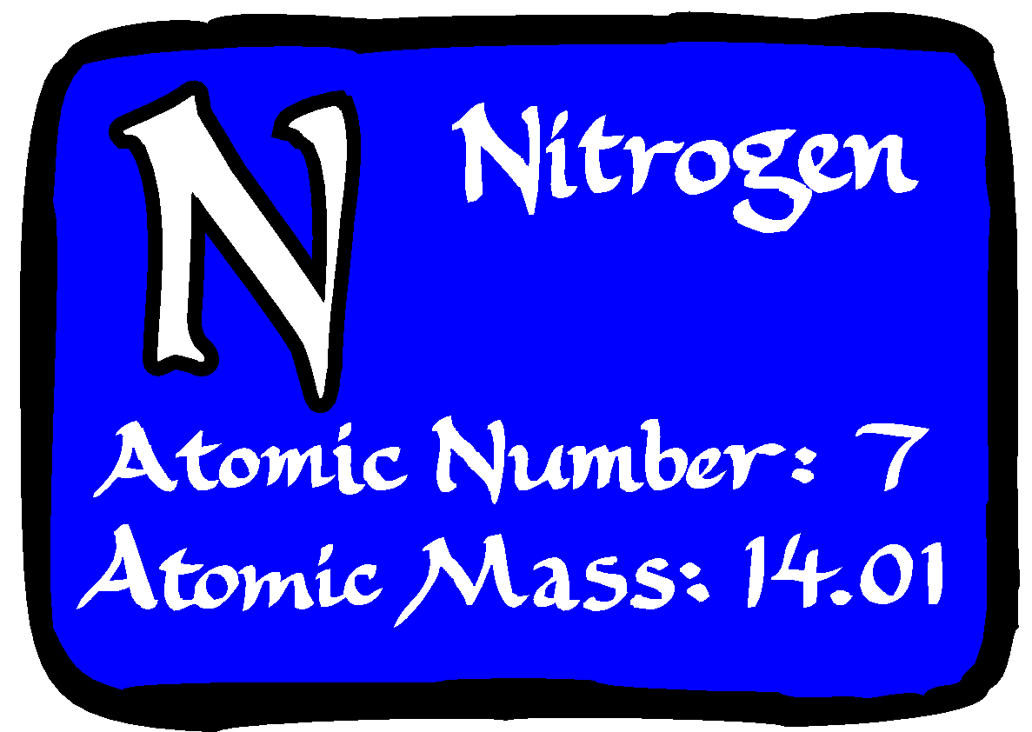
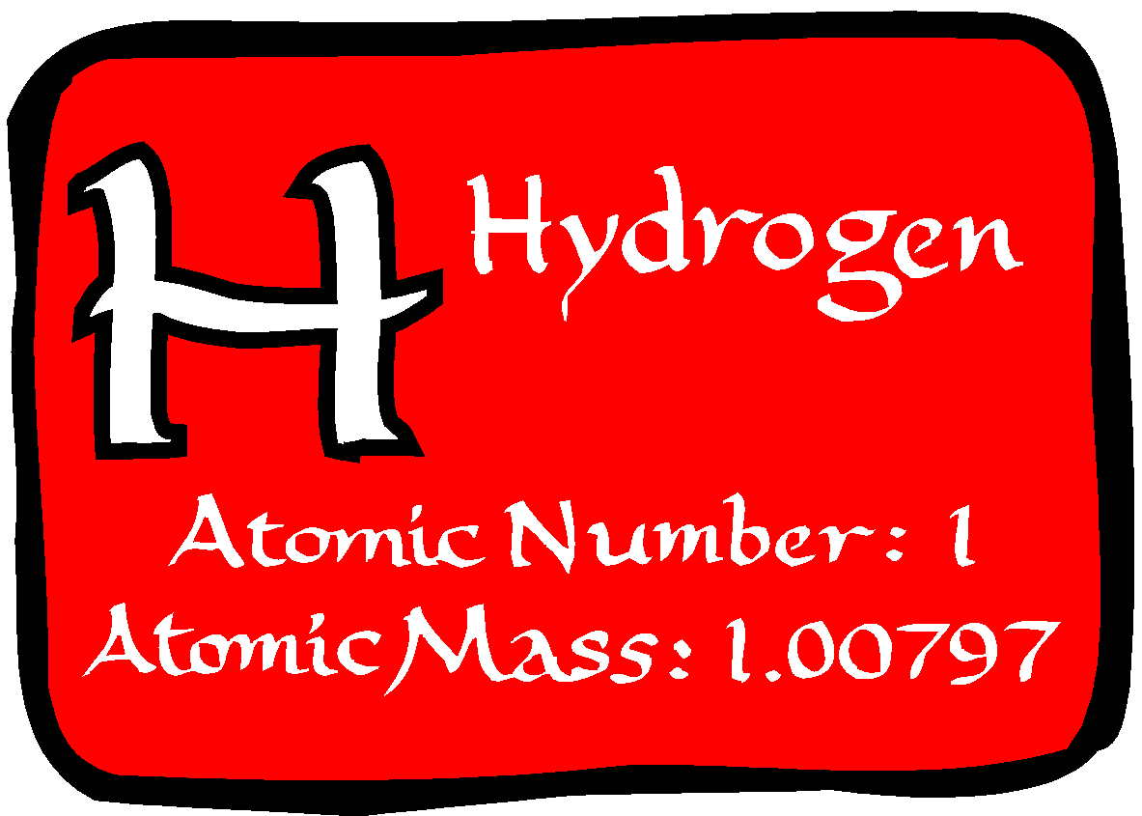
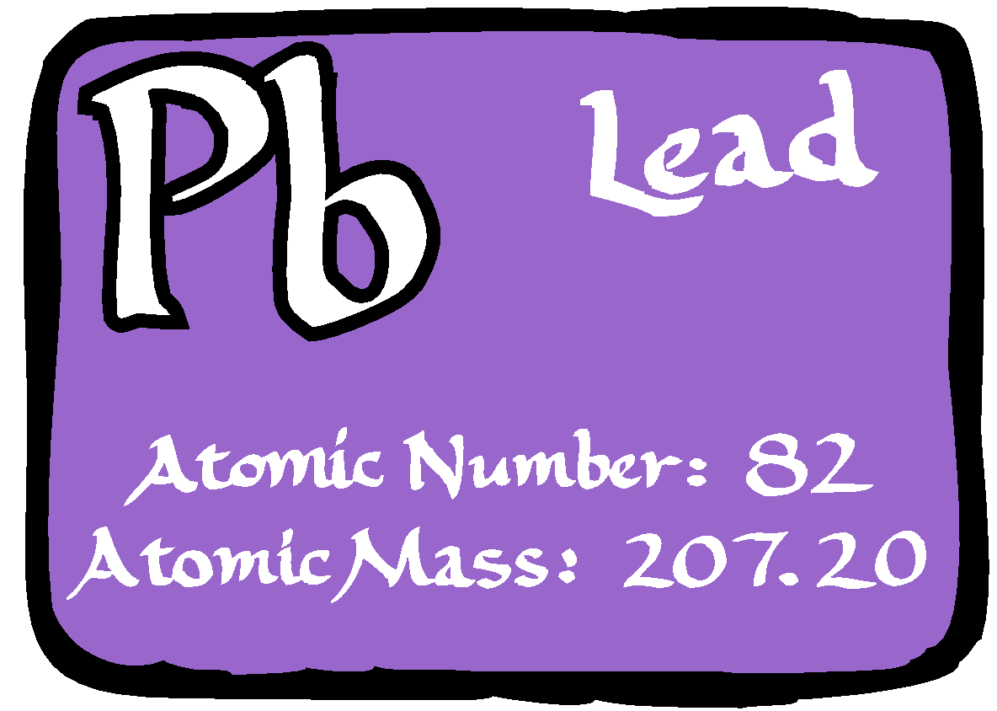
Elements
Substances that CANNOT be broken down
Made up of all the same ATOMS.
Elements symbols:
1 letter capitalized
If it has a second letter it’s always lower case
Examples of elements: H, N, Pb

Slide 9
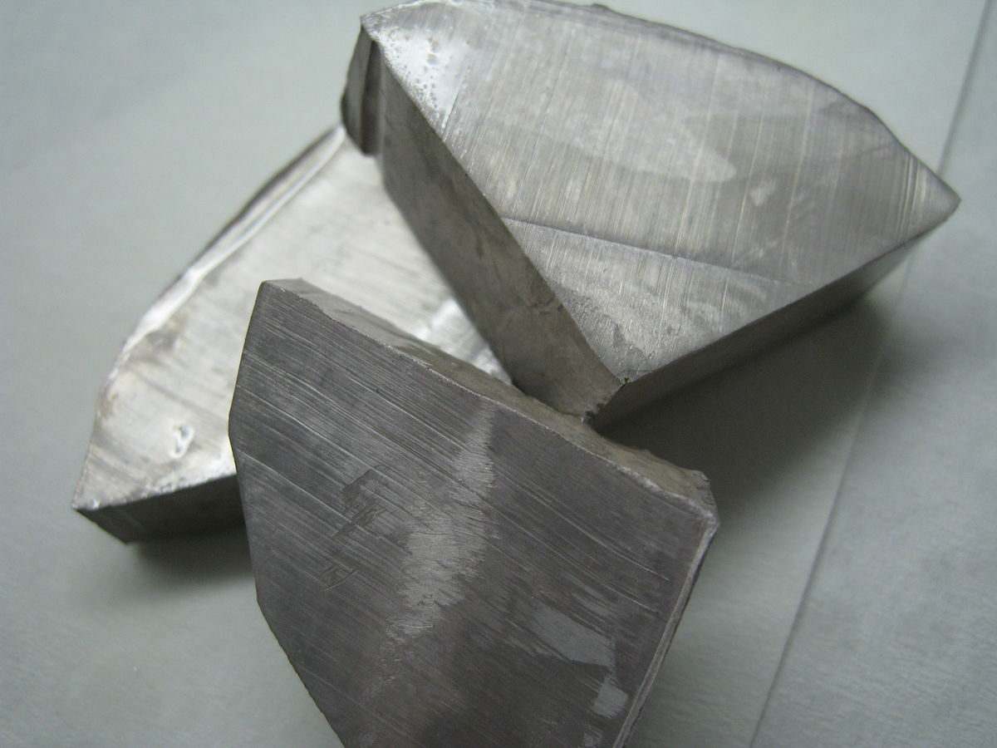
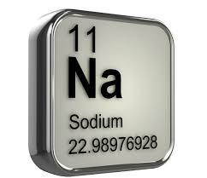
Monoatomic Elements
Composed of a single type of atom not bonded to each other Ex. Sodium (Na)
Na
Na
Na
Na

Slide 10
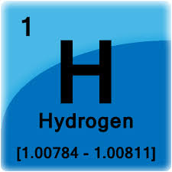
Diatomic Elements
Composed of two of the same types of atoms bonded to each other Ex. H₂
H
H
H
H
H
H

Slide 11
Memorize These!!!
Elements that exist as diatomic molecules
Br I N Cl H O F Bromine (Br₂) Hydrogen (H₂) Iodine (I₂) Oxygen (O₂) Nitrogen (N₂) Fluorine (F₂) Chlorine (Cl₂)

Slide 12
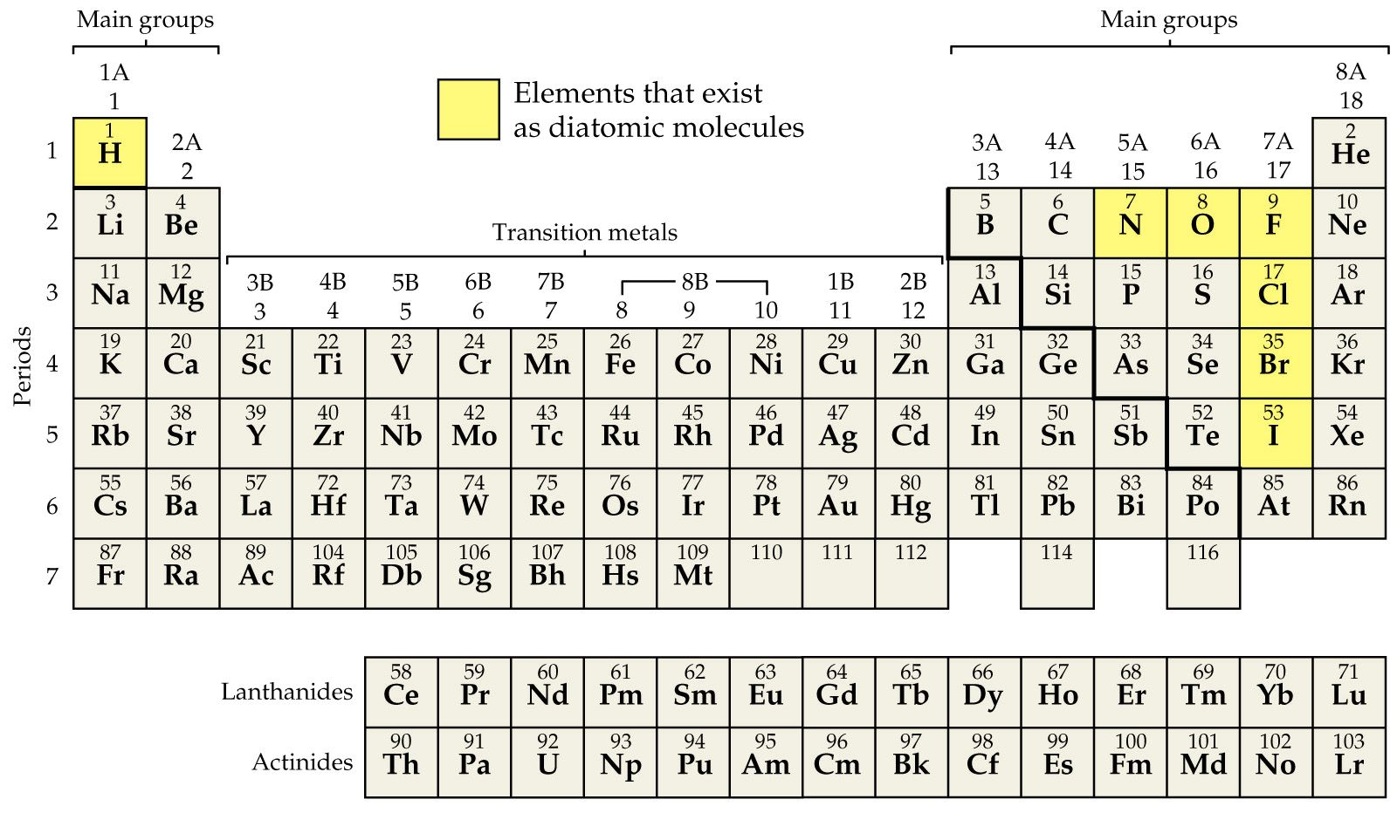
The 7 Diatomic Elements

Slide 13
Compounds
Made up of 2 or more different atoms chemically combined
Have a fixed composition (doesn’t change e.g. H₂O)
Can be broken apart into elements
O
H
H

Slide 14
You should be able to:
Differentiate between elements, compounds and mixtures
Identify the diatomic elements

Slide 15
Classifying Elements

Slide 16
Lesson Objectives
Differentiate between different classifications of elements
Classify elements as metals, nonmetals and metalloids and determine their properties

Slide 17
Elements
Elements: Consist of one type of particle and cannot be broken down by chemical means
Na
Na
H
H
H
H
Na
Na
H
H

Slide 19
Properties of Metals:
Luster (shiny)
Excellent conductors of heat and electricity
Malleable (can be hammered or rolled into thin sheets)
Ductile (can be drawn into a wire)
Solid @ STP (except Hg)
Na
Na
Na
Na

Slide 20
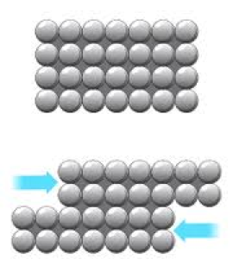
Why are metals Malleable & Ductile?
Metals consist of layers of particles that can slide over each other

Slide 21
Metal Alloys
Alloys such as brass (mixture of copper and zinc) are harder than the original metals
Irregularity in the structure helps to stop slipping over each other

Slide 22
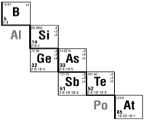
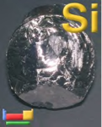
Properties of Metalloids
Semiconductors (Good/moderate conductor)
Luster (like metals) and Brittle (like nonmetals)
Used for making computer microchips

Slide 23
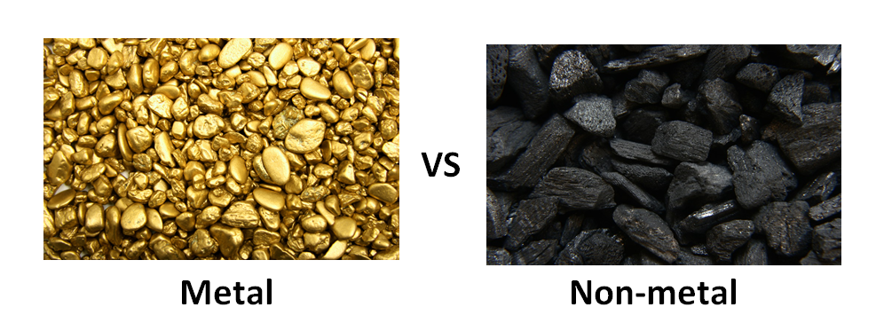
Properties of Nonmetals
Poor conductors of heat and electricity
Brittle (shatter when struck)
Dull

Slide 24
Differentiate between different classifications of elements
Classify elements as metals, nonmetals and metalloids and determine their properties

Slide 25
Classifying Compounds

Slide 26
Lesson Objectives
Differentiate between atoms and molecules and compounds
Classify compounds as ionic or covalent
Determine the type of compound based on its properties
Determine if a covalent compound is polar or nonpolar

Slide 27
Atom vs Molecule
Atom: single particle
Molecule: made up of 2 or more atoms chemically combined
O
C
O
O
O

Slide 28
Compounds
Two or more different types of atoms chemically bonded together in a definite, whole number ratio
C
O
O
H
H
Ex. CO
Ex. H₂O

Slide 29
Ionic Substances
Made up of a metal and a nonmetal element
Example: NaCl
Na
Cl

Slide 30
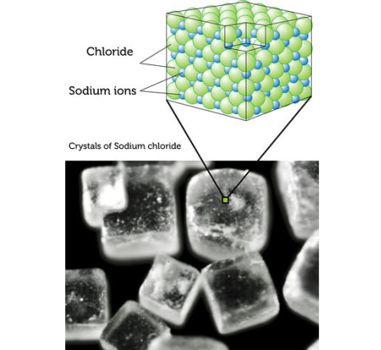
Properties of Ionic Substances
Hard, crystalline structure
HIGH Melt/Boiling Pt
SOLUBLE in water
Conduct ELECTRICITY
only when dissolved in water (aq)

Slide 31
Covalent Substances
Made up of 2 or more nonmetal elements
Example: CO₂
O
C
O

Slide 32
Properties of Covalent Substance
Low melting and boiling pts
due to weak attraction between particles
Do not conduct electricity

Slide 33
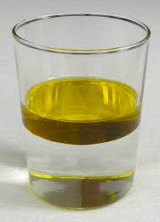
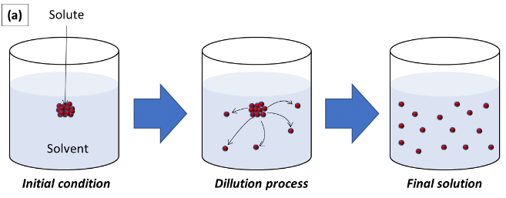
Properties of Covalent Substances
Polar Covalent: dissolves in water
Nonpolar covalent: insoluble in water
insoluble
Soluble

Slide 34
Differentiate between atoms and molecules and compounds
Classify compounds as ionic or covalent
Determine the type of compound based on its properties
Determine if a covalent compound is polar or nonpolar

Slide 35
Formulas of Compounds

Slide 36
Lesson Objectives:
Determine how many atoms are in a compound and how many molecules/compounds are in a reaction
Explain the laws of definite and multiple proportions

Slide 37
Subscripts
The little number following an element symbol.
Indicates the # of ATOMS of ONLY THAT ELEMENT in the compound. Example: H₂O CO₂ (2 H’s and 1 O) (1 C and 2 O’s)
O
O
C
O
H
H

Slide 38
Coefficients
The big number in front of a formula
Indicates the number of molecules/compounds there are Example: 3H₂O is 3 molecules of the compound H₂O
O
H
H

Slide 39
Example
How many atoms of Hydrogen are indicated by the formula: 2H₂O?
O
O
4 atoms of H
H
H
H
H
How many molecules of water are indicated by the formula: 2H₂O?
2 molecules of water

Slide 40
Law of Multiple Proportions
When 2 elements react to form more than one compound, a fixed mass of one element will react with fixed masses of the other element in a ratio of small, whole numbers

Slide 41
Law of Multiple Proportions (pg. 12)
Compounds of carbon (C) and oxygen (O)
Compound A: 57.1g O and 42.9g C
Compound B: 72.7g O and 27.3g C
Determine the value of the ratio
in each compound. A _____ B _____
57.1g O
42.9g C
72.7g O
27.3g C
mass O
mass C
1.33
2.66

Slide 42
Law of Multiple Proportions
How does the mass ratio for compound B compare to that in compound A? compound. A _____ B _____
1.33
2.66
The ratio in B is twice as great as that in A.

Slide 43
Law of Multiple Proportions
Express these mass ratios as improper fractions
compound A _____ compound B _____
1.33
2.66
1 1/3 = 4/3
2 2/3 = 8/3

Slide 44
A = 4/3 O/C
B = 8/3 O/C
= carbon
= oxygen
Hypothesis 1
Hypothesis 2
Particles of C and O have the same mass | Particles of O are heavier than C particles by the ratio in compound A
C₃O₄
CO
C₃O₈
CO₂

Slide 45
Law of definite proportions
A given chemical compound always contains the same elements in the exact same proportions by mass.
Ex. CO₂

Slide 46
Law of Definite Proportions
Table sugar is a compound known as sucrose. Sucrose is composed of the elements carbon, hydrogen, and oxygen. Analysis of a 20.0 g of sucrose from a bag of sugar finds that the sugar is composed of 8.44 g of carbon, 1.30 g of hydrogen, and 10.26 g of oxygen.
Express, as fractions, the ratio of the mass of each element to the total mass of the sample.
8.44g C
1.30g H
10.26g O
20.0g
20.0g
20.0g

Slide 47
Law of Definite Proportions
Using these ratios, calculate the percent composition by mass of each element in the compound.
8.44g C
X 100 = 42.2% C
20.0g
10.26g O
X 100 = 51.3% O
20.0g
1.30g H
X 100 = 6.5% H
20.0g
This will remain the percent composition of each element in any sample of sucrose.

Slide 48
You should be able to:
Determine how many atoms are in a compound and how many molecules/compounds are in a reaction
Explain the laws of definite and multiple proportions

Slide 49
Classifying Mixtures

Slide 50
Lesson Objectives
Determine if a mixture is homogeneous or heterogeneous
Idenitify ways to separate a mixture.

Slide 51
Classification of Matter
MATTER
yes
no
Can it be physically separated?
MIXTURE
PURE SUBSTANCE
yes
no
yes
no
Is the composition uniform?
Can it be chemically decomposed?
Homogeneous Mixture
(solution)
Heterogeneous Mixture
Compound
Element

Slide 52
Mixture
Combinations of 2 or more different elements, compounds or both, in no fixed ratio, and not bonded together
Each substance in mixture keeps its own properties
Ex. Mixture of element and compound

Slide 53
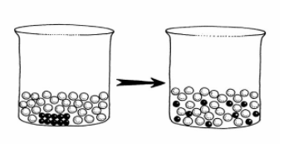
Homogeneous Mixture
Substances are uniformly (evenly) mixed
All solutions are homogeneous mixtures
Example: Salt water NaCl (aq)
(aq) aqueous (dissolved in water)

Slide 54
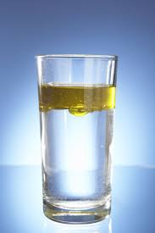
Heterogeneous Mixture
Substances are not uniformly (unevenly) mixed
Example: oil and water

Slide 55
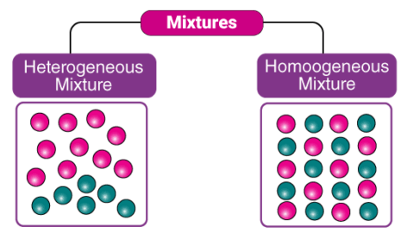
Heterogeneous vs homogeneous

Slide 56
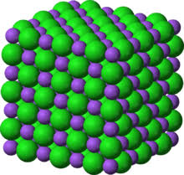
Example:
Classify as an element compound or mixture:
NaCl (s)
NaCl (aq)
compound
mixture

Slide 57
Symbols
If a single symbol, with one capital letter = element.
Example: Au (gold)
If two or more combined symbols, with two or more capital letters = compound.
Example: PbO (lead oxide)

Slide 58
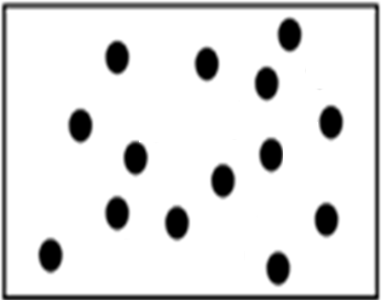
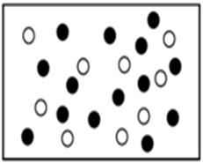
Example
Which represents a mixture of substances?

Slide 59
Separating Mixtures
Separating mixtures can be done based on physical properties as:
1. boiling point/freezing pt
2. Density
4
3. particle size
3. particle size
4. Solubility
5. magnetism

Slide 60
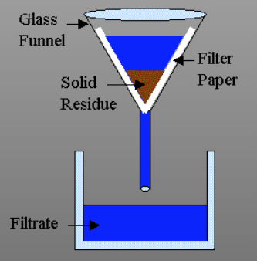
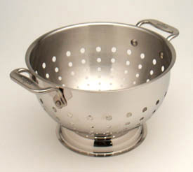
Filtration
Separates a solid from a liquid
Must be a heterogenous mixture

Slide 61
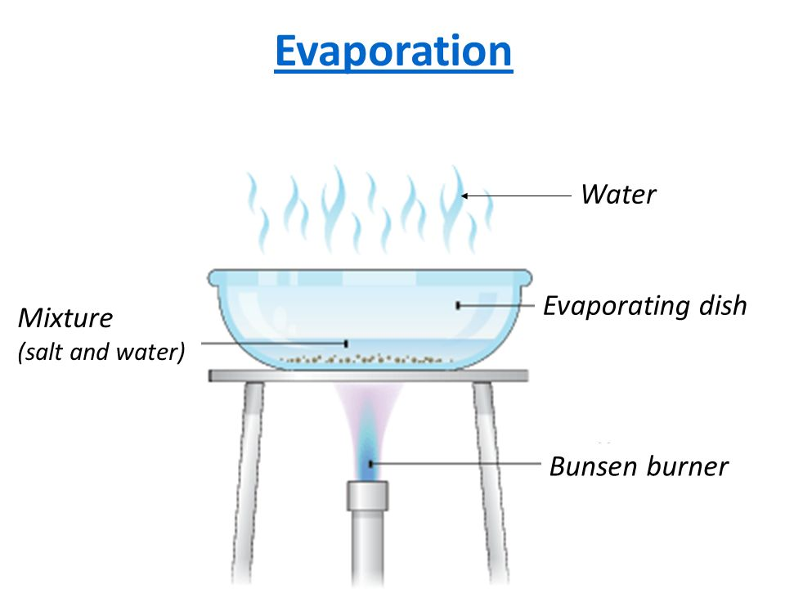
Evaporation
Separates an aqueous solution
Ex. NaCl (aq)

Slide 62
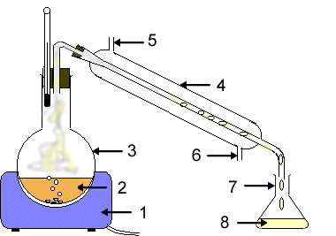
Distillation
Separates a mixture of 2 0r more different liquids based on boiling point

Slide 63
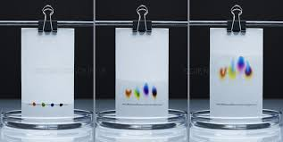
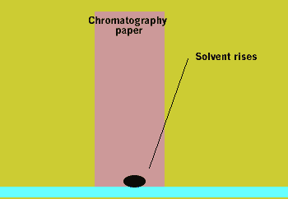
Chromatography
Separates particles based upon size and polarity

Slide 64
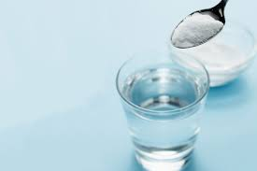
Example
A student wants to separate a solution of sugar water. What method would they use?

Slide 65
You should be able to:
Determine if a mixture is homogeneous or heterogeneous
Identify ways to separate a mixture.

Slide 66
Properties & Changes
of Matter

Slide 67
Lesson Objectives:
Differentiate between physical and chemical changes

Slide 68
Physical Properties/Changes
Characteristics that don’t change the substance
NO NEW SUBSTANCE is produced
Examples: density, crushing, solubility, conductivity, melting/boiling pt, phase changes etc.

Slide 69
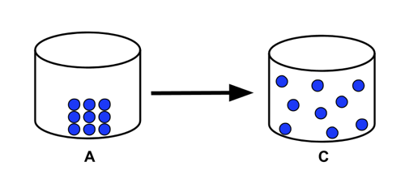
Physical Change
The particles don’t change during a physical change

Slide 70
Signs of a physical property/change
Still the same substance but in a different form or state of matter (s,l,g) Words to look for: Dissolves, phase change, melts or boils, Is a solid, liquid or gas etc

Slide 71
Chemical properties/changes
Characteristics that change the substance A NEW SUBSTANCE is made Examples: Reactivity, flammable, corrosive, bubbling

Slide 72
Chemical Change
New substances are formed during a chemical change
CO₂
C and O₂
O
C
O
C
O
O

Slide 73
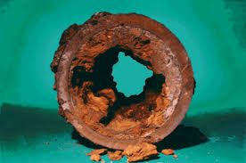
Signs of a chemical property/change
A NEW substance is made that has different properties than its elements
Words to look for: reacts with (water etc.) Combusts corrodes

Slide 74
Examples:
rusting iron
dissolving in water
burning a log
crushing a compound
chemical
physical
chemical
physical

Slide 75
Physical vs Chemical Change
Chemical change -> compounds formed or broken down by changing the bonds between them
Physical change -> phase change or mixtures created or separated by changing the forces between them

Slide 76
You should be able to:
Differentiate between physical and chemical changes

