Slide 1
Stoichiometry
The math of Chemistry

Slide 2
Moles and Dimensional Analysis

Slide 3
Objectives
You should already be able to…
Explain the unit of a mole and calculate molar mass.
Use significant figures to round calculations.
By the end of this video you should be able to…
Use dimensional analysis to calculate the moles of a substance.
Use dimensional analysis to find the mass of a substance.

Slide 4
“You should already be able to”
If at any time in the school year you see a bullet labeled with this heading and you can’t already do it you need to catch up! You can:
Come to extra help and ask questions
Search for videos online or ask me for additional videos
Use textbooks and review books I have in class to review
Find old regents/honors packets you have from years prior

Slide 5
Memorize
Everything you must memorize will be marked in this color.
Any questions? Chat me on remind or canvas ASAP!

Slide 6
Question of the Video
What does four birthday balloons, a sip of water, and 40 nails have in common?

Slide 7
Stoichiometry
The Mole represents 6.02x10²³ particles such as atoms and molecules.

Slide 8
The Mole = 6.02x10²³
The mole is based on the fact that 12 grams of Carbon-12 has a mole of atoms.

Slide 9
Molar Mass
Molar Mass (aka gram formula mass or molecular mass) is the mass of one mole of a substance.
Element’s molar masses are reported on the periodic table.

Slide 10
Molar Mass Examples: Elements
What is the molar mass of iron?
What is the molar mass of copper?
55.85 g/mol
63.55 g/mol

Slide 11
Molar Mass Examples: Compounds
What is the molar mass of water?
H₂O = 2(1.008) + 16.00 =
18.016g/mol
What is the gram-formula-mass of calcium chloride?
CaCl₂ = 40.1 + 2(35.5) =
111.1 g/mol

Slide 12
Dimensional Analysis
Start with the number given as a numerator over 1.
MULTIPLY by a new fraction
Place a conversion with the same unit on the denominator of the new fraction.
Multiply numerators, divide denominators.
Check SF
Calculate the mass of 6.00 moles of Neon.
6.00 moles
1
20.18g =
1 mole
X
121.08 g
= 121 g

Slide 13
Dimensional Analysis
2. Calculate the mass of 0.0230 moles of NH₃.
0.0230 moles
1
17.034 g =
= 0.392 g
1 mole
0.391782 g
X

Slide 14
Dimensional Analysis
3. Determine the number of moles in 8.00 grams of Helium.
8.00 g
1
1 mole =
2
4.00 g
= 2.00 g
X

Slide 15
Dimensional Analysis
4. Determine the number of moles in 8.00 grams of CCl₄.
8.00 g
1
1 mole =
153.81
0.05201222 g
= 0.0520 g
X

Slide 16
DA pointers summarized
Start with the number given as a numerator over 1.
MULTIPLY by a new fraction
Place a conversion with the same unit on the denominator of the new fraction.
Multiply numerators, divide denominators.
(maybe pause and copy all this?)

Slide 17
Question of the Video
What does four birthday balloons, a sip of water, and 40 nails have in common?
Each 1L balloon has approximately 1.00g of He inside. 4.00grams of He is equivalent to 1 mol of Helium.
A sip of water is on average close to 18mL. The density of pure water is 1.00g/mL, therefore, the mass of the sip of water is 18g which is equivalent to 1 mol of water.
Each iron nail weighs approximately 1.40g. So 40 nails equals 56g, equivalent to… you guessed it… 1 mole of Fe!
Each of these have the same number of particles, regardless of their different masses and volumes.

Slide 18
Now you must be able to…
Use dimensional analysis to calculate the moles of a substance.
Use dimensional analysis to find the mass of a substance.

Slide 19
Molecules and atoms

Slide 20
Objectives
You should already be able to…
Describe the unit of moles and calculate moles and mass of a substance.
By the end of this video you should be able to…
Convert between moles and number of particles of a gas using dimensional analysis.
Use chemical reaction equations to convert between measurements of substances.

Slide 21
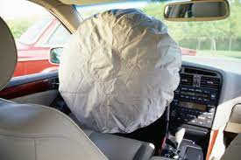
Question of the Video
2NaN₃(s) → 2Na(s) + 3N₂(g)
Typical airbags in small cars require approximately 65. 1 L of N₂ gas to inflate to the proper size. How many grams of NaN₃ must be included to generate this amount of N₂? (Hint: The density of N₂ gas at this temperature is about 0. 916 g/L).

Slide 22
Mole Road Map
mass
Gram formula mass
particles
Atoms or molecules: use 6.02x10²³

Slide 23
Examples
1. Calculate the number of molecules in 4.00 moles of Lithium sulfide, Li₂S.
2. Calculate the number of atoms in question 1.
4.00 moles
1
6.02x10²³ molecules =
2.41x10²⁴ molecules
X
1 mole
2.41x10²⁴ molecules
1
3 atoms =
7.22x10²⁴ molecules
1 molecule
X

Slide 24
Examples
3. How many moles are present in 1.20x10²⁴ molecules of H₂O_{(l)}?
1.20x10²⁴ molecules 1
1 mole =
2.00 moles
X
6.02x10²³

Slide 25
THINK
Why do chemists use moles to measure substances? Why aren’t grams, liters and molecules enough?

Slide 26
Examples
4. Calculate the number of atoms of P in 120.0 grams of P₂O₅.
5.073x10²³ atoms
6.02x10²³ molecules x
2 atoms =
120.0g
1
1 mole x
1 mole
141.94g
X
1 molecule

Slide 27
Reactions
Many AP questions will give you information about a reactant used in a reaction and ask you about the product formed. Use the balanced equation to create a mole ratio to convert between moles of substances.

Slide 28
Examples
5. Water decomposes into its elements when electrified at high voltages. If 24.0 grams of water is completely decomposed, how many grams of oxygen will be produced? 2H₂O → 2H₂ + O₂
1 mole H₂O x
32.00 g =
1 mole O₂
21.3 g
1 mole O₂ x
24.0g H₂O
1
18.016g
2 mole H₂O
X

Slide 29
Examples
6. Lithium and magnesium chloride react according to the equation below. Calculate the number of atoms of magnesium that form when 2.50 g of lithium are used.
2Li + MgCl₂ → 2LiCl + 2Mg
1 mole Li x
6.02x10²³ atoms =
1 mole Mg
2 mole Mg x
2.50g Li
1
6.94g
2 mole Li
X
2.13x10²⁴ atoms

Slide 30
Question of the Video
2NaN₃(s) → 2Na(s) + 3N₂(g)
Typical airbags in small cars require approximately 65. 1 L of N₂ gas to inflate to the proper size. How many grams of NaN₃ must be included to generate this amount of N₂? (Hint: The density of N₂ gas at this temperature is about 0. 916 g/L).
D=m/v 0.916 = x/65.1 m= 58.6g
58.6g N₂ x 1mole N₂ x 2 mol NaN₃ x 65.02 gNaN₃ = 90.7g NaN₃
1 28.02g 3 mole N₂ 1 mol

Slide 31
Now you must be able to…
Convert between moles and number of particles of a gas using dimensional analysis.
Use chemical reaction equations to convert between measurements of substances.

Slide 32
Balancing Reactions and Net Ionic Equations

Slide 33
Objectives
You should already be able to…
Balance reactions and use solubility rules
By the end of this video you should be able to…
Memorize solubility rules to determine which substances dissolve in reactions
Identify insoluble solid precipitates.
Write net ionic equations.

Slide 34
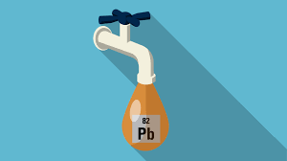
Question of the Video
Lead (II) nitrate is dissolved in a sample of water. Lead ions are particularly unsafe for human consumption. What are some ways to get the lead out? Will just filtering work?

Slide 35
Reactions
Reactions in chemistry are written in the following manner:
REACTANTS → PRODUCTS
Coefficients before compounds and elements will tell you how many of that substance reacts.
Mix + 2 Eggs + 1 cup water = Cake
Reactants Products
4Al + 3O₂ → 2Al₂O₃

Slide 36
Conservation of Mass
In a reaction, atoms and molecules cannot appear or disappear. Mass must stay constant from the beginning to the end of the reaction.
H₂ + O₂ → H₂O
___H₂ + ___O₂ → ___ H₂O
2
2

Slide 37
Balancing Reactions
3
2
___ N₂ + ____H₂ → ____ NH₃
___Li + ____O₂ → ___Li₂O
4
2

Slide 38
Balancing
2
__Pb(NO₃)₂ +__K₂CrO₄→___PbCrO₄ + ___KNO₃
___C₄H₈ + ___O₂ → ___CO₂ + ___H₂O
6
4
4

Slide 39
Solubility
The ability to dissolve in water depends on many factors such as polarity (defined later), chemical nature of ions, and attractive forces. There are varying degrees of solubility.
Substances that are characterized as “mostly soluble” will dissolve in water under most conditions- but will still have a limit to dissolving known as saturation.
Moderately soluble ions are soluble dependent on the other ion it is bonded to.
Insoluble substances may not actually be INSOLUBLE, per se. They are just not visibly soluble and may only dissolve a few molecules.

Slide 40
Memorize this list of soluble ions
Group 1 ions: Li⁺ Na⁺ K⁺ Rb⁺ Cs⁺
Ammonia NH₄⁺
Acetate C₂H₃O₂⁻
Nitrate NO₃-
Note: these are all +1 or -1 ions… If these are with ANY other ion, they are soluble. For the purposes of the AP Exam, all other substances are insoluble unless noted in the question.

Slide 41
Are these soluble or insoluble?
NaI
K₂CO₃
Al(OH)₃
PbSO₄
AgCl
(NH₄)₂S
AlPO₄
Na₂SO₃
MgC₂O₄
Li₂O
CaCrO₄
BaF₂
Mg(ClO₃)₂
Cs₂CO₃
RbC₂H₃O₂
Sr(NO₃)₂

Slide 42
Net Ionic Equations
Molecular Equations are frequently used to show what chemicals are mixed in a reaction, not which actually react. Net Ionic Equations are a simplified form of molecular equations that eliminate spectator ions and shows only those species that react.

Slide 43
Net Ionic Equations
Molecular Equation:
BaCl₂ + Na₂SO₄ → BaSO₄ + 2NaCl
Ionic Equation:
Ba⁺² + 2Cl⁻ + 2Na⁺ + SO₄²⁻ → BaSO₄ + 2Na⁺ + 2Cl⁻
Net Ionic Equation:
Ba⁺² + SO₄²⁻ → BaSO₄
Why did Na⁺ and Cl⁻ cancel???

Slide 44
Tips:
For practice, write out the ionic form, breaking down only soluble aqueous substances. Then cancel and re-write the net ionic.
Don’t worry about writing the phases, although it may help to write if a substance is a solid or gas, to remind you not to ionize it.
The AP will always give reactions that have a net ionic reaction, but your exercises may not. If every substance ionizes, then the reaction does not occur.

Slide 45
THINK
How will you know if a substance is solid, aqueous, liquid, or gas?
Substances are only aqueous if they are soluble and water is present.
All insoluble compounds that contain metals are solids. Also, if the compound has a metal but no water is present, it is a solid.
Most compounds that do not contain metals are not soluble and will not be broken down into ions.

Slide 46
Practice
3
+ NaNO₃
Al(OH)
3
Al(NO₃)₃ + NaOH →
Al⁺³ + 3NO₃⁻ + 3Na⁺ + 3OH⁻ → Al(OH)₃ + 3Na⁺ + 3NO₃⁻
Al⁺³ + 3OH⁻ → Al(OH)₃
2K₃PO₄ + 3 Ca(NO₃)₂ →
6K⁺ + 2PO₄⁻³ + 3Ca⁺² + 6NO₃⁻ → 6K⁺ + 6NO₃⁻ + Ca₃(PO₄)₂
2PO₄⁻³ + 3Ca⁺² → Ca₃(PO₄)₂
₃
KNO₃
+ Ca (PO₄)
6
₃ ₂

Slide 47
Question of the Video
Lead (II) nitrate is dissolved in a sample of water. Lead ions are particularly unsafe for human consumption. What are some ways to get the lead out?
Mix with a different anion to form a precipitate:
Pb(NO₃)₂ + NaI →
Pb⁺² + 2NO₃⁻ + Na⁺ + I⁻ → PbI₂(s) + Na⁺ + NO₃-
Pb⁺² + 2I- → PbI₂(s)
If we filter now, what will come out and what will still be in the water?
2
PbI₂(s) + NaNO₃(aq)
2
2
2
2
2

Slide 48
Now you should be able to…
Memorize solubility rules to determine which substances dissolve in reactions
Identify insoluble solid precipitates.
Write net ionic equations.

Slide 49
Limiting Reactants and Percent Yield

Slide 50
Objectives
You should already be able to…
Calculate the moles, mass, number of molecules/atoms in a substance
Balance reactions
By the end of this video you should be able to…
Use balanced equations to determine the amount of a product that will form.
Calculate the percent yield of a lab.

Slide 51
Question of the Video
Mass of filter paper | 0.130g
Mass of filter paper + purified product | 2.299
Acetylsalicylic acid, aspirin, is synthesized by the conversion of Salicylic acid to Acetylsalicylic acid using acetic anhydride in the presence of a catalyst, H₃PO₄. Chemical companies want the highest percent yield possible to sell their product as pure and cost friendly.
If 2.009g of salicylic acid reacts with 5.400g of acetic anhydride calculate the theoretical yield.
Using the data table, calculate the percent yield.

Slide 52
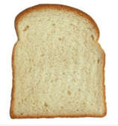
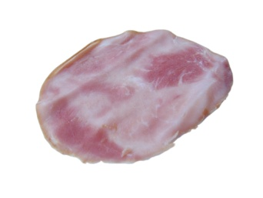
Limiting Reagents
Given:
20 11 36
1 sandwich =
2 + 1 +3
How many sandwiches can I make if I used all of the bread with unlimited other resources?
How many sandwiches can I make if I used all of the cheese with unlimited other resources?

Slide 53
Limiting Reagents
Given:
20 11 36
1 sandwich =
2 + 1 +3
3. How many sandwiches can I make if I used all of the ham with unlimited other resources?
4. How many sandwiches can I make if I used only what is given?
5. What ingredient was the limiter? Why?

Slide 54
Limiting Reagents Examples
1. S + 3F₂ → SF₆
Suppose you have 4 moles of sulfur and 2 moles of fluorine, which is the limiter and which is in excess? How many moles of SF₆ can be produced?
4S produces 4 SF₆
2F₂ produces 0.6 moles of SF₆
(F₂ Limiter!)

Slide 55
Limiting Reagents Examples
2. 2NH₃ + CO₂ → (NH₂)₂CO + H₂O
If 637.2 grams of ammonia react with 1142 grams of carbon dioxide, find the limiting reactant and the mass of urea produced.
1,123 g urea
637.2g NH₃
1
1 mole NH₃ x
1 mole urea x
60.062 g. =
17.034g
2 mole NH₃
1 mole urea
X
1,559 g urea
1142g CO₂
1
1 mole CO₂ x
1 mole urea x
60.062 g. =
44.01g
1 mole CO₂
1 mole urea
X
1,123 g urea

Slide 56
Percent Yield
In a lab, you may not create the exact amount you should have due to errors in the lab. Percent Yield calculates how close you were to the theoretical (calculated) amount you should have created.
Percent yield = Actual mass created x 100
Theoretical mass

Slide 57
If in the previous lab, only 1000.g were created, what was the percent yield?
Recall, the calculated or theoretical yield was 1123g.
1000/1123 x 100 = 89.0%
Percent yields over 85% are generally considered accurate enough.

Slide 58
Limiting Reagents Example
3. 5Ca + V₂O₅ → 5CaO + 2V
1960 grams of calcium react with 1540 grams of V₂O₅. Find the limiting reactant and the mass of V produced.
4. If 803 grams of V are actually made calculate the percent yield.
1960g Ca
1
1 mole V
996 g V
1 mole Ca x
2 mole V x
50.94 g V =
40.08g
5 mole Ca
X
50.94g V
= 862 g V
1 mole V₂O₅ x
2 mole V x
1540g V₂O₅
1
181.88g
1 mole V₂O₅
1 mole V
X
803/862 x 100 = 93.1%

Slide 59
Question of the Video
Mass of filter paper | 0.130g
Mass of filter paper + purified product | 2.299
If 2.009g of salicylic acid reacts with 5.400g of acetic anhydride calculate the theoretical yield.
Using the data table, calculate the percent yield.
2.009g SA x 1mol SA x 1mol aspirin x 180.2 g aspirin = 2.621g aspirin
1 138.1g 1 mol SA 1 mol aspirin
2.621g aspirin
5.400g AA x 1mol AA x 1mol aspirin x 180.2 g aspirin = 9.531g aspirin
1 102.1g 1 mol AA 1 mol aspirin
2.299-0.130 = 2.169g aspirin created
2.169g/ 2.621g x 100 = 82.75%

Slide 60
Now you should be able to…
Use balanced equations to determine the amount of a product that will form.
Calculate the percent yield of a lab.

Slide 61
Types of Reactions

Slide 62
Objectives
You should already be able to…
Identify types of reactions
By the end of this video you should be able to…
Write products of all reactions.

Slide 63
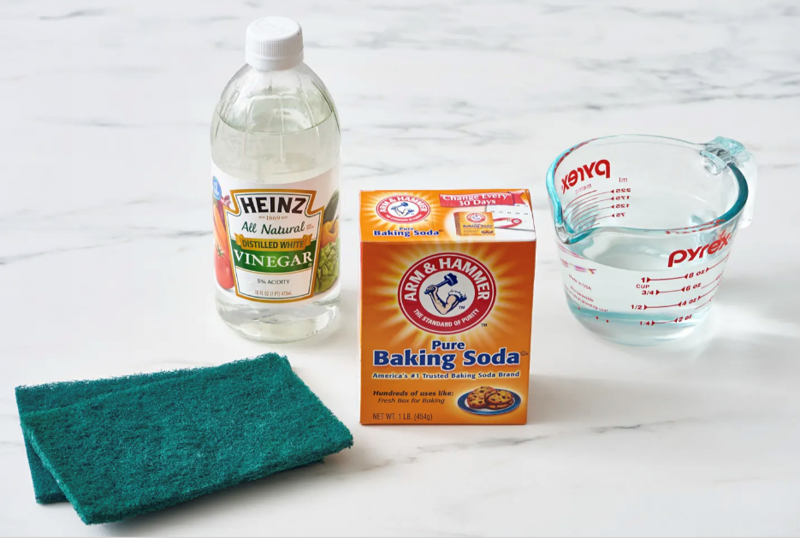
Question of the Video
Sometimes the best way to clean something is to use baking soda and vinegar. Baking soda, NaHCO₃ is a slightly abrasive, basic solid that absorbs odors. Vinegar, HC₂H₃O₂, is an acid. Write their molecular reaction and net ionic equation to help explain what really is going on.

Slide 64
Synthesis: involves two or more reactants which combine to form one compound as a product.
A metal can combine with a non metal to form a compound.
-Lithium reacts with nitrogen: 6Li + N₂ → 2Li₃N
-Sodium reacts with fluorine: 2Na + F₂ → 2NaF
Metallic oxides and water form bases (compounds ending in hydroxide (OH)).
-Solid sodium oxide reacts with water: Na₂O + H₂O → 2NaOH
-Magnesium oxide solid dissolves in water: MgO + H₂O → Mg(OH)₂

Slide 65
Synthesis
Nonmetallic oxides and water from acids (compounds starting with the hydrogen ion).
-Carbon dioxide is bubbled into water: CO₂ + H₂O → H₂CO₃
-Dinitrogen pentoxide gas is dissolved into water: N₂O₅ + H₂O → 2HNO₃
Metallic oxides and nonmetallic oxides combine to form a salt.
-Solid sodium oxide reacts with carbon dioxide: Na₂O + CO₂ → Na₂CO₃
-Solid calcium oxide is added to sulfur trioxide: CaO + SO₃ → CaSO₄
*HINTS*: Look for single elements combining or oxides. Add all atoms together in order of the periodic table. Always reduce to empirical formulas. Watch out for diatomic elements!

Slide 66
Synthesis practice
Potassium oxide + water
Sulfur dioxide + water
3. Calcium + Fluorine
K₂O + H₂O → 2KOH
SO₂ + H₂O → H₂SO₃
Ca+ F₂ → CaF₂

Slide 67
Decomposition
Decomposition reactions occur when a single reactant breaks down into multiple products. All decomposition reactions result in gas formation. The gases CO₂, NH₃, SO₂ and O₂ will be subtracted from the original reactant. Water is another common product.
Solid magnesium carbonate is heated: MgCO₃ → CO₂ + MgO
Solid magnesium chlorate is heated: Mg(ClO₃)₂ → 3O₂ + MgCl₂
Solid ammonium carbonate is heated: (NH₄)₂CO₃ → 2NH₃ + CO₂ + H₂O
Sulfurous acid decomposes: H₂SO₃ → SO₂ + H₂O
Carbonic acid is heated: H₂CO₃ → CO₂ + H₂O
Solid ammonium hydroxide is heated: NH₄OH → NH₃ + H₂O

Slide 68
Decomposition
Exceptions to the rules:
1. Hydrogen peroxide solutions forms water and O₂, not H₂!
Hydrogen peroxide solution is heated: 2H₂O₂ → O₂ + 2H₂O
2. Compounds with neither of these gases break down into elements.
Molten sodium chloride is electrolyzed: 2NaCl → 2Na + Cl₂
*HINTS*: Look for a single reactant. Subtract gas particles. Memorize exceptions. Watch out for diatomic elements!

Slide 69
Decomposition practice
Strontium carbonate is heated.
Ammonium carbonate is heated.
SrCO₃ → SrO + CO₂
(NH₄)₂CO₃→ 2NH₃ + CO₂ + H₂O

Slide 70
Decomposition Practice
3. Ammonium hydroxide is heated.
4. Sulfurous acid is heated.
NH₄OH→ NH₃ + H₂O
H₂SO₃→ H₂O + SO₂

Slide 71
Single Replacement
Single Replacement Reactions involve an element replacing a part of the compound it is reacting with. Metals replace metals. Nonmetals replace nonmetals. However, since hydrogen forms a cation like metals, hydrogen replaces metals.
Magnesium is added to a solution of iron(III) chloride 3Mg + 2FeCl₃ → 3MgCl₂ + 2Fe
Sodium is added to water 2Na + 2HOH → 2NaOH + H₂

Slide 72
Single Replacement
Lithium metal is added to hydrochloric acid 2Li + 2HCl → 2LiCl + H₂
Chlorine gas is bubbled in to a solution of potassium iodide Cl₂ + 2KI → 2KCl + I₂
*HINTS*: Write water HOH so you remember to replace only one hydrogen atom. A single element should be on each side as well as a compound. Watch out for BrINClHOF! If a compound is an oxide, it is a synthesis reaction, not single replacement.

Slide 73
Single Replacement
Bromine gas is added to aqueous lithium iodide.
Hydrochloric acid reacts with potassium.
Br₂ + 2LiI → 2LiBr₂ + I₂
HCl + K → KCl + H₂

Slide 74
Double Replacement
Double Replacement Reactions involve two compounds that trade cations to form two new compounds. No changes in oxidation number occur. They have the general formula AX + BY → AY + BX. Keep cations first in the formula. A precipitate will form. The precipitate is an insoluble solid.
A solution of potassium bromide is mixed with a solution of silver nitrate
KBr + AgNO₃ → KNO₃ + AgBr
*HINTS*: Always look for a driving force (precipitate = insoluble = solid). Charges don’t change; check all charges and drop and swap. Keep cations (positive ions) first in the formula.

Slide 75
Gas Forming DR
These double replacement reactions are the same as the last set, but instead of a precipitate forming, a gas forms. This gas is the driving force in these reactions. One of the following gases must be present in order for these reactions to “work”: H₂S, CO₂, SO₂, NH₃. H₂S is formed directly from a double replacement reaction. The other three are formed when a compound in the products breaks down:
H₂CO₃ → H₂O + CO₂
H₂SO₃ → H₂O + SO₂
NH₄OH → H₂O + NH₃

Slide 76
Gas forming DR
Solid sodium sulfite reacts with a solution of hydrochloric acid.
Na₂SO₃ + 2HCl → 2NaCl + H₂SO₃
Na₂SO₃ + 2HCl → 2NaCl + H₂O + SO₂
Solid potassium carbonate reacts with a solution of nitric acid.
K₂CO₃ + 2HNO₃ → 2KNO₃ + H₂CO₃
K₂CO₃ + 2HNO₃ → 2KNO₃ + H₂O + CO₂
Solutions of ammonium chloride and sodium hydroxide mix.
NH₄Cl + NaOH → NaCl + NH₄OH
NH₄Cl + NaOH → NaCl + H₂O + NH₃
Iron (II) sulfide solid reacts with hydrochloric acid. FeS + 2HCl → FeCl₂ + H₂S

Slide 77
Double Replacement Practice
Barium nitrate is added to lithium sulfate.
Aluminum acetate is added to potassium hydroxide.
Magnesium sulfide reacts with hydrobromic acid.
Ba(NO₃)₂ + Li₂SO₄ → BaSO₄ + 2LiNO₃
Al(C₂H₃O₂)₃ + 3KOH → 3KC₂H₃O₂ + Al(OH)₃
MgS + 2HBr → MgBr₂ + H₂S

Slide 78
Net Ionic Equations
Recall: Net ionic equations are reduced reactions that show the species that actually react in the formula. All soluble reactants and products will break into ions when they dissolve in water. All the species that do not ionize are called “driving forces.” Species that are alike of either side of the arrow will cancel. At least one of the driving force species must be present in order for a reaction to “work.” Otherwise, all species would cancel out.

Slide 79
Net Ionic Equations
All insoluble solid precipitates will not ionize.
A solution of potassium bromide is mixed with a solution of silver nitrate
KBr + AgNO₃ → KNO₃ + AgBr
K⁺ + Br⁻ + Ag⁺ + NO₃⁻ → K⁺ + NO₃⁻ + AgBr
Ag⁺ + Br⁻ → AgBr

Slide 80
Net Ionic Equations
Gases such as O₂, CO₂, SO₂, NH₃ and H₂S will not ionize.
Solid sodium sulfite reacts with a solution of hydrochloric acid.
Na₂SO₃ + 2HCl → 2NaCl + H₂SO₃
Na₂SO₃ + 2HCl → 2NaCl + H₂O + SO₂
2Na⁺ + SO₃ ⁻² + 2H⁺ + 2Cl⁻ → 2Na⁺ + 2Cl⁻ + H₂O + SO₂
SO₃⁻² + 2H⁺ → H₂O + SO₂

Slide 81
Net Ionic Equations
Water and other covalent compounds (nonmetals only) will not ionize.
Solid sodium oxide reacts with water
Na₂O + H₂O → 2NaOH
Na₂O + H₂O → 2Na⁺ + OH⁻

Slide 82
Net Ionic Equations
Weak acids will not ionize.
Calcium acetate solution reacts with hydrochloric acid
Ca(C₂H₃O₂)₂ + 2HCl → 2HC₂H₃O₂ + CaCl₂
Ca⁺² + 2C₂H₃O₂⁻ + 2H⁺ + 2Cl⁻ → 2HC₂H₃O₂ + Ca⁺² + 2Cl⁻
2C₂H₃O₂⁻ + 2H⁺ → 2HC₂H₃O₂

Slide 83
Net Ionic Equations
All reactions will work on the exam but not in real life. Just proof:
Lithium nitrate reacts with sodium chloride
LiNO₃ + NaCl → LiCl + NaNO₃
Li⁺ + NO₃⁻ + Na⁺ + Cl⁻ → Li⁺ + Cl⁻ + Na⁺ + NO₃⁻
EVERYTHING CANCELS!
*HINTS*: Net ionic equations are only necessary if the species are in water. Watch out for solids, liquids and gases; they do not ionize. Check solubility rules, ions, and BrINClHOF! Memorize the 7 strong acids (HCl, HBr, HI, HNO₃, HClO₄, H₂SO₄, H₃PO₄) that ionize and remember that all other compounds that start with H do not ionize.

Slide 84
Question of the Video
Sometimes the best way to clean something is to use baking soda and vinegar. Baking soda, NaHCO₃ is a slightly abrasive, basic solid that absorbs odors. Vinegar, HC₂H₃O₂, is an acid. Write their molecular reaction and net ionic equation to help explain what really is going on.
NaHCO₃(s) + HC₂H₃O₂(aq) →
NaC₂H₃O₂ + H₂CO₃
→ NaC₂H₃O₂ (aq) + H₂O(l) + CO₂(g)
NaHCO₃(s) + HC₂H₃O₂(aq) → Na⁺ + C₂H₃O₂⁻ + H₂O(l) + CO₂(g)

Slide 85
Now you must be able to…
Write products of all reactions.

Slide 86
Empirical and Molecular Formulas

Slide 87
Objectives
You should already be able to…
Identify empirical and molecular formulas.
Calculate percent composition.
By the end of this video you should be able to…
Calculate empirical and molecular formulas from percent composition.

Slide 88
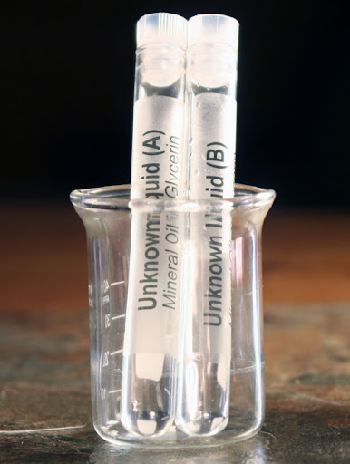
Question of the Video
When a compound is first isolated, we often don’t know much about it. Some spectrometers can determine how many atoms are present in the isolated sample so you can calculate and determine what the chemical is.
A compound is found to contain 64.80 % carbon, 13.62 % hydrogen, and 21.58 % oxygen by weight. What is the empirical formula for this compound?
The molecular weight for this compound is 74.14 g/mol. What is its molecular formula?

Slide 89
Percent Composition
% By mass: mass part x 100
total mass
Find the % by mass of H in phosphoric acid.
H₃PO₄ 3(1.0) x 100
3(1.0)+32.1+4(16.0)
= 3.02%

Slide 90
Example 2
Find the percent by mass of Ca in Ca(OH)₂.
40.0 x 100
40.0+2(16.0)+2(1.0)
= 54.1%

Slide 91
Example 3
A sample of a substance containing only magnesium and chlorine was tested in the laboratory and found to be composed of 74.5% chlorine by mass. If the total mass of the sample was 190.2 grams, what is the mass of the chlorine?
0.745 (190.2) =
141.7 grams

Slide 92
Empirical Formulas
Empirical formula refers to any molecular formula in it’s reduced form.
Are these empirical? If not, reduce them:
C₄H₈
C₆H₁₂O₆
N₃O₆
Na₂(OH)₂
CH₂
CH₂O
NO₂
NaOH

Slide 93
Molecular Formulas
Molecular Formulas are some multiple of the empirical formula.
If the empirical formula is CH₄ a molecular formula could be CH₄, C₂H₈, C₃H₁₂ etc.
A compound whose empirical formula is NH₃ has a mass of 34 g/mol. What is the molecular formula?
NH₃ = 17.0 g/mol 34/17 = 2
2NH₃ = N₂H₆

Slide 94
Steps:
Find the mass of the empirical formula.
Divide the mass given by the empirical mass.
Distribute your answer through the empirical formula.
If a compound has a mass of 45 g/mol and an empirical formula of CH₃, what is the molecular formula?
CH₃ = 15 g/mol 45/15 = 3
3CH₃ = C₃H₉
Copy this?

Slide 95
Calculating Empirical Formulas From Percent Composition
Rules:
Find the empirical formula of a compound with 40.92% C, 4.58% H and 54.50% O by mass.
Convert the % to grams, assuming the total mass of the sample is 100 grams.
40.92g C, 4.58g H, 54.50g O
2. Convert mass to moles, using atomic masses.
40.92/12 = 3.40 moles C
4.58/ 1 = 4.58 moles H
54.50/16 = 3.4o moles O
Divide each element’s moles by the smallest number of moles.
Find a whole number ratio.
1 mole C, 1.5 mole H, 1 mole O
C₂H₃O₂

Slide 96
Example 1
A sample of nitrogen and oxygen contains 1.52 g N and 3.47g O and a molar mass of about 90 grams. Find the empirical and molecular formulas.
1.52g N / 14.01 g = 0.108 mol N
3.47g O / 16 g = 0.216 mol O
.216/.108 = 2
NO₂ empirical formula
NO₂ = 46g/mol. Molecular formula = N₂O₄

Slide 97
Example 2
Find the empirical and molecular formula of approximately 14 gram sample with 6.44 grams of Boron and 1.803 grams of hydrogen.
6.44g B / 10.81 g = 0.596 mol B
1.803g H / 1 g = 1.803 mol H
1.803/0.596 = 3
BH₃ = 13.8g/mol. Empirical and Molecular formula = BH₃

Slide 98
Example 3
A sample of a compound contains 47.0% silicon and the rest is oxygen. If the total mass is 180 grams, what is a possible set of empirical molecular formulas of the compound?
a. SiO₂ and SiO
b. Si₄O₄ and SiO
c. Si₂O₄ and SiO₂
d. Si₃O₆ and SiO₂
47.0g Si / 28.09 g = 1.67 mol Si
53.0g O / 16 g = 3.31 mol O
3.31/1.67 = 2
SiO₂ = 60g/mol. Molecular formula = Si₃O₆

Slide 99
Question of the Video
A compound is found to contain 64.80 % carbon, 13.62 % hydrogen, and 21.58 % oxygen by weight. What is the empirical formula for this compound?
The molecular weight for this compound is 74.14 g/mol. What is its molecular formula?
64.80 g C / 12 = 5.4 mol C 13.62 g H/ 1 = 13.62 mol H 21.58 g O/ 16 = 1.349 mol O
5.4 / 1.349 = 4C 13.62 / 1.349 = 10H 1.349 / 1.349 = 1 O
C₄H₁₀O
48 + 10 + 16 = 74 / 74.14 = 1
Empirical and Molecular formula = C₄H₁₀O butanol

Slide 100
Now you must be able to…
Calculate empirical and molecular formulas from percent composition.

Slide 101
Combustion Analysis

Slide 102
Objectives
You should already be able to…
Identify combustion reactions.
Identify hydrocarbons.
Use dimensional analysis to convert units.
By the end of this video you should be able to…
Find the formula of hydrocarbons burned during combustion.

Slide 103
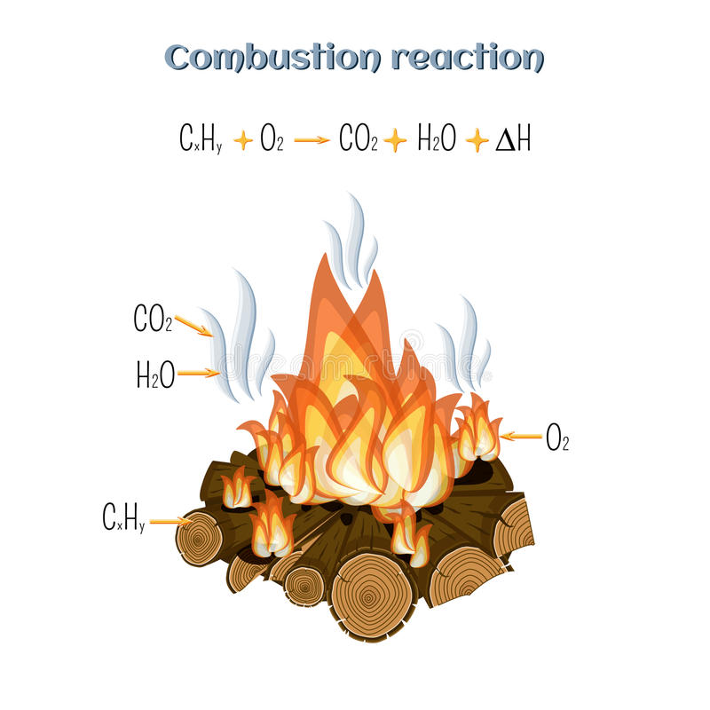
Question of the Video
Another way to identify an organic substances’ composition is to burn it and analyze the products of the reaction. After combustion with excess oxygen, a 12.501 g of a petroleum compound produced 38.196 g of carbon dioxide and 18.752 of water. A previous analysis determined that the compound does not contain oxygen. Establish the empirical formula of the compound.

Slide 104
Organic versus Hydrocarbon
Organic molecules must have the element C.
Hydrocarbons can only have the elements H and C.
Therefore hydrocarbons are organic but not all organic compounds are hydrocarbons:
CH₄ is a hydrocarbon and is organic
CCl₄ is organic but not a hydrocarbon
O₂ is neither organic nor a hydrocarbon

Slide 105
Organic molecules
Found in fossil fuels, plants and animals.
Examples include gasoline, oil, kerosene, butane, propane…

Slide 106
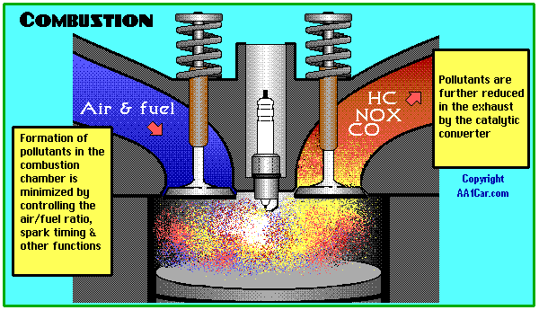
Combustion
An organic compound is burned in the presence of oxygen to form CO₂ and H₂O only.
CH₄ + 2O₂ → CO₂ + 2H₂O

Slide 107
Combustion
CH₄ + 2O₂ → CO₂ + 2H₂O
C₂H₆ + 7/2 O₂ → 2CO₂ + 3H₂O
C₃H₈ + 5 O₂ → 3CO₂ + 4H₂O
Notice that the subscript of C in the hydrocarbon matches the coefficient of CO₂
The subscript of H in the hydrocarbon is twice the coefficient of H₂O.
We can determine the amount of C from CO2 produced and the amount of H from H2O produced.

Slide 108
The molecular formula of a hydrocarbon is to be determined by analyzing its combustion products and investigating its properties. C_{X}H_{Y} + ___O₂ → ___CO₂ + ___H₂O
The hydrocarbon burns completely, producing 7.2 grams of water and 17.6g of CO₂ at standard conditions. What is the empirical formula of the hydrocarbon?
7.2g H₂O / 18.016 g = 0.400 mol H₂O x 2H/1H2O = 0.800mol H
17.6g CO₂ / 44.01 g = 0.400 mol CO2 x. 1C/1CO2 = 0.400mol C
0.800/0.400 = 2
Empirical formula = CH₂

Slide 109
Using the empirical formula, the molecular mass is 42.0g/mol. Write the balanced combustion reaction.
Empirical formula = CH₂ molar mass = 14.0gmol
42.0/14.0 = 3 molecular formula = 3CH₂ = C₃H₆
_____ C₃H₆ + _____ O₂ → _____CO₂ + _____H₂O
1
9/2
3
3

Slide 110
Question of the Video
After combustion with excess oxygen, a 12.501 g of a petroleum compound produced 38.196 g of carbon dioxide and 18.752 of water. A previous analysis determined that the compound does not contain oxygen. Establish the empirical formula of the compound.
38.196 g CO₂ × 1 mol CO₂ x 1 mol C = 0.86787 mol C
1 44.01g 1 mol CO₂
18.752 g H₂O × 1 mol H₂O x 2 mol H = 1.0817 mol H
1 18.016g 1 mol H₂O
1.0817 mol H ÷ 0.86787 = 2.3996 mol H for every 1 mole C
2.3996 mol × 5 = 11.998 ≈12 mol H C₅H₁₂ pentane

Slide 111
Now you must be able to…
Find the formula of hydrocarbons burned during combustion.

Slide 112
Molarity and Dilutions

Slide 113
Objectives
You should already be able to…
Define concentrated and dilute solutions.
Calculate the molarity of a solution.
By the end of this video you should be able to…
Calculate molarity and dilutions.
Explain dilution steps.

Slide 114
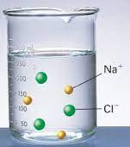
Question of the Video
Imagine each ion represents a mole of particles dissolved with in the water in the beaker. We can see 3Na⁺ and 3Cl⁻ meaning that 3 moles of NaCl were added to this beaker that has a total of 275mL of solution.
How concentrated is this solution?
How many grams of NaCl were added to get this solution?
How many particles of NaCl are actually in the solution at this concentration?
Would the same mass of sugar, C₆H₁₂O₆, be added to an equal volume of water in order to acquire the same concentration of a sugar water solution?

Slide 115
Solutions
Solutions are homogeneous physical mixtures of two or more pure substances. They should be transparent and pass through a filter.
In a solution, the solute is dispersed uniformly throughout the solvent.
Solute: The minor part, get dissolved.
Solvent: The major part, does the dissolving. Water is a universal solvent.

Slide 116
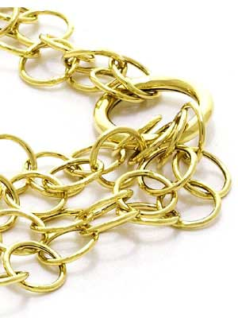
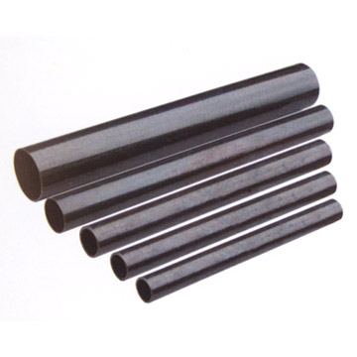
Solutions
Aqueous solutions have a water solvent.
The solute can change phase in order to dissolve.
Solids and gases can be solutions too like air and alloys (steel, brass, jewelry).

Slide 117
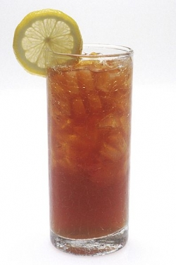
Concentration
Concentrated solutions contain large amounts of solutes dissolved in the solvent.
Dilute solutions contain small amounts of solutes dissolved in solvent.
Which is concentrated?

Slide 118
Molarity
The amount of solute (dissolvable substance) in a solvent (does the dissolving like water) is known as concentration and can be represented many ways.
Molarity is the moles of solute per liter of solution. Find this on your reference tables!
The units for molarity are mol/L or mol.L⁻¹ or just M.
If you don’t know what this means, maybe write a note to ask me in class…

Slide 119
Molarity (M)
mol of solute
L of solution
M =
Because volume is temperature dependent, molarity can change with temperature.

Slide 120
Examples can be done without a calculator!
If 3.0 moles of NaCl are dissolved in 6.0L of water, what is the molarity?
If 29 grams of NaCl are dissolved in one liter of water, what is the molarity?
0.50M
3moles/6L =
29g/58g = 0.50moles
0.5moles/1L =
0.50M

Slide 121
Examples may need a calculator or can be estimated
If 100. grams of KF are dissolved in 300.ml of water, what is the molarity?
Calculate the volume needed to create a 2.0M solution with 3.5 moles of Li₂O.
100g/58.1g =1.72mol
5.70M
1.72mol/.300L =
2.0M=3.5mol/x
X = 1.8L

Slide 122
THINK
If the glass of iced tea I made is too strong for you, what could you do to make it weaker?
This process is known as dilution. It is very important in chemistry because we often purchase large quantities of highly concentrated chemicals. In order to use the chemicals in class, for labs, teachers must dilute the chemicals so they aren’t as dangerous.

Slide 123
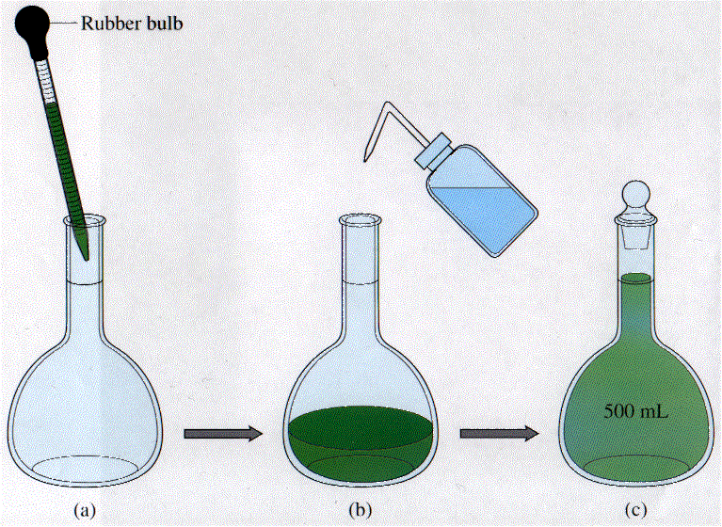
Dilutions
A dilution is a procedure for preparing a less concentrated solution from a more concentrated (or stock) solution. Use the formula: M₁V₁ = M₂V2 ← Not on the reference tables!

Slide 124
Calculations
240mL of a 3.5M solution is diluted to 300 mL of solution. Calculate the new molarity.
7.8L of 2.0M solution is diluted by the addition of 10.0L of water. Calculate the new molarity.
3.5(240) = x(300)
2.8M
2.0(7.8) = x(17.8)
0.88M

Slide 125
Calculations
What volume of 9.3M H₂SO₄ is needed to obtain 450mL of 2.0M H₂SO₄?
What always happens to the molarity when water is added?
9.3(x) = 2.0(450)
97mL
M decreases
What would you have to do in order to have the molarity increase?
Increase moles or evaporate water

Slide 126
Dilutions
A lab calls for 100mL of 3.0M HCl per pair of students. The stock room has a large amount of 12.0M HCl and 1.0M HCl. Which acid will you use to set up the lab?
If the classroom has 26 students, explain how to create enough 3.0M acid for the lab. Use calculations to support your answer.
12M is easier to dilute than evaporating water from 1M
3(26/2)(100) = 12x
x = 325mL

Slide 127
What you need to say…
Write this!
If a question asks you how to dilute a solution make sure you mention…
Measure the amount of water needed using a pipet (it is pretty accurate and if not use the cylinder). Place into the volumetric flask (most accurate!!!)
Start with the highest molarity of solute: Measure the concentrated solution with the pipet (or cylinder).
Always add the acid to the water (the acid is more dense and will sink to the bottom resulting in less splashing and can be added slowly to reduced the amount of heat generated at a time).
Add small drops of water using a dropper until the solutions meniscus reaches the mark on the flask.

Slide 128
Question of the Video
Imagine each ion represents a mole of particles dissolved with in the water in the beaker. We can see 3Na⁺ and 3Cl⁻ meaning that 3 moles of NaCl were added to this beaker that has a total of 275mL of solution.
How concentrated is this solution?
How many grams of NaCl were added to get this solution?
How many particles of NaCl are actually in the solution at this concentration?
Would the same mass of sugar, C₆H₁₂O₆, be added to an equal volume of water in order to acquire the same concentration of a sugar water solution?
M= mol/L
3moles /0.275L
10.9M concentrated!
3mol x 58.44g/mol = 175.3g
3mol x 6.02x10²³ = 1.81x10²⁴ particles
10.9= x/0.275 3 moles of sugar will also have 1.81x1⁰²⁴ particles dissolved in the water
3 x 180.156g/mol = 540.5g

Slide 129
Now you must be able to…
Calculate molarity and dilutions.
Explain dilution steps.

Slide 130
Naming Compounds Part 1

Slide 131
Objectives
You should already be able to…
Name simple compounds
By the end of this video you should be able to…
Name all binary compounds.

Slide 132
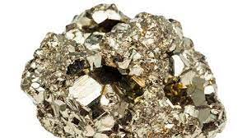
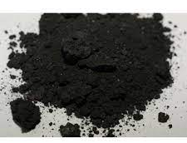
Question of the Video
How can we distinguish between the chemical names of fool’s gold (pyrite) from this black sludge made up of the same elements?
Pyrite FeS₂ Sludge FeS

Slide 133
Binary Compounds
Binary Compounds consist of only two of elements. To name: write the complete name of the first element. The second element should then be named, ending in “-ide.”
NaCl sodium chloride
KI potassium iodide
MgCl₂ magnesium chloride
Ca₃N₂ calcium nitride

Slide 134
Remember: When naming, always name the positive, cation first and then the negative, anion last.

Slide 135
Practice
Li₃P
Al₂S₃
SrBr₂
Rb₂O
BaSe
CsI
Lithium phosphide
Aluminum sulfide
Strontium bromide
Rubidium oxide
Cesium iodide

Slide 136
Problem:
FeCl₂ and FeCl₃ are different compounds but seem to have the same name. How can we name them different?
FeCl₂ is iron (II) chloride FeCl₃ is iron (III) chloride.
What do the roman numerals represent?

Slide 137
Transition Metals and nonmetals
Transition Metals are in the middle group of the periodic table.
Nonmetals are on the right side of the staircase.
They have multiple charges or oxidation numbers and so you must show which charge you are using with roman numerals:
Memorize them in order:
I
II
III
IV
V
VI
VII

Slide 138
General Rule about charges
First Column: +1
Second Column: +2
Third Column: +3
Fourth Column: +4
Fifth Column: -3
Sixth Column: -2
Seventh Column: -1
Eighth Column: 0

Slide 139
Careful:
This rule doesn’t ALWAYS work for cations. Find the anion’s charge and equalize that with the cation’s charge.

Slide 140
Give the name:
-1
FeCl₂
CuF
ZnO
N₂O₃
SO₃
PCl₃
CH₄
Iron (II) chloride
Copper (I) fluride
Zinc oxide
Nitrogen (III) oxide
Sulfur (VI) oxide
Phosphorus (III) chloride
Carbon (IV) hydride
-1
-2
-2
-6/2
-2
-1
-1

Slide 141
Give the formula:
+1
-1
Potassium iodide
Magnesium chloride
Aluminum sulfide
Hydrogen oxide
Barium selenide
Cesium phosphide
Strontium phosphide
Copper (II) flouride
Iron (III) telluride
KI
MgCl₂
Al₂S₃
H₂O
BaSe
Cs₃P
Sr₃P₂
CuF₂
Fe₂Te₃
+2
-1
+3
-2
+1
-2
+2
-2
+1
-3
+2
-3
+2
-1
+3
-2

Slide 142
Question of the Video
How can we distinguish between the chemical names of fool’s gold (pyrite) from this black sludge made up of the same elements?
Pyrite FeS₂ Sludge FeS
+2
+4
-2
-2
Iron (IV) sulfide
Iron (II) sulfide

Slide 143
Now you must be able to…
Name all binary compounds.

Slide 144
Naming Compounds Part 2

Slide 145
Objectives
You should already be able to…
Name simple compounds
By the end of this video you should be able to…
Name all ternary compounds.

Slide 146
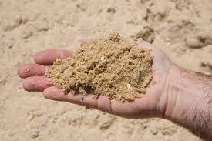
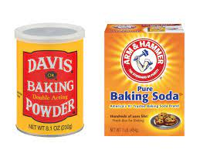
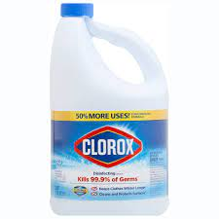
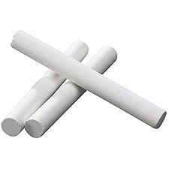
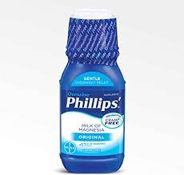
Question of the Video
Common names of household chemicals vary from country to country and even state to state sometimes. Chemists need a universal way to name chemicals in order to communicate effectively. What are the chemical names of these common household chemicals?
Baking powder Na₂CO₃
Baking soda NaHCO₃
Bleach NaClO
Laughing gas N₂O
Sand SiO₂
Chalk CaCO₃
Milk of Magnesia Mg(OH)₂

Slide 147
Ternary Compounds
When compounds have more than 2 elements, it contains a polyatomic ion.
AgNO₃ silver nitrate
CaCO₃ calcium carbonate
LiClO₂ lithium chlorite
NaOH sodium hydroxide
(NH₄)₃PO₄ ammonium phosphate

Slide 148
Tricks for memorization:
Memorize the “-ates”
Any similar polyatomic with one more oxygen is a “per—ate”.
Any similar polyatomic with one less oxygen is a “ite”.
Any similar polyatomic with two less oxygens is a “hypo—ite”.

Slide 149
Memorize these “ates” names, symbols, charges, and the rules:
Acetate C₂H₃O₂⁻
Bicarbonate HCO₃⁻
Bisulfate HSO₄⁻
Bromate BrO₃⁻
Carbonate CO₃²⁻
Chlorate ClO₃⁻
Chromate CrO₄²⁻
Dichromate Cr₂O₇²⁻
Iodate IO₃⁻
Nitrate NO₃⁻
Phosphate PO₄³⁻
Sulfate SO₄²⁻
Note: “bi means an H+ is added to your normal polyatomic. Not all oxygen atom amounts are the same.

Slide 150
What are these?
Perchlorate
IO₄⁻
Remember: “per” means add an O, keep the same charge.
ClO₄⁻
periodate

Slide 151
What are these?
ClO₂⁻
Chlorite
SO₃²⁻
Nitrite
PO₃³⁻
Remember: “ite” means subtract an O, keep the same charge.
sulfite
NO₂⁻
phosphite

Slide 152
What are these?
Hypochlorite
BrO-
Remember: “hypo-ite” means subtract 2 O, keep the same charge.
ClO⁻
hypobromite

Slide 153
Name these:
Potassium sulfate
Cesium nitrite
Strontium chlorate
Aluminum bicarbonate
Rubidium acetate
K₂SO₄
CsNO₂
SrClO₃
Al(HCO₃)₃
RbC₂H₃O₂

Slide 154
Covalent Compounds
Compounds with only nonmetals (elements on the right side of the staircase).
1 mono-
2 di-
3 tri-
4 tetra-
5 penta-
6 hexa-
7 hepta-
8 oct-
9 non-
10 dec-

Slide 155
Name or write the formula:
NO
H₂O
PCl₅
Cl₂O₇
Carbon tetrachloride
Phosphorous tribromide
Silicon dioxide
Nitrogen monoxide
Dihydrogen monoxide
Phosphorous pentachloride
Dichlorine heptoxide
CCl₄
PBr₃
SiO₂

Slide 156
Diatomic Molecules
Diatomic molecules are the more reactive nonmetals that react with themselves, forming two atoms bonded together. Only these seven elements do this:
Br₂ I₂ N₂ Cl₂ H₂ O₂ F₂

Slide 157
Question of the Video
What are the chemical names of these common household chemicals?
Baking powder Na₂CO₃
Baking soda NaHCO₃
Bleach NaClO
Laughing gas N₂O
Sand SiO₂
Chalk CaCO₃
Milk of Magnesia Mg(OH)₂
Sodium carbonate
Sodium bicarbonate
Sodium hypochlorite
Dinitrogen monoxide
Silicon dioxide
calcium carbonate
Magnesium hydroxide

Slide 158
Now you must be able to…
Name all ternary compounds

