Slide 1
CSI Teams

Slide 2
The Crime Scene Investigation Team
Who is at the crime scene?
Police and possibly a district attorney.
Crime scene investigators.
Medical examiners.
Detectives.
Specialists.

Slide 3
The Seven S’s of Crime Scene Investigation
Secure the scene.
Separate the witnesses.
Scan the scene.
See that photos are taken.
Sketch the scene.
Search for evidence.
Secure the collected evidence.

Slide 4
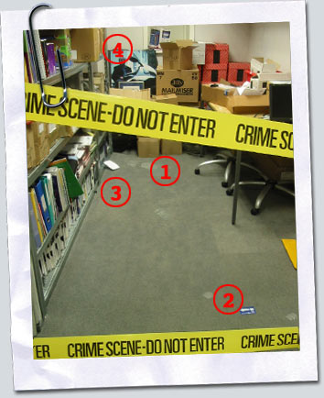
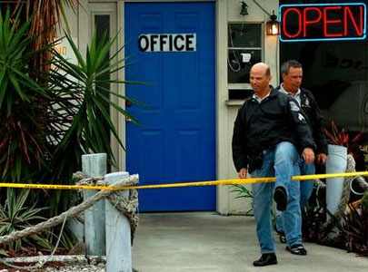
1. Secure the Scene

Slide 5
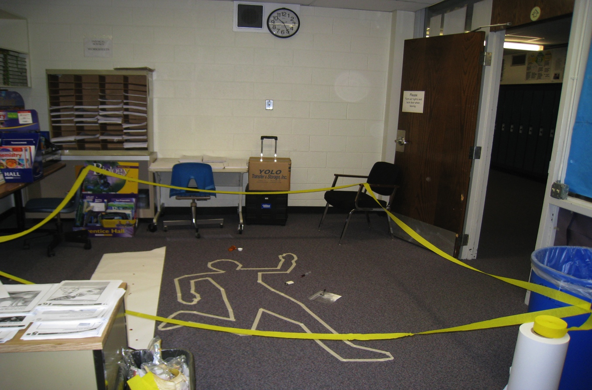

Slide 6
2. Separate the Witnesses
Do not allow witnesses to talk to each other
Witness accounts will be compared
Avoid witnesses working together to create a story
Asked: who, what, where, when?

Slide 7
3. Scan the scene
Determine primary and secondary crime scenes
Primary: where murder took place
Secondary: where corpse was found
Where should photos be taken?
Wear protective gear to prevent contamination of crime scene

Slide 8
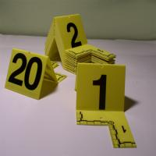
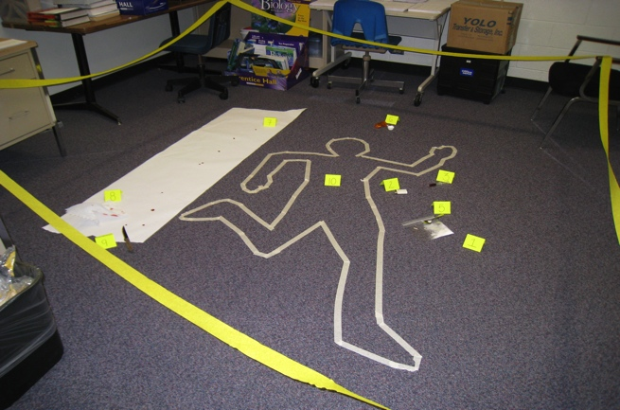
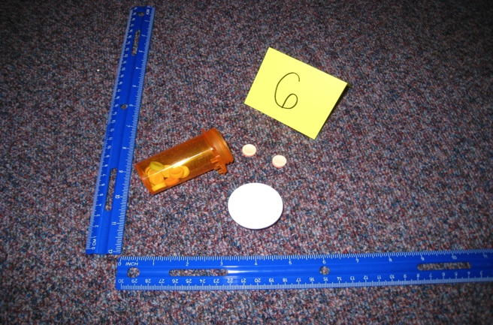
Marking Evidence

Slide 9
4. See that photos are taken
Show the scene exactly as it was when you first saw it
If something was moved before you arrived, don’t try to reconstruct the scene – just take the pictures the way you see it
Be careful not to destroy any evidence while taking photos
Notes:
Discuss 360 scanners that create virtual crime scene

Slide 10
Overall Shots – Outside the Scene
Outside science office
First shot entering door:
Exit (door)

Slide 11
Overall Shots – Inside the Scene

Slide 12
Evidence: Knife (possible weapon)
Midrange Photo
Close-Up (with ruler)

Slide 13
5. Sketch the Crime Scene
Make accurate rough sketch
Note direction (N) and scale of distance
Include relevant objects (body, doors, windows, furniture, immovable landmarks)
Make final copy for court

Slide 14
Rough sketch

Slide 15
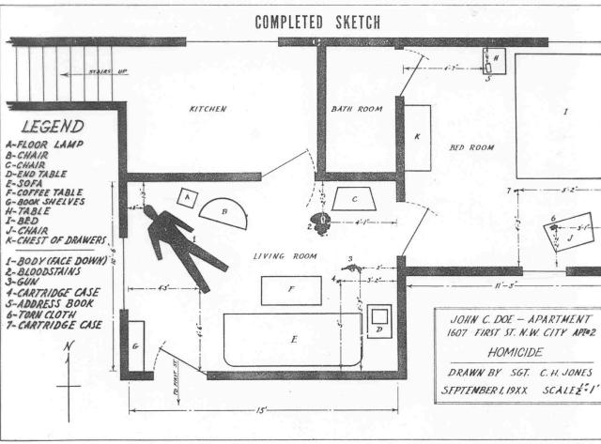
Final Sketch

Slide 16
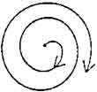
6. Search for evidence
Grid, strip or lane, spiral search pattern
Use flashlight to find hair and fibers
Use forceps, vacuum cleaner to collect evidence
Grid
Strip or Lane
Spiral

Slide 17
7. Secure the Evidence
Properly package, seal, and label ALL evidence!
Liquid: airtight, unbreakable containers
Wet items (biological): dry out in breathable container
Dry item: bindle → plastic or paper container
Seal with tape and labeled with pertinent info
Notes:
Demonstrate how to package evidence
A Bindle is folded paper for small amounts of trace evidence

Slide 18
http://www.youtube.com/watch?v=ur1GxXZGnNI
Notes:
No digital copy of this activity

Slide 19
The Chain of Custody
In order to present credible evidence in court, a chain of custody log is essential. (in real life there is more involved but for this class do as follows)
Bag evidence (seal, sign and date)
Fill out evidence log every time you open it.

Slide 20
Evidence Collection and Crime Scene Investigation

Slide 21
Objective: Differentiate between the different types of evidence
Edmond Locard (1877-1966)
Locard’s Principle:
There always an exchange or transfer of material when two objects come into contact
Examples:
Hair from yourself, children or cat
Fibers from carpets or clothing
Finger prints or shoeprints
Dust/dirt/plant material in shoes

Slide 22
Types of Evidence

Slide 23
Types of Evidence
Direct: firsthand observations (eyewitness account, video camera, confessions) shows that something is a fact without inference or presumption

Slide 24
Types of Evidence
Circumstantial: indirect evidence; implies a fact, but does not directly prove it requires making an inference
Trace Evidence:
Physical – bullets, weapons, impressions
Biological – body fluids, plant parts, hair

Slide 25
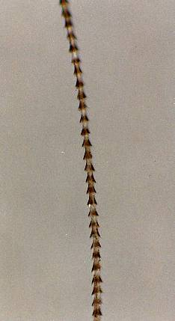
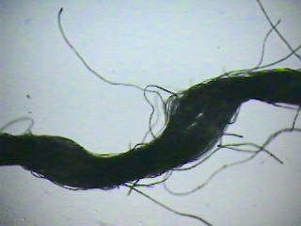
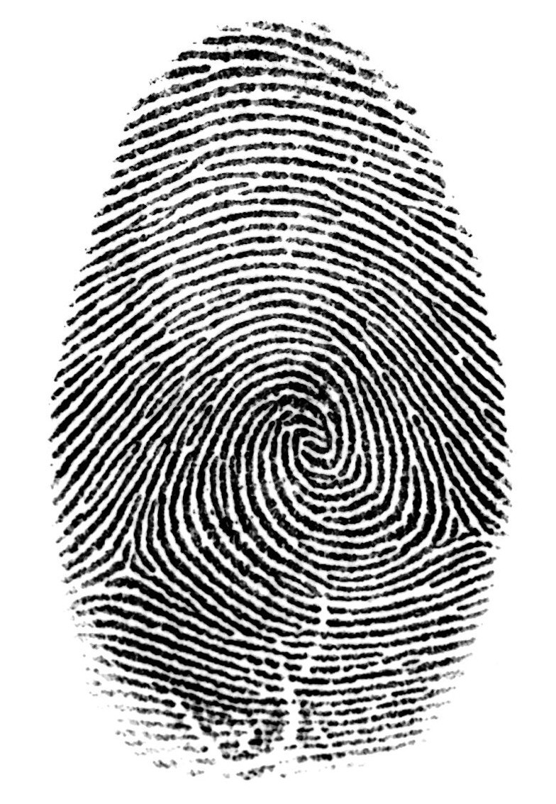
Trace Evidence
Small but measurable amounts of physical or biological material found at a crime scene

Slide 26
Examples of Trace Evidence
Hair
Fibers
Soil
fingerprints
Body fluids (semen, blood, saliva, mucus)
Paint chips
Broken glass
Chemical residue

Slide 27
Categories of Evidence
Class Evidence
Narrows identity to a group of persons or things
Example: blood type
Individual Evidence
Narrow identity to a single person or thing
Example: fingerprint

Slide 28
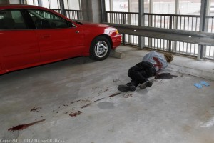

Slide 29
Scott Peterson
https://www.youtube.com/watch?v=sWIYqIoDsyY

Slide 30
OJ Case Study

Slide 31
OJ Case Study
http://www.youtube.com/watch?v=dr6uTw2Eh6M
Complete the case study on OJ Simpson
Closure: Do you agree or disagree with the OJ verdict?

Slide 32
Sketching the Crime Scene

Slide 33
Lab Sketching the Crime Scene
Objective: In your groups complete the lab on sketching the crime scene.
Do Now: Finish taking notes on the crime scene and length/width of the room
Find two fixed positions and measure the distance between the two points and your victim and the evidence (data table 2). Start rough sketches on the white paper. Rough and final sketches are due at the end of the period.
Notes:
Set up an area in your room as a crime scene. Make a tape outline on the floor representing a body. Put 2-4 pieces of evidence near the body. Students will need plain paper, meter sticks, rulers, graph paper a compass (most have one on their phone)

Slide 34
Lab Sketching the Crime Scene
Objective: In your groups complete the lab on sketching the crime scene.
In groups, create a final version on graph paper. It should be just like your rough draft but to scale. Mark the scale you used on your paper. Also mark North, which is in the direction of the bathroom door.
Finish lab questions on the third page.
Rough and final sketches with the lab paper are due at the end of the period. Hand in when done. Make sure your names are on all papers.
Notes:
Set up an area in your room as a crime scene. Make a tape outline on the floor representing a body. Put 2-4 pieces of evidence near the body. Students will need plain paper, meter sticks, rulers, graph paper a compass (most have one on their phone)

