Slide 1
UNIT 3: FORENSIC ANTHROPOLOGY

Slide 2
Identifying Bones

Slide 3
To Do List
Look over the OJ Simpson materials and take notes on anything you may want to use on future quizzes.
Take notes on the bones hand out pages 1 and 2.
Take notes on the Male/Female handout.

Slide 4
What is Forensic Anthropology?
The field of study that deals with the analysis of human skeletal remains resulting from unexplained deaths

Slide 5
Development of Bone
Bones begin as cartilage then harden to form bone (ossification)

Slide 6
206 Bones in Human Body
Joint- location where bones meet
Cartilage- found at ends of bones and protect bone
Ligaments- connects bones to bones
Tendons- connect muscle to bone

Slide 7
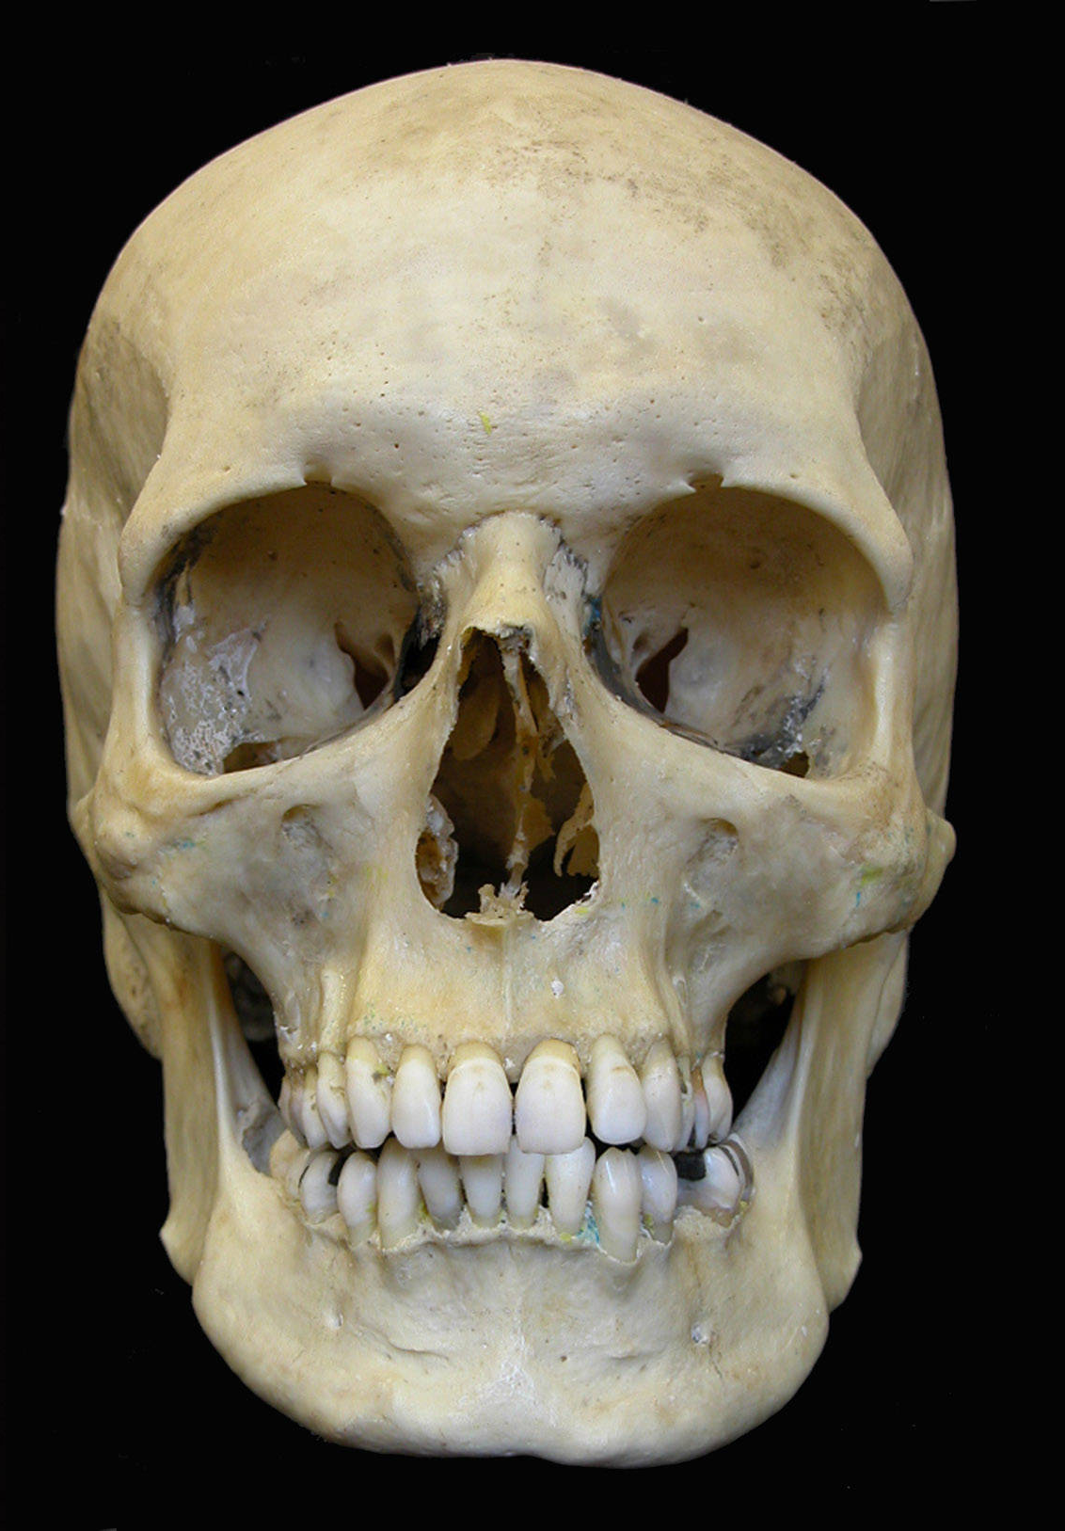
Basic Bones
SKULL
Contains bones of the
cranium and face

Slide 8
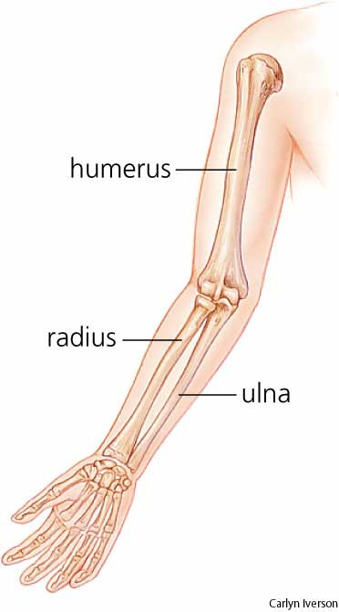
Basic Bones
HUMERUS
Upper arm bone
ULNA & RADIUS
Forearm bones

Slide 9
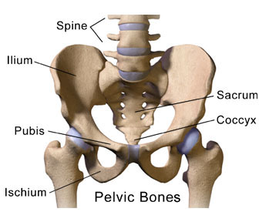
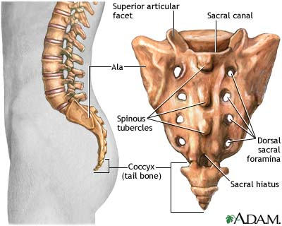
Basic Bones - Pelvis
SACRUM
Triangular bone at the end of the spine
COXAL
Hip Bones

Slide 10
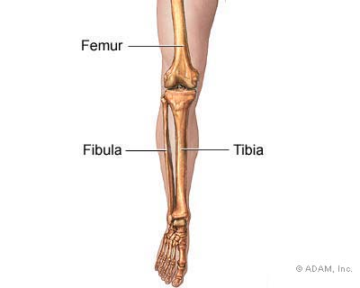
Basic Bones
FEMUR
Thigh bone
TIBIA & FIBULA
Lower leg bones

Slide 11
Male versus Female Bones

Slide 12
Male or Female?
Female- Skeleton is much smoother
Male-
Skeleton is thicker, rougher, bumpier
Muscles are more developed so where they attach need to be stronger
ex. knee

Slide 13
Male vs Female: Orbits
M: square F: round
Male
Female

Slide 14
Male vs Female: The Jaw
M: square – 90 deg
F: round, V-shape - >90 deg
Male
Female

Slide 15
Male vs Female: Frontal Bone
M: low and sloping
F: high and rounded
Male
Female

Slide 16
Male vs Female: Occipital bone (back of skull)
M: bump present F: bump absent
Male
Female

Slide 17
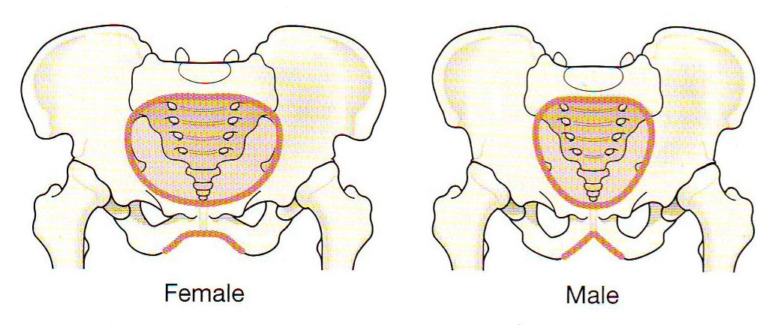
Male vs Female: Shape of Pelvic Cavity
M: Heart shaped, narrow
F: Oval shaped, wider

Slide 18
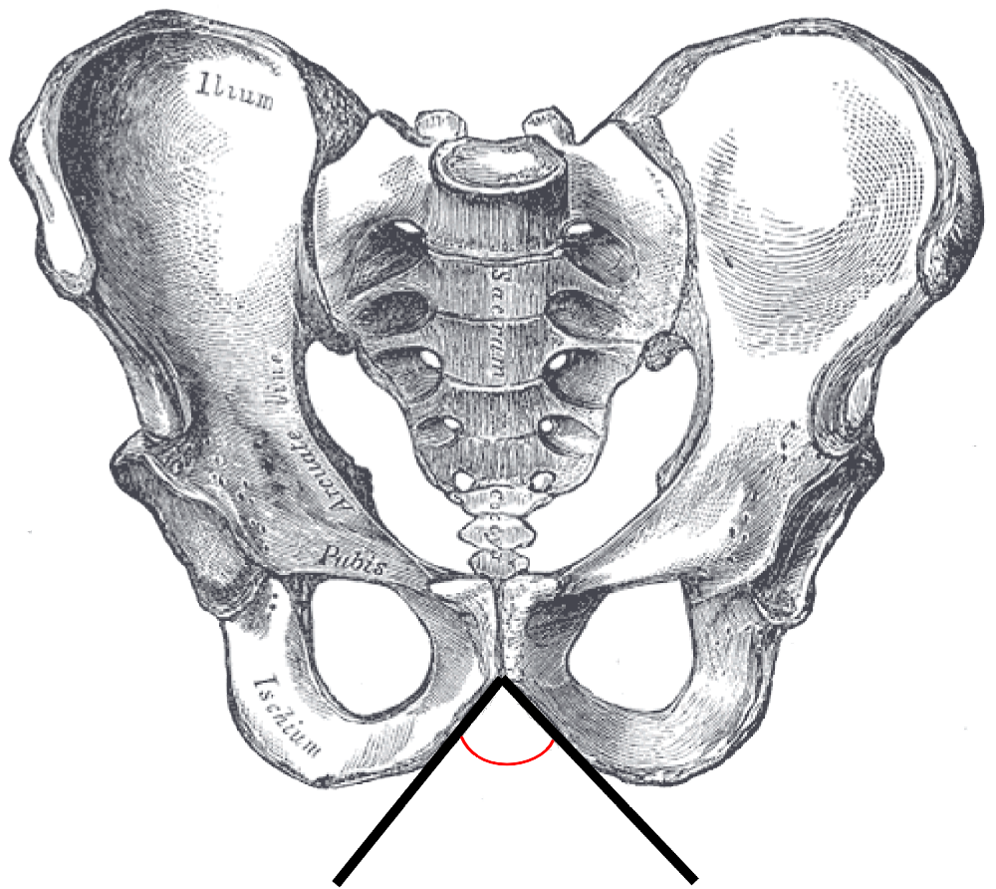
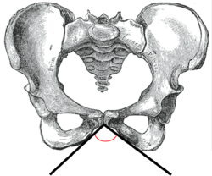
Male vs Female: Subpubic Angle
M: 50 – 82 deg F: 90 deg
MALE FEMALE

Slide 19
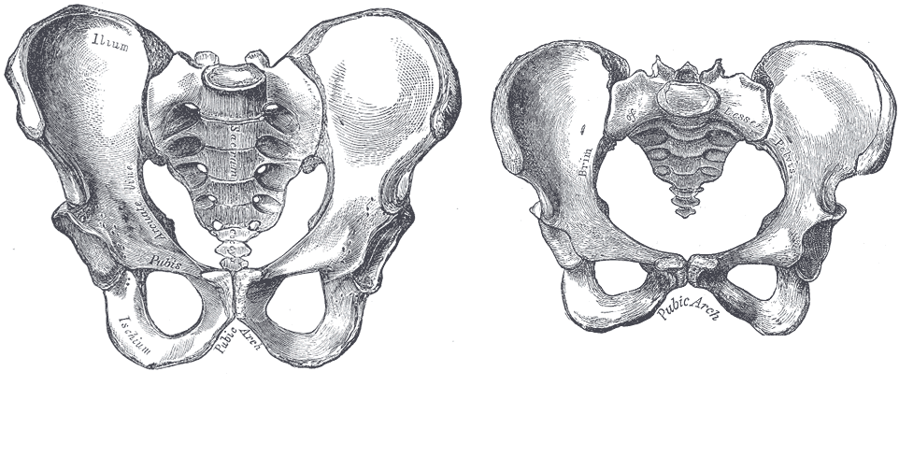
Male vs Female: Sacrum
M: long, narrow, curves inward
F: short, broad, curves outward
MALE FEMALE

Slide 20
Male vs. Female
Do Now: Determine if the skulls are male or female on the worksheet. Circle and describe features that helped you decide.
Take notes on your case study handout from the third page of our notes handout on Determining Age.
Answer age questions on the back of the first worksheet.
Read the “Woodchipper” case and answer questions on the case study template. Hand in.

Slide 21
Age of Bones

Slide 22
Determining Age
One can determine the approximate age of a victim by looking at certain bones for any cartilage still remaining.

Slide 23
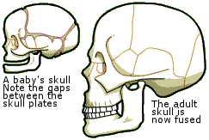
Age: Infant or Not?

Slide 24
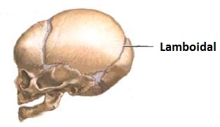
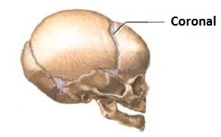
Age: Sutures are where skull bones connect
Lamboidal suture (back of head) – 30 yrs
Coronal suture (front of head) – 50 yrs

Slide 25
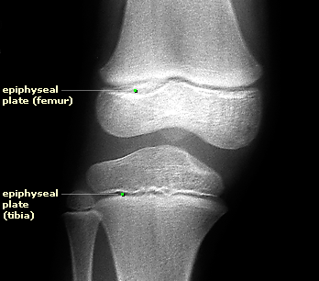
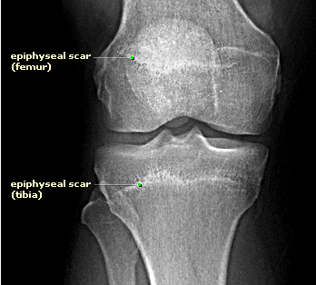
Age- Epiphysis
The presence of a line that marks where cartilage is replaced by bone
The age of completion varies for each bone

Slide 26
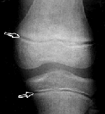
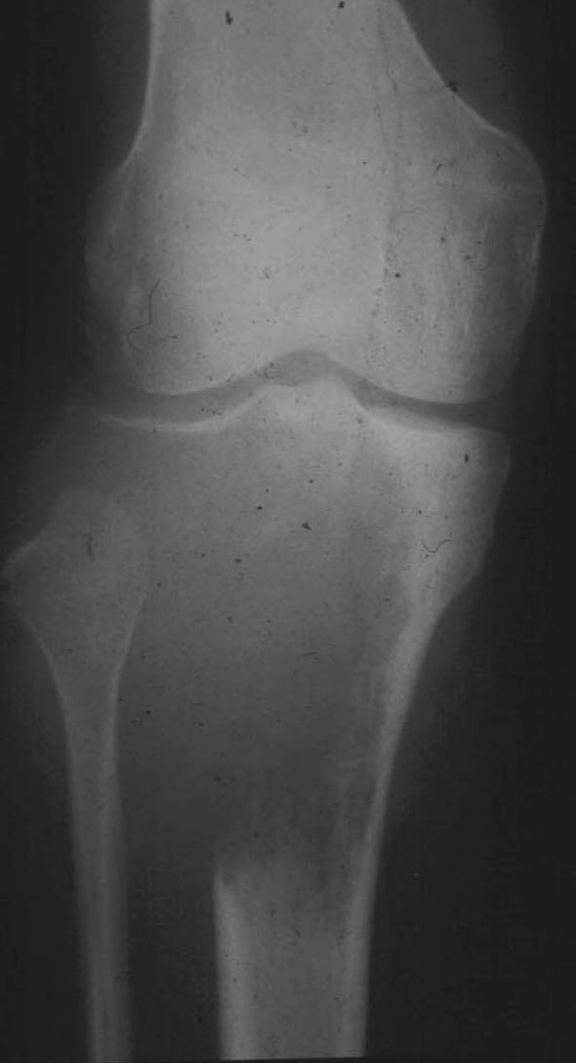
Young (unfused) older (fused) even older (fused)

Slide 27
Age
When the head of a long bone has fused with the shaft it can help determine age

Slide 28
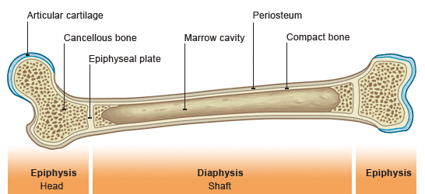
Example:
Humerus head fused: 4 – 6 yrs
Humerus head fused to shaft: 18 - 20

Slide 29
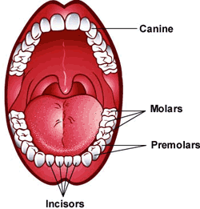
Age: Teeth
Have deciduous teeth fallen out?
Have wisdom teeth erupted?

Slide 30
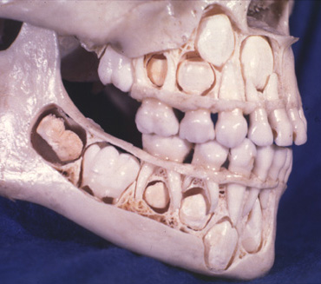

Slide 31
Determining Height

Slide 32
Determining Height
Part 1: In the first data table, record all your measurements with your names.
Part 2: On separate paper, using the charts in your lab, calculate your heights. Record for each bone.
My Example: femur: 2.47 * 39 + 54.13 = 150.46cm
humerus: 3.36 * 24 + 57.97 = 138.61cm
tibia: 2.90 * 30 + 61.53 = 148.53cm
radius: 4.74 * 21 + 54.93 = 154.47cm
My actual height is 157 cm and these answers show what my bones measure my height to be.

Slide 33
Determining Height
Female | tibia (cm) x 2.53 + 72.57 = height (cm) radius (cm) x 3.87 + 73.50 = height (cm)
Male | tibia (cm) x 2.39 + 81.68 = height (cm) radius (cm) x 3.65 + 80.40 = height (cm)
A 41.3 cm Caucasoid male tibia was found in a wooded area.
How tall was the this person?
41.3 cm x 2.39 + 81.68 = 180 cm (5’-11”)

Slide 34
Objective: Finish the Height Lab
After completing the calculations for part one, move on to part 2.
Calculate the height in cm first in the data table. Then change the heights to feet by dividing the height by 30.48. You can write these values in the margin next to the cm you recorded in order to match up to the victims easier.
Answer the questions to complete the lab. Hand in the lab and you work stapled together.

Slide 35
Determining Race

Slide 36
Race (ancestry)
Can be difficult due to interracial people so not as significant as other factors
Best determined with skull and femur
Three categories are Caucasian, African, and Asian as we saw in the lab.

Slide 37
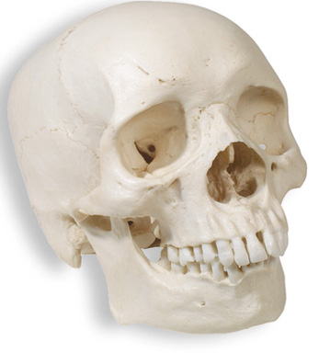
What major differences can you see?
Mongoloid/Asian Skull
Nose
Eye sockets
Caucasian/European Skull
Negroid/African Skull

Slide 38
Facial Reconstruction
Size and shape of bones vary in people
Facial markers are placed on the skull and clay is applied to follow the height of the markers
Today computer programs can do this
Programs can adjust features and age a person

Slide 39
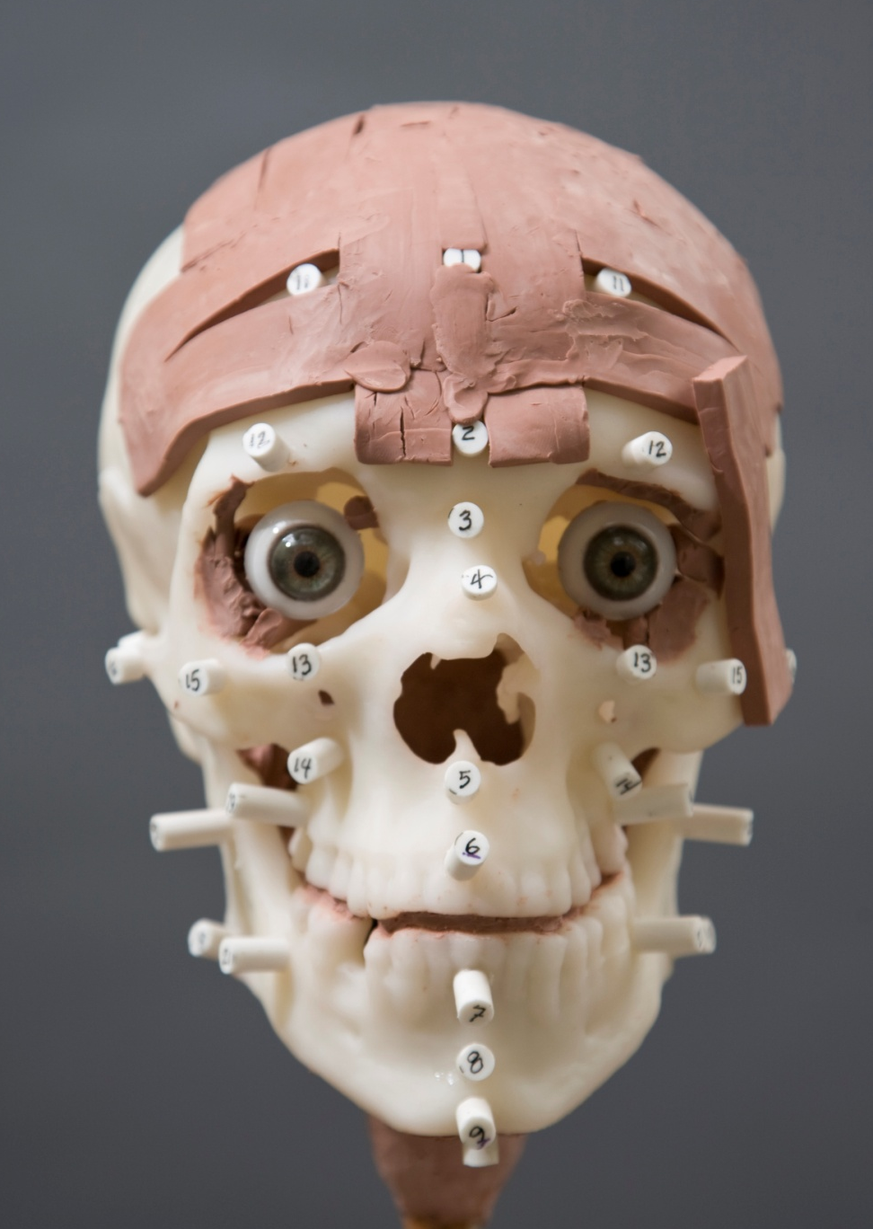
Facial Reconstruction

Slide 40
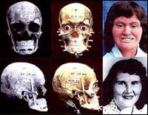
Facial Reconstruction

Slide 41
Facial Reconstruction
http://www.youtube.com/watch?v=VF1cVAb0J2Q

Slide 42
DNA in Bones

Slide 43
DNA Evidence
Bones contain little nuclear DNA but do contain mitochondrial DNA
One can compare mitochondrial DNA with living relatives on the mother's side to identify bones.

Slide 44
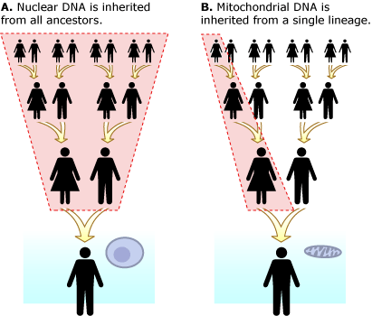

Slide 45
Bone Trauma

Slide 46
Skeletal Trauma Analysis
Forensic anthropologists determine if damage to bones occurred before or after death
Antimortem- before death
Perimortem- at or around time of death
Postmortem- after death

Slide 47
There are distinctions between damage caused by weapons and those created by the environment after death

Slide 48
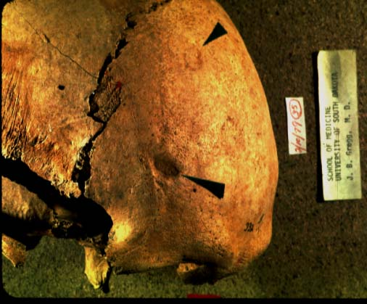
Perimortem damage

Slide 49
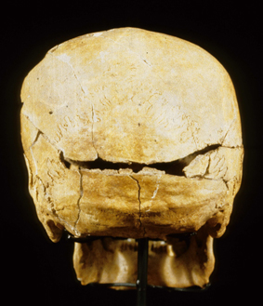
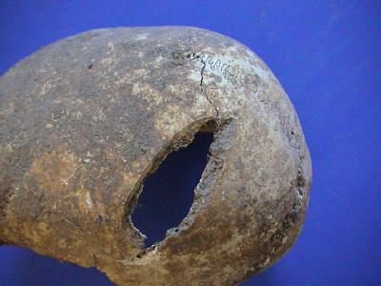
Perimortem vs Antimortem Ex. Sword wound

Slide 50
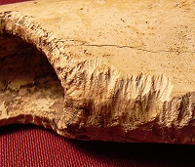
Postmortem Damage

Slide 51
http://www.youtube.com/watch?v=FGcN9_Gd5zQ

Slide 52
Types of Trauma
Sharp-force trauma, blunt force trauma, and gunshot wounds have distinct patterns

Slide 53
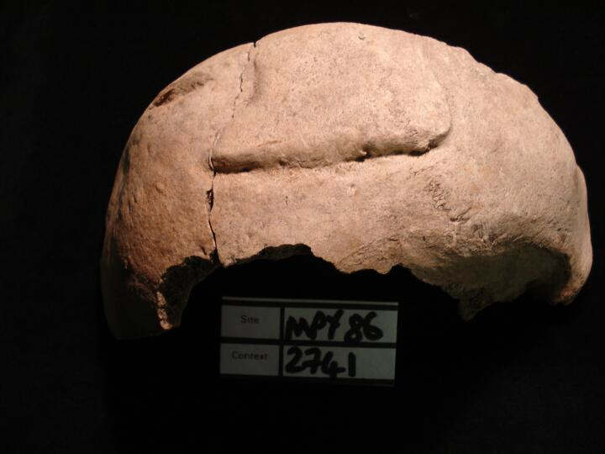
Sharp force trauma

Slide 54
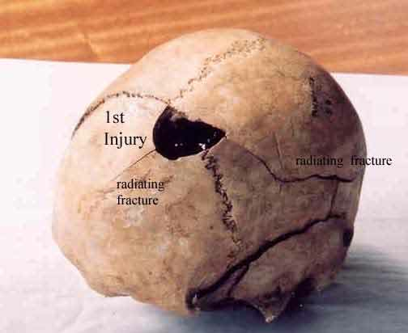
Blunt force Trauma

Slide 55
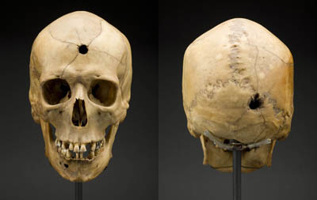
Gunshot wound

Slide 56
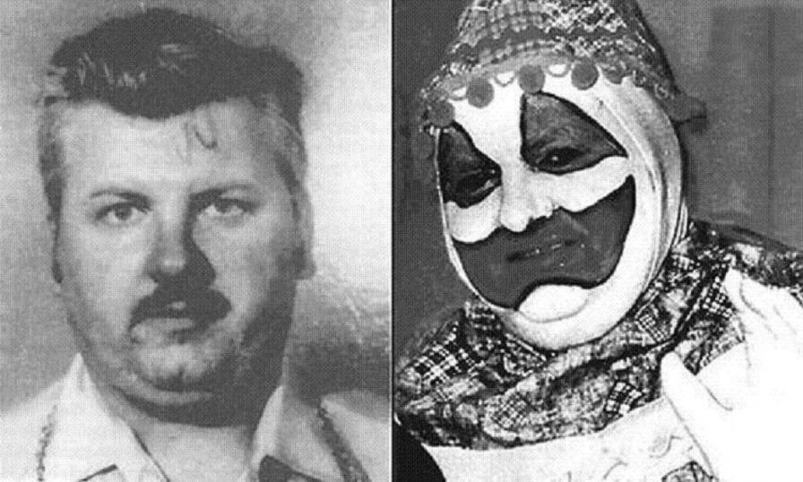
Objective: Video Case Study John Wayne Gacy
Do Now: If more than one body is found, what specific bones can be used to figure out just how many victims are at the scene?
Read the case study and answer questions about John Wayne Gacy.
Watch the video on
John Wayne Gacy.

Slide 57
Skeleton Lab
Do Now: At first glance, which skeleton is the female and why?
Complete the skeleton observations lab and hand in.
Closure: The skeletons are actually from India. Other than that, we are not sure what the age or gender is specifically because they were donated to the school. If we had funding, how could we get a better idea of who these people are?

Slide 58
The Body Farm
http://www.youtube.com/watch?v=-qZmLo8qIx4

