Slide 1
Impressions

Slide 2
Impressions
Impressions are created when…
one object is pressed against another material with enough force to leave an impression or imprint of the object.

Slide 3
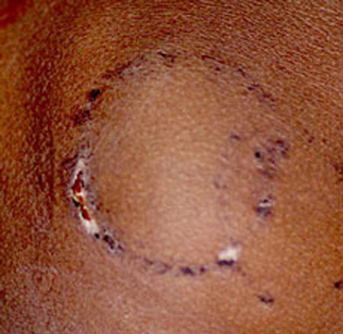
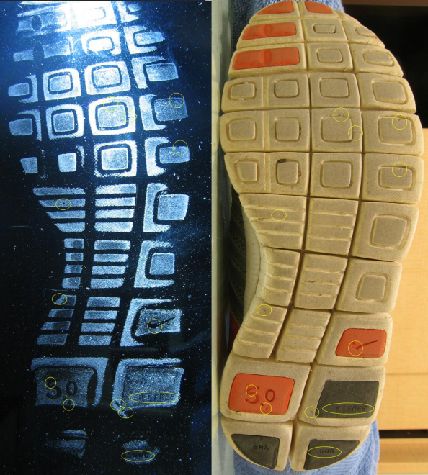
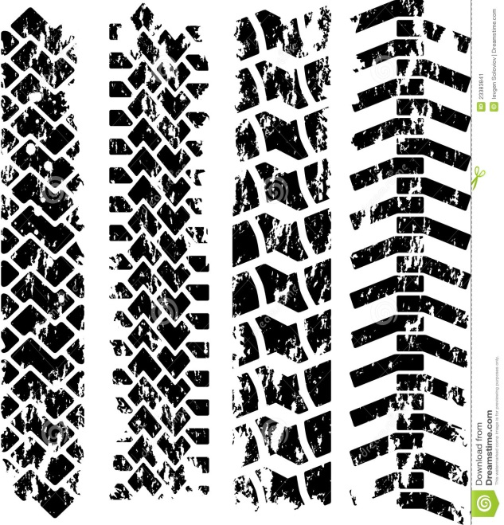
Examples of Impressions
Bite Marks, shoeprints, tire tracks, etc.

Slide 4
Bite Marks
Forensics Odontology/Dentistry: The study of teeth as it relates to a crime.
Humans have 32 teeth if they have their “Wisdom” teeth and 28 if they don’t (age at which they appear – can come in up until you are 25!)
What can they tell: if a person played an instrument, chips in teeth, age of person by “wear and tear” on the teeth
Individual evidence if the investigator has the right tools and the mark is full.
Investigators can also analyze bite marks for the following:
Characteristics of the teeth (position, evidence of dental work, wear patterns, etc.)
Saliva or blood (DNA)
When the bite occurred

Slide 5
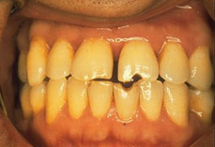
http://www.youtube.com/watch?v=thfHB5e51q8

Slide 6
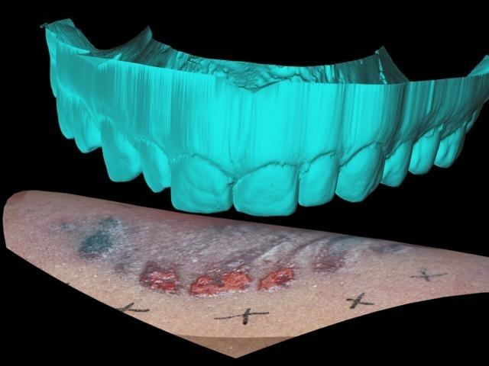
Computer Generated Overlays

Slide 7
Shoe Impressions

Slide 8
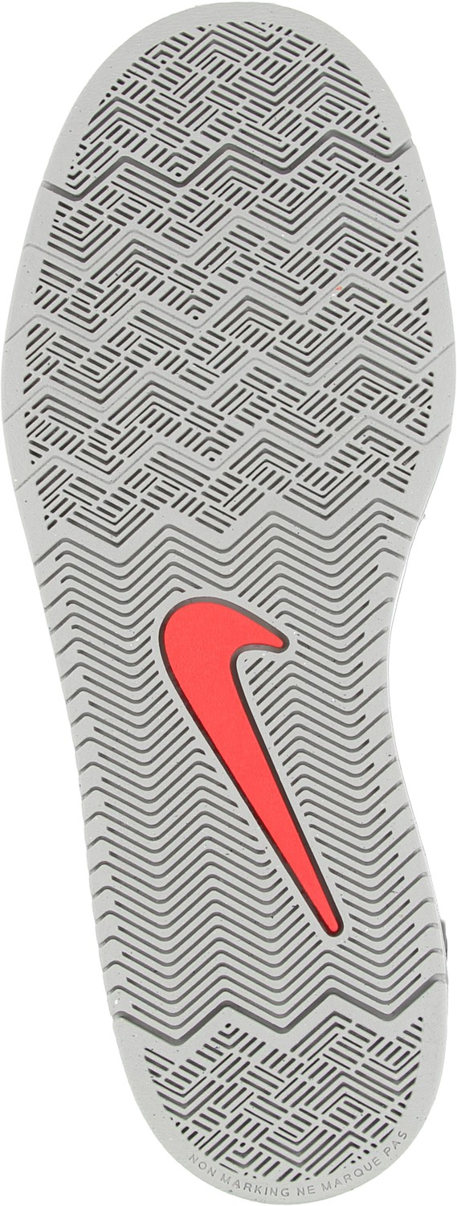
Shoe Prints
Investigators can analyze a shoe print to determine its…
Class, or the type and brand of shoe
Manufacturer, model and size
Approximate height of wearer
Activity of wearer when imprint was made
Link between footwear impression and piece of footwear

Slide 9
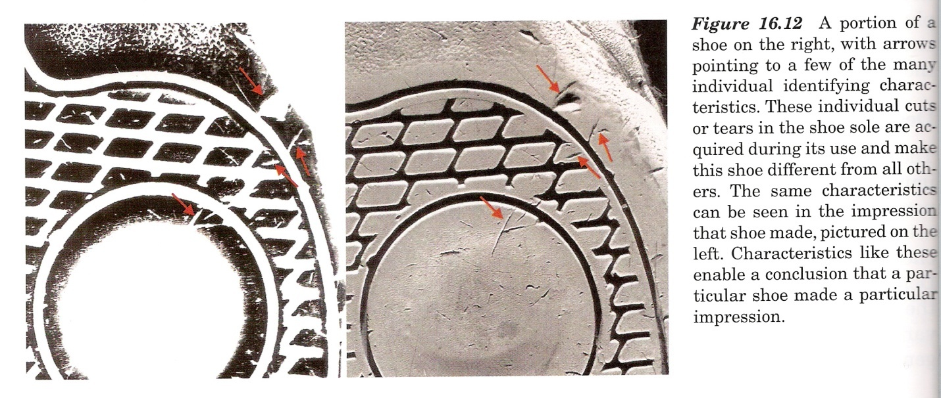
Individual characteristics, such as wear patterns and specific damages or defects

Slide 10
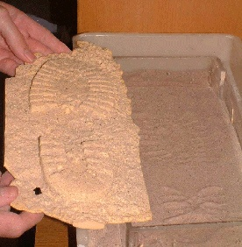
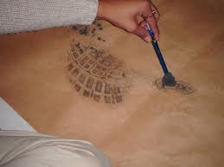
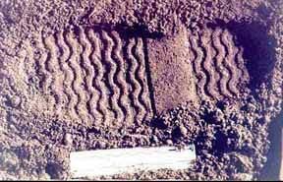
How to obtain shoeprints?
Photograph
Dusting (2-D print)
Casting (3-D print)
Notes:
There are more ways than the 3 listed above

Slide 11
Tire Impressions

Slide 12
Tire Impressions
Tires are made of semi-hard rubber
Treads
Pattern of rubber on tire which usually wears down as the tire is used
The softer surface (usually) the better the impression (snow, soil)

Slide 13
Tire Tracks Lab
http://www.youtube.com/watch?v=KEyRE6KYbIs&list=PL2338C482AE4DF52E

Slide 14
Ted Bundy

Slide 15
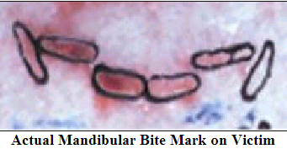
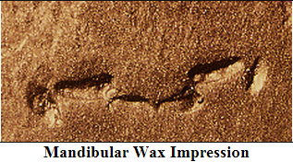
Case Study: Ted Bundy
Complete the case study on Ted Bundy.
https://www.youtube.com/watch?v=YZDwHbnPdzk
Notes:
Left pic is actual bite left on ted bundys victim right pic is an impression taken from bundy

Slide 16
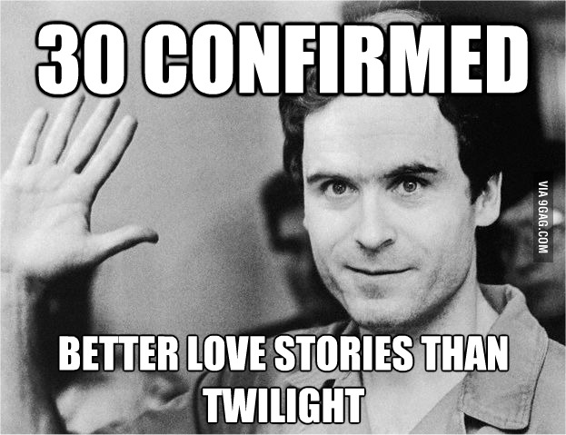
Closure:
How did impressions play a role in catching Bundy?

Slide 17
Shoe Impressions
http://www.youtube.com/watch?v=kz1rrpoESa0
Caught by shoe impressions:
https://www.youtube.com/watch?v=IpziYcQOIbI
Complete O.J. Simpson shoeprint case study

