Slide 1
Unit 5: Hair

Slide 2
Objective: SWBAT identify forensic evidence found in hair samples.
Hair is the most frequently found piece of trace evidence.
Hair is usually Class evidence unless:
DNA in root is found = individual
Sometimes mtDNA testing can be done (still class evidence but more narrowed)
Notes:
mtDNA done from mitochondria in shaft cells. Come from maternal blood line so not individual evidence but links to suspect and maternal side of family

Slide 3
From hair one can determine:
Objective: SWBAT identify forensic evidence found in hair samples.
Human vs animal?
Race (sometimes)
Location of hair on body (head, leg...)
Was hair was forcibly removed ?
Was hair treated with chemicals?
Were drugs/ toxins ingested?
Individualized if root is present (DNA)
Things hair can’t determine: • Age (except infant hair) • Gender (unless DNA in root)

Slide 4
Objective: SWBAT identify forensic evidence found in hair samples.
Hair is composed of three principal parts (sketch in your notes):
Cuticle
Cortex
Medulla

Slide 5
Objective: SWBAT identify forensic evidence found in hair samples.

Slide 6
Objective: SWBAT identify forensic evidence found in hair samples.
The cuticle is the outside covering made of overlapping scales.
Scales point down towards tip (older part) of hair.

Slide 7
3 Basic Patterns of Cuticle
Objective: SWBAT identify forensic evidence found in hair samples.

Slide 8
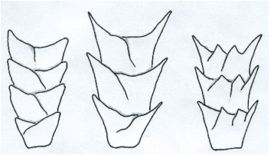
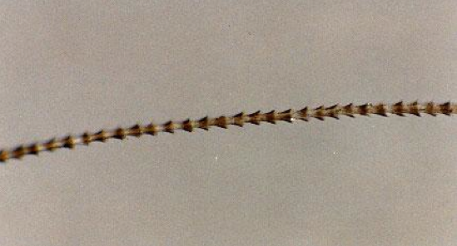
Cuticle Structure: Coronal
Objective: SWBAT identify forensic evidence found in hair samples.
Scales stacked like paper cups (draw a pic in notes)
Non human…. Ex. Bat Hair

Slide 9
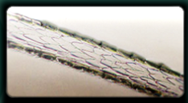
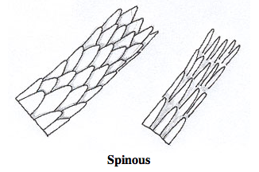
Cuticle Structure: Spinous
Objective: SWBAT identify forensic evidence found in hair samples.
Scales shaped like petals (draw a pic in notes)
Non human…. Ex. Rabbit Hair

Slide 10
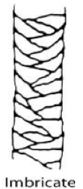
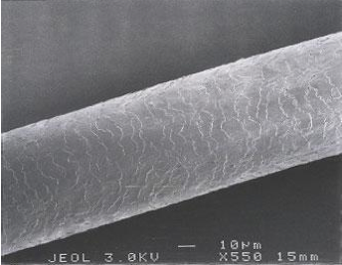
Cuticle Structure: Imbricate
Objective: SWBAT identify forensic evidence found in hair samples.
Scales flattened and close together (draw a pic in notes)
Human hair has imbricate structure

Slide 11
Hair structure

Slide 12
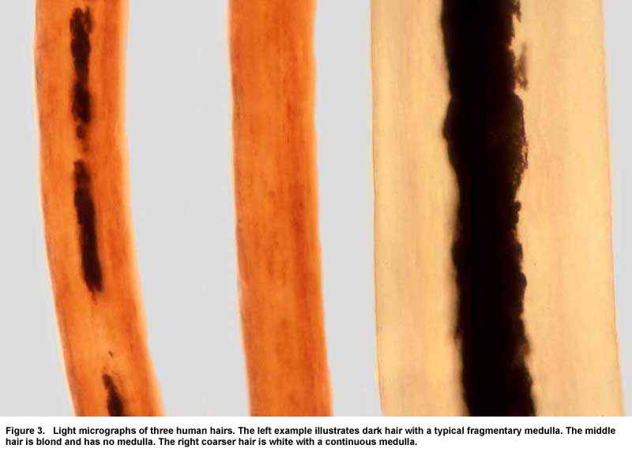
Medulla
Objective: SWBAT identify forensic evidence found in hair samples.
3 types in Humans:
Interrupted
Fragmented/Absent
Continuous

Slide 13
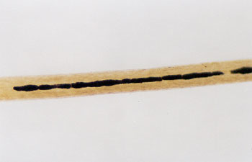
Medulla: Interrupted
Objective: SWBAT identify forensic evidence found in hair samples.
Medulla is seen as individual cells or fragments in repeating intervals

Slide 14
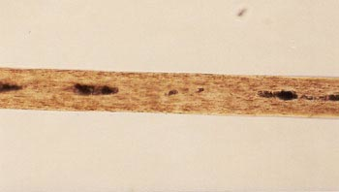
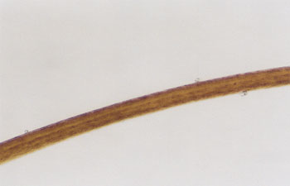
Medulla: Fragmented/ Absent
Objective: SWBAT identify forensic evidence found in hair samples.
Fragmented: few parts visible
Absent: no medulla visible

Slide 15
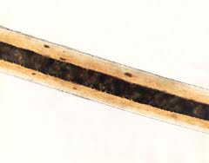
Medulla: Continuous
Objective: SWBAT identify forensic evidence found in hair samples.
Formed as a solid center line

Slide 16
Animal Vs. Human

Slide 17
Objective: SWBAT identify forensic evidence found in hair samples.
The medullary Index is the ratio of diameter of medulla to the overall diameter of the hair
Medullary index:
Humans < 1/3
Animal > 1/2

Slide 18
Objective: SWBAT identify forensic evidence found in hair samples.
Measure the medulla and the entire hair cross sections and divide.
The medulla is half the size of this hair, therefore, it is animal hair.

Slide 19
How hair is shed

Slide 20
Naturally Shed Hair: rounded
Objective: SWBAT determine the condition of hair and generate an idea on how it was lost.

Slide 21
Forcible Removal of Hair: bent or pointed
Objective: SWBAT identify forensic evidence found in hair samples.
Notes:
Exhibits stretching and damage to root area and may have tissue attached

Slide 22
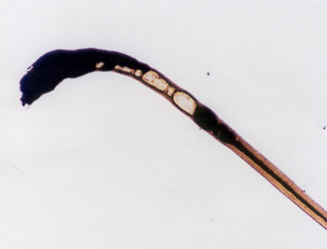
Burned Hair: black and bent
Objective: SWBAT determine the condition of hair and generate an idea on how it was lost.

Slide 23
Toxicology

Slide 24
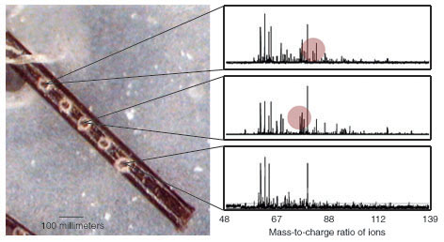
Toxicology
Objective: SWBAT determine the condition of hair and generate an idea on how it was lost.

Slide 25
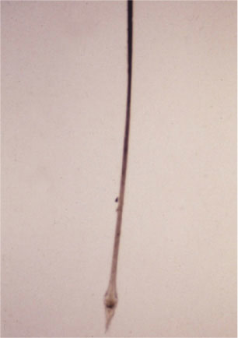
Objective: SWBAT determine the condition of hair and generate an idea on how it was lost.
Hair grows approximately 0.5 inches (1.3cm) per month.
1cm
2cm
3cm
4cm

Slide 26
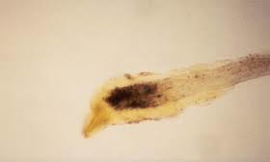
Objective: SWBAT determine the condition of hair and generate an idea on how it was lost.
Complete the toxicology worksheet and hand in.
2.

Slide 27
Photos

Slide 28
Black versus Blonde Hair

Slide 29
Eyelashes: C, I, F, or A?

Slide 30
Beard Hair

Slide 31
Bleached Hair

Slide 32
Dyed Red Hair

Slide 33
Split Ends

Slide 34
Case Studies

Slide 35
Objective: SWBAT identify forensic evidence found in hair samples.
Video: https://www.youtube.com/watch?v=tgS6k-Dcn70
Read the “Central Park Jogger” case study and fill out the worksheet. Hand it in.

Slide 36
How fibers are similar to hair
https://www.youtube.com/watch?v=74QtI_b3tuY

