Slide 1
Unit 6: Fingerprinting

Slide 2
Intro to identification

Slide 3
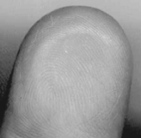
Objective: SWBAT debate the value of the Bertillion measurement system
Every individual, including identical twins, has a unique fingerprint
Type of Evidence: Fingerprints are classified as individual evidence
Cool fact: Fingerprints formed in womb around 10 weeks into pregnancy

Slide 4
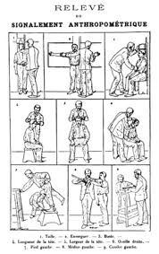
Objective: SWBAT debate the value of the Bertillion measurement system
Bertillion Measurements: uses precise measurements of the body to identify an individual

Slide 5
The West Brothers
Read the short article and summarize why fingerprints would be a better identification system than the Bertillon measurement system. If Will and William West were identical twins separated at birth, would their Bertillion measurements be the same? Would there fingerprints be the same?

Slide 6
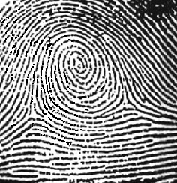
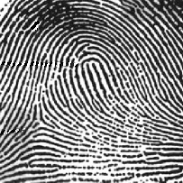
Types of Fingerprints
Objective: SWBAT identify the types of fingerprint patterns in order to determine similar prints.
ARCH
WHORL
LOOP
5%
35%
60%

Slide 7
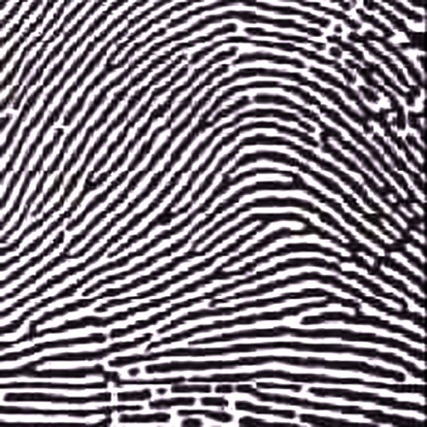
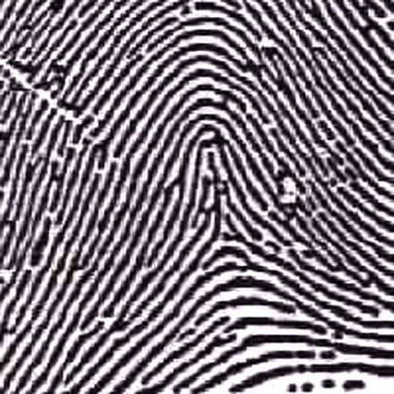
Objective: SWBAT identify the types of fingerprint patterns in order to determine similar prints.
Arches are the simplest type of fingerprints that are formed by ridges that enter on one side of the print and exit on the other. No deltas are present.
Spike or “tent”
Plain Arch
Ridges enter on one side and
exit on the other side.
Tented Arches
Similar to the plain arch,
but has a spike in the center.

Slide 8
Objective: SWBAT identify the types of fingerprint patterns in order to determine similar prints.
Whorls have at least one ridge that makes (or tends to make) a complete circuit. They also have at least two deltas. If a print has more than two deltas, it is most likely an accidental.
Central Pocket Whorl
Plain Whorl
Draw a line between the two deltas in the plain and central pocket whorls. If some of the curved ridges touch the line, it is a plain whorl. If none of the center core touches the line, it is a central pocket whorl.

Slide 9
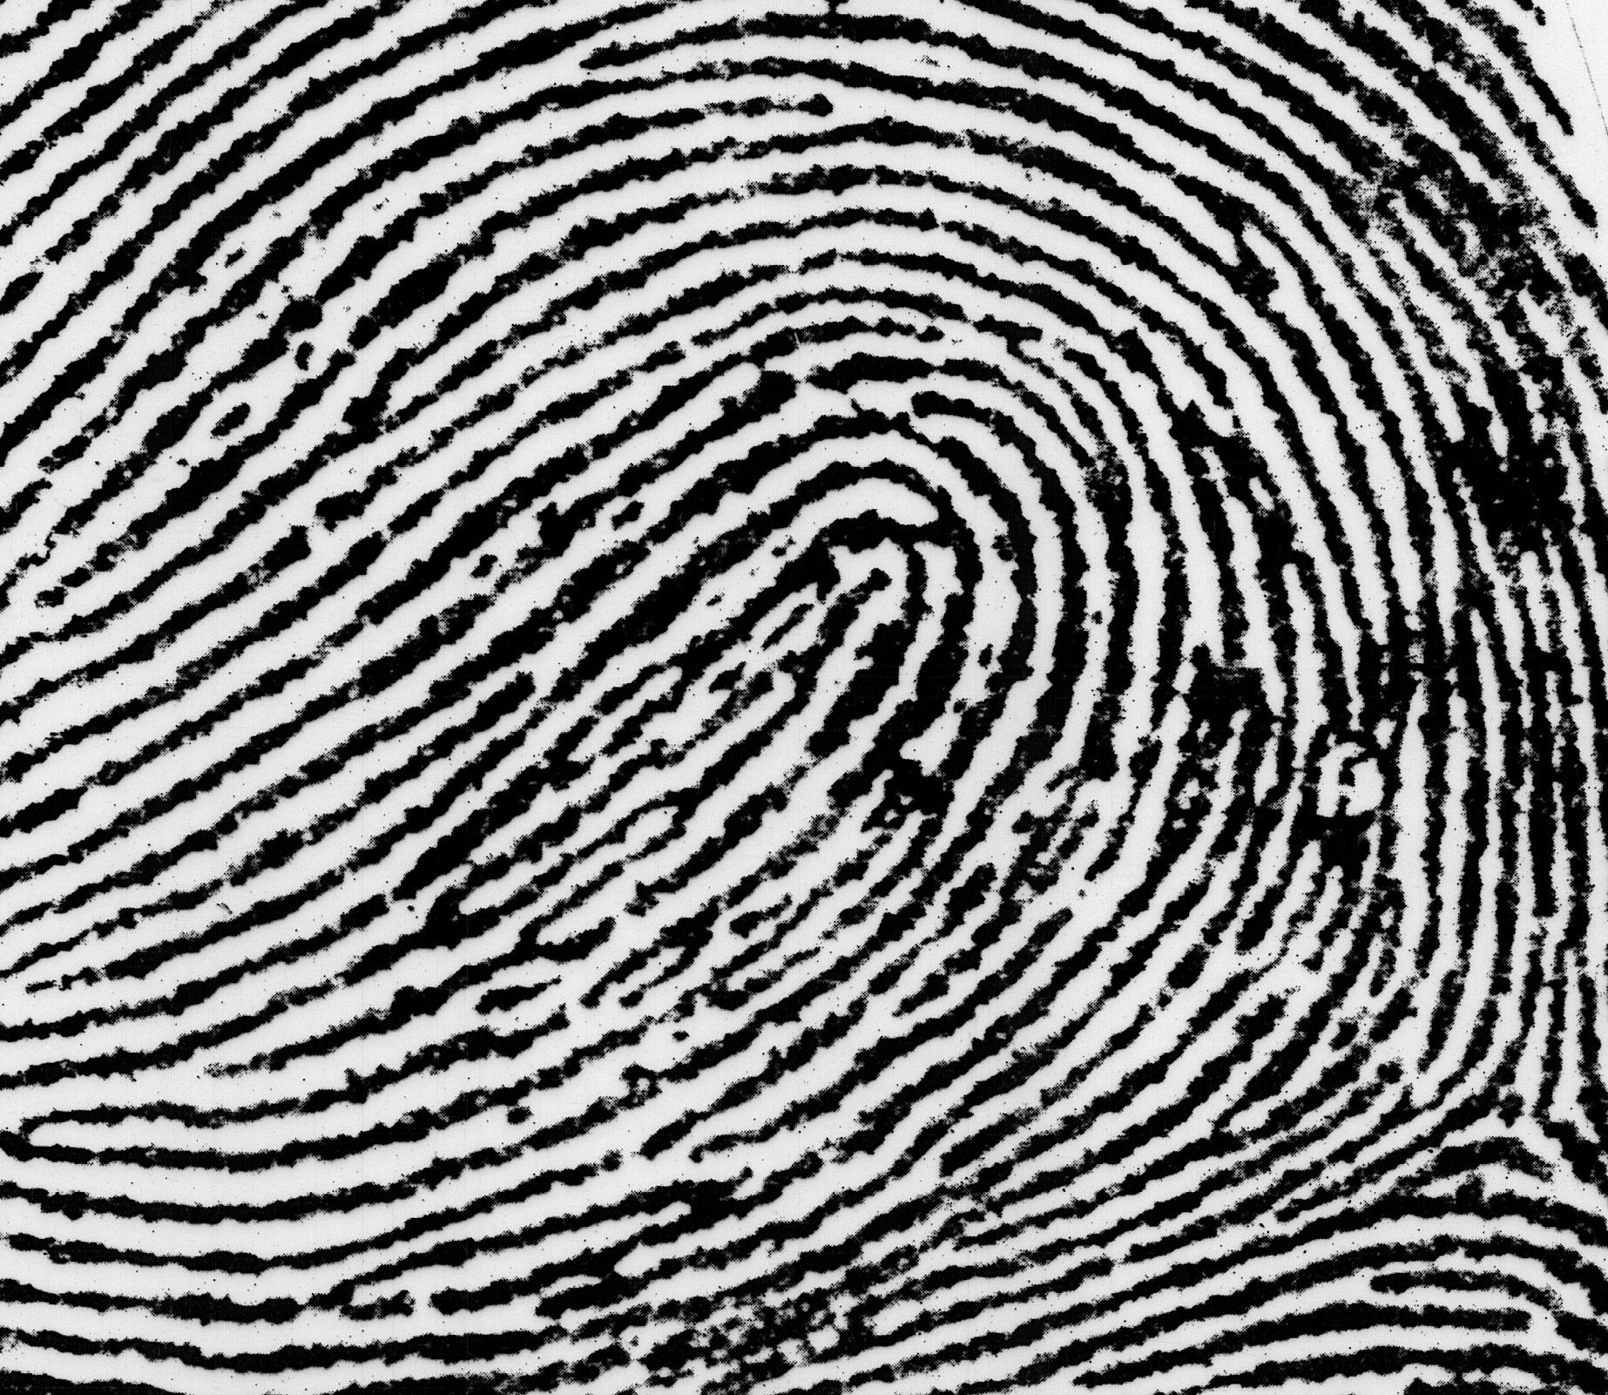
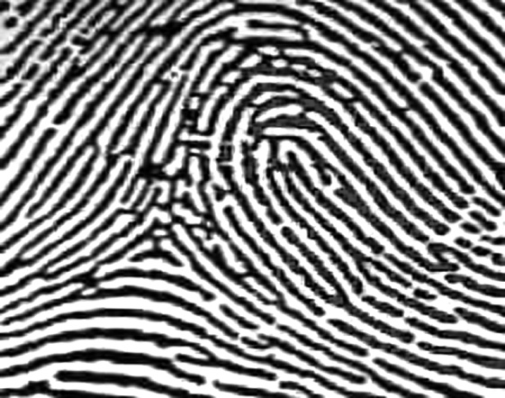
Objective: SWBAT identify the types of fingerprint patterns in order to determine similar prints.
Loops must have one delta and one or more ridges that enter and leave on the same side. These patterns are named for their positions related to the radius and ulna bones.
Delta
Ulnar Loop (Right Thumb)
Loop opens toward right or the ulna bone.
Radial Loop (Right Thumb)
Loop opens toward the left or the radial bone.
NOTE: On the left hand, a loop that opens to the left would be an ulnar loop, while one that opens to the right would be a radial loop.

Slide 10
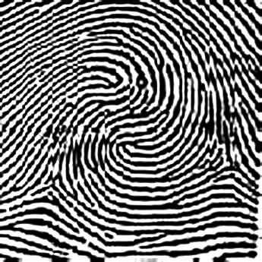
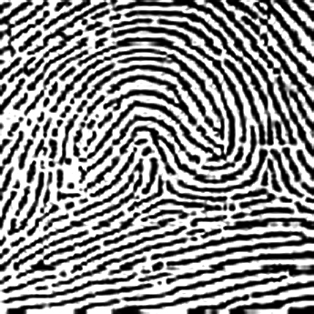
Objective: SWBAT identify the types of fingerprint patterns in order to determine similar prints.
Double Loop Whorl
Accidental Whorl
Delta
Delta
Double loop whorls are made up of any two loops combined into one print.
Accidental whorls contain two or more patterns (not including the plain arch), or does not clearly fall under any of the other categories.

Slide 11
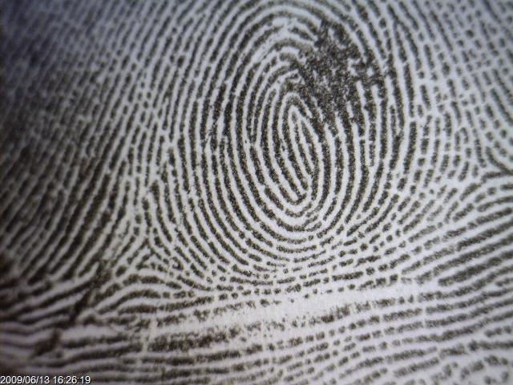
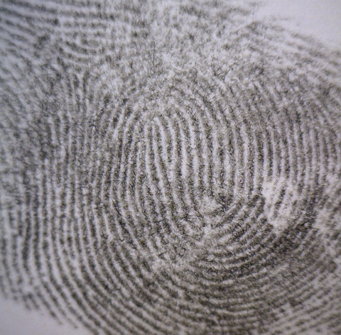
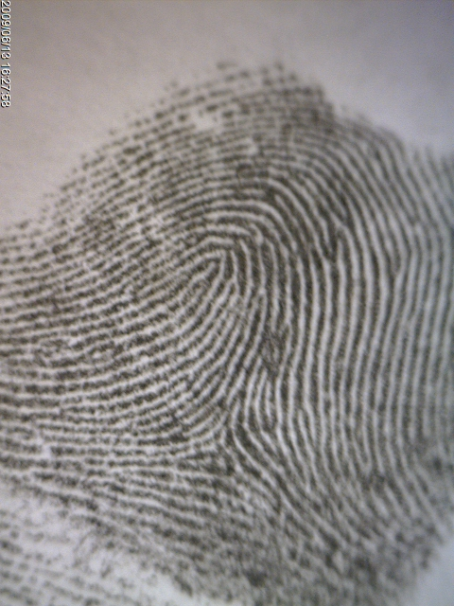
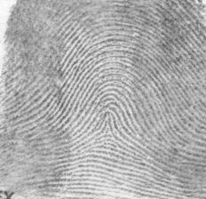
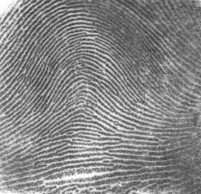
Closure: Identify each fingerprint pattern.
?
A
B
Left Hand
Right Hand
C
D
Right Hand
E
Right Hand
Left Hand
Notes:
Answer Key: A - Plain Whorl, B – Double Loop Whorl, C – Radial Loop, D – Tented Arch, E – Plain Arch

Slide 12
More Prints

Slide 13
Objective: SWBAT identify patterns in their own fingerprints used in comparisons.
Review of prints: http://www.youtube.com/watch?v=d7N-4UNAzsw
Important Fact: As humans get identified through their fingerprints, cats and dogs are by their nose prints. How could this be useful in a crime scene?
Complete the finger print card activity.

Slide 14
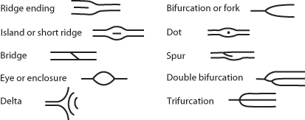
Ridge Characteristics
Objective: SWBAT identify patterns in their own fingerprints used in comparisons.
Minutiae—characteristics of ridge patterns

Slide 15
Example
Objective: SWBAT identify patterns in their own fingerprints used in comparisons.

Slide 16
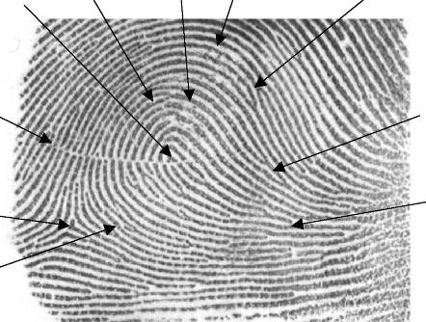
Comparison
Objective: SWBAT identify patterns in their own fingerprints used in comparisons.
There are no legal requirements in the United States on the number of points required for a match. Generally, criminal courts will accept 8 to 12 points of similarity.

Slide 17
Objective: SWBAT identify the types of fingerprint patterns in order to determine similar prints.
Important Fact: Fingerprints enable us to grasp objects. Fingerprints are impressions made by the ridges on the ends of the fingers and thumbs. These ridges provide friction, or traction, when we grasp objects so that those objects do not slip through our fingers. Scientists also believe that they may enhance our sense of touch.
Complete the “Identification of Minutiae” activity. Hand it in.

Slide 18
Objective: SWBAT identify the types of fingerprint patterns in order to determine similar prints.
Important Fact: Koalas have ridges on their fingers which create fingerprints almost identical to those of human beings. According to a number of websites, this means that koala fingerprints could be confused for human fingerprints at a crime scene. However, koalas have two thumbs on each hand.. Human beings have ridges over all of their palms, whereas koalas only have ridges over part of their palms.
Complete fingerprint challenge. Hand it in.
Notes:
Answers: A – 1, B – 7, C – 9, D – 11, E – 3, F – 10, G – 6, H – 2, I – 4, J – 12, K – 5, L – 8
the natural oils in the skin. The skin's sebaceous glands produce natural oils which, together with the salts produced by our sweat glands, leave a fingerprint residue when we touch most objects.

Slide 19
The Night Stalker
https://www.youtube.com/watch?v=l1F0pnTegUA

Slide 20
Lifting Prints

Slide 21
Objective: SWBAT research ways to pick up fingerprints.
Lifting prints off hard nonporous surfaces (super glue fuming) such as glass and plastic: http://www.youtube.com/watch?v=R0e8WXkFA64

Slide 22
Objective: SWBAT research ways to pick up fingerprints.
Iodine Fuming for lifting prints of paper: http://www.youtube.com/watch?v=SQ9dYQ_OSPg
Mythbusters http://www.youtube.com/watch?v=MAfAVGES-Yc

Slide 23
Objective: SWBAT research ways to pick up fingerprints.
Developing Prints by dusting with Powder: http://www.youtube.com/watch?v=tqFzVfPRd5s
Night Stalker dusting: http://www.smithsonianchannel.com/videos/how-to-dust-for-fingerprints/17020
Notes:
If using white powder have students lift prints and place on black paper

Slide 24
Objective: SWBAT research ways to pick up fingerprints.
Complete Dusting/Lifting Print Activity and hand it in.
Important Fact: The FBI’s fingerprint database is the largest in the world; because they (FBI) receives 34,000 fingerprint cards every day. It has 10 times more data than that on DNA. What are some reasons fingerprints could be taken?

Slide 25
James Earl Ray

Slide 26
Objective: SWBAT research ways to pick up fingerprints.
Do Now: Experts say that an Egyptian mummy still has very clear fingerprints even if they were embalmed years ago. How can this fact be useful if you are investigating a cold case?
Complete case study on James Earl Ray.
http://www.youtube.com/watch?v=-bZ-Vdhnno8
http://www.youtube.com/watch?v=v6u98z9MiwY
Closure: Explain whether you think James Earl Ray would have been convicted if no fingerprints were found on the gun.

Slide 27
Latent Prints Lab

Slide 28
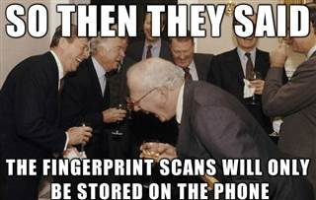
Objective: SWBAT identify the types of fingerprint patterns in order to determine similar prints.
Complete Latent Fingerprints Lab and hand it in.
Closure: Fingerprint scanners use fingerprints to unlock the phone or pay for items. Could this eventually infringe on our privacy rights?

