Slide 1
Heat

Slide 2
Calorimetry

Slide 3
Objectives
You should already be able to…
Define heat and energy
Define endothermic and exothermic
By the end of the video you should be able to…
Determine how heat and work affect the system and surroundings using E=q+w
Use q=mcΔT to determine the heat of a change to a system
Convert the heat in J to KJ/mol for a reaction

Slide 4
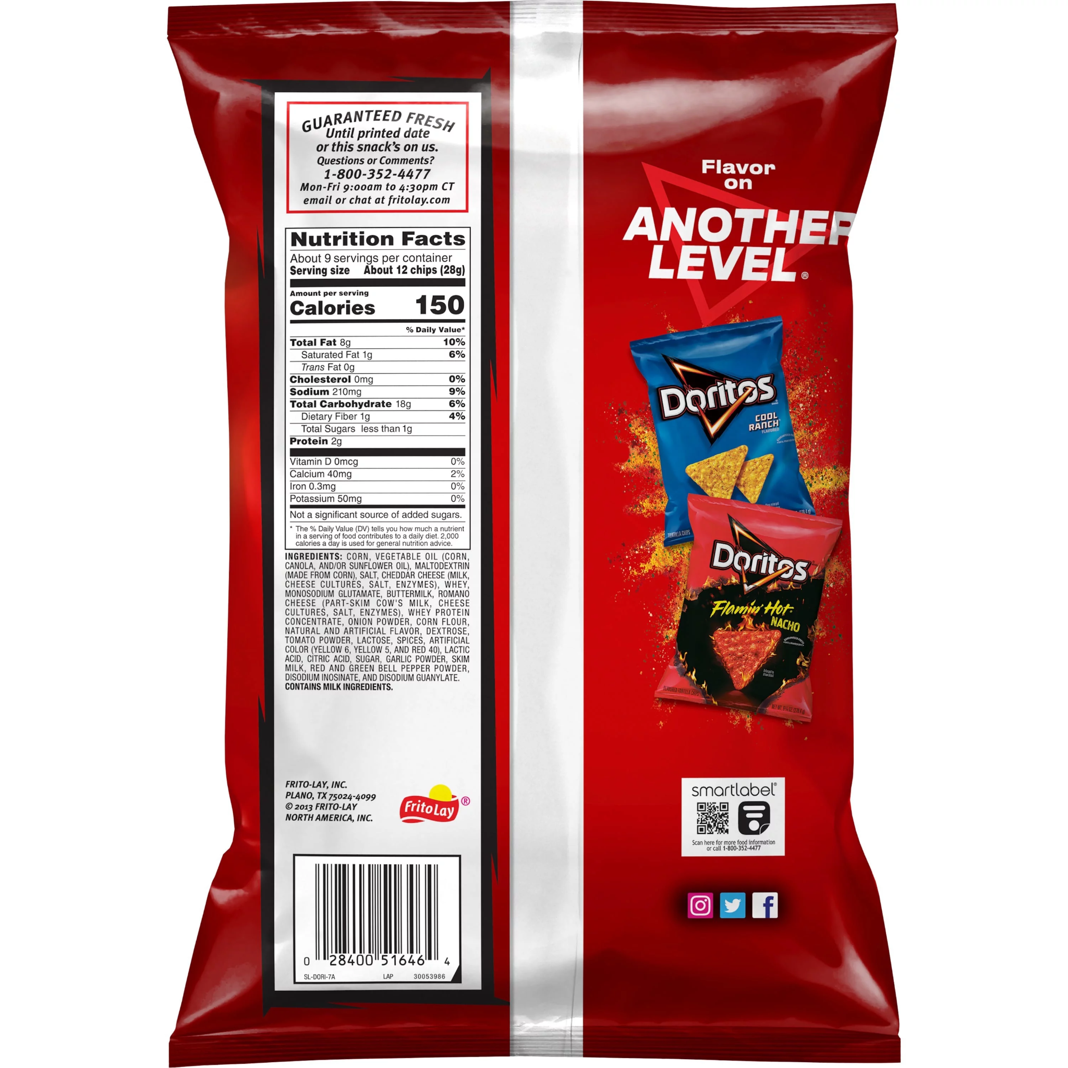
Question of the video:
When a bag of doritos burns, how many Joules of energy does it provide? The calories are 150 but how do they know that?

Slide 5
System and Surroundings
The system includes the molecules we want to study (here, the hydrogen and oxygen molecules).
The surroundings are everything else (here, the cylinder and piston).

Slide 6
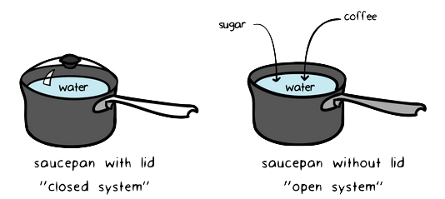
Systems
An open system allows for energy and mass to change, like an open cup of coffee or beaker.
A closed system allows for changes in energy only, like a closed coffee cup or beaker.

Slide 7
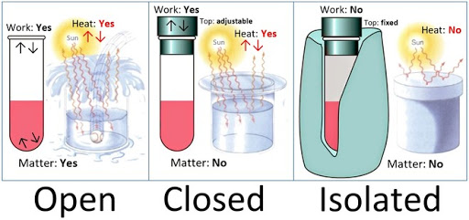
Systems
An isolated system doesn’t allow any change in temperature or heat to occur, like a perfect calorimeter.

Slide 8
Changes in Internal Energy
When energy is exchanged between the system and the surroundings, it is exchanged as either heat (q) or work (w).
ΔE = q + w

Slide 9
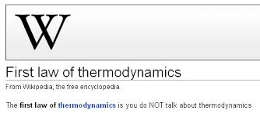
Energy
The ability of the system to do work or transfer heat.
First Law of Thermodynamics Energy may be transferred, but not created or destroyed (Conservation of Energy)

Slide 10
Heat (q)
Endothermic: Energy goes into the system, the reaction is probably not spontaneous (low stability), positive value.
Exothermic: Energy comes out of the system, the reaction is probably spontaneous (high stability), negative value.

Slide 11
Work (w)
Work done on a system, such as compression of a gas, will be positive because energy is going into the system.
Work done by a system, such as a gas expanding, will be negative because energy is exiting the system.
W=-PΔV

Slide 12
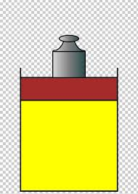
Work and Heat Examples
The work done when a gas is compressed in a cylinder is 462J. The heat change equals 128J from gas to surroundings. Calculate the total change in energy.
A gas expands and works on the surroundings equal to 279J. It absorbs 216J. Calculate the change in energy.
-128+462= 334J
-279+216= -63J

Slide 13
ΔE, q, w, and Their Signs Summary
Q (heat) | + gains heat | -loses heat
W (work) | + work done on system | - Work done by the system
E (energy) | + gain of energy | - Loss of energy

Slide 14
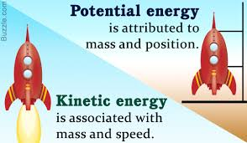
Energy
Heat energy is used to cause the temperature of an object to rise. Heat transfers from warm to cold.
Kinetic Energy refers to the energy of motion. It is proportional to temperature.
Potential energy refers to stored energy.
1
KE = ⎯ mv²
2

Slide 15
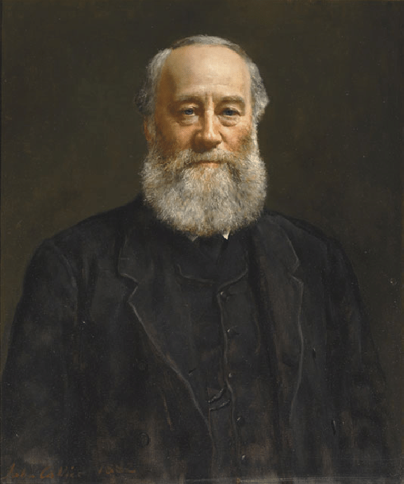
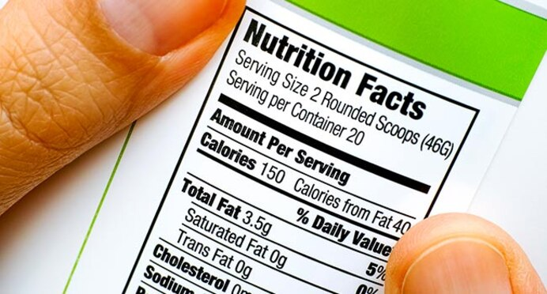
Units of Energy
The SI unit of energy is the joule (J).
An older, non-SI unit is still in widespread use: The calorie (cal).
1 cal = 4.184 J
kg m²
1 J = 1 ⎯⎯
s²

Slide 16
Calorimetry
Since we cannot measure the exact enthalpy of the reactants or products, we measure ΔH through calorimetry, the measurement of heat flow.

Slide 17
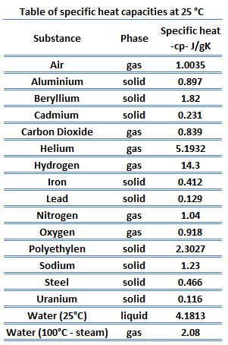
Specific Heat
We define specific heat capacity (or simply specific heat, c) as the amount of energy required to raise the temperature of 1 g of a substance by 1 K (or 1°C) .

Slide 18
Heat Capacity
The amount of energy required to raise the temperature of a substance with a fixed mass (such as the calorimeter) by 1 K is its heat capacity, C.
C = mc

Slide 19
Constant Pressure Calorimetry
By carrying out a reaction in a calorimeter, you can measure the heat change for the system by measuring the heat change for the surroundings (the calorimeter and water).
The specific heat for water is 4.184 J/gK. We measure ΔH for the reaction with the equation: q = m × c × ΔT

Slide 20
Calorimetry Examples
A 466g sample of water is heated from 8.5 to 74.6C. Calculate the heat change.
A 869g sample of Fe (with c=0.46J/g C) cools from 84 to 5C. Calculate the heat change.
q = mcT = (466)(4.18)(66.1) = 130000J
q = mcT = (869)(0.46)(-79) = -32000J

Slide 21
Calorimetry Example
7.85g of Cu is heated to 70.0C and placed in a calorimeter with 5.00g of water at 10.0C. At equilibrium, the temperature equals 20.0C. Calculate the specific heat of the Cu.
Q_{H2O} = (5.00)(4.184)(10.0) = 209.2
Q_{Cu}= -Q_{H2O} = -209.2 = (7.85)(x)(-50.0)
x =0.533 J/gC

Slide 22
Heat of vaporization
q=mH_{v}
Used when no temperature change has taken place, but the substance turns from gas to liquid or liquid to gas.
H_{v} is specific to the substance like specific heat (c). The stronger the IMF, the ______ the H_{v}.
Calculate the heat absorbed when 5 grams of water vaporizes (H_{v}=2260 J/g).
11300J

Slide 23
Heat of Fusion
q=mH_{f}
Used when no temperature change has taken place, but the substance turns from solid to liquid or liquid to solid.
H_{f} is specific to the substance like specific heat (c). The stronger the IMF, the ______ the H_{f}.
Calculate the heat absorbed when 5 grams of ice melts (H_{f}=334 J/g).
1670J
🡪Which took more energy, to fuse or to vaporize the 5 g?

Slide 24
Heat
q=mcΔT q=mH_{v} q=mH_{f}
Notice it takes longer for water to evaporate than melt which is why the Hv is higher than it’s Hf.
Which q formula will you use for each part of this graph?

Slide 25
Examples
1.435g of decyne is burned in a calorimeter and the temperature rose from 20.17 to 25.84C. The mass of the water equals 2000g and the heat capacity of the calorimeter equals 1.80KJ/C. Calculate the molar heat of combustion.
(2000)(4.18)(5.67)+(1800)(5.67) = 57607.2J
1.435g/138g = 0.0104 moles
57607.2J/0.0104 = 5550000J/mol = 5550KJ/mol

Slide 26
Enthalpy
Enthalpy is an extensive property, meaning it depends on the amount of sample you have.
ΔH for a reaction in the forward direction is equal in size, but opposite in sign, to ΔH for the reverse reaction.
If a reaction is multiplied by any number, the Δ H should also be multiplied by that number.

Slide 27
Examples
H₂ + I₂ → 2HI ΔH=53.0 kJ/mol
Calculate the heat that can be absorbed when 4 moles of HI are formed.
Calculate the number of moles of H₂ and I₂ that must react to absorb 106kJ/mol.
4HI x 53kJ = 106kJ
1 2HI
106kJ x 1H₂ = 2 mole H₂ and 2 moles I₂
1 53kJ

Slide 28
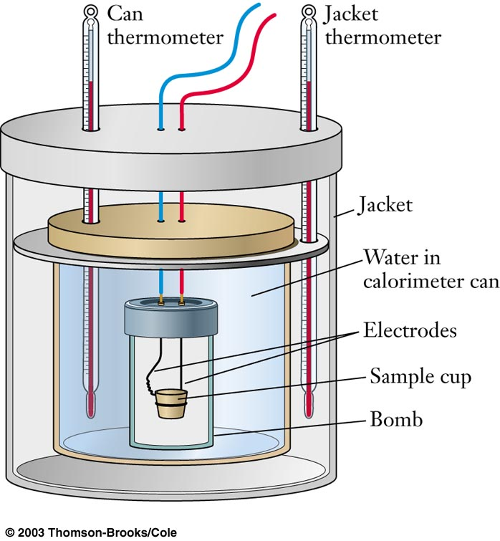
Question of the video:
When a bag of doritos burns, how many Joules of energy does it provide? The calories are 150 but how do they know that?
water: q = (100)(4.18)(1.5) = 627J
doritos: 150cal = 627J
1cal = 4.18J
100 g water
Ti = 20.0C
Tf = 21.5C
Mass doritos 28g

Slide 29
YOU MUST BE ABLE TO:
Determine how heat and work affect the system and surroundings using E=q+w
Use q=mcΔT to determine the heat of a change to a system
Convert the heat in J to KJ/mol for a reaction

Slide 30
Enthalpy of Formation
Thermodynamics

Slide 31
Objectives
You should already be able to…
Define heat and energy
By the end of the video you should be able to…
Calculate ΔH_{rxn} using ΔH_{f}
Calculate ΔH_{rxn} using Bond Energies

Slide 32
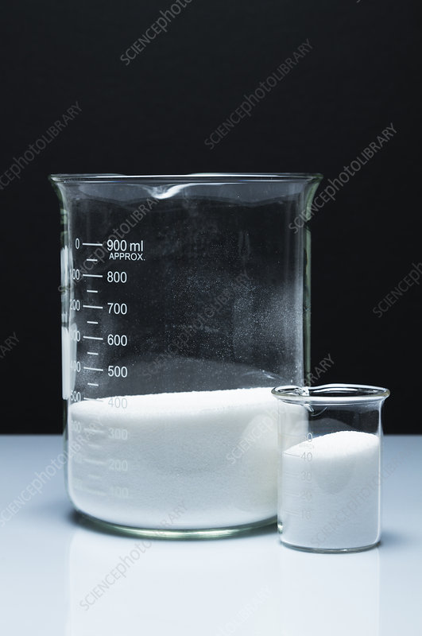
Question of the video:
How much energy is released when one mole of sugar is burned in a system like the human body?

Slide 33
Enthalpies of Formation
A standard enthalpy of formation, ΔH_{f}°, is defined as the enthalpy change for the reaction in which one mole of a compound is made from its elements in their elemental forms at 1 atm and 25C. Elements are zero if the element is at it’s standard state.
Δ H_{rxn}° is the standard heat of a reaction at 1atm and 25C. This is obtained by Δ H_{f}°(P-R)

Slide 35
Enthalpy of Formation Example
Given the values below, calculate the ΔH_{rxn}° of:
C₃H_{8(g)} + 5O_{2(g)} 🡪 3CO_{2(g)} + 4H₂O(l)
C₃H₈ ΔHf° = -103.85kJ/mol
CO₂ ΔHf° = -393.5kJ/mol
H₂O ΔHf° = -285.8 kJ/mol
[3(-393.5) + 4(-285.8)] - [-103.85 + 5(0)] = -2220.0 kJ/mol
Notice all elements are zero and units are in kJ/mol
This tells us only that the reaction is exothermic and may be favorable.

Slide 37
Bond Energy

Slide 38
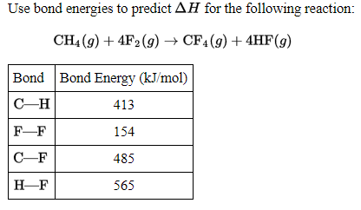
BARF
4(413) + 4(154) - 4(485) – 4(565)
-1932KJ/mol

Slide 39
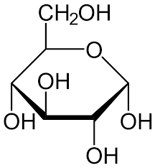
Question of the video:
How much energy is released when one mole of sugar is burned in a system like the human body?
C₆H₁₂O₆ + 6O₂ → 6CO₂ + 6H₂O
ΔH = P-R = [6(-393.5) +6(-285.8)] - [-1260 + 6(0)] = -2815.8kJ/mol
or
ΔH = BB-BF = [5(347)+5(467)+7(358) +7(413)+6(498) ] - [12(799) + 12(467)] = -2737 kJ/mol
5 C-C
5O-H
7C-O
7C-H

Slide 40
YOU MUST BE ABLE TO:
Calculate ΔHrxn using ΔHf
Calculate ΔHrxn using Bond Energies

Slide 41
Hess’ Law
Thermodynamics

Slide 42
Objectives
You should already be able to…
Define heat and energy
Calculate ΔH_{rxn} using ΔH_{f}
Calculate ΔH_{rxn} using Bond Energies
By the end of the video you should be able to…
Calculate ΔH_{rxn} using Hess’ Law

Slide 43
Question of the video:
SO… what is the heat given off by burning a mole of glucose??? Let's use other equations to help:
enthalpy of formation of water: 2H₂(g) + O₂(g) → 2H₂O(l) ΔH = -571.6 kJ/mol
enthalpy of formation of carbon dioxide: C(s) + O₂(g) → CO₂(g) ΔH= -393.5 kJ/mol
enthalpy of formation of glucose: 6C(s)+6H₂(g)+3O₂(g)→C₆H₁₂O₆(s) ΔH = -1271 kJ/mol
C₆H₁₂O₆ + 6O₂ → 6CO₂ + 6H₂O

Slide 44
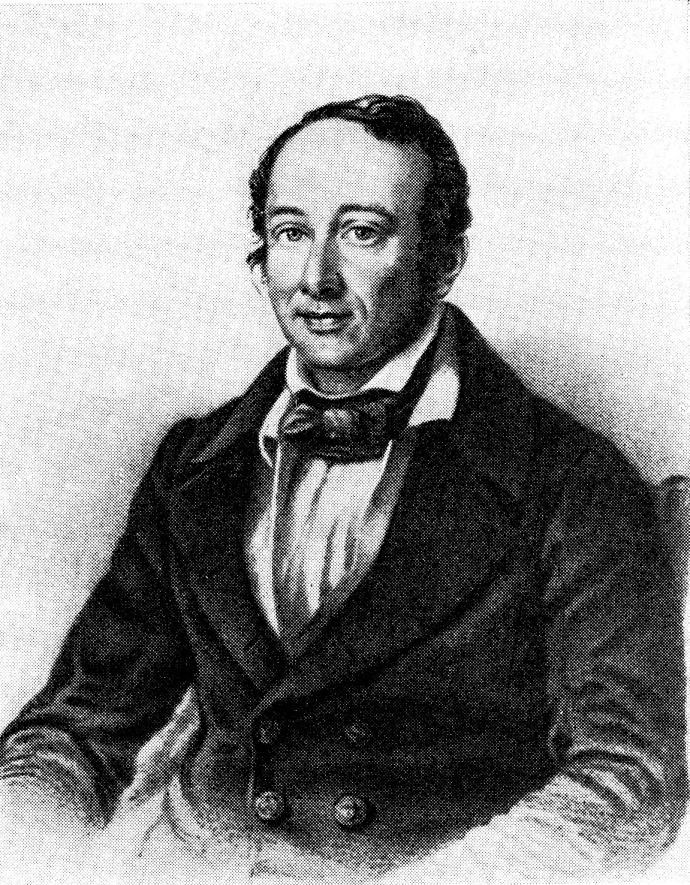
Hess’s Law
ΔH° is well known for many reactions, and it is inconvenient to measure ΔH° for every reaction in which we are interested.
However, we can estimate ΔH° using other ΔH° values that are published.
Hess’s law states that “If a reaction is carried out in a series of steps, ΔH° for the overall reaction will be equal to the sum of the enthalpy changes for the individual steps.”

Slide 45
Enthalpy
Enthalpy is an extensive property, meaning it depends on the amount of sample you have.
ΔH for a reaction in the forward direction is equal in size, but opposite in sign, to ΔH for the reverse reaction.
If a reaction is multiplied by any number, the Δ H should also be multiplied by that number.

Slide 46
Example
Given: H₂O_{(s)} 🡪 H₂O_{(l)} ΔΗ°=6.01KJ
CH_{4(g)}+2O_{2(g)}🡪CO_{2(g)}+2H₂O_{(l)} ΔH°=-890.4KJ
Calculate the heat of reaction of:
2CH_{4(g)}+4O_{2(g)}🡪2CO_{2(g)}+ 4H₂O_{(s)}
Multiply equation 2 by 2: 2CH_{4(g)}+ 4O_{2(g)}🡪2CO_{2(g)}+4H₂O_{(l)} ΔH=2(-890.4KJ)
Reverse quadruple equation 1: 4H₂O_{(l)} 🡪 4H₂O_{(s)} ΔΗ=-4(6.01KJ)
Combine new equations : 2(-890.4)+-4(6.01) = -1804.84kJ

Slide 47
Another Example
Overall Reaction: CS₂(l) + 3O₂(g) → CO₂(g) + 2SO₂(g)
C(s) + O₂(g) → CO₂(g) ∆H= -395 kJ/mol S(s) + O₂(g) → SO₂(g) ∆H= -295 kJ/mol C(s) + 2S(s) → CS₂(l) ∆H= +90 kJ/mol
2S(s) + 2O₂(g) → 2SO₂(g) ∆H= -295 kJ/mol x 2
CS₂(l) → C(s) + 2O₂(g) ∆H= -90 kJ/mol
-395 + 2(-295) - 90 = -1075kJ/mol

Slide 48
Question of the video:
enthalpy of formation of water: 2H₂(g) + O₂(g) → 2H₂O(l) ΔH = -571.6 kJ/mol
enthalpy of formation of carbon dioxide: C(s) + O₂(g) → CO₂(g) ΔH= -393.5 kJ/mol
enthalpy of formation of glucose: 6C(s)+6H₂(g)+3O₂(g)→C₆H₁₂O₆(s) ΔH = -1271 kJ/mol
C₆H₁₂O₆ + 6O₂ → 6CO₂ + 6H₂O
reverse glucose: C₆H₁₂O₆(s) → 6C(s)+6H₂(g)+3O₂(g) ΔH = +1271 kJ/mol
6x carbon dioxide: 6C(s) + 6O₂(g) → 6CO₂(g) ΔH= 6(-393.5 kJ/mol)
3x water: 6H₂(g) + 3O₂(g) → 6H₂O(l) ΔH = 3(-571.6 kJ/mol)
ΔH = -2804 kJ/mol

Slide 49
Question of the video:
How much energy is released when one mole of sugar is burned in a system like the human body?
C₆H₁₂O₆ + 6O₂ → 6CO₂ + 6H₂O
ΔH = P-R = [6(-393.5) +6(-285.8)] - [-1260 + 6(0)] = -2815.8kJ/mol
or
ΔH = BB-BF = [5(347)+5(467)+7(358) +7(413)+6(498) ] - [12(799) + 12(467)] = -2737 kJ/mol
5 C-C
5O-H
7C-O
7C-H
Recall that bond energies are average values and are at most, “approximate” values.

Slide 50
YOU MUST BE ABLE TO:
Calculate ΔHrxn using Hess’ Law

