Slide 1
Unit 6
Subatomic particles

Slide 2
Rutherford’s model
Of the atom

Slide 3
Lesson Objectives:
Describe Rutherford’s gold foil experiment and the conclusions he made

Slide 4
Recall: J. J. Thomson (1897)
Discovered ELECTRONS using a cathode ray tube.
His Model of the Atom:
“plum pudding” model
Atom is positively charged with negative electrons “stuck” in it.

Slide 5
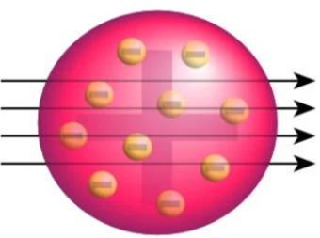
Rutherford’s Gold Foil Experiment
The experiment:
Shot positively charged alpha particles at gold foil.
+
+

Slide 6
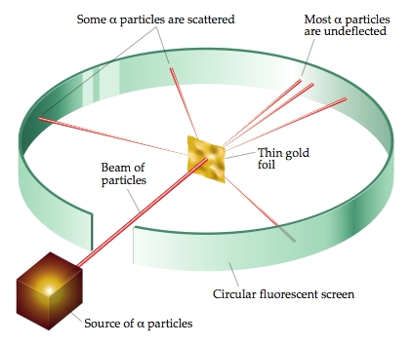
Rutherford’s Gold Foil Experiment
The Results:
Most particles went straight through.
A few were deflected.
+

Slide 7
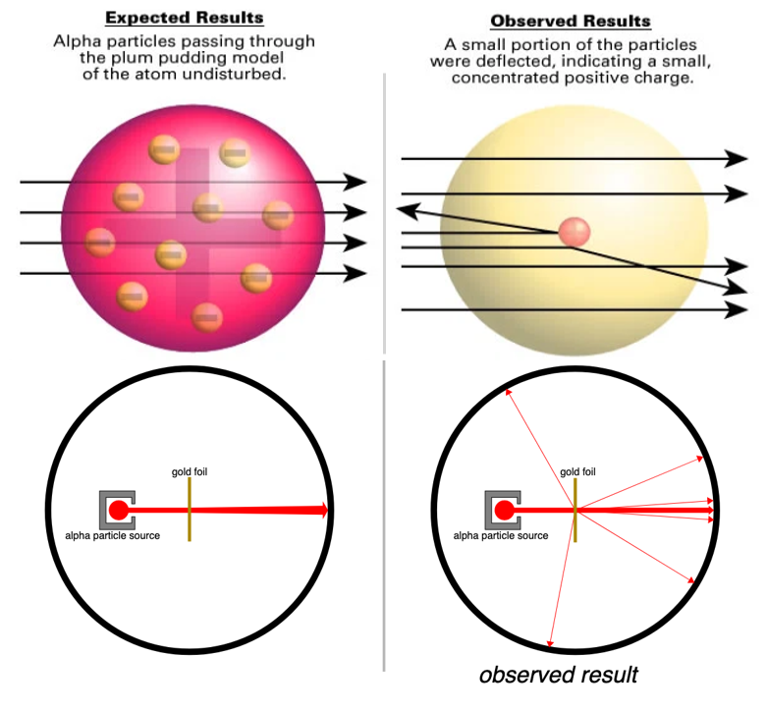

Slide 8
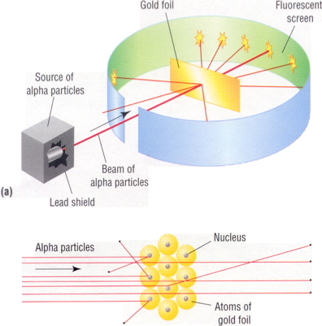
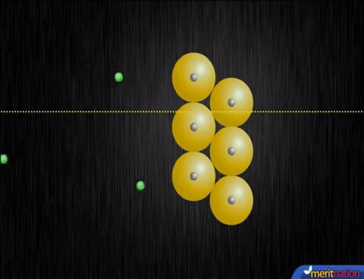
Rutherford’s Gold Foil Experiment
+
+

Slide 9
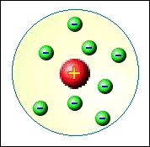
Rutherford’s Model of the atom
Discovered the NUCLEUS
His Model of the Atom:
Small dense positive nucleus
Atom is mostly empty space

Slide 10
Describe Rutherford’s gold foil experiment and the conclusions he made

Slide 11
Subatomic Particles

Slide 12
Lesson Objectives:
Identify the subatomic particles of an atom (proton, neutron, and electron)
Determine the number of protons, neutrons, electrons in a neutral atom

Slide 13
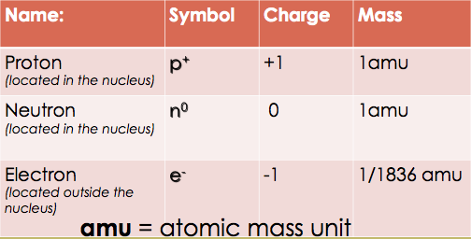
Subatomic Particles

Slide 14
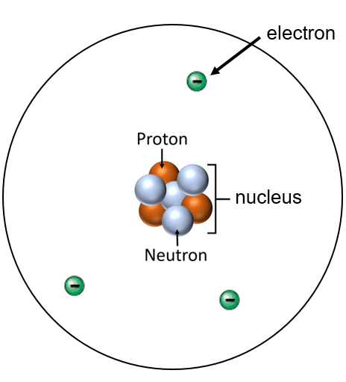
Parts of the atom
Nucleons = protons + neutrons

Slide 15
Parts of the atom
Atoms are neutral
# of protons (+) = # of electrons (-)
+
+
+
+3 -3 = 0

Slide 16
Atomic Number
Equal to the number of protons
Every element has its own atomic number
How periodic table is arranged

Slide 17
Mass Number
Equal to the sum of the protons and the neutrons (whole number)
Can be written as carbon-12

Slide 18
To Find: # of Protons
Look up atomic number on Periodic Table Ex. Lithium has 3 protons

Slide 19
To find the # of electrons
The # of electrons are equal to the # of protons in a neutral atom
Ex. Lithium has 3 electrons

Slide 20
To Find: # of neutrons
Protons + Neutrons = Mass
# of neutrons = mass # - number of protons
Ex. Lithium has 4 neutrons (7 – 3) = 4

Slide 21
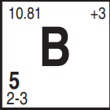
Example: I do
Element | Atomic # | Mass # | # of protons | # of neutrons | # of electrons
Boron (B)
5
11
5
6
5

Slide 22
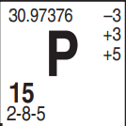
Example: We do
Element | Atomic # | Mass # | # of protons | # of neutrons | # of electrons
Phosphorus (P)
15
31
15
16
15

Slide 23
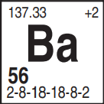
Example: You do
Element | Atomic # | Mass # | # of protons | # of neutrons | # of electrons
Barium (Ba)
56
137
56
81
56

Slide 24
Identify the subatomic particles of an atom (proton, neutron, and electron)
Determine the number of protons, neutrons, electrons, and nuclear charge in a neutral atom

Slide 25
Ions

Slide 26
Lesson Objectives:
Determine the number of protons, neutrons, and electrons in an ion
Determine the nuclear charge of an atom and ion

Slide 27
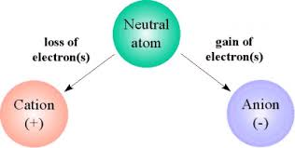
Ions
Charged particles
Formed when atoms gain or lose electrons

Slide 28
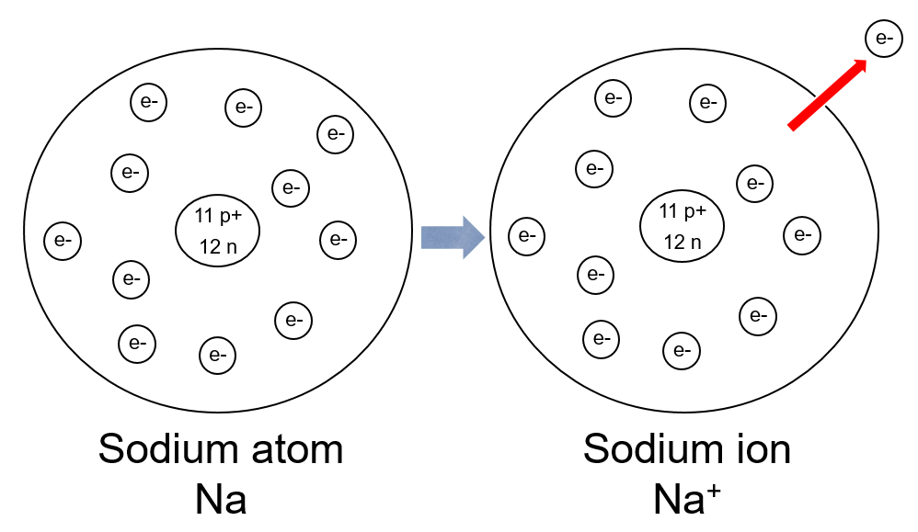
Cation
The atom loses electron(s) becomes positively charged (oxidation) Ex. Na⁺
11 e-
10 e-

Slide 29
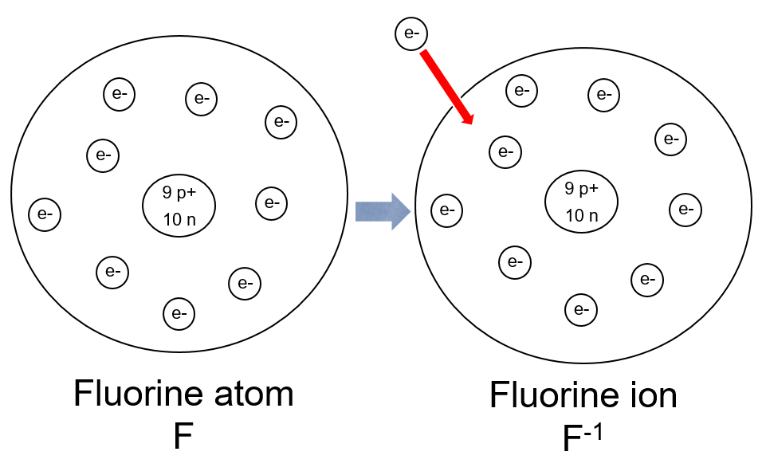
Anion
The atom gains electron(s) becomes negatively charged (reduction) Ex. Cl⁻¹
9 e-
10 e-

Slide 30
Example: I do
Element | Atomic # | Mass # | p⁺ | n | e⁻
Fe | 26 | 56 | 26 | 30 | 26
Fe⁺³ | 26
56
26
30
23
26⁺
23⁻
= ⁺3

Slide 31
Example: We do
Element | Atomic # | Mass # | p⁺ | n | e⁻
Br | 35 | 80 | 35 | 45 | 35
Br⁻¹ | 35
80
35
45
36
35⁺
36⁻
= ⁻1

Slide 32
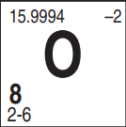
Example: You do
Element | Atomic # | Mass # | p⁺ | n | e⁻
O | 8 | 16 | 8 | 8 | 8
O⁻² | 8
16
8
8
10
8⁺
10⁻
= ⁻2

Slide 33
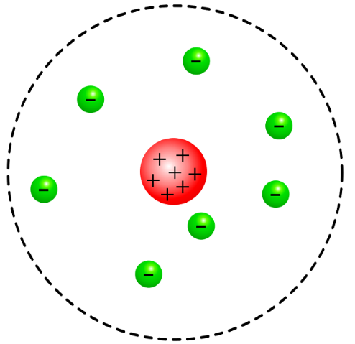
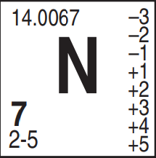
Nuclear Charge
The only charged particle in nucleus is protons (+)
Ex. nuclear charge of N is +7
+7
+6

Slide 34
Example:
What is the nuclear charge of the sodium atom and the sodium ion?
11 +
11 +
11 -
10 -
Na atom
Na⁺ ion

Slide 35
Determine the number of protons, neutrons, and electrons in an ion
Determine the nuclear charge of an atom and ion

Slide 36
Isotopes

Slide 37
Lesson Objectives:
Differentiate between atomic number, mass number, and (average) atomic mass
Calculate the number of neutrons in an isotope

Slide 38
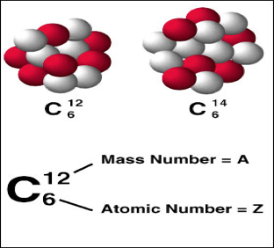
Isotopes
Elements that have the same # of protons (atomic #) but different # of neutrons resulting in a different mass.

Slide 39
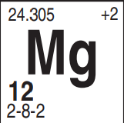
Isotope Symbols
Show the mass of isotope
Same atomic #, different mass #
Ex. isotope symbol of element X X
Mass #
Atomic #

Slide 40
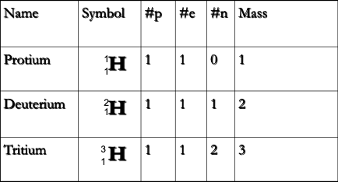
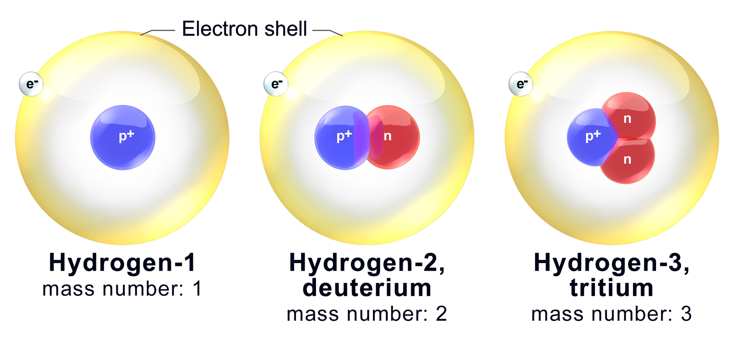
Common Isotopes of Hydrogen

Slide 41
Example
Write the isotope symbol for oxygen-17
How many neutrons does it have?
17
O
8
9

Slide 42
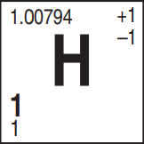
Example:
Which isotope of hydrogen is most abundant?

Slide 43
You should be able to:
Differentiate between atomic number, mass number, and (average) atomic mass
Calculate the number of neutrons in an isotope

Slide 44
Calculating average
Atomic Mass

Slide 45
Lesson Objective
Calculate the (average) atomic mass for all isotopes of an element
Determine the average atomic mass and identity of an element from Mass Spectrometry

Slide 46
Why is atomic mass not a whole #?
Mass number = protons + neutrons
Atomic mass on the periodic table is a weighted avg. of all the naturally occurring isotopes of that element and the relative abundances (amounts)
Chlorine-35 (67.49%) chlorine-37 (32.51%)

Slide 47
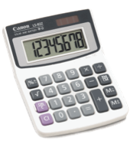
Example of a general weighted avg
50% exams 85 10% quizzes 100. 15% labs 95 25% HW/CW 80
(50 x 85) + (10 x 100.) + (15 x 95) + (25 x 80.) =
87 avg
100

Slide 48
Example: I do
Boron-10 19.78% 10.013 amu Boron-11 80.22% 11.009 amu Multiply the mass of each isotope by its percent abundance then divide by 100
10.013 amu
11.009 amu
(19.78 x 10.013) + (80.22 x 11.009)
=
10.82 amu
100

Slide 49
Example: We do
Determine weighted atomic mass Potassium-39 93.12% 38.964 amu Potassium-41 6.88% 40.962 amu
40.962 amu
38.964 amu
(93.12 x 38.964) + (6.88 x 40.962)
= 39.10 amu
100

Slide 50
Example: You do
Determine weighted atomic mass Magnesium -24 78.70% 23.98504 amu Magnesium-25 10.13% 24.98584 amu Magnesium-26 11.17% 25.98259 amu
(78.70 x 23.98504) + (10.13 x 24.98584) + (11.17% x 25.98259)
100
= 24.31 amu

Slide 51
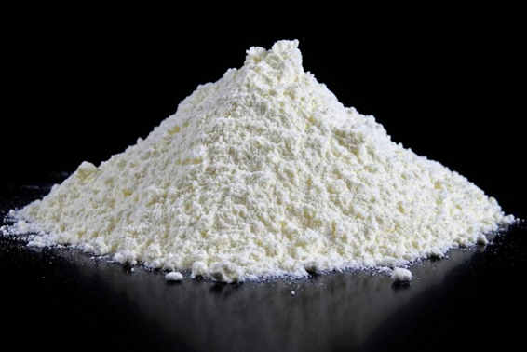
Question
How do we tell if this substance is sugar or an illegal drug?

Slide 52
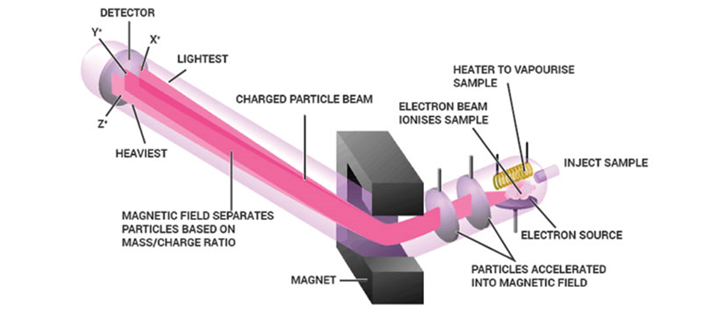
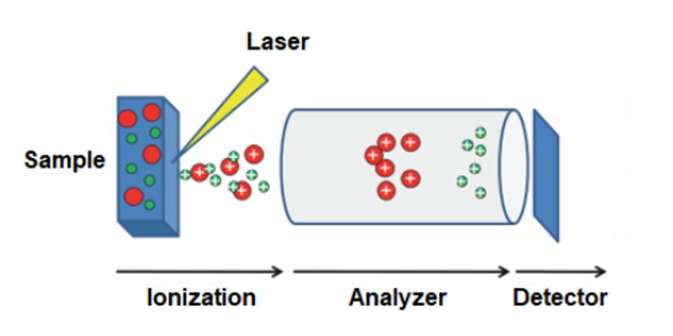
How does Mass Spectrometry Work?

Slide 53
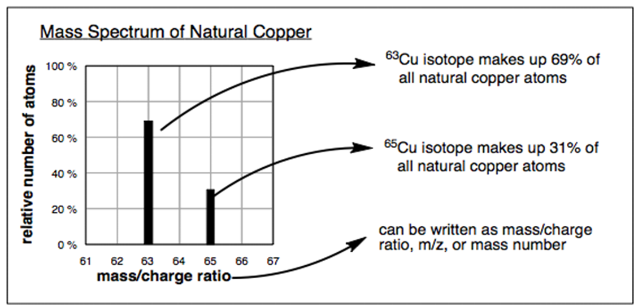
Copper Mass Spec Analysis

Slide 54
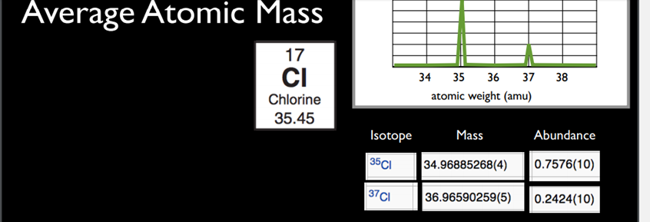
Chlorine Mass Spec Analysis
Atomic Mass = (mass)(% abundance) = (mass)(%abundance)….
(34.97)(.7576) + (36.96)(.2424) = 35.45amu

Slide 55
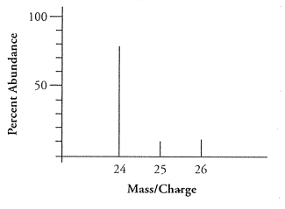
Example:
Determine the average atomic mass and identify of this element
(80 x 24) + (10 x 25) + (10 x 26)
100
= 24.3 amu

Slide 56
Calculate the (average) atomic mass for all isotopes of an element
Determine the average atomic mass and identity of an element from Mass Spectrometry

Slide 57
Bohr Diagrams

Slide 58
Lesson Objectives:
Construct Bohr diagrams for atoms
Construct Bohr diagrams for ions

Slide 59
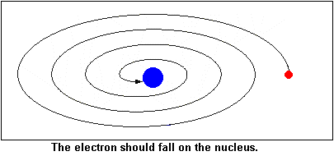
Bohr’s Model of the atom
Problems with Rutherford’s Model:
Bohr knew any charged particle that is moving like an electron would give off electromagnetic radiation (energy)
Notes:
Would quickly spiral into the middle of the atom and destroy the atom and he knew this wasn’t the case

Slide 60
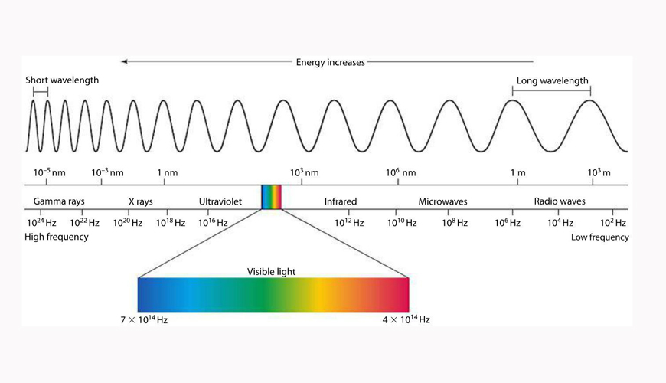
Bohr Model of the Atom
He also knew that if it was giving off energy, the wavelength of that radiation would vary producing a continuous spectrum of electromagnetic energy in the form of visible light.

Slide 61
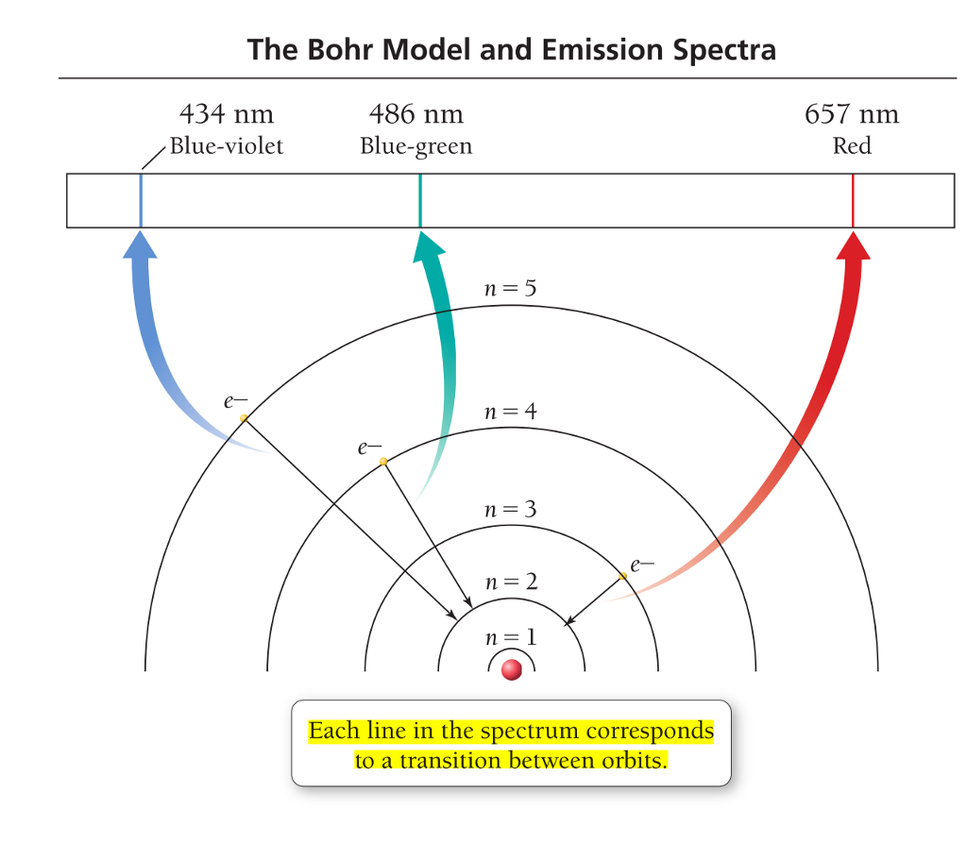
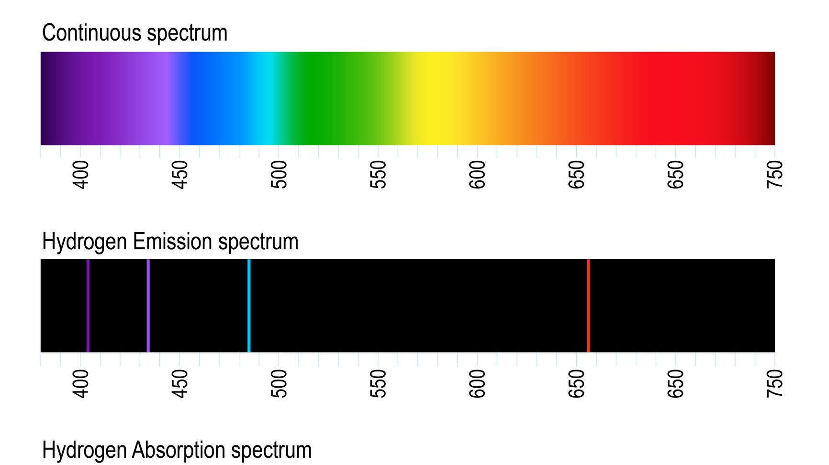
What Bohr Discovered
The energy given off wasn’t continuous
Had discrete units of energy

Slide 62
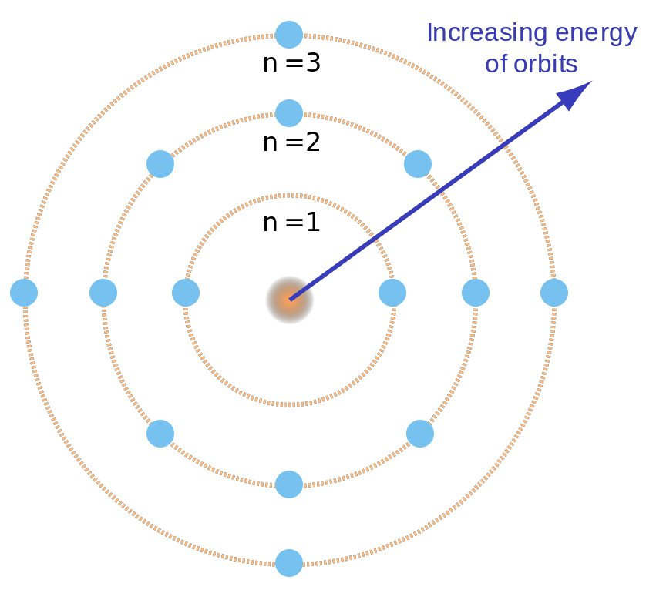
Bohr’s Model of the Atom
Determined that electrons are located in energy levels called orbits.
Each energy level (orbit):
is a fixed distance from the nucleus
can hold a specific number of electrons
has a definite amount of energy
+

Slide 63
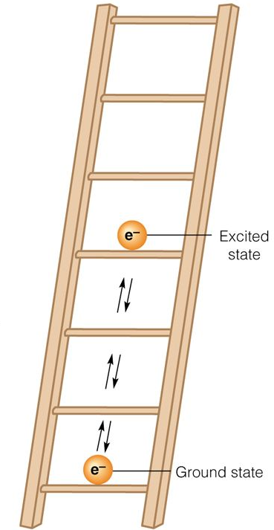
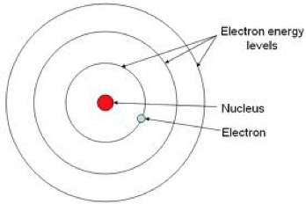
Bohr’s Model of the Atom
The further away from nucleus the greater the energy of the electrons
Increasing energy

Slide 64
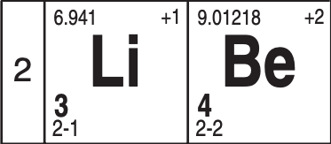
Constructing Bohr Diagrams
Look up electron configuration on periodic table
Draw a circle for nucleus and write # of protons and neutrons in it.
Draw in energy levels and write the # of electrons in each shell

Slide 65
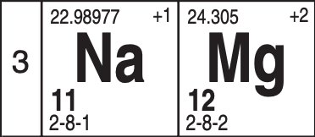
Example: Bohr Diagram of Mg
12 p+
12 e-
0
8 e-
12p+
12n⁰
2 e-
2 e-

Slide 66
Constructing Bohr Diagrams: Ions
Same as for atoms except you add/subtract the e- from the outermost energy level)

Slide 67
Example: Mg⁺²
12 p+
10 e-
2 e-
8 e-
+2
12p+
12n⁰
2 e-

Slide 68
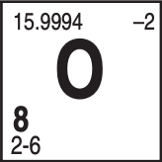
Example: O⁻²
8 p+
10 e-
2 e-
6e-
-2
8p+
8n⁰
8e-
2e-

Slide 69
Construct Bohr diagrams for atoms
Construct Bohr diagrams for ions

Slide 70
Bright Line Spectra

Slide 71
Lesson Objectives:
Differentiate between excited and ground state
Explain how light is produced
Identify substances based upon their bright line spectra

Slide 72
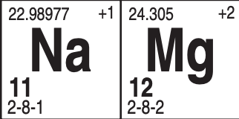
Ground State
Ground State- When electrons occupy the LOWEST available ENERGY LEVELS. (configuration on periodic table)

Slide 73
Excited State
Excited State- Electrons NO LONGER occupy the lowest available energy levels (different than electron configuration)

Slide 74
Example: Possible Excited States of Na
Energy
11p+
12n⁰
Total # of electrons doesn’t change
11
11
11
11

Slide 75
How to determine if configuration is ground or excited
Add up total # of electrons in configuration
Determine element
If it matches element configuration on periodic table = GROUND
If it doesn’t match = EXCITED

Slide 76
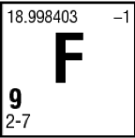
Example: I do
Identify the electron configuration as being ground state or excited state: 2-6-1
2+6+1 = 9
Fluorine
Excited State

Slide 77
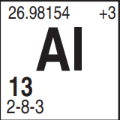
Example: We do
Identify the electron configuration as being ground state or excited state: 2-8-3
2+8+3+1 = 13
13 = Al
ground state

Slide 78
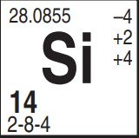
Example: You do
Identify the electron configuration as being ground state or excited state: 2-8-3-1
2+8+3+1 = 14
14 = Si
excited state

Slide 79
Light

Slide 81
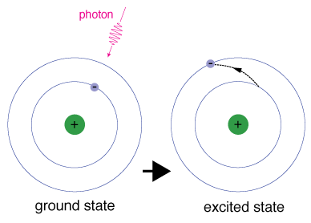
Absorption
Excited State: Electrons absorb energy as they move to higher energy levels
This excited state is temporary and unstable.

Slide 82
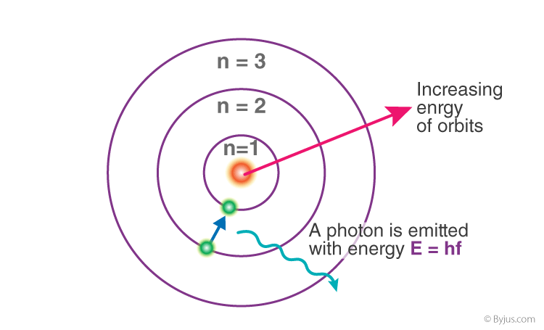
Emission
Ground State: Lowest energy configuration. Electrons will eventually lose the absorbed energy and return back to ground state.
They give off the energy in the form of light energy

Slide 83
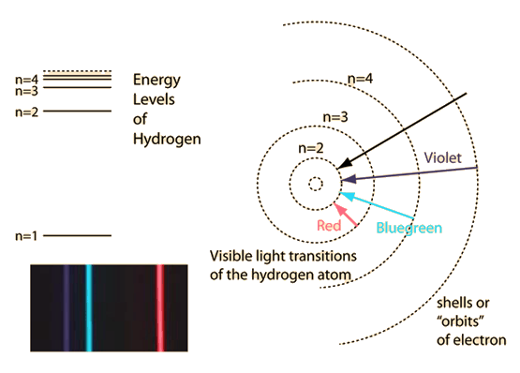
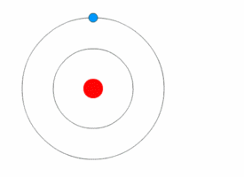
Light Energy
The color of light (wavelength) is determined by the amount of energy lost by the electron when it falls back to its ground state.

Slide 84
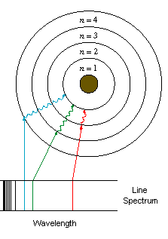
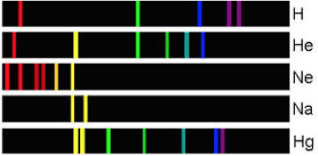
Bright Line Spectra
Each element has its own bright line spectra that is unique. (like a fingerprint)
Can be used to identify an unknown mixture of gases.

Slide 85
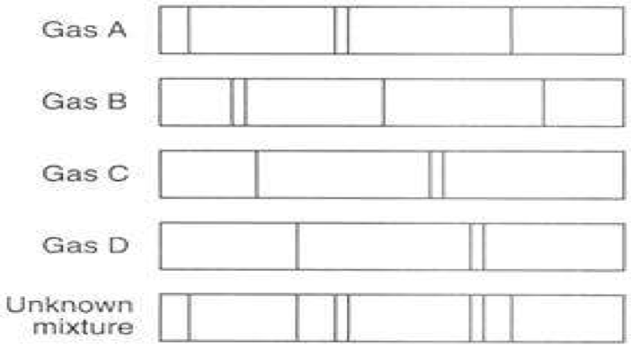
Example: What gases make up the unknown?

Slide 86
Differentiate between excited and ground state
Explain how light is produced
Identify substances based upon their bright line spectra

Slide 87
Lewis Dot Diagrams

Slide 88
Lesson Objectives:
Construct Lewis dot diagrams for atoms
Construct Lewis dot diagrams for ions

Slide 89
Lewis Dot Diagrams
Only show VALENCE ELECTRONS
Valence shell: outermost shell of an atom that contains electrons
Valence electrons: electrons that occupy the valence shell (last number in electron configuration)

Slide 90
Steps for Drawing Lewis Dot Diagrams
Draw the element’s symbol
Locate the valence electron number (last # in the electron configuration
Give out 1 electron to each side. Once all sides have 1 valence e- then give another to each side

Slide 91
Example: Carbon Dot Diagram
C

Slide 92
Example: Oxygen Dot Diagram
O

Slide 93
Example: Aluminum Dot Diagram
Al

Slide 94
Lewis Dot Diagrams: Ions
Draw brackets around the element symbol
Write charge of ion outside bracket on top right corner of symbol
Positive ions no dots
Negative ions 8 dots

Slide 95
Example: Positive Ion
Potassium IOn K⁺
2-8-8
-1
[
]
K

Slide 96
Example: Negative Ion
Sulfide IOn S⁻²
8
2-8-
6

Slide 97
Example: Negative Ion
oxide IOn O⁻²
2-
6
8
[
]
O

Slide 98
Construct Lewis dot diagrams for atoms
Construct Lewis dot diagrams for ions

Slide 99
Quantum Mechanical Model

Slide 100
Objectives
Construct electron configurations using sublevels.
Describe the Heisenberg Uncertainty Principle.
Describe the shape of electron orbitals.
Explain and utilize Aufbau and Hund's Rules.

Slide 101
If there are 7 principle energy levels of a Bohr diagram, how many transitions are there that would emit light?
Does that correlate to the number of possible lines in a spectra?

Slide 102
Quantum Mechanical Model
Schrodinger, de Brogli, and Heisenberg solved mathematical equations to describe the behavior of e⁻ in the H atom as being both particle and wavelike, which lead to the quantum mechanical model. The QMM specifies that each e⁻ has a specific energy, however, they do not follow a specific path. Instead, there are areas of probable e⁻ location, which are called orbitals.

Slide 103
Quantum Mechanical Model
The scientists chose to study the hydrogen e⁻ with the lowest energy (ground state), which they labeled 1s. They found that the e⁻ is moving but not necessarily in circles.

Slide 104
Heisenberg Uncertainty Principle
It’s impossible to know both the location of an e⁻ and its velocity (speed) at the same time. It is more probable to find an e⁻ near the nucleus. The size of the 1s orbital is described as the radius of a sphere that encloses 90% of the total e⁻ probability.

Slide 105
Quantum Mechanical Model
These calculations continued until they could describe any e⁻ from any element. The first number for the electron represents the row that the element can be found in. This is the energy level.
The letter represents the sublevel the electron is in, based on area of the periodic table. It will tell you the shape of the orbital. (s is spherical, p is lobes and d has 2 lobes).
The superscript represents the number of electrons in that sublevel.

Slide 106
S p d orbitals

Slide 107
P orbitals

Slide 108
D orbitals

Slide 110
Examples
Give the row number and sublevel of each of the following elements:
a. Fluorine
b. Carbon
c. Manganese
d. Sodium
e. Phosphorous
2p
2p
3d
3s
3p

Slide 111
Aufbau Principle
As protons are added one by one to the nucleus to build up the elements, so are e⁻. A new and more specific e⁻ configuration can be written using all the first three quantum letters. Here is the order to fill the orbitals:
1s² 2s² 2p⁶ 3s² 3p⁶ 4s² 3d¹⁰ 4p⁶ 5s² 4d¹⁰ 5p⁶ 6s² 4f¹⁴ 5d¹⁰ 6p⁶ 7s² 5f¹⁴ 6d¹⁰ 7p⁶

Slide 112
Examples
The configuration for Be ends at 2s and the second element in. S it ends at 2s². Write everything before 2s²:
Be is 1s² 2s²
The configuration for Sulfur ends at 3p⁴.
S is 1s² 2s² 2p⁶ 3s² 3p⁴

Slide 113
Problems?
You will notice that it seems to skip around a lot and this is because this is the order of the periodic table. This shows that 4s is in fact a lower energy level than 3d and 4f is higher energy than many other sublevels in energy level five.

Slide 114
Orbital Energies

Slide 115
Using a diagram like the one to your left, it is easy to show the way e⁻ fill the orbitals.

Slide 116
Hund’s Rule
Notice that Carbon’s 6th arrow is in the second p orbital. Hund’s Rule states the lowest energy configuration is one having the maximum number of unpaired electrons allowed by Pauli Principle in a particular set of degenerate orbitals. They should have parallel spins.
In English? Put one up arrow in each box before any get two.

Slide 117
Examples
How many unpaired electrons does nitrogen have?
How many unpaired electrons does nitrogen have?

Slide 118
Valence electrons
Valence e⁻ are e⁻ in the outermost principal energy level. The rule still holds: the elements in the same group have the same number of valence e⁻. Therefore, Nitrogen with a configuration of 1s²2s²2p³ and Phosphorous with a configuration of 1s²2s²2p⁶3s²3p³ both have 5 valence e⁻ because they are both in group 15.

Slide 119
You should be able to:
Construct electron configurations using sublevels.
Describe the Heisenberg Uncertainty Principle.
Describe the shape of electron orbitals.
Explain and utilize Aufbau and Hund's Rules.

Slide 120
Electron Configurations

Slide 121
Lesson Objectives
Construct electron configurations using sublevels for ions including exceptions to Aufbau.
Understand and utilize the noble gas short cut.
Label atoms as diamagnetic or paramagnetic.
Define nodes and isoelectric pairs of atoms.

Slide 122
Ions
Remember, when ions form, electrons are added and subtracted to the valence shell!
Fluorine is 1s² 2s² 2p⁵
The F⁻ is 1s² 2s² 2p⁶
Manganese is 1s² 2s² 2p⁶ 3s² 3p⁶ 4s² 3d⁵
The Mn⁺² ion is 1s² 2s² 2p⁶ 3s² 3p⁶ 3d⁵

Slide 123
Noble Gas Short Cut
Larger elements will have extremely long configurations. A shortcut is to use noble gas configurations. So Sodium has 11e- and a configuration of 1s²2s²2p⁶3s¹ or [Ne]3s¹.

Slide 124
Isoelectronic
When two ions or atoms have the same number of electrons. Example: Ar and K⁺¹.
Argon: 1s² 2s² 2p⁶ 3s² 3p⁶
Potassium: 1s² 2s² 2p⁶ 3s² 3p⁶ 4s¹
Potassium Ion: 1s² 2s² 2p⁶ 3s² 3p⁶

Slide 125
Magnetism
Paramagnetism: A type of induced magnetism associated with unpaired electrons that cause a substance to be attracted to the inducing electric field.
Diamagnetism: a type of magnetic field associated with paired electrons that cause a substance to be repelled from the inducing electric plate.

Slide 127
You should be able to:
Construct electron configurations using sublevels for ions including exceptions to Aufbau.
Understand and utilize the noble gas short cut.
Label atoms as diamagnetic or paramagnetic.
Define nodes and isoelectric pairs of atoms.

