Slide 1
Unit 7 – Blood and Blood Spatter

Slide 2
Blood Structure and Types

Slide 3
Composition of Blood

Slide 4
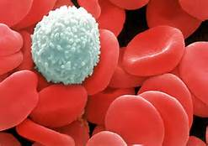
Composition of Blood
Red Blood Cells – Carries Oxygen, contains hemoglobin (makes blood red)
White Blood Cells – fight disease, contains DNA*
Platelets – helps blood to clot
Plasma – liquid portion of blood

Slide 5
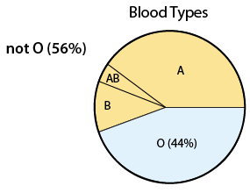
Blood Typing: Class or Individual?
Because many people in the world share the same blood type, this type of blood evidence is considered to be class evidence.

Slide 6
Blood Type Test
Blood Type | Antigen on Red Blood Cells | Antibodies in Plasma
A | A | B
B | B | A
AB | A and B | None
O | None | A and B
The name of the blood is generated by which antibodies are on the red blood cell. Antibodies are in the plasma of the blood, opposite of the blood type.

Slide 7
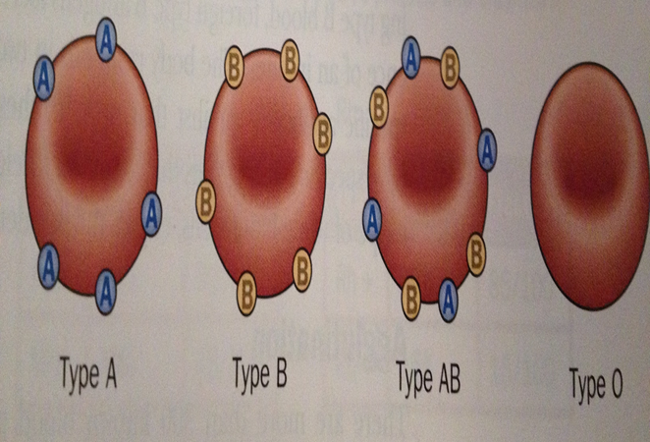
Blood Types
Blood Type | Can Receive | Can Donate
A | O, A | A, AB
B | O, B | B, AB
AB | O, AB, A. B | AB
O | O | O, A, B, AB
What type of blood is known as the universal donor? And which is the universal recipient?

Slide 8
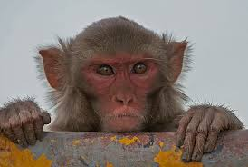
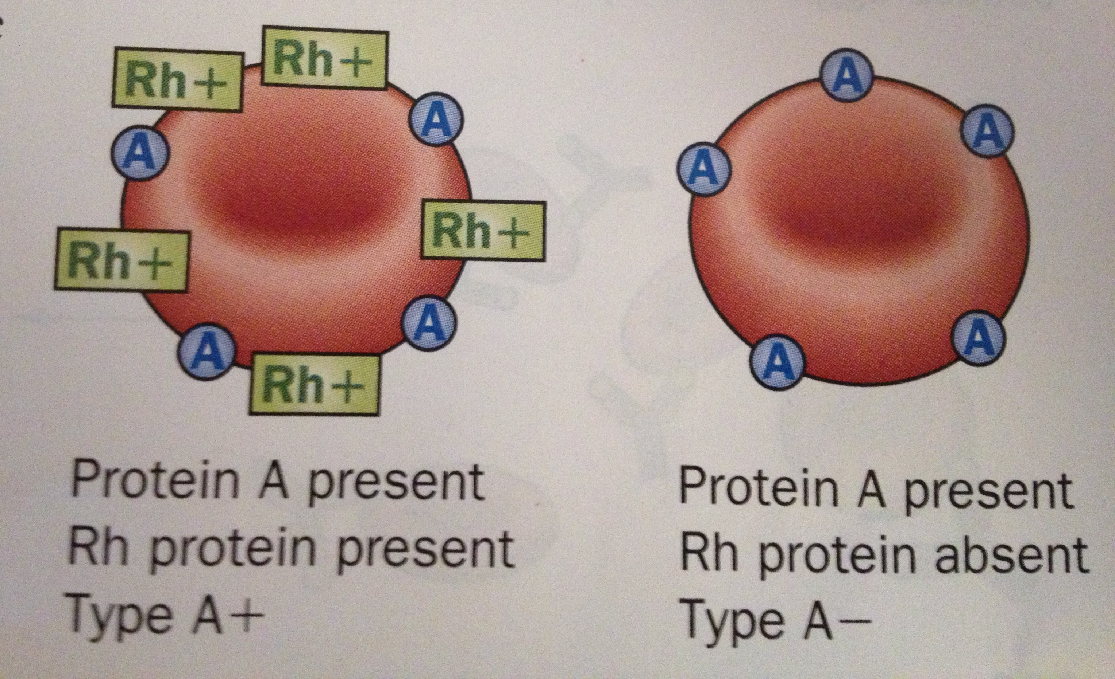
Blood Type Test
The blood can also have the Rh protein (named after the Rhesus monkey) and therefore named Rh+ or Rh-

Slide 9
Blood Types
Blood is tests with antiserums to determine the blood type. If the blood serum clumps the blood, it can tell you about the blood type.
What would happen if a person was given the wrong blood in a transfusion?

Slide 10
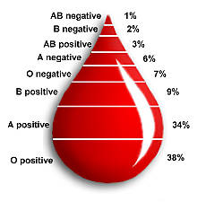
By identifying additional blood proteins in the blood we can limit the size of the suspect populations and help identify a suspect.

Slide 11
Different Regions have different percentages

Slide 12
Blood Identification

Slide 13
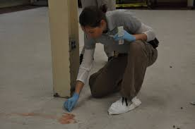
Steps to Identify an Unknown Stain at the Scene
Crime-Scene Investigation of Blood
Confirm the stain is blood
Confirm the blood is human
Determine blood type/DNA testing
Use blood spatter analysis to help reconstruct the crime (BPA)

Slide 14
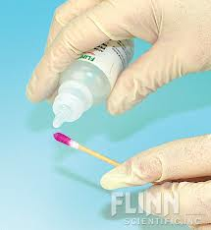
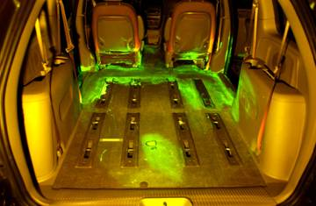
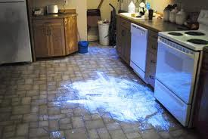
1. Confirm the stain is blood
Kastle-Meyer color test
Mix phenolphthalein and peroxide; reacts with blood to cause a deep pink color.
Positive tests for all blood, cauliflower, and broccoli.
Leukomalachite test
Reacts with blood to cause a green color.
Positive test for all blood.
Luminol test
Reacts with blood to produce light.
Positive tests for all blood, starch, horseradish, and bleach.

Slide 15
2. Confirm the blood is human
ELISA Test (Enzyme Linked Immunosorbent Assay)
Blood is injected into a rabbit to produce antibodies
Antibodies are isolated and stored
When a sample of human blood is mixed with these anti-human antibodies a positive reaction occurs and the presence of human blood is confirmed
Only a small sample is needed

Slide 16
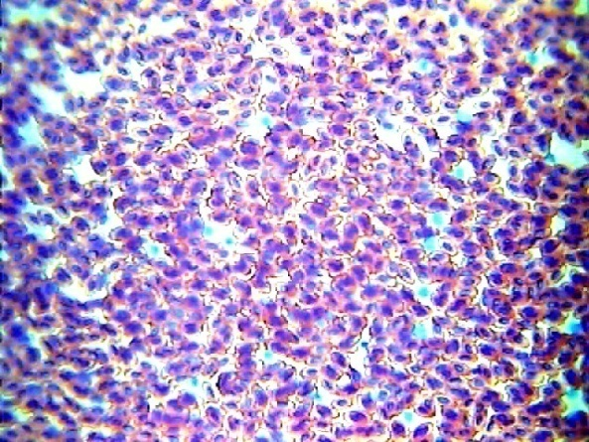
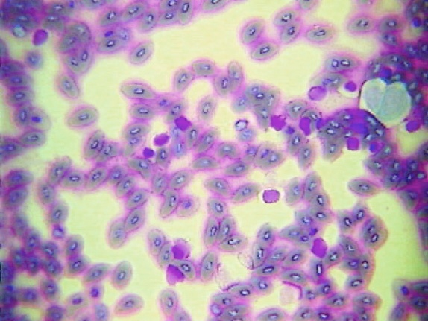
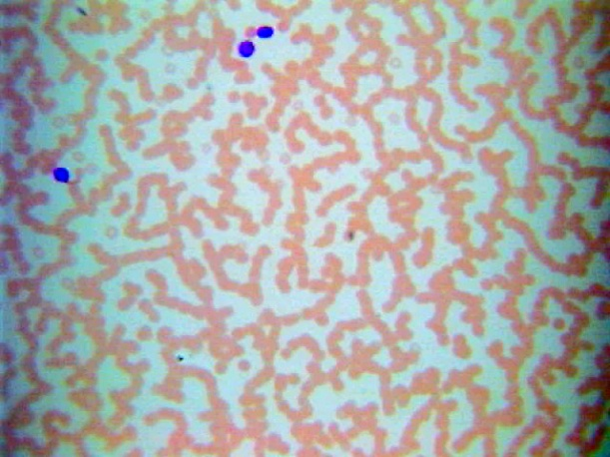
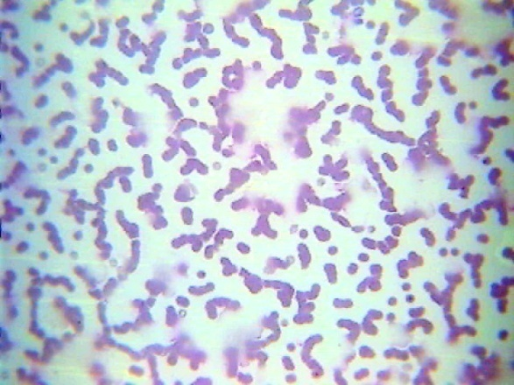
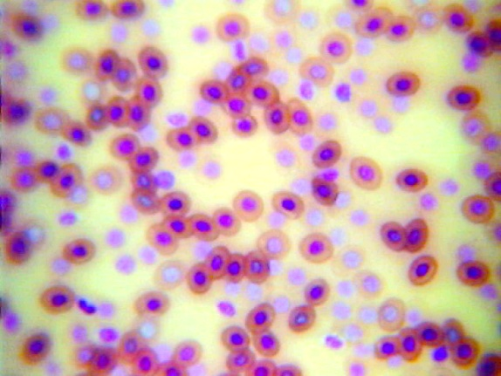
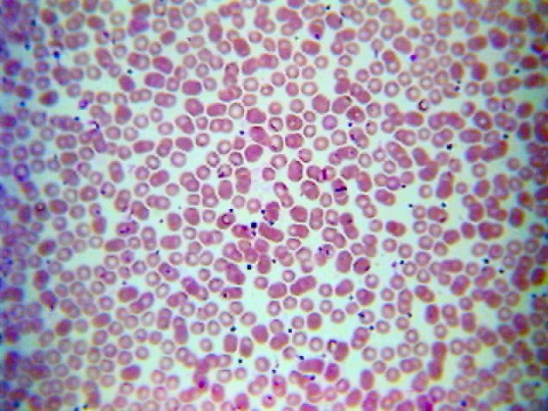
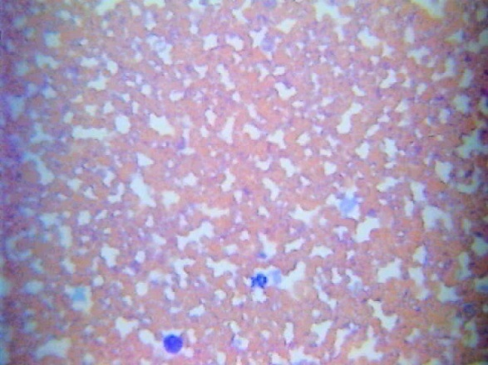
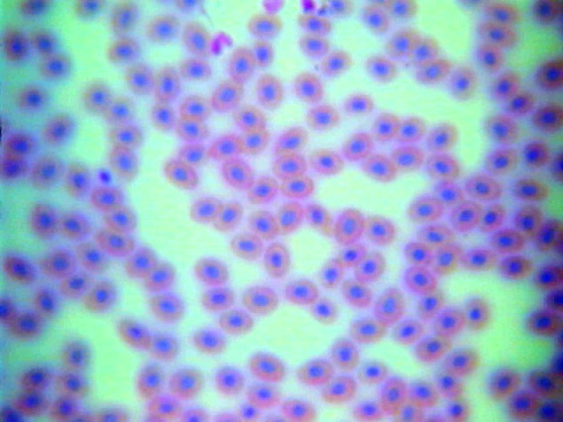
Microscopic Blood Samples
Bird Blood
Fish Blood
Horse Blood
Cat Blood
Frog Blood
Human Blood
Dog Blood
Snake Blood

Slide 17
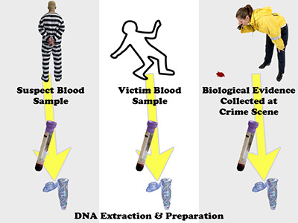
3. Determine the blood type/conduct a DNA analysis
Blood typing = class evidence
Can narrow down suspects/be used to exclude non-matching suspects
DNA Analysis = Individual evidence

Slide 18
Blood Spatter

Slide 19
Bloodstain Pattern Analysis (BPA)
The examination of the shapes, locations, and distribution patterns of bloodstains in order to provide an interpretation of the physical events which gave rise to their origin…

Slide 20
Keywords:
Spatter – Bloodstains created from the application of force to the area where the blood originated.
Origin/Source – The place from where the blood spatter came from or originated.
Angle of Impact– The angle at which a blood droplet strikes a surface.
Satellite Spatters
Spines
Parent Drop– The droplet from which a satellite spatter originates.
Satellite Spatters– Small drops of blood that break of from the parent spatter when the blood droplet hits a surface.
Spines – The pointed edges of a stain that radiate out from the spatter; can help determine the direction from which the blood traveled.
Parent Drop

Slide 21
Factors affecting Shape of Blood Droplet
Size of the droplet
Angle of the impact
Velocity at which blood droplet left its origin height
Bloodstains can occur on any surfaces such as carpet, wood, tile, wallpaper, clothing, etc.
Texture of surface:
On a clean glass or plastic, droplet will have smooth outside edges
On a rough surface, droplet will produce scalloping on the edges

Slide 22
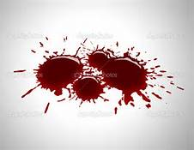
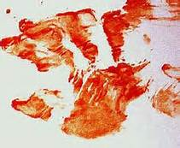
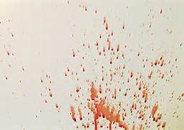
Types of Bloodstain Patterns
Passive Bloodstains
Transfer or contact blood stains
Projected Blood stains

Slide 23
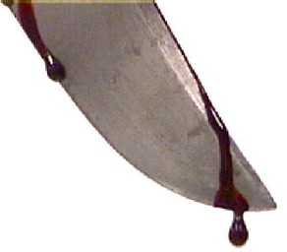
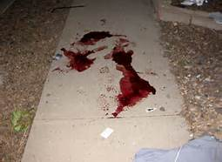
Types of Bloodstain Patterns
Passive Bloodstains
Patterns created from the force of gravity
Drop, series of drops, flow patterns, blood pools, etc.

Slide 24
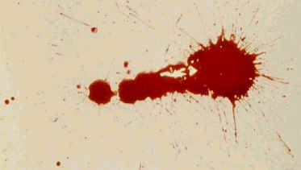
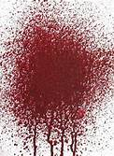
Types of Bloodstain Patterns
Projected Bloodstains
Patterns that occur when a force is applied to the source of the blood
Includes low, medium, or high impact spatters, cast-off, arterial spurting, expiratory blood blown out of the nose, mouth, or wound.

Slide 26
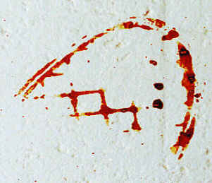
Types of Bloodstain Patterns
Transfer or Contact Bloodstains
These patterns are created when a wet, bloody object comes in contact with a target surface; may be used to identify an object or body part.
A wipe pattern is created from an object moving through a bloodstain, while a swipe pattern is created from an object leaving a bloodstain.

Slide 27
What can an investigator learn from the analysis of a blood spatter?
Distance between target surface and origin of blood
Type and velocity of weapon
Number of blows
Handedness of assailant (right or left-handed)
Position and movements of the victim and assailant during and after the attack
Which wounds were inflicted first
Type of injuries
How long ago the crime was committed
Whether death was immediate or delayed

Slide 28
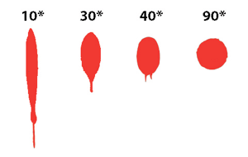
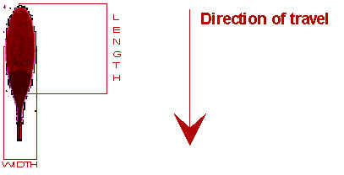
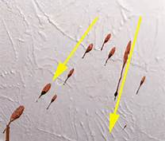
Examination of Directionality
Direction drop of blood traveled in space from its point of origin

Slide 29
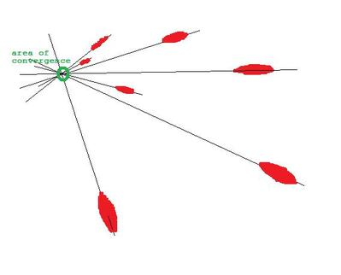
Lines of Convergence
The location of the source of blood can be determined if there are at least two drops of blood spatter.
Done by drawing a line down the long axis of the blood spatter and noting where the lines intersect

Slide 30
Closure: What do you think your blood type is based on Japanese personality trait assignments?

Slide 31
Labs

Slide 32
Kastle Meyer Test
Do Now: What are the 4 components of blood? What is hemoglobin? What is it’s function and where is it found?
https://www.youtube.com/watch?v=sF0Z0jJGwX8
Using a cotton swab, take small amounts of the positive blood. Add 1-2 drops of ethyl alcohol, 1-2 drops of phenolphthalein, and then 1-2 drops of H₂O₂. Record observations and repeat with the negative control and the unknown samples.
When finished, complete the questions and hand it in. Then fished the “Forensics of Blood” reading from yesterday and hand it in.

Slide 33
Is it Animal or Human?
Do Now: Describe one test that can be used to determine if blood is animal or human.
Read the article “Animal versus Human Blood” and answer the questions.
Look at the Human and Frog blood under the microscope and draw what you see, in color.
When finished, staple the reading and the drawing together and hand them in.

Slide 34
Blood Type
Do Now: What are the four major blood types? What makes them positive or negative?
https://www.youtube.com/watch?v=ttjn1jVACk8&index=1&list=PLKsoT4YTX5Db-H5haP2E3Ou9ke_IWtB6d
Complete the blood type lab, following the directions on the desk. Hand in a list of what blood type each patient is.
When finished, complete the OJ reading and questions.

Slide 35
Blood Spatter
https://www.youtube.com/watch?v=zjfdpenl1Rc&list=PLKsoT4YTX5Db-H5haP2E3Ou9ke_IWtB6d&index=2
https://www.youtube.com/watch?v=jzUhhOgK62g&list=PLKsoT4YTX5Db-H5haP2E3Ou9ke_IWtB6d&index=3
Complete the blood spatter lab. Hand it in.

Slide 36
Case Studies
https://www.youtube.com/watch?v=CMBv6OAnZUA

