Slide 1
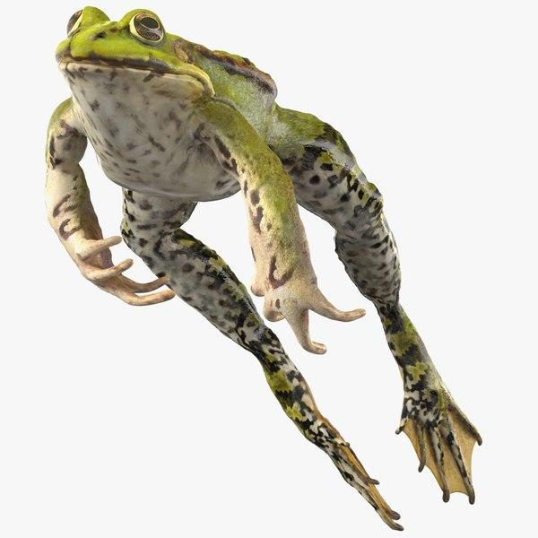
What makes a frog jump?

Slide 2
https://commons.wikimedia.org/wiki/File:Luigi_Galvani_Experiment.jpeg
Notes:
https://commons.wikimedia.org/wiki/File:Luigi_Galvani_Experiment.jpeg

Slide 3
“I had dissected and prepared a frog and I had put it on the table where there was an electric machine. As soon as one of my assistants, by accident, touched the internal nerves of the frog with a scalpel, at once, he saw all the muscles go into a violent convulsion.”
St John’s University
https://commons.wikimedia.org/wiki/File:Luigi_Galvani_Experiment.jpeg
Notes:
https://commons.wikimedia.org/wiki/File:Luigi_Galvani_Experiment.jpeg
https://www.coursehero.com/file/45598914/lianne-stsdocx/

Slide 4
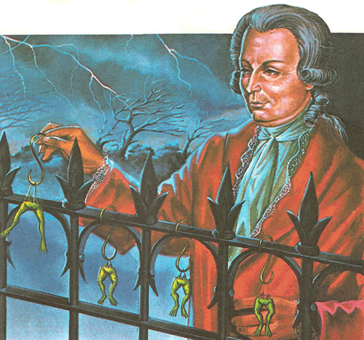
https://www.daviddarling.info/encyclopedia/G/Galvani.html
Notes:
https://www.daviddarling.info/encyclopedia/G/Galvani.html

Slide 5
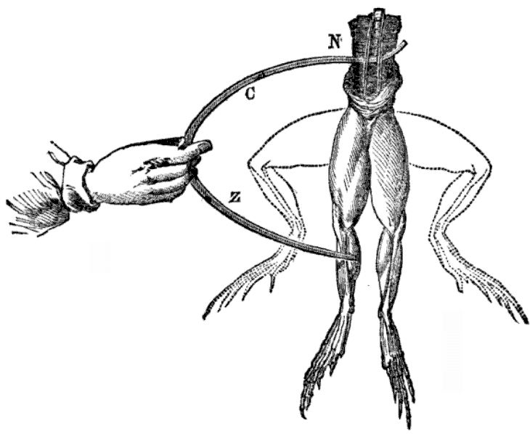
https://en.wikipedia.org/wiki/Galvanism#/media/File:Galvani-frogs-legs-electricity.jpg
Notes:
https://en.wikipedia.org/wiki/Galvanism#/media/File:Galvani-frogs-legs-electricity.jpg

Slide 6
Evidence
Frog legs “jump”
in presence of static electricity when cut into with a scalpel
when outside in a thunderstorm when hanging on a metal fence
when hanging on metal fence on a clear day
the lab when touched by metal pieces
Galvani concluded that he was seeing the effects of animal electricity.

Slide 7
Alessandro Volta
1745 – 1827
Professor of Physics
Specialist in electricity
https://lemelson.mit.edu/resources/alessandro-volta
Notes:
Picture Source: https://lemelson.mit.edu/resources/alessandro-volta

Slide 8
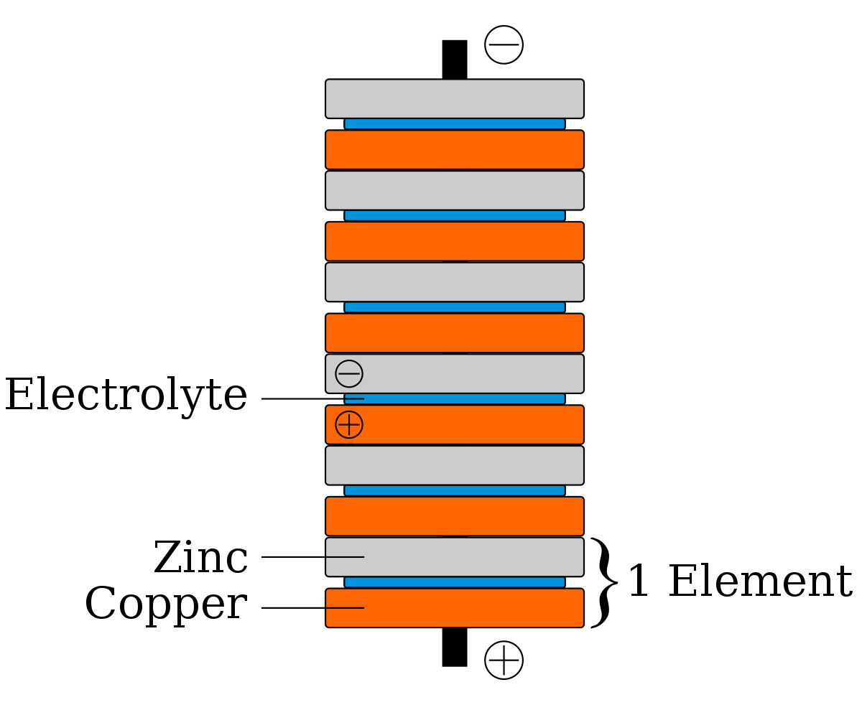
Voltaic Pile
Electrolyte
Zinc
1 unit
Silver
https://libraries.mit.edu/collections/vail-collection/topics/electricity/the-voltaic-pile/
Notes:
Picture source: https://libraries.mit.edu/collections/vail-collection/topics/electricity/the-voltaic-pile/
Source 2: https://en.wikipedia.org/wiki/Voltaic_pile

Slide 9
Voltaic Pile
https://libraries.mit.edu/collections/vail-collection/topics/electricity/the-voltaic-pile/
Notes:
Picture source: https://libraries.mit.edu/collections/vail-collection/topics/electricity/the-voltaic-pile/

Slide 10
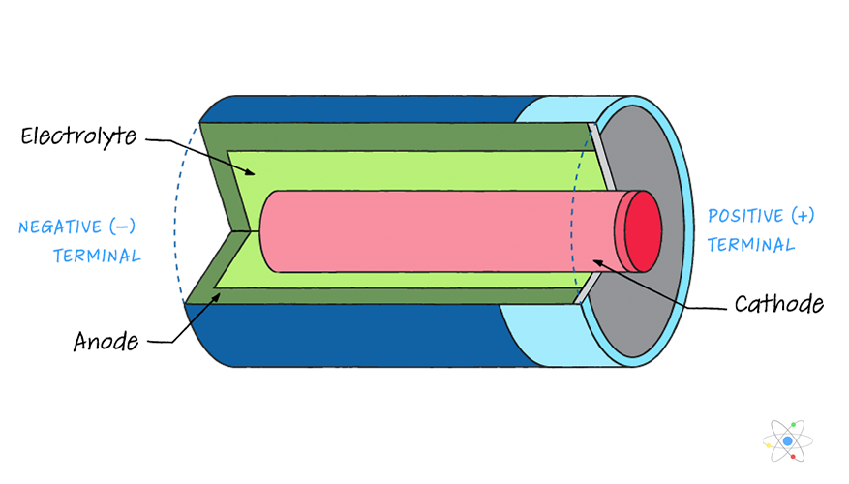
https://sciencing.com/how-do-batteries-work-parts-types-terminology-w-diagram-13721182.html
Notes:
https://sciencing.com/how-do-batteries-work-parts-types-terminology-w-diagram-13721182.html

Slide 11
Alessandro Volta
Volt – unit of electric potential difference
Voltage – electric potential difference

Slide 12
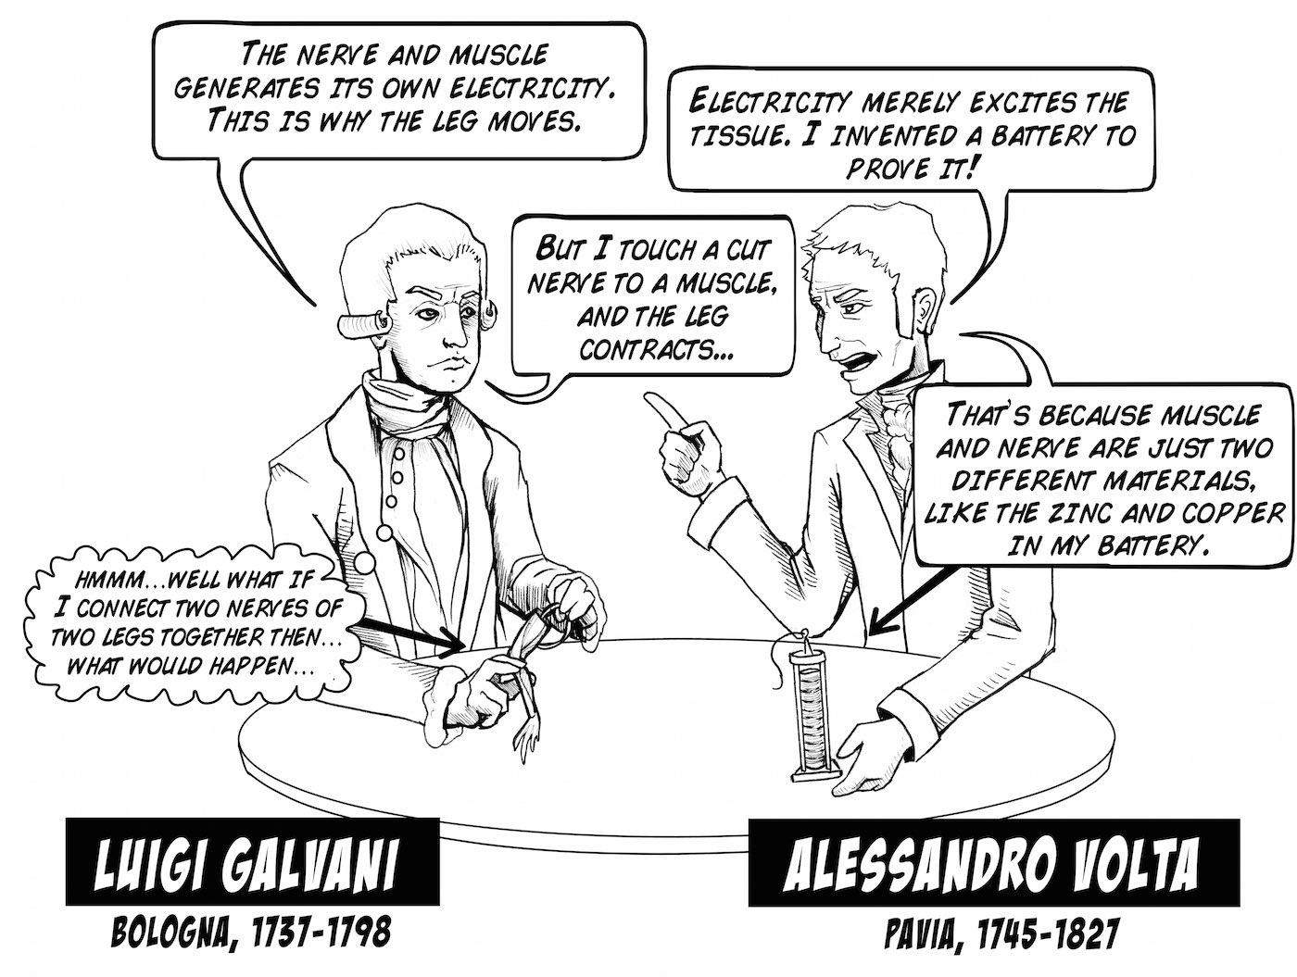

Slide 13
Dissecting frog on the table
Galvani described what happened “I had dissected and prepared a frog and I had put it on the table where there was an electric machine. As soon as one of my aides by accident touched the internal nerves of the frog with a scalpel at once he saw all the muscles go into a violent convulsion.”
Followed this with many experiments to see what would make the frog jump
Found two things: (1) frog legs are sensitive machines to detect electricity (2) started the study of how electricity works within living systems
Outside experiment – lightning make frogs jump too, frog jumped during thunderstorms BUT the frog would jump on clear days with no atmospheric electricity – frogs store electricity? Had to do with garden (copper hooks, iron fence, reanimating the frog when touch the two metals together
Acid in frog leg reacted to add and remove frog legs
Volta – 1st nonbiological battery
Leading expert in electricity (Italy) – loud man
Recreated galvanis experiments – galvani wasn’t reanimating the frog, just responding to the electricity from the two different metals
Galvani was correct that all living things use and produce electricity, Mary Shelly also was inspired by experiment and wrote frankenstein
Volta was correct that the two metals were creating electricity, missed the acid in the frog leg was important and that it was a chemical reaction
Volta – silver and zinc worked the best – put to tongue, found they had to be wet, cups of water in a row, then wet cardboard between alternating discs, and increasing discs you got more of a shock
Creating continuous flow of electricity – “electric battery”
Why we measure potential of a battery in volts, voltages – after volta

